Slide 1
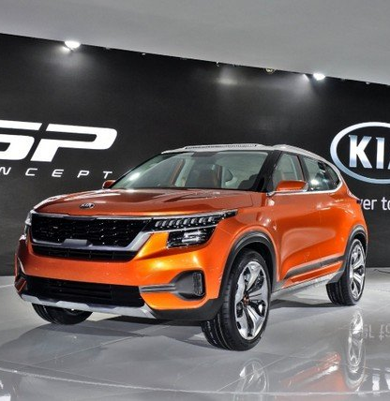

Protecting Kia vehicles against theft
Dsc 640 fall 2024
Garth scheck

Slide 2
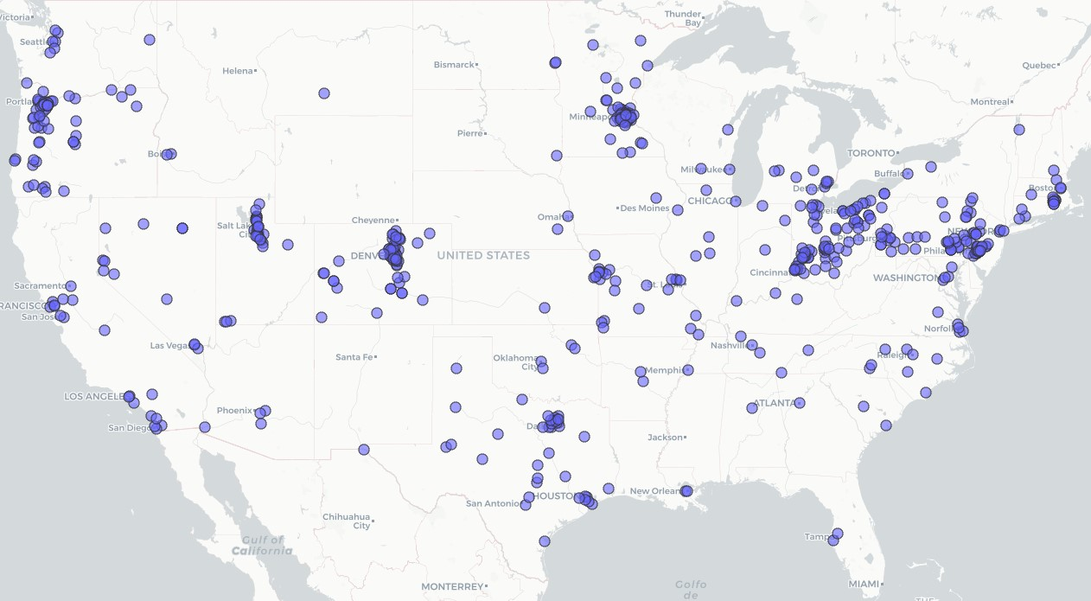
US Map of Car Thefts
How widespread are car thefts?

Slide 3
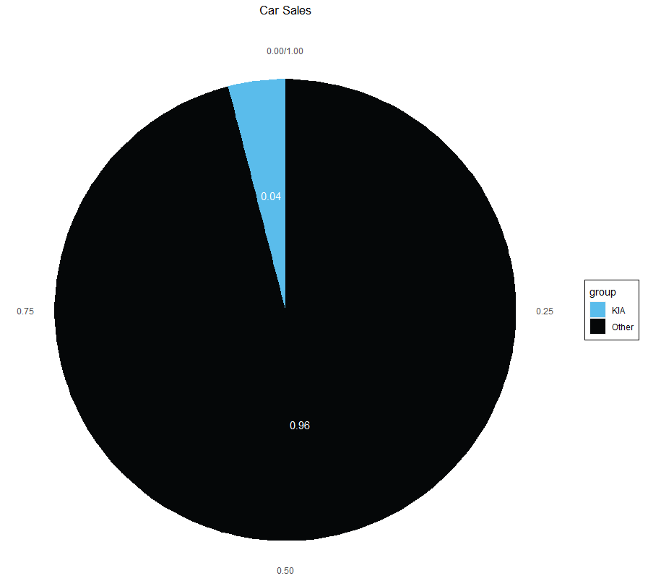
How does this affect KIA?
KIA accounts for 4% of all vehicle sales in the US.
KIA

Slide 4
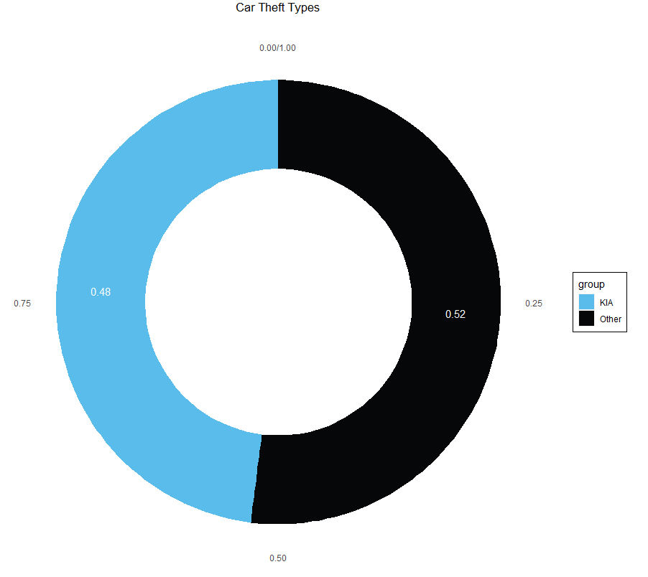
Yet KIA thefts are almost half of all vehicle thefts in the US.

Slide 5
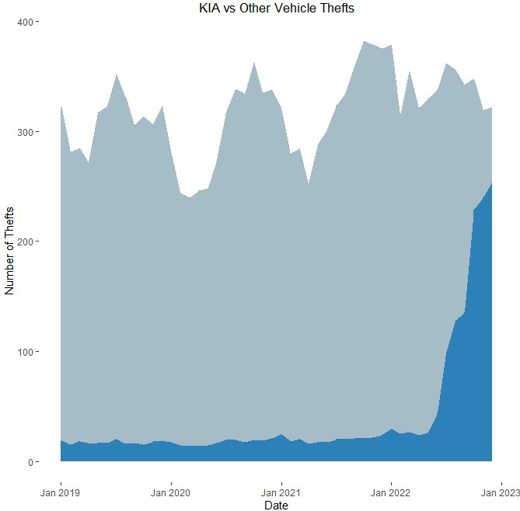
Other Types
Has this always been a problem?
Not really, KIA thefts have been on the rise since around April of 2022.
KIA

Slide 6
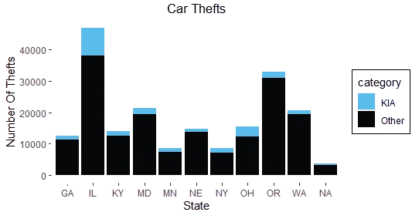
Where should we start?
Top states for vehicle thefts are Illinois, Oregon, Maryland and Washington. They should be the first to receive anti-theft devices.

Slide 7
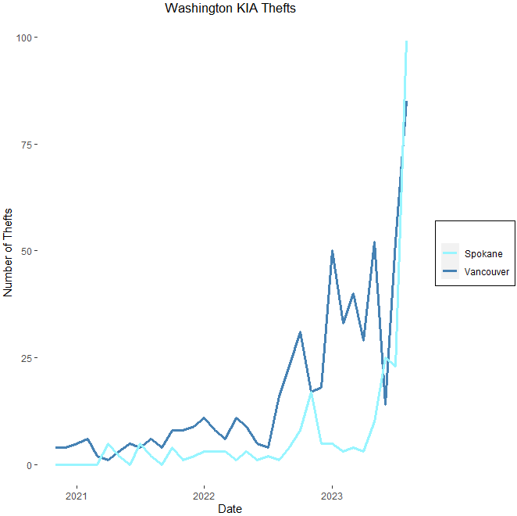
Taking Washington as an example, we can see the same trend in KIA thefts as nation wide.

Slide 8
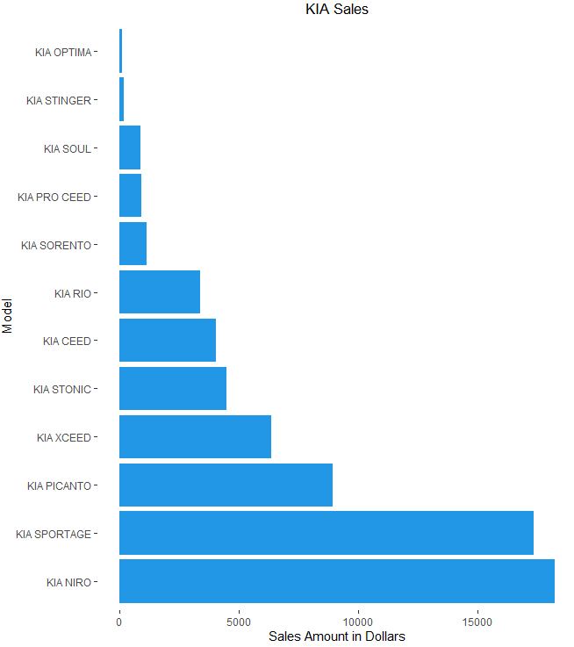
What models should we target?
Start with protecting the top two KIA models, which are the Niro and Sportage.
KIA

Slide 9
Thank You!
Summary
KIA vehicle thefts are on the rise and are almost half of all vehicles stolen.
Better anti-theft devices are need to protect against loss.

Slide 10
References
Vehicle Sales Data:
https://deepvisualmarketing.github.io/

