Slide 1

Home Credit Default Risk
Team 25
Dharani Doppalapudi
Saiabhinav Chekka
Krishna Sannidhi
Godha Priyanka Gummula

Slide 2

Outline for Presentation
Team Information
Project Description
Summary of Tasks
Summary of Visual EDA
Overview of Modeling Pipelines
Results and discussions
Conclusion

Slide 3
Project Description
Data Description:
We are working on Home Credit Default Risk dataset which is hosted on Kaggle. Our project will calculate every factor which can help a person repay the loan they took. Analysis of monthly income from all the sources, existing loans, and history of repayment will be considered before approving a loan.
We are currently working on the files application_train.csv, previous_appliation.csv, installments_payments.csv and credit_card_balance.csv.

Slide 4
Project Abstract
In Phase 2, our goal is to establish pipeline with feature engineering setup and test on different models. We have completed Feature Engineering, hyper parameter tuning, feature selection, analysis of feature importance, ensemble methods and we have constructed optimal joins for the dataset. We have checked the RFM metrics and it’s matching with our data. The correlation between the merged features and the target variable has also been calculated. On this premise, we established the Pipeline, which consists of the most positively and negatively correlated features. Numerical pipeline and categorical pipeline make up the Pipeline. A Standard Scaler and Imputer are used in the numerical pipeline, while a Data frame Selector and One Hot Encoder are used in the categorical pipeline. We tested with Support Vector Machine, Random Forest, Logistic Regression and K-Nearest Neighbors models. Out of all, Random Forest model provided better accuracies and so we considered it as the best suited model for our data. The Random Forest Model has a test accuracy of 68 percent, AUC score of 97 percent, Error rate of 2.6407. Kaggle score of 0.72559 and private score of 0.72778.

Slide 5
Summary of Tasks
Completed Tasks :
Visual EDA
Feature Engineering
Hyper parameter tuning
Feature selection
Analysis of Feature Importance
Ensemble methods
Constructing optimal joins in the dataset.
Tested with Support Vector Machine, Random Forest, K-Nearest Neighbors and Logistic Regression models.
Tasks to be Done :
Build a multi-layer perception (MLP) model

Slide 6
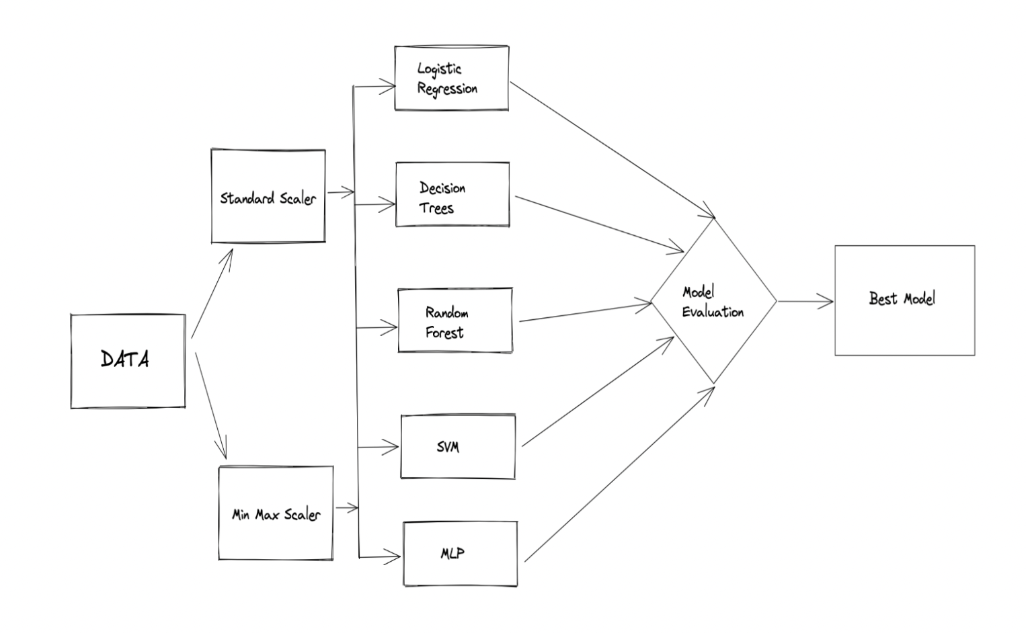
WORKFLOW

Slide 7
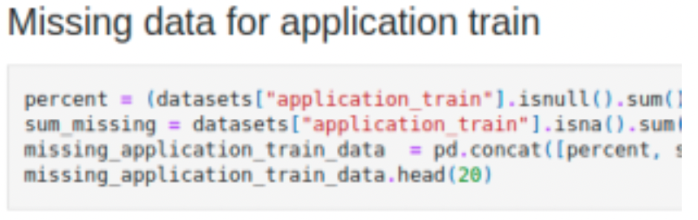
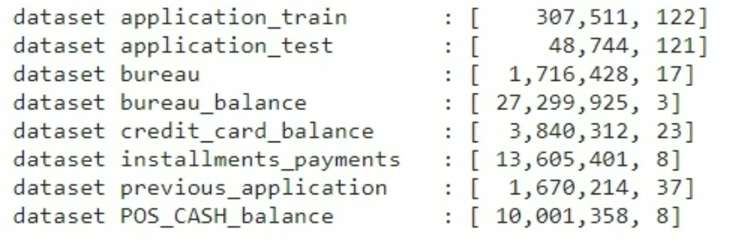
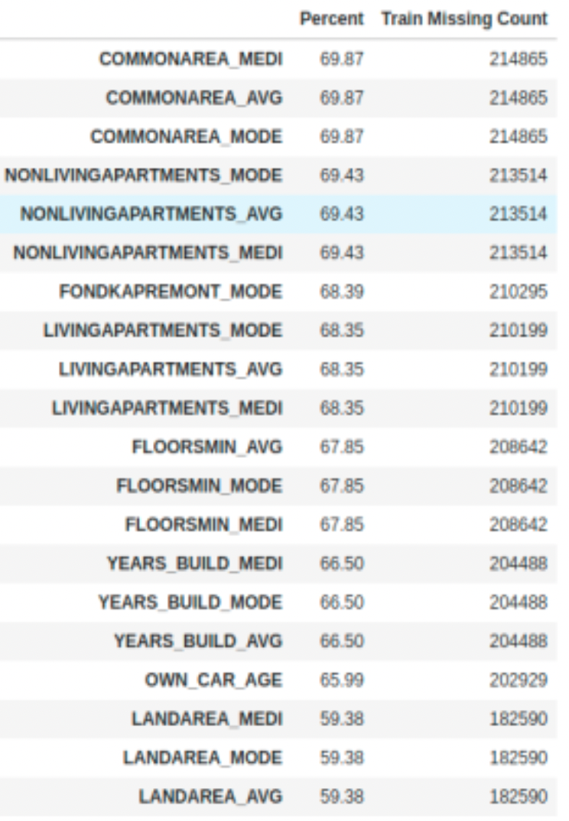
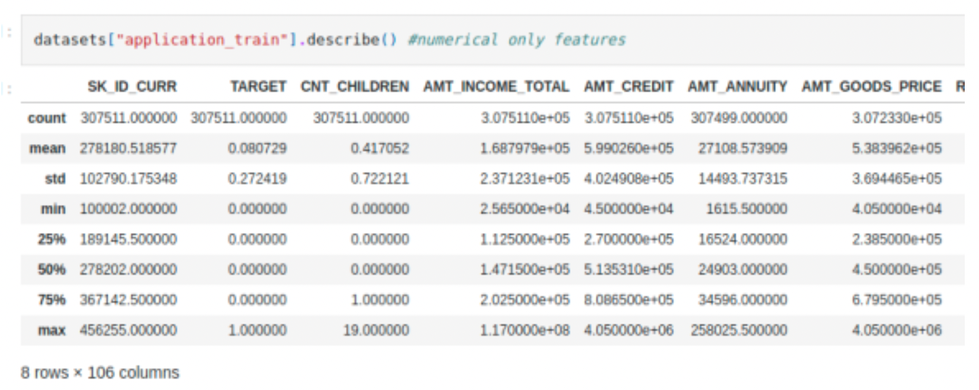
EXPLORATORY DATA ANALYSIS

Slide 8
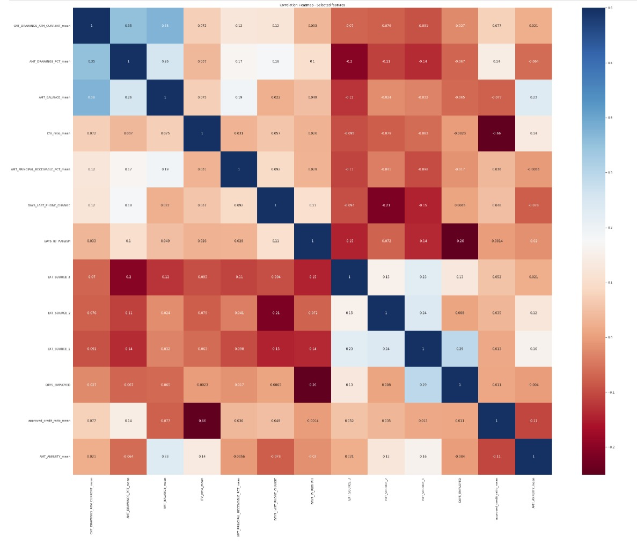
SUMMARY VISUAL EDA

Slide 9
OVERVIEW OF MODELING PIPELINES
We tested on Logistic Regression, Support Vector Machine, Decision Trees, Random Forest and K-Nearest Neighbors models.
LOGISTIC REGRESSION:
From the dataset we can see Target values either 0 or 1 which comes under the Binomial Logistic Regression. This model is trained to predict the probability of loan repayment dependent variable based on one or more independent variables that can be either continuous or categorical. As we are finding the probability the most suitable cost function would be log loss.
SUPPORT VECTOR MACHINE:
Support Vector Machine algorithm finds the hyperplane in an N-dimensional space which distinctly classifies the target value. We are planning to use linear and non-linear kernels.

Slide 10
DECISION TREES:
Decision tree builds classification model in the form of a tree structure. It breaks down a dataset into smaller and smaller subsets based on the conditions. The result is a tree with decision nodes and leaf nodes. We are planning to use Information Gain and Gini Index techniques to select the best attribute using Attribute Selection Measure (ASM).
RANDOM FOREST:
It is an ensemble tree-based learning algorithm. The Random Forest Classifier is a set of decision trees from randomly selected subset of training set. We are planning to use the Bagging and Boosting ensemble strategies.
K-NEAREST NEIGHBORS:
It is a data categorization approach that is used to estimate the chance that a data point will belong to one of two groups based on the data points closest to it.

Slide 11
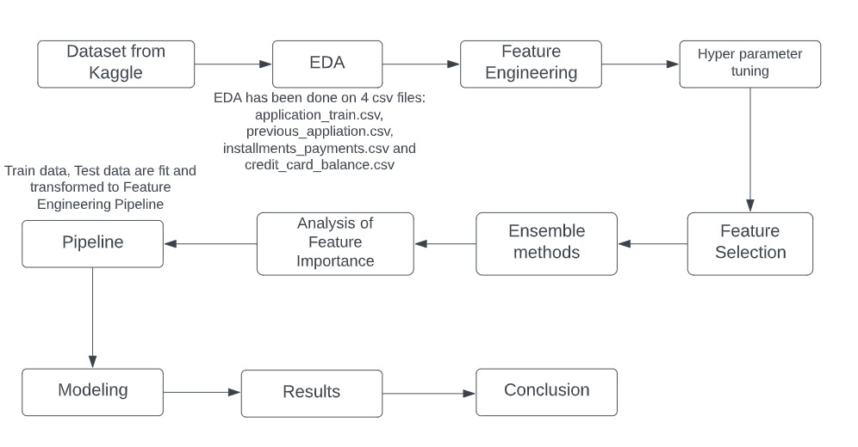
Block diagram of Modeling Pipelines

Slide 12
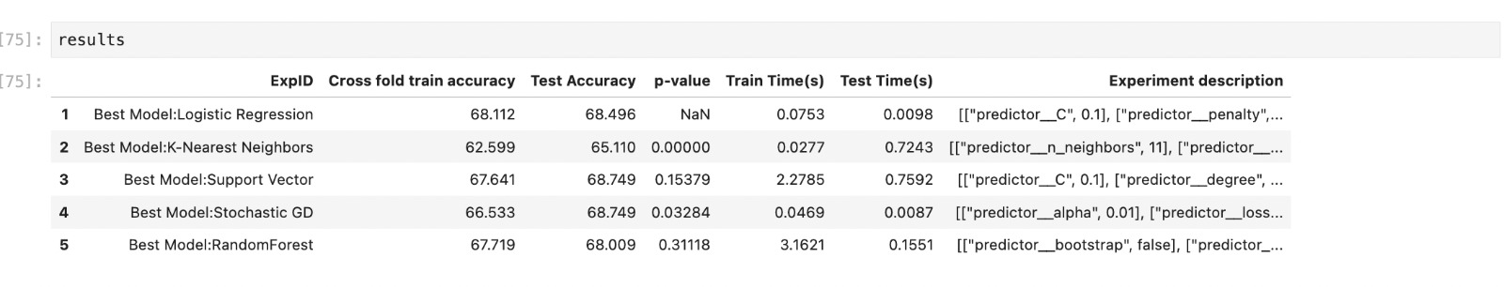
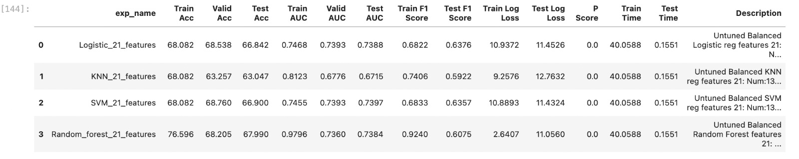
RESULTS AND DISCUSSIONS

Slide 13
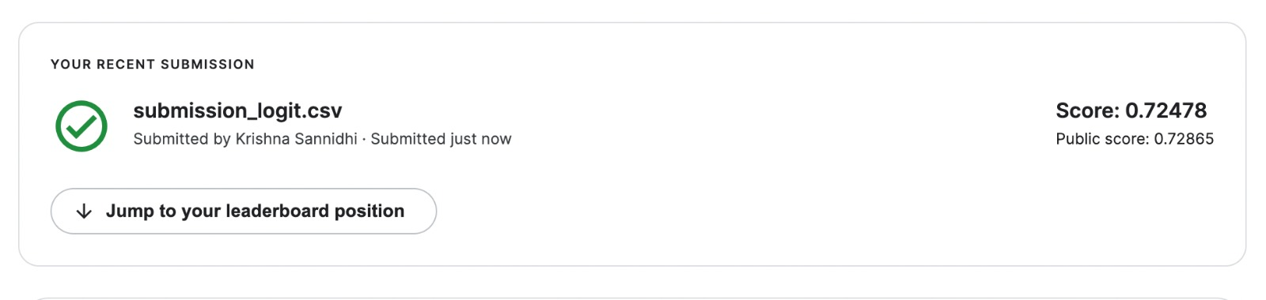
For Logistic regression, We have achieved an accuracy 66.842, error rate of 10.9372 an AUC score of 0.7393
Kaggle score: 0.72478
Screenshot:

Slide 14
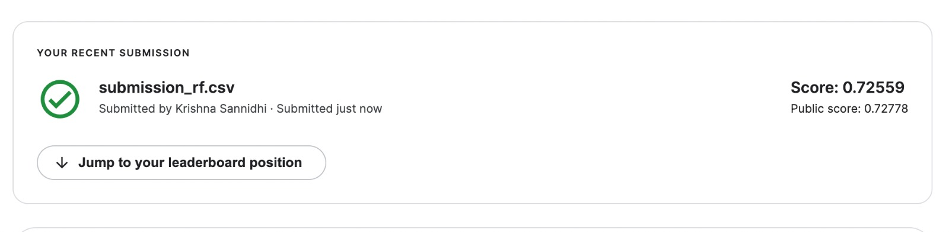
For Random Forest, We have achieved an accuracy 67.990, error rate of 2.6407 and an AUC score of 0.9796
Kaggle score: 0.72559
Screenshot:

Slide 15
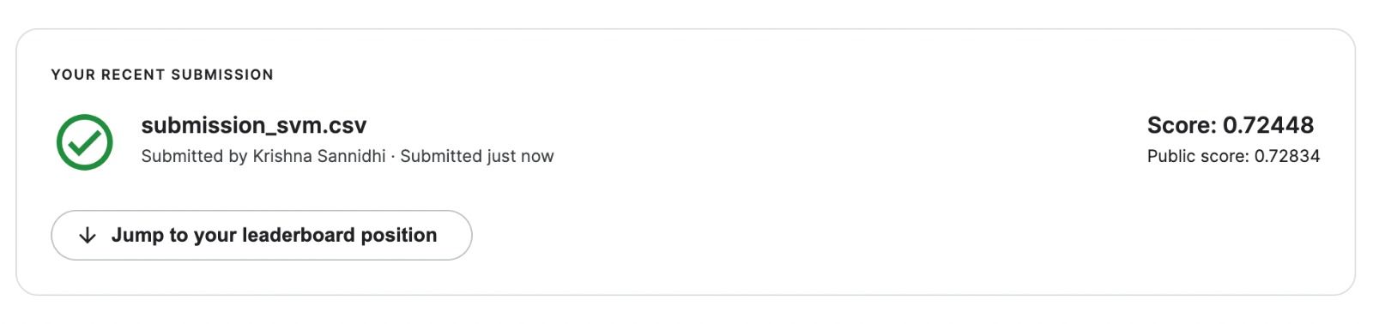
For Support Vector Machine, We have achieved an accuracy 66.900, error rate of 11.4324 and an AUC score of 0.7397
Kaggle score: 0.72448
Screenshot:

Slide 16
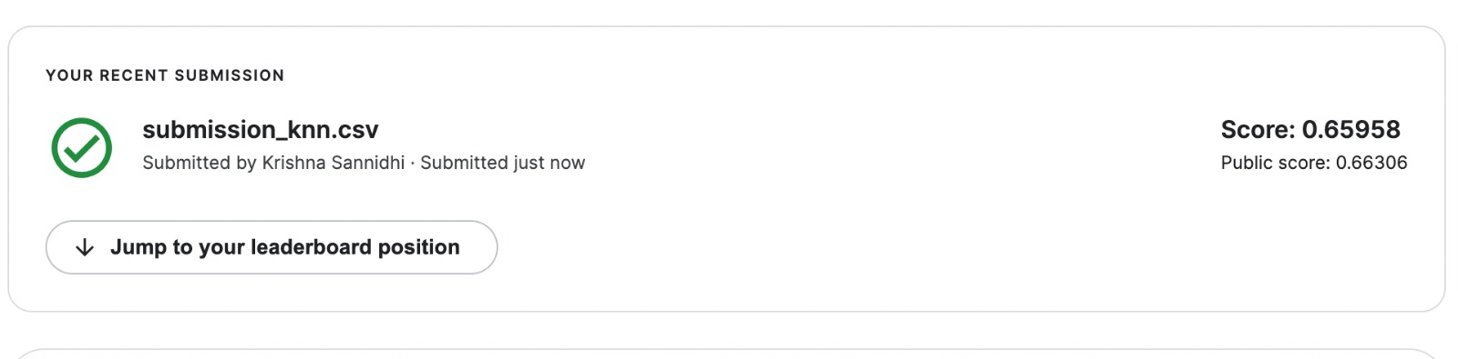
For K-Nearest Neighbors, We have achieved an accuracy 63.047,error rate of 2.6407 and an AUC score of 0.6715
Kaggle score: 0.65958
Screenshot:

Slide 17
Out of all, Random Forest model provided better accuracies and so we considered it as the best suited model for our data. The Random Forest Model has a test accuracy of 68 percent, AUC score of 97 percent, Error rate of 2.6407. Kaggle score of 0.72559 and private score of 0.72778.

Slide 18
CONCLUSION
The primary goal of this project is to build a Machine Learning model that can predict a person will be able to repay the loan that is granted. Our project is to predict if a person can repay their loan based on many factors like their previous application history, monthly balances of previous credits, credit card balance etc. This model aids in choosing the applicants if they can repay the loan based of variety of factors considered. Created a pipeline model and tested on Support Vector Machine, Logistic Regression, Random Forest, Decision Trees and K-Nearest Neighbors models. We have also submitted these on Kaggle.
The logistic regression achieved an accuracy of 92%. We have also submitted this on kaggle which got us a score of 0.71530.
In future we will build a multi-layer perceptron model using PyTorch.

Slide 19
THANK YOU

