Slide 1
Behavioural data – control analyses
Different types of ‘perfect observer’:
If you knew your exact error on a trial, you wouldn’t make the error
instead, perfect insight into ‘performance’ across trials (i.e. you know the shape of your performance distribution
Confidence on the single trial thus un-linked to actual response error on that trial
Instead, randomly samples confidence from the across-trial error distribution
Two ways of exploring this

Slide 2
Observed data
1. Permutation-based control analysis
Error:
26
1
14
31
12
Confidence:
12
8
11
10
10
Steps:
Separately for each condition, shuffle confidence
Preserves shape of confidence distribution, but removes link between single trial response & confidence
Calculate correlation between error ~ confidence with this shuffled data, separately for each condition
Repeat 10,000 times per participant
This generates a null distribution of error~confidence correlations under the hypothesis that insight isn’t linked to single trial response error, but across trial knowledge of the confidence (error) distribution
We then get the expected correlation between error & confidence under this null hypothesis, per participant and condition
Can formally compare the observed correlation vs expected correlation under this null (with a t-test on fisher-transformed correlations
Permuted data
Error:
26
1
14
31
12
Confidence:
10
10
12
11
8

Slide 3
1A. Permutation-based control analysis - confidence ~ error correlation
One-sided paired-samples t-tests on fisher transformed values:
Are the observed correlations reliably greater than the expected (mean) correlation under the null distribution
Neutral: t(19) = 7.27, p = 3.39 x 10⁻⁷
Cued: t(19) = 6.29, p = 2.43 x 10⁻⁶
Notes:
Also done this for the linear mixed effects model analysis (figures not shown)

Slide 4
1B. Permutation-based control analysis - random effects analysis

Slide 5
1B. Permutation-based control analysis - linear mixed-effects analysis

Slide 6
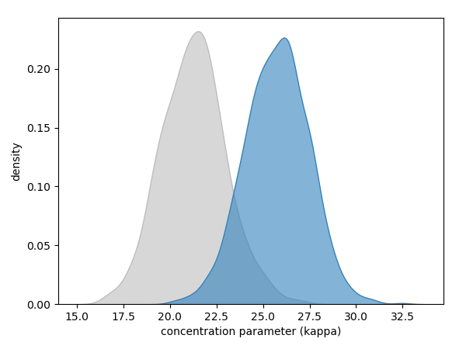
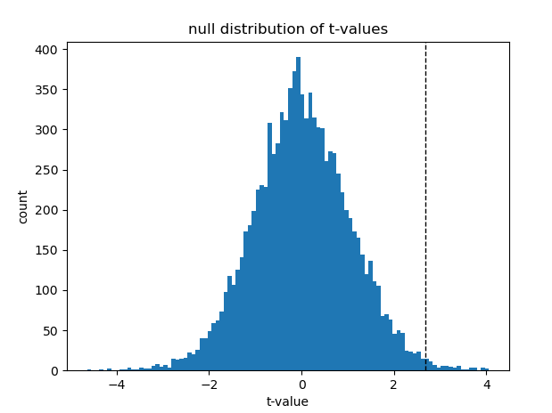
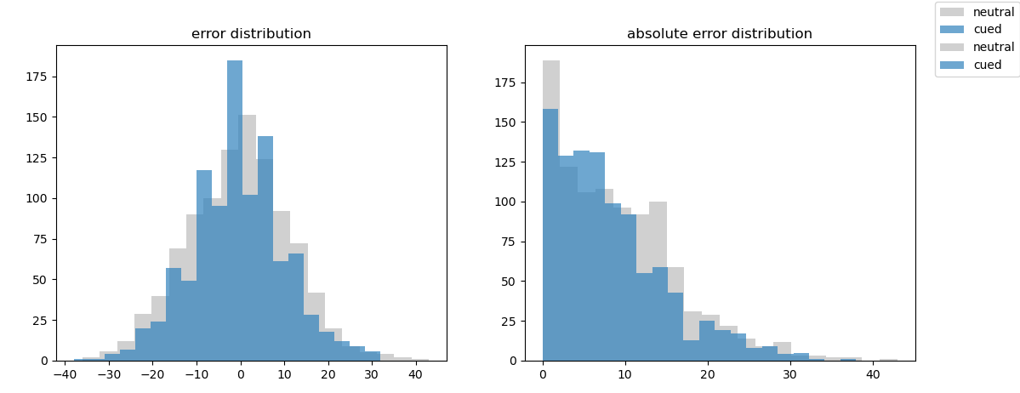
2. Simulation of effects
Randomly sample to get kappa for cued and neutral trials for simulated participant
Generate parent distribution of response errors (1k samples) using the concentration parameter for this simulated participant
Using this simulation based approach, the empirically observed effects in experiment 1 (in both a simulated random-effects analysis and linear mixed-effects analysis) are significant
Not expected under the null belief that confidence arises not from single-trial insight, but perfect knowledge of across-trial error
Notes:
Note, have done this for the LMM version too – same effect, our results don’t really stand under the null belief
Reasons LMM isn’t necessarily the right thing:
Makes inferences at the trial level – i.e. if we run another trial of this task on any participant, what do we expect the confidence judgement to be given response error + cue condition
Random-effects analysis where GLM is run at the single subject level, and a t-test is done on the output betas across subjects:
Inference of the second-level analysis is about reliability across participant
i.e. if we ran this task on a new participant, would we reliably expect this relationship to hold up?

Slide 7
2. Simulation of effects
2A. Random-effects simulation
2A. Linear mixed-effects simulation

Slide 8
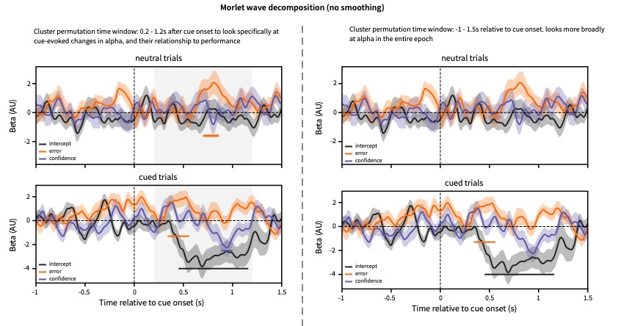
Confidence EEG data – extra analyses

Slide 9
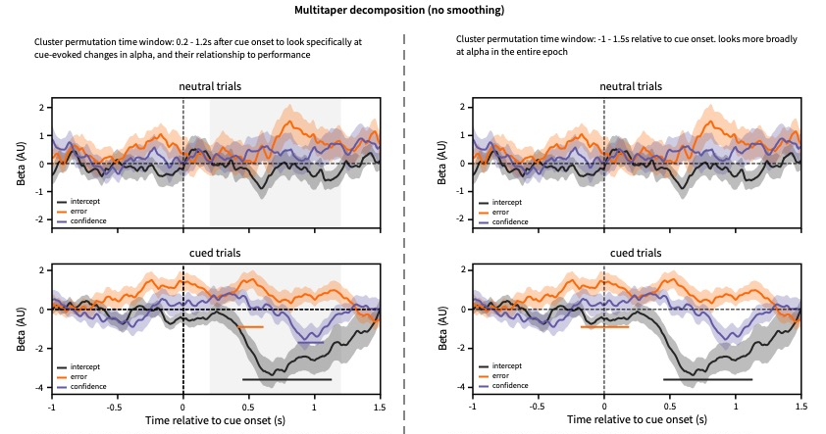
EEG data – extra analyses

