Slide 1
Behavioural data – control analyses
Different types of ‘perfect observer’:
If you knew your exact error on a trial, you wouldn’t make the error
instead, perfect insight into ‘performance’ across trials (i.e. you know the shape of your performance distribution
Confidence on the single trial thus un-linked to actual response error on that trial
Instead, randomly samples confidence from the across-trial error distribution
Two ways of exploring this

Slide 2
Observed data
1. Permutation-based control analysis
Error:
26
1
14
31
12
Confidence:
12
8
11
10
10
Steps:
Separately for each condition, shuffle confidence
Preserves shape of confidence distribution, but removes link between single trial response & confidence
Calculate correlation between error ~ confidence with this shuffled data, separately for each condition
Repeat 10,000 times per participant
This generates a null distribution of error~confidence correlations under the hypothesis that insight isn’t linked to single trial response error, but across trial knowledge of the confidence (error) distribution
We then get the expected correlation between error & confidence under this null hypothesis, per participant and condition
Can formally compare the observed correlation vs expected correlation under this null (with a t-test on fisher-transformed correlations
Permuted data
Error:
26
1
14
31
12
Confidence:
10
10
12
11
8

Slide 3
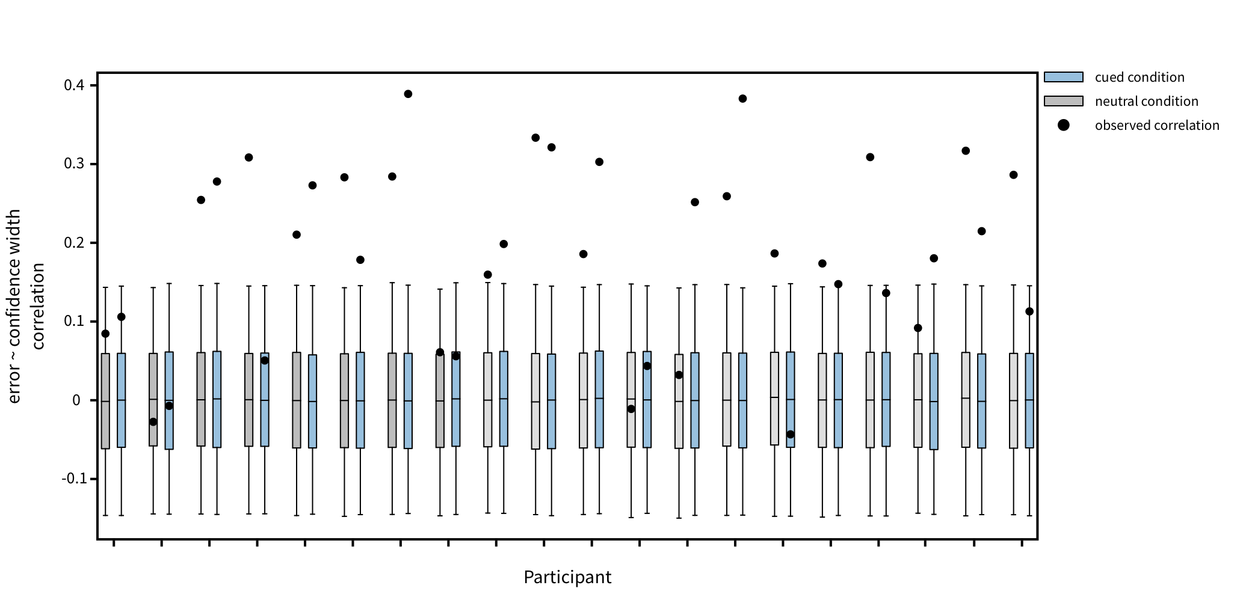
1. Permutation-based control analysis
One-sided paired-samples t-tests on fisher transformed values:
Are the observed correlations reliably greater than the expected (mean) correlation under the null distribution
Neutral: t(19) = 7.27, p = 3.39 x 10⁻⁷
Cued: t(19) = 6.29, p = 2.43 x 10⁻⁶

Slide 4
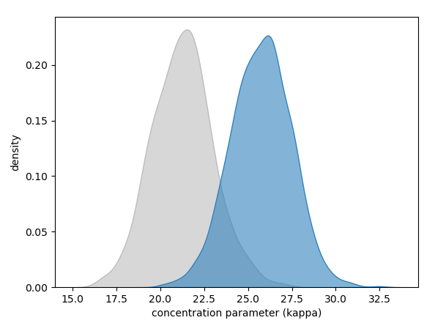
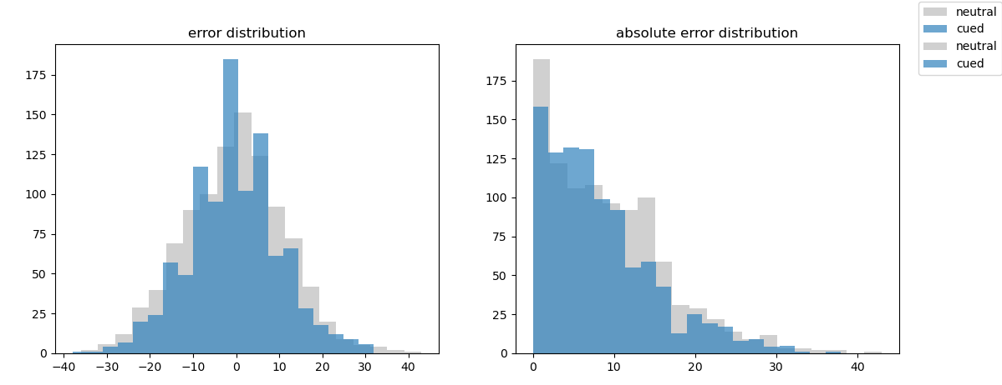
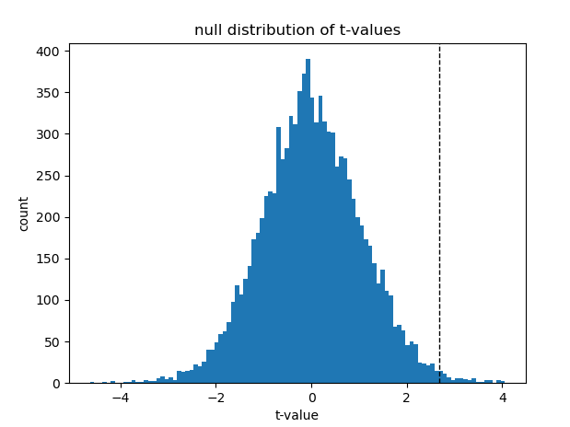
2. Simulation of effects
Can we simulate what the relationship could look like under the belief that people don’t have single trial insight, but instead have perfect knowledge of their across-trial error distribution?
Run 10,000 simulations where we:
Simulate error distributions for neutral and cued trials separately, for 20 subjects in each simulated data set
For each simulated participant, generate a ‘confidence’ on each ‘trial’ by randomly sampling from the absolute error distribution for the condition.
This simulates what confidence would look like with perfect insight into across-trial performance, but not the single-trial response error (the null hypothesis)
Run the analysis looking at confidence ~ error as a function of cue condition for the simulated dataset
Store the t-value for the error*cue interaction here (the difference in error ~ confidence slope between cue conditions)
Repeat this 10,000 times
Generate null distribution of these t-values (effect sizes) that arise under the null hypothesis
Proportion of t-values larger than our observed effect size is the p-value for our observed effect size
For comparison with observed effect in a random-effects analysis (across-subject t-test of within-subject GLM interaction beta-weights)
Observed interaction (t(19) = 2.689, p = 0.0145)
p-value for this observed effect under the null: 0.0074 (0.74% of simulated interaction effects were larger than our observed effect)
Suggests that our observed effect is unlikely to occur under the null hypothesis that confidence judgements were made with perfect insight into across-trial response error, but no insight into single-trial error
Randomly sample to get kappa for cued and neutral trials for simulated participant
Generate parent distribution of response errors (1k samples) using the concentration parameter for this simulated participant
Notes:
Note, have not done this for the LMM version, but probably should
Reasons LMM isn’t necessarily the right thing:
Makes inferences at the trial level – i.e. if we run another trial of this task on any participant, what do we expect the confidence judgement to be given response error + cue condition
Random-effects analysis where GLM is run at the single subject level, and a t-test is done on the output betas across subjects:
Inference of the second-level analysis is about reliability across participant
i.e. if we ran this task on a new participant, would we reliably expect this relationship to hold up?

