Slide 1


Concurrency and threads
.
Jens Egholm Pedersen
<jeep@cphbusiness.dk>

Slide 2
About me
Political science from Aarhus University
Software development from IT-University
4 years of work experience
  Mainly in Java
Generally a nice guy
  Don’t be afraid to ask questions

Slide 3
About these lectures
One-way communication
  You receive information
  Make sure you understand it!
Exploit what we prepared for you
  Bloom’s Taxonomy
  Lecture = Understanding
  Lecture + Preparation = Analyzing
  Lecture + Preparation + Exercises = Creating
When studying for the exam use ‘see also’
  Not part of the curriculum!
See also: Something to read, Bloom’s taxonomy
Notes:
Remembering – Understanding – Applying – Analyzing – Evaluating – Creating

Slide 4
What you should know
Goal of todays and tomorrows lectures on threads
Understand concurrency and develop concurrent applications
Use mechanisms to synchronise threads
Understand and identify deadlocks
Understand and use the publish-subscribe pattern in Java
Litterature: Introduction to Java threads

Slide 5
An instruction
Basic building block of software
Written by the programmer, translated into machine code
10 + 10 // 20
See also: Instruction Set example

Slide 6
A core
Processes instructions
One instruction at the time
  One core: speed x 1
  Two cores: speed x 2
  Four cores: speed x 4
  … Not entirely true
See also: Central Processing Unit (CPU)

Slide 7

A thread
A list of many instructions
Can be assigned to a core
Can start and stop
See also: Java API for Thread class

Slide 8
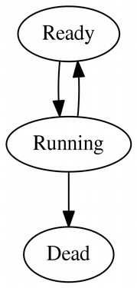
Threads in Java 1/2
Can be created, started and stopped
Creating threads
  With Thread
  With Runnable
Who decides when a thread is run?
Java thread states
See also: Java thread states

Slide 9
A scheduler
Schedules when threads should be run
  ‘God mode’ - you have almost no control
Consequences:
  Nondeterministic
  Overhead
    Scheduling is work
    More threads, more work
      Hint: don’t create 1.000.000 threads
        Unless you have 1.000.000 cores
See also: Definition of ‘scheduling’, Almdahl’s law

Slide 10
Multi-core architecture
Having many cores in one CPU
  One core: one thread at once
  Two cores: two threads at once
  1.000.000 cores: 1.000.000 threads at once
  One core trying to run 1.000.000 threads = disaster
Many cores but shared hardware
What are the threads doing?
  Manipulating memory and interacting with I/O devices
See also: Multicore processors

Slide 11
Recap
A thread is a list of instructions
A core can execute one thread at the time
No one knows when threads starts or stops
Threads share memory
A process can create and use threads

Slide 12
Coming up
How and why concurrency can will fail
More threading in Java
Synchronising threads
Deadlock and starvation

Slide 13
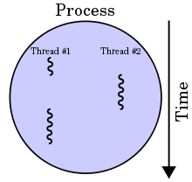
Processes and threads
A process is a running application
A process can have one or more threads
Every process has a main thread
  In Java: public static void main(String[] args)
See also: Definition of process

Slide 14
A process in Java
One thread
Two threads
Many threads

Slide 15
Concurrency
“Happening at the same time”
Normal program: A – Z
Concurrent program: G, S, A, D, Y, …
What could go wrong?
This is very very very hard
See also: Concepts of Concurrent programming (glossary), Rust Concurrency

Slide 16
Thread unpredictability
Threads can start and stop at all times
  Even between instructions!
How many instructions are count++?
  3: Load, sum, store
See also: java.util.concurrent.atomic package in Java

Slide 17
Problems with concurrency
Race condition
Deadlocking
Starvation
See also: java.util.concurrent.atomic package in Java

Slide 18
Race condition
Problem with shared memory
  Who comes first?
Happens when order of threads matter
Example: Summing numbers in Java
Good news: Can be avoided with practice
See also: Java Thread synchronisation tutorial

Slide 19
Deadlocking in Java
When two threads wait for the same thing
Example: deadlock in Java
Bad news: No easy solution
  Advice from book
  ‘To avoid deadlock, you should ensure that when you acquire multiple locks, you always acquire the locks in the same order in all threads.’
See also: Java deadlock tutorial

Slide 20
Starvation in Java
When threads cannot progress
  Greedy threads steals resources
  Thread slows down
Hard to reproduce

Slide 21
Recap
A thread is a list of instructions
Threads run randomly but share memory
Java processes can create and run threads
Threads are dangerous!
  They share memory and risk race conditions
  They deadlock
  They can steal resources from others

Slide 22
Coming up
History of CPU development
Multi-core processor architecture
Benefits of multi threaded computing

Slide 23

Moore’s law
See also: Moore’s law

Slide 24
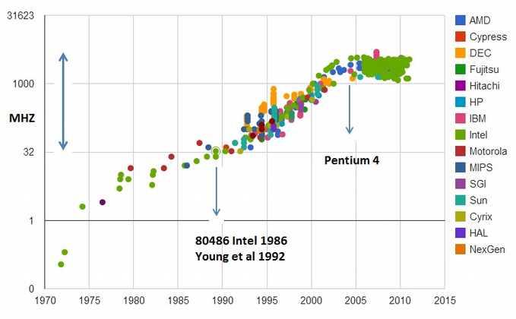
Clock frequency
See also: Technology roadmap for semiconductors

Slide 25
Where does the computing
power come from?

Slide 26
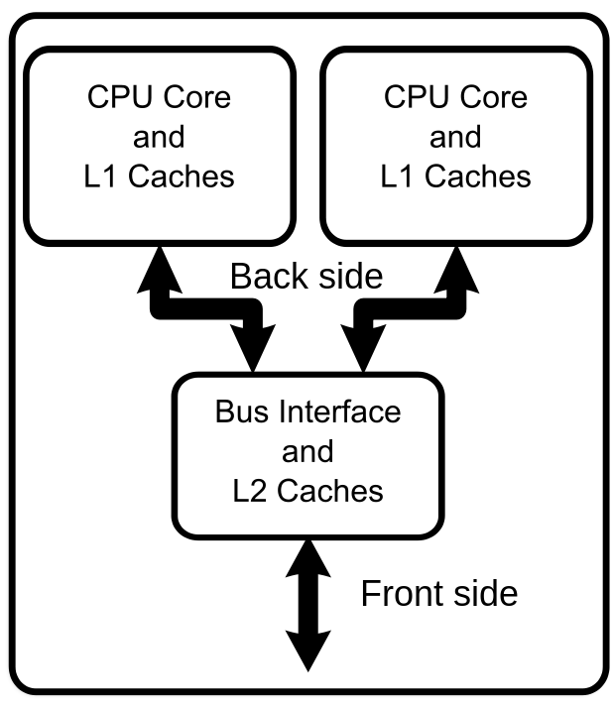
Multi-core processor

Slide 27
Multi-core processor
CPU 1
CPU 2
CPU 3
CPU 4
Memory
Memory
Memory
Memory
Memory

Slide 28

Power consumption
High frequency = high energy consumption
Low frequency + more cores = efficiency

Slide 29
Parallelisation benefits
A core can work one instruction at the time
  1 core = speed x 1
  2 cores = speed x 2
  4 cores = speed x 4
… If you parallelise your software!

Slide 30
Recap
Number of cores are growing fast!
Cores in a multi-core processor share memory
Perfect parallelisation means a speedup factor equal to the number of cores
  Fast!

Slide 31
Coming up
Atomic variables
Critical sections of code
Locking and synchronisation
More about threads
Controlling threads in Java

Slide 32
Critical section
Critical sections may not run concurrently
  Example: variable
Thread safety
  A guarantee for the same behaviour with many threads
How to control access to a section?
  Gatekeeper / locking variable
Who protects the protector?
  Good question!

Slide 33
Locking a variable
Atomic operations cannot be intercepted
  Also known as thread-safety
  Lock-free
  Solves race-conditions for counters
Javas atomic classes
  AtomicInteger counter = new AtomicInteger();
  counter.get(); // 0
  counter.getAndIncrement();
  counter.get(); // 1
Why ‘getAndIncrement’?
    Because increments are 3 operations
See also: java.util.concurrent.atomic

Slide 34
Locking a section
Why not just a simple variable?
  Because it is not thread safe!
volatile keyword
  Ensures that reads and writes are atomic
  Is this good enough?
No, not always good enough
  Good for reading (loop condition)
  Bad for counting (race-condition)
See also: Mutual exclusion (mutex)

Slide 35
Synchronisation
Only allow one thread to access code at once
Method synchronisation
Block synchronisation
  Synchronising on this
  Synchronizing on object(s)
Which one is preferred?
  Block synchronisation. It only locks the critical section and not the whole method
See also: Java synchronization

Slide 36
Synchronisation question
Is this implementation thread safe?
int i = 0;
synchronized void increment() {
  i++;
}
No! i is public!
  Synchronize does not mean you do not have to think
  Encapsulate, encapsulate, encapsulate

Slide 37
Recap
Thread is a list of instructions
Concurrency can go wrong!
Atomic operations
Locks
Synchronisation
Thread-safety

Slide 38
Thread safety question
Is this thread-safe?
class Singleton {
  private static Singleton instance = null;
  private Singleton() { /* private constructor */ }
  public static Singleton getInstance() {
    if (instance == null) {
      instance = new Singleton();
    }
    return instance;
  }
}
No! getInstance is not synchronized

Slide 39
Coming up
Locking and synchronisation
More about threads
Controlling threads in Java
Semaphores

Slide 40
Threads in Java 1/2
Can be created, started and stopped
Creating threads
  With Thread
  With Runnable
I lied!
Java thread states
See also: Java thread states

Slide 41
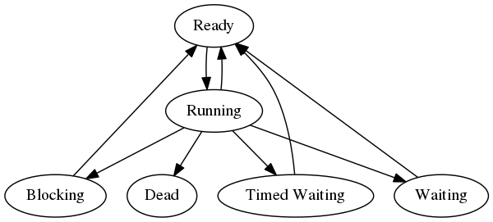
Threads in Java 2/2
Threads have three more states
Blocking
  Waiting for resource until released
  For instance when waiting for access to synchronized
Waiting
  Object.wait();
  Thread.join();
Waiting with a timeout
  Object.wait(...);
  Thread.join(...);
  Thread.sleep(...);
!
See also: Java API for Thread class

Slide 42
Controlling threads 1/2
Threads can be controlled (a little)
  interrupt()
    Sends a signal to the thread to stop what it’s doing
    Can be ignored by the thread
  join() and join(...)
    Wait until a thread dies
  sleep(...)
    Do nothing
See also: Java API for Thread class

Slide 43
Controlling threads 2/2
Threads can also be controlled via Object
  wait() and wait(...)
    Blocks current thread until someone calls notify()
  notify()
    Wakes a single thread
  notifyAll()
    Wakes all threads
  Both are tied to an object
    MUST be synchronized
See also: Java API for Thread class

Slide 44
A Semaphore
Data used to control access for multiple threads
Useful metaphor: How many units are available?
Two types of semaphores
  Binary (1 resource)
  Counting (2+ resources)
Is the synchronized keyword a semaphore?
See also: Java API for Semaphore

Slide 45
Semaphore examples
Two operations
  acquire() access to critical region
  release() access permission
Binary semaphore
  Semaphore s = new Semaphore(1);
Counting semaphore
  Semaphore s = new Semaphore(10);
See also: Java API for Semaphore

Slide 46
Locks in Java
Another way to controls access to critical section
Fairness
  Longest waiting thread gets the lock
Lock interface
  lock()
  unlock()
ReadWriteLock interface
  readLock() - returns a Lock
  writeLock() - returns a Lock
Remember to release the lock!
  Use try-finally
See also: Java API for Lock, Java API for ReadWriteLock

Slide 47
Locks in Java example
ReentrantLock
  Reentrant means that a thread can have more than one lock
  ReentrantLock lock = new ReentrantLock();
  lock.lock();
  try { … } finally { lock.unlock(); }
ReentrantReadWriteLock
  ReentrantReadWriteLock lock = new ReentrantReadWriteLock();
  WriteLock writeLock = lock.writeLock();
  writeLock.lock();
  try { … } finally { writeLock.unlock(); }
See also: ReentrantReadWriteLock versus StampedLock

Slide 48
Synchronisation versus locks
Lock provides more visibility and functionality
  For instance tryLock()
Lock require try-finally blocks
  Synchronization code can be cleaner
Lock can be aquired in one method and released in another
  Good or bad?
Lock provide fairness
  The longest waiting threads get the lock first

Slide 49
Recap
Critical sections consist of code that cannot run concurrently
Atomic operations cannot be intercepted
Controls to critical sections
  synchronized
  Semaphores (can allow one or more threads at once)
  Lock
Threads can be join()’ed and interrupt()’ed

Slide 50
Coming up
Getting data out of threads
Producer-consumer problem
Observable
Thread pools and ExecutorService in Java
Threads in Swing
Thread priority

Slide 51
Getting data out of threads
Threads and Runnables return void
How do we get the data out?!
Use class variables
  Not thread safe?
Use collections like lists, queues etc.
  Producer/consumer problem!
Use observables
  Only notified when something happens (reactive)

Slide 52
A note on java.util.concurrent
Great collection library
Contains the atomic package
Contains the locks package
Contains CopyOnWriteList
Contains ConcurrentHashMap

Slide 53
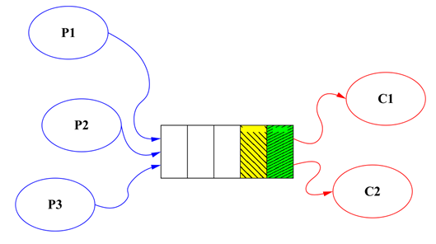
Producer-consumer problem 1/2
Consider two processes:
  One process puts elements in a queue
  One process takes elements from the queue
The queue has a fixed size
What happens if
  The producer slows down?
    Starvation
  The consumer slows down?
    Buffer overflow
Ekstra læsning: Guarded blocks

Slide 54
Producer-consumer problem 2/2
In modern Java: ArrayBlockingQueue
Example
  ArrayBlockingQueue q = new ArrayBlockingQueue();
  // Thread 1 - Producer
  q.put(…);
  // Thread 2 – Consumer
  q.take();

Slide 55
Observer pattern
Instead of pushing (producing) we can observe
Observer versus Observable
An Observer is registered in an Observable
The Observable will notify the Observer
      Don’t call us, we’ll call you!
interface Observable<T> {
public void onEvent(T event);
}

Slide 56
Executors in Java
Creating threads is not free
  Reuse them!
Thread pool in Java
Executors
  .newCachedThreadPool()
  .execute(runnable);
Ekstra læsning: OSI Model

Slide 57
Threads in Swing
Swing uses a special event dispatch thread
All Swing component methods must be invoked from this thread
  Unless the API states it is thread safe
Example
  SwingUtils.invokeLater(() -> text.setText(“hi”));
What if you submit a 1000 second task?
  It blocks!
Ekstra læsning: Swing event dispatch thread

Slide 58
Thread priority
Thread can have a priority
  Tells the scheduler how to prioritise
Ranges from 1 (min) to 10 (max)
  Thread.MIN_PRIORITY and Thread.MAX_PRIORITY
Must be set before start
Thread t = ...;
t.setPriority();
t.start();

Slide 59
Detecting deadlocks
ThreadMXBean mx =
ManagementFactory.getThreadMXBean();
long[] deadlocked = mx.findDeadlockedThreads();
Ekstra læsning: ThreadMXBean

Slide 60
Recap
Threads can be prioritised
Use executors when you have many tasks
Swing uses one single event thread
Producer-consumer problem

Slide 61
Todays exercise
Getting stuff from the web
Waiting for stuff from the web
Fibonacci observer
  1 – 1 – 2 – 3 – 5 – 8 - …
Fibonacci observer GUI
Deadlock detection

