Slide 1
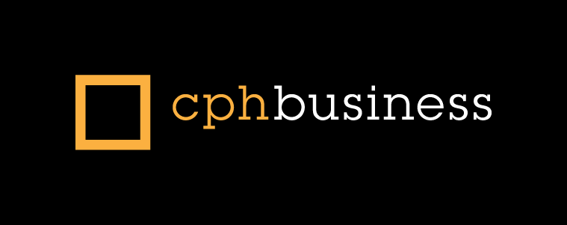
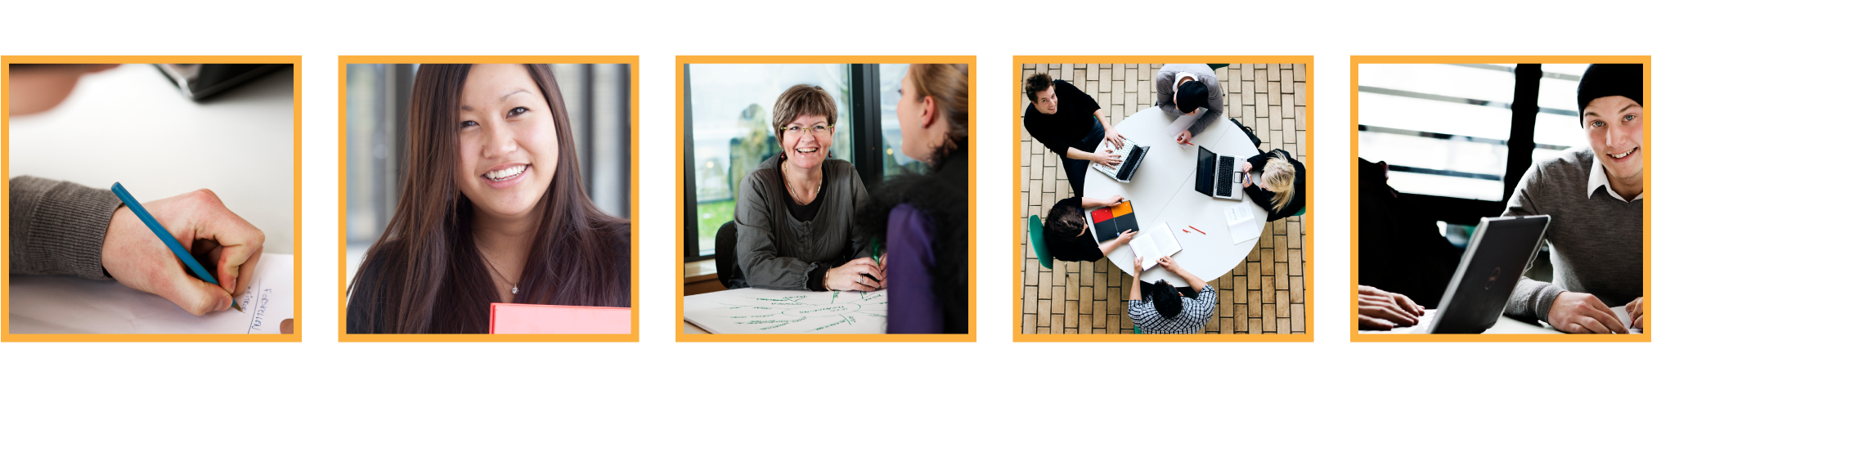
Network and sockets
.
Jens Egholm Pedersen
<jeep@cphbusiness.dk>

Slide 2
Learning Goals
Network – Socket Programming
Main Topics | Socket Programming Network protocols
When this lesson is over you should be able to: | Understand ports and IP Addresses Implement Network Clients using either TCP (or UDP) Implement Servers using either TCP (or UDP) Implement thread safe multi threaded servers Implement a simple user defined application layer protocol

Slide 3
Ports
An endpoint of communication in an operating system
Like a plug; only one at the time!
16 bit unsigned number
  (0 – 65535)
Ports beneath 1024 typically needs elevated permissions
See also: Wikipedia on Socket

Slide 4
Known ports
20 FTP -- Data
21 FTP -- Control
22 SSH Remote Login Protocol
23 Telnet
25 Simple Mail Transfer Protocol (SMTP)
37 Time
42 Host Name Server (Nameserv)
43 WhoIs
53 Domain Name System (DNS)
80 HTTP
110 POP3
115 Simple File Transfer Protocol (SFTP)
156 SQL Server
194 Internet Relay Chat (IRC)
197 Directory Location Service (DLS)
389 Lightweight Directory Access Protocol (LDAP)
443 HTTPS
546 DHCP Client
547 DHCP Server
See also: List of known ports

Slide 5
IPv4 Addresses
An IPV4 address is a 32-bit address. (The future is IPV6)
Binary Notation
10000001 10100101 00001101 11100100
Decimal
129
165
13
228
Hex
81
A5
0D
E4
= 0x81A50DE4

Slide 6
IP address ranges
Ranges of valid addresses
Usually expressed in subnet mask or CIDR (Classless Inter-Domain Routing)
Subnet mask (IPv4 only)
  Expressed in dot-decimal (like IPv4 addresses)
  Address: 192.168.0.0, net mask: 255.255.255.0
CIDR range (IPv4 and IPv6)
  Expressed in remaining bits
  192.168.0.0/24
See also: IP subnetting, CIDR notation

Slide 7
Socket
An endpoint of network communication
Like a plug; only one at the time!
Consists of an IP address and port number
See also: Wikipedia on Socket

Slide 8
Using sockets
java.net.Socket
java.net.ServerSocket
java.net.SocketAddress
socket.bind()
  What can go wrong?
    IOException
See also: Wikipedia on Socket

Slide 9
IO Exceptions
Input/Output = stort set alt
Known subclasses:
  ChangedCharSetException, CharacterCodingException, CharConversionException, ClosedChannelException, EOFException, FileLockInterruptionException, FileNotFoundException, FilerException, FileSystemException, HttpRetryException, IIOException, InterruptedByTimeoutException, InterruptedIOException, InvalidPropertiesFormatException, JMXProviderException, JMXServerErrorException, MalformedURLException, ObjectStreamException, ProtocolException, RemoteException, SaslException, SocketException, SSLException, SyncFailedException, UnknownHostException, UnknownServiceException, UnsupportedDataTypeException, UnsupportedEncodingException, UserPrincipalNotFoundException, UTFDataFormatException, ZipException
See also: Java API on IOException

Slide 10
Recap
Ports
IP addresses
IP address ranges
Sockets

Slide 11
Socket Programming
Application Layer
TCP (Transmission Control Protocol)
TCP provides a connection-oriented service to its applications. This service includes guaranteed delivery of application-layer messages to the destination .
Transport
Layer
Internet
Layer
Network Layer
UDP (User Datagram Protocol)
UDP provides a connectionless service with no guaranteed delivery of application-layer messages to the destination .
The Internet protocol stack

Slide 12
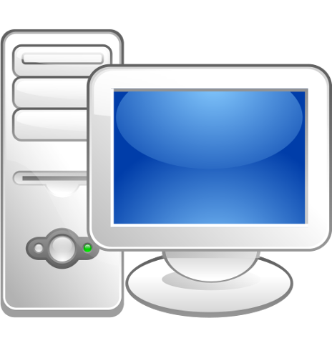

TCP
YES if you slow down and give me time to store
Are you Getting
This

Slide 13
Socket Programming with TCP
Host or Server
Host or Server
Controlled by you -
the application developer
Process
Process
SOCKET
SOCKET
Internet
TCP with buffers, variables
TCP with buffers, variables
Controlled by the OS
The application developer has the ability to fix a few TCP parameters, such as maximum buffer and maximum segment sizes.

Slide 14
Socket and Streams
Host or Server
Host or Server
Process
Process
Input
Stream
Output
Stream
Output
Stream
Input
Stream
SOCKET
SOCKET
TCP with buffers, variables
TCP with buffers, variables
Internet

Slide 15
TCP Socket Programming with Java
1: Create a ServerSocket object.
1: Establish a connection to the server
(Three way handshake)
ServerSocket ss=new ServerSocket(8080);
2: Put server into waiting state
Socket link = new Socket(“lmo”,8080);
Socket link = ss.accept();
3: Set up input and output streams
2: Set up input and output streams
BufferedReader in =
new BufferedReader(
new InputStreamReader(
link.getInputStream()));
PrintWriter out = new PrintWriter(
link.getOutputStream(),true);
3: Send and Receive Data
4: Send and Receive Data
4: Close Connection
5: Close Connection
Link.close()
Link.close()
Listen for connecting clients
Connection is established
(Three way handshake is completed)

Slide 16
Sockets for Servers and Clients
Server
  Server Socket (java.net.ServerSocket )
    Handles the initial contact from a client.
  Socket (java.net.Socket)
    Is created at initial contact of client.
    New socket that is dedicated to the particular client.
Client
  Socket (java.net.Socket)
    Initiate a TCP connection to the server by creating a socket object. (Three-way handshake)
    Specify the address of the server process, namely, the IP address of the server and the port number of the process.

Slide 17
Sockets for Servers and Clients
java.net.Socket
    Implements client sockets (also called just “sockets”).
    An endpoint for communication between two machines.
    Constructor and Methods
      Socket(String host, int port): Creates a stream socket and connects it to the specified port number on the named host.
      InputStream getInputStream()
      OutputStream getOutputStream()
      close()
java.net.ServerSocket
    Implements server sockets.
    Waits for requests to come in over the network.
    Performs some operation based on the request.
    Constructor and Methods
      ServerSocket(int port)
      Socket Accept(): Listens for a connection to be made to this socket and accepts it. This method blocks until a connection is made.

Slide 18
The bind(..) method
In the simple examples we have done so far we only gave a port number when we constructed a ServerSocket
What if the server had more than one network interface?
Bind your Socket to an IP + a PORT
Never hardcode IP and Port numbers
They will change when you deploy
public static void main(String args[]){
if(args.length==2){
ip = args[0];
port = Integer.parseInt(args[1]);
} else throw new IllegalArgumentException();
ServerSocket serverSocket = new ServerSocket();
serverSocket.bind(new InetSocketAddress(ip, port));
...
On a server you need to bind to a specific network interface (IP), otherwise it won't work

Slide 19
Example: Chat system
Goal: Design a chat system
Three actions: Log in, log out and send message
What transport protocol to use?
    TCP
How would you log in and out?
    List of clients
How would you send messages?
      Observables

Slide 20
Recap
Sockets
Like plugs – only one connection per plug!
TCP and UDP
What is the difference?
IP addresses
Unique addresses
… for that network

Slide 21
Protocols
In telecommunication, a protocol is the special set of rules that end points in a network connection use when they communicate
Protocols specify interactions between the communicating entities
What are examples of protocols for:
    Client and server on the Web
    Sending files between client and server
    Human to human

Slide 22

Protocols - example
http://docs.oracle.com/javase/tutorial/networking/sockets/clientServer.html
Download and test the file knockknock.zip

Slide 23
Protocols - example
This could be part of a protocol for a CHAT system
Client
Server
CONNECT#name
The server expects to receive a CONNECT message as the very first message from a client. If not, you break the protocol, and the server will not be able to serve you.
ONLINE#name1,name2…
The Client expects to receive an ONLINE message as the very first message from a the server. If not, you break the protocol, and the Client will not now what to do.

Slide 24
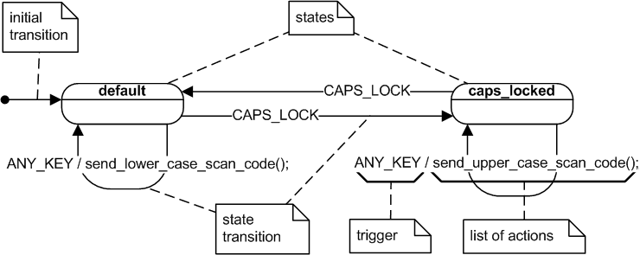
State diagrams
Finite State Machines and State Diagrams can be used to describe protocols.
http://en.wikipedia.org/wiki/UML_state_machine

Slide 25
Patterns for simple protocols
One Protocol Handler Class as in the Knock Knock example (only for simple protocols)
The GOF State Pattern (http://en.wikipedia.org/wiki/State_pattern)
The GOF Command Pattern (http://en.wikipedia.org/wiki/Command_pattern )
…

