Slide 1


HTTPS and certificates
.
Jens Egholm Pedersen
<jeep@cphbusiness.dk>

Slide 2
Networking so far
IP
TCP
HTTP
→ Everything‘s visible!
Which layer should be encrypted?
  Transport Layer
Application Layer
Transport Layer
Internet Layer
Network Layer
See also: Transport Layer Security

Slide 3
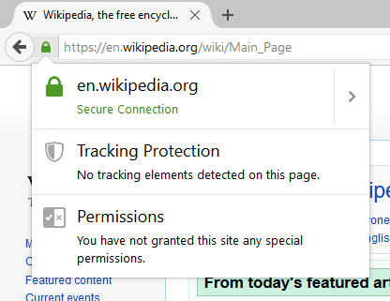
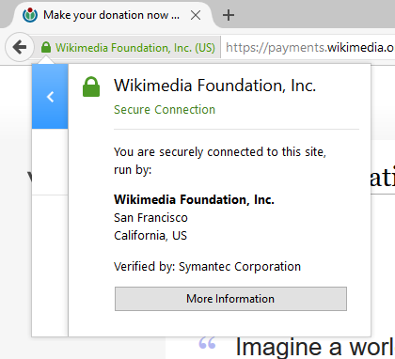
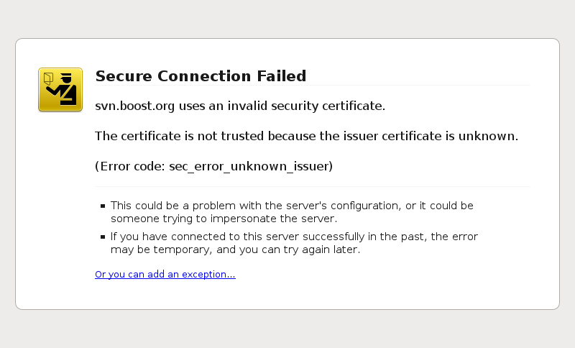
HTTPS
HTTP over TLS (on what port?)
Simply HTTP inside a TLS tunnel
See also: HTTPS

Slide 4
Security
Hiding the content of a communication
  Coding/encrypting
Hiding the parties in the communication
  Anonymisation
Hiding that a communication takes place
  Security by obscurity
See also: Secure communication

Slide 5
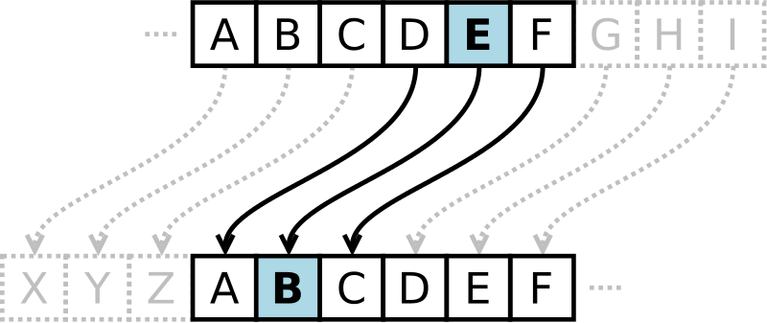
Cryptography
Study of secure communication
Classic: Caesar cipher
Now: Symmetric-key and public-key

Slide 6
Symmetric-key cryptography
Decryption by key
Classic: Caesar cipher
Modern: AES, DES, ...
See also: Advanced Encryption Standard (AES)

Slide 7
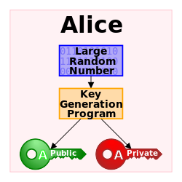
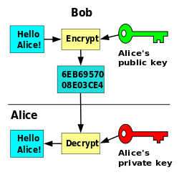
Public-key cryptography
Asymmetric
  public and private key
Encryption by the public key
Decryption by the private key

Slide 8
TLS
Transport layer security
  Protects the transport layer with public-private keys
Problem solved?
Where do you get the public key from?
  The server
Who is the server?
  ?!

Slide 9
HTTPS
HTTP over TLS
Need trusted third party to authenticate the server
See also: Certificate Authority

Slide 10
HTTPS certificate
We will use Let‘s encrypt
Because it‘s free!
  https://letsencrypt.org/

Slide 11
HTTPS certificate
Cerifies that a domain belongs to a server
Certificates only for domains
DNS hack! http://xip.io/

Slide 12
Reverse proxy
It‘s possible to install using Tomcat
We will be using a ‚gatekeeper‘
  Reverse proxy
HTTP server
Tomcat

Slide 13
Load balancing
How many connections can a computer have?
  65536
HTTP server
Backend 1
Backend 2
Backend n

Slide 14
Our gatekeeper
Nginx
  In Ubuntu:
    sudo apt-get install nginx
  Now open port 80 on your host

Slide 15
HTTPS
What port is used for HTTPS?
  443
How can we fix this with the HTTP protocol?
  Redirect
  301 Moved permanently

Slide 16
Installing certificate
Let‘s encrypt Certbot
    https://certbot.eff.org/
    → Choose Nginx and your OS

Slide 17
Exercises for today
Getting a Digital Ocean server running
Installing a reverse proxy
Installing a certificate via https://certbot.eff.org
Installing the certificate in Nginx
Watching the fruits of your labour!

