Slide 1


Networks Application Layer
Jens Egholm Pedersen <jeep@cphbusiness.dk>
Litterature:
http://en.wikipedia.org/wiki/Internet_protocol_suite
http://en.wikipedia.org/wiki/Domain_Name_System

Slide 2
Learning Goals
Network
Main Topics | TCP/IP and the OSI model Network analysis/sniffing Application Layer Protocols HTTP (Covered in another lesson) DNS DHCP
When this lesson is over you should be able to: | Explain what a network protocol suite is Describe the layers of the TCP/IP protocol system and the purpose of each layer Describe the purpose of network sniffing/analysis tools, an use nslookup, ipconfig (ifconfig), ping, traceroute (tracert) and Wireshark for simple analysis scenarios Give examples of popular Application Layer Protocols

Slide 3
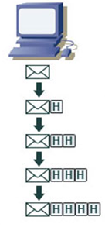
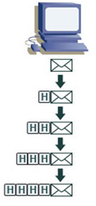
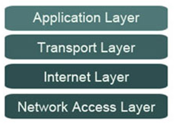
TCP/IP protocol suite
A system of protocols
TCP/IP maintained by the Internet Engineering task force (IETF)
See also: TCP/IP on Wikipedia

Slide 4
Network interface
Interface between two pieces of equipment
  Computer ↔ Router
Typically a network card
  But also a local virtual interface
  If a server listens on localhost, who else sees it?
    No one!
One computer = many interfaces
  Ethernet, Wifi, Loopback, etc.
See also: Network interface controller, Loopback interface

Slide 5
The TCP/IP Protocol Stack
The application layer contains all protocols for specific data communications services on a process-to-process level.
HTTP, DNS, FTP, POP, Telnet ....
Application Layer
Transport
Layer
The transport layer handles host-to-host communication.
TCP, UDP
Internet
Layer
Network Layer
The internet layer (IP) connects local networks, that is, it establishes internetworking.
The link layer contains communication technologies for a local network.

Slide 6
The Application Layer
The application layer contains the higher-level protocols used by most applications for network communication.
Data coded according to application layer protocols are then encapsulated into a transport layer protocol (such as TCP or UDP), which in turn use lower layer protocols to effect actual data transfer.
Application layer protocols generally treat the transport layer (and lower) protocols as black boxes which provide a stable network connection across which to communicate, although the applications are usually aware of key qualities of the transport layer connection such as the end point IP addresses and port numbers
Application Layer
Transport
Layer
Internet
Layer
Network Layer

Slide 7
The Transport Layer
The transport layer establishes host-to-host connectivity.
Its responsibility includes end-to-end message transfer independent of the underlying network, along with error control, segmentation, flow control, congestion control, and application addressing (port numbers).
The two major protocols in this layer are:
TCP (Transmission Control Protocol)
  a connection-oriented protocol that addresses numerous reliability issues to provide a reliable connection
  data arrives in-order
  data is error free
  duplicate data is discarded
  lost/discarded packets are resent
  includes traffic congestion control
UDP (User Datagram Protocol )
  a connectionless unreliable datagram protocol.
Application Layer
Transport
Layer
Internet
Layer
Network Layer
What address information would you expect to find at this layer?

Slide 8
The Internet Layer
Provides logical addressing so that data can pass among subnets of different types.
Provides packet routing, the task of sending packets of data (datagrams) from source to destination by sending them to the next network node (router) closer to the final destination
Relates physical addresses (used at the Network Access layer) to logical addresses.
Application Layer
Transport
Layer
Internet
Layer
Network Layer
What address information would you expect to find at this layer?

Slide 9
The Network Layer
The link layer is the networking scope of the local network connection to which a host is attached.
As a result TCP/IP is able to be implemented on top of virtually any hardware networking technology.
The link layer is used to move packets between the Internet layer interfaces of two different hosts on the same link. The processes of transmitting and receiving packets on a given link can be controlled both in the software device driver for the network card, as well as on firmware or specialized chipsets.
Application Layer
Transport
Layer
Internet
Layer
Network Layer
What address information would you expect to find at this layer?

Slide 10
A network frame
The smallest transmission unit in networking and telecommunications
Consists of a header and a packet
Separated by tiny pauses so the hardware can tell frames apart
  100 Gb/s: 0.96ns
Application Layer
Transport
Layer
Internet
Layer
Network Layer
See also : Frame (networking), Data Link Layer (OSI)

Slide 11
Network layer
Physical or logical network
ARP
  Maps IP to MAC
MAC
  Handles frames
PPP
  Direct connection between two hosts
Application Layer
Transport
Layer
Internet
Layer
Network Layer
See also : Network layer on Wikipedia

Slide 12
Internet layer
Transports packages
IP
IPsec
  Encrypts IP packages
ICMP
  Network requests and errors
  Fx traceroute or ping
Application Layer
Transport
Layer
Internet
Layer
Network Layer
See also : Internet Layer on Wikipedia

Slide 13
Ping and traceroute
ping google.com
traceroute google.com
See also: Ping on wikipedia, Traceroute on Wikipedia

Slide 14
Internet layer
Host-to-host communication
TCP
UDP
Application Layer
Transport
Layer
Internet
Layer
Network Layer
See also : Internet Layer on Wikipedia

Slide 15
Package sniffing
Transport layer sends packages
These can be sniffed!
  Wireshark example
Application Layer
Transport
Layer
Internet
Layer
Network Layer
See also : Internet Layer on Wikipedia

Slide 16
Application layer
Process-to-process communication
A lot !
Application Layer
Transport
Layer
Internet
Layer
Network Layer
See also : Application layer on Wikipedia

Slide 17
Application Layer Protocols
DHCP - DHCPv6 – DNS – FTP – HTTP - IMAP – IRC – LDAP – MGCP – NNTP – BGP – NTP – POP – RPC – RTP – RTSP – RIP - SIP – SMTP – SNMP – SOCKS - SSH - Telnet - TLS/SSL …

Slide 18
Tools we will use this semester
nslookup
ipconfig (MAC ifconfig)
Ping
Netstat
TraceRoute (Windows tracert)
(Telnet can sometimes be useful to check if a port is blocked by your ISP, or to "test" a TCP server (your chat server) without a client)

Slide 19
The Domain Name System
The Domain Name System, or DNS, is a globally distributed, scalable, reliable, dynamic database, used to map between hostnames and IP addresses, and to provide electronic mail routing information.
Basically three components are involved:
A Domain Name Space
Servers making the Domain Name Space available
Clients which query the servers about the name space

Slide 20
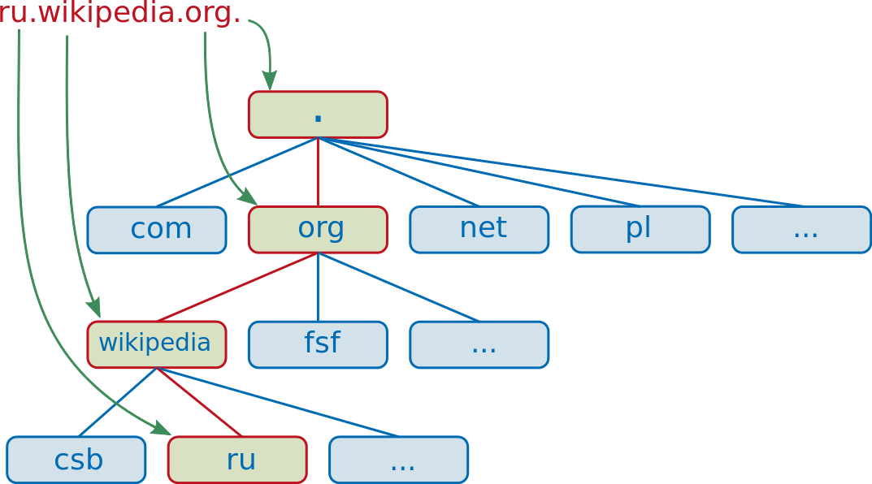
Domain name
Read from right to left
Fully qualified domain name (FQDN)
  Begins with the root domain "."
Root domain
Top-level domain
Second or third level
See also : Network Address Translation on Wikipedia

Slide 21
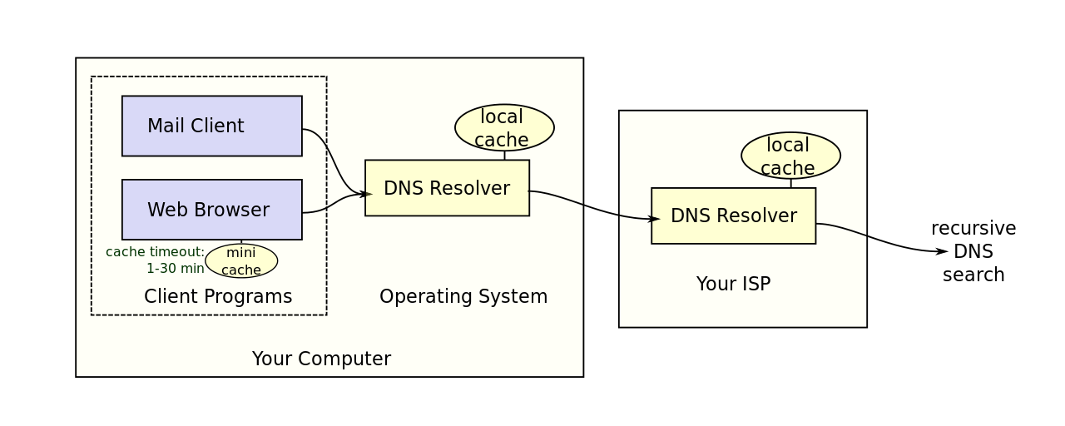
DNS Resolving

Slide 22
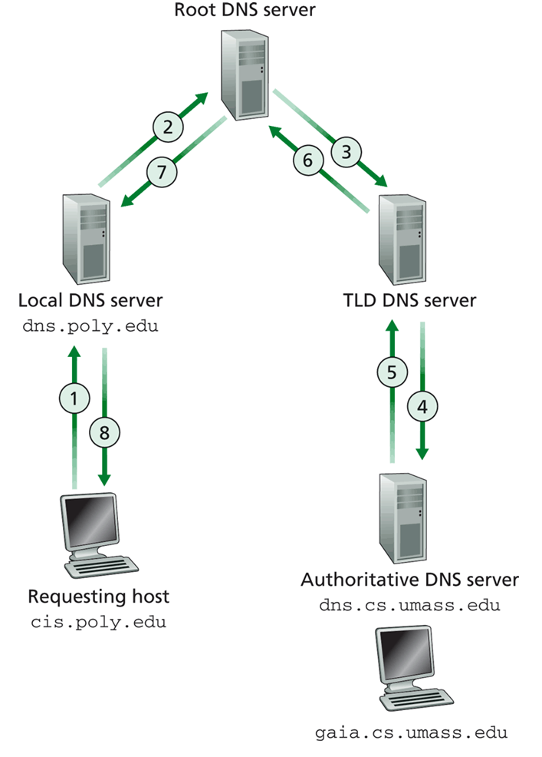
Recursive DNS search
Root
Name Server
Authoritative
Name Server
Top Level Domain
Name Server
Authoritative
Name Server

Slide 23
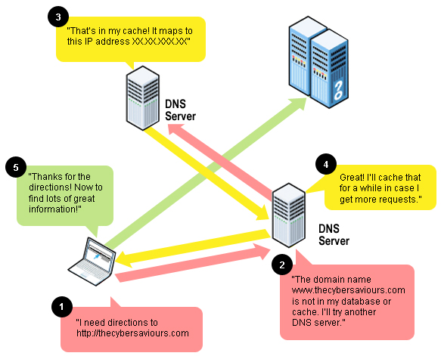
DNS Caching

Slide 24
nslookup
nslookup google.com
Who sets these addresses ?

Slide 25
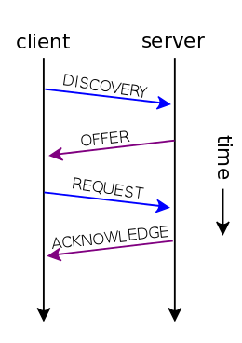
DHCP
Dynamic Host Configuration Protocol
Dynamically distributes addresses and subnetmasks, gateway etc.
See also: DHCP on Wikipedia

Slide 26
DHCP - Operation
When a DHCP-configured client connects to a network, it sends a broadcast query requesting necessary information to a DHCP server.
The DHCP server manages a pool of IP addresses and information such as default gateway, domain name, and so forth.
On receiving a valid request, the server assigns the computer an IP address, a lease (length of time the allocation is valid), and parameters, such as the subnet mask and the default gateway.
The query is typically initiated immediately after booting, and must complete before the client can initiate IP-based communication with other hosts.
Upon disconnecting, the IP address is returned to the pool for use by other clients

Slide 27
Network Address Translation
With subnets comes local IPs
How can hosts reach local Ips?
  A gatekeeper switches addresses!
See also : Network Address Translation on Wikipedia

Slide 28
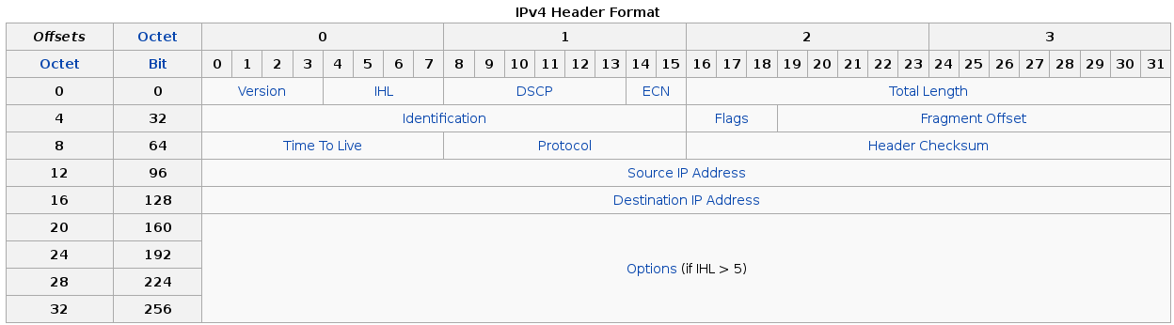
The IP package
How do you translate a package from one network to another?
  You switch the source and destination addresses

Slide 29
Network Address Translation
Local machine sends package
Router sees package and replaces source IP with the router’s own IP
Remote host replies to router
Router sees reply and replaces destination IP with local IP
See also : Network Address Translation on Wikipedia

Slide 30
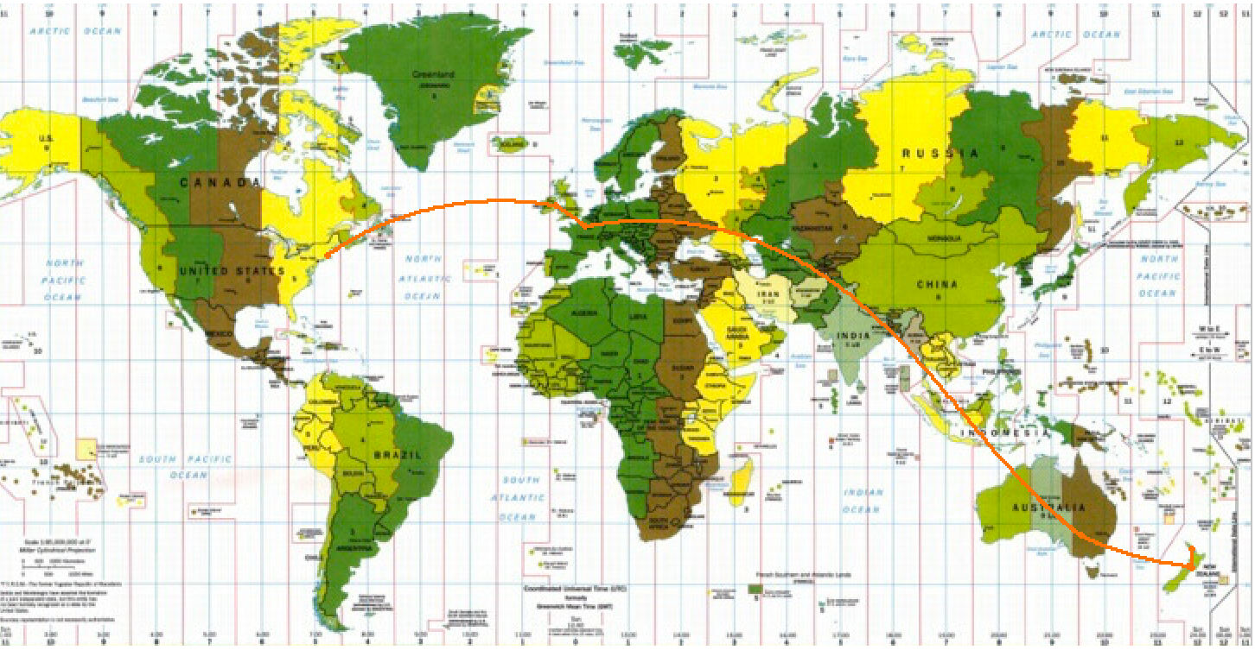
traceroute
Linux: traceroute google.com
Windows: tracert google.com

Slide 31
traceroute
Linux: traceroute google.com
Windows: tracert google.com
Who sees your traffic?
  Everyone!

Slide 32
netstat
netstat
Active connections (sockets) on your machine
Who opens these?
  Active connections on your computer

Slide 33
Learning Goals
Network
Main Topics | TCP/IP and the OSI model Network analysis/sniffing Application Layer Protocols HTTP (Covered in another lesson) DNS DHCP
When this lesson is over you should be able to: | Explain what a network protocol suite is Describe the layers of the TCP/IP protocol system and the purpose of each layer Describe the purpose of network sniffing/analysis tools, an use nslookup, ipconfig (ifconfig), ping, traceroute (tracert) and Wireshark for simple analysis scenarios Give examples of popular Application Layer Protocols

