Slide 1
Scratch Visual Programming

Slide 2
Visual Programming Languages
One focus for the 20 level course is to provide balance exciting hooks for computer science and to sequence things in such a way as to minimize frustrations that are common to novices learning to programming (syntax errors, etc...)
Visual programming languages are an excellent place to begin as overhead to create interesting and interactive programs is low
fun projects can be achieved within a short amount of time (animation, games, sound)
click-in bricks allow for more intuitive ordering of instructions and control structures
Helps lay a foundation for the rest of the class, but are best suited to a short introductory unit (3-5 weeks).
not practical to address all curricular outcomes

Slide 3
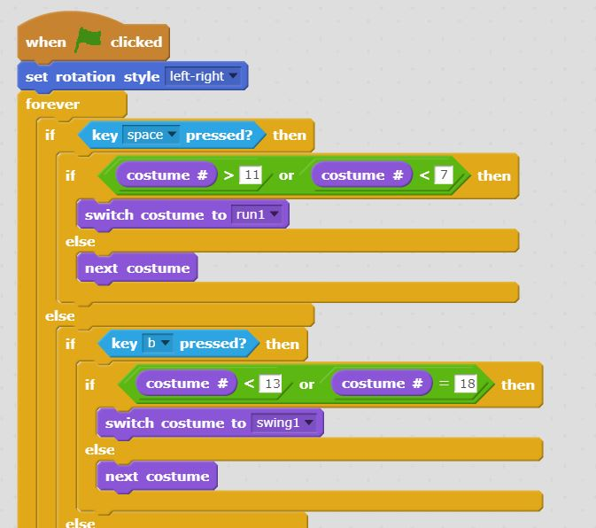
Scratch
Visual Programming Language, built at MIT media lab.
There are many alternative Visual Programming Environments.
If it is to be used for a short unit, however, it likely doesn't matter which one is used
Resources in the open textbook have been created for Scratch
Students can be organized into a 'class', with signup code. Gives teacher ability to reset passwords if needed.

Slide 4
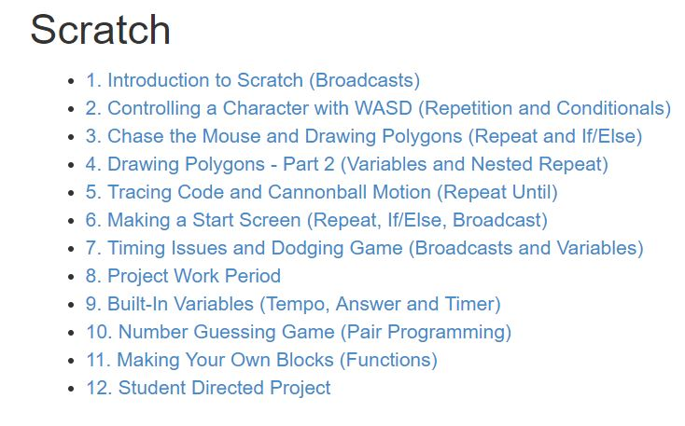
Open Textbook Resources
Open Textbook (www.cs20.ca) has 12 items built around this environment.
Can be used in-class as primary lesson materials, or as supplemental for students who miss class or need additional practice

Slide 5
Sequence in Class
Scratch offers an excellent format to introduce the following:
Instruction Flow, Conditional Statements, Repetition, Events (Broadcasts), Variables
Short lessons paired with code-along demos work well to introduce these ideas
Small quizzes can be used to quickly determine how well a concept was grasped by the group
Increasingly complex assignments challenge students to apply the knowledge and skills themselves

Slide 6


Demo – Logic and Sprite Animation
The following demo can be done in-class to reinforce control structures for decision making.
Navigate to the Scratch Website: https://scratch.mit.edu/ Click “Create” No login is necessary if you don’t have an account.
Download the folder “Scratch Demo – Sprites” from GitHub. bit.ly/cs-usask2018 → scratch
Notes:
Start by creating a sprite and loading all the images for just the idle animation. Create a simple script to cycle through all frames. This is quite a simple script.
Add to the costumes by also loading the images from a second action – slide. Using the original script, the animation switch back and forth continually, which is not likely very useful. Instead, we want to cycle either action depending on what the user is doing! Work through the decisions needed to make this work.
Usually students are challenged to incorporate two more actions on their own. For today, as a group implement the third action as well (jump) to see the logic may need to be expanded depending on how well thought-through step two was.

Slide 7
Open Project
An open “Coolest Scratch Project” challenges students to be creative and demonstrate their learning so far.
Introduce the project briefly at the start of the unit, so that students have time to come up with a great idea.
Video of Sample Projects available on GitHub: “Coolest Scratch Project Samples Video.mp4”
Finish the unit with this project. Usually 4-5 full classes given to its construction.

Slide 8
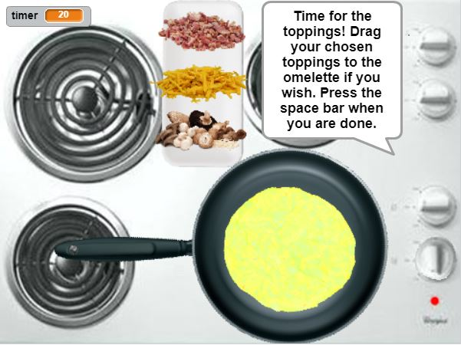
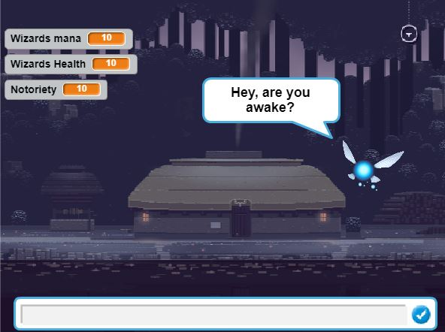
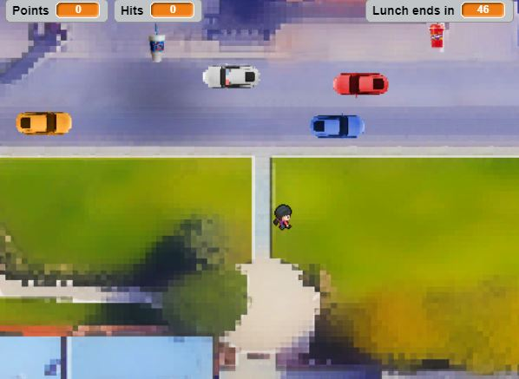
Beta Testing Activity
A one-class Beta Testing activity can be a interesting way for students to share their work with each other, and to give/receive feedback.
Students are able to read feedback during the final minutes of class, then all feedback forms are handed in to the teacher.
Allow a few days where students can make refinements as homework before the project is due to be submitted.
Peer-Assessment feedback form is available on GitHub: “Scratch Project Peer Assessment.docx”
Notes:
Students load their project (and log-out so no changes can be made), and are given a feedback sheet to leave by their computer.
Teacher instructs everyone to shift a random number of computers in one direction, and students spend 10 minutes trying out a program, then give written feedback.
Repeat 3x, then rest of class to read feedback before returning to teacher.

Slide 9
Time to Explore
1. Take some time to look at and work through some of the materials hosted on GitHub: (http://bit.ly/cs-usask2018)
Assignment Descriptions and Sample Solutions (includes a few major projects)
Coolest Scratch Project Samples Video
Presentation Slides for Teaching
2. Open up the Scratch Editor and make something!
3. Discuss / Share / Work with your neighbours.
Notes:
Pull up the Open Text at this point to show the layout there. Cs20.ca

