Slide 1


Navigating Controller Design Tradeoffs under Computational Constraints
Nikolai Matni
^{Associate Professor}
Department of Electrical and Systems Engineering
^{University of Pennsylvania}
CODAC University Center of Excellence Kickoff
24 September 2026 · Van Metre Hall, George Mason University, Arlington VA

Slide 2
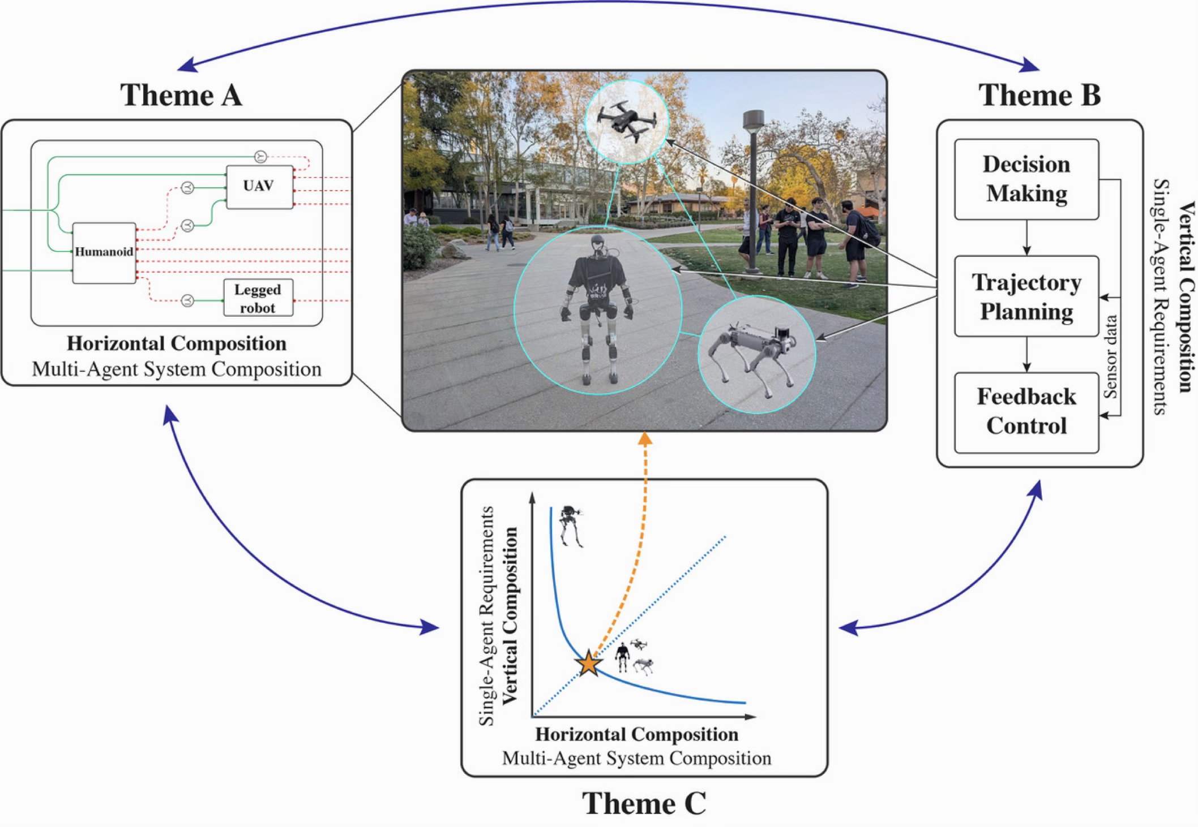
Three themes, one formalism, three directions
The same co-design language applied across agents, down through layers, and to the decomposition itself
Theme A
Horizontal composition
Heterogeneous agents and infrastructure composed sideways. Categorical co-design, contracts, uncertainty-aware optimization.
Theme B
Vertical composition
Objectives that stay feasible and safe when handed to one agent. Layered control with reduced-order models, consistent across layers.
Theme C
Unified composition
Global and local integration in one meta-model. Compositional Pareto optimality across layers and agents, and the metrics for it.
THE FIVE CHALLENGES
C1
Scale
C2
Heterogeneity
C3
Partial specifications
C4
Decentralization
C5
Context dependence
A carries C1, C2 and C3.
B carries C1, C2, C4 and C5.
C spans all five.
Each theme carries three tasks. X.1 theory, X.2 operationalization, X.3 scalability.
IN CO-DESIGN TERMS a design problem is a monotone relation between functionality and resources, closed under series, parallel and feedback. A wires them sideways, B stacks them, C asks which wiring.
The themes are three views of one object, and the interfaces between them are where the center earns its keep.
Notes:
One minute. Walk the figure clockwise, and say the co-design sentence at the bottom slowly. It is the spine of everything that follows. Two theme leads speak later this morning.

Slide 3
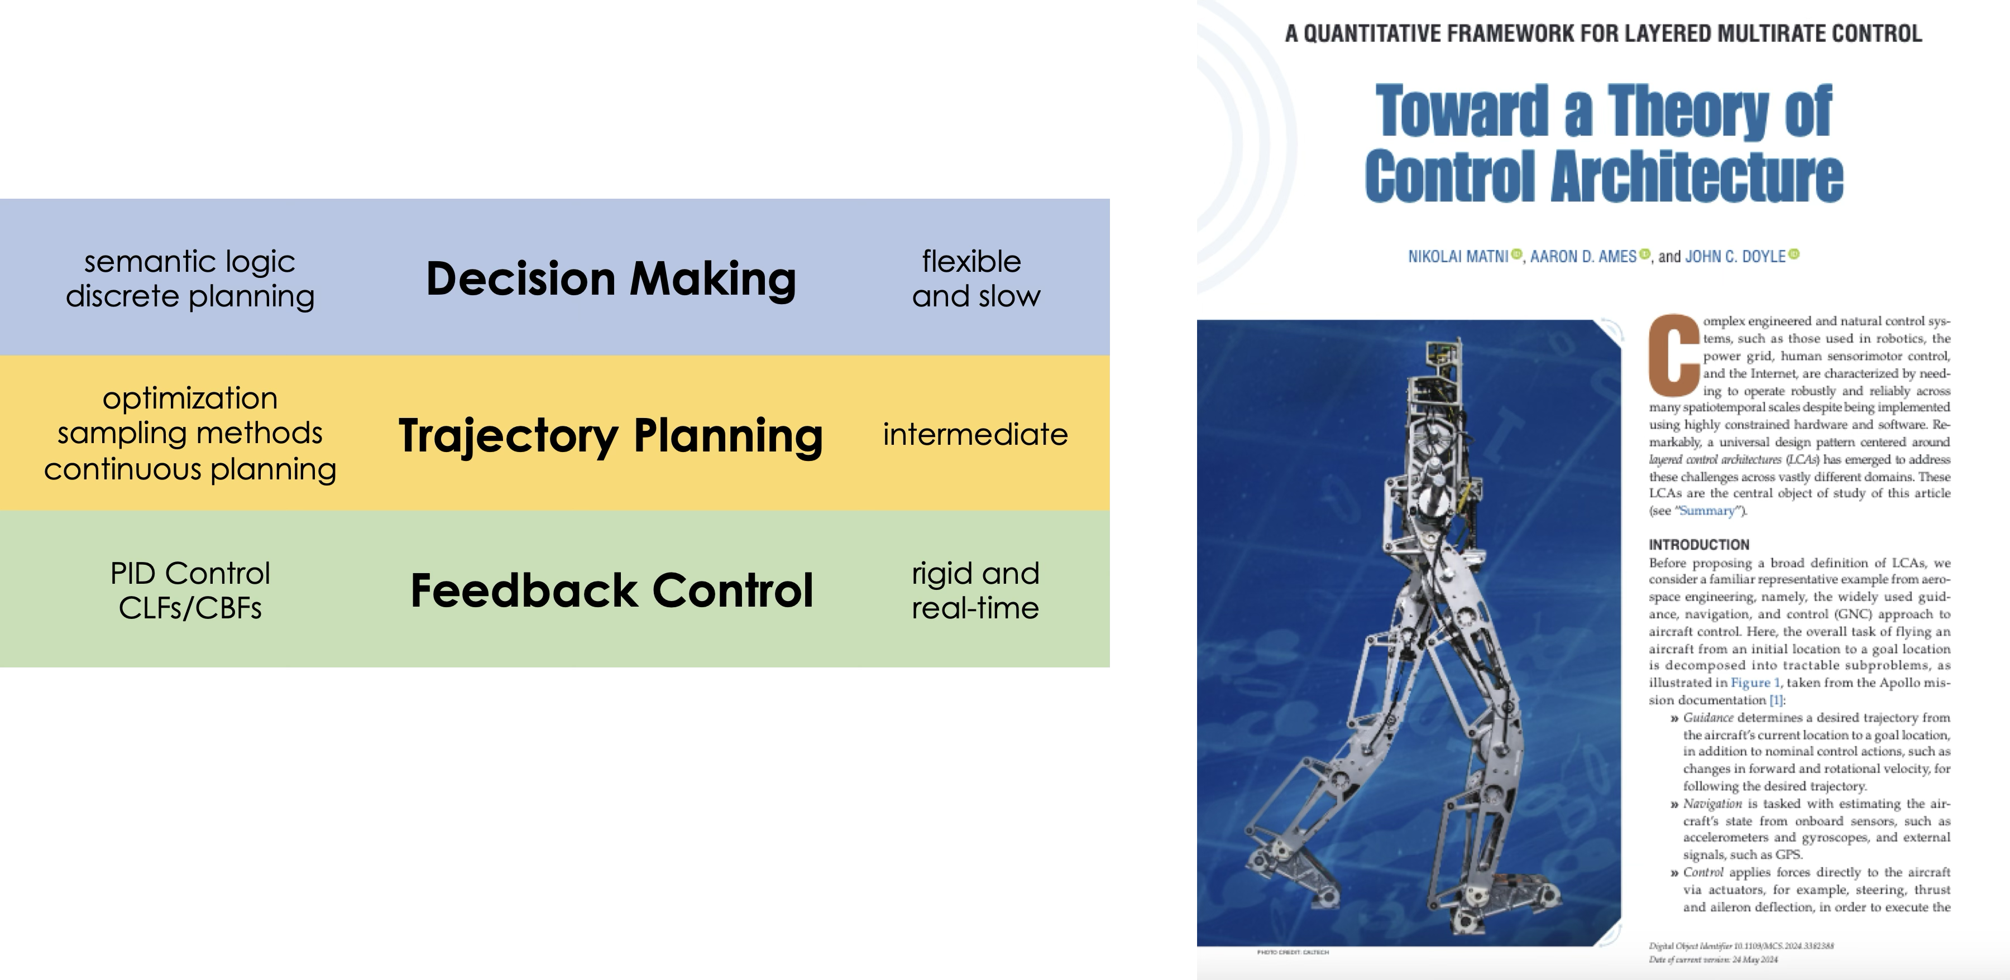
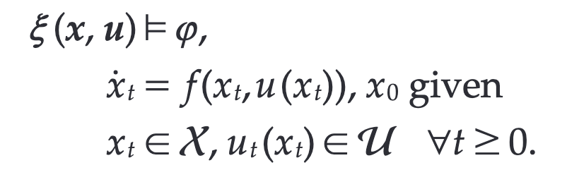
Intractable problem!
System trajectory $ξ$ should satisfy specification $φ$
subject to continuous dynamics and & constraints
Relax to layered control architecture

Slide 4
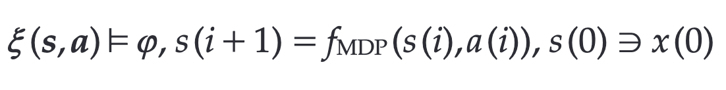
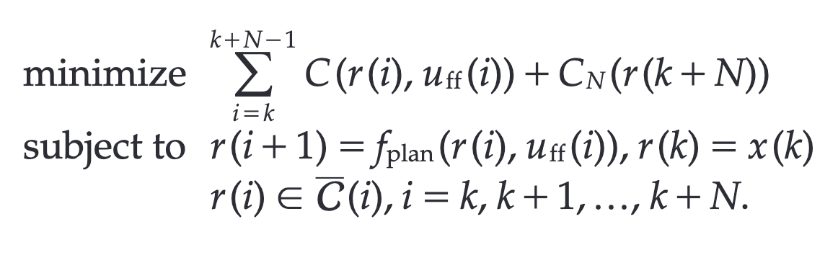

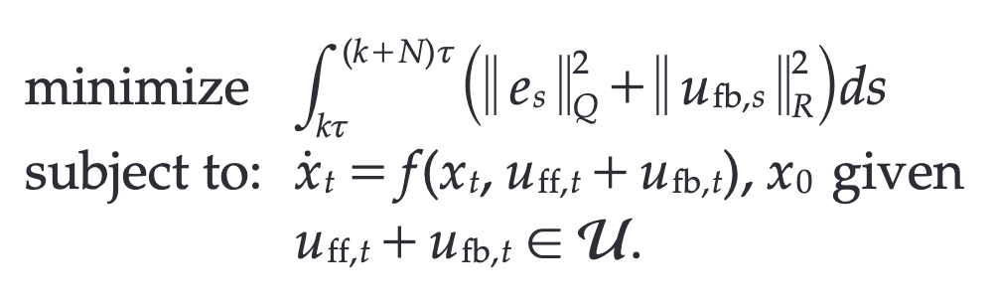
(Slow) Discrete state/action decision making
(Intermediate) ROM MPC-based Planning
(Fast) Feedback Control

Slide 5




Motivation and introduction
Why layering?
Ubiquitous in engineered, human &
natural systems
Amazing success stories
  The Internet
  Power grid
  Space craft
  ASML’s lithography machines
So, why study this? No systematic theory!

Slide 6
Motivation and introduction
What is the keyword here?
Compute:
Breaks up complexity based on resources
Natural concepts: Time-scale separation
Feasibility is central
But, rarely a first-class design constraint!
This work: Quantify tradeoffs in control design
This work: subject to compute constraints!
now: one layer | later: multiple layers

Slide 7
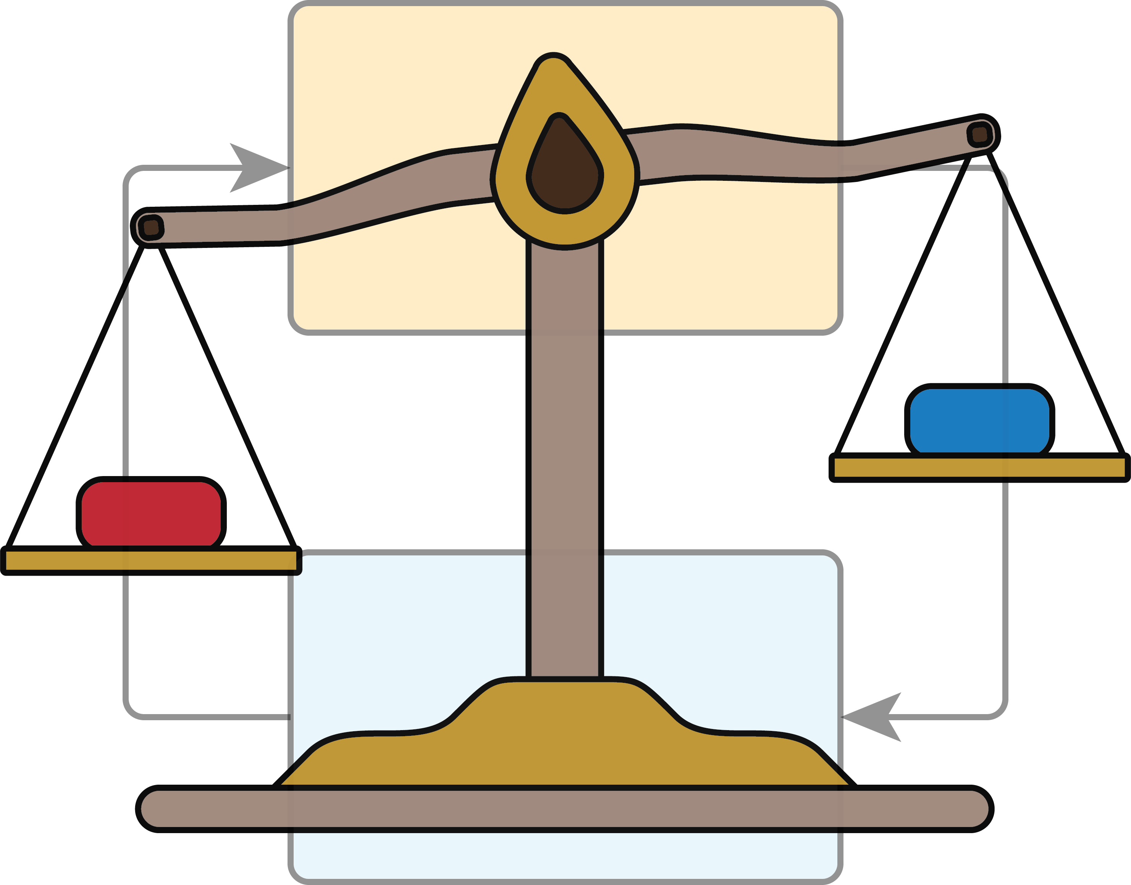
Contents
Motivation and introduction
Problem statement
The design meta-problem
A simple example
A step back
Conclusions

Slide 8
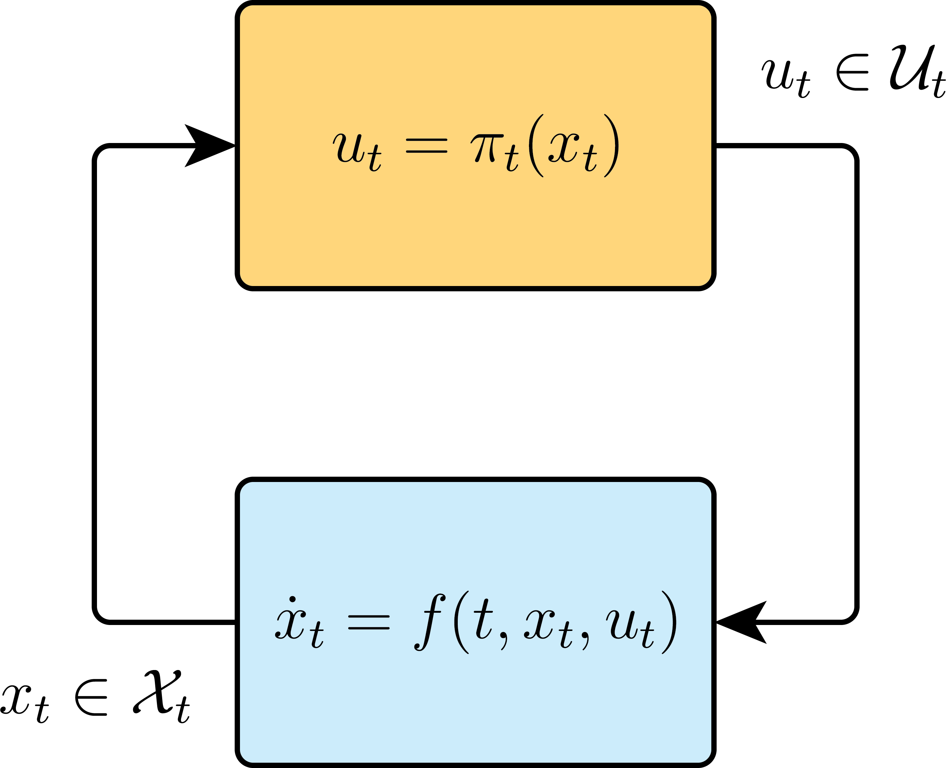
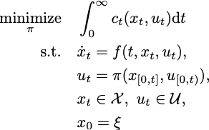
Problem statement
Generic controller design task:
(deterministic) optimal-control problem:
How can we solve this problem? Tractable solution? Online implementation?

Slide 9
Problem statement
Solve problem by making approximations:

Slide 10
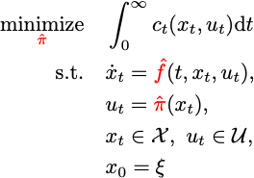
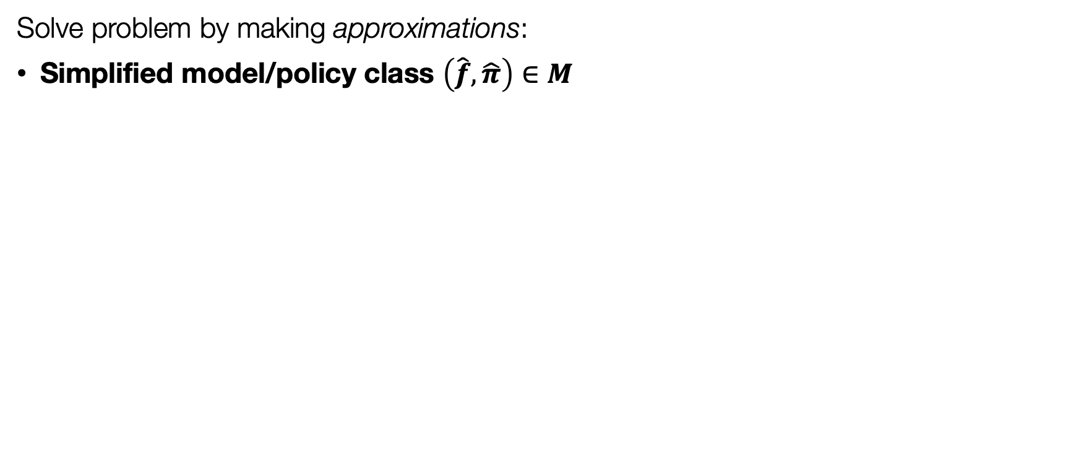
Problem statement
Solve problem by making approximations:
Simplified model/policy class $\left(\hat{f}, \hat{π}\right)∈M$

Slide 11
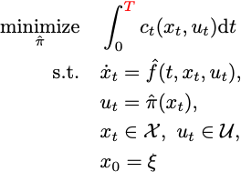
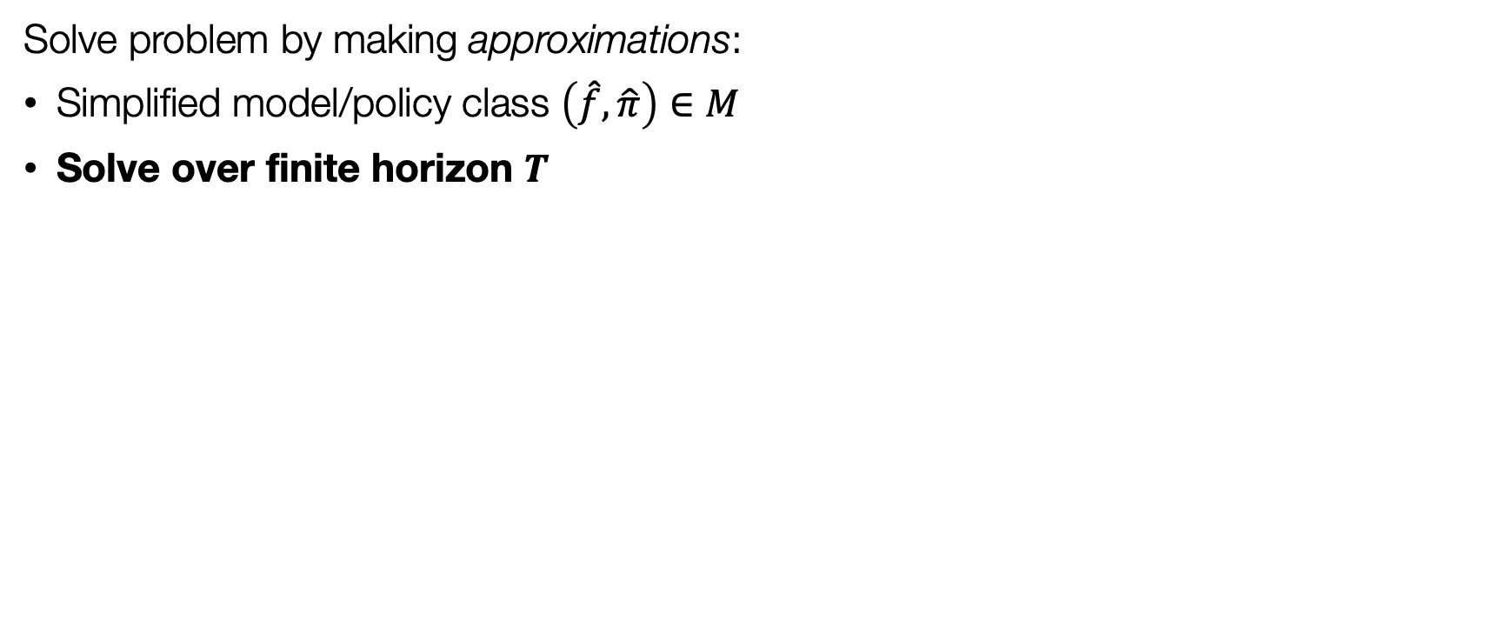
Problem statement
Solve problem by making approximations:
Simplified model/policy class $\left(\hat{f}, \hat{π}\right)∈M$
Solve over finite horizon $T$

Slide 12
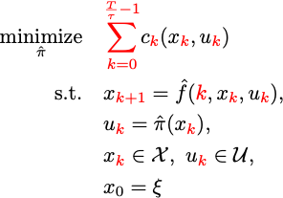
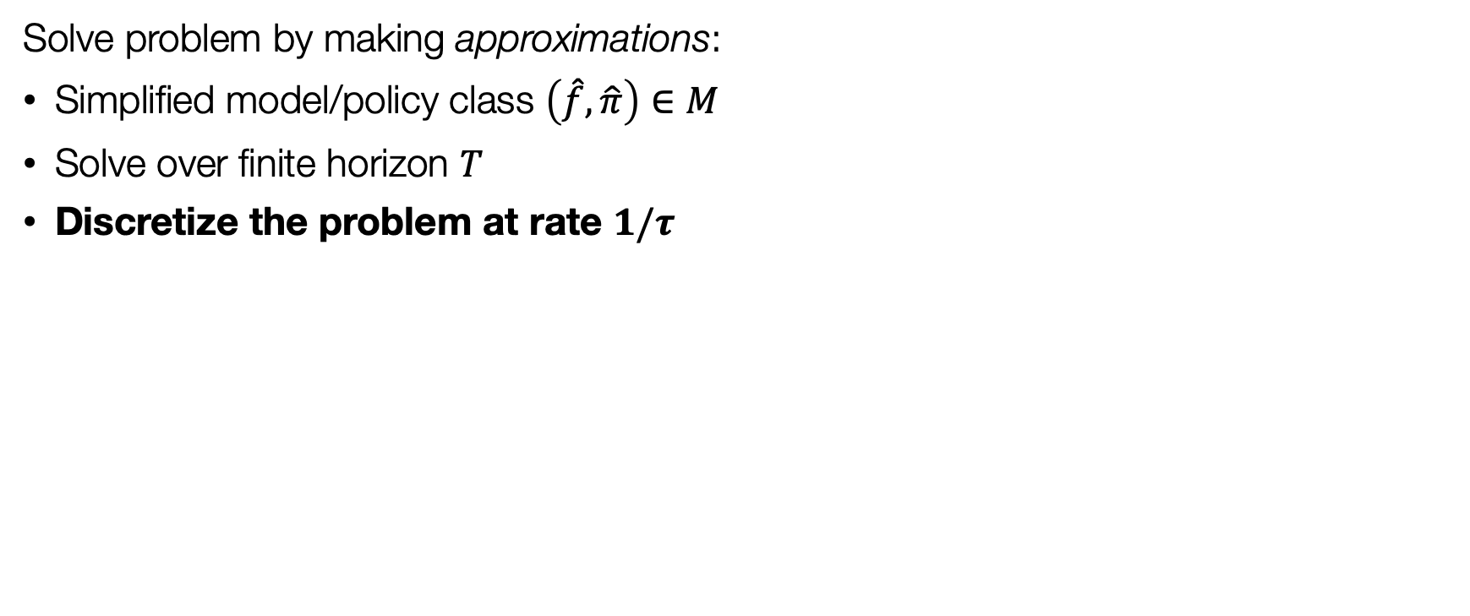
Problem statement
Solve problem by making approximations:
Simplified model/policy class $\left(\hat{f}, \hat{π}\right)∈M$
Solve over finite horizon $T$
Discretize the problem at rate $1/τ$

Slide 13
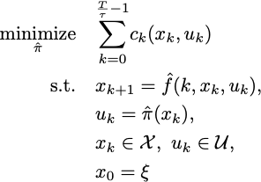
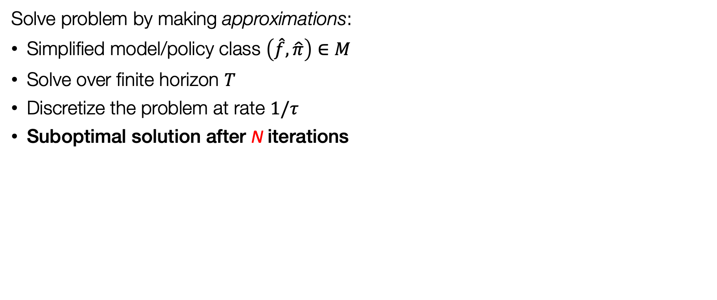
Problem statement
Solve problem by making approximations:
Simplified model/policy class $\left(\hat{f}, \hat{π}\right)∈M$
Solve over finite horizon $T$
Discretize the problem at rate $1/τ$
Suboptimal solution after N iterations

Slide 14
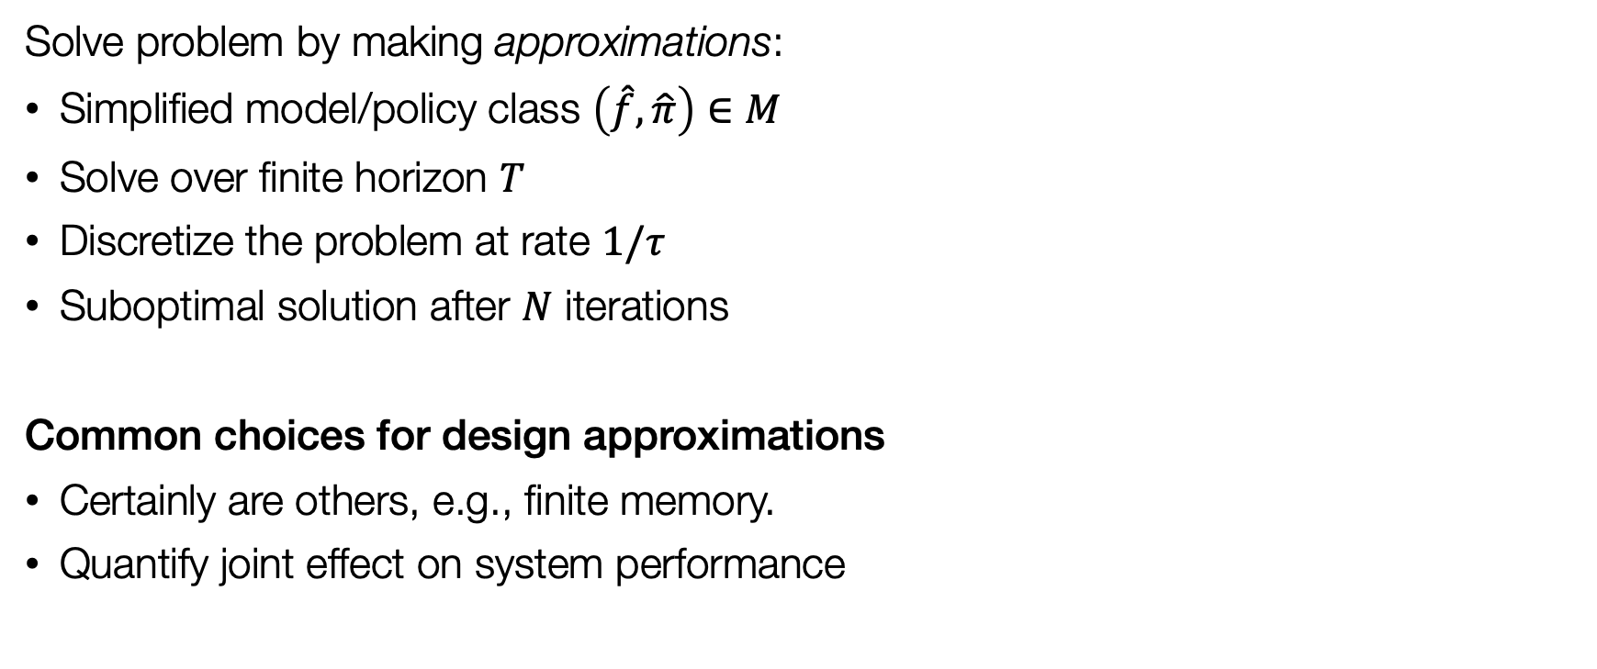
Problem statement
Solve problem by making approximations:
Simplified model/policy class $\left(\hat{f}, \hat{π}\right)∈M$
Solve over finite horizon $T$
Discretize the problem at rate $1/τ$
Suboptimal solution after $N$ iterations
Common choices for design approximations
Certainly are others, e.g., finite memory.
Quantify joint effect on system performance

Slide 15
Problem statement
Nice… but approx. problem must satisfy design & implementation constraints:
Stabilize true system
Guarantee performance
Satisfy offline compute constraints
Satisfy online compute constraints
Individually well understood… Joint effect?
Problem statement: How to systematically quantify these design choices and constraints?
Antoulas (2005); Grüne and Rantzer (2008); Chen and Francis (1995); Shi et al. (2026).

Slide 16
Contents
Motivation and introduction
Problem statement
The design meta-problem
  Formulation of the DMP
  Incremental input-to-state-stability
  Formalizing the DMP
A simple example
A step back
Conclusions

Slide 17
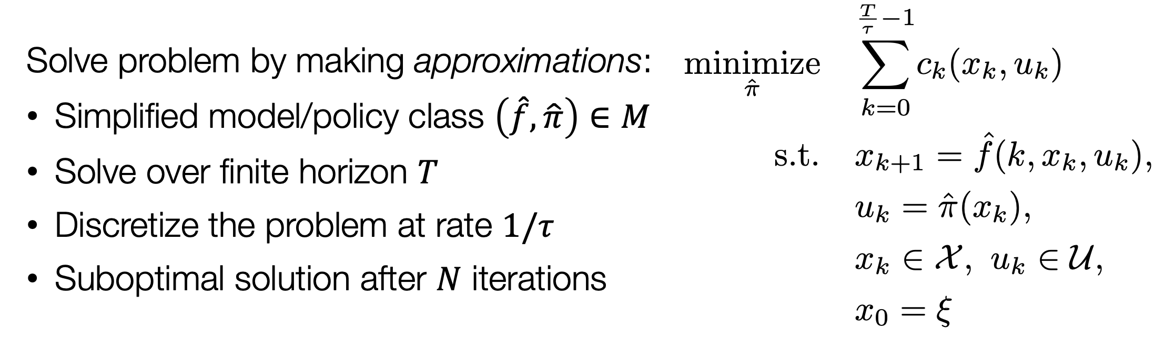
The design meta-problem
Our approach:
Associate policy to every approximation:
Bound policy difference in terms of design-dependent sector bound
Analyze performance gap w.r.t. baseline policy: J
Guarantee stability w/ incremental input-to-state stability & small-gain conditions
Which results in:
A design meta-problem to quantitatively navigate design tradeoffs
Performance gap is minimized s.t. stability, real-time compute, timing constraints
Simple verification through design-dependent sector bound on policy difference
Notes:
This was an awkward slide. Already introduce the decomposition of pi here

Slide 18
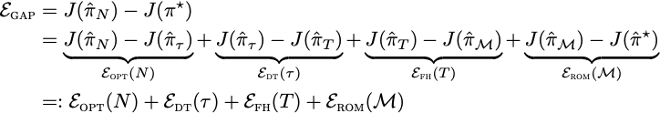
The design meta-problem
Quantify performance gap by sequential decomposition
Order of decomposition is design-specific
Earlier choices affect performance gap later on
  ​T inherently influences effect with N
Jointly minimize terms subject to design constraints
Notes:
Include policy decomposition

Slide 19
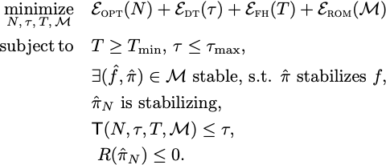
The design meta-problem
Informal design meta-problem:

Slide 20
The design meta-problem
Informal design meta-problem:
Plan far enough in future

Slide 21
The design meta-problem
Informal design meta-problem:
Sample sufficiently fast
to ensure stabilization

Slide 22
The design meta-problem
Informal design meta-problem:
Reduced order model class must be complex enough (e.g., include unstable modes)

Slide 23
The design meta-problem
Informal design meta-problem:
Enough optimization steps to obtain a stabilizing policy

Slide 24
The design meta-problem
Informal design meta-problem:
Online computation time (function T, e.g., # flops) within sampling time

Slide 25
The design meta-problem
Informal design meta-problem:
Policy admit performance requirements: encoded by the R constraint

Slide 26
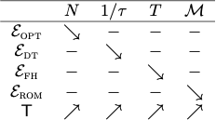
The design meta-problem
Informal design meta-problem:
Relationship between approximation choices

Slide 27
The design meta-problem
Informal design meta-problem:
Quantifies performance gap of design
Explicit tradeoffs s.t. compute constraints
Let’s formalize this to make it actionable

Slide 28

Incremental input-to-state stability
How to make problem more concrete?
Leverage incremental input-to-state stability (δISS)
Is implied by existence of p.d. V s.t.
Combine with small-gain condition (SGC)
Definition: A system is δISS if there exists functions and
, such that for all , all input signals and all
Angeli (2002)
Notes:
This was an awkward slide

Slide 29
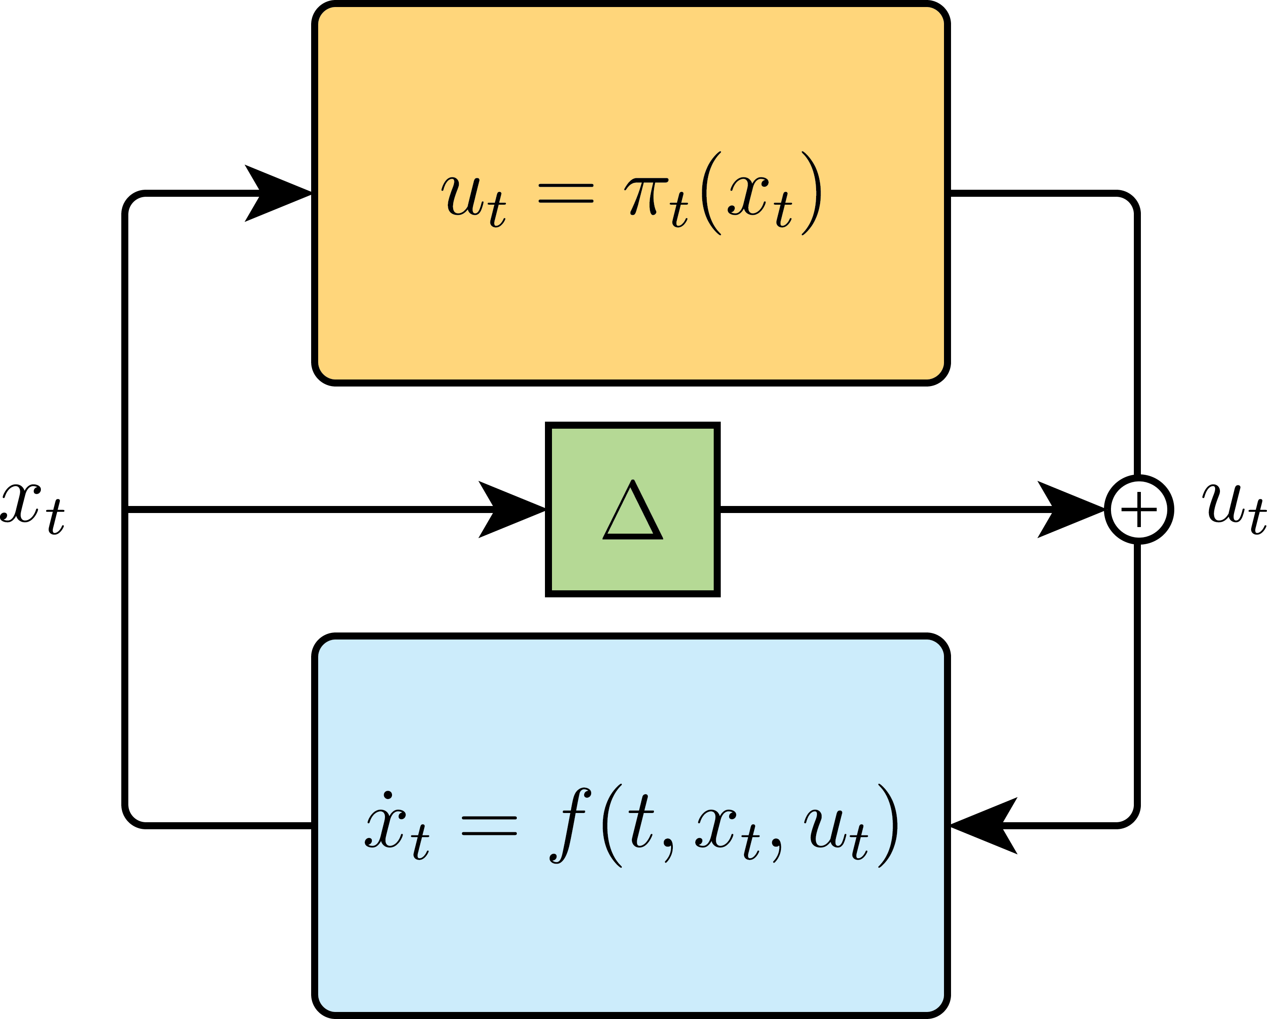

Incremental input-to-state stability
How?
Approximate closed-loop is perturbation of ‘unrealistic’ closed-loop:
  Approximate policy:
  ‘Unrealistic’ closed-loop:
  Approximate closed-loop:
Apply δISS with Δ(x) as input perturbation!
Notes:
This was an awkward slide

Slide 30

Formalizing the design meta-problem
Use similar sequential decomposition to bound input perturbation
Policy decomposition:
Design-dependent sector bound for each approximation of control problem:
Apply sector bounds with δISS and SGC

Slide 31

Incremental input-to-state stability
Putting things together:
Analyze closed-loop response with δISS under perturbation Δ
Use sector bound in combination w/ small-gain condition (SGC)
Under sector bound & δISS (informally and simplified)
Design-dependent stability condition → Ensured by tuning sector bound
If approx. with is such that SGC
holds, then
Recall
Notes:
Explain alpha_1, alpha_2
Design pi_hat such that SGC is satisfied -> Stability condition for a given design approximation
Must hold
This was an awkward slide
Explain that L is design dependent

Slide 32
Incremental input-to-state stability
Putting things together:
Stability condition for approximate policies: ✅
Bound performance gap for given approximate policies
We can show under SGC & regularity of cost: (informally and simplified)
Bounding performance gap: Ensured by tuning sector bound!
If
Then
Performance gap scales linearly with L

Slide 33
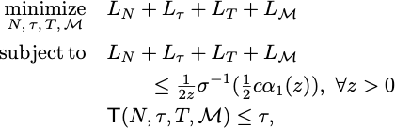
Formalizing the design meta-problem
All ingredients present!
Informal design meta-problem:
Formalized design meta-problem:
Notes:
Omit performance function, but under similar smoothness conditions as on the cost, we can similarly bound R in terms of the design-dpendent sectorbounds

Slide 34
Formalizing the design meta-problem
All ingredients present!
Informal design meta-problem:
Formalized design meta-problem:
Notes:
Where we simply rewrote the small gain condition for the sum of L’s

Slide 35
Formalizing the design meta-problem
All ingredients present!
Joint analysis of design approx., subj. to stability, performance and compute!
  Optimize design dependent sector bounds on policy difference
Informal design meta-problem:
Formalized design meta-problem:
Notes:
Using only the design dependent sector bounds: rather easy to optimize over!
Mention rho dependence in paper

Slide 36
Contents
Motivation and introduction
Problem statement
The design meta-problem
A simple example
A step back
Conclusions

Slide 37
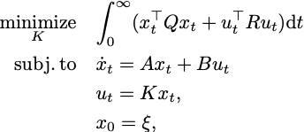
A simple example
Stylized LQR problem
Given A, B, Q, R : solution is analytic
Assume base problem is intractable
Order of approximations: ROM → Discretize → Finite Horizon
Online computational load T: flops required for Riccati recursions
We can show:
(see paper for details)

Slide 38
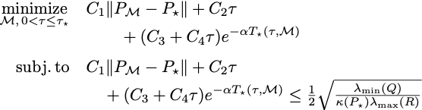
A simple example
Constructing the LQR DMP
Constants C_{i} dependent on system:
  Obtain empirically
SGC directly from Lyapunov condition
Substitute in DMP:
We can show:
(see paper for details)
Discrete in continuous in

Slide 39
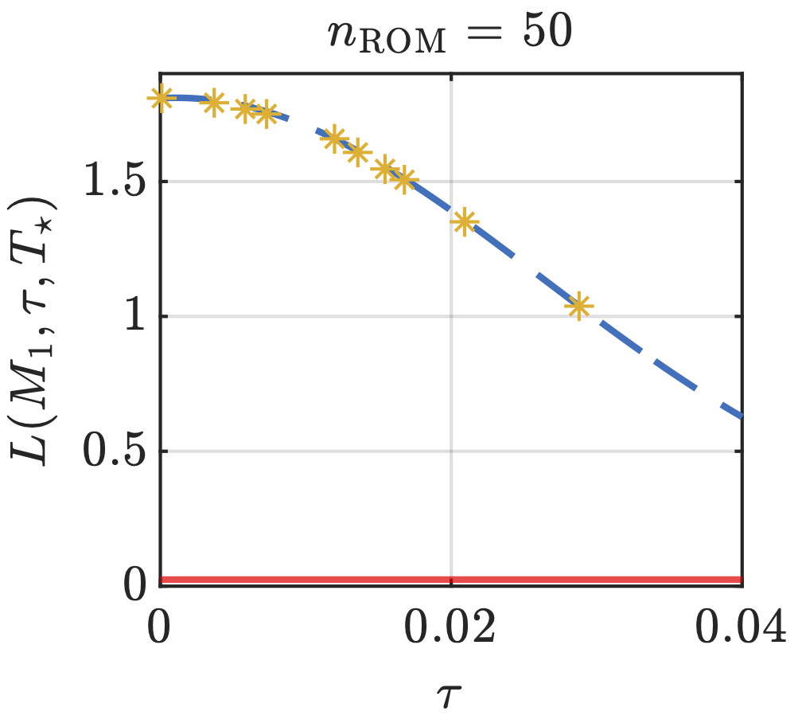
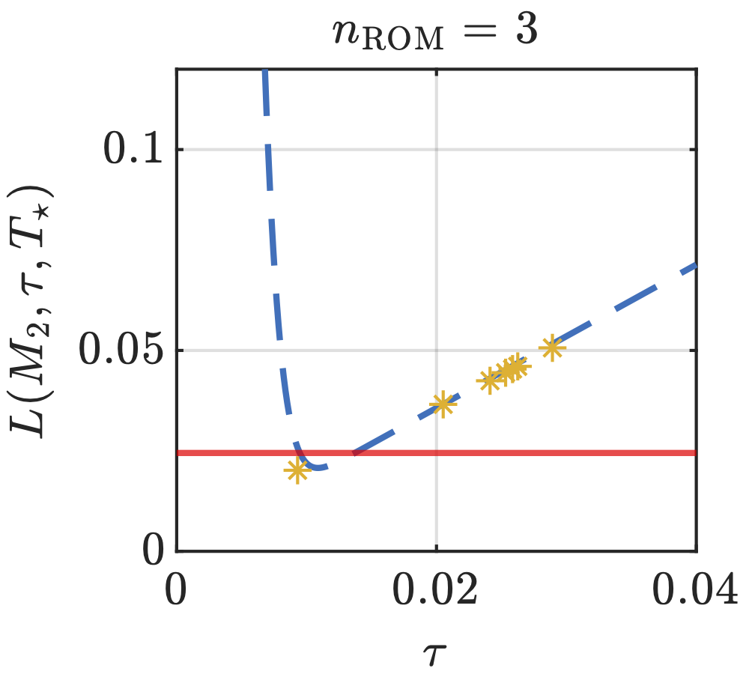
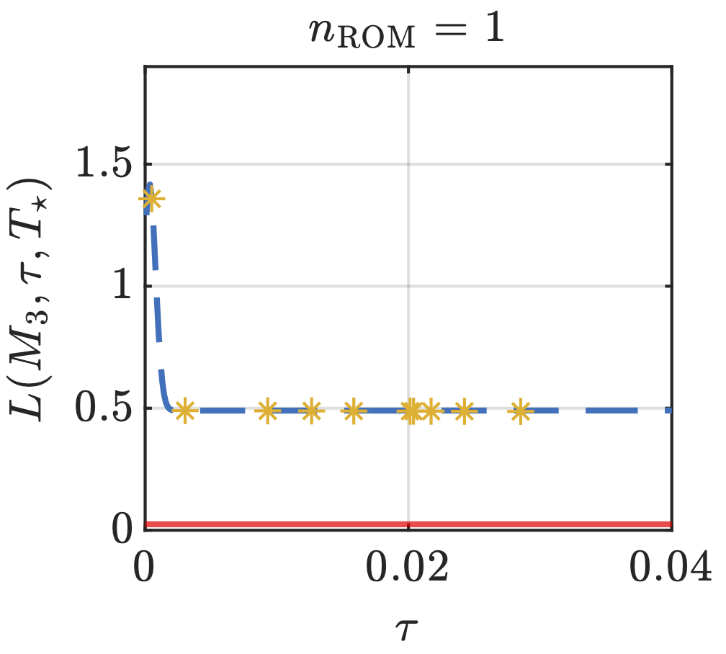
A simple example
WIP:
Nonlinear examples
Estimate sector bounds for MPC
Some numerics: True system: n_{x} = 97 with 3 dominant poles
Compute K for and some : fit functional form!
Plot left-hand side and right-hand side of SGC
Not able to
meet compute requirements
Not able to guarantee
stability

Slide 40
Contents
Motivation and introduction
Problem statement
The design meta-problem
A simple example
A step back
Conclusions

Slide 41
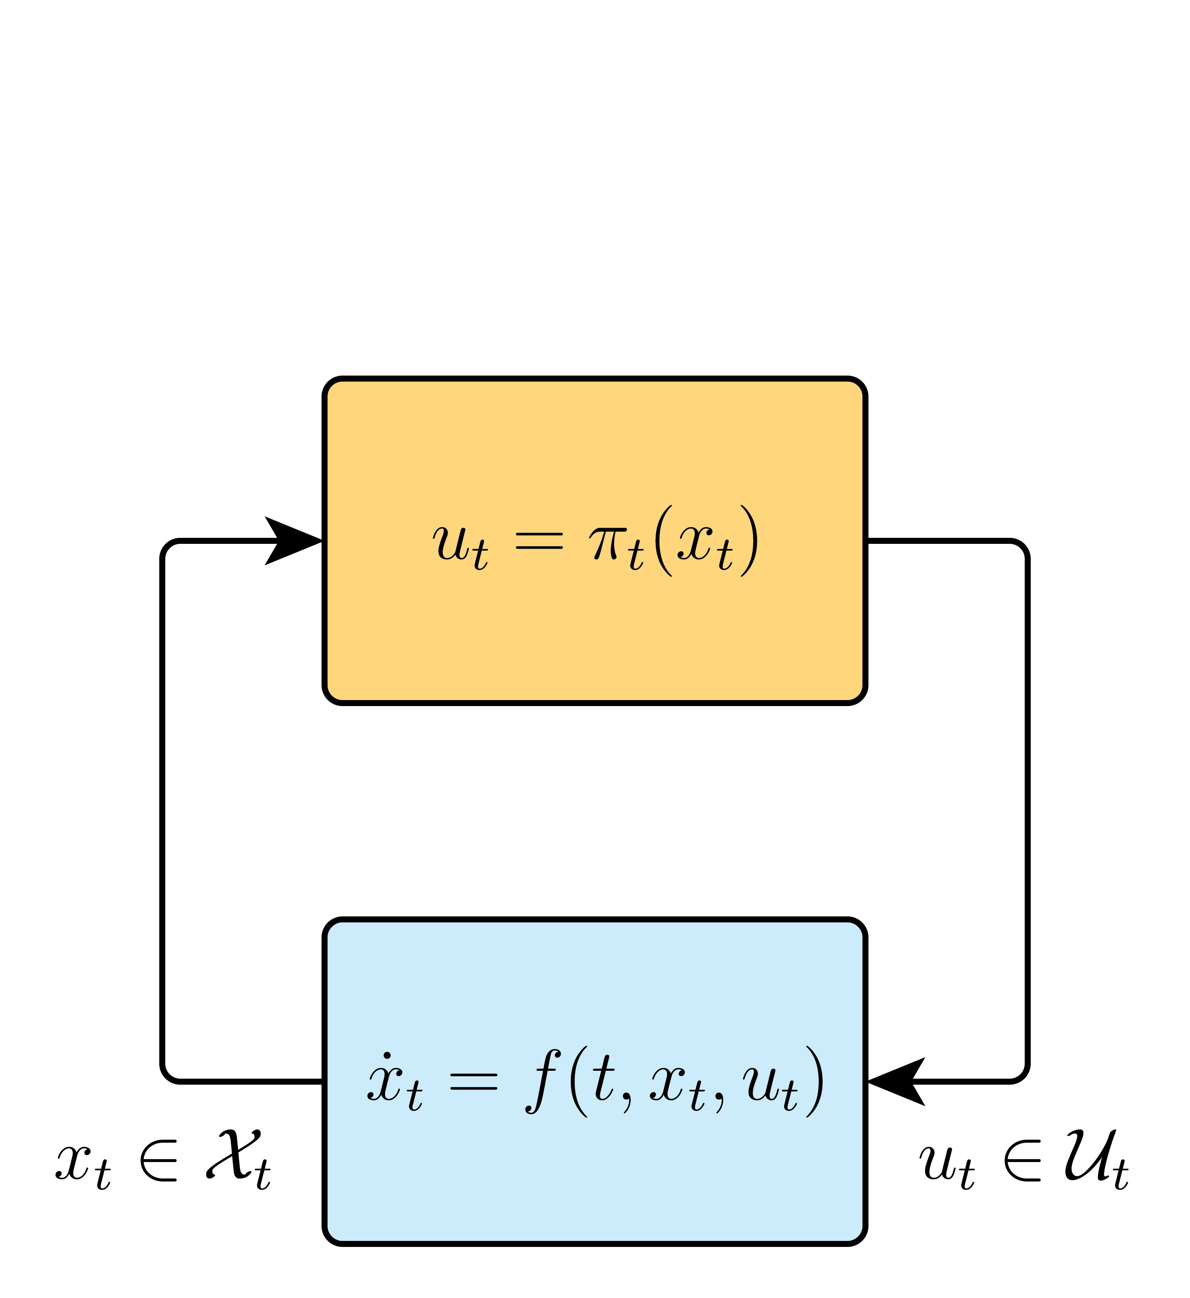
A step back
How does this fit in the architecture story line?
Now, tradeoffs in design of one controller
  What if DMP infeasible?
⚡️

Slide 42
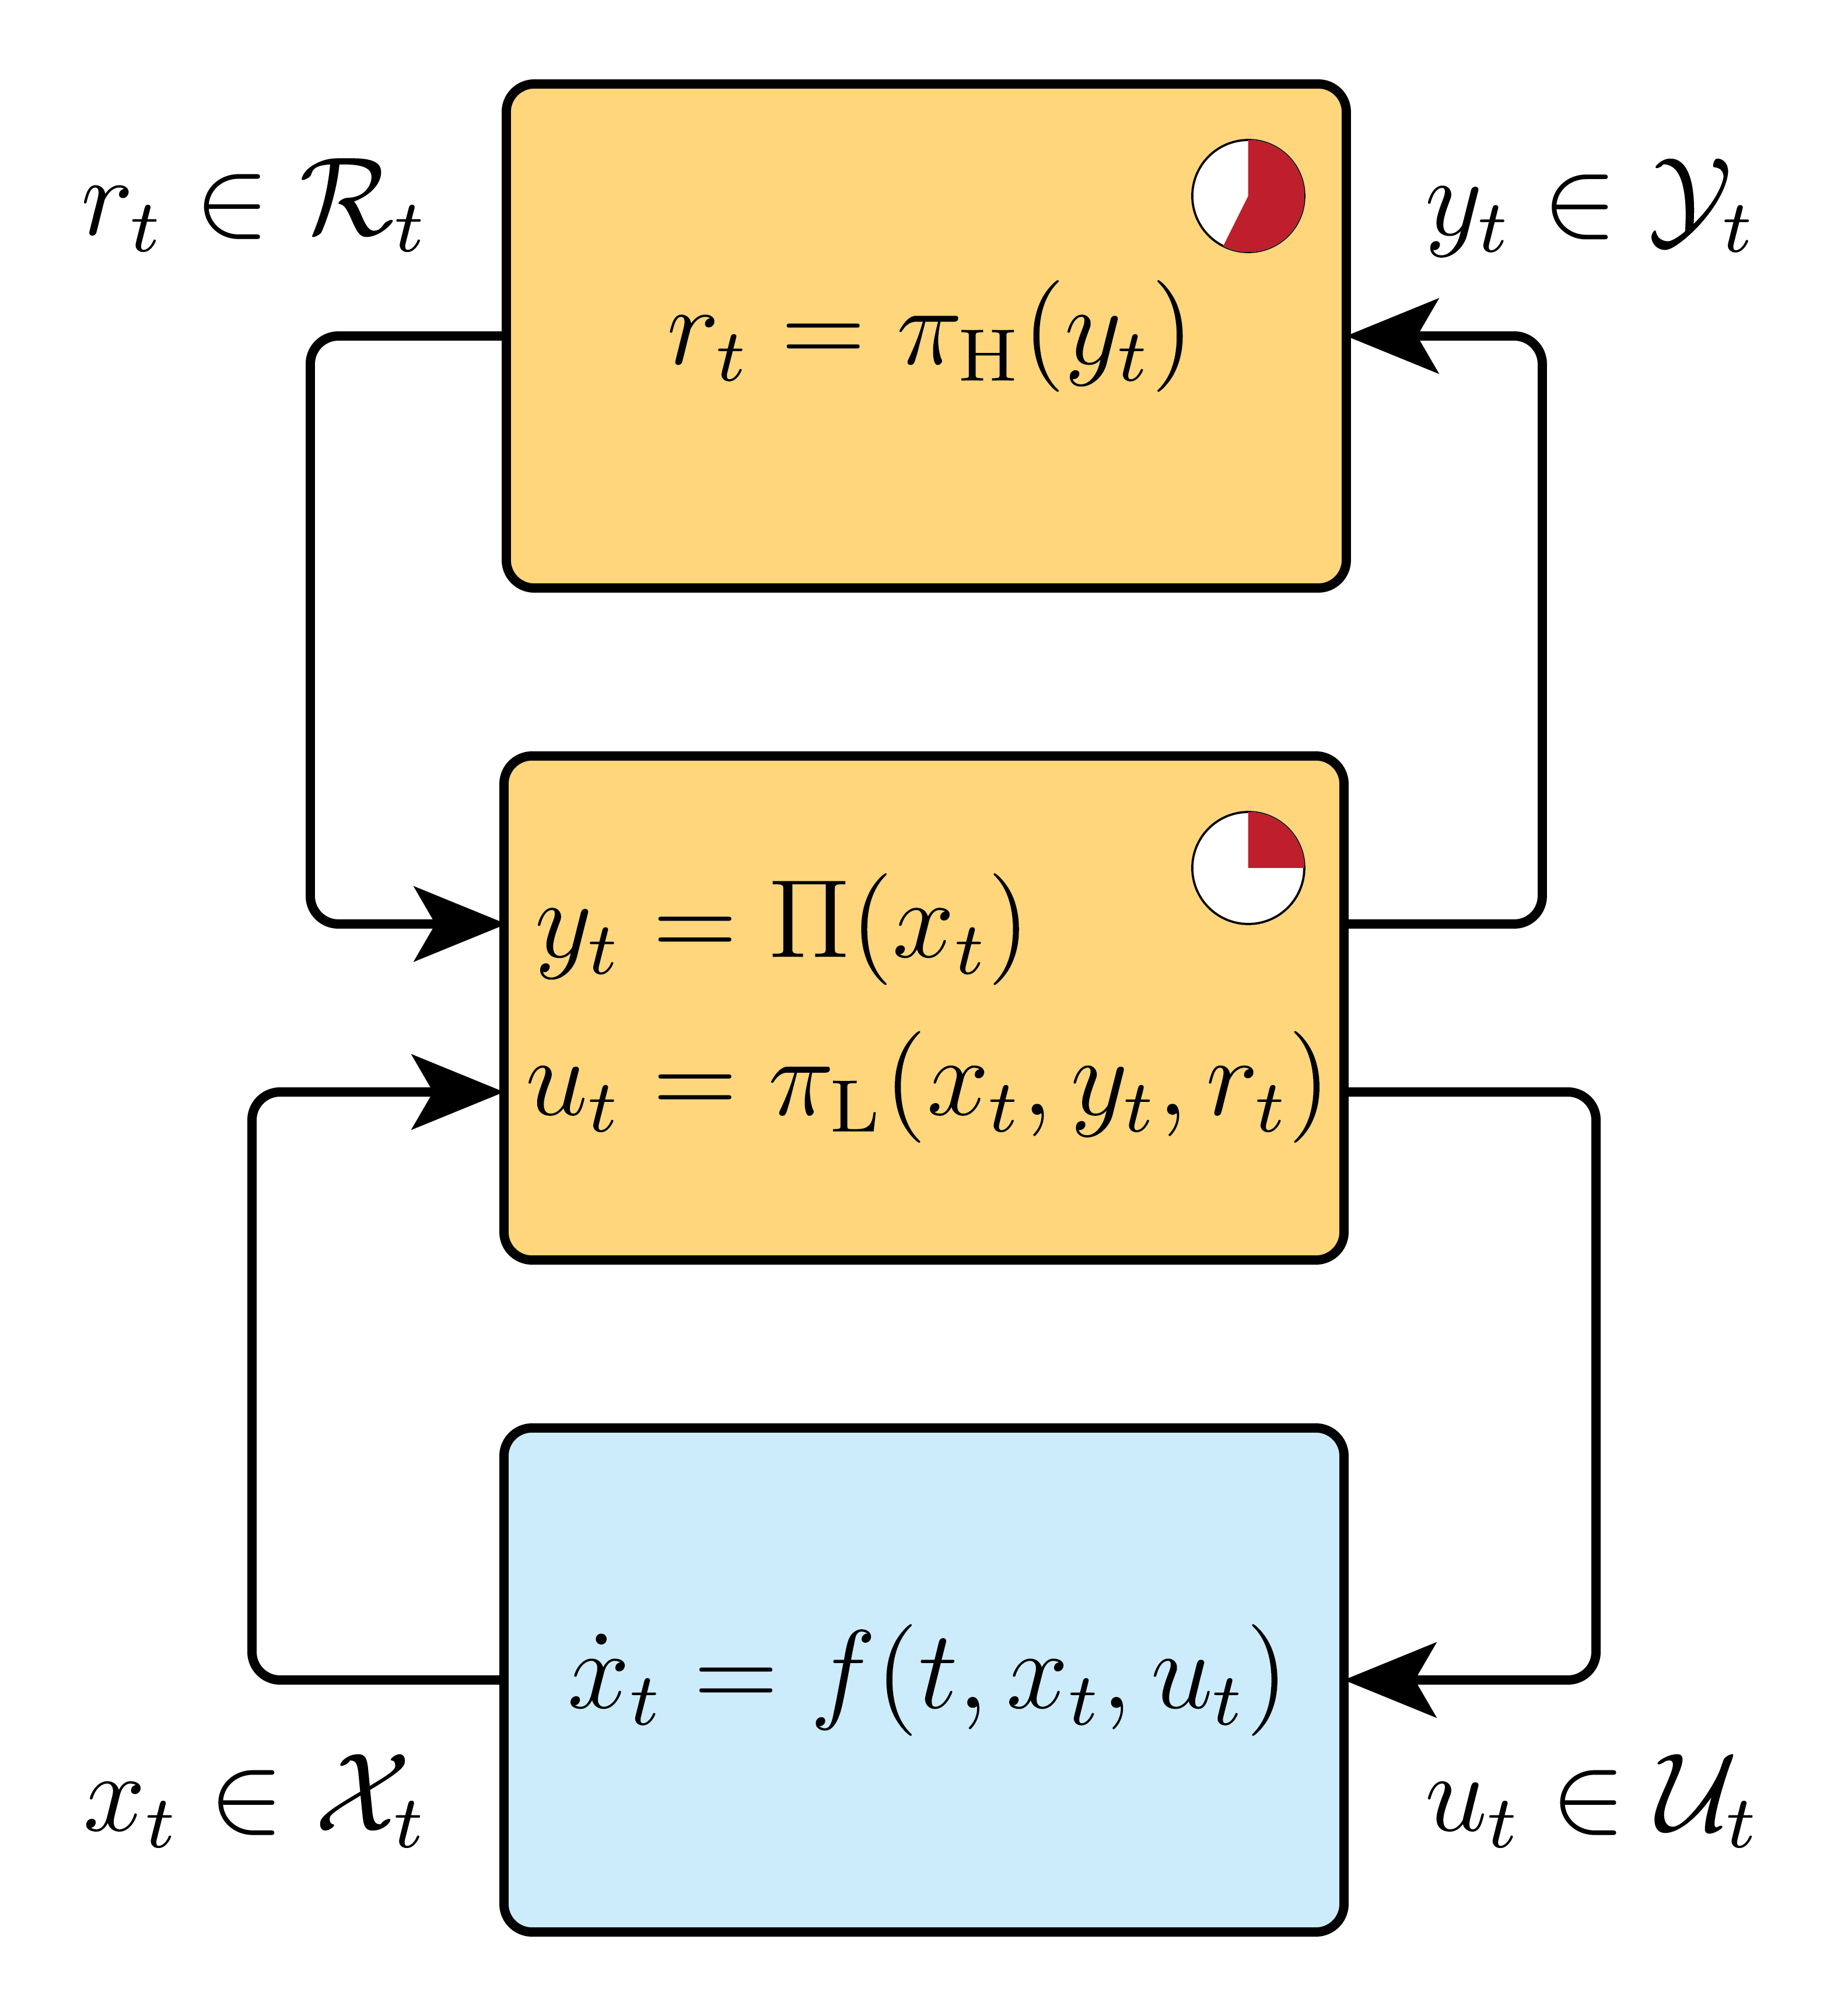
A step back
How does this fit in the architecture story line?
Now, tradeoffs in design of one controller
  What if DMP infeasible?
Divide up resources between layers!
Multiple time-scales, levels of complexity, etc.
Each layer its own DMP
How to design the ‘best’ architecture?
Joint design of layers:
  Co-designing layered control architectures

Slide 43
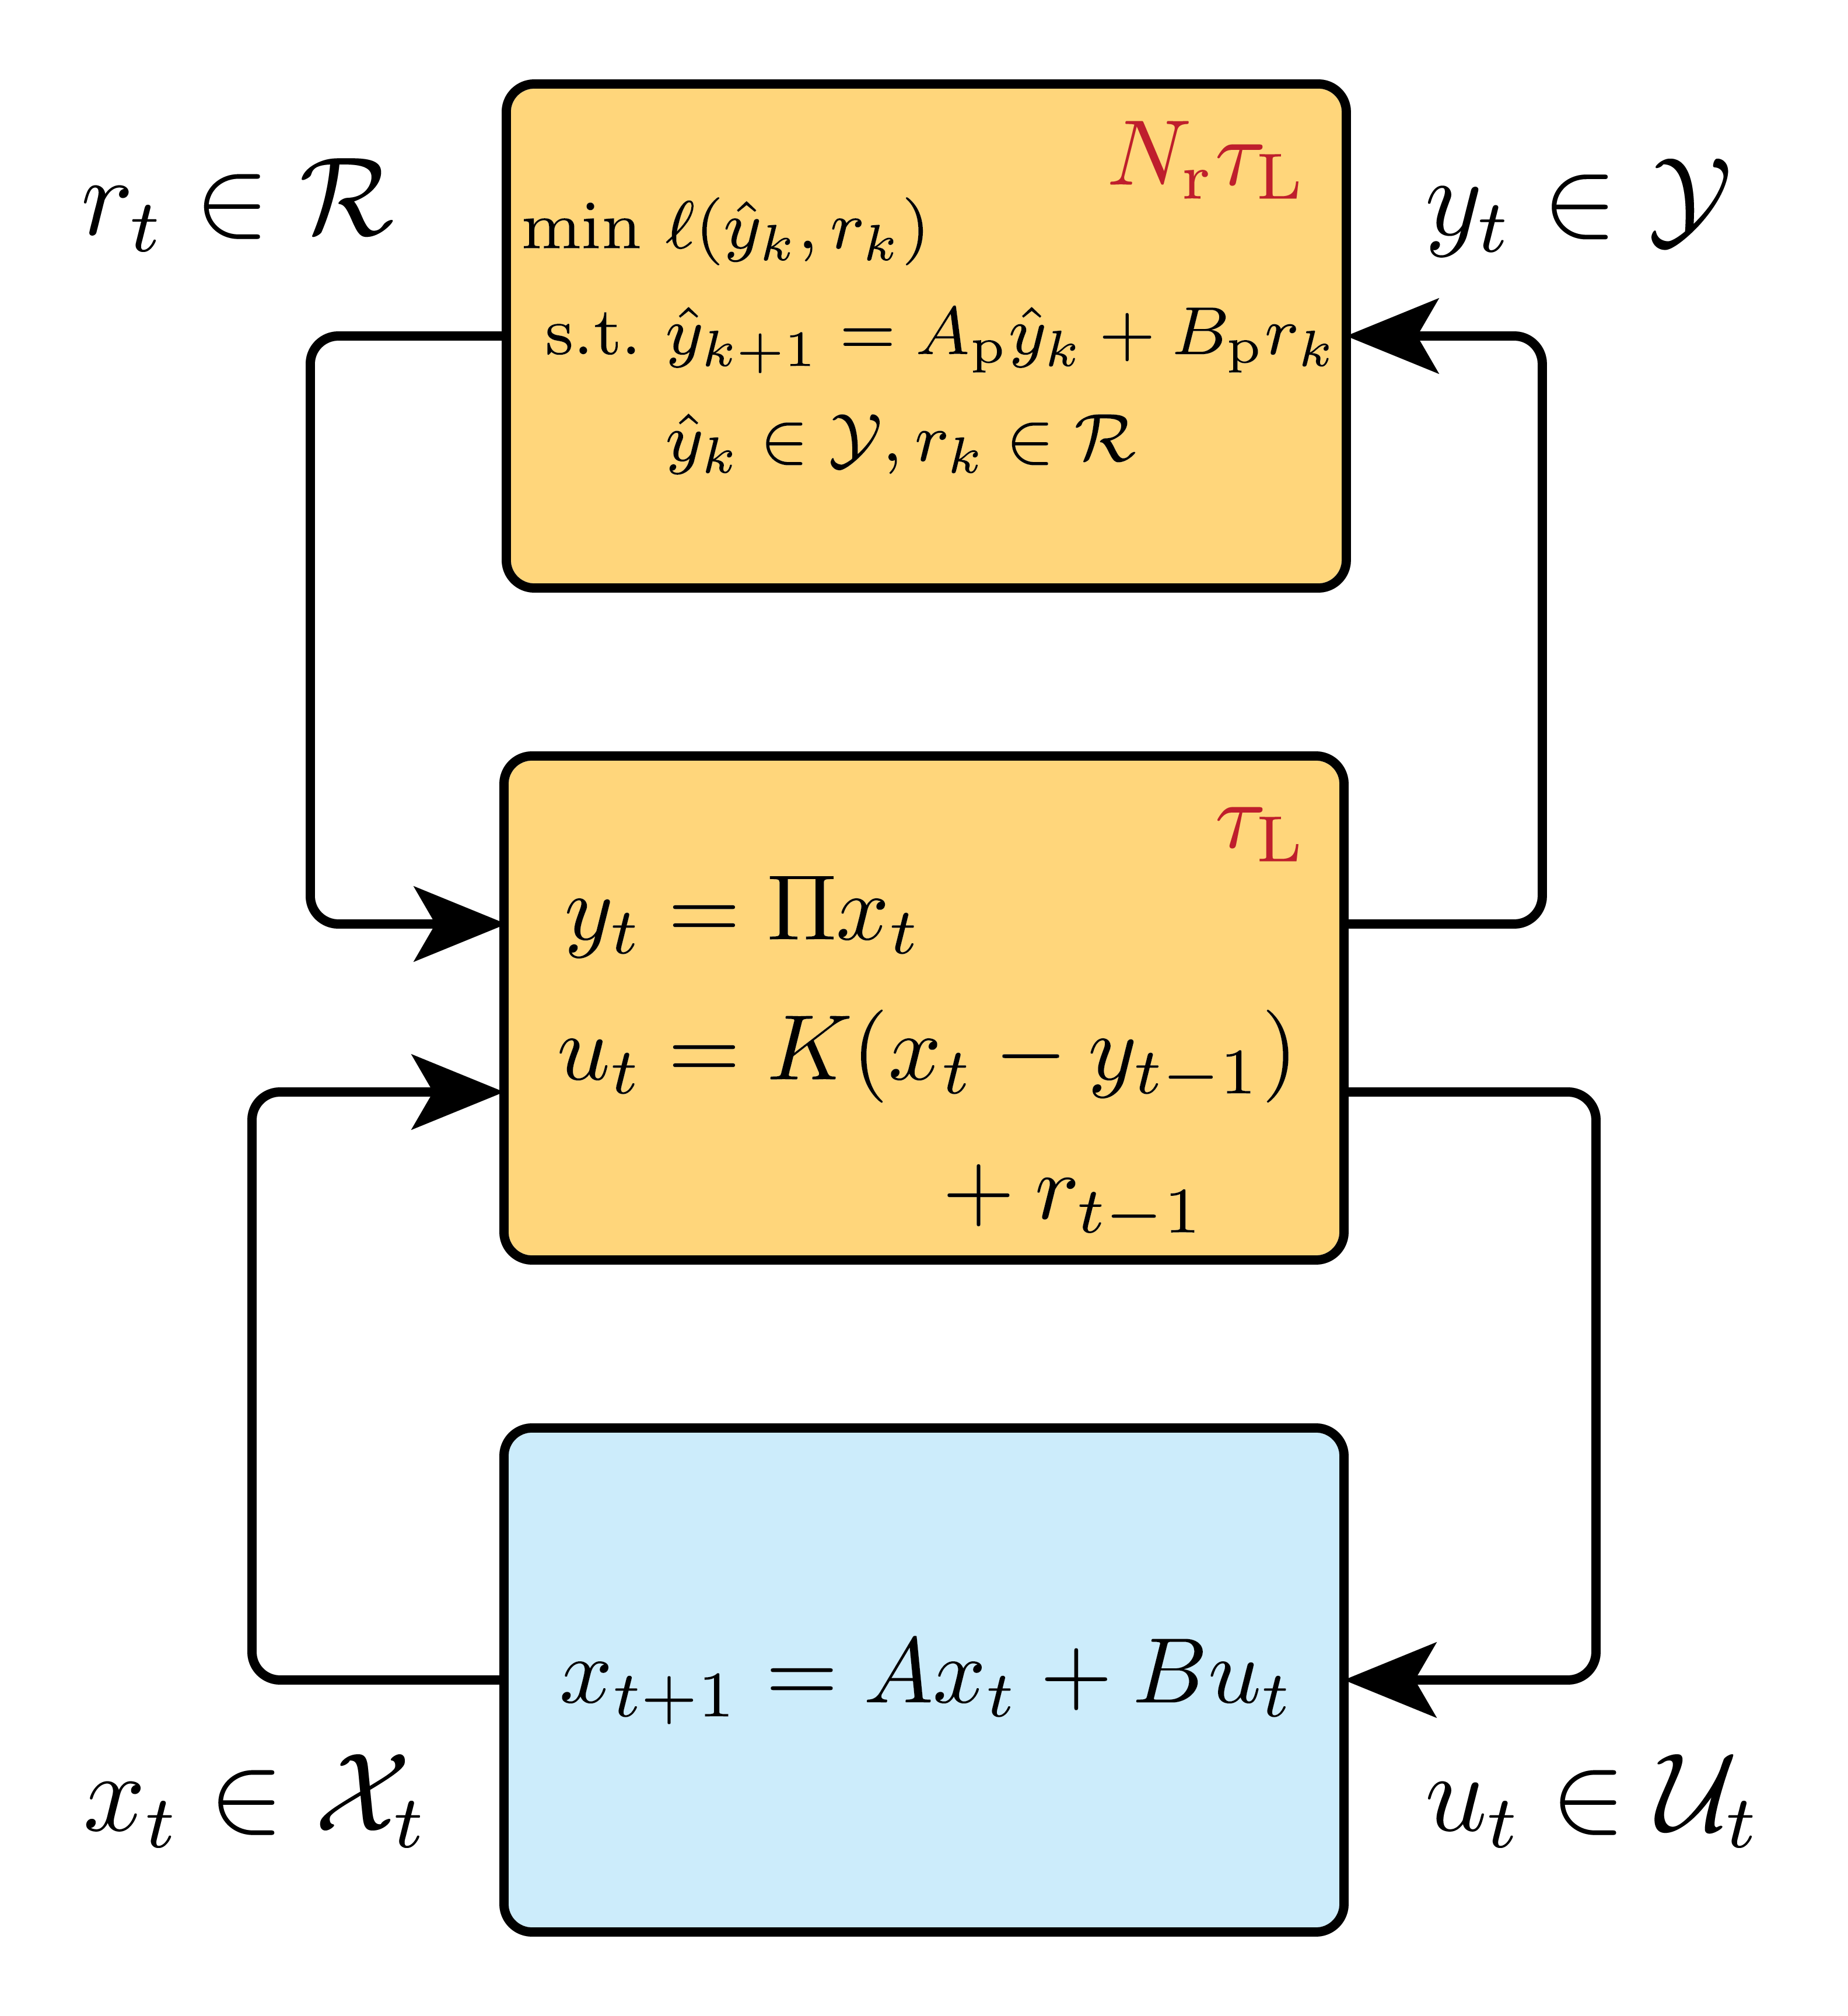
A step back
A (preliminary) simple example
Discrete-time LTI plant
Control architecture:
  Low layer: state feedback
  High layer: MPC controller (N_{r} times slower)
How to choose planner model, constraint sets,
ratio between timescales?
Desired specs of control system?
  Accuracy? Speed? Cheap implementation?
  Cannot have it all

Slide 44
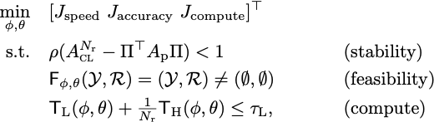
A step back
A preliminary, simple example
Architecture co-design problem:
Traces Pareto front
Similar structure as design meta-problem!
  Current ?: How to generalize DMP for
  architecture design?

Slide 45
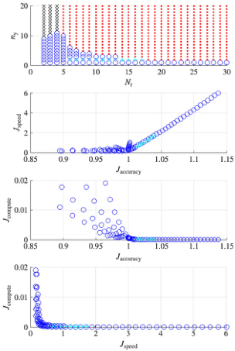
A step back
Some numerics:
Plant: chain of stable integrators
Planner model: Ap = A[:ny, :ny]
‘Solve’ on dense grid n_{y}×N_{r}

Slide 46
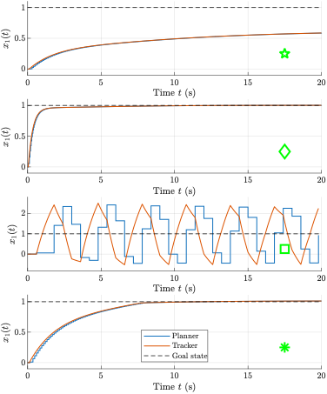
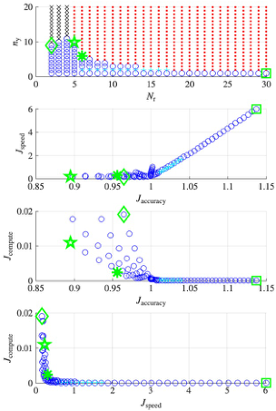
Focus on:
← Accuracy
← Speed
← Compute
← Weighted
tradeoff

Slide 47
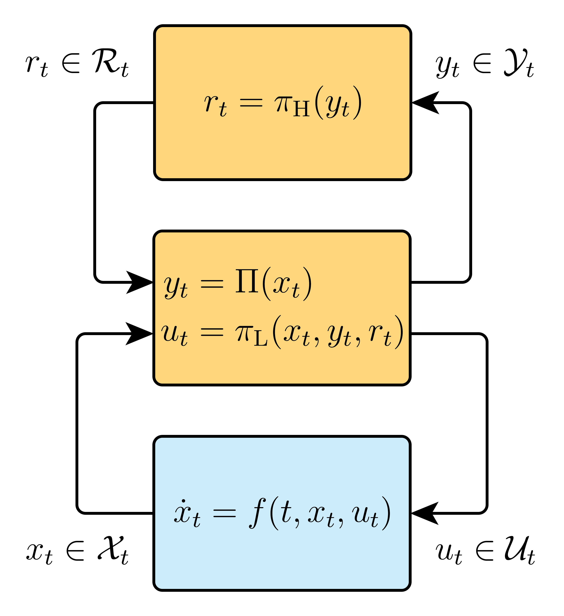
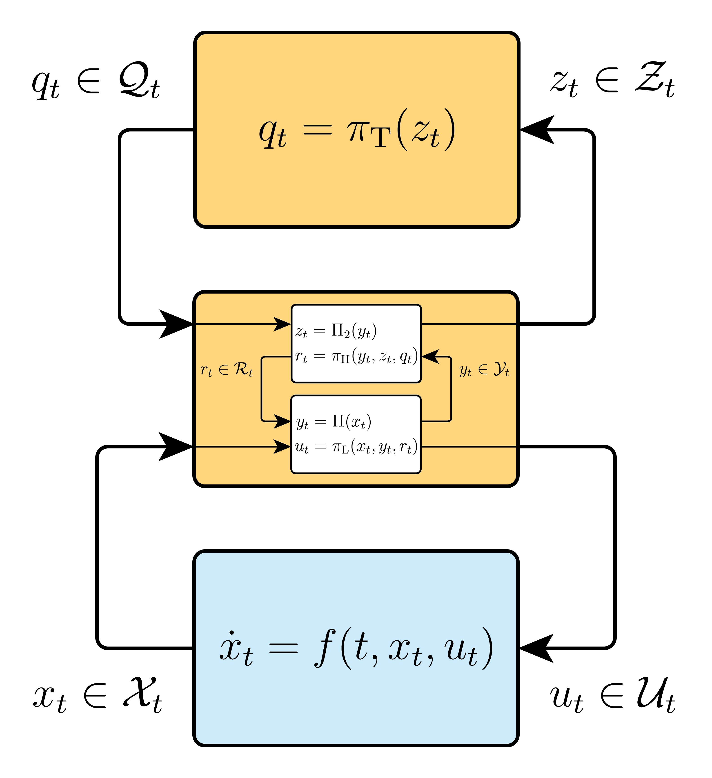

Outlook
Compositionality: Same concept, different interface

Slide 48
Contents
Motivation and introduction
Problem statement
The design meta-problem
A simple example
A step back
Conclusions

Slide 49

Conclusions
Compute is a fundamental aspect in control architecture design
Systematic framework for navigating tradeoffs in control design
subject to explicit compute constraints
Design meta-problem for reasoning about the design
Outlook:
Functional forms of sector bounds beyond LTI
Development of sampling-based estimation of L’s
How can this theory assist in systematic layered
control architecture design?
Paper:
chrisverhoek.com/tradeoffs
Or scan:

