Slide 1
Q-Learning Algorithm
Andy wang & Song Chen

Slide 2
What is Q-Learning?
Type of Machine Learning Algorithm
Previously familiar w/ some Supervised Learning Algorithms
Logistic Regression, Support Vector Machines

Slide 3
What is Q-Learning?
However, Q-learning is a type of Reinforcement Learning Algorithm
Essentially, supervised learning involves creating a model with a pre-labelled training data.
Reinforcement Learning involves a Learning agent that takes many (possibly random) actions to reach a Goal State while continuously assessing feedback
Deep Reinforcement Learning (combining Neural Networks & Reinforcement Learning) was used in AlphaGo.

Slide 4
What is Q-Learning?
In Q-Learning we start with an environment.
The environment is represented as a set of states that the agent (the AI) explores.
The AI is always currently in one of these states at any given time.
The set of States are typically represented as a graph (2D matrix)
The Agent can make actions represented as going from a given state to another state (represented as an edge on a graph).
The AI starts at some given position and tries to traverse the set of states (graph) until it reaches some goal state.
A
G

Slide 5
What is Q-Learning?
Grid World
S = Start
G = Goal
= Black Hole Horizon
 |  |  |  |  | G
 | S
Reinforcement Learning is often studied on Grid World.
Given a starting position & a goal State, the learning agent needs to learn how to get to the goal as quickly as possible while avoiding getting hurt.

Slide 6
What is Q-Learning?
Grid World
S = State
G = Goal
= Black Hole Horizon
 |  |  |  |  | G
 | S
Here the learning agent makes random actions from one state to another state.
The learning agent also keep track of actions where it reaches favorable states (Goal) and actions where it reaches unfavorable states (the black hole)

Slide 7
What is Q-Learning?
Grid World
S = State
G = Goal
= Black Hole Horizon
 |  |  |  |  | G
 | S
Now the learning agent knows what to do with actions it hasn’t taken before: go in the direction of previously found favorable actions.
The dark green arrows represent favorable actions. The lighter green arrows represent other favorable actions because they lead to even more favorable actions.

Slide 8
What is Q-Learning?
Grid World
S = State
G = Goal
= Black Hole Horizon
 |  |  |  |  | G
 | S
The Learning agent also knows how to handle actions leading to unfavorable states: avoid them.
Here the algorithm is avoiding heading towards the black regions (orange). Subsequent actions heading towards unfavorable actions are also avoided.

Slide 9
The Algorithm - Pseudocode
init(R[n][n]) //set the reward for all existing edges
init(Q[n][n]) //set all entries to zero & initial Q for //goal state
init(maxQ[n])
gamma = 0.8
episodes = 100
for i in [0, episodes]:
currState = rand() % n
While(!goalReached(currState)):
nextState = rand % n
Q[currState][nextState] = R[currState][nextState] + gamma*max(Q[nextState][all actions])
currState = nextState
for i in [0,n]:
maxQ[i] = max(Q[i][all actions])

Slide 10
So how does this make sense?
1
Example:
0
0
0
100
0
100
2
3
5
Goal State
0
100
0
0
0
4
0

Slide 11
So how does this make sense?
1
Example:
0
0
0
100
0
100
2
3
5
Goal State
0
100
0
0
0
4
0

Slide 12
So how does this make sense?
1
Example:
0
0
0
100
0
100
2
3
5
Goal State
0
100
0
0
0
4
0

Slide 13
So how does this make sense?
1
Example:
80 = 0 + 0.8*100
0
80
0
100
0
100
2
3
5
Goal State
0
100
0
0
0
4
0

Slide 14
So how does this make sense?
1
Example:
64 = 0 + 0.8*80
0
80
0
100
64
100
2
3
5
Goal State
0
100
0
0
0
0
0
4
0

Slide 15
So how does this make sense?
1
The bolded arrows tell you the
actions the AI has learned to
take from a given state to
head towards the goal
Example:
80
80
0
100
64
100
2
3
5
Goal State
51
100
80
64
64
80
0
4
80

Slide 16
So …

Slide 17
So … Could we train Q-Learning to play Tetris?

Slide 18
So … Could we train Q-Learning to play Tetris?
Kind of … it’s complicated.

Slide 19
So … Could we train Q-Learning to play Tetris?
We decided to work with small Tetris boards and piece sets (4 X 4) and work our way up from there.
We’d try different parameters, namely the # of episodes the algorithm would be allowed to run and the learning factor, γ.
Then measure performance against human players and a computer that played randomly
Also look at long it would take to converge, total # of actions explored, and when Q-Learning would start to break down.

Slide 20
So Exactly how much space would this require?
Representing a Tetris Board:
A state is given by a the current state of the board & the given piece
A (4x4) board could be represented as a binary string of 16 digits (color doesn’t matter)
1011
0000000001111111
State = Board + piece = 0000000001111111 1011

Slide 21
So Exactly how much space would this require?
Representing a Tetris Board:
A state is given by a the current state of the board & the given piece
A (4x4) board could be represented as a binary string of 16 digits (color doesn’t matter)
So the total # of states is: 2⁽¹⁶⁺⁴⁾
1011
0000000001111111
State = Board + piece = 0000000001111111 1011

Slide 22
So Exactly how much space would this require?
Representing a Tetris Board:
A state is given by a the current state of the board & the given piece
A (4x4) board could be represented as a binary string of 16 digits (color doesn’t matter)
So the total # of states is: 2⁽¹⁶⁺⁴⁾
To store Q-matrix: 2²⁰ x 2²⁰ x 4 bytes
1011
0000000001111111
State = Board + piece = 0000000001111111 1011

Slide 23
So Exactly how much space would this require?
Representing a Tetris Board:
A state is given by a the current state of the board & the given piece
A (4x4) board could be represented as a binary string of 16 digits (color doesn’t matter)
So the total # of states is: 2⁽¹⁶⁺⁴⁾
To store Q-matrix: 2²⁰ x 2²⁰ x 4 bytes
= 4 Terabytes
1011
0000000001111111
State = Board + piece = 0000000001111111 1011

Slide 24
Our Implementation
However, the state space for Tetris is actually very sparse
A given piece could only have 4 orientations and for (4x4) only be placed within one of 4 columns.
So for each board we have 4 piece orientations x 4 places x 4 different pieces = only 64 other boards that could be reached.
Now the 4 Terabytes can be brought down to a manageable 2²⁰ x 64 x 4 bytes = 256 Mbytes
The AI losing represents the goal state, and completing a row earns the AI a reward.

Slide 25
Our Implementation
Instead of using an adjacency matrix or an adjacency list, we use a hash table to store the actions.
Hash table has constant time (up to linear when full) for accessing and inserting elements
The hash table is initially empty
Whenever an action to an unexplored state is made, add an entry to the hash table
All implementation including Q-Learning and computing Tetris boards were done in C++
Q[“00000000011111111011 00001100111111111011]
= 82
+

Slide 26
A note on Time Complexity Analysis & Convergence
Q-Learning was shown to be intractable in both running the algorithm and also to convergence.
Reaching a goal state could be exponential in the total # of states [Whitehead, 1991]
Q-Learning was shown to converge, although not necessarily in polynomial time [Watkins, 1989]
Tweaking the properties of the state graph could actually dramatically affect time complexity
Grid World is O(n²) [Aleliunas et al., 1979]
Tetris in particular is very sparse with many goal states

Slide 27
Experimental Setup
Train several models to play Tetris using Q-Learning with several parameters:
# of episodes -> 10, 10000, 1000000
learning rate γ -> 0.2, 0.5, 0.8, 0.9
size of Tetris board -> 4x4, 7x7, 20x10
Look at effect on overall performance compared to humans
Total # of unique edges explored
Total time in milliseconds to complete
Did the algorithm converge?

Slide 28
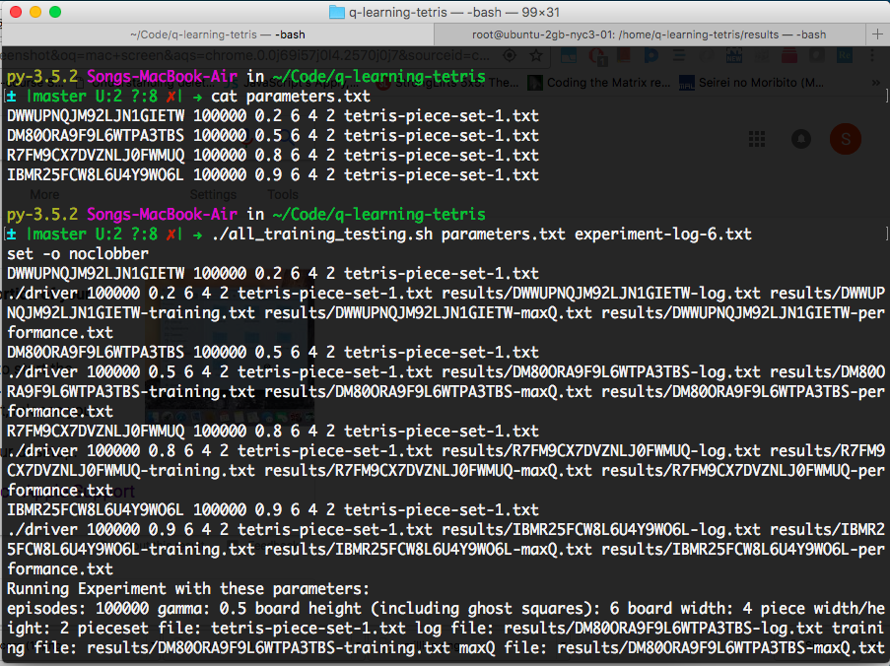
A Demonstration
A bash script given a file with multiple line separated parameters running one instance of the experiment on a single process.

Slide 29
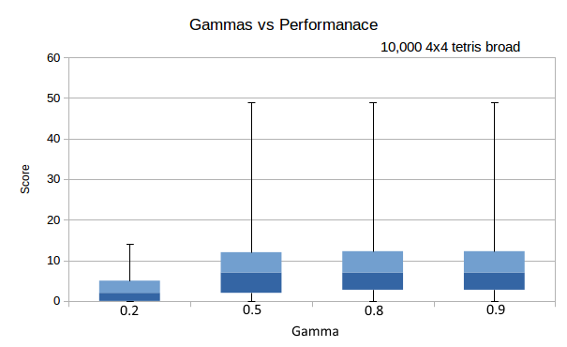
The Results
It seems like as long as a learning factor, gamma,
was chosen to be high enough (threshold is at 0.5),
the performance difference is negligible (tested on
4x4 boards with 10,000 episodes).
Various gammas remain to be tested with
> 10,000 episodes.
This seems to signify that future rewards are just as
important as immediate rewards when the AI
learns to play Tetris.

Slide 30
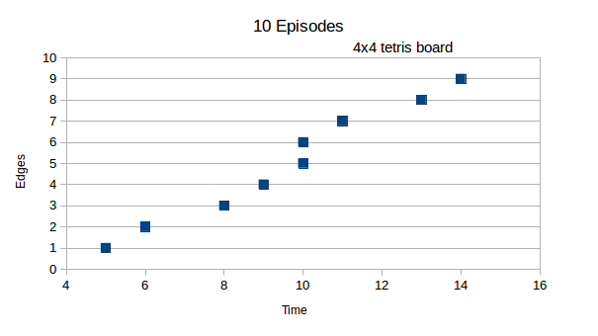
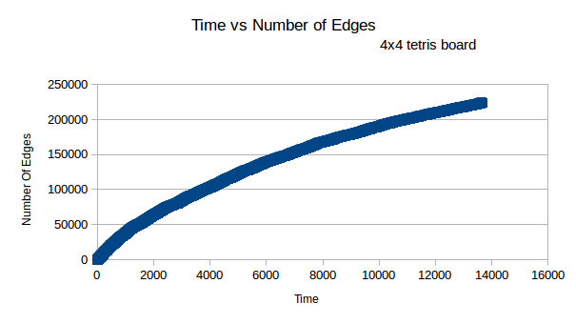
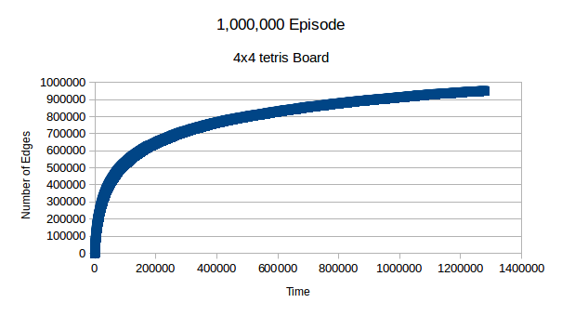
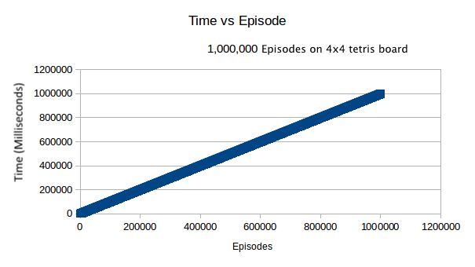
The Results
The time vs. episode chart seems to imply that the time to reach a goal state (or complete) an episode is not actually exponential in the # of states but actually much lower.
The three time vs. number of unique edges explored charts shows that when choosing edges randomly to explore, it becomes more difficult to discover edges/actions as the # of episodes increases.

Slide 31
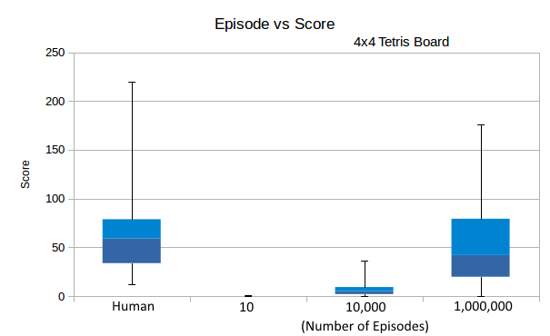
The Results
On 4x4 boards, the AI performance becomes
comparable to human performance.
However, the variance on performance is so large that we believe that even on 1,000,000 episodes Q-Learning hasn’t converged.

Slide 32
The Results
The performance for larger boards (7x7 and standard board + pieces) is basically random
7 x 7 boards with 1,000,000 could not complete after several hours
Past 4 x 4 the state space becomes so large that below 10,000 episodes is not enough to train the AI to show any results

Slide 33
Limitations & Future Work
Limited Computing resources
Actually being able to watch the AI play in real-time
Our implementation of Q-Learning only scratches the surface of Reinforcement Learning
Future Extensions:
Including Feedback loop
Best-first Search & Pruning techniques for traversing the state space
Q-Neural Networks to handle the large state space
Using different representations of the Tetris State space -> Melax, Bdolah & Livnat

Slide 34
Conclusion
Q-Learning works well for sufficiently small state spaces
The worst – case runtime for Q-Learning with Tetris may be in polynomial time
Lower variance on performance can indicate Q-Learning convergence
Reinforcement Learning on Tetris works better when weighing future rewards more equally to immediate rewards.
You can’t just throw a problem at machine learning and just expect it to work
Past 4 x 4 Tetris boards, Q – Learning can barely perform better than random

