Slide 1




LITS: An Optimized Learned Index for Strings
YIFAN YANG
yangyifan22z@ict.ac.cn
SHIMIN CHEN
chensm@ict.ac.cn
Institute of Computing Technology, CAS & University of Chinese Academy of Sciences

Slide 2
Sorted Index is Important
Applications
Important for main-memory database systems
Common index operations:
lookup/insert/delete/update
scan
queries
results
index ops
index results
Index
data

Slide 3
Learned Indexes for Fixed-Sized Keys
Learned Index
Fixed-Sized Keys: integer, floating-point numbers
Learned indexes perform well on fixed-sized keys
Learned Index[SIGMOD’18], ALEX[SIGMOD’20], RadixSpline[SIGMOD’20], PGM Index[PVLDB’20], LIPP[PVLDB’21], LISA[SIGMOD’20], DILI[PVLDB’23],
... ...
key
Model
position
data

Slide 4



String Keys: Common in Real World
Characteristics of string keys
long, variable-sized: bring pointer-chasing dereferences
skewed prefixes: examine a large number of bytes
URL
address
user ID
“google.cn” “124 Elm Street, Spring Field” “2024K8001”

Slide 5
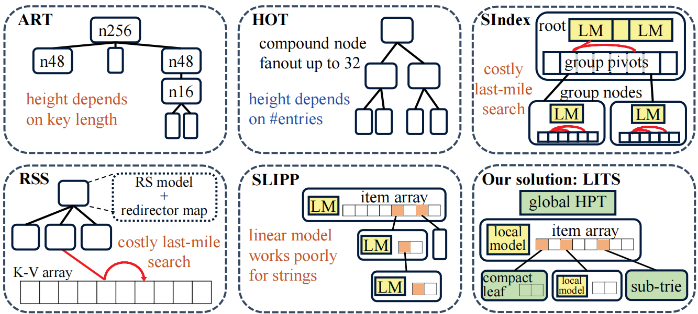
Existing Indexes Optimized for Strings

Slide 6

Our Solution: LITS
LITS: Learned Index with Hash-enhanced Prefix Table and Sub-tries
model-based node
Hash-enhanced Prefix Table
Performance Model for Structure Selection
subtrie node
(HPT)
(PMSS)
compact leaf
kv-entry

Slide 7
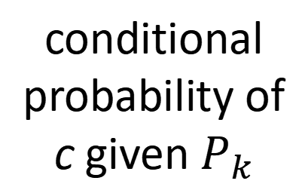
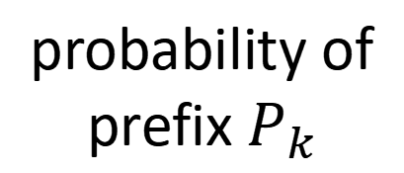
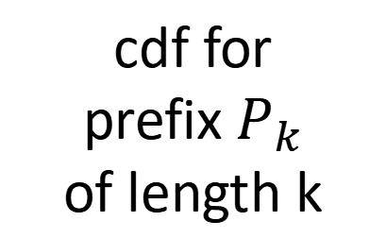
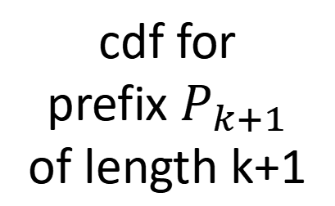
Learn the Pattern of Strings
Basic idea: conditional probability of characters given prefix
e.g. url: “http” “:”, “s”
address: “stree” “t”
Recursive Formula for CDF Computation:
cdf for
prefix $P_{k+1}$
of length k+1
cdf for
prefix $P_{k}$
of length k
probability of
prefix $P_{k}$
conditional probability of c given $P_{k}$

Slide 8
Learn the Pattern of Strings
Conditional probability distributions should be captured by CDF model!
Recursive Formula for CDF Computation:
cdf for
prefix $P_{k+1}$
of length k+1
cdf for
prefix $P_{k}$
of length k
probability of
prefix $P_{k}$
conditional probability of c given $P_{k}$

Slide 9
Optimization 1: Hash-enhanced Prefix Table(HPT)
cdf prob | a | b | c
0 | 0.1 0.2 | 0.3 0.4 | 0.7 0.3
1 | 0.2 0.1 | 0.3 0.5 | 0.8 0.2
2 | 0.1 0.3 | 0.4 0.1 | 0.5 0.5
3 | 0.4 0.4 | 0.8 0.1 | 0.8 0.1

Slide 10
Optimization 1: Hash-enhanced Prefix Table(HPT)
alphabet
cdf prob | a | b | c
0 | 0.1 0.2 | 0.3 0.4 | 0.7 0.3
1 | 0.2 0.1 | 0.3 0.5 | 0.8 0.2
2 | 0.1 0.3 | 0.4 0.1 | 0.5 0.5
3 | 0.4 0.4 | 0.8 0.1 | 0.8 0.1

Slide 11

Optimization 1: Hash-enhanced Prefix Table(HPT)
alphabet
cdf prob | a | b | c
0 | 0.1 0.2 | 0.3 0.4 | 0.7 0.3
1 | 0.2 0.1 | 0.3 0.5 | 0.8 0.2
2 | 0.1 0.3 | 0.4 0.1 | 0.5 0.5
3 | 0.4 0.4 | 0.8 0.1 | 0.8 0.1
hash values of prefixes
$$value=hashFunc(prefix)$$

Slide 12
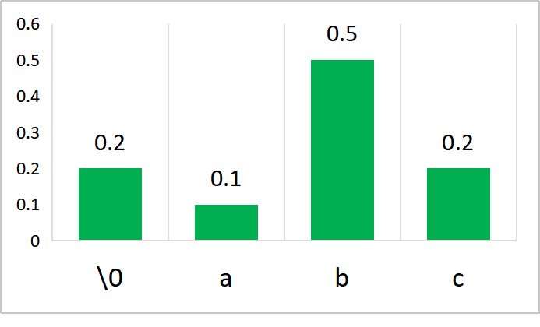
Optimization 1: Hash-enhanced Prefix Table(HPT)
alphabet
cdf prob | a | b | c
0 | 0.1 0.2 | 0.3 0.4 | 0.7 0.3
1 | 0.2 0.1 | 0.3 0.5 | 0.8 0.2
2 | 0.1 0.3 | 0.4 0.1 | 0.5 0.5
3 | 0.4 0.4 | 0.8 0.1 | 0.8 0.1
hash values of prefixes
distribution given hashed prefixes

Slide 13
Model-based Node in LITS
model-based node
$$pos(S)={slope}_{local}∗GetCDF(HPT, S)+{intercept}_{local}$$
#key | prefix | item array len | local model
item | item | item | ... | ... | ... | item
3-bit node type | 13-bit reserved | 48-bit pointer

Slide 14
Calculation Process of HPT
left = 0
range = 1
bac
b
0
left += range * 0.3
range *= 0.4
1
bac
ba
0.3
left += range * 0.1
range *= 0.3
0.7
bac
bac
0.34
left += range * 0.8
range *= 0.2
0.46
0.436
0.46

Slide 15
Optimization 1: Hash-enhanced Prefix Table(HPT)
model-based node
Hash-enhanced Prefix Table
Performance Model for Structure Selection
subtrie node
(HPT)
(PMSS)
compact leaf
kv-entry

Slide 16
Optimization 2: Compact Leaf Nodes
model-based node
Hash-enhanced Prefix Table
Performance Model for Structure Selection
subtrie node
(HPT)
(PMSS)
compact leaf
kv-entry

Slide 17
Optimization 2: Compact Leaf Nodes
N0: model-based node
head | N1 | ... | ... | kv5
C0: Compact Leaf Node
head | kv1 | kv2 | kv3 | kv4 | kv5
N1
head | N2 | N3 | ...
N2
N3
16-bit hash | 48-bit pointer
head | kv1 | kv2
head | kv3 | kv4
(hash-enhanced pointer)

Slide 18
Optimization 2: Compact Leaf Nodes
model-based node
Hash-enhanced Prefix Table
Performance Model for Structure Selection
subtrie node
(HPT)
(PMSS)
compact leaf
kv-entry

Slide 19
Optimization 3: Sub-Trie Node and PMSS
model-based node
Hash-enhanced Prefix Table
Performance Model for Structure Selection
subtrie node
(HPT)
(PMSS)
compact leaf
kv-entry

Slide 20
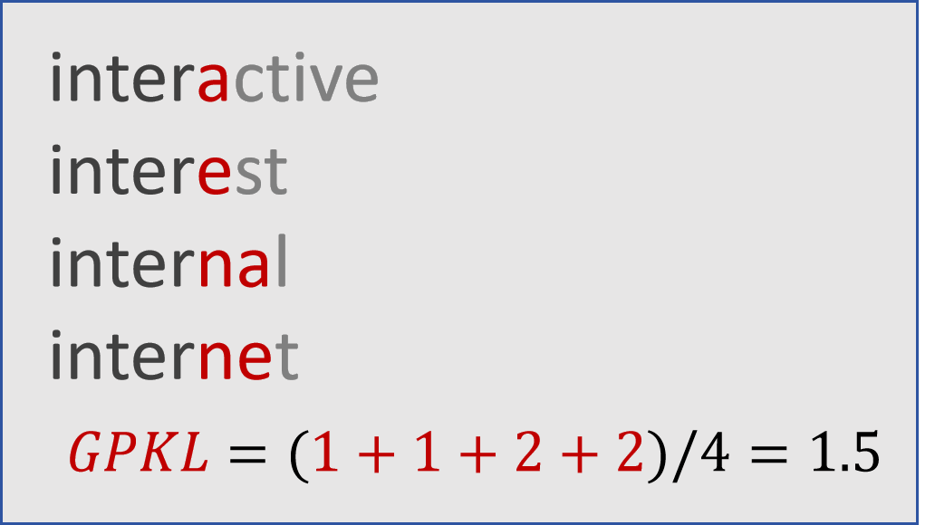
Optimization 3: Sub-Trie Node and PMSS
Group Partial Key Length(GPKL)
↑GPKL, ↑bytes to consider
remove common prefix
single-pass calculation

Slide 21
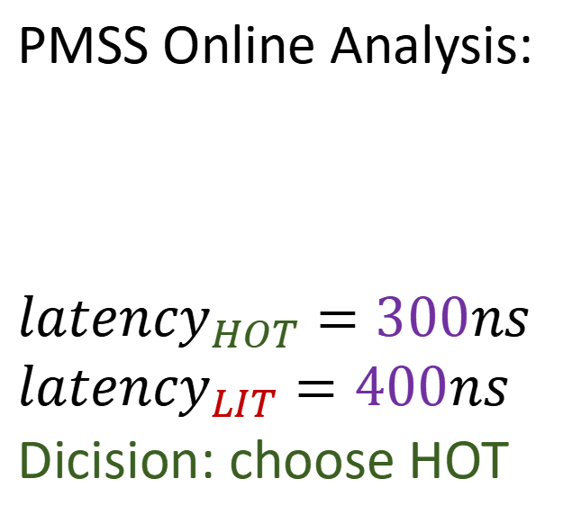
Optimization 3: Sub-Trie Node and PMSS
sub-trie
PMSS Online Analysis:
$${latency}_{HOT}=300ns$$
$${latency}_{LIT}=400ns$$
Dicision: choose HOT
model-based node
subtrie node
head | N1 | ... | ... | Nk
kv-entry
... ...
... ...
... ...

Slide 22
Optimization 3: Sub-Trie Node and PMSS
sub-trie
PMSS Online Analysis:
$${latency}_{HOT}=300ns$$
$${latency}_{LIT}=400ns$$
Dicision: choose HOT
model-based node
subtrie node
head | N1 | ... | ... | Nk
kv-entry
... ...
... ...
... ...
Trie-based index will be an alternative solution when the model does not perform well

Slide 23
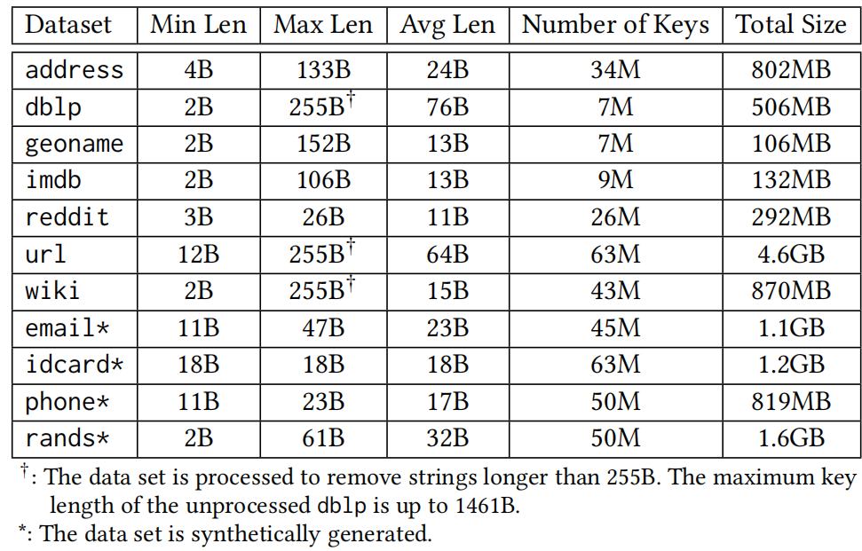
Experimental Setup
Machine configuration
- 3.4GHz Intel Xeon Platinum 8380
- 256 GB memory size
Data sets
- 7 real world data sets
- 4 synthetic data sets

Slide 24
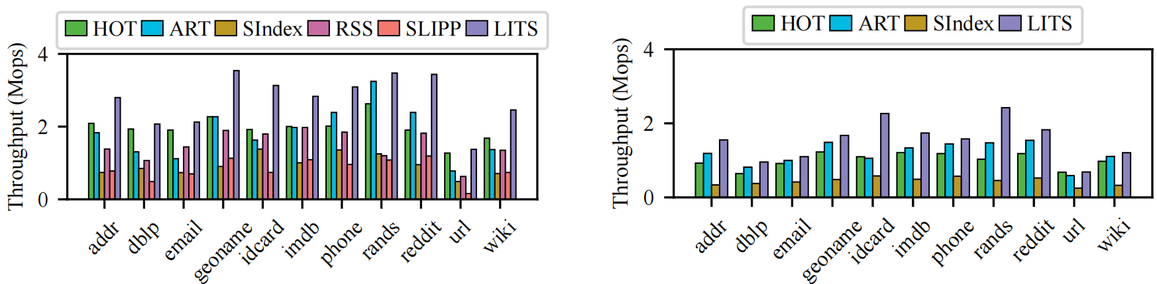
Single Thread Read/Write Performance
Read-Only Performance
Insert-Only Performance
LITS shows 1.09~2.07x better performance on average

Slide 25
More Details in Paper
More details
- mathematical proof of CDF formula
- pseudocode of search & insert
- experiements about model comparisions
- YCSB workloads
- queries of different distributions
- memcost & bulk load time
- multi-thread throughput

Slide 26
Conclusion
LITS: An Optimized Learned Index for Strings
A noval string CDF model: HPT
Compact Leaf Node
Sub-trie Node with PMSS
LITS outperforms state-of-the-art indexes for strings
code: https://github.com/schencoding/lits

Slide 27
Thank you!
YIFAN YANG
yangyifan22z@ict.ac.cn
SHIMIN CHEN
chensm@ict.ac.cn
Institute of Computing Technology, CAS & University of Chinese Academy of Sciences

