Slide 1
KISS-Tree: Smart Latch-Free In-Memory Indexing on Modern Architectures
Thomas Kissinger

Slide 2
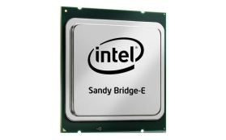
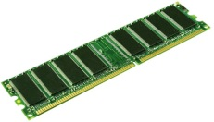
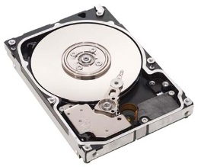
Introduction (1)
Data Processing
…
More and more cores and CPUs
~40 GB/s
→ Efficient parallel access becomes important
8KB | 8KB | …
Buffer
…
More and more main memory per Server
(2TB currently)
~100 MB/s
Entire data pool in-memory
Reduction of disk-accesses memory-accesses is optimization goal
Hard Disk Storage

Slide 3
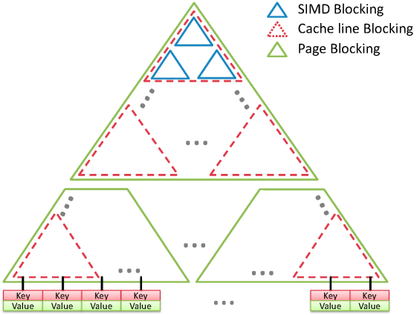
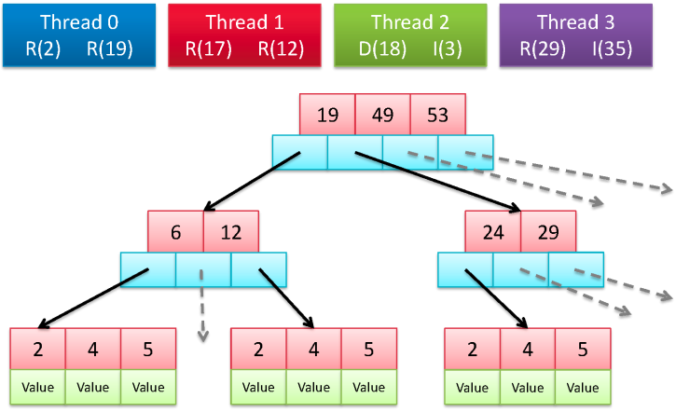
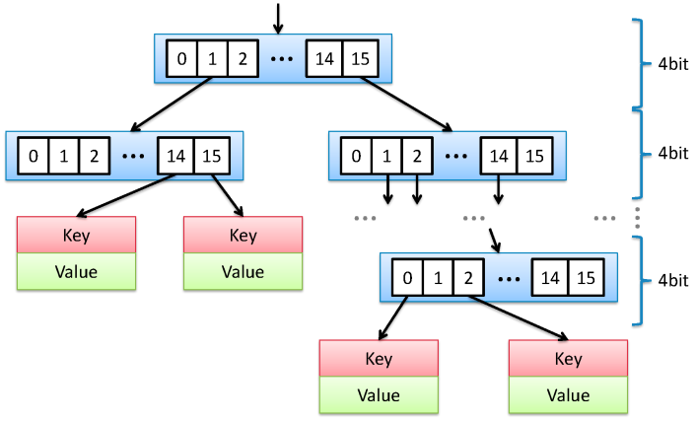
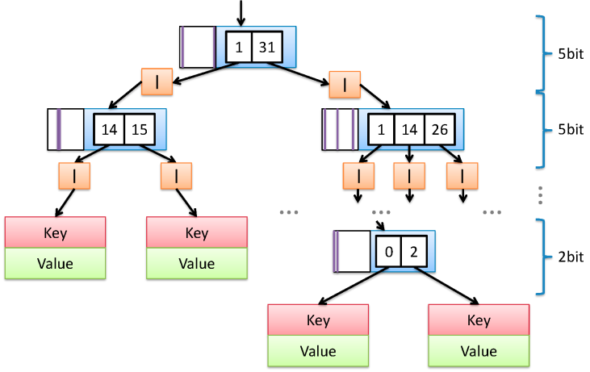
Related Work
B-Tree based
Complex locking schemes
Comprehensive balancing tasks
→ Cache-awareness
FAST
PALM
Unbalanced trees
Deterministic path
Balanced read/update rate
→ Memory access-optimized
Prefix Tree
CTrie

Slide 4
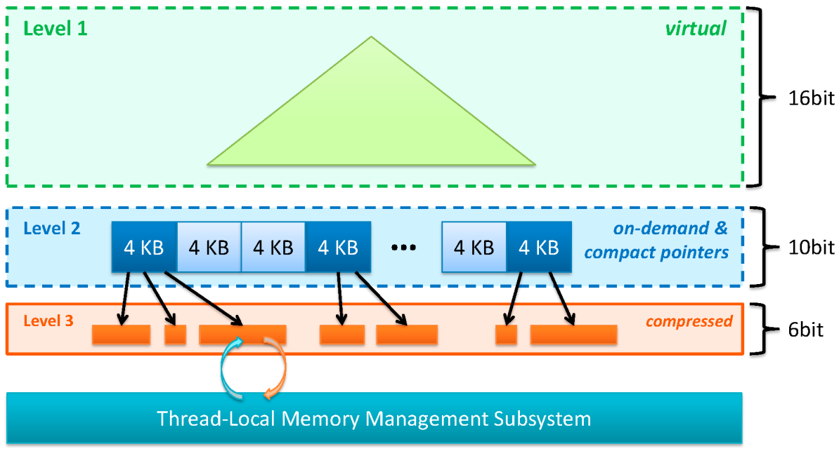
KISS-Tree Overview
Based on Prefix Tree
Specialized version for 32bit keys
Latch-free updates
Order-preserving
2-3 memory accesses per key
Fastest reported read performance for order-preserving in-memory indexes
High update performance
Heterogeneous in-memory index structure
Combination of direct and indirect addressing
Takes advantage of virtual memory management of the hardware and the operating system
Compression mechanisms

Slide 5



Level 1: Virtual Level
Decimal Key: 42
0000 0000 0000 0000
0000 0000 00
10 1010
Split key in 3 fragments
16bit ($f_{1})$
10bit ($f_{2}$)
6bit ($f_{3}$)
Calculate corresponding 2nd node address from the first fragment
→Direct addressing
→No memory required for level 1
0
Level 2
…
Node
Node
Node
Node
Node
Node
Node
Node
Requirement for Level 2: All nodes have to be stored sequentially in memory

Slide 6



Level 2: on-demand level
Change over to indirect addressing
1024 buckets per node containing a compact pointer to the 3rd level node
256 MB maximum
Decimal Key: 42
0000 0000 0000 0000
0000 0000 00
10 1010
16bit ($f_{1})$
10bit ($f_{2}$)
6bit ($f_{3}$)
Virtual Memory Address
Level 2
…
4 KB
4 KB
4 KB
4 KB
4 KB
4 KB
4 KB
4 KB
Page Directory
Memory Management Unit (MMU)
Hardware
OS
Physical Memory Address
…
4 KB
4 KB
4 KB
4 KB
4 KB
4 KB
4 KB
4 KB
4 KB

Slide 7


Level 3: compression
Decimal Key: 42
0000 0000 0000 0000
0000 0000 00
10 1010
16bit ($f_{1})$
10bit ($f_{2}$)
6bit ($f_{3}$)
42
64 possible node sizes
Bitmap indicates which bucket is in use
Only existing values are stored
Value
Value
Value
Value
64bit Bitmask
Values
Read-copy-updates
→ No in-place updates possible (lost updates)
Thread-Local Memory Management Subsystem

Slide 8



Insert Example
1
Decimal Key: 42
0000 0000 0000 0000
0000 0000 00
10 1010
Virtual Page
Physically allocated Page
16bit ($f_{1})$
10bit ($f_{2}$)
6bit ($f_{3}$)
2
…
…
…
…
…
…
0
1023
0
23
1023
0
1023
10bit
5
4
Value
Value
Value
Value
6bit
3
Thread-Local Memory Management Subsystem

Slide 9
Batched Reads
42
938
4459
17
Batch Size = 4
Each thread processes multiple read operation at a time → Software pipelining
Better cache usage
Prefetching of next nodes possible
…
…
…
…
…
…
0
1023
0
23
1023
0
1023
10bit
Value
Value
Value
Value
6bit

Slide 10
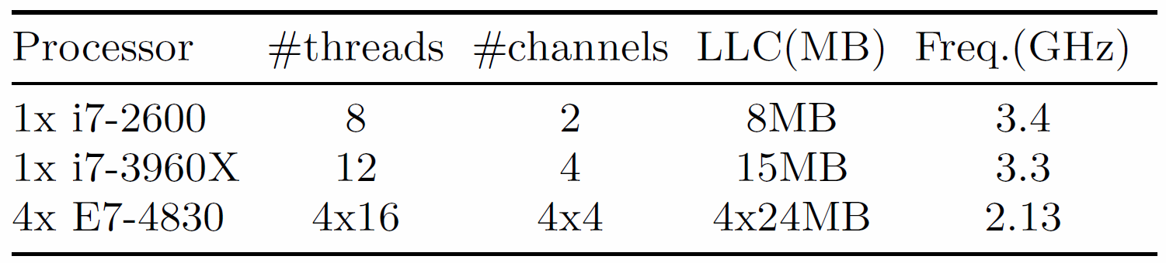
Evaluation
Workloads
Uniform key distribution
Sequential workload (keys randomly picked from the sequence range)
Evaluation Hardware
Intel i7-2600 (SMP, 4 cores with Hyper-Threading)
8 MB LLC
16 GB main memory
Ubuntu 11.10
All Hardware Platforms

Slide 11
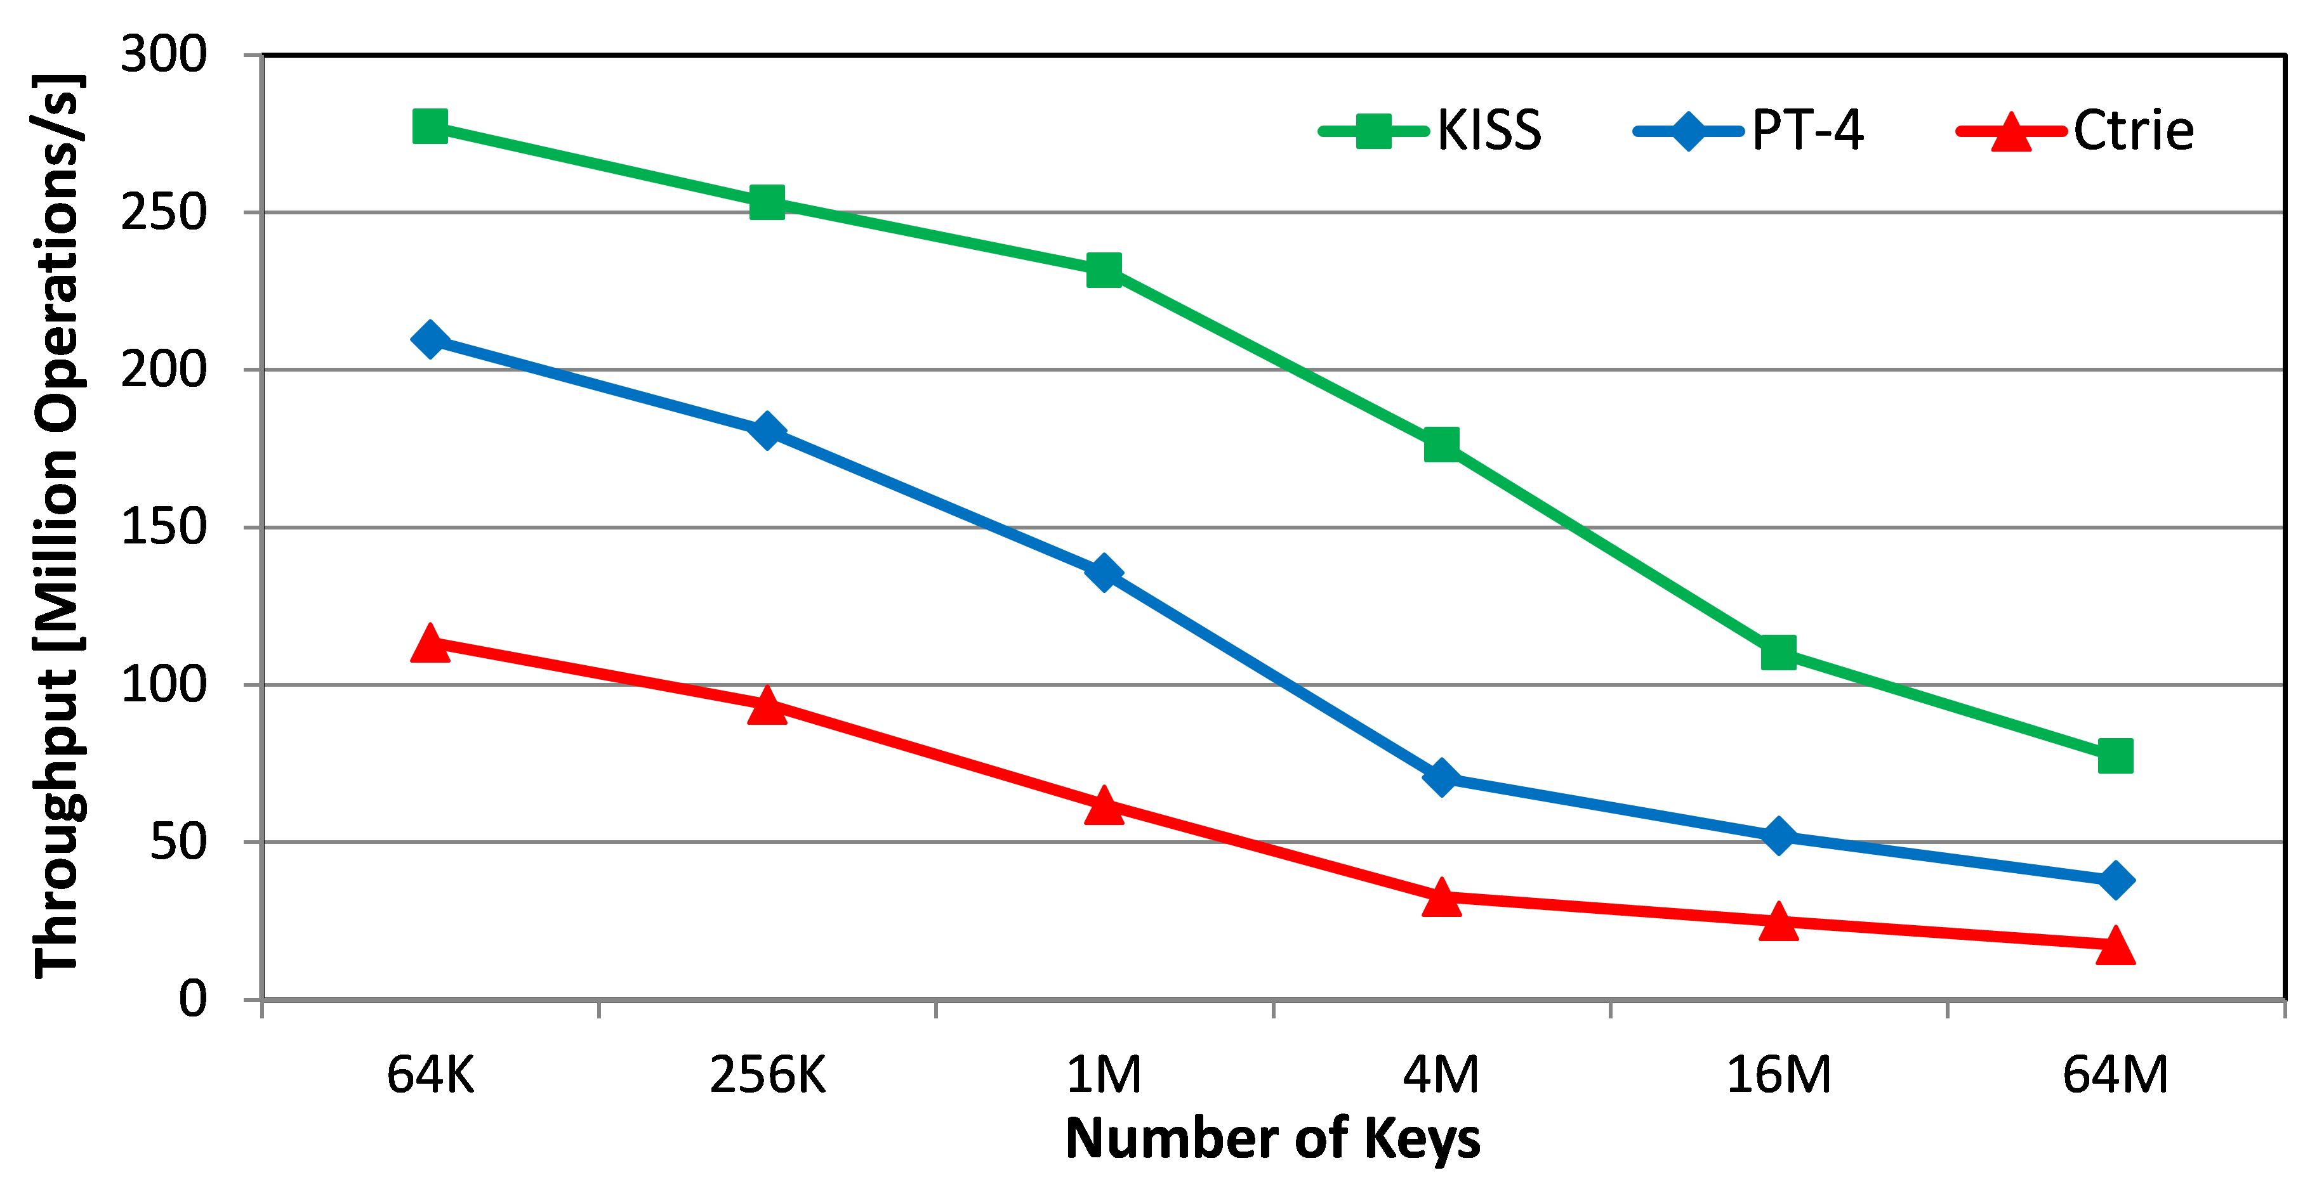
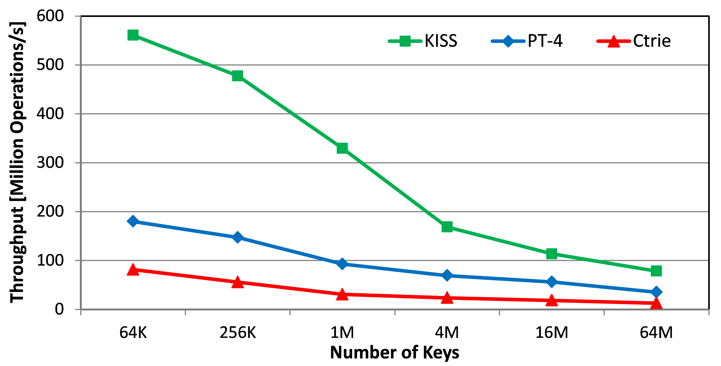
Read Performance
Uniform Distribution
Single-threaded CSB+-Tree: ~3Million Ops/s
KISS-Tree: 18 Million Ops/s with one thread
(64M Keys)
Sequence

Slide 12
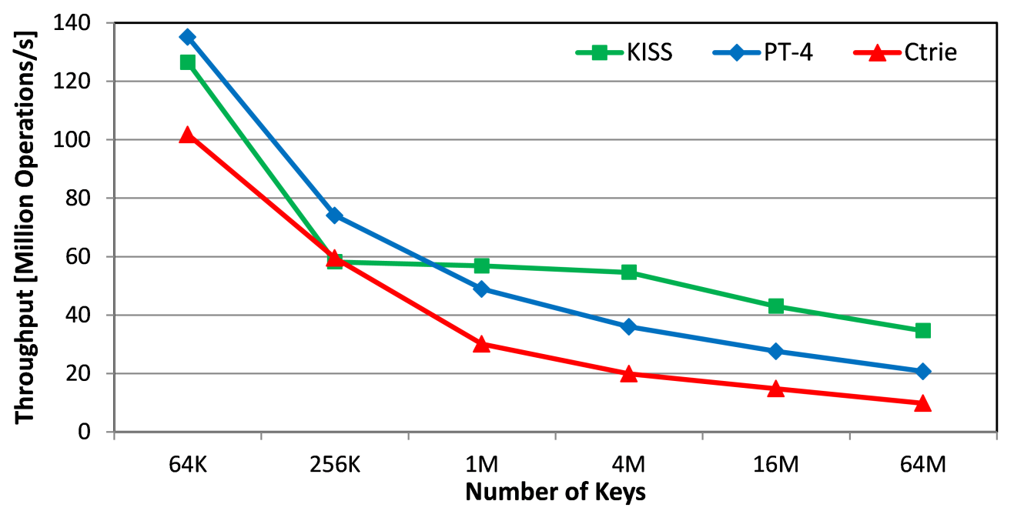
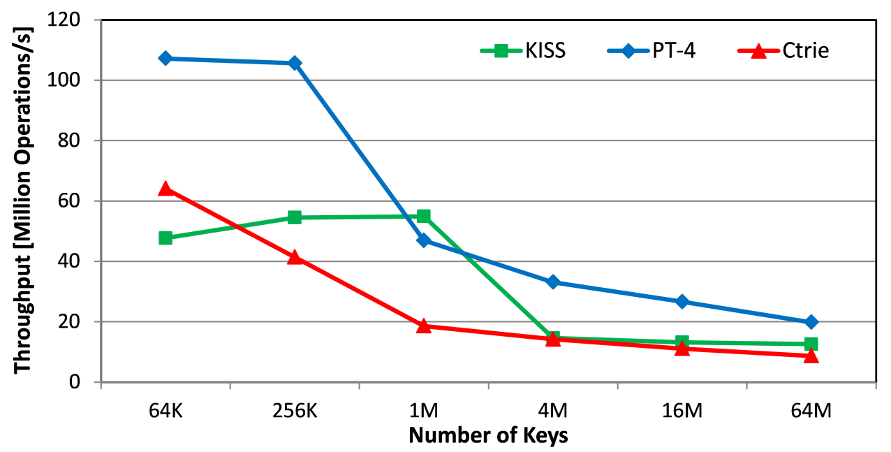
Update Performance
Uniform Distribution
Sequence

Slide 13
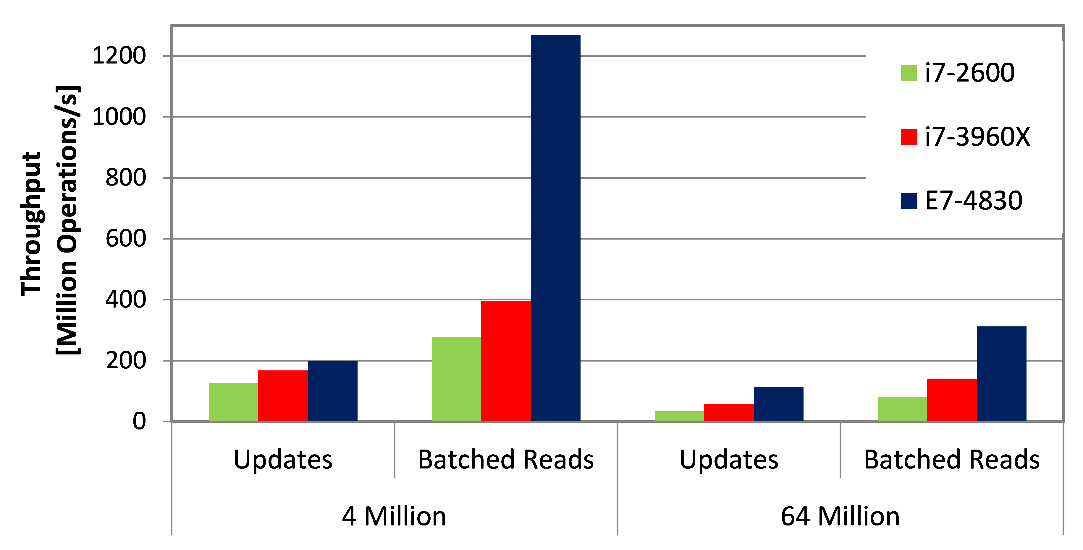
Hardware Platforms

Slide 14
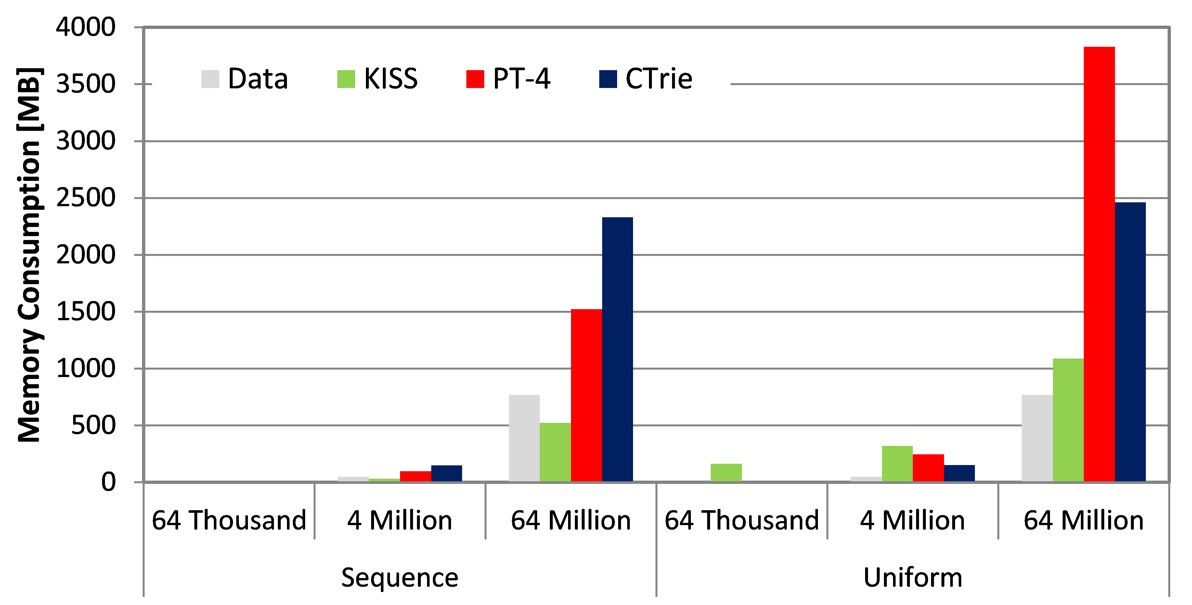
Memory Consumption

Slide 15
Conclusion
Hardware Trends
More and more parallel Hardware
High capacities of main memory affordable
KISS-Tree
Prefix Tree based in-memory index structure
2-3 memory access per key
Currently only for 32bit keys
Outlook
Support for larger keys, especially 64bit
Allow in-place updates for existing keys
Optimizations for NUMA-systems

Slide 16
KISS-Tree: Smart Latch-Free In-Memory Indexing on Modern Architectures Questions? Feedback? wwwdb.inf.tu-dresden.de/dexter
Thomas Kissinger

Slide 17
Memory Management
1
1
2
2
1
…
64
RCU-Aware Free Lists
1
…
64
2
2
64
64
Thread-Local Memory
1
…
1
…
63
63
64
64
1
…
63
64
Global Memory

Slide 18
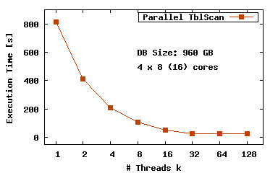
Scan vs. Index
About 40 GB/s scan performance with in-memory Databases
Real-Time Analytics requires low response time
813 s
23 s
>10⁷
<1µs
→ Indexing is still necessary for ordering, grouping, point- and range-queries

Slide 19
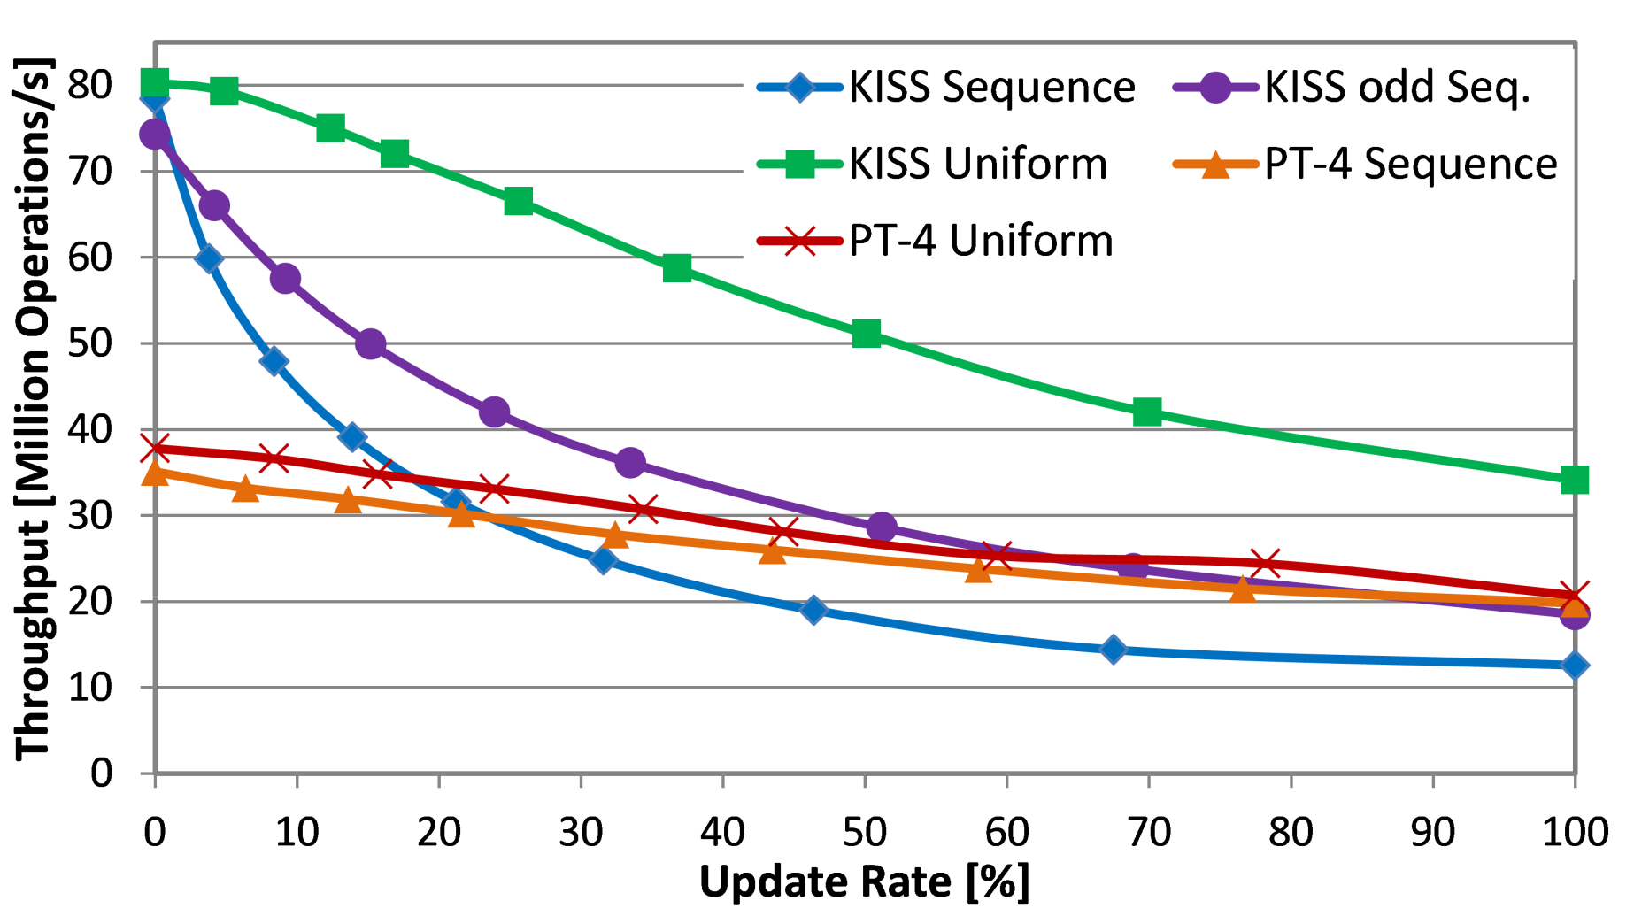
Update Rate

