Slide 1
Hathi: Durable Transactions for Memory using Flash
Mohit Saxena
University of Wisconsin-Madison
(work done at HP Labs)
Mehul A. Shah and Stavros Harizopoulos, Nou Data
Michael M. Swift, University of Wisconsin-Madison
Arif Merchant, Google

Slide 2
Durable Storage
2
Relational DBMS
Fine-grained control over durability
High-level interface for structured relations
Complex heavy-weight ACID transaction management
File Systems
Low-level interface to read/write bytes in a file
Coarse-grained control over durability
Designed for secondary storage

Slide 3
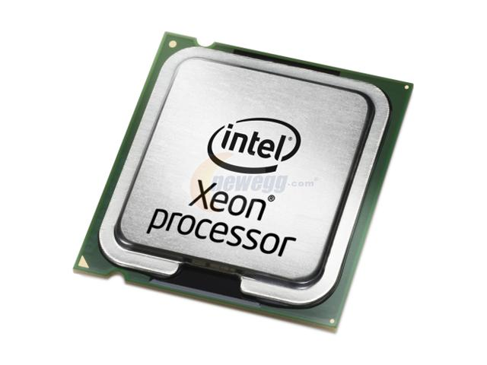
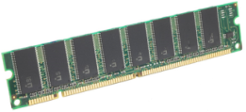
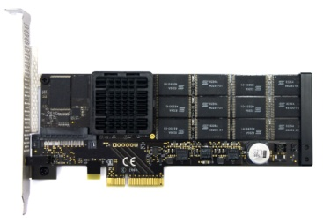
What has changed?
Technology
Large main-memory sizes for in-core data-sets
Fast flash SSD for persistence
Multi-core processor for parallelism
Application workloads
Memory-resident: Main-memory key-value stores, social network graphs, persistent logs for network servers, and massively multiplayer online games
Need fast, scalable and fine-grained durable storage
3

Slide 4
Hathi: Rethinking Durable Storage
4
Persistent Heap
Convenient in-memory data structures
Simple low-latency memory load/stores
Memory Transactions
Minimal Design: Software Transactional Memory
Concurrency Control and ACI
Durability Control
Fine-grained control over commit of memory transactions
Optimized for high-speed flash SSDs
Mnemosyne, NV-Heaps [ASPLOS ‘11]→ Hathi
Transactions on Storage Class Memory → Flash SSDs

Slide 5
Outline
5
Introduction
Design
Transaction Interface
Partitioned Logging & Durability Control
Checkpoint-Recovery
Evaluation
Conclusions

Slide 6
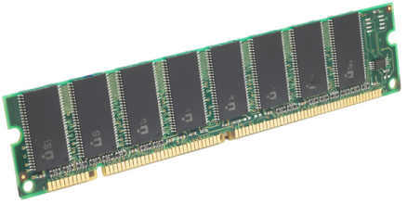
Hathi Design Goals
Application
Simple : application interface
Persistent Heaps
Memory Transactions
Fast : scales with txn threads
Partitioned Logging
TM-based Checkpointing
Durable : fine-grained control
Partitioned & Split-Phase Commit
Recovery
Transaction Interface
DRAM
Hathi Transaction Manager
Flash Packages
SSD
6

Slide 7
Persistent Heap
createHeap
allocate memory segments
associate with a checkpoint on SSD
read_heap, write_heap
read from given heap address into user buffer
write updates thread-local copy
example data structures
graphs, trees, hash tables
Heap *hp = createHeap(size)
read_heap(hp,offset,len,dstbuf)
write_heap(hp,offset,len,srcbuf)
Compiler Instrumentation
update_item_price(items,n,newprice) {
if(newprice < 0)
return FALSE;
items->price[n] = newprice;
return TRUE;
}
Data Structure Update
7

Slide 8
Durability Interface
Txn Threads
Hathi Transaction (ACI-D)
update_item_price(items,n,newprice) {
if(newprice < 0)
return FALSE;
tx_start
items->price[n] = newprice;
tx_commit
return TRUE;
}
Log Records
Memory Log
tx_commit
Transactional Update
Durable log
How to make tx_commit fast and scalable?
8

Slide 9
Split-Phase Commit
Worker Threads
Challenge
Achieve durability of sync commit with performance of async commit
Borrow fsync idea for memory txns
Solution
initiate lsn=tx_commit(async) early
optionally use isStable(lsn,wait) later
more fine-grained durability control for txns than fsync
tx_start
read(hp,offset,len,dstbuf)
…
write(hp,offset,len,srcbuf)
lsn=tx_commit(async)
…
isStable(lsn,wait)
9

Slide 10
Partitioned Logging
Challenge
Scale tx_commit with multiple cores
Make tx_commit fast on SSDs
Solution
write inserts log records in a per-thread memory log
tx_commit flushes log records to a per-thread durable log
Advantages
Lower contention
More concurrent requests to SSD
Memory Log
Partitioned Memory Logs
Partitioned Durable Logs
Durable log
10

Slide 11
Partitioned Commit
p1
Challenge
Partitioned logging requires synchrony across txn threads
Increases latency of txn commit
Solution
Observation: partitioned data structures do not require isolation
commit(partition) flushes the local memory buffer to its thread log
p2
p3
T1
T2
T3
1
2
1
2
3
tx_commit(partition)
3
Partitioned Durable Logs
Partitioned Durable Logs
11

Slide 12
Checkpoint
Challenge
Bounded log and recovery time
Checkpointing heap should not conflict with concurrent transactions
Solution
Incremental checkpointing at chunk sizes minimizes conflicts
STM protects chunk writes during checkpointing
Checkpoint Thread
Worker Threads
for i^{th} chunk in heap hp do
tx_start
read(hp,i,chunksize,copyBuffer)
chunkLSN =tx_commit(async)
end for
isStable(lastChunkLSN,true)
update checkpoint header
sleep(timer)
Memory Checkpointing
12

Slide 13
Recovery
Ordered Log
Records
Challenge
Inter-partition log and checkpoint dependencies need to be resolved during recovery
Solution
Load checkpoint chunks in memory
Merge log records in LSN order from all partitions
Roll-forward replay until it reaches the end of one partition or a gap in the LSNs
2
Checkpoint
Chunk LSN: 1
3
5
Checkpoint
Chunk LSN: 4
6
Merge Sort
5
2
8
9
3
6
On-flash
log partitions
13

Slide 14
Outline
14
Introduction
Design
Evaluation
Durability Cost
Commit Mode Performance
Conclusions

Slide 15
Methodology
Systems for Comparison
TinySTM: Software Transactional Memory (ACI)
Hathi: TinySTM + Partitioned/Single Logging for Durability
(ACI-D) with group commit support
Workload: Synthetic and OLTP
Synthetic: Each thread continuously executes transactions, six random read/write word offsets per transaction
OLTP: STAMP travel reservation benchmark
Setups: Two machines
High-end Server: 3.0 GHz Intel Xeon quad-core server, 4 GB heap, 80 GB PCIe FusionIO ioDrive
Mainstream: 2.5 GHz Intel Core 2 quad, 1 GB heap, 80 GB Intel X-25M SSD
15

Slide 16
Durability Cost
38% short
1.25 M Txns/s
Tx Throughput (1000 Txns/s)
130% faster
Txn: memcpy six random words
HP Proliant server
FusionIO ioDrive (async commit)
Number of Threads
16

Slide 17
Commit Mode Performance
47% short
15% faster
Tx Throughput relative to async (%)
STAMP Workload
(Mainstream)
Commit Mode
17

Slide 18
Summary
18
Hathi: Rethinking Durable Storage
Persistent Heap - simple programming interface for main-memory workloads
Software Transactional Memory - fast memory transactions for concurrency control
Partitioned & Split-Phase Commit - better performance on flash SSDs for durability

Slide 19
Thanks!
Hathi: Durable Transactions for Memory using Flash
Mohit Saxena
University of Wisconsin-Madison
Mehul Shah and Stavros Harizopoulos, Nou Data
Michael M. Swift, University of Wisconsin-Madison
Arif Merchant, Google
19
Notes:
19

