Slide 1

Ameliorating Memory Contention of OLAP Operators on GPU Processors
Evangelia A. Sitaridi, Kenneth A. Ross
Columbia University
DaMoN Workshop
21st May 2012

Slide 2
Introduction (1/2)
Earlier GPU implementations of data processing operators have resulted in significant speedups
Limitations
low memory capacity of GPU processors
low GPU to CPU bandwidth
Increase in GPU memories (-6GB)
cluster GPU instances (-22GB memory) offered from Amazon EC2

Slide 3
Introduction (2/2)
Extra effort required for GPU programming
special thread organization
radically different memory hierarchy
high parallelization degree
Target Architecture NVIDIA CUDA
other architectures similar design principles

Slide 4
CUDA Architecture (1/2)
Thread-blocks: independent groups of threads executing CUDA kernels
Warps: groups of 32 threads applying the same instruction stream on different data
CUDA Memories
global memory: plentiful (-6GB) but slow
shared memory: fast but limited capacity (-48KB)

Slide 5
CUDA Architecture (2/2)
Shared memory organized in interleaved 4-byte banks to maximize performance
Bank Conflict: accessing the same bank within a warp results to thread serialization
Value Conflict: multiple threads accessing the same address & at least one modifying its contents

Slide 6
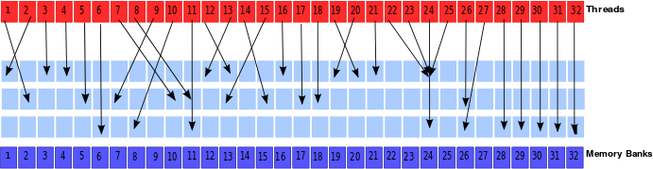
Example
Write access – 4 serialization rounds
Read access – 2 serialization rounds

Slide 7
Contribution (1/2)
Study role of bank & value conflicts on performance
Reads: foreign-key join Writes: grouped aggregation
Fact Table
Base Table
C1 C2 C3
C1 C2 C3 C4
0
3
2
1
4
5
2
34
Running Aggregates
Dimension Table
Shared Memory
Shared Memory
56
C3
359
127
17
24
87
119
519
335
Global Memory
Global Memory

Slide 8
Contribution (2/2)
Use extra shared memory to store copies of dimension/running-aggregate values
Modify fact table so that rows point to copies of the values rather than the original
Maximum performance achieved for 2X-4X increase in shared memory footprint

Slide 9
Problem Description (1/3)
In-memory OLAP setting
Data tables stored columnwise with 4-byte keys
Chunk: set of memory addresses requested from threads in a warp
Avoiding Bank Conflicts
writes: all values in a chunk belong to a different bank
reads: duplicate values can be broadcast

Slide 10
Problem Description (2/3)
Value Conflicts
intra-warp between threads in the same warp
inter-warp between threads in different warps processing data chunks within a specified window
Inter-warp value conflicts
every cycle a warp picked from the active warps for execution
warps processing nearby chunks active at the same time
optimization window: number of chunks for which we "remember" their set of values

Slide 11
Problem Description (3/3)
Unbounded Version: no limit on total number of copies
maximum 32 copies for bank conflicts
>32 copies for value conflicts
Space Bounded: limit on the total number of copies
e.g.: for budget=5 replicated structure size up to 5 times the original

Slide 12
Algorithm (1/3)
Initially all values have one copy
Create copies dynamically, based on demand
For each chunk
assign as many records without causing a conflict
2) for each unassigned value run BFS to find shortest relocation sequence leading to a conflict-free assignment
in case of failure create a new copy for the value, if space budget not exceeded

Slide 13
Algorithm (2/3)
Assignment of a value fails for two reasons:
1. number of distinct banks in chunk < number of the banks
2. empty bank-slots not reachable
Reads: in case of duplicate keys within a chunk run insertion algorithm only for the first occurrence
Inter-warp conflicts: in case of failure, insert for relaxed constraints (forget value conflicts)

Slide 14
Algorithm (3/3)
0
1
2
3
4
5
6
7
128
49
2
14
6
0
D1 D2 D3 D4
…
Values 531, 15 remain unassigned
6
128
49
2
14
531
0
15
0
1
2
3
4
5
6
7
Key Copy
128
49
2
531
6
14
0
0
2
6
14
15
49
128
531
0,7
2,4
5,6
3,6
1,7
1
0,5
3
Relocation sequence 531→14→6 resolves conflicts
0
1
2
3
4
5
6
7
128
49
2
531
15
6
14
0
Fact Table
Replica Table
Creation of a new copy in bank 4 for value 15

Slide 15
Experimental Setting
Optimization on a dual-chip Intel E5620 CPU
using 16 threads
GPU performance measured on an NVIDIA Tesla C2070 machine
thread block-size: 1024 threads
6GB of RAM with bandwidth of 144GB/s
48KB of shared memory /SM

Slide 16
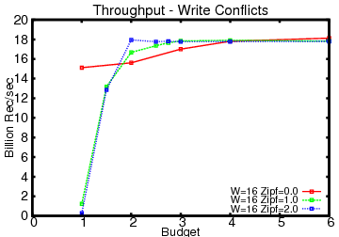
Limited Space Budget
for uniform data maximum performance at 4X
for skewed data at 2X

Slide 17
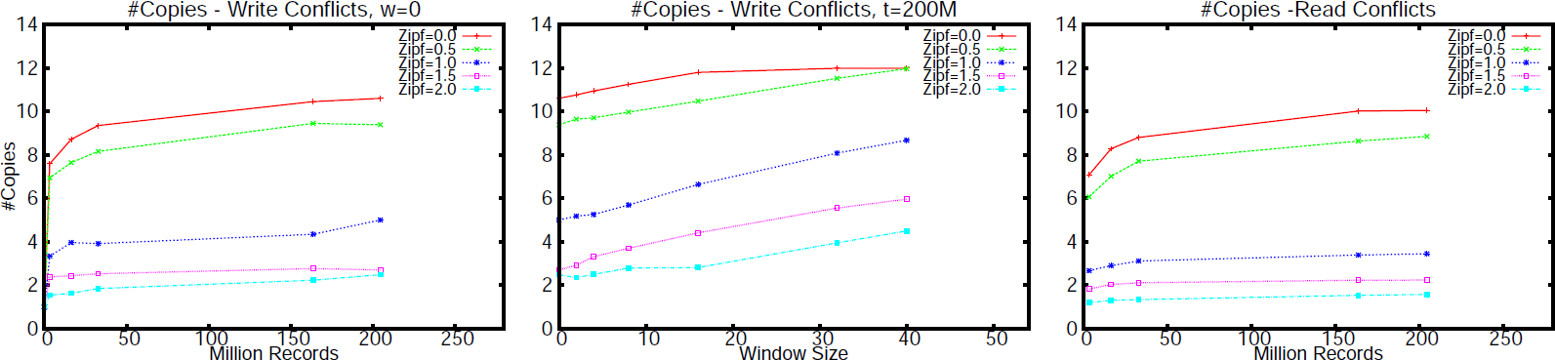
Number of Copies
for higher skew number of copies decreasing
number of copies increasing for larger table sizes but increase mild after 50M

Slide 18
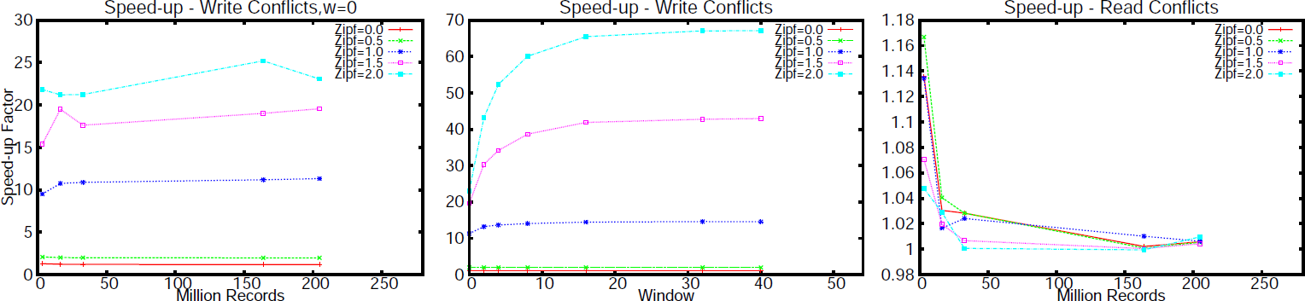
Speedups (1/2)
significant speed-ups for high skew
for uniform data speed-up still important 1.2

Slide 19
Speedups(2/2)
Speed-ups less significant for reads
for high skew more values are broadcast
reads faster than atomic write operations
Windowing: most of the performance benefits for w=16

Slide 20
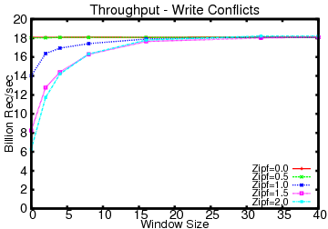
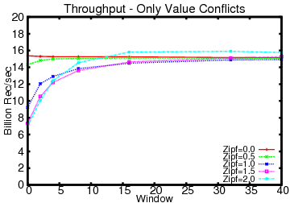
Throughput
full optimization: 18 billion records/sec: 73GB
performance drop 20% when optimizing only value conflicts

Slide 21
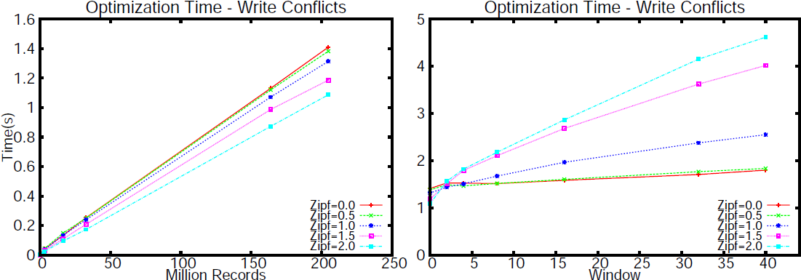
Optimization Time
for moderately large windows optimization time few seconds

Slide 22
Related Work
Extensive work on GPU data processing
Cuckoo hashing
randomized walk to find relocation sequence
Framework for thread level contention detection during aggregation on CPUs
Data declustering techniques
- distribute data partitions across different units to maximize resource parallelization

Slide 23
Discussion
Static data partitioning between threads
predetermined which records each thread will process
Algorithm sensitive to change of physical location
Combine selection and aggregation into one joint kernel
Cluster data

Slide 24
Conclusions
Defined & studied bank and value conflict problem for OLAP operators on GPU processors
Achieved maximum perfomance for 2X-4X increase in shared memory footprint
Potential grouping columns should be optimized for writes
Apply same techniques
on clustered data
different key-sizes

Slide 25
Thank you!

Slide 26
References (1/3)
[1] P. Bakkum and K. Skadron. Accelerating sql database operations on a GPU with CUDA. In GPGPU, 2010.
[2] J. Cieslewicz, K. A. Ross, and I. Giannakakis. Parallel buffers for chip multiprocessors. In DaMoN, 2007.
[3] J. Cieslewicz, K. A. Ross, K. Satsumi, and Y. Ye. Automatic contention detection and amelioration for data-intensive operations. In SIGMOD, 2010.
[4] G. P. Copeland and S. Khoshafian. A decomposition storage model. In SIGMOD Conference, 1985.
[5] N. Corporation. NVIDIA CUDA C Programming Guide. NVIDIA Corporation, November 2011.
[6] U. Erlingsson et al. A cool and practical alternative to traditional hash tables. In Workshop on Distributed Data and Structures, 2006.
[7] R. Fang et al. GPUQP: query co-processing using graphics processors. In SIGMOD, 2007.
[8] W. Fang, B. He, and Q. Luo. Database compression on graphics processors. Proc. VLDB Endow., 3, 2010.
[9] N. K. Govindaraju et al. Fast computation of database operations using graphics processors. In SIGMOD, 2004.

Slide 27
References (2/3)
[10] B. He et al. Relational joins on graphics processors. In SIGMOD, 2008.
[11] B. He et al. Relational query coprocessing on graphics processors. ACM Trans. Database Syst., 34, 2009.
[12] B. He, W. Fang, Q. Luo, N. K. Govindaraju, and T. Wang. Mars: a MapReduce framework on graphics processors. In PACT, 2008.
[13] B. He, N. K. Govindaraju, Q. Luo, and B. Smith. Efficient gather and scatter operations on graphics processors. In Supercomputing, 2007.
[14] M. Holland and G. A. Gibson. Parity declustering for continuous operation in redundant disk arrays. SIGPLAN Not., 1992.
[15] C. Kim et al. Fast: fast architecture sensitive tree search on modern cpus and gpus. In SIGMOD, 2010.
[16] M. Lu, B. He, and Q. Luo. Supporting extended precision on graphics processors. In DaMoN, 2010.
[17] J. MacCormick et al. Kinesis: A new approach to replica placement in distributed storage systems. Trans. Storage, 2009.
[18] V. Markl, F. Ramsak, and R. Bayer. Improving OLAP performance by multidimensional hierarchical clustering. In IDEAS, 1999.

Slide 28
References (3/3)
[19] S. Padmanabhan et al. Multi-dimensional clustering: A new data layout scheme in DB2. In SIGMOD, 2003.
[20] R. Pagh and F. F. Rodler. Cuckoo hashing. J.Algorithms, 51, 2004.
[21] P. Pucheral, J.-M. Thevenin, and P. Valduriez. Efficient main memory data management using the DBGraph storage model. In VLDB, 1990.
[22] K. A. Ross. Efficient hash probes on modern processors. In In Proceedings of the 23nd International Conference on Data Engineering, 2007.
[23] K.-Y. Whang and R. Krishnamurthy. Query optimization in a memory-resident domain relational calculus system. ACM TODS, 15(1), 1990.
[24] Y. Ye, K. A. Ross, and N. Vesdapunt. Scalable aggregation on multicore processors. In DaMoN, 2011.

Slide 29
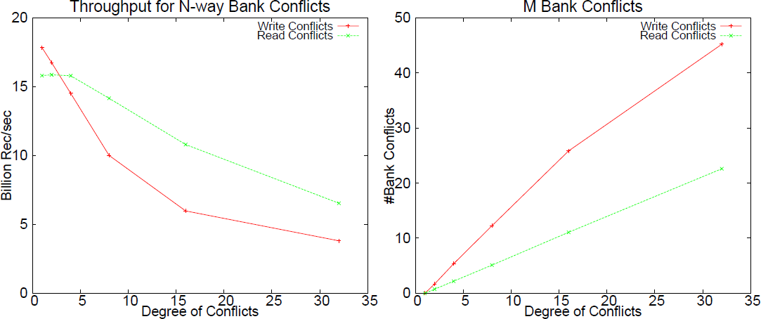
Profiler Results (1/2)
Performance for varying degree of bank conflicts for both read and write conflicts

Slide 30
Profiler Results (2/2)
No duplicates values in a chunk to show worst case scenario for read conflicts
Performance less than half for reads when all threads in a warp serialized
Confirm that impact more significant for writes than reads

Slide 31
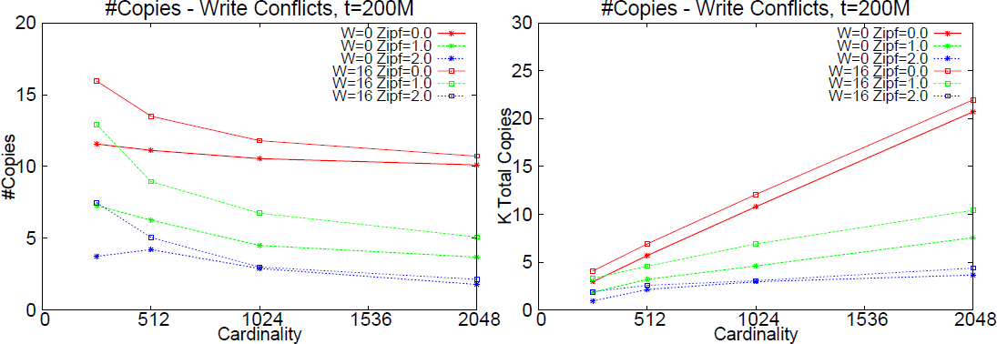
Varying Cardinality

