Slide 1
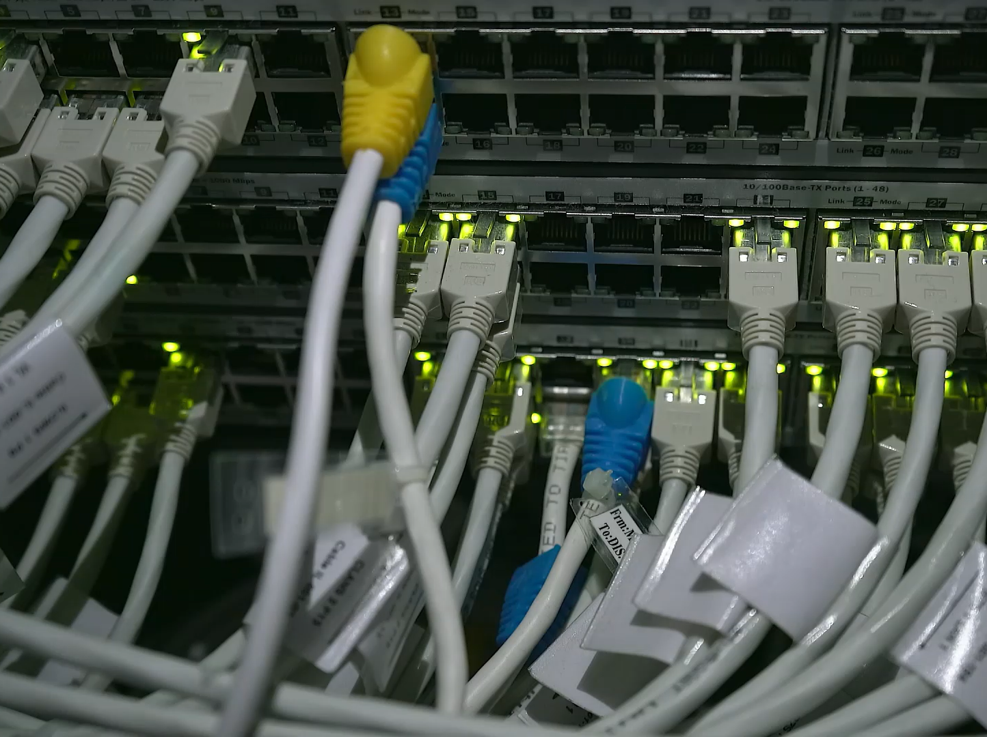
Network Automation Demonstration using Ansible
Leo, Skyler, Rehan

Slide 2

The Problem
• Manual network configuration
• Time-consuming
• Human error
• Poor scalability

Slide 3

Team Roles & Collaboration
Leo – Testing & Validation Engineer
Skyler – Documentation & GitHub Lead
Rehan – Automation Engineer

Slide 4
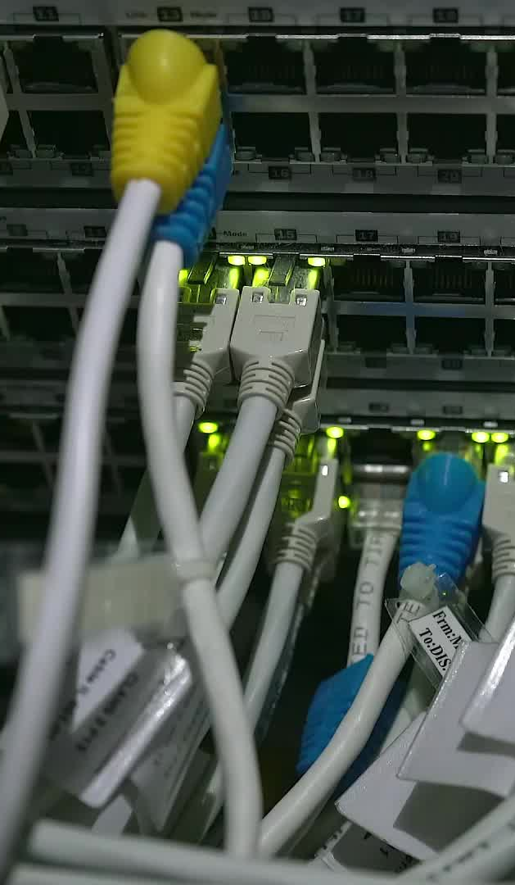
Network Setup & Scope
Simple lab setup: routers, switches, Ansible control machine.
Devices pre-configured with IP addressing and SSH.

Slide 5
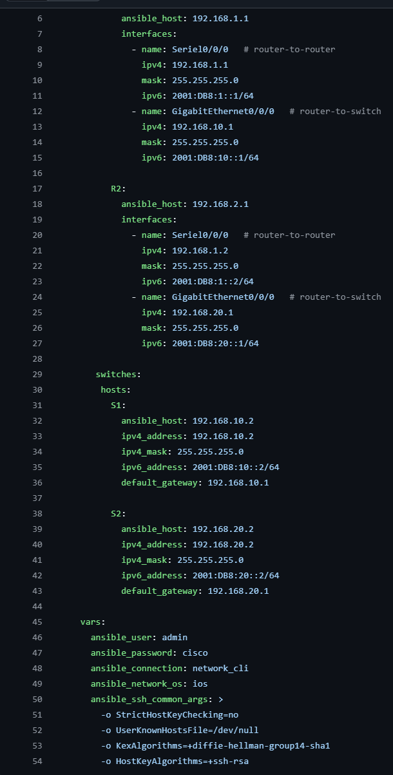
Ansible Components
Inventory file – defines devices.
Playbooks – define automated tasks.

Slide 6
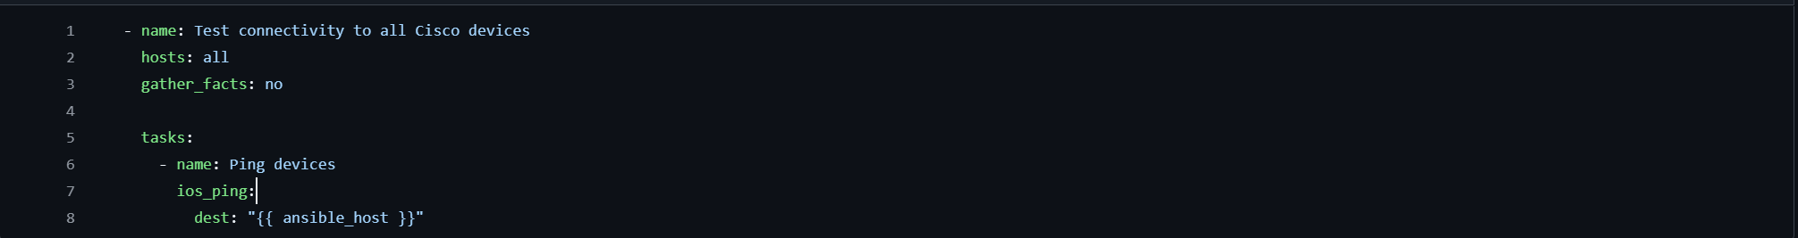
ping.yml
Tests the reachability of all devices
Confirms network is ready for automation
No configuration changes

Slide 7
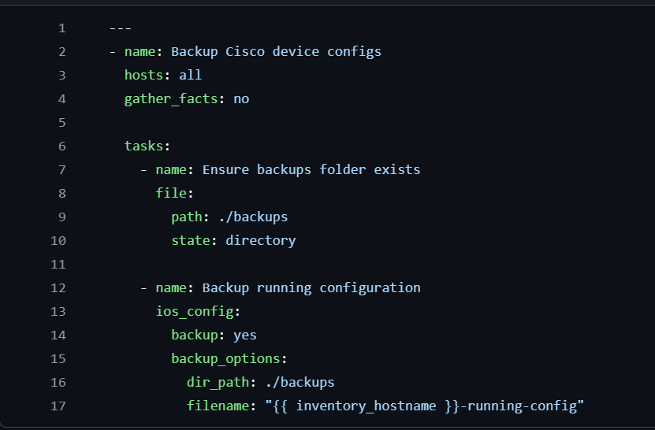
Backup.yml
Automatically saves running configurations
Creates backups directory if required
Supports disaster recovery

Slide 8
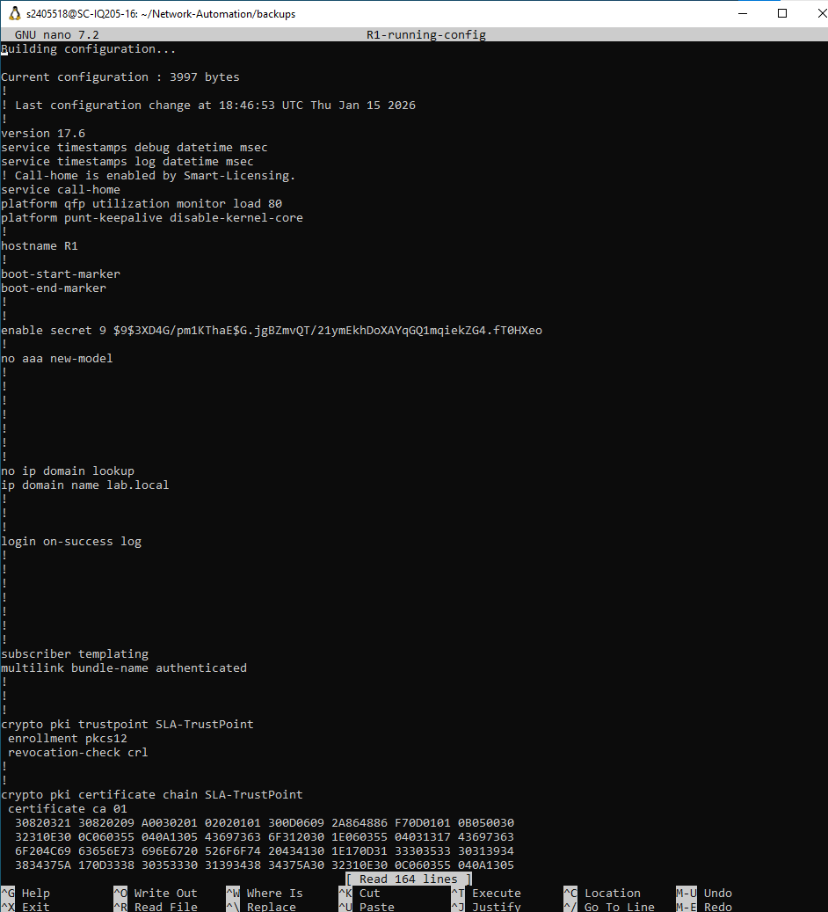
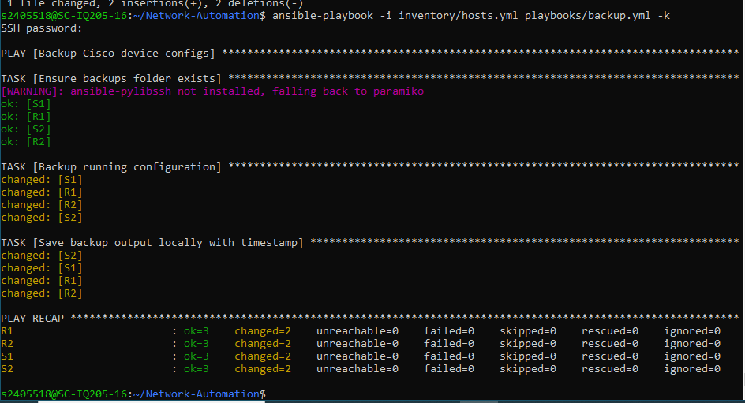
Backup result

Slide 9
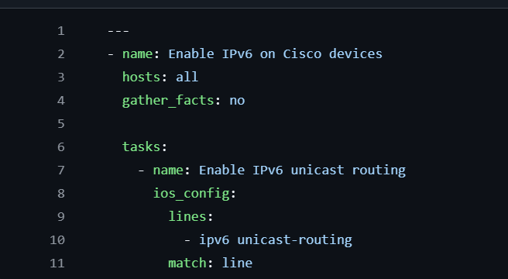
IPv6 Enable
Applies global IPv6 configuratiuon
Ensures consistency across all devices
Easy to verify

Slide 10
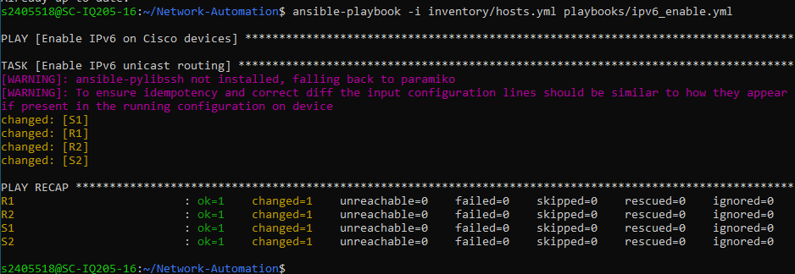
IPv6 Enable Result

Slide 11
Why Automation Matters
• Speed
• Consistency
• Scalability
• Reliability
Relevant to real-world enterprise environments.

Slide 12

Summary
Manual vs automated configuration.
Key automation benefits.
Any questions?

