Slide 1
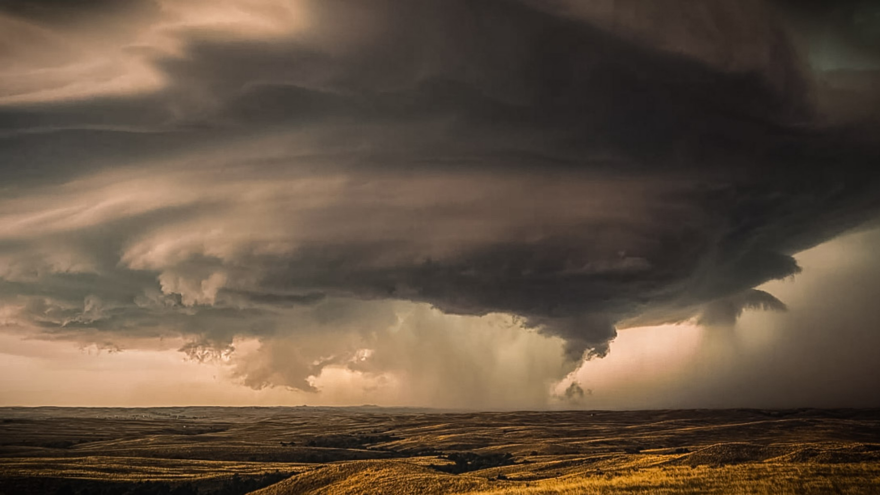
Severe Weather Alert System
Dion Scheper, Terence Beijloos & Bart van Nimwegen

Slide 2
The Idea
- Real-time alerts
Configurable by region
Different events

Slide 3
Methodology
- Agile/Remote
GitHub
FeatureIDE
Opt: AspectJ

Slide 4
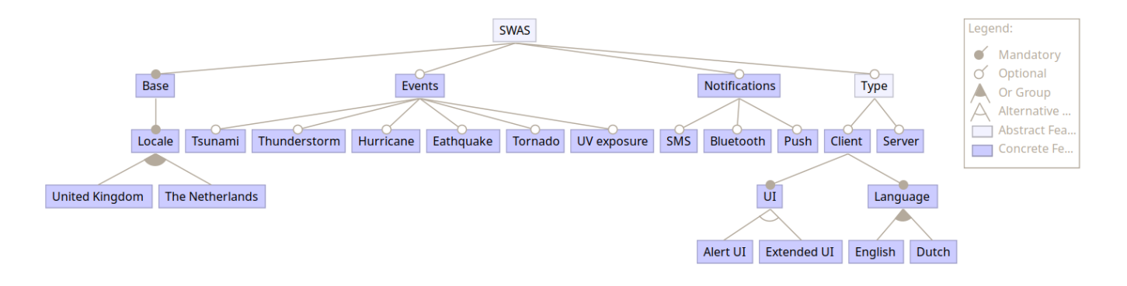
Deliverables
- Config
Translations
Compile Time feature selection
Feature selection by user

