Slide 1
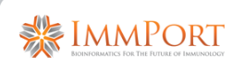
Genotyping Data Request Process
To obtain Genotyping data, users will submit requests to the DAIT Data Access Committee
The process is based on that utilized by dbGAP
For Genotyping experiments, metadata about the experiments such as the type of platform used, number of subjects, etc will be shared for all ImmPort users to see
NO GT results will be viewable!
A Link to a “ImmPort Data Request Form” will be provided in the experiment descriptions and in other locations in ImmPort

Slide 2
Genotyping Data Request Process (cont’d)
The form will request information such as:
Data set requested (identified by ImmPort accession number)
Project title and detailed description
PI (and collaborating investigator) contact information within the same institution ; collaborators with other institutions would need to submit additional forms
Signatures by the PI and official designee of the institution
Agreements to honor the Genomic Data Use Code of Conduct as well as the Security Procedures for Handling Genomic Data

Slide 3
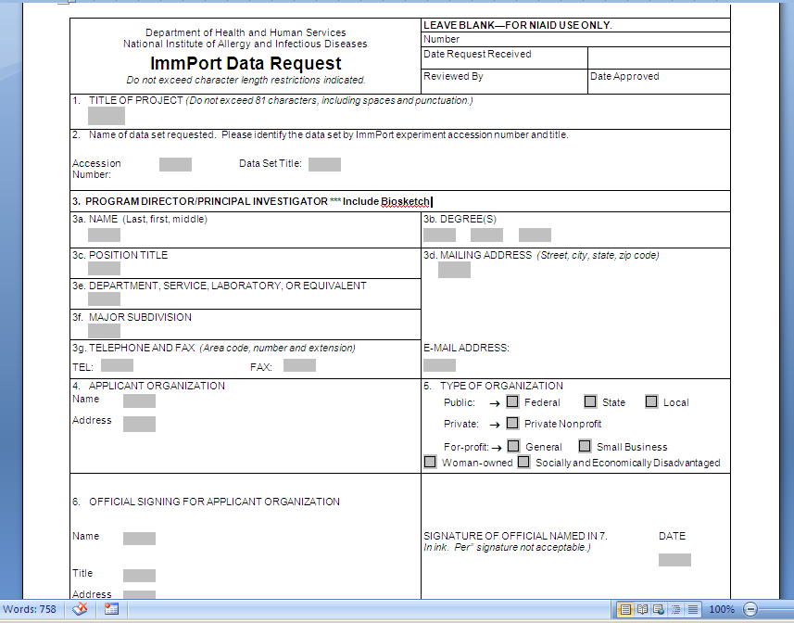
Genotyping Data Request Process (cont’d)

Slide 4
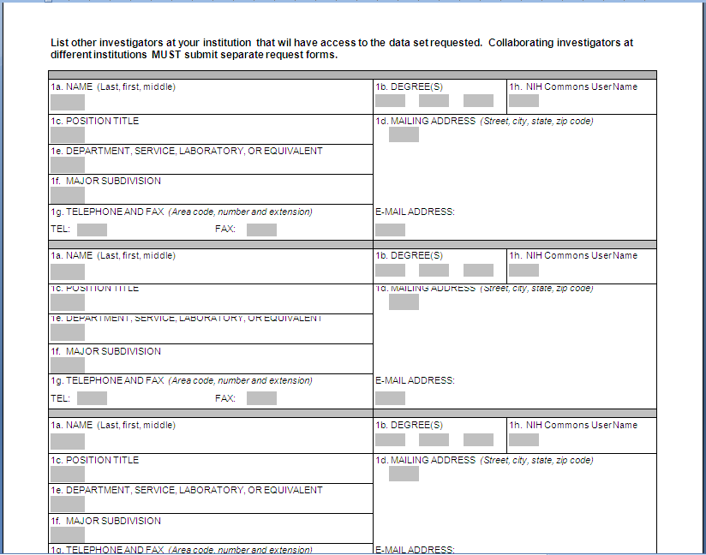
Genotyping Data Request Process (cont’d)

Slide 5
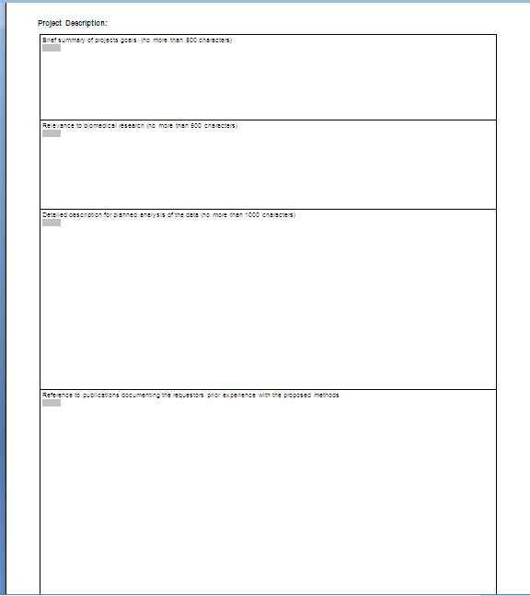
Genotyping Data Request Process (cont’d)

Slide 6
Genotyping Data Request Process (cont’d)
After filling out the form, the user will sign, scan, and email to immport_gt_request@niaid.nih.gov
This will notify appropriate staff within DAIT to forward to the request to the Data Access Committee to review
If the Data Access Committee accepts the proposal, the requestor will be contacted and external media sent to the requestor containing the data sets

