Slide 1
Programming Basics using Jupyter Notebooks

Slide 2
Get set up
Open your terminal, navigate to where you saved the notebook and start jupyter:
$ cd where/my/notebook/is
$ jupyter notebook
Open browser and go to http://localhost:8888/
Click on Programming basics.ipynb

Slide 3
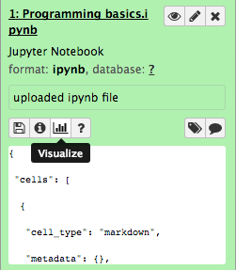
Get set up / Galaxy
Go to usegalaxy.org & login
Go to:
https://usegalaxy.org/u/drcris/h/immport-workshop
Import the history to your account by clicking on ‘Import history’, top right corner.
Click on Programming basics.ipynb
Click on the graph icon
Click on Jupyter

Slide 4
Programming syntax
Crucial for accurate interpretation
Depends on programming language
refer to your favorite language manual for specifics.
Python: pep8
https://www.python.org/dev/peps/pep-0008/

Slide 5
Programming syntax - Comments
# this is a comment
green_worms = [] # this is also a comment
Annotate your code (please do)
Comment out line(s) for troubleshooting or development
Notes:
# in python, R, PERL
// in javascript, java, C++
/* comment */ C, javascript, java
<!-- --> in HTML, XML

Slide 6
Programming syntax - Indentation
green_worms = []
for worm in all_worms_on_the_plate:
if all_worms_on_the_plate[worm]['color'] == 'green':
green_worms.append(worm)
Python:
4 spaces for one indent – NOT tabs
Notes:
For python, do not use tabs. That said, a good text editor will allow you to use spaces instead of tabs when pressing the tab key.

Slide 7
Special characters break I
White spaces are critical, esp. in Python
TAB - tab key (avoid in Python)
SPACE – space key
NEWLINE – enter/return key

Slide 8
Programming syntax – End of line
End of line indicator
PERL
my @green_worms;
for my $i (0..$#all_worms_on_the_plate) {
if ($worm_color[$i] eq 'green'){
push(@green_worms, $all_worms_on_the_plate[$i]);
}
}
(NOT IN PYTHON)

Slide 9
Programming concepts
Variables
List of things
Dictionary of things
Functions
Modules
Objects

Slide 10
Programming concepts
Variables
Reserved memory location for a given construct
Notes:
Variables are nothing but reserved memory locations to store values. This means that when you create a variable you reserve some space in memory

Slide 11
Variables - Declaration vs. assignment
Declaration Reserving memory slot to store value
Assignment Value of the variable is defined
green_worms = []
Python: assignment is declaration
Notes:
Not always declaration upon assignment.
Assignment not always done with ‘=‘ – R: ‘<-’

Slide 12
Programming concepts - variables
worm_species = "C. remanei"
worm_dev_stage = 3
green_worms = []
all_worms_on_plate = {}
dev_stages = ("E", "L1", "L2", "L3", "L4", "A", "D")
Notes:
Variables are nothing but reserved memory locations to store values. This means that when you create a variable you reserve some space in memory

Slide 13
Python main data types
worm_species = "C. remanei"
worm_dev_stage = 3
green_worms = []
all_worms_on_plate = {}
dev_stages = ("E", "L1", "L2", "L3", "L4", "A", "D")
String
Number
List
Dictionary
Tuple

Slide 14
Programming concepts
Variables
List of things
Dictionary of things
Functions
Modules
Objects

Slide 15
Programming concepts
Variables
List of things
Indexed list of constructs
Python: Lists and Tuples

Slide 16
Programming concepts - lists
empty_list = []
empty_tuple = ()
prime_numbers = [1, 3, 5, 7, 9, 11, 13, 17]
primary_colors = ("red", "green", "blue")
list_of_variables = [var1, var2, var3]
prime_numbers[2]
>> 5
primary_colors[0]
>> 'red'

Slide 17
Indexing break
Counting starts at 0 (except in R)
primary_colors = ("red", "green", "blue")
Index
0
1
2

Slide 18
Programming concepts - lists
list_of_lists = [[1,2], [3,4], [5,6], [7,8]]
misc_list = [1, [2,3], {4:5, 6:7}, (8,[9,10])]
misc_tuple = (1, [2,3])
list_of_lists[2][0]
>> 5
misc_list[2][4]
>> 5
Notes:
Perl -> array
R -> vectors, lists, matrix

Slide 19
Programming concepts
Variables
List of things
Dictionary of things
Functions
Modules
Objects

Slide 20
Programming concepts
Variables
List of things
Dictionary of things
Unordered list of key:value pairs
Python: Dictionaries
Notes:
Also called associative arrays
Perl -> hash
R -> dataframes
C -> hash tables

Slide 21
Programming concepts – dictionaries
SNP position
SNP
1013340
A
1298347
C
2348893
A
2458789
-
2798876
G

Slide 22
Semantics breaks
SNP position
SNP
1013340
A
1298347
C
KEYS
VALUES
snp_per_position = {
1013340 : "A",
1298347 : "C",
2348893 : "A"
}
Notes:
Perl -> hash
R -> dataframes

Slide 23
Programming concepts – dictionaries
empty_dict = {}
snp_per_position = {
1013340 : "A",
1298347 : "C",
2348893 : "A"
}
snp_per_position[1298347]
>> 'C'
NO index,
UNIQUE keys
Notes:
Perl -> hash
R -> dataframes

Slide 24
Programming concepts – dictionaries
dict_of_lists = {
"wormA" : ["dpy","unc","fem"],
"wormB" : ["gfp","dpy"],
"wormC" : ["dpy","unc"]
}
dict_of_lists["wormB"][0]
>> 'gfp'
Notes:
Perl -> hash
R -> dataframes

Slide 25
Programming concepts – dictionaries
Dataframes
Developmental Stage
Worm ID
Worm Sex
GFP
1
ND
L1
no
2
ND
L2
yes
3
Male
Adult
no
4
Female
L4
no
5
Female
Late L4
yes
Notes:
Perl -> hash
R -> dataframes

Slide 26
Programming concepts – dictionaries
dict_of_dicts = {
"worm1": {
"sex" : "ND",
"dev_stage" : 1,
"GFP" : False
},
"worm2": {
"sex" : "ND",
"dev_stage" : 2,
"GFP" : True
}
}
Notes:
Perl -> hash
R -> dataframes

Slide 27
Programming concepts – dictionaries
dict_of_dicts = {
"worm1": {
"sex" : "ND",
"dev_stage" : 1,
"GFP" : False,
"conditions" : ("20C", "OP50")
},
"worm2": {
"sex" : "ND",
"dev_stage" : 2,
"GFP" : True,
"conditions" : ("20C", "OP50")
}
}
Notes:
Perl -> hash
R -> dataframes

Slide 28
Best practice break
Reserved words:
Words that already mean something in programming language speak and cannot be used as variables
Don’t call your list ‘list’ or your dictionary ‘dict’
https://docs.python.org/3/reference/lexical_analysis.html

Slide 29
Programming concepts
Variables
List of things
Dictionary of things
Functions
Modules
Objects

Slide 30
Programming concepts
Functions
New data
Data

Slide 31
Programming concepts - functions
Built-in functions
worm_species = "C. remanei"
print(worm_species)
>> C. remanei
Python list of built-in functions:
https://docs.python.org/3/library/functions.html

Slide 32
Programming concepts - functions
User-defined functions
def new_function(data):
# do something to data
# and call it new_data
new_data = data + 1
return new_data
my_data = 3
my_new_data = new_function(my_data)
my_new_data >> 4

Slide 33
Variable scope
a = 0
def do_stuff(b):
c = b + 3
return c
print(a)
print(b)
print(c)
http://python-textbok.readthedocs.io/en/1.0/Variables_and_Scope.html#variable-scope-and-lifetime

Slide 34
Variable scope
a = 0
def do_stuff(b):
c = b + 3
return c
print(a)
print(b)
print(c)
Global
scope
http://python-textbok.readthedocs.io/en/1.0/Variables_and_Scope.html#variable-scope-and-lifetime

Slide 35
Variable scope
a = 0
def do_stuff(b):
c = b + 3
return c
print(a)
print(b)
print(c)
Global
scope
Local
scope
http://python-textbok.readthedocs.io/en/1.0/Variables_and_Scope.html#variable-scope-and-lifetime

Slide 36
Variable scope
a = 0
def do_stuff(b):
c = b + 3
return c
print(a)
print(b)
print(c)
Global
scope
Local
scope
Error: b and c not defined
http://python-textbok.readthedocs.io/en/1.0/Variables_and_Scope.html#variable-scope-and-lifetime

Slide 37
Programming concepts
Variables
List of things
Dictionary of things
Functions
Modules
Objects

Slide 38
Programming concepts
Modules / Libraries / Packages
File containing code that you can use and re-use

Slide 39
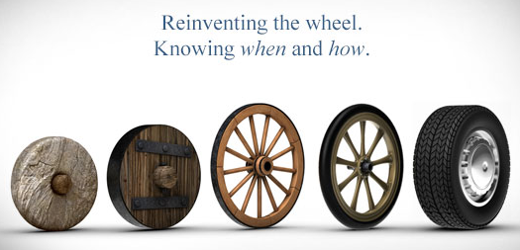
Programming concepts - modules
Existing modules or packages?
Make yours re-usable by yourself or others

Slide 40
Programming concepts - modules
# tell your computer which library you want
import package_name
# use a function from the library
package_name.some_function()
# other valid import statements:
import package_name as pn
pn.some_function()
from package_name import some_function
some_function()

Slide 41
Programming concepts - modules
# avoid this:
from package_name import *
everything

Slide 42
Programming concepts
Variables
List of things
Dictionary of things
Functions
Modules / Libraries
Objects

Slide 43
Programming concepts
Classes >> Objects

Slide 44
Programming concepts - classes
Blueprint

Slide 45

Programming concepts - classes
Blueprint

Slide 46
Programming concepts - classes
Blueprint -- States
Worms
Common name: Nematodes
Main studied species: C. elegans
Sister species: C. remanei, C. briggsae, C.brenneri, C. japonica
Larval stages: 4
Mating system: Androdioceous
Chromosomes: 5 + X

Slide 47
Programming concepts - classes
Blueprint -- Behaviors
Worms
Common name: Nematodes
Main studied species: C. elegans
Sister species: C. remanei, C. briggsae, C.brenneri, C. japonica
Larval stages: 4
Mating system: Androdioceous
Chromosomes: 5 + X
Crawl around
Eat
Mate
Dauer formation

Slide 48
Programming concepts - classes
Blueprint
Worms
Common name: Nematodes
Main studied species: C. elegans
Sister species: C. remanei, C. briggsae, C.brenneri, C. japonica
Larval stages: 4
Mating system: Androdioceous
Chromosomes: 5 + X
Crawl around
Eat
Mate
Dauer formation
Attributes
Methods

Slide 49
Programming concepts – classes & objects
An object is an instance of a class

Slide 50
Programming concepts – classes & objects
Every Worm:
Common name: Nematodes
Main studied species: C. elegans
Sister species: C. remanei, C. briggsae, C.brenneri, C. japonica
Larval stages: 4
Mating system: Androdioceous
Chromosomes: 5 + X
Crawl around
Eat
Mate
Dauer formation
Attributes
Methods

Slide 51
Programming concepts - objects
class Worm:
def __init__(self, name):
self.species_name = name
self.sister_sp = []
self.state = "hungry"
def eat(self, food):
if food == 'OP-50':
self.state = "happy”
else:
self.state = "grumpy"
def enter_dauer(self):
self.state = "staaaaaarving"
def assessment(self):
print("I’m " + self.state)

Slide 52
Programming concepts - objects
class Worm:
def __init__(self, name):
self.species_name = name
self.sister_sp = []
self.state = "hungry"
def eat(self, food):
if food == 'OP-50':
self.state = "happy”
else:
self.state = "grumpy"
def enter_dauer(self):
self.state = "staaaaaarving"
def assessment(self):
print("I’m " + self.state)
Attributes
Methods

Slide 53
Programming concepts - objects
harry = Worm("C. elegans")
print(harry.species_name)
>> C. elegans
harry.assessment()
>> I’m hungry
harry.eat("salad")
harry.assessment()
>> I’m grumpy
harry.enter_dauer()
harry.assessment()
>> I’m staaaaaarving

Slide 54
Programming concepts - objects
harry.eat("OP-50")
harry.assessment()
>> I’m happy
print(harry.sister_sp)
>> []
harry.sister_sp.append("C. briggsae")
print(harry.sister_sp)
>> ['C. briggsae']
sally = Worm("C. elegans")
print(sally.sister_sp)
>> []

Slide 55
Programming concepts – Python & objects
Everything is an object

Slide 56
Python main data types
worm_species = "C. remanei"
worm_dev_stage = 3
green_worms = []
all_worms_on_plate = {}
dev_stages = ("E", "L1", "L2", "L3", "L4", "A", "D")
String
Number
List
Dictionary
Tuple

Slide 58
Standard Data Analysis
Open File
Look at data
Curate data
Make pretty graphs
Publish cool paper
Take over the world

Slide 59
Standard Data Analysis
Open File
Look at data
Curate data
Make pretty graphs
Publish cool paper
Take over the world

Slide 60


I/O operations
Double-click on file
2. Open in excel
3. Create new data in (new) file
4. Save file
5. Close file
Give path to file
2. Read in file
3. Create new data in memory
4. Write to (new) file
5. Close file

Slide 61

I/O operations
Double-click on file
2. Open in excel
3. Create new data in (new) file
4. Save file
5. Close file
Give path to file
2. Read in file
3. Create new data in memory
4. Write to (new) file
5. Close file

Slide 62
I/O operations
For this tutorial, let’s look at an ImmPort file.
Locate the folder in which you saved the material for this course.
We’ll use the file called subject.txt

Slide 63
I/O operations
my_file = 'path/to/my/file/subject.txt'
Or:
my_file = input('File to open for analysis: ')
Reads input and returns a string
Pro: no hard-coding
Con: need to type your file path every time

Slide 64
Best practice break
Hard coding:
Using a value instead of a variable
Avoid this:
f = open('path/to/my/file/subject.txt', 'r')
Instead, do this:
my_file = 'path/to/my/file/subject.txt'
f = open(my_file, 'r')
Good discussion about this here:
http://softwareengineering.stackexchange.com/questions/67982/is-it-ever-a-good-idea-to-hardcode-values-into-our-applications

Slide 65
I/O operations
my_file = 'path/to/my/file/subject.txt'
f = open(my_file, 'r')
w write
r read (default)
r+ read + write
a append
Path to file
File object

Slide 66
Assumption
my_file = 'path/to/my/file/subject.txt'
f = open(my_file, 'r')
This is a text file

Slide 67
I/O operations
my_file = 'path/to/my/file/subject.txt'
f = open(my_file, 'r')
Do stuff
f.close()

Slide 68
I/O operations
Better practice:
my_file = 'path/to/my/file/subject.txt'
with open(my_file, 'r') as f:
Do stuff
Closes the file handle after block

Slide 69
Standard Data Analysis
Open File
Look at data
Curate data
Make pretty graphs
Publish cool paper
Take over the world

Slide 70
I/O operations
my_file = 'path/to/my/file/subject.txt'
with open(my_file, 'r') as f:
first_line = f.readline()
Reads file up until first NEWLINE
First line in file as a string
INCLUDING newline character

Slide 71
Useful tidbits - Strings
line.strip([chars])
String
Removes leading and trailing characters specified by chars in line (default white space)
my_line = " a simple example "
my_line.strip()
>> 'a simple example'

Slide 72
Special characters break II
Some non-alphanumeric characters need to be coded or 'escaped':
TAB - tab key - '\t'
SPACE – space key - ' '
NEWLINE – enter/return key - '\n'

Slide 73
I/O operations
my_file = 'path/to/my/file/subject.txt'
with open(my_file, 'r') as f:
first_line = f.readline().strip()
First line in file as a string
WITHOUT newline character

Slide 74
Useful tidbits - Strings
line.split(sep)
List
Splits the given line at every sep
(default white space)
my_line = " a simple example "
my_line.split()
>> ['a', 'simple', 'example']

Slide 75
I/O operations
my_file = 'path/to/my/file/subject.txt'
with open(my_file, 'r') as f:
first_line = f.readline().strip()
headings = first_line.split("\t")
List of file’s headings

Slide 76
File content
my_file = 'path/to/my/file/subject.txt'
with open(my_file, 'r') as f:
first_line = f.readline().strip()
headings = first_line.split("\t")
second_line = f.readline().strip().split("\t")
# do something

Slide 77
File content
my_file = 'path/to/my/file/subject.txt'
with open(my_file, 'r') as f:
first_line = f.readline().strip()
headings = first_line.split("\t")
second_line = f.readline().strip().split("\t")
# do something
Repeat this
for all lines

Slide 78
Start Here
Loops
Do
something
Test condition
Yes
No
Exit loop

Slide 79
Loops in Python
for ITEMS in LIST:
# do something
while condition:
# do something
https://docs.python.org/3/reference/compound_stmts.html

Slide 80
Loops in Python
for ITEMS in LIST:
# do something
for i in range(0, 10):
print(i)
for letters in 'bananas':
print(letters)
for colors in primary_colors:
print(colors)
while condition:
# do something

Slide 81
Loops in Python
for i in range(0, len(some_list)):
print(i)
for index, element in enumerate(primary_colors):
print(index, element)
for words in some_dictionary:
print(words + " " + some_dictionary[words])

Slide 82
Loops in Python
for ITEMS in LIST:
# do something
while condition:
# do something
i = 0
while i < 10:
print(i)

Slide 83
Start Here
Infinite Loops
Do
something
Condition
always True
Yes
Exit loop

Slide 84
Loops in Python
for ITEMS in LIST:
# do something
while condition:
# do something
i = 0
while i < 10:
print(i)
i += 1

Slide 85
File content
my_file = 'path/to/my/file/subject.txt'
with open(my_file, 'r') as f:
first_line = f.readline().strip()
headings = first_line.split("\t")
for line in f:
line_content = line.strip().split("\t")

Slide 86
File content
my_file = 'path/to/my/file/subject.txt'
with open(my_file, 'r') as f:
first_line = f.readline().strip()
headings = first_line.split("\t")
for line in f:
line_content = line.strip().split("\t")
# if subject is male, print race

Slide 87
Conditional statements
if condition:
# do something
elif condition:
# do something
elif condition:
# do something
else:
# do something

Slide 88
Conditional statements
if i == 0:
print("i is null")
elif i == 1:
print("i is 1")
elif i > 1:
print("i is positive")
else:
print("i is negative. Or between 0 and 1")

Slide 89
Conditional statements
if carrots:
print("let’s make a salad")
else:
print("where is the rabbit?")

Slide 90
Useful tidbits - Boolean
Will evaluate as:
true
false
True
False
None
1, 1.3, 4J
0, 0.0, 0j
'hi', [1,2], (2,3)
'', [], ()
{fr: "non", en: "no"}
{}

Slide 91
Conditional statements
color = "red"
if color in primary_color:
print(color + " is a primary color")
if color not in primary_color:
print(color + " is not a primary color")

Slide 92
File content
my_file = 'path/to/my/file/subject.txt'
with open(my_file, 'r') as f:
first_line = f.readline().strip()
headings = first_line.split("\t")
for line in f:
line_content = line.strip().split("\t")
# if subject is male, print race:
if line_content[4] == 'Male':
print(line_content[5])

Slide 93
String matching
str.startswith(prefix)
str.endswith(suffix)
True/False
Checks if str starts or ends with prefix/suffix
new_line1 = 'a simple example'
if new_line1.startswith('a'):
print('yay!')
>> yay!
For more complex string matching:
re module:
https://docs.python.org/3/library/re.html

Slide 94
Regular expression – matching a pattern
Sequence of characters that defines a pattern

Slide 95
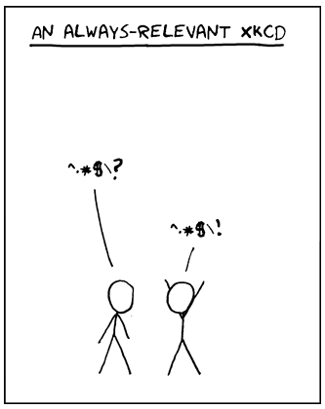
Regular expression – matching a pattern

Slide 96
Regular expression – matching a pattern
^.*$\?
Start of a string
Escapes character
Any character except newline
End of a string
0 or more occurences
https://www.debuggex.com/cheatsheet/regex/python
http://www.pyregex.com/

Slide 97
Regular expression – matching a pattern
Any
question?
Any answer!

Slide 98
File content
my_file = 'path/to/my/file/subject.txt'
with open(my_file, 'r') as f:
first_line = f.readline().strip()
headings = first_line.split("\t")
for line in f:
line_content = line.strip().split("\t")
# if subject is male, print race:
if line_content[4].startswith('M'):
print(line_content[5])

Slide 99
File content
with open(my_file, 'r') as f:
first_line = f.readline().strip()
headings = first_line.split("\t")
male_div = []
for line in f:
line_content = line.strip().split("\t")
# if subject is male, remember race:
if line_content[4].startswith('M'):
male_div.append(line_content[5])
Add element to list

Slide 100
File content
with open(my_file, 'r') as f:
first_line = f.readline().strip()
headings = first_line.split("\t")
male_div = []
for line in f:
line_content = line.strip().split("\t")
# if subject is male, remember race:
if line_content[4].startswith('M'):
male_div.append(line_content[5])

Slide 101
File content
with open(my_file, 'r') as f:
first_line = f.readline().strip()
headings = first_line.split("\t")
male_div = []
for line in f:
line_content = line.strip().split("\t")
# if subject is male, remember race:
if line_content[4].startswith('M'):
male_div.append(line_content[5])

Slide 102
File content
with open(my_file, 'r') as f:
first_line = f.readline().strip()
headings = first_line.split("\t")
male_div = []
sex_ratio = {'M':0, 'F':0}
for line in f:
line_content = line.strip().split("\t")
# if subject is male, remember race:
if line_content[4].startswith('M'):
male_div.append(line_content[5])
sex_ratio['M'] += 1

Slide 103
File content
with open(my_file, 'r') as f:
first_line = f.readline().strip()
headings = first_line.split("\t")
male_div = []
sex_ratio = {'M':0, 'F':0}
for line in f:
...
Get data back?

Slide 104
I/O operations
with open(output_file, 'w') as outf:
outf.write('stuff')
Opens file for writing. If the file already exists, erases it
Writes to file

Slide 105
Special characters break III
White space are not included automagically.
TAB - tab key - '\t'
SPACE – space key - ' '
NEWLINE – enter/return key - '\n'

Slide 106
I/O operations
with open(output_file, 'w') as outf:
outf.write('stuff\n')
Adds a newline character

Slide 107
I/O operations
with open(output_file, 'w') as outf:
outf.write('GENDER\tDIVERSITY\tCOUNT\n')

Slide 108
I/O operations
with open(output_file, 'w') as outf:
outf.write('GENDER\tDIVERSITY\tCOUNT\n')
for gender in sex_ratio:
line_to_write = gender + "\t" + \
div[gender] + "\t" + \
sex_ratio[gender] + "\n"

Slide 109
Useful tidbits - Strings
sep.join(list)
String
Creates a single string from list elements joined by sep
new_line2 = ['a', 'simple', 'example']
"-".join(new_line2)
>> 'a-simple-example'

Slide 110
I/O operations
with open(output_file, 'w') as outf:
outf.write('GENDER\tDIVERSITY\tCOUNT\n')
for gender in sex_ratio:
line_to_write = "\t".join([
gender,
div[gender],
sex_ratio[gender]
])

Slide 111
Useful tidbits – Unique set
set(list)
List
Gets unique set of elements in list
rep_list = ['a', 'b', 'c', 'a', 'c', 'b']
unique_list = set(rep_list)
print(unique_list)
>> ['a', 'b', 'c']

Slide 112
I/O operations
with open(output_file, 'w') as outf:
outf.write('GENDER\tDIVERSITY\tCOUNT\n')
for gender in sex_ratio:
diversity = set(div[gender])
line_to_write = "\t".join([
gender,
diversity,
sex_ratio[gender]
])

Slide 113
Useful tidbits – Type casting
str(object)
String
Changes object to string
not_a_string = 3
str(not_a_string)
>> '3'

Slide 114
Useful tidbits – Type casting
an_integer = 2
a_float = 2.0
int(3.8)
>> 3
float(5)
>> 5.0
Pro-tip: be aware that with Python 2.x, 1/2 = 0

Slide 115
I/O operations
with open(output_file, 'w') as outf:
outf.write('GENDER\tDIVERSITY\tCOUNT\n')
for gender in sex_ratio:
diversity = set(div[gender])
line_to_write = "\t".join([
gender,
str(diversity),
str(sex_ratio[gender])
])
outf.write(line_to_write + "\n")

Slide 116
Reality check break
There are many many valid ways to do things

Slide 117
Standard Data Analysis
Open File
Look at data the easier way
Curate data
Make pretty graphs
Publish cool paper
Take over the world

Slide 118
Exploratory Data Analysis
import pandas as pd
my_file = 'path/to/my/file/subject.txt'
df = pd.read_table(my_file)
Reads in a general delimited file
DataFrame object (eq. to R’s dataframes)

Slide 119
Standard Data Analysis
Open File
Look at data
Curate data
Make pretty graphs
Publish cool paper
Take over the world

Slide 120
Pre-analysis Data Curation
Familiarize yourself with the file structure:
How many columns, how are they separated, headings or not, strings or numbers…
Expect inconsistent data:
Empty columns / Nas / 0s, inconsistent data types, missing columns, ‘hi’ vs. ‘Hi’, Excel misconception of dates…
Strategize your code to minimize I/O operations

Slide 121
Standard Data Analysis
Open File
Look at data
Curate data
Make pretty graphs
Publish cool paper
Take over the world
Notes:
See next session

Slide 122
EDA - Resources
Coursera class R. Peng, J. Leek and B. Caffo (in R)
https://www.coursera.org/learn/exploratory-data-analysis
Analyzing and Manipulating Data with Pandas by J. Rocher
https://www.youtube.com/watch?v=0CFFTJUZ2dc
Awesome Data Science. 2.0 Introduction to Pandas and Exploratory Data Analysis
https://www.youtube.com/watch?v=ZrRpN_IrcBA
More advanced Jupyter / Pandas tutorial by J. Vanderplas
https://www.youtube.com/playlist?list=PLYCpMb24GpOC704uO9svUrihl-HY1tTJJ

Slide 123
Going back to functions
If you are going to be using this snippet of code you just wrote a lot, make it into a function.

Slide 124
Modules / libraries
If this code you just wrote would be useful to more than just you, make it into a library.
Consider sharing it with the community.
Consider making it a Galaxy tool.

Slide 125
Troubleshooting
print p[k]
File "<ipython-input-31-25a740847cb6>", line 1
print p[k]
^
SyntaxError: Missing parentheses in call to 'print'

Slide 126
Troubleshooting
print(p[k])
NameError
<ipython-input-32-cfed065d0920> in <module>()
----> 1 print(p[k])
NameError: name 'p' is not defined

Slide 127
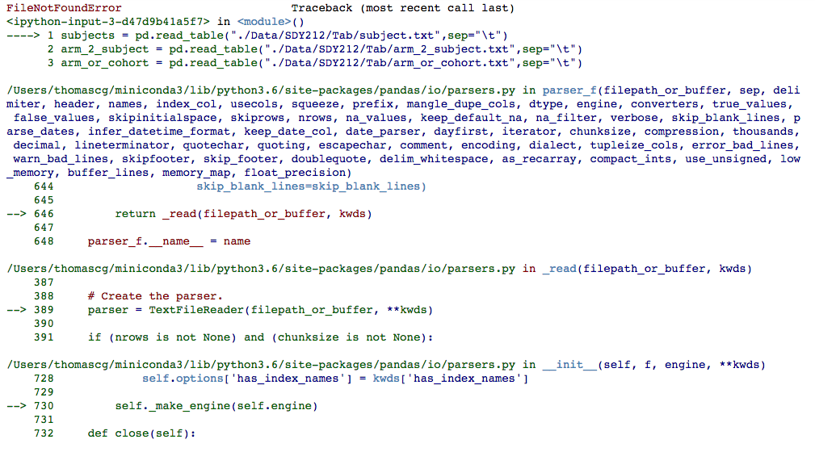
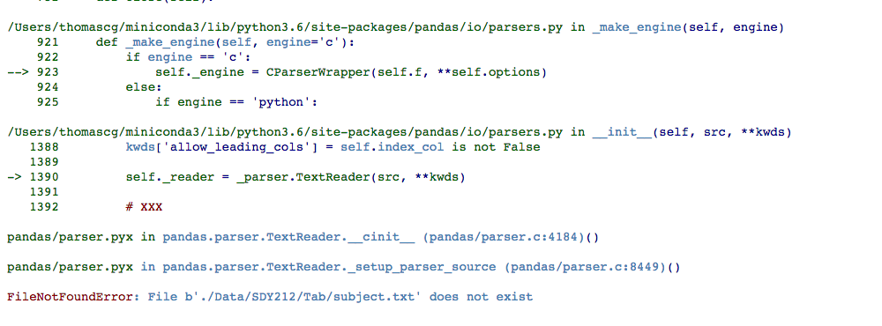

Slide 128
Troubleshooting
Read the traceback to see where the error comes from
Google
Stack overflow
http://www.blog.pythonlibrary.org/2012/09/12/python-101-exception-handling/
https://doughellmann.com/blog/2009/06/19/python-exception-handling-techniques/

Slide 129


Any more questions?
Immport.org
Material and more tutorials:
immport.org/resources/tutorials
immport@immport.org
Cristel.Thomas@nih.gov
@ImmPortDB
@crstlthms
Bisc NG

