Slide 1
What is Programming?
Cristel Thomas (Molecular Biology PhD!!!)

Slide 2
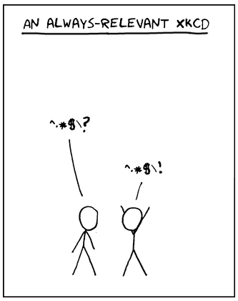
pro·gram·ming
/ˈprōˌɡramiNG/
noun
1. the action or process of writing computer programs.
2. the magic key to understanding some XKCD jokes.

Slide 3
Programming
Set of instructions given to a computer to do something

Slide 4
Programming
Set of instructions given to a computer to do something
Problem?
Notes:
Typically, need to program arises when there is a problem of some sort to solve.

Slide 5
Programming
Set of instructions given to a computer to do something
Problem
Steps to solve the problem (in plain English)
Notes:
First thing to do once the problem is clearly defined is to think about what steps should be taken to solve the problem.

Slide 6
Programming
Set of instructions given to a computer to do something
Problem
Steps to solve the problem (in plain English)
Steps to solve the problem (in computer speak)
Notes:
Once you know what you want to do, need to figure out how to tell the computer to do it.

Slide 7
Programming
Set of instructions given to a computer to do something
Problem: Which worms on the plate are expressing GFP?
Steps to solve the problem (in plain English):
- get a fresh plate for the green worms
- look at all the worms
- identify glowing worms and move them to the fresh plate
Steps to solve the problem (in computer speak)
Notes:
example

Slide 8
Programming
Set of instructions given to a computer to do something
Problem: Which worms on the plate are expressing GFP?
Steps to solve the problem (in plain English):
- get a fresh plate for the green worms
- look at all the worms
- identify glowing worms and move them to the fresh plate
Program:
var greenWorms = [];
allWormsOnThePlate.forEach(function(worm){
if (worm.color === 'green'){
greenWorms.push(worm);
}
});

Slide 9
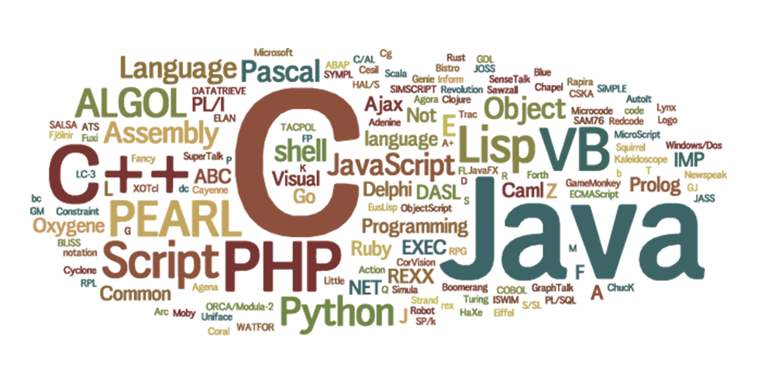
Programming Languages
Notes:
Which brings me to programming languages. There are a lot of programming languages – here is represented a lot of them, size proportional to how much use they get worldwide.
World cloud

Slide 10
Programming Languages
Javascript
var greenWorms = [];
allWormsOnThePlate.forEach(function(worm){
if (worm.color === 'green'){
greenWorms.push(worm);
}
});
Notes:
What does that look like though practically? Because if the instructions are simple enough, what langauge to pick? Here’s the example from our example problem. This is javascript.

Slide 11
Programming Languages
Javascript
var greenWorms = [];
allWormsOnThePlate.forEach(function(worm){
if (worm.color === 'green'){
greenWorms.push(worm);
}
});
PERL
my @green_worms;
for my $i (0..$#all_worms_on_the_plate) {
if ($worm_color[$i] eq 'green'){
push(@green_worms, $all_worms_on_the_plate[$i]);
}
}
Python
green_worms = []
for worm in all_worms_on_the_plate:
if all_worms_on_the_plate[worm]['color'] == 'green':
green_worms.append(worm)
R
green_worms <- all_worms[all_worms$color == 'green']
Notes:
Here’s code to do the same thing in diffrernet languages. Note the differences – in words used as well as in programming logic. Each language has strength and weaknesses and is used efficientily to solve the same problem in very different ways.

Slide 12
Programming Language Choice
Text manipulation
Statistics
Pretty graphs
Interactive output
Notes:
Which language to use really depends on what you want to do with it

Slide 13



Programming Language Choice
Text manipulation
Statistics
Pretty graphs
Interactive output
Notes:
Which language to use really depends on what you want to do with it

Slide 14
Programming Language Choice
Text manipulation
Statistics
Pretty graphs
Interactive output

Slide 15
Programming Language Choice
Text manipulation
Statistics
Pretty graphs
Interactive output

Slide 16
Programming Language Choice
Text manipulation
Statistics
Pretty graphs
Interactive output

Slide 17
Programming Language Choice
Text manipulation
Statistics
Pretty graphs
Interactive output
Ease of (re-)use
Local support
Notes:
But really, those matter too:
What are other people using in your field?
What are other people using on your floor?

Slide 18
Programming Language Choice
Same underlying logic and concepts
Notes:
No matter what language you pick, the underlying concept of programming stay the same

Slide 19
Programming Language Choice
Best practice for all
Notes:
No matter what language you pick, the underlying concept of programming stay the same, and they all have a best practice standards defined somewhere.

Slide 20
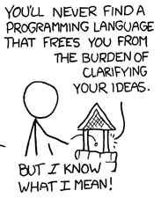
Programming Language Choice
Notes:
No matter what language you pick, you still need to define clearly your problem and the steps to solve it so that the computer can do the work for you.

Slide 21
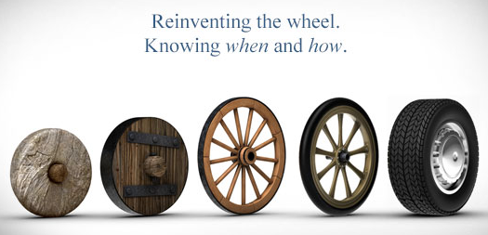
Programming Languages
Spend some time
- online
- talking with your local expert
- reading papers
Notes:
Another thing to take into consideration is what is out there already. Check before you do anything if what you want to do has been done before. Chances are they have.

Slide 22
Getting Started – What do you need?
Computer
Brains
Coffee/Tea/Beer
Terminal
Text editor (not Word)
Interpreter / Compiler
Developing environment
Access to internet
Different operating systems handle programming languages differently
Notes:
Take a minute to see what people have in the room – platform/OS/admin rights
Talk about OS!!!! Explain unix

Slide 23
Getting Started – What do you need?
Computer
Brains
Coffee/Tea/Beer
Terminal
Text editor (not Word)
Interpreter / Compiler
Developing environment
Access to internet

Slide 24
Getting Started – What do you need?
Computer
Brains
Coffee/Tea/Beer
Terminal
Text editor (not Word)
Interpreter / Compiler
Developing environment
Access to internet
Notes:
Check around the room -

Slide 25
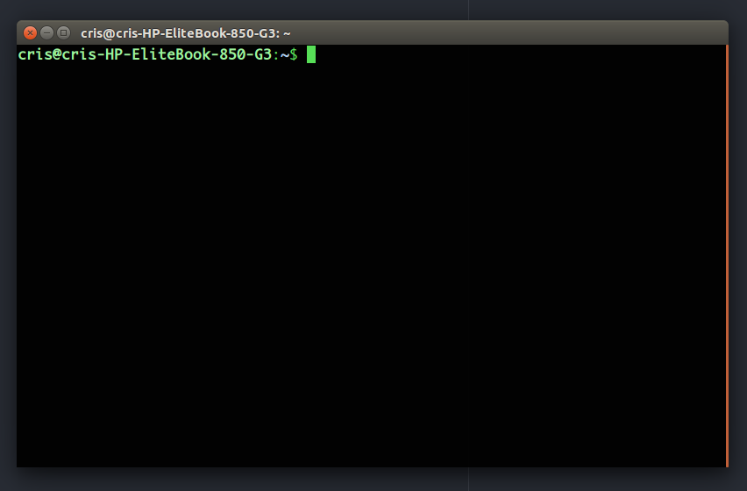
Command Line Prompt - Unix
Ctrl – Alt - T

Slide 26
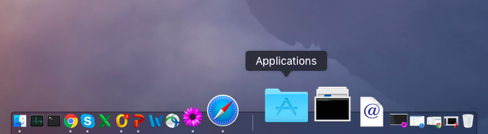
Command Line Prompt - Apple
Applications/Utilities/Terminal

Slide 27
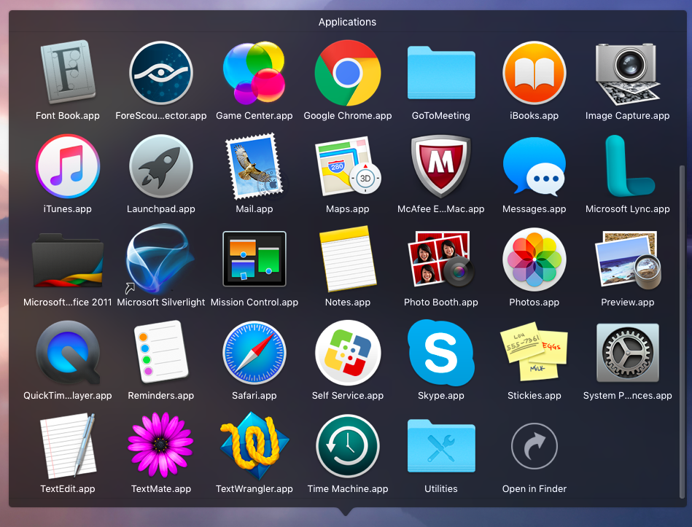
Command Line Prompt - Apple
Applications/Utilities/Terminal

Slide 28
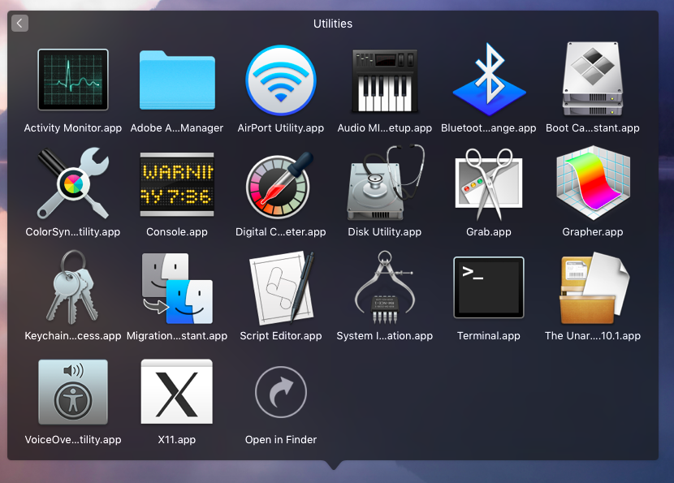
Command Line Prompt - Apple
Applications/Utilities/Terminal

Slide 29
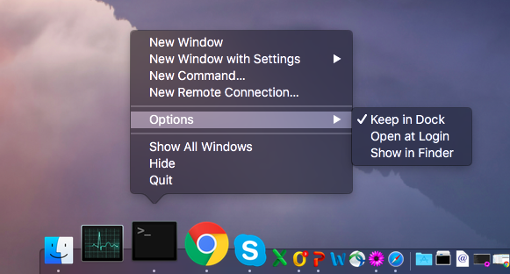
Command Line Prompt - Apple
Applications/Utilities/Terminal

Slide 30
Command Line Prompt - Windows
Depends on windows version:
Windows 10/8/8.1
Start
All apps
Windows System
Command prompt
Windows 7/XP/Vista
Start
All programs
Accessories
Command prompt
https://www.lifewire.com/how-to-open-command-prompt-2618089

Slide 31
Command Line Prompt - Windows
Depends on windows version:
Windows 10/8/8.1
Start
All apps
Windows System
Command prompt
Windows 7/XP/Vista
Start
All programs
Accessories
Command prompt
Or, install Cygwin
https://www.lifewire.com/how-to-open-command-prompt-2618089
https://cygwin.com/install.html

Slide 32
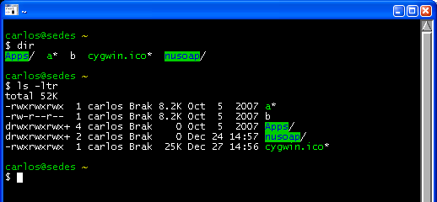
Command Line Prompt - Windows
Cygwin
Command line prompt for Windows
https://cygwin.com/install.html

Slide 33
Getting Started – What do you need?
Computer
Brains
Coffee/Tea/Beer
Terminal
Text editor (not Word)
Interpreter / Compiler
Developing environment
Access to internet
Notes:
Check around the room -

Slide 34



Simple Text Editors
Linux
Apple
Windows
TextWrangler
TextMate
gedit
Notepad++
atom
Sublime Text
Pros:
Syntax highlighting
Integrated code linting
Notes:
What is the penguin??
Syntax highlighting
Integrated code linting (to be up to best standards + helps with syntax)

Slide 35
Getting Started – What do you need?
Computer
Brains
Coffee/Tea/Beer
Terminal
Text editor (not Word)
Interpreter / Compiler
Developing environment
Access to internet
Depends on programming language
Notes:
Might need to install something esp. if on windows, but we’ll get back to that.

Slide 36
Getting Started – What do you need?
Computer
Brains
Coffee/Tea/Beer
Terminal
Text editor (not Word)
Interpreter / Compiler
Developing environment
Access to internet
Depends on programming language

Slide 37
Getting Started – What do you need?
Computer
Brains
Coffee/Tea/Beer
Terminal
Text editor (not Word)
Interpreter / Compiler
Developing environment
Access to internet
Notes:
Check around the room -

Slide 38
Good (online) resources
Google
Stack overflow
Whatever website for your favorite language / library
Youtube (tutorials / pycon)
Coursera / edX
Your local bioinformatician

