Slide 1

Data Wrangling and Exploratory Analysis -Healthcare Stroke data
Susmitha Chereddy

Slide 2
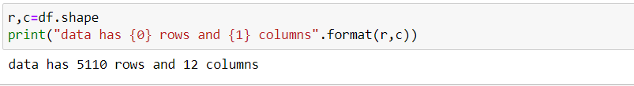
Introduction
For purpose of this project, I have chosen Health care stroke Data form Kaggle to perform Data wrangling and exploratory analysis on the same.
Kaggle link: https://www.kaggle.com/code/rishabh057/healthcare-dataset-stroke-data/notebook
Data Contains 5110 rows and 12 Columns as shown below.
0 id 1 gender 2 age 3 hypertension
4 heart_disease 5 ever_married 6 work_type 7 Residence_type
8 avg_glucose_level 9 bmi 10 smoking_status 11 stroke

Slide 3
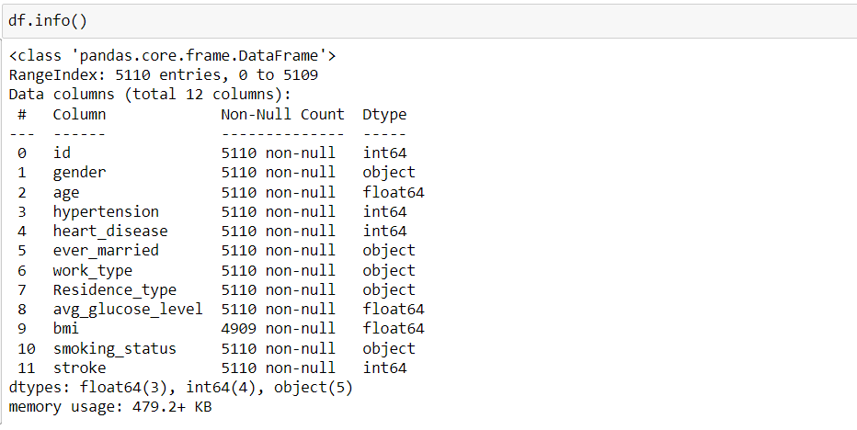
Data Exploration
Data Contains 7 numerical columns (of which 3 are float and 4 are integer) and 5-character columns as shown below.

Slide 4
Data Exploration
Below are the ranges of both Numerical and categorical data.
0 id - A unique id on the data
gender - Male/Female
age - Numerical column ranging from 0.08 - 82
hypertension - It a categorical variable 0 /1
heart_disease - categorial variable 0/1
ever_married - categorial variable 0/1
work_type - categorical varible with 5 levels
(Private/Self_employed/children/Govt_Job/never_worked)
Residence_type - catergorical variable with two levels (Urban/Rural)
avg_glucose_level - Numerical variable ranging from min 55.1 to max of 271.7
Bmi - Numerical variable ranging form 10.3 to 97.6
smoking_status - categorical variable with four levels
(never_smoked/Unknown/formerly_smoked/smokes)
Stroke - categorical variable 0/1

Slide 5

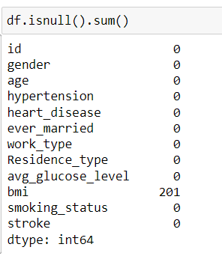
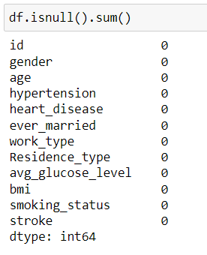
Dealing with missing values
From the data we see that there are 201 values in BMI that are missing, and we replaced them by mean of BMI.

Slide 6
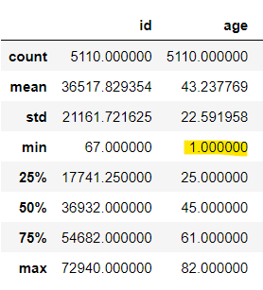
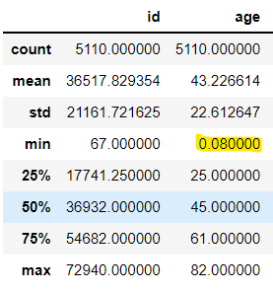
Data Wrangling
We observed that age contains Decimal values, and we are converting that to whole numbers using ceil function.

Slide 7
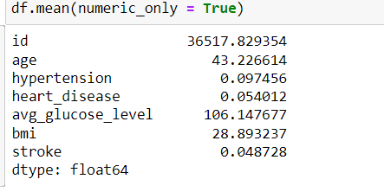
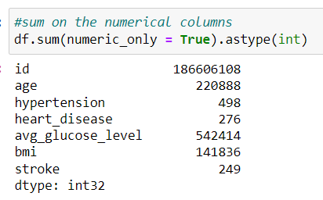
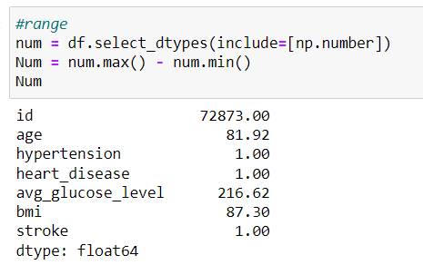
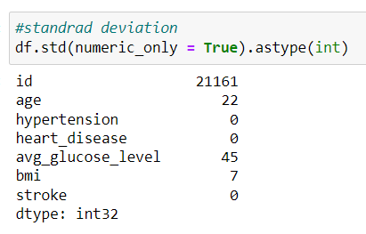
Exploratory Data Analysis
Mean, sum, range and standard deviation of all numerical columns.
Mean age of the patient from the data is 43.2 while the mean avg_glucose_level is 106 and mean BMI is 28.8.
we can see that the sum of ages of all patient is 220,888 years and their total BMI and avg_glucose levels are 542,414 and 141,836 respectively. Also, among the data,498 patient have hypertension, 276 have heart disease and 249 have stroke

Slide 8
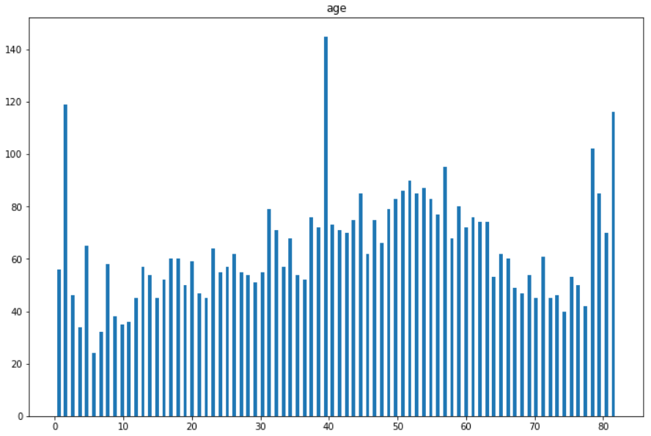
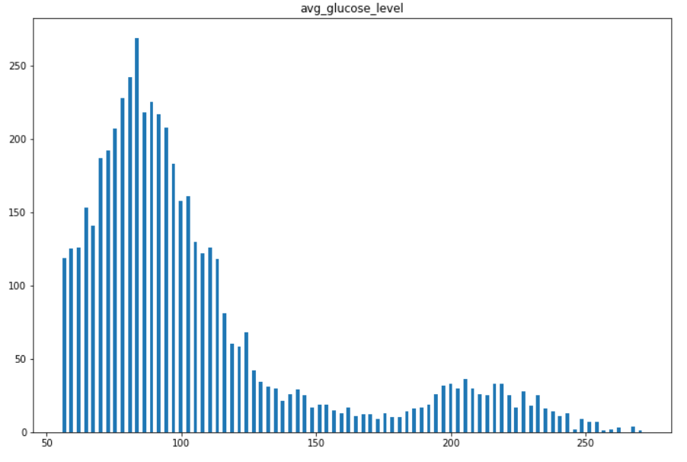
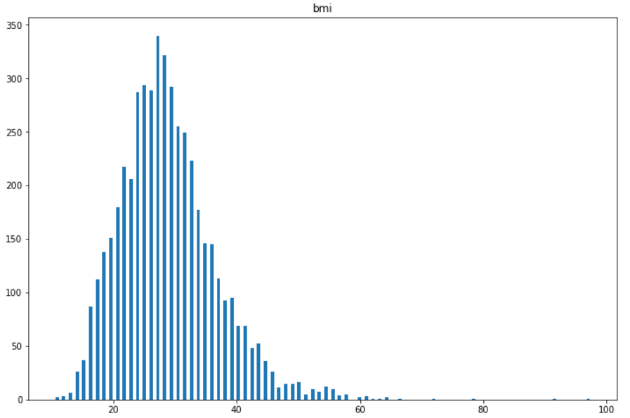
Data Exploration
Exploring Numerical Columns using Histograms.
Age
Average_glucose_level
BMI
From the above histograms, we could observe the below
Data has people aged from 0 to 82 with majority of them being aged 40.
From Avg_glucose_level distribution we see that it is left skewed as most of the patients fall in 50 - 120 and very less patient having glucose_index greater than 150.
From BMI distribution, we could see that the distribution is centered around the mean 28.8 with majority of the records falling between 10 - 35

Slide 9
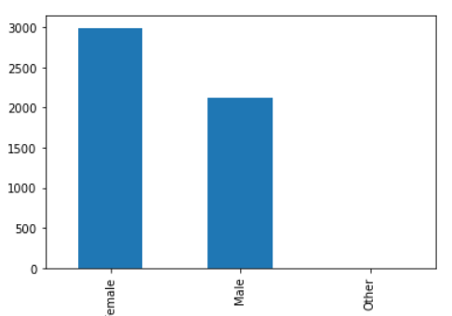
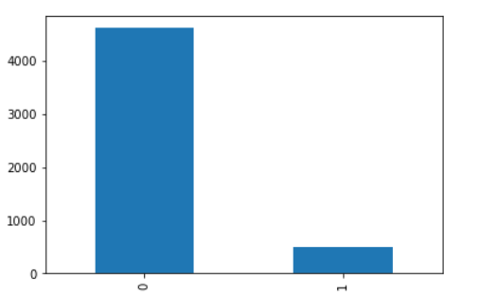
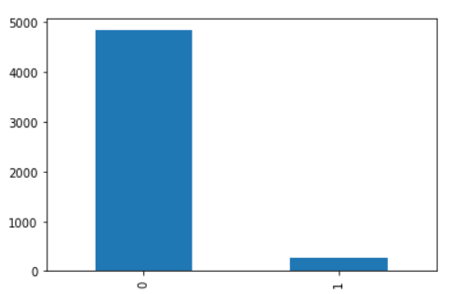
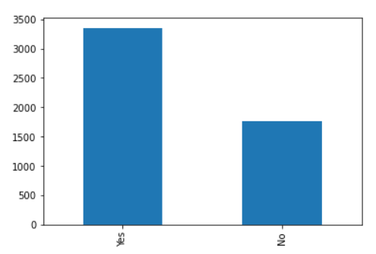
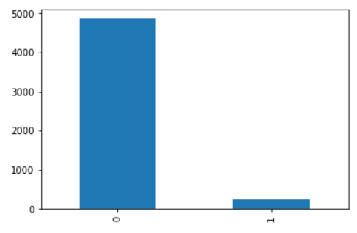
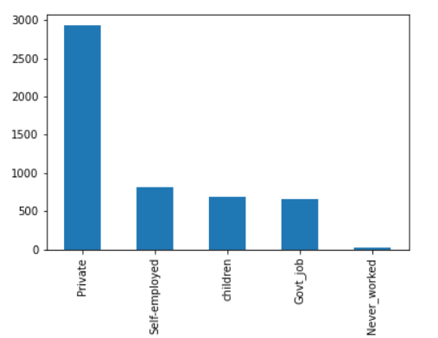
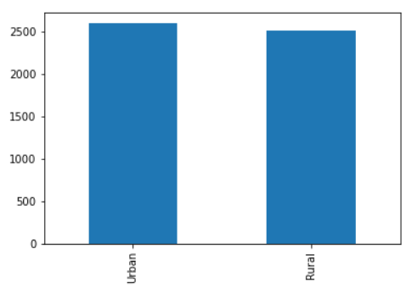
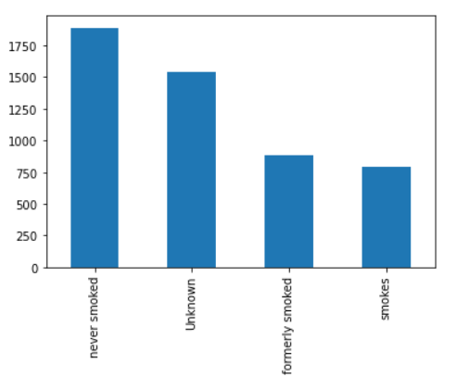
Data Exploration
Exploring categorical Columns using Histograms.
gender
Hyper-Tension
Heart Disease
Marital status
stroke
Work_type
Smoking status
Residency Type
From the above bar charts, we could observe the below
majority of people in dataset are female
very less number of people have heart disease/hyper tension
About 2/3 of them are married and majority of the subjects work in private sector.
very minor percentage of them actually have had a stroke.
Private
Self_employed
children
Govt_Job
never_worked
never_smoked
Unknown
formerly_smoked
smokes

Slide 10
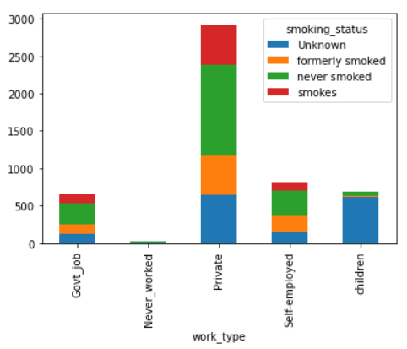
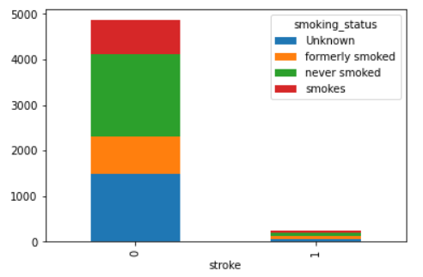
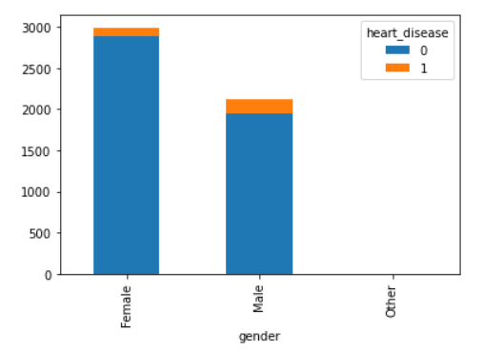
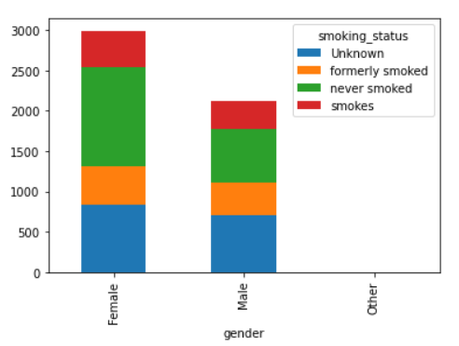
Data Exploration
Exploring Relation between columns using bar chart and scatter plot.
From the above bar charts, we could see the below
Although most of the children don't smoke, there is a tiny percentage of children who have smoked in the past.
percentage of patients who never smokes seems to be much higher among women.
Heart disease seems to be slightly more in men compared to women.
smoking does not seem to a strong indicator of heart disease since there seem to a lot patients who actively smoke/have smoked in past among the patients who did not have stroke.

Slide 11
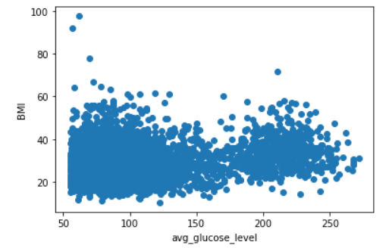
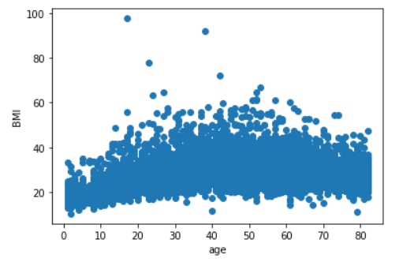
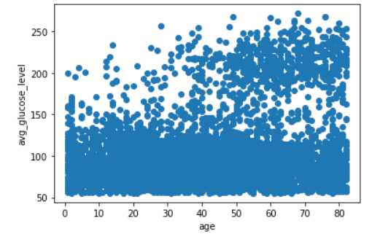
Data Exploration
Exploring Relation between columns using scatter plot.
From the above scatter plots, we could see the below
1. BMI tends to go up with increase in avg glucose levels.
2. As the age of the patient progresses, BMI tends to go up. But, we see a slight correction in trends as the patient age near 70's and 80's
3. Also, from the last lot, we see that Avg_glucose_level seems to be slowly increasing with age.

Slide 12
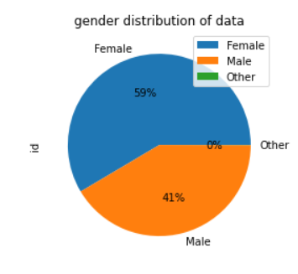
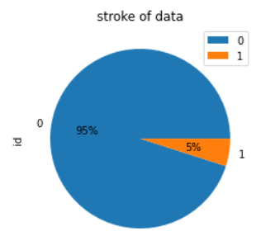
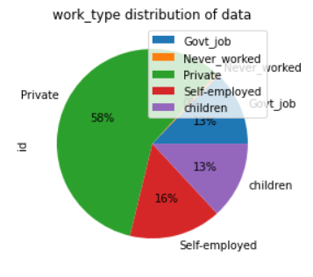
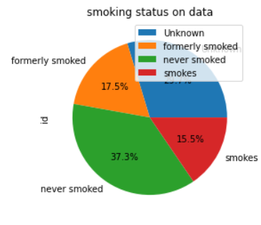
Data Exploration
Exploring Relation between columns using pie chart.
From the above pie charts, we could see the below
Only 5% of the entries in the data have stroke. In other words, only a few patients are stroke affected.
Majority of the people are privately employed form the above pie charts with 58% being employed in private sector
while most of them don't smoke, we have almost 1/3 of people who either smoke actively/have smoked in the past.
We also see unequal distribution of data when it comes to gender with 59% being female and 41% being male.

Slide 13
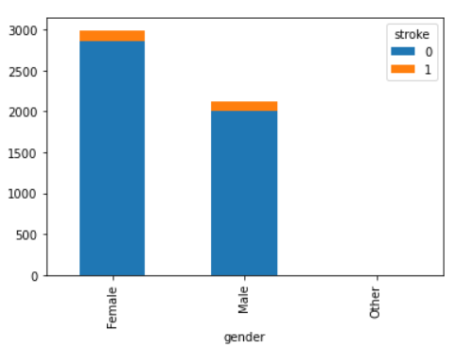
Data Exploration: Interesting Questions
Question 1: Are males more prone to stroke than females?
From the above the bar chart, we can see that stroke does affect male patients and female patients equally. In other words, Male patients are not more prone to stroke compared to female patients.

Slide 14
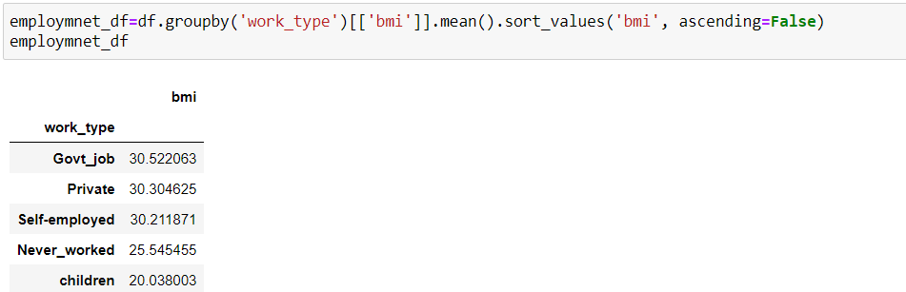
Data Exploration: Interesting Questions
Question2: Does people with Govt jobs have a higher BMI?
When we look at the mean of BMI among different work types, we see that people with Govt jobs tend to have slightly higher BMI than other groups.

Slide 15

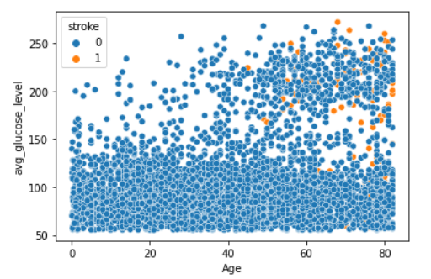
Data Exploration: Interesting Questions
Question 3 :what is the effect of age and avg_glucose_level for getting a stroke?
From the above plot, we can say as age progress and your glucose level increases, you are more prone to stroke.

Slide 16
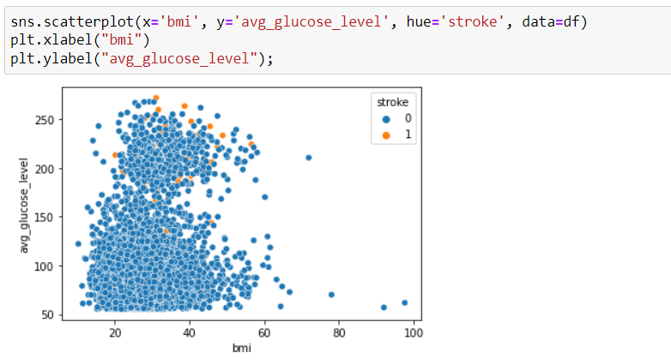
Data Exploration: Interesting Questions
Question 4: how does bmi and avg_glucose_level affect stroke
From the above plot, we could say that although bmi and glucose level are contributors for stroke, it is evidnet that avg_glucose_level is bigger constributer for stroke.

Slide 17
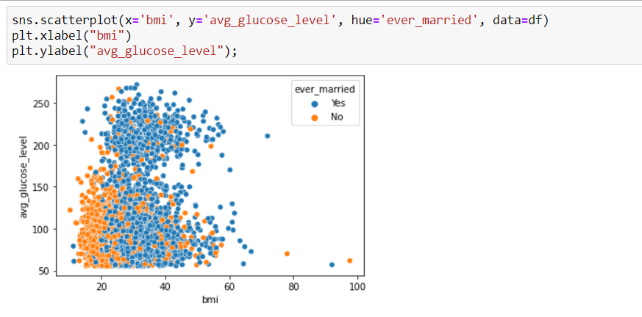
Data Exploration: Interesting Questions
Question 5:does your bmi and avg_glucose_level go up after getting married?
At the first glance it might looks like people who are not married have a good chance of keeping their bmi and glucose levels low. but let's look more details to conclude this.

Slide 18
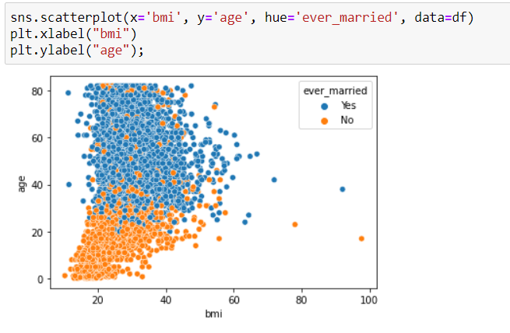
Data Exploration: Interesting Questions
Question 5:does your bmi and avg_glucose_level go up after getting married?
Certainly our previous observation is not right since unmarried people are usually young and healthy. Hence we marital status has nothing to with BMI and Glucose levels.

Slide 19
Inferences and conclusions
Below are some of the inferences from the health-care stroke dataset:
- Based on the data, we see that 59% of the records corresponds to women while only 41% is male.
- Although data unequally distributed in terms of males and females, we see that number of stroke patient among males and females is equally distributed.
- Although this data is focused on predicting the stroke on patients. Only 5% of the patients in the records actually had a stroke which 95% never had it.
- Majority of the patient work in private sector and very less percentage of people have not worked.
- One of the major health indices considered worldwide is BMI - Body Mass Index and from the data, we observe that Average BMI of people working at Govt Institutions is slightly higher than people working in private institutions.
- When we look at the age and the avg_glucose_level of the patients, we see that as age progresses, with higher glucose level, patients have a much higher chance of ending up with a stroke.
- One interesting observation we see was among unmarried people bmi and average glucose levels relatively much better. But form another observation, we saw that most of the unmarried people have better BMI because they are below 20's and healthy.

Slide 20


