Slide 1


Sergey Chernolyas
Contributor of Hibernate OGM
sergey.chernolyas@gmail.com

Slide 2
Why JPA for NoSQL storages?
Standard way for declare and describe domain model
Common way for working with entities
One way for working with different storages
Notes:
The slide for talk about:
Common problems in NoSQL
What is JPA offers for solve the problems?

Slide 3
Introduction the project
Main goals
Main targets
Main achievements
Notes:
The slide for talk about:
Main goals
Main targets
Main achievments

Slide 4
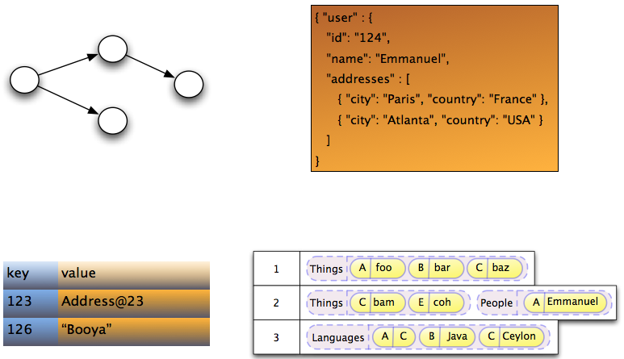
Supported types of storages

Slide 5
Supported types of data storage
Graph storage
Document storage
Key-value storage
Column-oriented storage
Multi-model storage
Notes:
Talk about how each type store data

Slide 6
Supported storages
Infispinian, Ehcache, Redis(Experimental)
MongoDB, CouchDB(Experimental)
Neo4j
Cassandra(experimental)
OrientDB (preparing to release in version 5.2)
Apache Ignite (preparing to release)
Notes:
Talk about how each type store data

Slide 7
Supported features table
Data storage | Features
 | Associations | Queries | Transactions | Remote/Embedded
Mongodb | + | Native, JPQL | Emulation | Remote
CouchDB | + | Native | Emulation | Remote
Infispinian | + | JPQL | JTA | Remote/embedded
Ehcache | + | - | - | Remote
Redis | + | JPQL | Emulation | Remote
Neo4j | + | Native, JPQL | Emulation | Embedded
Cassandra | + | Native | Emulation | Remote
Notes:
JP-QL supported by Hibernate Search

Slide 8
Architecture
em.getTransaction().begin();
em.persist(new Person("name1"));
em.getTransaction().commit();
Hibernate ORM Core
Hibernate OGM Core
4.commit()
3.insertTuple()
2.createTuple()
1.begin()
Hibernate OGM Module for Concrete Storage
GridDialect
DatastorageProvider
Notes:
Image with architecture of HIbernate OGM

Slide 9
OrientDB database
Multi-model (document + graph) storage
SQL-like query language
Supports stored procedures (any JSR-223 language)
Multi-master replication
Part of table (cluster) as object for query language
Notes:
Talk about how each type store data

Slide 10
Q&A

