Slide 1


Sergey Chernolyas
Contributor of Hibernate OGM
sergey.chernolyas@gmail.com

Slide 2
Subjects:
JPA for NoSQL
Hibernate OGM presentation
OrientDB presentation
My contribution for Hibernate OGM (module for OrientDB )

Slide 3
Why JPA for NoSQL storages?
Standard way for declare and describe domain model
Common way for working with entities
One way for working with different storages
Notes:
The slide for talk about:
Common problems in NoSQL
What is JPA offers for solve the problems?

Slide 4
Introduction the project
Main goals
Main targets
Main achievements
Notes:
The slide for talk about:
Main goals
Main targets
Main achievments

Slide 5
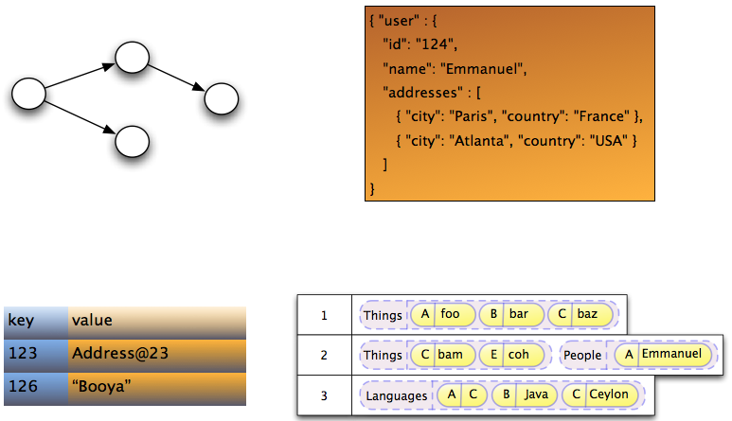
Supported types of storages

Slide 6
Supported types of data storage
Graph storage
Document storage
Key-value storage
Column-oriented storage
Multi-model storage
Notes:
Talk about how each type store data

Slide 7
Supported storages
Infispinian, Ehcache, Redis(Experimental)
MongoDB, CouchDB(Experimental)
Neo4j
Cassandra(experimental)
OrientDB (preparing to release in version 5.2)
Apache Ignite (preparing to release)
Notes:
Talk about how each type store data

Slide 8
Supported features table
Data storage | Features
 | Associations | Queries | Transactions | Remote/Embedded
Mongodb | + | Native, JPQL | Emulation | Remote
CouchDB | + | Native | Emulation | Remote
Infispinian | + | JPQL | JTA | Remote/embedded
Ehcache | + | - | - | Remote
Redis | + | JPQL | Emulation | Remote
Neo4j | + | Native, JPQL | Emulation | Embedded
Cassandra | + | Native, JPQL | Emulation | Remote
Notes:
JP-QL supported by Hibernate Search
Emulation is not traditional JTA and deferent with storage

Slide 9
Architecture
em.getTransaction().begin();
em.persist(new Person("name1"));
em.getTransaction().commit();
Hibernate ORM Core
Hibernate OGM Core
4.commit()
3.insertTuple()
2.createTuple()
1.begin()
Hibernate OGM Module for Concrete Storage
GridDialect
DatastorageProvider
Notes:
Image with architecture of HIbernate OGM

Slide 10
OrientDB database advantages :
Developed by Java
Multi-model (document + graph) storage
SQL-like query language
Supports stored procedures (any JSR-223 language)
Multi-master replication
Part of table (cluster and index) as object for query language
Excellent performance
API for many languages and frameworks
Notes:
Add links to performance test.

Slide 11
OrientDB database disadvantages :
Small team and community
Implementation is enough green ( current state: 3.0.0-snapshot)
Notes:
Talk about how each type store data

Slide 12
Hibernate OGM for Orient DB
Supports:
embedded and remote modes
document model
Transactions by emulation
Associations ( one-to-one, one-to-many, many-to-many )
Embedded objects ( limitedly )
Notes:
Talk about how each type store data

Slide 13
Hibernate OGM for Orient DB
Plans:
Using @RID as primary key for best performance
Graph model
Embedded objects as primary keys
Notes:
Talk about how each type store data

Slide 14
Q&A

