Slide 1
Evaluating Asymmetric Multiprocessing for Mobile Applications
Songchun Fan, Benjamin Lee
Duke University

Slide 2
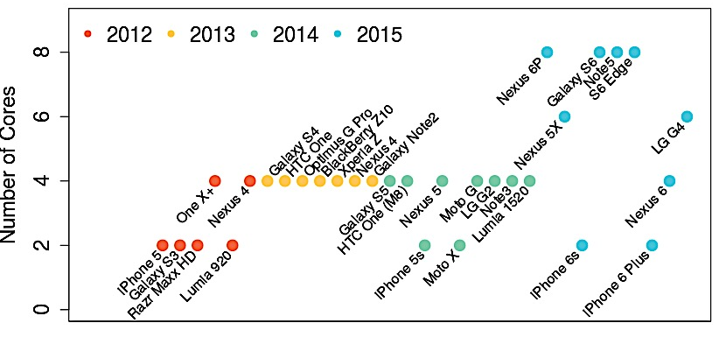
Mobile Processor Trends

Slide 3
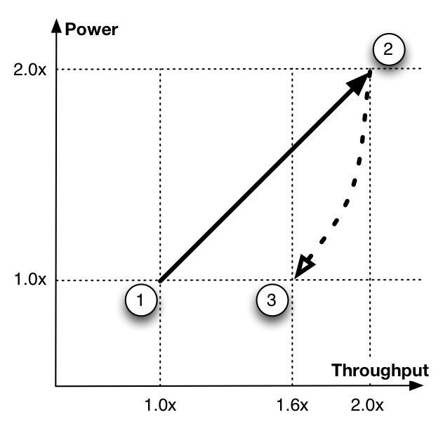
Case for Multicore
1. Single Core
2. Double Cores
2x cores
2x power
2x throughput
3. Tune Design
Reduce voltage, frequency
Simplify microarchitecture
-1% perf, -3% power

Slide 4
Multicore Challenges
Limited Parallelism
68% time with one core
Gao et al. ISPASS’15

Slide 5






Multicore Challenges
Limited Parallelism
68% time with one core
Gao et al. ISPASS’15
Heterogeneous Apps
Compute- vs non-compute intensive
Non-Compute Intensive
Compute Intensive

Slide 6


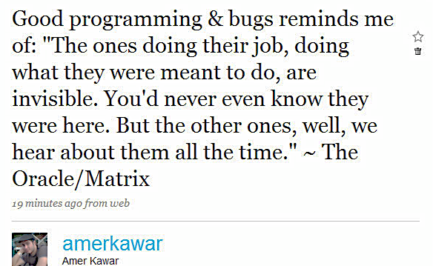
Multicore Challenges
Limited Parallelism
68% time with one core
Gao et al. ISPASS’15
Heterogeneous Apps
Compute- vs non-compute intensive
Heterogeneous Events
User inputs trigger computation

Slide 7

Heterogeneity for Efficiency
Define big and little core
Different voltage, frequency
Qualcomm S800 Series
1GHz
800MHz

Slide 8
Heterogeneity for Efficiency
Define big and little core
Different voltage, frequency
Qualcomm S800 Series
Different microarchitecture
NVIDIA Tegra 3
Samsung Exynos 5 Octa
Cortex
A15
Cortex
A7

Slide 9
Agenda
Benchmarks for intra-app diversity
Case study for heterogeneity scenarios

Slide 10

Intra-App Diversity
Click
Type
Scroll
Read

Slide 11
User and Processor Activity
Launching
Scrolling
Reading
Typing
Notes:
We find that these four types of user actions present distinct computational requirements.
Each graph here represents the instruction per cycle of a user input.
The higher the numbers, the more intensive the computation is.
For example, reading is not computational intensive.
The spikes here are due to background threads of other android tasks.
A mobile benchmark set should include not only the inter-app diversity, but the intra-app diversity as well.

Slide 12
Benchmarking User Events
Inserting User Inputs
Use Android Instrumentation to create activities
Emulate touches, swipes, keyboard events
Create Android images for gem5 simulation
# Initialize an instrumentation
Instrumentation inst = new Instrumentation();
# Insert a keyboard event
inst.sendKeyDownUpSync(KeyEvent.KEYCODE_A);
Notes:
To implement these benchmarks, we create “activities” within Android, loading activity text and pictures locally. We inject touches, swipes, and keyboard events using Android In- strumentation, an API that allows app developers to test their activity windows with emulated user behavior. This method requires access to application source code; our benchmarks are open-sourced.
Other methods use Android MonkeyRunner or write I/O events to the Linux input driver file. However, these methods require a time-stamp for each injected event and precisely specifying the time-stamp to trigger the right event during cycle-accurate, microarchitectural simulation is difficult. Al- ternatively, AutoGUI supports record-replay through VNC and may be useful once it becomes public [33].

Slide 13
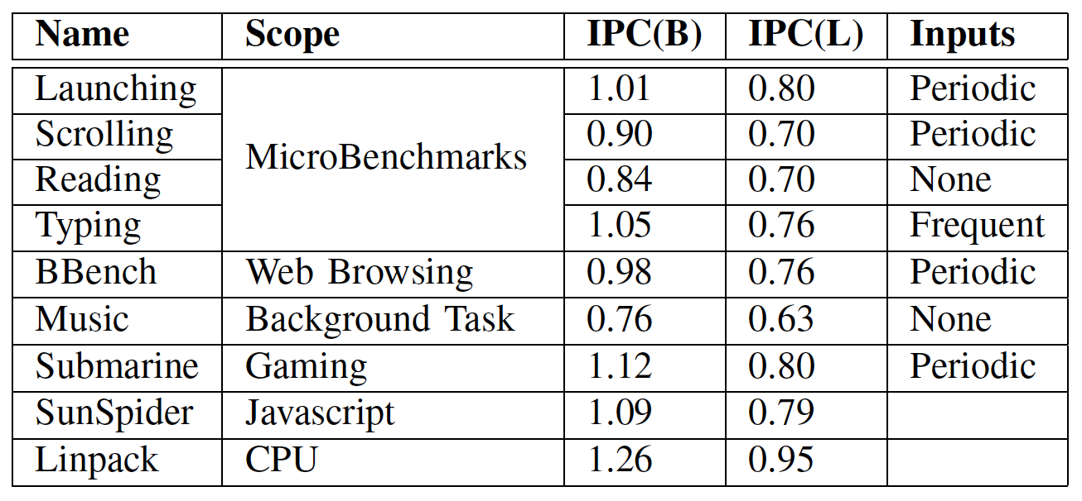
Benchmarks
Interactive
Notes:
Sunspider and Linpack are not interactive apps

Slide 14
Agenda
Benchmarks for intra-app diversity
Case study for heterogeneity scenarios

Slide 15
Heterogeneity Scenarios
Processor
1GHz, 3-issue, 32KB L1, 512KB L2
Big: out-of-order
Little: in-order
Shared L1
Spill state to L1 – 30 cycle transition
Big
Little
registers
registers
L1
Notes:
We study three types of interconnections between the big and little cores.
(the other could be power-gated or clock-gated)

Slide 16
Heterogeneity Scenarios
Processor
1GHz, 3-issue, 32KB L1, 512KB L2
Big: out-of-order
Little: in-order
Shared L1
Spill state to L1 – 30 cycle transition
Shared L2
Flush dirty L1 lines – 500 cycle transition
Big
Little
registers
registers
L1
L1
L2
Notes:
We study three types of interconnections between the big and little cores.
(the other could be power-gated or clock-gated)

Slide 17
Heterogeneity Scenarios
Processor
1GHz, 3-issue, 32KB L1, 512KB L2
Big: out-of-order
Little: in-order
Shared L1
Spill state to L1 – 30 cycle transition
Shared L2
Flush dirty L1 lines – 500 cycle transition
Shared Memory
Flush dirty L1 / L2 lines – 10K cycle transition
Big
Little
registers
registers
L1
L1
L2
L2
DRAM
Notes:
We study three types of interconnections between the big and little cores.
(the other could be power-gated or clock-gated)

Slide 18
Oracular Transitions
Estimate upper bound on little core utilization
Obtain big, little performance from oracle.
Check for profitable transition, given tolerance
* Non-oracular results included in the paper.
Notes:
First, the simulation provides the oracle knowledge of the IPC of big and little cores for each interval.
Then, the oracle calculates the transition points such that a transition would not violate the performance penalty.
Then, the oracle applies transition cost to those transition points, and decide whether the resulting IPC will be satisfying. If not, it checks one point after the current point. The process iterates until an ideal transition point is found.

Slide 19
Little Core Utilization

Slide 20
Energy Efficiency

Slide 21
Penalty Tolerance
?
Tolerance of Performance Penalty (x)
Notes:
The cross-over point between 30-cy and 500-cy strategies highlights a counter-intuitive observation: sometimes, the 500- cy strategy uses the little core more often.
This is because switching back to the big core is difficult when switching costs are high and performance penalties cannot be tolerated

Slide 22
Conclusions
Benchmark Design
Input heterogeneity is critical
User inputs trigger distinct compute patterns
Benchmarks should inject diverse inputs
Microarchitectural Design
User actions shape efficiency gains
Little cores need performance
Switching costs are critical for utilization
https://github.com/schfan/actionbench-

Slide 23
Evaluating Asymmetric Multiprocessing for Mobile Applications
Songchun Fan, Benjamin Lee
Duke University
Notes:
Advisor… computer architecture and resource management
Two projects that I did in the past two years about leveraging heterogeneity for mobile computing

Slide 24
Q & A
Thank you!

Slide 25
Backup slides

Slide 26
Benchmarking Mobile Apps
Current benchmarks neglect user events
BBench
Automatically loaded webpages for simulators
A game for testbeds
MobileBench
Photo viewing, video playback for simulators
Moby
Email, word processing, maps, social network for simulators

Slide 27
Core Architectures
Big core = Out-of-Order core
Little core = In-Order core
IPC
Notes:
This graph shows that in case of branch mis-predictions, the big core to perform no better than the little core
This is because in out-of-order cores, the cost of branch mis-predictions are higher because the sequence of instructions have been speculated and rescheduled,
And if a miss happens, the big core wastes many cycles to recover from it.
Therefore, if in certain programs these mispredictions happen a lot, a little core is a better choice.

Slide 28
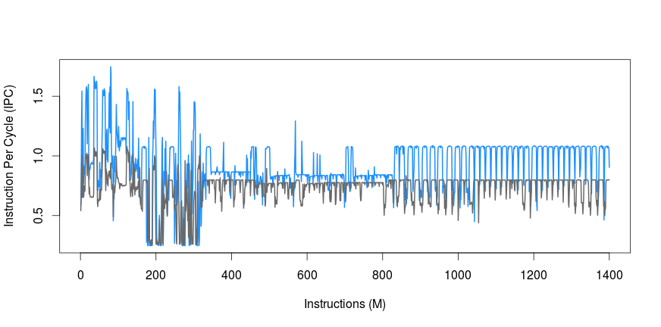
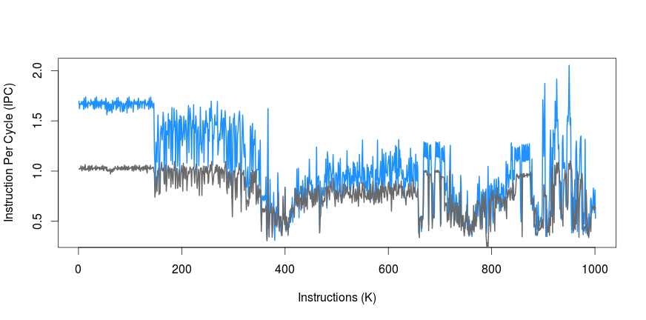
Core Architectures
Big core = Out-of-Order core
Little core = In-Order core
Big core has higher IPC
Notes:
We define an architecture with a big core and a little core.
In reality, they can be a cluster of cores, but for simplicity, in this study we view them as two individual cores of different microarchitectures.
An out of order core contains more components than an in-order core, such as a reorder buffer that can explore the instruction level parallelism,
Therefore it generally has a better performance than an in-order core.
As a cost of those reordering components, it also consumes more power than the in-order core.
Observe the instruction per cycle lines in this graph. The blue line is the IPC of the big core.
It is higher, meaning that in each cycle, a big core can execute more instructions.
However, there are also cases when an in-order core can do same well

Slide 29
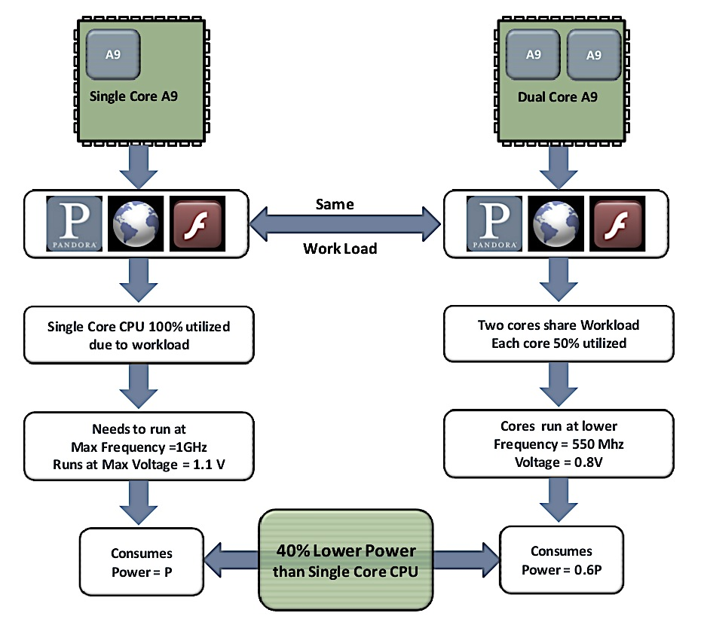
Synchronous Symmetric Multiprocessing
Cores can be at a lower frequency
NVIDIA Tegra 2, Qualcomm S4 dual,
Samsung Exynos 4, TI OMPA 4...
P=cV²f
http://www.nvidia.com/content/PDF/tegra_white_papers/Benefits-of-Multi-core-CPUs-in-Mobile-Devices_Ver1.2.pdf
Notes:
In this example, with one core, the single CPU runs at 100% load, requiring 1GHz frequency and 1.1 volt.
With two cores, each core is 50% utilized and requires 550MHz frequency and 0.8volt.
As a result, two cores uses 40% less power than the single core.

Slide 30
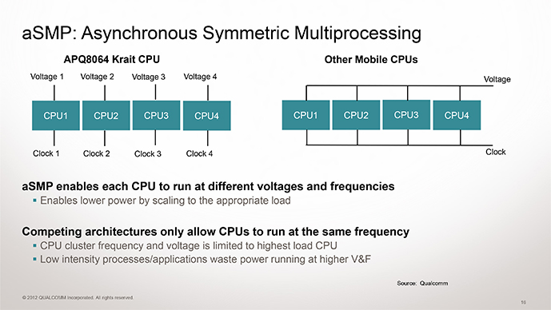
Asynchronous Symmetric Multiprocessing
Cores can be at different frequencies
Qualcomm S800 Series
http://www.brightsideofnews.com/2012/07/25/qualcomm-snapdragon-s4-benchmarking-day/
Notes:
Qualcomm took another approach, where cores are connected to different power supplies so that they can run at different frequencies,
Providing more scheduling flexibility and efficiency that the previous approach.
The downside of this approach is the complexity.
Before, all the cores share a single power supply. Now, each core has separate power supply.

Slide 31
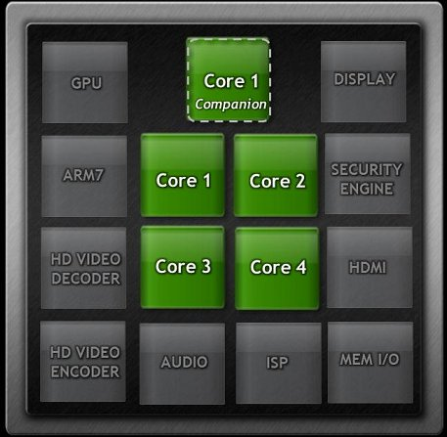
Asymmetric Multiprocessing
Cores can be of different architectures
NVIDIA Tegra 3
http://www.brightsideofnews.com/2012/07/25/qualcomm-snapdragon-s4-benchmarking-day/
Notes:
Previous approaches used cores that are same.
Heterogeneous multicores have asymmetric multiprocessing,
Meaning using different microarchitectures,
some cores can be more powerful that other cores.
Nvidia tegra adopts a companion core that is a low power, small core which assists mobile tasks that are lightweight,
While letting the other four big cores to sleep and save power.

Slide 32
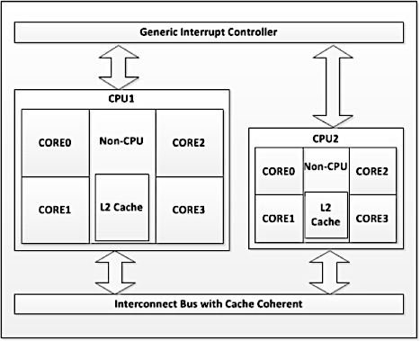
Asymmetric Multiprocessing
Cores can be at different architectures
Samsung Exynos 5 Octa
Notes:
Samsung proposed big little architecture. In this design, each processor has two clusters of cores. One cluster of big cores and one cluster of small cores.

Slide 33
Looking into the future
Lack of proof which architecture is better for mobile CMP
Does big-little suit mobile apps
How should it be designed (e.g., interconnections)
Need for realistic benchmarks
Notes:
Despite the blooming market and all different solutions of improving energy efficiency,
there is no proof which architecture is most efficient for mobile processors.
Is asymmetric processing, such as big-little, the best approach?
If so, how should it be designed?
In order to quantitatively study mobile processor architectures,
we need realistic applications that represent real user activities.

