Slide 1



Telepath: Sensory Offloading for Wearable Devices
Songchun Fan,
Qiuyun Llull,
Benjamin C. Lee
Duke University
Notes:
This work was done with my colleague Qiuyun and my advisor Ben at Duke.

Slide 2
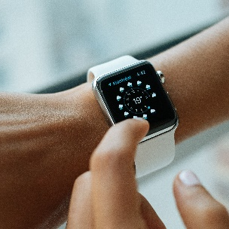
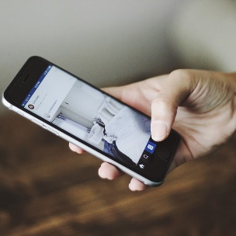
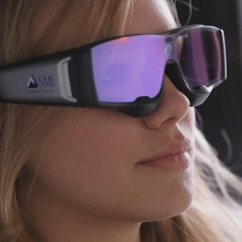
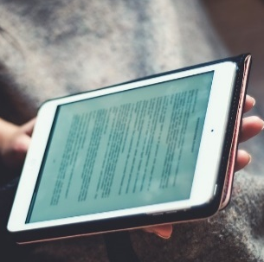
Scope
Aggregating resources from multiple mobile/wearable devices
Notes:
The scope of this paper is to aggregate resources from multiple mobile or wearable devices, that are often carried simultaneously by today’s users.

Slide 3
Continuous-Sensing Wearable Apps for Activity Tracking
In this paper, we focus on…
Notes:
In specific, this work focuses on continuous sensing wearable apps, and how aggregated resources can help activity tracking

Slide 4
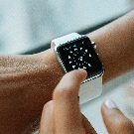
Today’s wearable devices
Computing power
Battery capacity
As powerful as phones
11% of phones on average
Notes:
If we look at the specs of today’s wearable devices, we notice that todays wearable devices are equipped with computing power that is competitive with phones.
They might have even more sensors.
However, a smart watch, for example, due to its small size, has only about 11% of a phone’s battery capacity on average.
This huge gap contributes to the limited wearable usages.

Slide 5
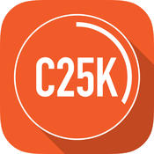





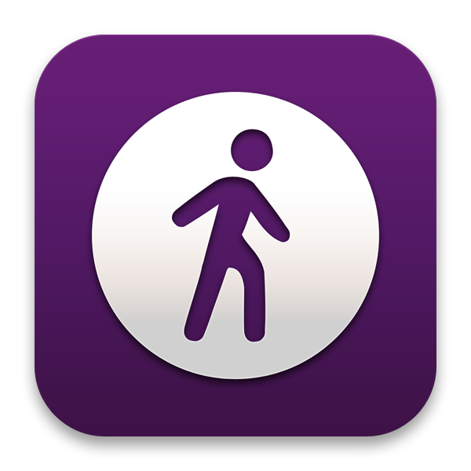





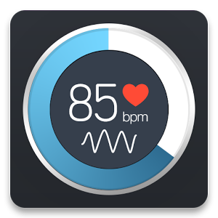
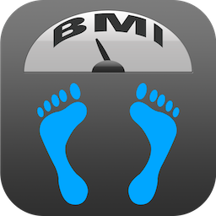




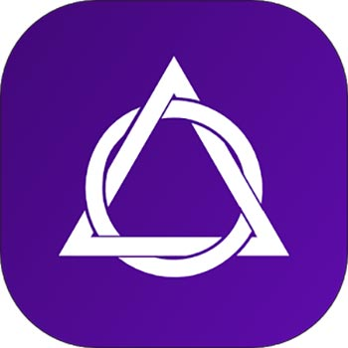
Continuous Sensing Wearable Apps
Activity tracking
Gesture recognition
Health monitoring
……
……
……
Notes:
On the one hand, wearables are suitable for continuous sensing apps, as they are placed at fixed, convenient positions on users.
This makes activity recognition easier and stimulates the growing market of wearable sensing apps.
On the other hand, these apps are energy hungry, and the tiny battery in a wearable might not able to support these apps for day long.

Slide 6
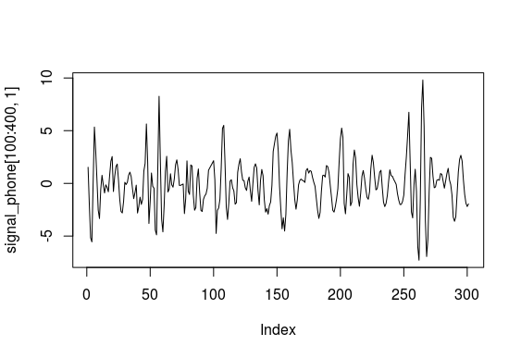

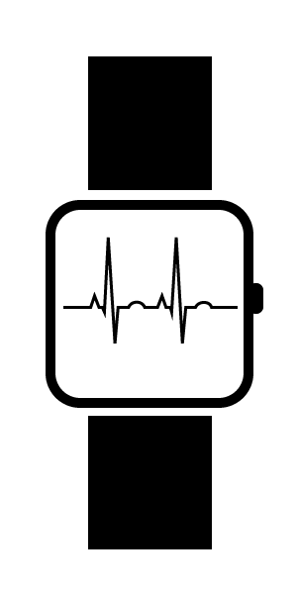
Problem: High sensing cost
ExampleApp
Sensing
Sensing
Feature Extraction
sd_x = 2.36
Computing
2.36 > Threshold
=> “Running”
Classification
Notes:
The problem is the high sensing cost.
Let us looks at an example app. It is a watch app that reads the accelerometer data from the sensors, processes it, and classifies if the user is doing a certain activity.
The energy cost of this app can be divided into sensing cost and computing cost.

Slide 7
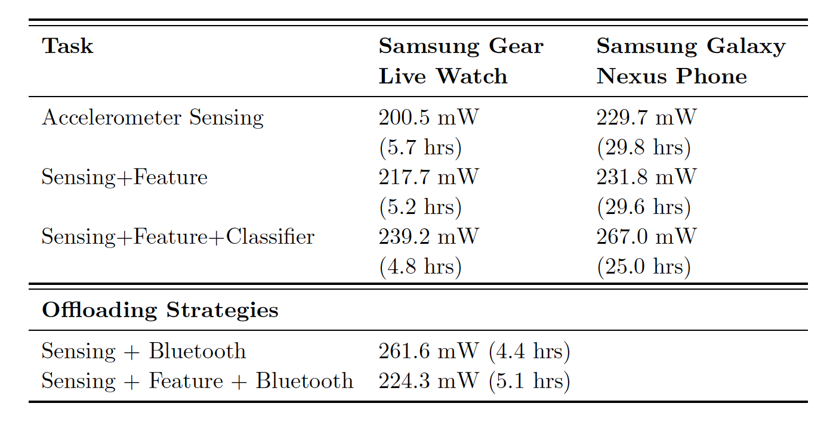
Problem: High sensing cost
The cost of sensing dominates the power consumption
Computational offloading does not help with sensing
Notes:
The power measurements tell us that the cost of sensing dominates the power consumption, and this is because the main CPU has to be awake to move and process the sensing data
Due to the large amount of data, the cost of sensing cannot be mitigated by traditional computational offloading.

Slide 8
One Solution: Wearable Hardware Improvement
Energy efficient
(main CPU can sleep)
Fast
(specialized hardware)
Not scalable
(limited to a few activities)
Long development cycles
(simulation, ASIC design, verification, tapeout…)

Slide 9
Ideal Solution
Energy efficient
Fast
Scalable for any sensing app
Easy to deploy
Easy to adapt to existing apps

Slide 10
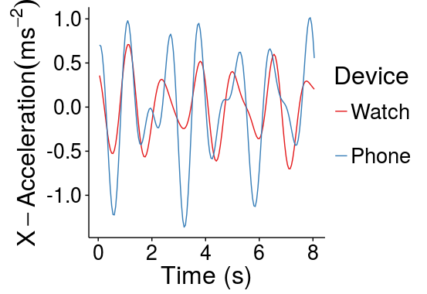
Our Solution: Offload Sensing + Computing
Observation: same user carries multiple devices
Motion signals on phone and watch are highly correlated
Use phone to take over watch’s sensing and computing
Notes:
Therefore, we propose a software based solution, that is to offloading both sensing and computing to the phone.
Our observation is that…
And that the motion signals …
If such correlation is strong, why not use the phone to …, as a “battery extender”?

Slide 11
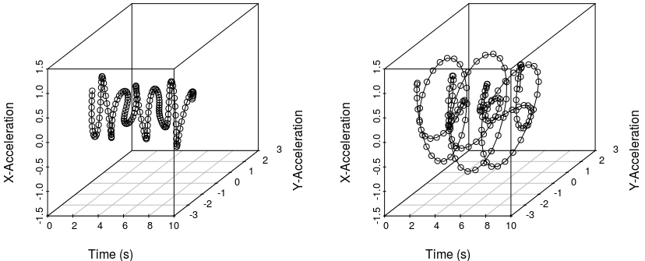
Solution: Let Phone Emulate Watch
Watch
Phone
Predict
Step 1: Predict what the watch senses

Slide 12
Solution: Let Phone Emulate Watch
Watch
Phone
Predict
Step 1: Predict what the watch senses

Slide 13
Solution: Let Phone Emulate Watch
Step 2: Activity recognition with watch’s model
Notes:
Activity recognition apps have carefully calibrated classifiers, such as a support vector machine to determine if the user is biking or running based on sd of x-accel, and y-accel.
Training data is collected from many users to make the model accurate.
Instead of letting developers retrain the model, we want to re-use the model by clone it into the phone.
Using the predicted sensing data to make the old model work again.

Slide 14
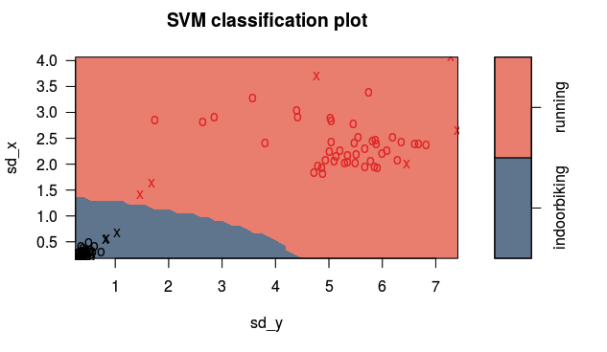
Solution: Let Phone Emulate Watch
Step 2: Activity recognition with watch’s model
Biking Running
Watch
Notes:
Instead of simple threshold based classifiers,
Activity recognition apps have carefully calibrated classifiers, such as a support vector machine to determine if the user is biking or running based on sd of x-accel, and y-accel.
Training data is collected from many users to make the model accurate.
Instead of letting developers retrain the model, we want to re-use the model by clone it into the phone.
Using the predicted sensing data to make the old model work again.

Slide 15
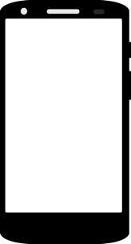
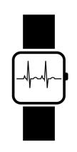
Solution: Let Phone Emulate Watch
Step 2: Activity recognition with watch’s model
clone
Biking Running
Watch
Notes:
Instead of simple threshold based classifiers,
Activity recognition apps have carefully calibrated classifiers, such as a support vector machine to determine if the user is biking or running based on sd of x-accel, and y-accel.
Training data is collected from many users to make the model accurate.
Instead of letting developers retrain the model, we want to re-use the model by clone it into the phone.
Using the predicted sensing data to make the old model work again.

Slide 16
Design Considerations
Phone must accurately predict the watch’s sensing data
Must be energy efficient for both devices
APIs must be easy to deploy
Must handle various device placements
Notes:
Such an approach requires the phone to accurately…
In this paper, we focus on the first two design points

Slide 17
Telepath Framework
Watch
Phone
Application
Clone
Use TelepathSensor & TelepathSensorListener
Telepath
Use SensorManager & SensorEventListener
OS
OS
Sensor Drivers
Sensor Drivers
Notes:
Telepath is a shim layer that sits on top of a mobile OS
Instead of talking to android sensor api directly, an app’s interface talks to telepath sensor api, which handles remote or local data streams

Slide 18
Telepath Framework
Wearable
Phone
App
Front-end
User Interface
Telepath (Receiver)
Telepath (Sender)
App
Back-end
Computing
Computing
App
Clone
Sensing
Sensing
Telepath (Sender)
Telepath (Predictor)
Verification
Operating System
Operating System
Local
Resources
Remote
Resources
Sensors
Sensors
Data flow Local Data flow Remote Verification & Results

Slide 19
Telepath Predictor
Raw Sensing Wearable
Transfer Function
Telepath (Predictor)
Clustering
Raw Sensing Phone
Notes:
The key technique behind the framework is the predictor.
After experiments many algorithms in machine learning and time series analysis,
we built a the predictor with two essential components. It contains two parts:

Slide 20
Telepath Predictor
Raw Sensing Wearable
Transfer Function
Telepath (Predictor)
Clustering
Raw Sensing Phone

Slide 21
Transfer Function Modeling (TFM)
Describes the relationship between correlated time series
Watch’s
History of X
Phone’s sensing data
Other effects
Notes:
The transfer function modeling is a time series analysis technique that captures the relationship…
A transfer function is the linear relationship between one time series history and another time series
The modeling process is to calculate the coefficients of this function.
Telepath borrows this technique to predict the watch’s sensing data from the phone’s.

Slide 22
Telepath Predictor
Raw Sensing Wearable
Transfer Function
Telepath (Predictor)
Clustering
Raw Sensing Phone

Slide 23
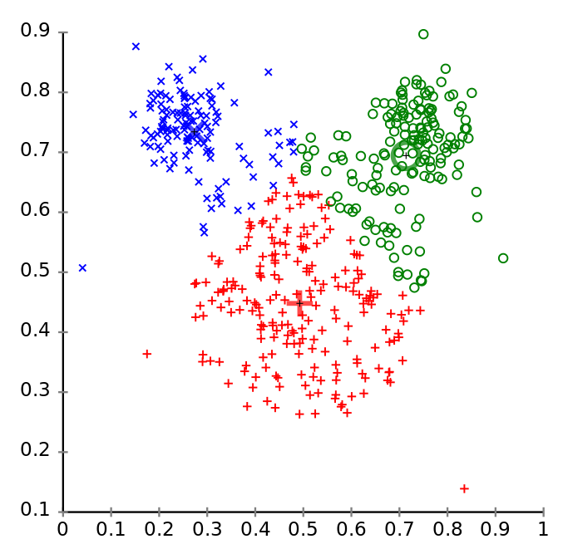
Data Clustering
Data stationarity
Users perform different motions -> data not stationary
Each independent activity -> stationary
Solution: data clustering -> one TFM for each cluster
v’’₀, v’’₁, v’’₂, v’’_{3,} N’’_{t}
v₀, v₁, v₂, N_{t}
v’₀, v’₁, N’_{t}
Notes:
TFM requires the time series data to be stationary. However, we found that…
We adopt a hierarchal approach.
We segment the time series to be segments, and classify each segment into clusters.
Segmentation length: 128 * 0.02 = 2.56s

Slide 24


Training Pipeline
Wearable
Telepath (Logger)
Phone
Telepath (Logger)
Pre-process
Computing
Transfer Function 1
Server
K-means
Clustering
…
Function M
A repetitive process that executes daily
Notes:
Overall, the training pipeline simply collects data, and…, and…
this process is repetitive and the transfer function models update everyday, adapts to users

Slide 25







Evaluation
 | App | Running | Walking | Cycling
 | C25K | ✔
 | Endomondo | ✔ | ✔ | ✔
 | Google Fit | ✔ | ✔ | ✔
 | Loseit |  | ✔
 | Map My Fitness | ✔ | ✔ | ✔
 | Map My Hike | ✔ | ✔
 | Map My Ride |  |  | ✔
 | Map My Run | ✔
 | Map My Walk |  | ✔
 | MevoLife | ✔
 | Misfit |  | ✔
 | Runkeeper | ✔
 | Runtastic | ✔ | ✔ | ✔
 | Under Armour Record | ✔ | ✔ | ✔
Baseline: directly using the phone to run watch’s tasks
Metrics: accuracy and power
Applications
Notes:
We select top 14 sensing wearable apps in Android app store
Common activities

Slide 26
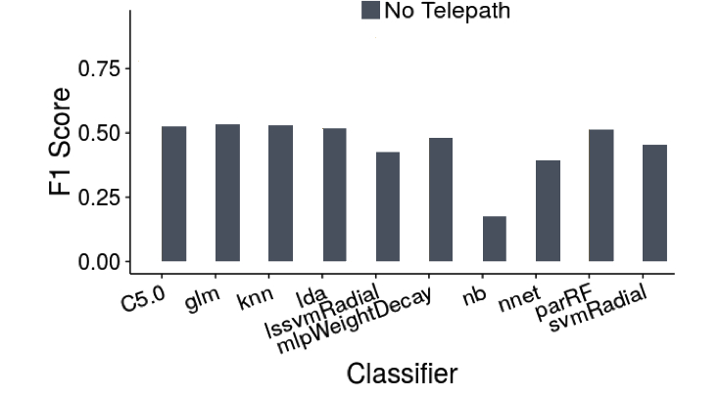
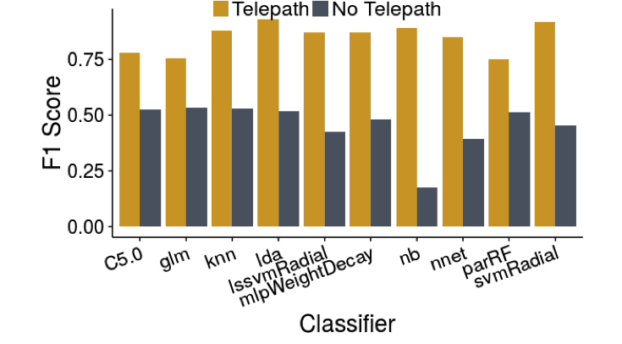
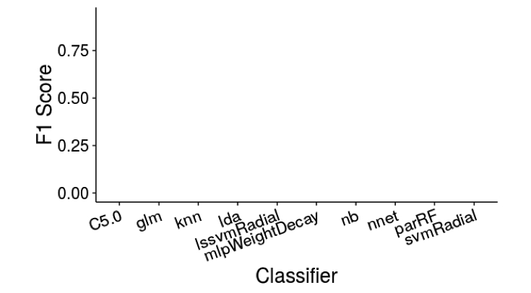
Evaluation: Accuracy
Telepath achieves on average 85% accuracy of the watch.
F1 Score = 2 * (precision * recall) / (precision + recall)
Notes:
Since we don’t know which classifiers are used in those commercial apps,
We select 10 classifiers that are commonly used in activity recognition.
Each classifier has been previously trained with watch’s data.
The y-axis is F1-score.

Slide 27
Evaluation: Power
Telepath extends the watch’s battery life by 2.1x
Sending raw sensing data
to process in phone
Sending extracted features
to classify in phone
Transfer battery life from phone to watch
Notes:
Explain baselines
“Transfer battery life”

Slide 28
Conclusion
Collaboration of Devices
This work attempts to aggregate sensing resources from multiple mobile devices
Wearable Sensing Apps
A prototype for sensing data prediction, applied to wearable sensing apps
Other Applications?
The idea of shared resources can be applied to other use cases for wearable devices.
Exploiting Signal Correlations
A training and prediction pipeline based on time series analysis and data clustering
Extending Wearables Battery
Trading 15% accuracy loss for 2x battery life improvement
Better Algorithms?
Advanced data processing & management schemes can be applied for optimization

Slide 29
Thanks!
Any questions ?
Read full paper at https://schfan.github.io/files/hotmobile6_0120.pdf.
Email me at schfan@google.com if you have any question.

Slide 30
Backup Slides

Slide 31
Telepath Deployment: Code Example
w/o Telepath
w/ Telepath
public class MainActivity extends WearableActivity
implements SensorEventListener {
SensorManager sensorManager = (SensorManager) getContext().getSystemService(SENSOR_SERVICE);
Sensor mSensor = sensorManager.getDefaultSensor(
Sensor.TYPE_ACCELEROMETER);
sensorManager.registerListener(this, mSensor,
SensorManager.SENSOR_DELAY_FASTEST);
public void onSensorChanged(SensorEvent event){
float[] accel = event.values;
double feature = getStandardDeviation(accel );
int label = (int) svm.predict(svmModel, feature);
display(label);
}
}
public class MainActivity extends WearableActivity
implements TelepathSensorListener{
TelepathWear tp = new TelepathWear(context, this);
tp.getTelepathSensor(Sensor.TYPE_ACCELEROMETER,
SensorManager.SENSOR_DELAY_FASTEST);
public void onTelepathEvent(TelepathEvent event){
int label = tp.getResults(event); //dynamic
display(label);
}
@override
public int compute(TelepathEvent event){
float[] accel = event.values;
double feature = getStandardDeviation(accel );
int label = (int) svm.predict(svmModel, feature);
return label;
}
}
Notes:
Easily change to use telepath api
Developers don’t need to manage device usages or know where the data is from

Slide 32
Evaluation: Accuracy in Activity Recognition
F1 = 2 * (precision * recall) / (precision + recall)
Notes:
Since we don’t know which classifiers are used in those commercial apps,
We select 10 classifiers that are commonly used in activity recognition.
Here we present the result of using a llinear discriminant classifier to recognize the three activities.
The classifier has been previously trained with watch’s data.
The y-axis is F1-score.

Slide 33
Impact on Latency
Logging apps are not latency sensitive
Prediction latency per data point is 3.42ms < sampling period

Slide 34
Credits for template
Special thanks to all the people who made and released these awesome resources for free:
Presentation template by SlidesCarnival
Photographs by Unsplash

