Slide 1
How autodiff changed the world
Machine Learning Operations
Nicki Skafte Detlefsen,
Postdoc
DTU Compute

Slide 2
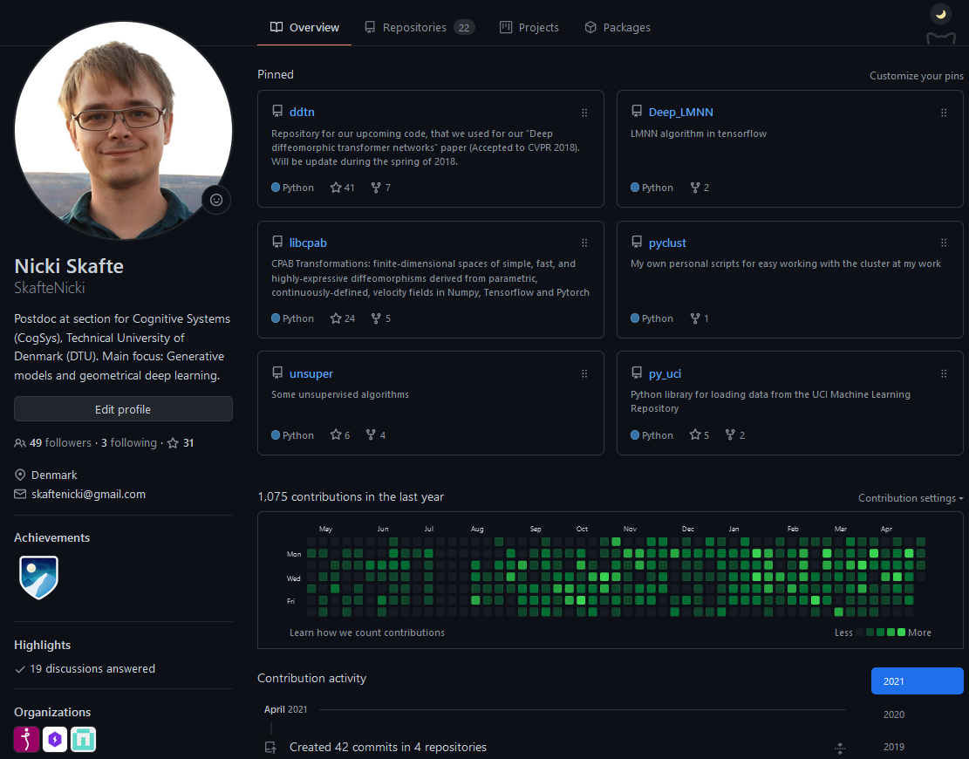
Who am I?
Bachelor, Master and PhD from DTU
Currently: Postdoc at section for cognitive systems
Focus: Inductive biases in deep learning
Eager open-source contributer

Slide 3
Course settings
5 ECTS
3 weeks period
Level: Master
Grade: Pass/not passed
Type of assessment: weekly project updates + final oral examination/presentation
Recommended prerequisites: 02456 (Deep Learning) or
General understanding of machine learning (datasets, probability, classifiers, overfitting etc..) and
Basic knowledge about deep learning (backpropagation, convolutional neural network, auto-encoders etc..)
Coding in Pytorch

Slide 4
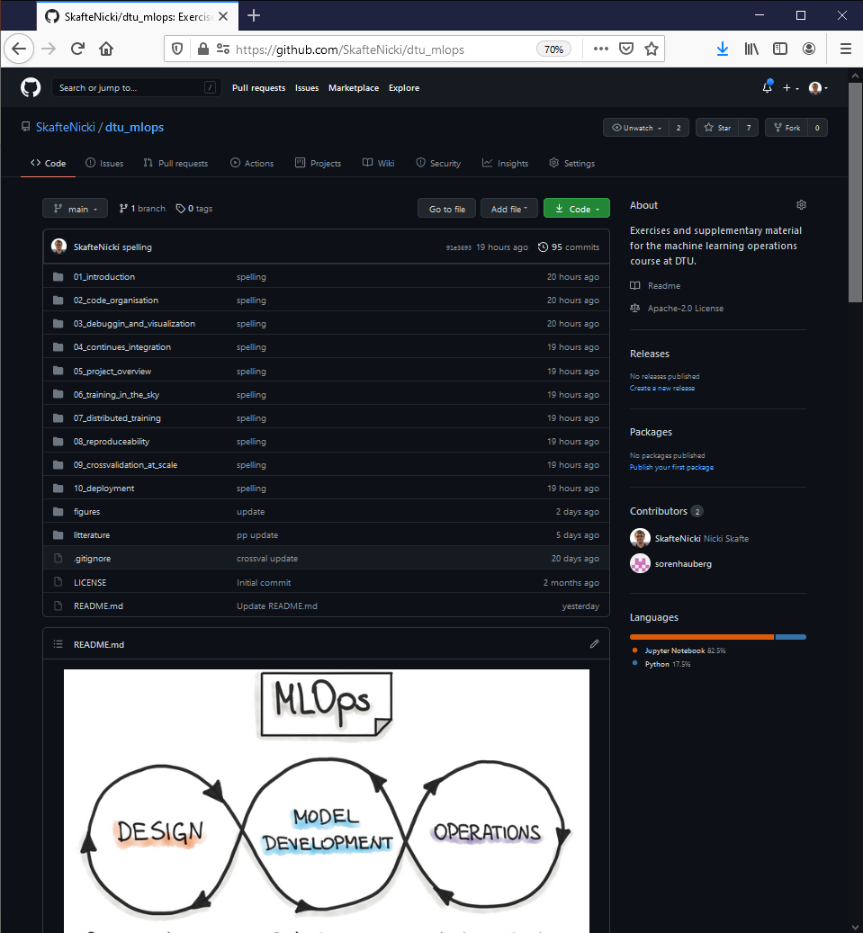
Course webpage
Webpage with lectures + exercises:
https://github.com/SkafteNicki/dtu_mlops
Join slack for communication:
https://join.slack.com/t/slack-ddr8461/shared_invite/zt-qzk7ho8z-1tBT_SkkkxtpgMU8x197pg

Slide 5
What is this course/What is it not
Introduce the student to a number of coding practices, that will help them do state-of-the-art research. To provide hands-on experience with a number of frameworks for doing deep learning.
Keywords:
Organization
Scalability
Reproducibility
Hands-on experience
How deep learning models works (02456)

Slide 6
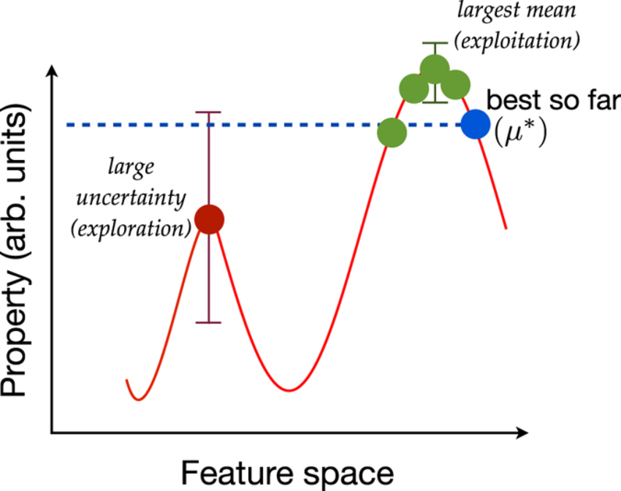

What do I expect from you
This course was developed over 1½ month, meaning that the material may be suboptimal
We provide lectures, exercises and guidence but encourage self-study
Make sure to both explore and exploit it!
Provide all the feedback you have, I can take it!
Your interest
Lectures

Slide 7

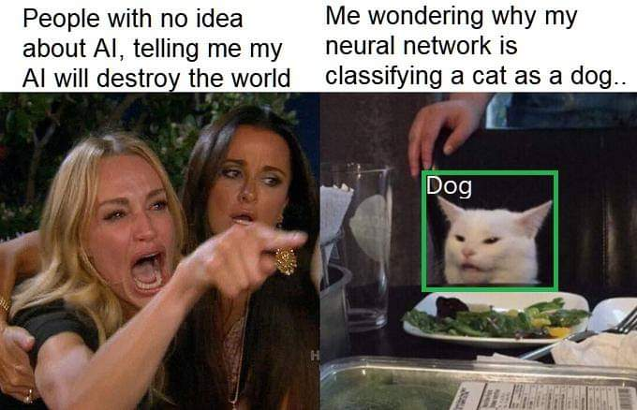
What I hope from this course
Have fun!
Playing around with the different frameworks
Maybe learn something along the way

Slide 8
History of deep learning

Slide 9
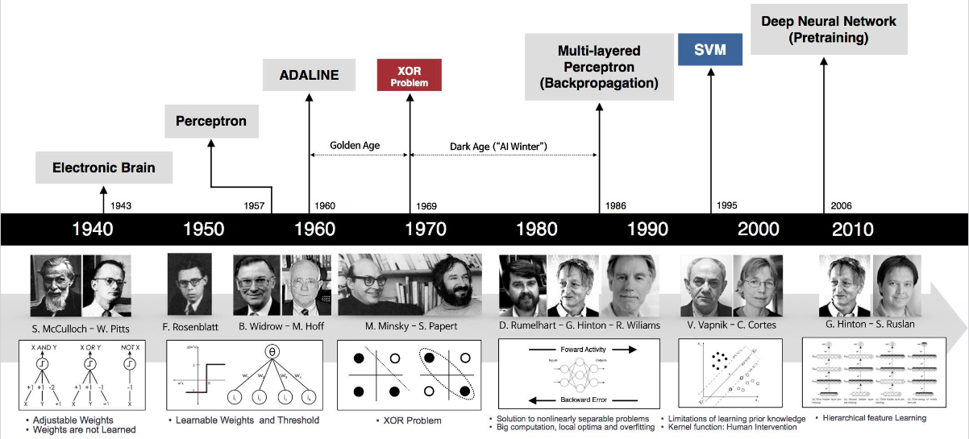
History of deep learning
Notes:
Alexey Grigoryevich Ivakhnenko 1965
Yann LeCun 1989

Slide 10
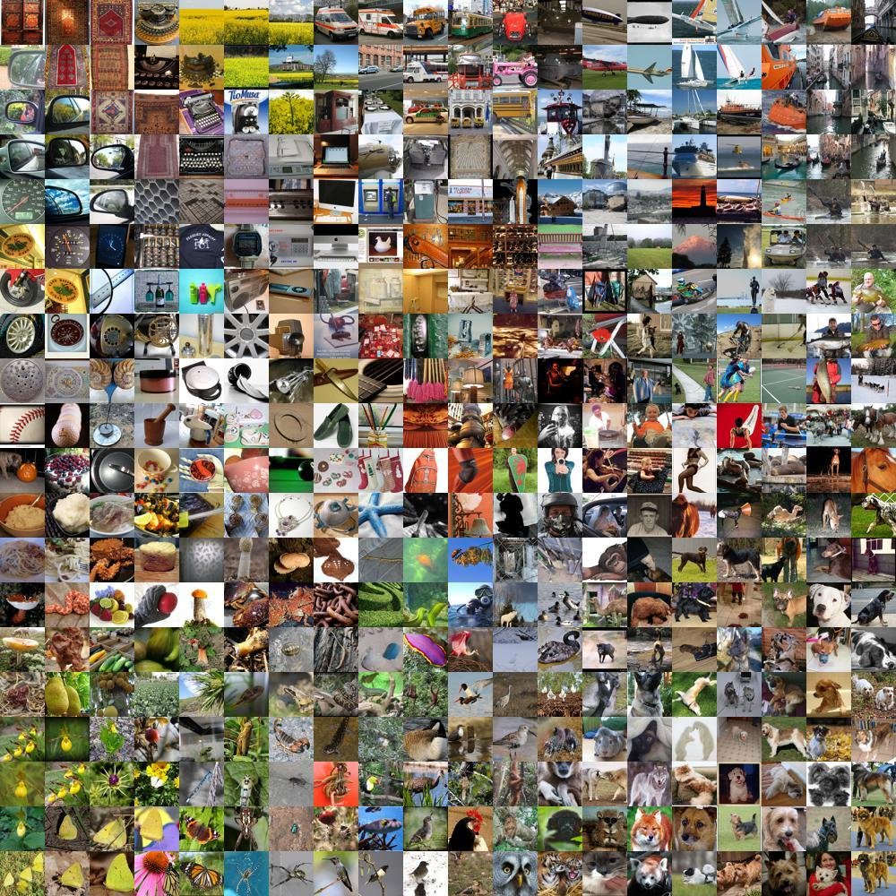
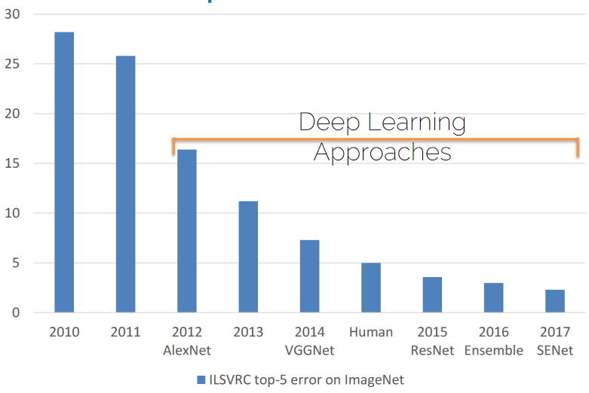
The Deep Learning Revolution

Slide 11
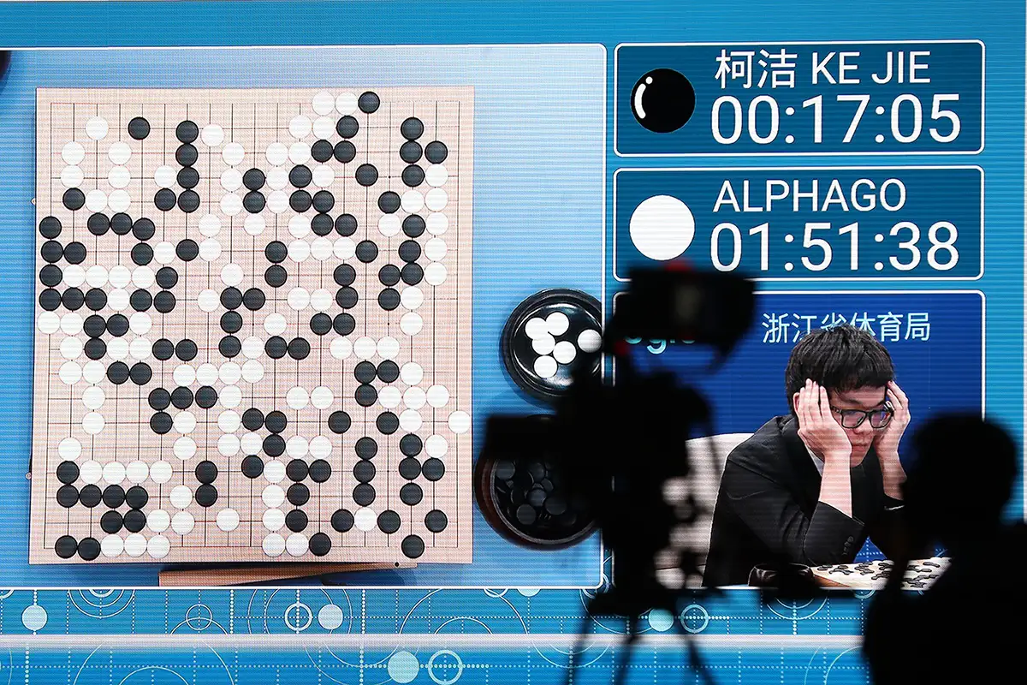
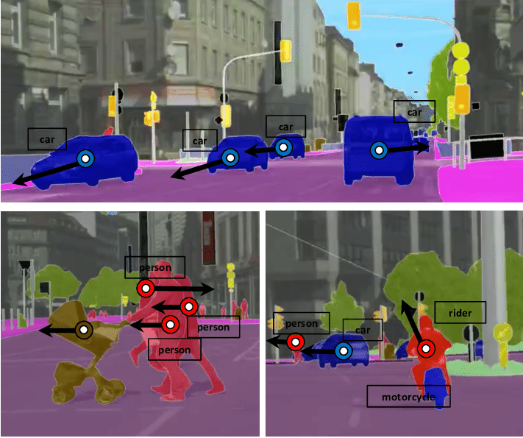
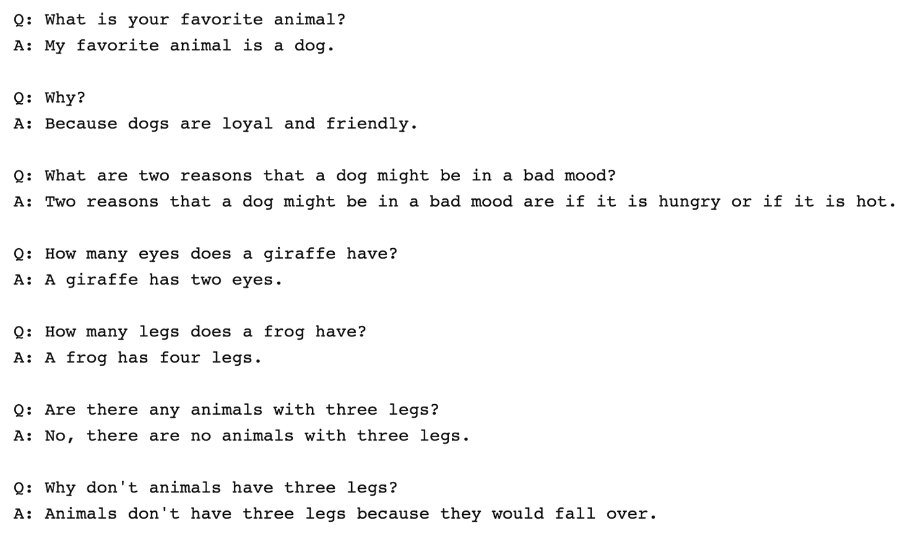
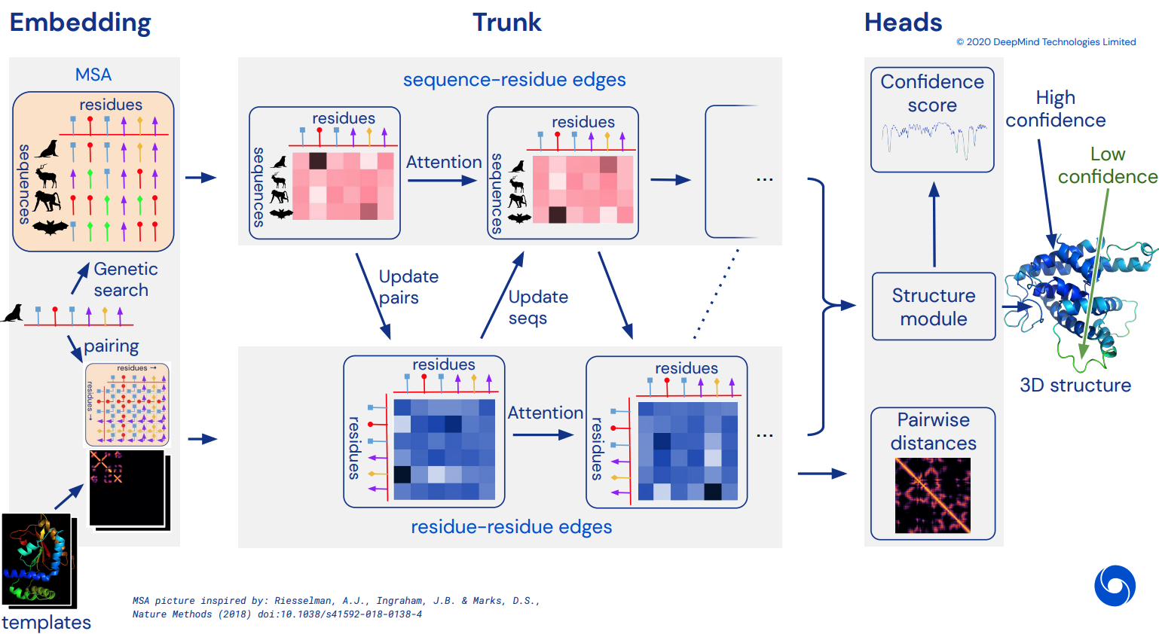
Since then...
AlphaGO:
Beating humans
Unet:
High quality semantic segmentation
GPT-3
Having conversations with humans
AlphaFold:
Solving protein engineering

Slide 12
What has changed?
Big Data
Hardware
Deepness
Hype
Software
Models can generalize
Models are trainable
Models are complex
Attacts more people
Models are easy to code
Commonly agreed on
Not talked about

Slide 13
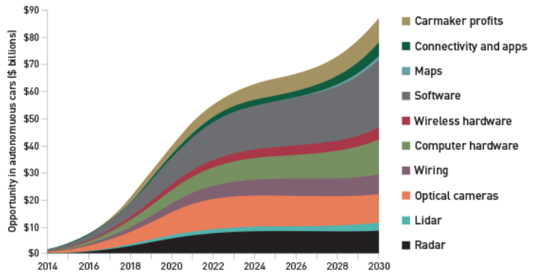
Why you should jump the wagon
“… the deep learning market is expected to be worth USD 1,722.9 Million by 2022”

Slide 14




The DL software landscape
No point in discussion who is best. The (biased) facts are:
Tensorflow are too a large extend used in production
Pytorch is used in research

Slide 15
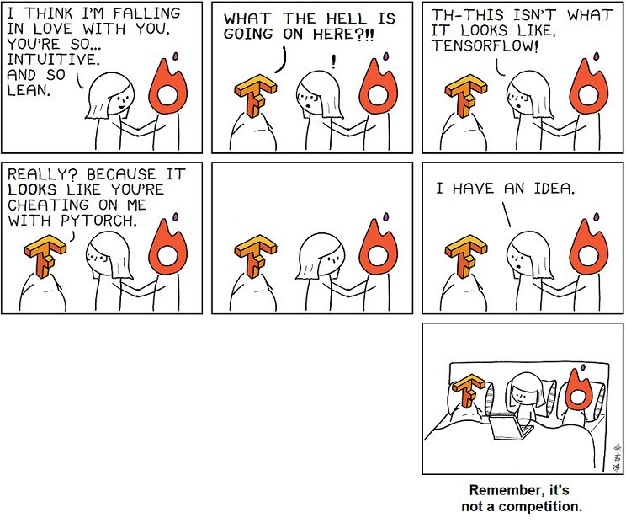
If you have the time, I recommend learning both

Slide 16
How to make a modern deep learning framework
3 key elements
Tensors
Hardware acceleration
Automatic differentation
Abstraction to higher order data
Faster computations
Ease of use

Slide 17
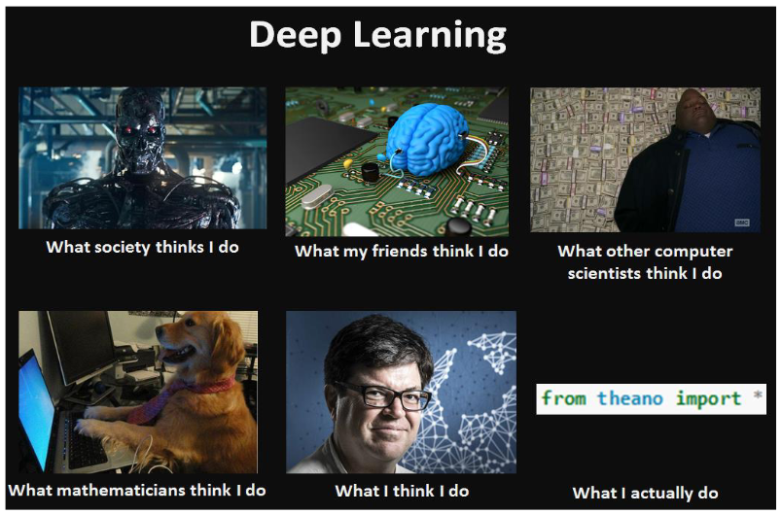
Meme of the day

