Slide 1
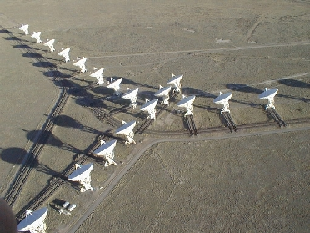
Calibration and Editing
George Moellenbrock
Why calibration and editing?
Formalism: Visibilities, signals, matrices
Laundry List of Calibration Components
Practical Calibration Planning
Editing and RFI
Calibration Sequence Examples
Evaluating Calibration Performance
Summary

Slide 2
Why Calibration and Editing?
Synthesis radio telescopes, though well-designed, are not perfect (e.g., surface accuracy, receiver noise)
Need to accommodate engineering (e.g., frequency conversion, digital electronics, etc.)
Hardware or control software occasionally fails or behaves unpredictably
Scheduling/observation errors sometimes occur (e.g., wrong source positions)
Atmospheric conditions not ideal (not just bad weather)
RFI
Determining instrumental properties (calibration)
is as important as
determining radio source properties

Slide 3
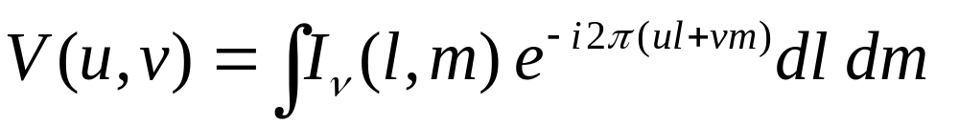
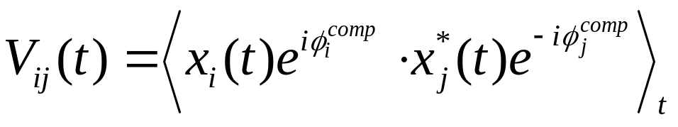
From Idealistic to Realistic
Formally, we wish to obtain the visibility function, which we intend to invert to obtain an image of the sky:
In practice, we correlate the electric field (voltage) samples taken at pairs of telescopes (baselines i-j):
Single radio telescopes are devices for collecting the signal x_{i}(t) and providing it to the correlator.

Slide 4
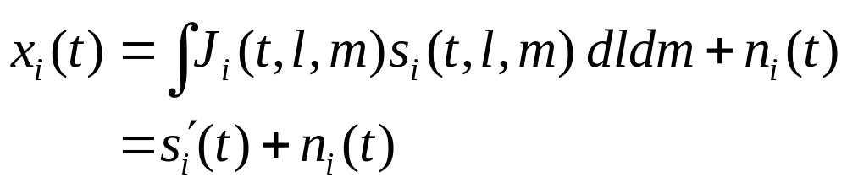
What signal is really collected?
The net signal delivered by antenna i, x_{i}(t), is a combination of the desired signal, s_{i}(t,l,m), corrupted by a factor J_{i}(t,l,m) and integrated over the sky, and noise, n_{i}(t):
J_{i}(t,l,m) is the product of a host of effects which we must calibrate
In some cases, effects contained in the J_{i}(t,l,m) term corrupt the signal irreversibly and the resulting data must be edited
J_{i}(t,l,m) is a complex number
J_{i}(t,l,m) is antenna-based

Slide 5
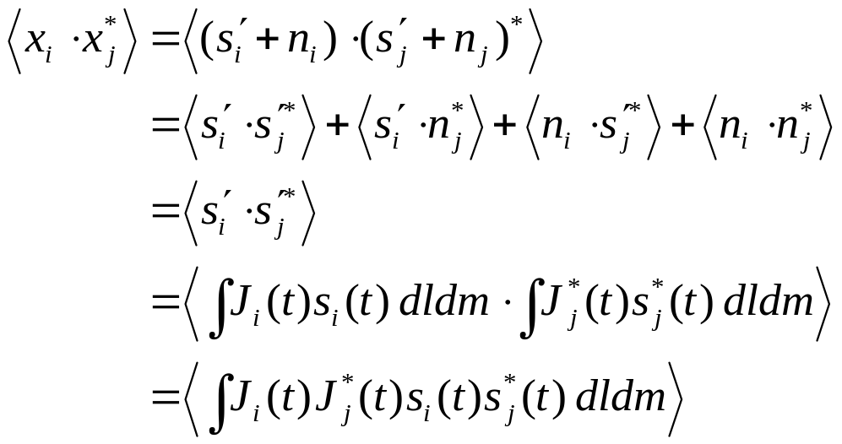

Aside: Correlation of signals
The correlation of two realistic signals from different antennas:
    Noise doesn’t correlate—even if n_{i}>> s_{i}, correlation isolates desired signals
    In integral, only s_{i}(t,l,m), from the same directions correlate, so order of integration and signal product can be exchanged and terms re-ordered
…and the auto-correlation of a signal from a single antenna:
    Desired signal not isolated from noise (less useful!)

Slide 6
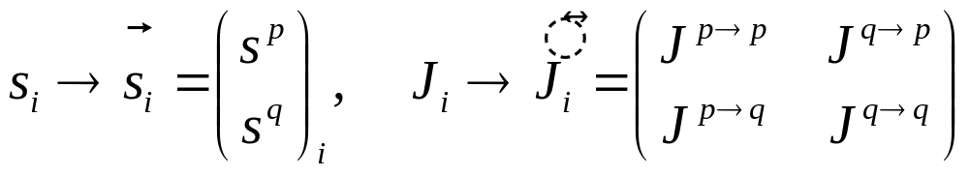
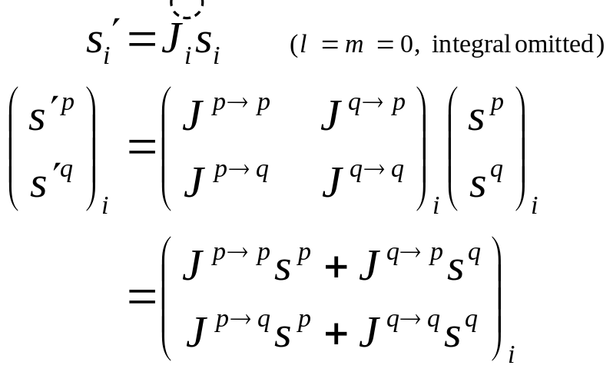
Formalism: Describe both polarizations via matrices
Need two polarizations (p,q) to fully describe sampled EM wave front, where p,q = R,L (circulars) or p,q = X,Y (linears)
Some components of J_{i} involve mixing of polarizations, so dual-polarization description desirable or even required
    So substitute:
    The Jones matrix thus corrupts a signal as follows:

Slide 7
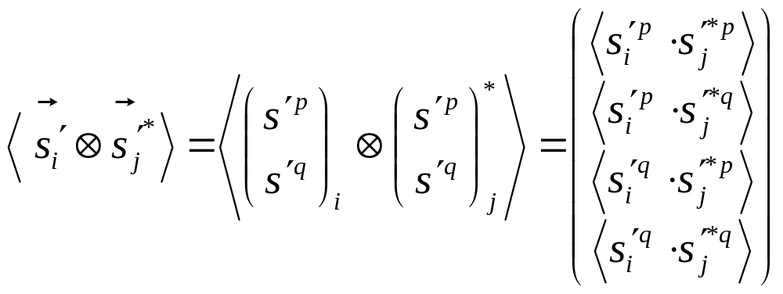

Signal Correlation and Matrices
Four correlations are possible from two polarizations. The outer product (a ‘bookkeeping’ product) forms them:
    These four correlations (pp, pq, qp, qq) map to Stokes (I,Q,U,V) visibilities
A very useful property of outer products:
    (where A,B,A’,B’ are matrices and/or vectors of appropriate dimensions):

Slide 8
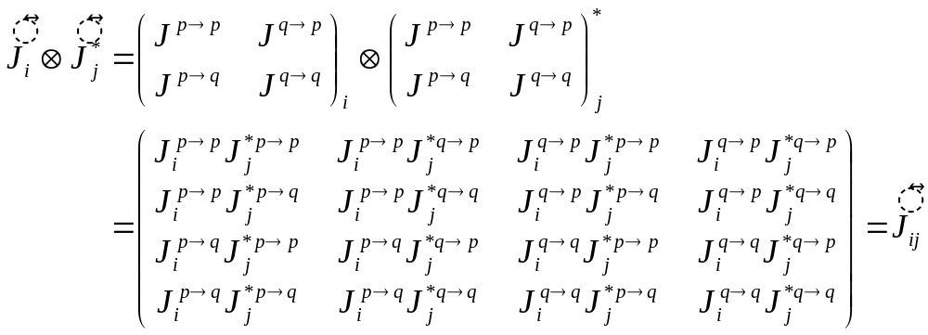
Signal Correlation and Matrices (cont)
The outer product for the Jones matrix:
    J_{ij} is a 4x4 Mueller matrix
    Antenna and array design thankfully driven by minimizing off-diagonal terms

Slide 9
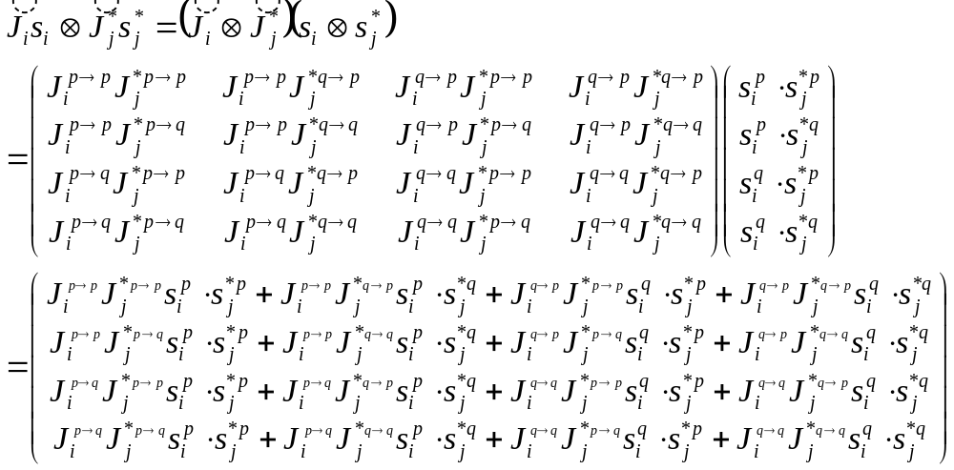
Signal Correlation and Matrices (cont)
And finally, for fun, the correlation of corrupted signals:
UGLY, but let’s think about individual calibration components in the signal domain, where the matrices are a factor of 2 less complicated…..

Slide 10
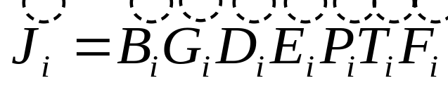
Calibration Components
J_{i} contains many components:
    F = ionospheric Faraday rotation
    T = tropospheric effects
    P = parallactic angle
    E = antenna voltage pattern
    D = polarization leakage
    G = electronic gain
    B = bandpass response
Order of terms follows signal path
Each term has matrix form of J_{i} with terms embodying its particular algebra (on- vs. off-diagonal terms, etc.)
The full matrix equation (especially after correlation!) is daunting, but usually only need to consider the terms individually or in pairs, and rarely in open form (matrix formulation = shorthand)

Slide 11
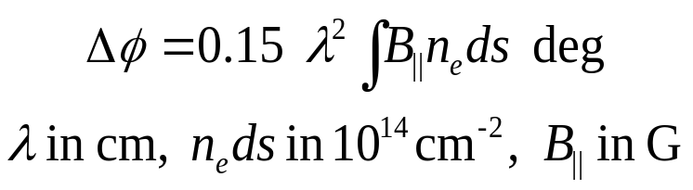
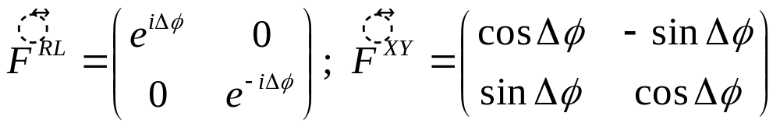
Ionospheric Faraday Rotation, F
The ionosphere is birefringent; one hand of circular polarization is delayed w.r.t. the other, introducing a phase shift:
    Rotates the linear polarization position angle
    More important at longer wavelengths:
    More important at solar maximum and at sunrise/sunset, when ionosphere is most active
    Beware of ‘patchiness’ and other variability (e.g., with elevation changes)
        Namir’s lecture: “Long Wavelength Interferometry” (next Tuesday)

Slide 12
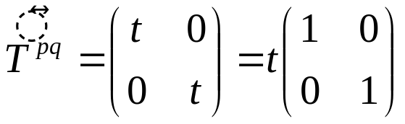
Tropospheric Effects, T
The troposphere causes polarization-independent amplitude and phase effects due to emission/opacity and refraction, respectively
    Typically 2-3m excess path length at zenith compared to vacuum
    Most important at ν > 15 GHz where water vapor absorbs/emits
    More important nearer horizon where tropospheric path length greater
    Clouds, weather = variability in phase and opacity; may vary across array
    Water vapor radiometry? Phase transfer from low to high frequencies?
        Claire’s lecture: “mm-Wave Interferometry” (next Monday)

Slide 13
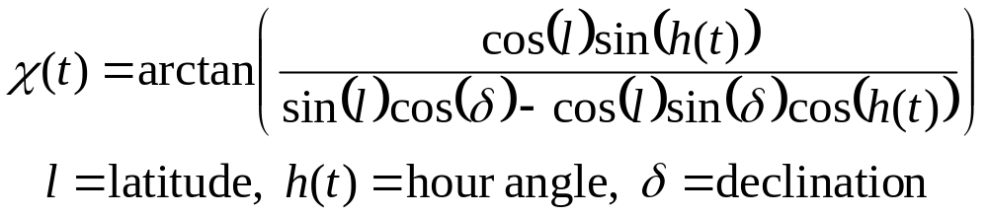
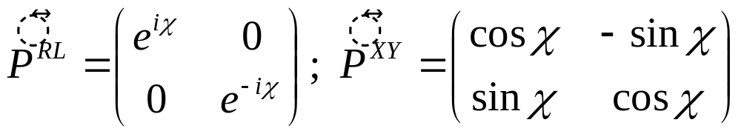
Parallactic Angle, P
Orientation of sky in telescope’s field of view
    Constant for equatorial telescopes
    Varies for alt-az-mounted telescopes:
    Rotates the position angle of linearly polarized radiation (c.f. F)
    Analytically known, and its variation provides leverage for determining polarization-dependent effects

Slide 14
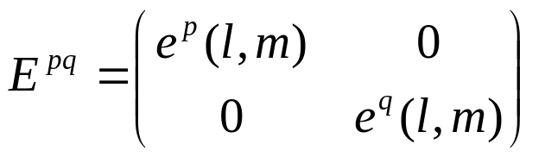
Antenna Voltage Pattern, E
Antennas of all designs have direction-dependent gain
    Important when region of interest on sky comparable to or larger than λ/D
        Kumar’s lecture: “Wide Field Imaging I” (next Monday)
        Debra’s lecture: “Wide Field Imaging II” (next Monday)
    Important at lower frequencies where radio source surface density is greater and wide-field imaging techniques required
    Beam squint: E^{p} and E^{q} not parallel, yielding spurious polarization
    For convenience, direction dependence of polarization leakage (D) may be included in E (off-diagonal terms then non-zero)

Slide 15
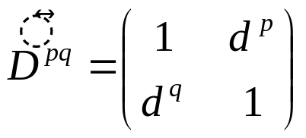
Polarization Leakage, D
Polarizer is not ideal, so orthogonal polarizations not perfectly isolated
    Well-designed feeds have d ~ a few percent or less
    A geometric property of the feed design, so frequency dependent
    For R,L systems, total-intensity imaging affected as ~dQ, dU, so only important at high dynamic range (because Q,U~d, typically)
    For R,L systems, linear polarization imaging affected as ~dI, so almost always important
        Greg’s lecture: “Polarization in Interferometry” (today!)

Slide 16
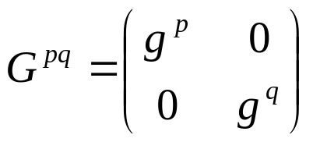
Electronic Gain, G
Catch-all for most amplitude and phase effects introduced by antenna electronics (amplifiers, mixers, quantizers, digitizers)
    Most commonly treated calibration component
    Dominates other effects for standard observations
    Includes scaling from engineering to radioastronomy units (Jy)
    Often includes ionospheric and tropospheric effects which are typically difficult to separate unto themselves
    Excludes frequency dependent effects (see B)

Slide 17
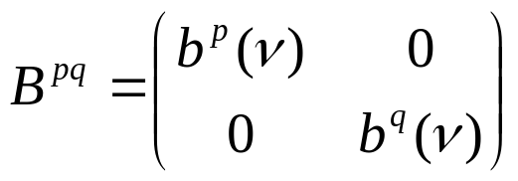
Bandpass Response, B
G-like component describing frequency-dependence of antenna electronics, etc.
    Filters used to select frequency passband not square
    Optical and electronic reflections introduce ripples across band
    Typically (but not necessarily) normalized

Slide 18
More-sophisticated effects
Errors in geometric/clock models in correlator cause poor phase compensation
    Routine problem in VLBI solved by fringe-fitting: parameterization of G to include phase terms which are linear in time and frequency
        Craig’s lecture: “VLBI” (Thursday)
Baseline-based errors do not decompose into antenna-based components
    Most digital correlators designed to limit such effects to well-understood and uniform scaling laws (absorbed in G)
    Additional errors can result from averaging in time and frequency over variation in antenna-based effects and visibilities (practical instruments are finite!)
    Correlated noise (e.g., RFI)
    Virtually indistinguishable from source structure effects
    Geodetic observers consider determination of radio source structure—a baseline-based effect—as a required calibration if antenna positions are to be determined accurately

Slide 19
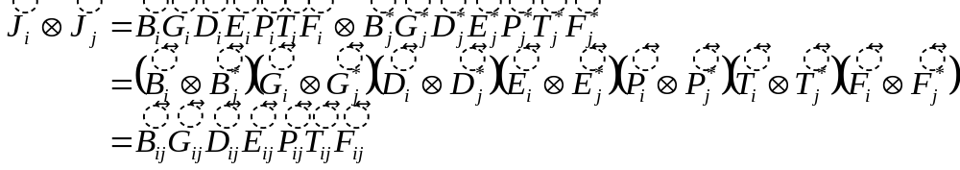
Putting it all back together
In the correlation of signals, like terms from the different antennas are conveniently grouped:
The total Measurement Equation has the form:
    S maps the Stokes vector, I, to the polarization basis of the instrument
    M_{ij} and A_{ij} are multiplicative and additive baseline-based errors, respectively
    In general, all J_{ij} may be direction-dependent, so inside the integral….

Slide 20
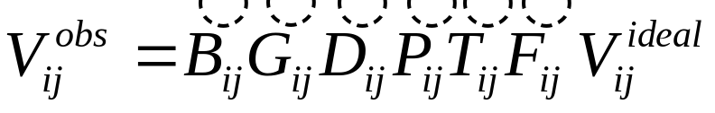
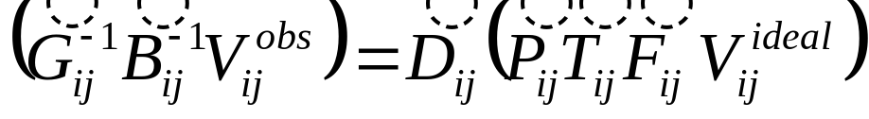
Realizing practical calibration
…but in practice, we often ignore the direction dependence of the calibration components and factor them out of the integral (dropping E_{ij}). The Measurement Equation then becomes a relation between the observed and ideal visibilities:
If the ideal visibilities are known (e.g., by choosing calibration source of known structure), we can solve for individual components using those we already know (if any), e.g.:

Slide 21
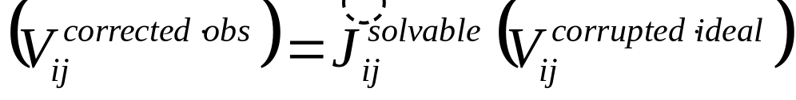
Realizing practical calibration (cont)
Formally, solving for any component is the same non-linear fitting problem:
    Algebraic particulars are stored safely and conveniently inside the matrix formalism (out of sight, out of mind!)
    Viability of the solution relies on the underlying algebra (hardwired in calibration applications) and proper calibration observations
    The relative importance of the different components enables deferring or even ignoring the more subtle effects

Slide 22
Planning for Good Calibration
A priori calibrations (provided by the observatory)
    Antenna positions, earth orientation and rate
    Clocks
    Antenna pointing, gain, voltage pattern
    Calibrator coordinates, flux densities, polarization properties
Absolute calibration?
    Very difficult, requires heroic efforts by visiting observers and observatory scientific and engineering staff
Cross-calibration a better choice
    Observe nearby point sources against which calibration components can be solved, and transfer solutions to target observations
    Choose appropriate calibrators for different components; usually point sources because we can predict their visibilities
    Choose appropriate timescales for each component

Slide 23
Calibrator Rules of Thumb
T, G:
    Strong and point-like sources, as near to target source as possible
    Observe often enough to track phase and amplitude variations: calibration intervals of up to 10s of minutes at low frequencies (beware of ionosphere!), as short as 1 minute or less at high frequencies
    Observe at least one calibrator of known flux density at least once
B:
    Strong enough for good sensitivity in each channel (often, T, G calibrator is ok)
    If bandwidth is wide, should be point-like to avoid visibility changes across band
    Observe often enough to track variations (e.g., waveguide reflections change with temperature and are thus a function of time-of-day)
D:
    Best calibrator is strong and unpolarized
    If polarized, observe over a broad range of parallactic angle to disentangle Ds and source polarization (often, T, G calibrator is ok)
F:
    Choose strongly polarized source and observe often enough to track variation
    If ionosphere is stable, rely on ionosonde observations for empirical corrections

Slide 24
Data Examination and Editing
After observation, initial data examination and editing very important
    Will observations meet goals for calibration and science requirements?
    Some real-time flagging occurred during observation (antennas off-source, LO out-of-lock, etc.). Any such bad data left over? (check operator’s logs)
    Any persistently ‘dead’ antennas (J_{i}=0 during otherwise normal observing)? (check operator’s logs)
    Amplitude and phase should be continuously varying—edit outliers
    Any antennas shadowing others? Edit such data.
    Be conservative: those antennas/timeranges which are bad on calibrators are probably bad on weak target sources—edit them
    Periods of poor weather? (check operator’s log)
    Distinguish between bad data and poorly-calibrated data. E.g., some antennas may have significantly different amplitude response which may not be fatal—it may only need to be calibrated
    Radio Frequency Interference (RFI)?
    Choose reference antenna wisely (ever-present, stable response)

Slide 25
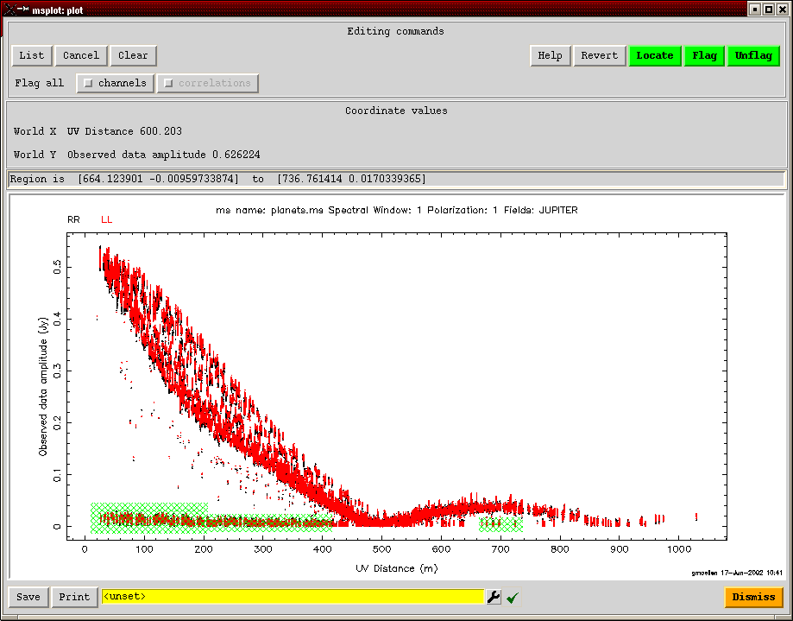
A Data Editing Example
msplot in aips++

Slide 26
Radio Frequency Interference
RFI originates from man-made signals generated in the antenna or by external sources (e.g., satellites, cell-phones, radio and TV stations, etc.)
    Obscures natural emission in spectral line observations
    Adds to total noise power in all observations, thus decreasing sensitivity to desired natural signal, and complicating amplitude calibration
    Though a contribution to the n_{i} term, can correlate between antennas if of common origin or baseline short enough
RFI Mitigation
    Careful electronics design in antennas
    Observatories world-wide lobbying for spectrum management
    Various on-line and off-line mitigation techniques under study
    Choose interference-free frequencies (try to find 50 MHz of clean spectrum in the 1.6 GHz band!)
    Observe continuum experiments in spectral-line modes so bad channels can be edited

Slide 27
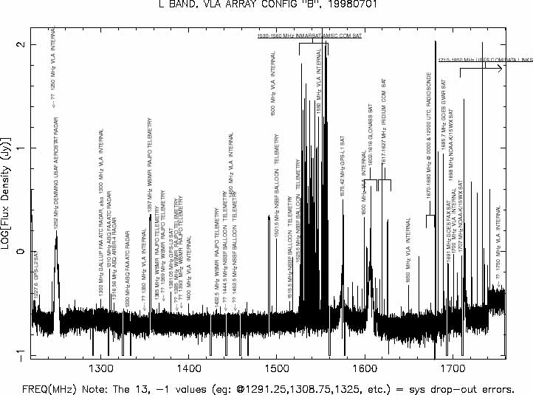
Radio Frequency Interference (cont.)
Growth of telecom industry threatening radioastronomy!

Slide 28
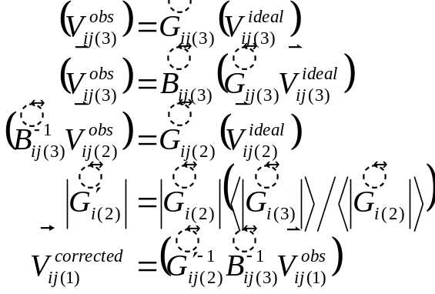
Calibration Sequence I
Observation: total intensity spectral line imaging of weak target
    A weak target source (1)
    A nice near-by point-like G, T calibrator (2), observed alternately, but too weak for good B calibration (flux density unknown)
    Three observations of strong flux density calibrator (3) which is also good for B calibration
Schedule (each digit is a fixed duration):
    33-2-111-2-111-2-111-2-111-2-33-2-111-2-111-2-111-2-111-2-111-2-33
Calibration sequence:
    On 3, solve for G:
    On 3, solve for B, using G:
    On 2, solve for G, using B:
    Scale 2’s Gs according to 3’s Gs:
    Transfer B, G to 1:

Slide 29
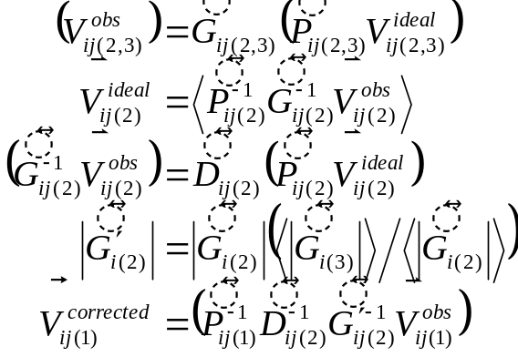
Calibration Sequence II
Observation: full-polarization imaging of weak target
    A weak target source (1)
    A nice, near-by, point-like, G, T calibrator (2), observed alternately, ok for D calibration, too (flux density and polarization unknown)
    Three observations of strong flux density calibrator
Schedule (each digit is a fixed duration):
    33-2-1111-2-1111-2-1111-2-1111-2-33-2-1111-2-1111-2-1111-2-1111-2-33
Calibration sequence:
    On 2 & 3, solve for G, using P:
    Apply G to 2, get improved poln model:
    On 2, solve for D, using P, G, & new model:
    Scale 2’s Gs according to 3’s Gs:
    Transfer D, G to 1, use P:

Slide 30
Evaluating Calibration Performance
Are solutions continuous?
    Noise-like solutions are just that—noise
    Discontinuities indicate instrumental glitches
    Any additional editing required?
Are calibrator data fully described by antenna-based effects?
    Phase and amplitude closure errors are the baseline-based residuals; see Chapter 5 in book
    Are calibrators sufficiently point-like? If not, self-calibrate: model calibrator visibilities (by imaging, deconvolving and transforming) and re-solve for calibration; iterate to isolate source structure from calibration components
        Jim’s lecture: “Self-Calibration” (Wednesday)
Any evidence of unsampled variation? Is interpolation of solutions appropriate?
    Self-calibration may be required, if possible

Slide 31
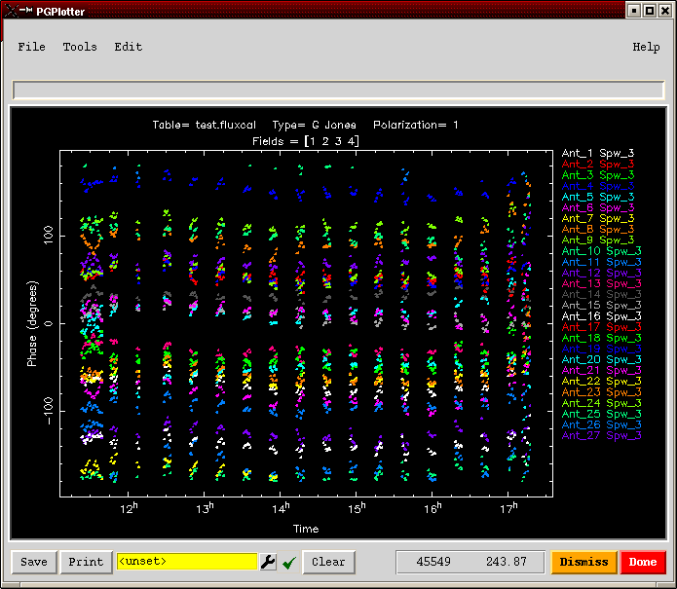
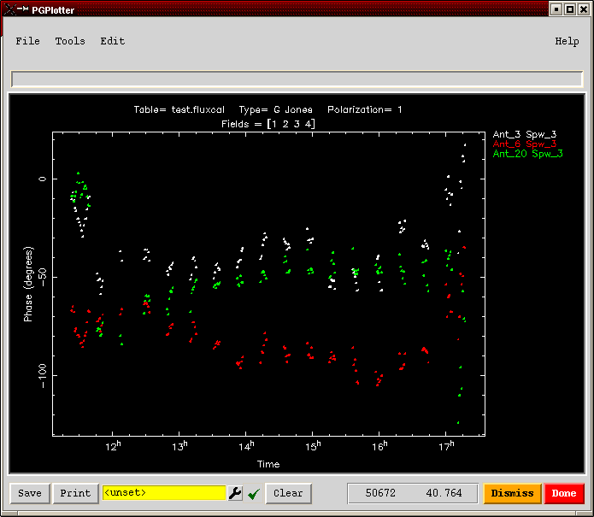
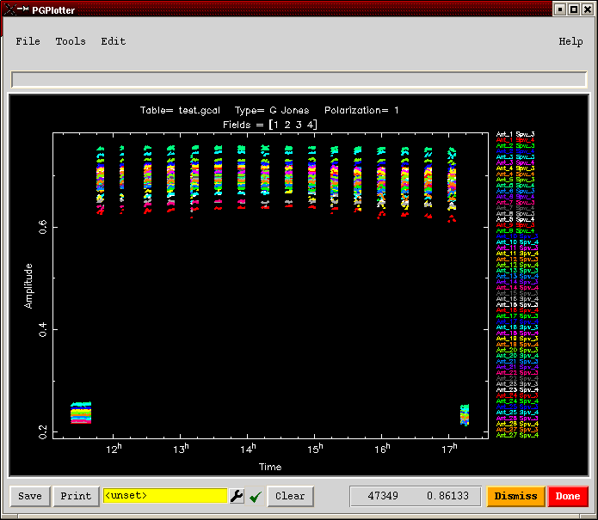
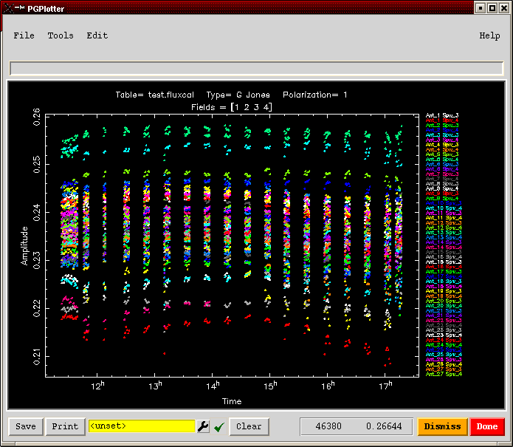
G Solution Examples

Slide 32
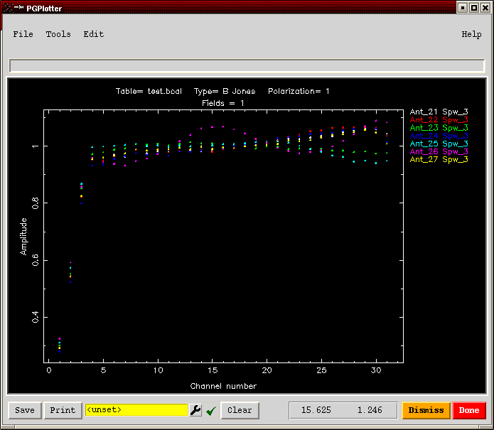
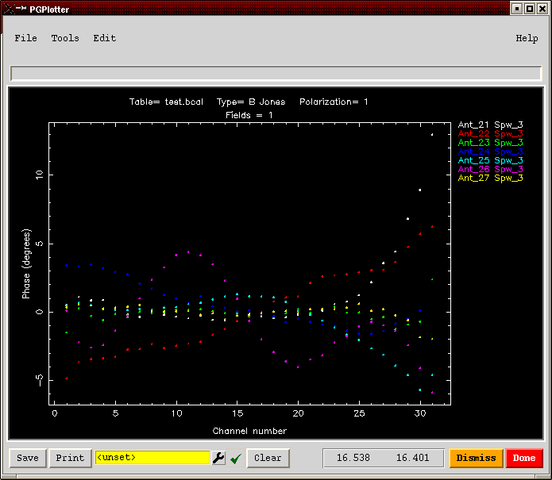
B Solution Examples

Slide 33
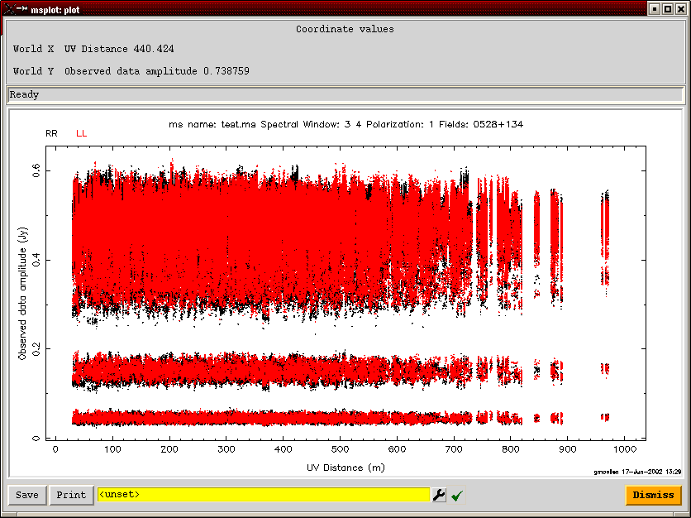
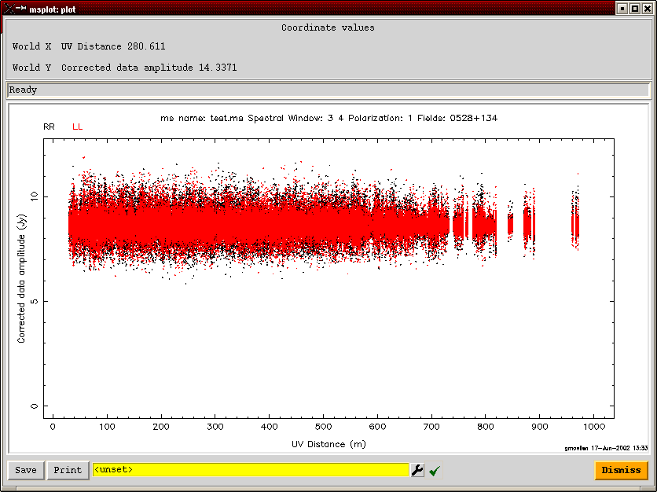
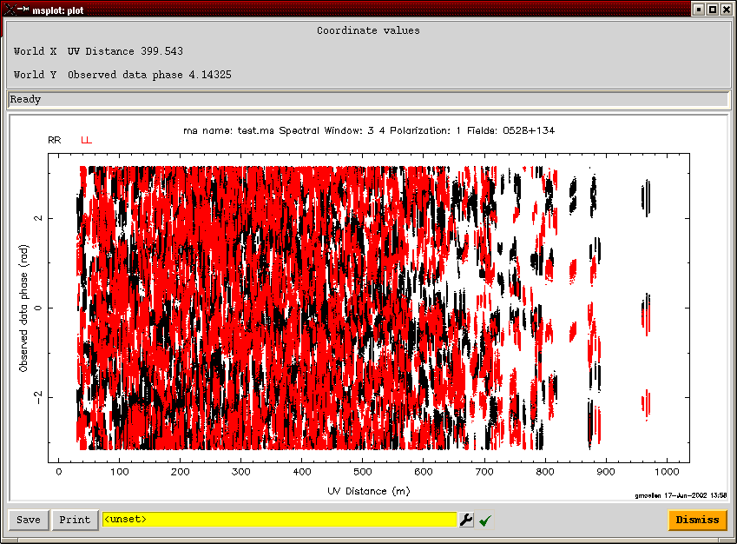
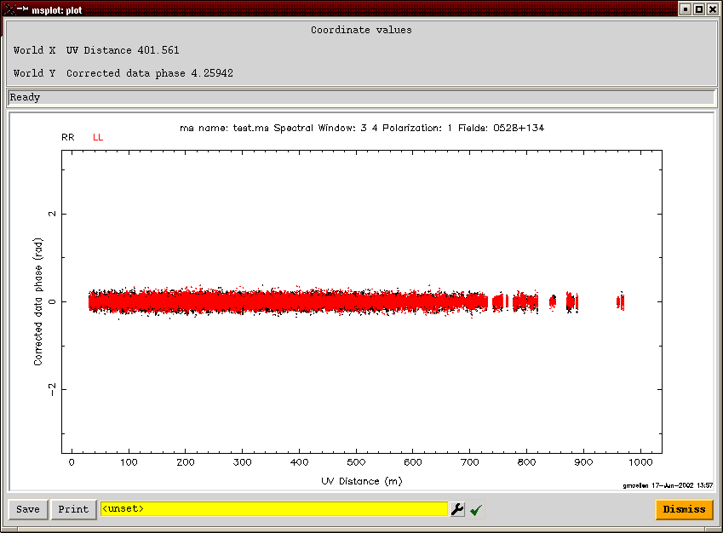
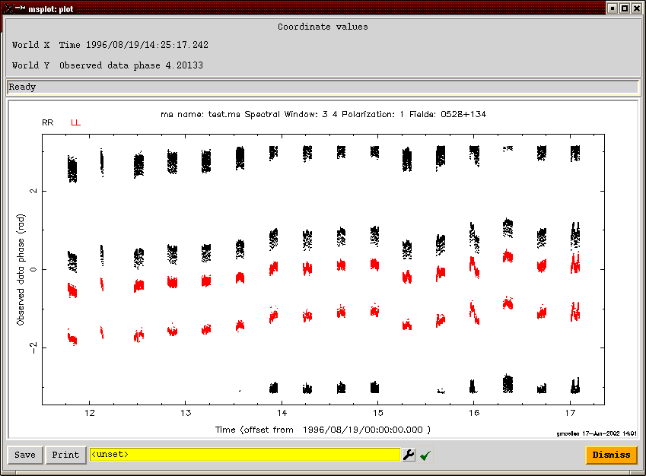
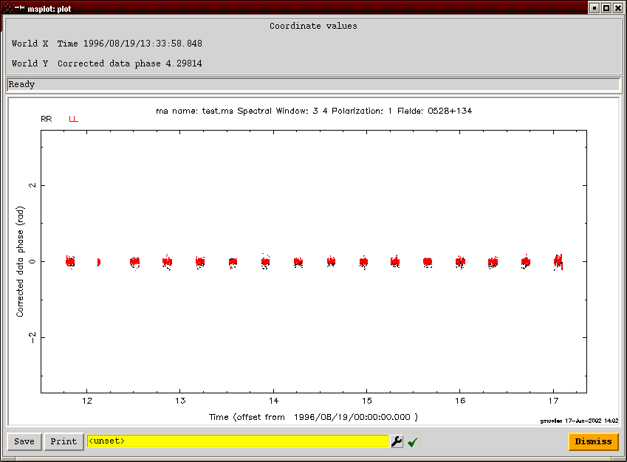
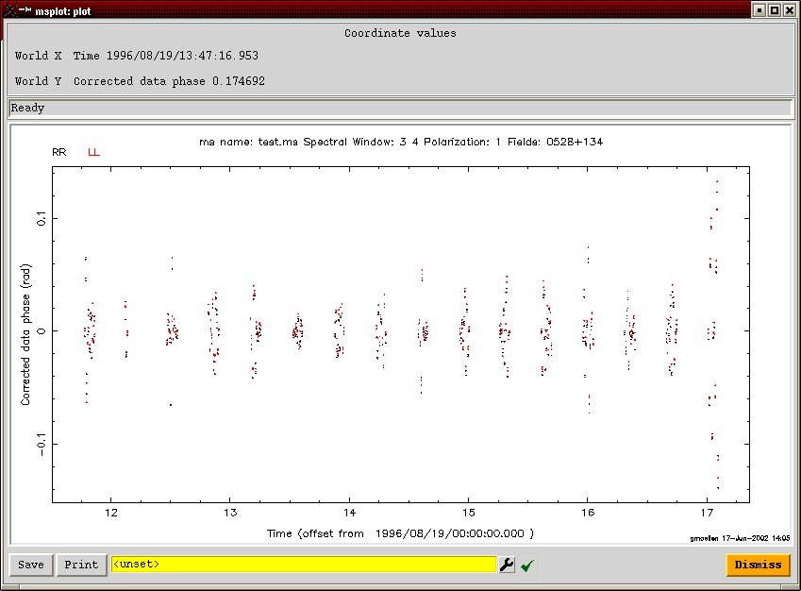
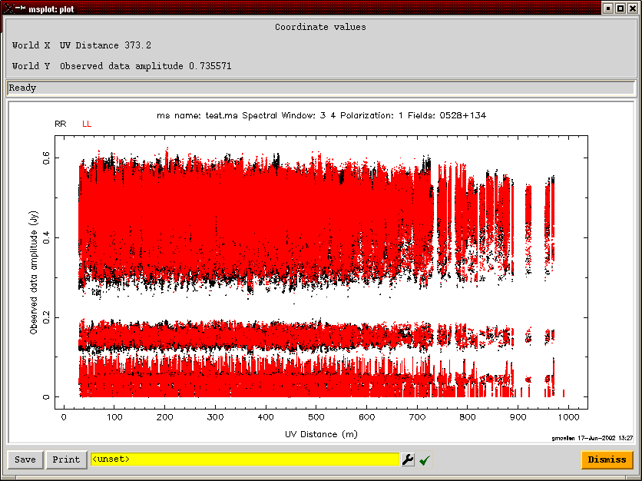
Effect of Calibration on Visibility Data

Slide 34
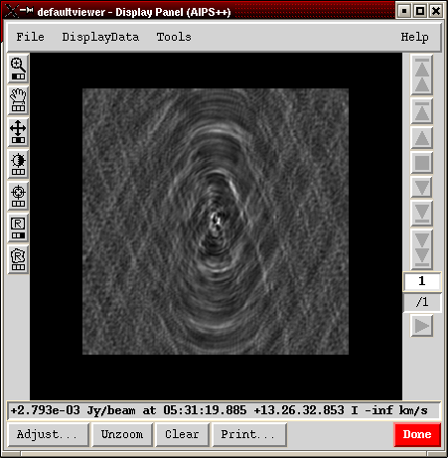
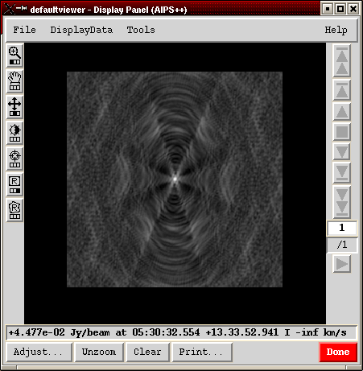
Effect of Calibration in the Image Plane
Uncalibrated Calibrated

Slide 35
Summary
Determining calibration is as important as determining source structure—can’t have one without the other
Data examination and editing and important part of calibration
Calibration dominated by antenna-based effects
Calibration formalism algebra-rich, but can be described piecemeal in comprehendible segments, according to well-defined effects
Calibration determination is a single standard fitting problem
Point sources are the best calibrators
Observe calibrators according requirements of components
Calibration sequences a juggling act of effects and corrections

