Slide 1
Wide field imaging
Non-copalanar arrays
Kumar Golap
Tim Cornwell

Slide 2
Goals of astronomical imaging
To recover the most faithful image of the sky
  Try to get the best signal to noise possible
  Reduce distortion as far as possible

Slide 3
Overview
Problems with imaging with non-coplanar arrays
  3D-imaging
  Wide-field imaging
  ‘w’ term issue
When we have to deal with this problem
Why it occurs and its effects
Some solutions
Related issues

Slide 4


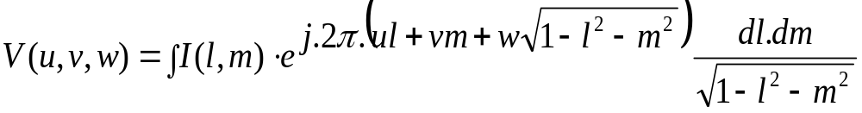
What is the ‘w’ term problem
The relationship between visibility measured and Sky Brightness is given by the equation below.
It is not straight forward to invert and is NOT a Fourier transform
is a 3-D function while is only a 2-D function
If we take the usual 2-D transform of the left side…the third variable manifests itself when the ‘w’ becomes large.

Slide 5

Some basic questions?
When ? : Imaging at low frequency (1.4, 0.3, 0.075 GHz with VLA)
  Field of view ~ many degrees
  Sky filled with mostly unresolved sources
    e.g. For VLA at 0.3 GHz, always 1 Jy point source, and > 12Jy total
    Also Galactic plane, Sun, bright sources (cygnus-A, Cas-A)
Why ? Simple geometric effect:
    The apparent shape of the array varies across the field of view
Why bother ? : Because it violates the basic aims of imaging
  Imaging weak sources in presence of diffraction patterns
    e.g. < 1 mJy/beam at 0.3 GHz
  Imaging extended emission
    e.g. Galactic center at 0.3 GHz

Slide 6
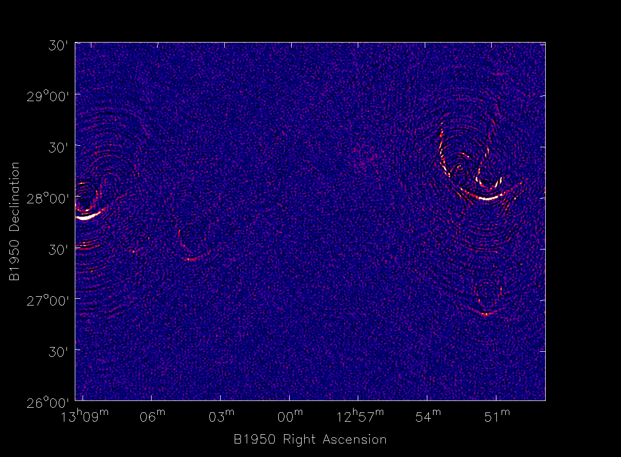
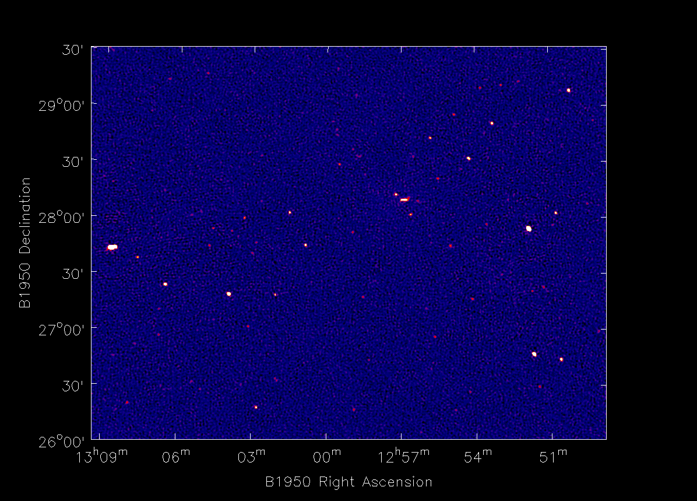
An example of the problem
Image on the left is done with ‘2d’ imaging and the one on the right shows what the region should look like. The region is away from the pointing center of the array

Slide 7
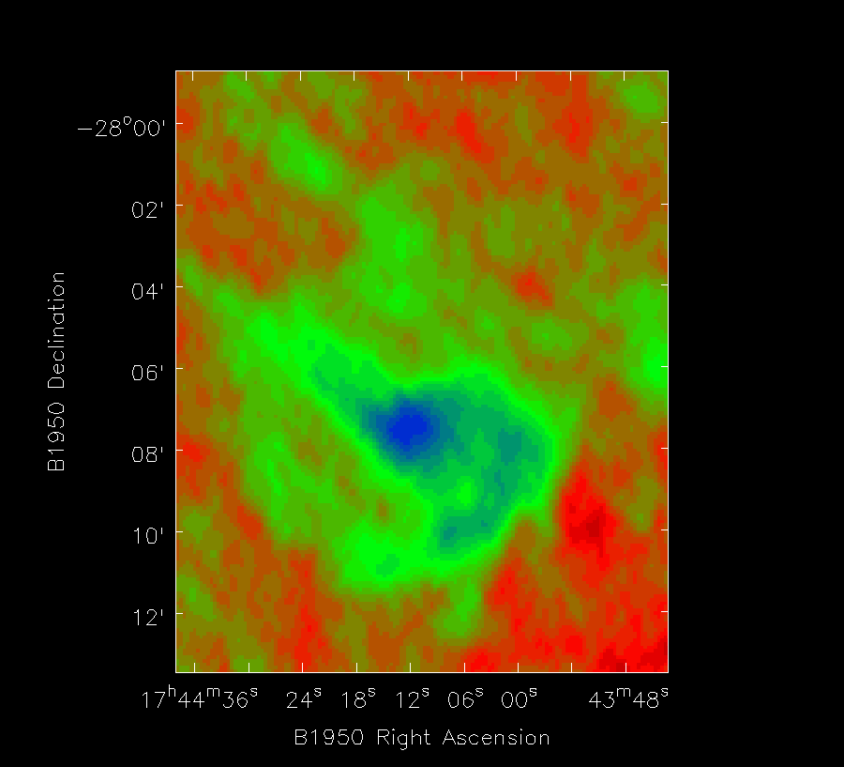
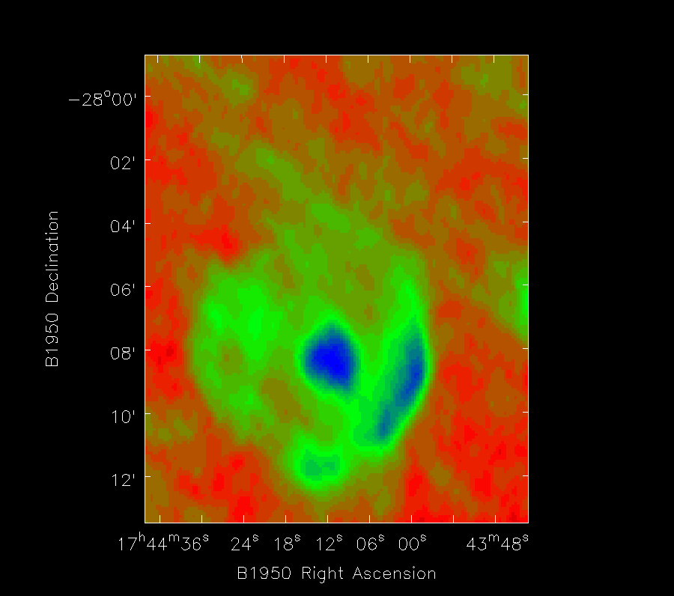
An example of the problem
Image of an SNR near the Galactic center while ignoring and not ignoring the ‘w’ term.

Slide 8
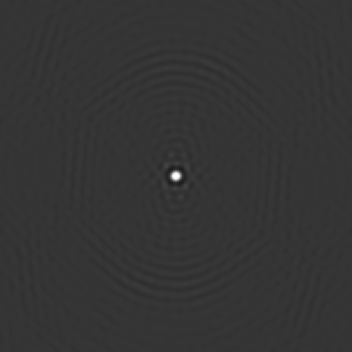
A demonstration
Response to a point source at various places in the field of view if we were to image as using the usual ‘2D’ transform method.

Slide 9
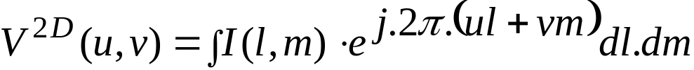
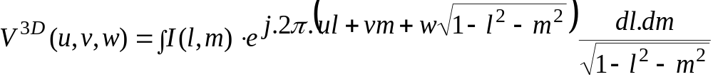
Formal description
For small fields of view, the visibility function is the 2-D Fourier transform of the sky brightness:
For large fields of view, the relationship is modified and is no longer a 2-D Fourier transform

Slide 10


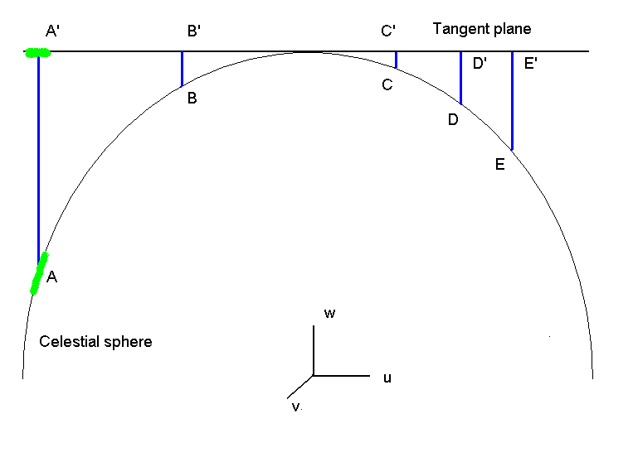
Projection
Must represent celestial sphere via a projection
Interferometers naturally use “sine” projection
Direction cosines:
Distance AA’:

Slide 11


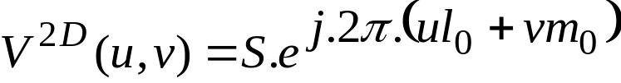
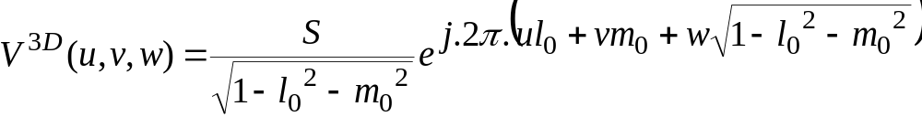


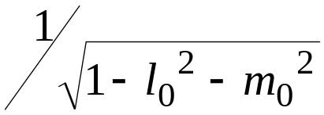
Point source
Consider a point source of flux at
The “extra” phase is given by AA’ multiplied by
Area projection term:

Slide 12
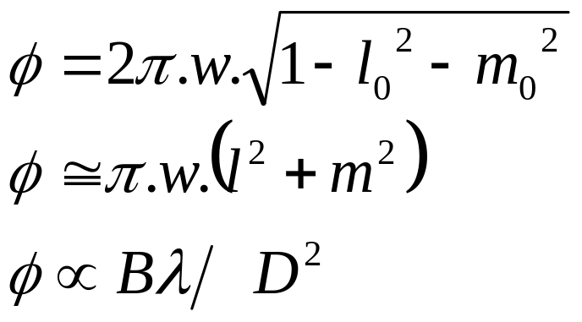
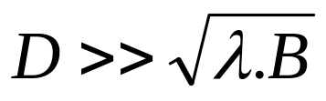
Analysis of effects
Phase error in neglecting non-coplanar term:
Require maximum baseline B and antenna diameter D
Or Clark rule:
  (Field of view in radians).(Field of view in beams) <<1

Slide 13
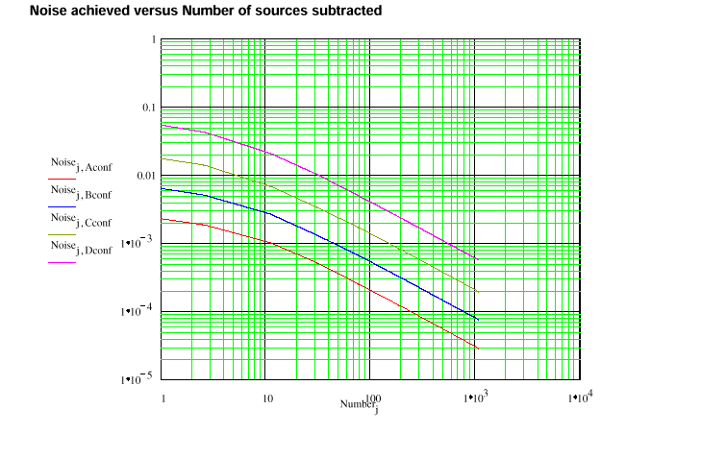
Effect on noise level
If nothing is done, side-lobes of confusing sources contribute to the image noise
Quadratic sum of side-lobes due to source counts over antenna primary beam

Slide 14
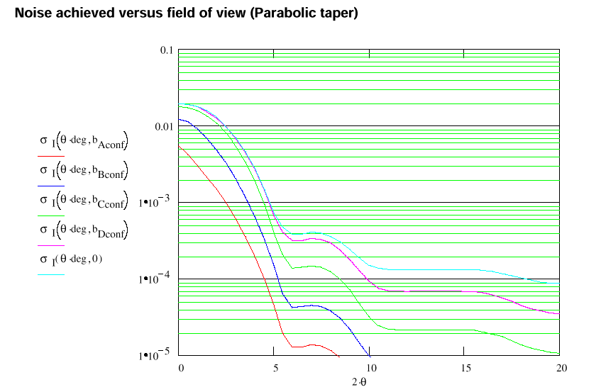
Noise achieved v/s Field of view cleaned

Slide 15


Coplanar baselines
There is a special case of considerable interest: coplanar baselines:
By redefining the direction cosines we can derive a 2D Fourier transform:
Using a simple geometric interpretation:
  a coplanar array is stretched or squeezed when seen from different locations in the field of view
Conversely:
  a non-coplanar array is “distorted” in shape when seen from different locations in the field of view

Slide 16
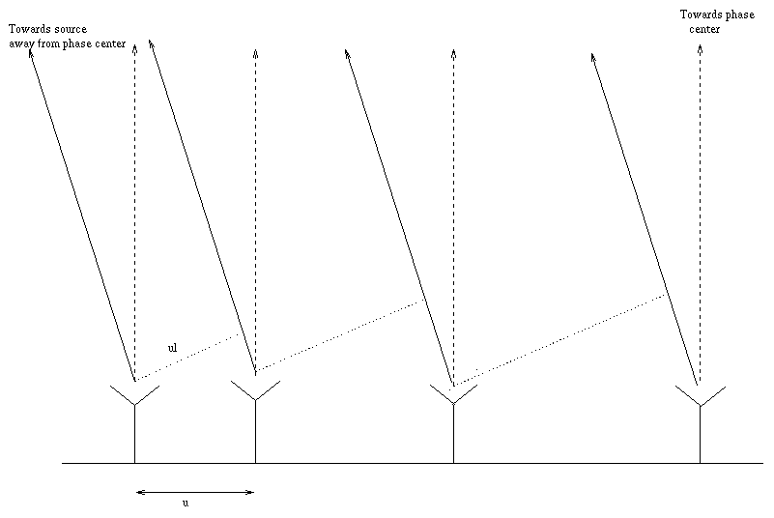
A simple picture: Planar array
Different points in the sky see a similar array coverage except compressed by the term ‘l’

Slide 17
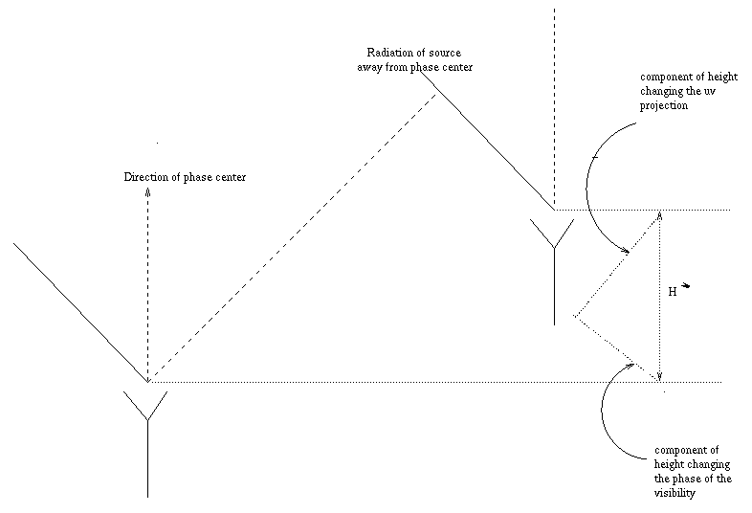
A simple picture: non planar array

Slide 18
Coplanar baselines
Examples:
  East-West array
    can ignore this effect altogether for EW array
  VLA for short time integration
    can ignore for sufficiently short snapshot

Slide 19
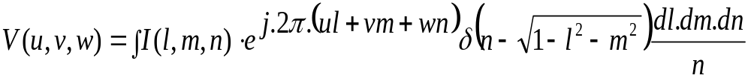


Possible solutions: 3D Fourier transform
Can revert to Fourier transform by embedding in a 3D space
Brightness defined only on “Celestial Sphere”:
Visibility measured in space
All 2D deconvolution theory can be extended straightforwardly to 3D
Solve 3D convolution equation using any deconvolution algorithm but must constrain solution to lie on celestial sphere

Slide 20
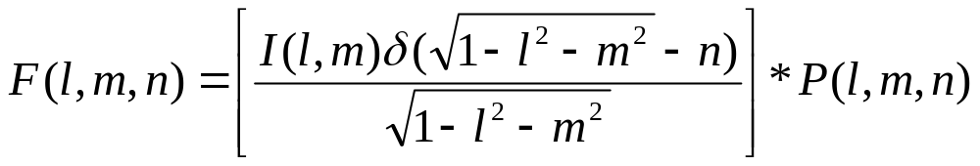

Explanation of 3-D transform
3-D Fourier transform of the sampled Visibility leads to the following ‘image volume’ function:
This has meaning on the surface of but we have to do a 3-D deconvolution which increases the number of points visibility a large factor.

Slide 21

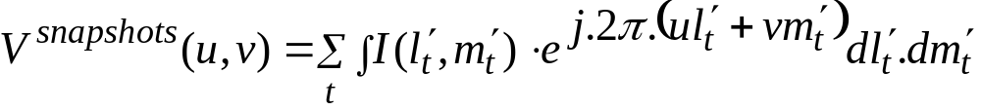
Possible solutions: Sum of snapshots
Decompose into collection of snapshots, each with different effective coordinate systems
Two approaches for deconvolution:
  Treat each image as independent:
    Easy but each snapshot must be deconvolved separately
  Derive each image from a “master” image:
    Expensive computationally, since the coordinate conversions take a considerable amount of time

Slide 22
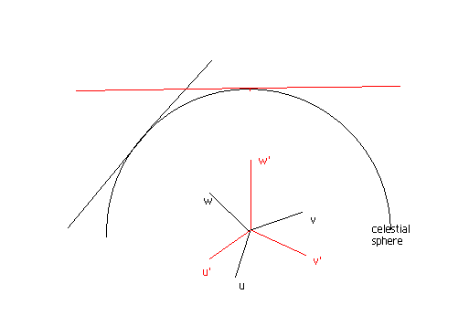
Picture of the different coordinate systems for different snapshots
2 different snapshots array positions appear planar in very different directions.

Slide 23
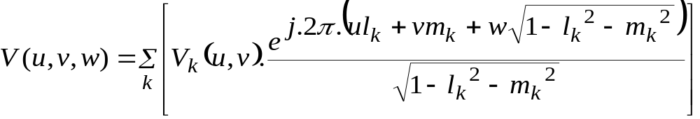
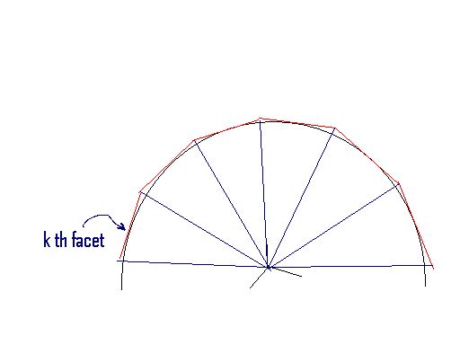
Possible solutions: Faceted transform
Decompose into summation of the visibilities predicted from a number of “facets”:
Where the visibility for the k th facet is:
  The apparent shape of the array is approximately constant over each facet field of view

Slide 24
Possible solutions: PSF interpolation in a image plane deconvolution
The facet size can be made very small, tending to a pixel. This makes a dirty image with the ‘w’ induced PHASE term corrected for. So image is not dephased. But the ‘uv’ projection is not self-similar for different directions, which implies that the PSF shape is a function of position.
The technique involves estimating PSF’s at different positions and then interpolating in between when deconvolving in the image plane.

Slide 25
Varying PSF
Even though in the ‘facetted’ and ‘interpolation’ method the dephasing due to the ‘w’ is corrected for. The different uv coverage still remains. We still need a position dependent deconvolution.
The following demonstration shows the PSF (at different point in the field of view) difference from the one in the direction of the pointing center. This difference is after the correcting for the phase part of the `w’ effect.

Slide 26
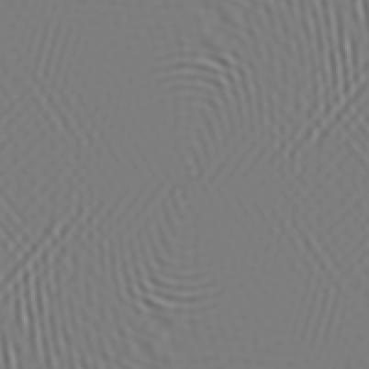
PSF difference

Slide 27
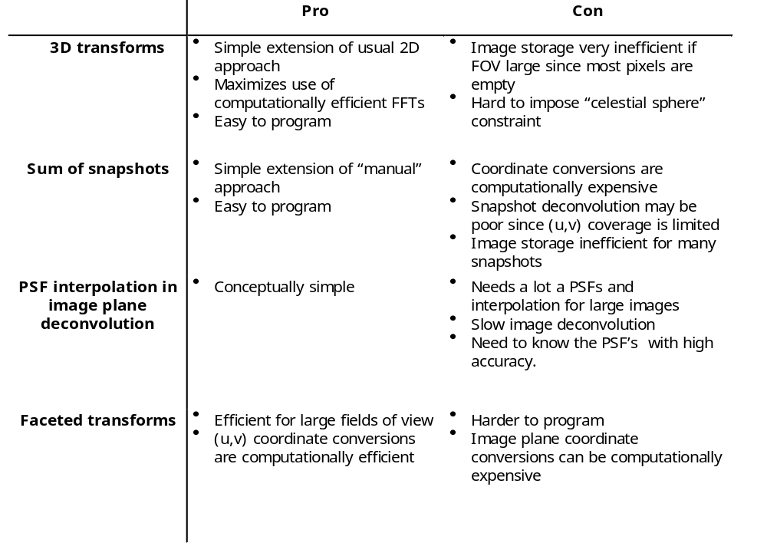
Overview of possible solutions

Slide 28
Faceted transform algorithm
Used in AIPS IMAGR task, AIPS++ imager, dragon tools
Iterative, multi-stage algorithm
  Calculate residual images for all facets
  Partially deconvolve individual facets to update model for each facet
  Reconcile different facets
    either by cross-subtracting side-lobes
    or by subtracting visibility for all facet models
  Recalculate residual images and repeat
Project onto one tangent plane
  image-plane interpolation of final cleaned facets
  (u,v) plane re-projection when calculating residual images

Slide 29
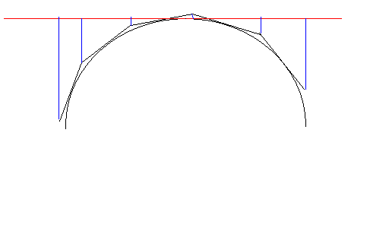
Reconciling Facets to single image
Facets are projected to a common plane. This can be done in image plane (in AIPS, flatn).
  Re-interpolate facet image to new coordinate systems
  Cornwell and Perley (1992)
or in equivalently transforming the (u,v)’s of each facet to the one for the common tangent plane (in AIPS++)
  Re-project (u,v,w) coordinates to new coordinate systems during gridding and de-gridding
  Sault, Staveley-Smith, and Brouw (1994)

Slide 30

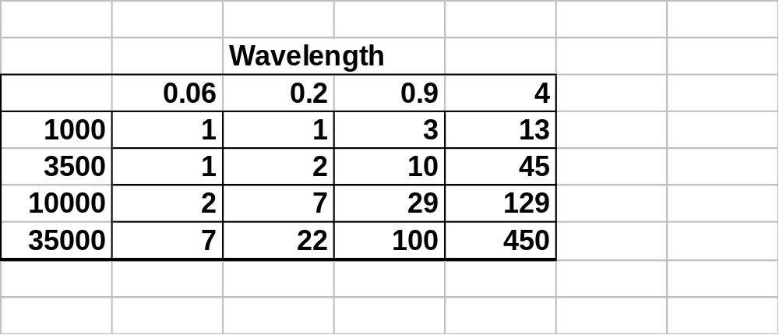
Number of facets
To ensure that all sources are represented on a facets, the number of facets required is (Chap 19) ~
Worst for large VLA configurations and long wavelengths
More accurate calculation:
  Remove best fitting plane in (u,v,w) space by choosing tangent point appropriately
  Calculate residual dispersion in w and convert to “resolution”
  Derive size of facet to limit “peeling” of facet from celestial sphere
  Implemented in AIPS++ imager tool via function “advise”

Slide 31
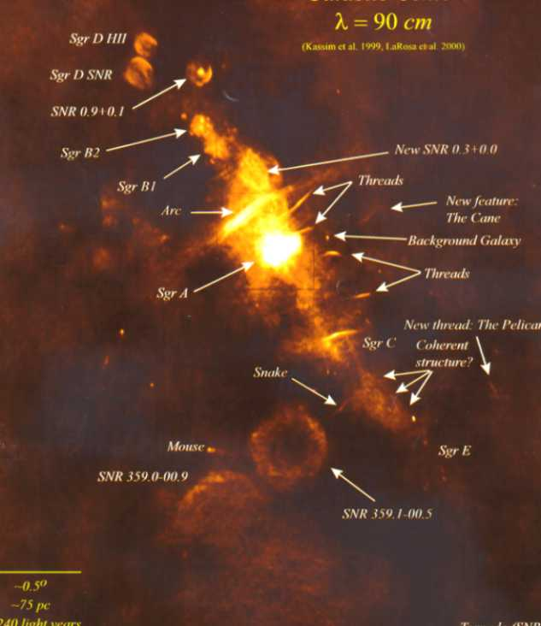
An example

Slide 32
An iterative widefield imaging/self-cal routine:
An AIPS++ implementation in dragon
Setup AIPS++ imager for a facetted imaging run with outlier fields (or boxes) on known strong confusing sources outside mainlobe
Make a first Image to a flux level where we know that the normal calibration would start failing
Use above model to phase self calibrate the data
Continue deconvolution from first image but with newly calibrated data to a second flux level. Repeat the imaging and self cal till Amplitude selfcal is needed… then do a simultaneous amplitude and Phase self cal.
Implemented as a glish script.

Slide 33
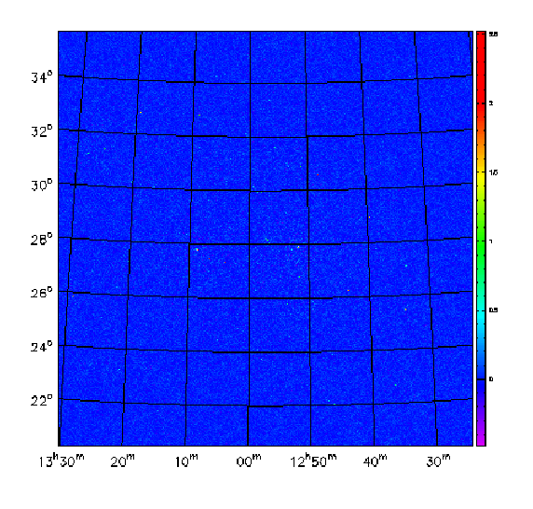
Example of a dragon output:

Slide 34
Other related issues with widefield imaging apart from ‘w’
Bandwidth decorrelation:
  Delay across between antennas cause signal across the frequency band to add destructively
Time average smearing or decorrelation (in rotational synthesis arrays only)
  Change in uv-phase by a given pair of antennas in a given integration time
If imaging large structures proper short spacing coverage or mosaicing if necessary (more on this in the next talk by Debra Shepherd)
  Missing short spacing causes negative bowl and bad reconstruction of
  large structures

Slide 35
Other related issues with widefield imaging apart from ‘w’…cont’d
primary beam asymmetry:
  Sources in the outer part of the primary beam suffers from varying gains (and phases) in long track observations. This may limit the Signal to noise achievable. If model of the beam is known it can be used to solve for the problem. Else can be solved for as a direction phase dependent problem as mentioned below.
Non isoplanaticity:
  Low frequency and long baselines problem. The 2 antennas on a baseline may see through slightly different patches of ionosphere. Cause a direction dependent phase (and amplitude) error. Can be solved for under some restraining conditions (More on this in Namir Kassim’s talk).

Slide 36
Summary
Simple geometric effect due to non-coplanarity of synthesis arrays
  Apparent shape of array varies across the field of view
For low frequency imaging with VLA and other non-coplanar arrays, will limit achieved noise level
Faceted transform algorithm is most widely used algorithm
  AIPS: IMAGR task
  AIPS++: imager (version for parallel computers available), dragon tools
Processing:
  VLA mostly can be processed on typical personal computer
  A-configuration (74MHz) and E_VLA needs parallelization

Slide 37
Bibliography
Cornwell, T.J., and Perley, R.A., “Radio interferometric imaging of large fields: the non-coplanar baselines effect”, Astron. & Astrophys., 261, 353-364, (1992)
Cornwell, T.J., “Recent developments in wide field imaging”, VLA Scientific Memorandum 162, (1992)
Cornwell, T.J., “Improvements in wide-field imaging” VLA Scientific Memorandum 164, (1993)
Hudson, J., “An analysis of aberrations in the VLA”, Ph.D. thesis, (1978)
Sault, R., Staveley-Smith, L., and Brouw, W.N., Astron. & Astrophys. Suppl., 120, 375-384, (1996)
Waldram, E.M., MCGilchrist, M.M., MNRAS, 245, 532, (1990)

