Slide 1





Scientific Scripting and Recipes
  George Moellenbrock
  (NRAO-Soc)

Slide 2
Scientific scripting philosophy
Allow complete and general access to all data, both user-defined and standard
Provide toolkit within which data may be manipulated at a variety of hierarchical levels
  "Low-level" tools for generic data access and manipulation---a very impressive "scientific calculator"
  "Intermediate-" and "High-level" tools for aggregate methods and traditional applications
Custom data analysis optionally combining traditional and user-developed methods

Slide 3
Scientific scripting capabilities
Basic scripting in Glish
Flexible Plotting via pgplotter tool
Variety of generic ("low-level") analysis functions and tools available (e.g., statistics, fft, fitting)
Seamless access to the intermediate-level data reduction and analysis tools (e.g., ms, imager, image)

Slide 4
Generic data analysis
The nuts and bolts methods which underlie standard data processing in aips++ are available in Glish as generic tools and global functions
  Mathematics module (statistics, randomnumbers, fftserver)
  Functionals
  Fitting
  Quanta and Measures
  Misc (stopwatch, misc)

Slide 5
Plotting with pgplotter
Familiar PGPLOT commands
Several new shortcut functions (plotxy, etc.)
Interactive plotter gui
  Zooming
  Printing
  Cursor methods incorporated
  as Glish/Tk events
Editor
  - include 'pgplotter.g'

Slide 6
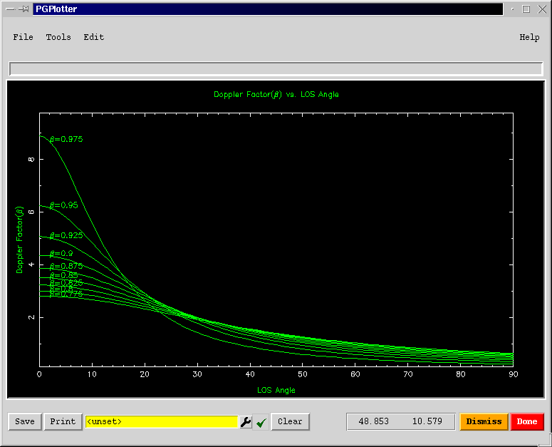
pgplotter
- include ‘pgplotter.g’
- mypg:=pgplotter()
- ang:=[0:90] ; nang:=shape(ang)
- beta:=0.75+[1:9]/40 ; nbeta:=shape(beta)
- D:=array(0.0,nbeta,nang)
- for (i in 1:nbeta) {
+ gamma:=1.0/sqrt(1-beta[i]^2)
+ for (j in 1:nang) {
+ D[i,j]:=1.0/
+ (gamma*(1-beta[i]*cos(ang[j]*pi/180)))
+ }
+ }
- mypg.env(0.0,90.0,0.5*min(D),1.1*max(D),0,0)
- mypg.sci(3)
- for (i in 1:shape(beta)) {
+ mypg.line(ang,D[,i])
+ mypg.ptxt(ang[3],D[i,3],0,0,
+ spaste('\\g=',as_string(beta[i])))
+ }
- mypg.lab('LOS Angle','Doppler Factor',
+ 'Doppler Factor vs. LOS Angle')

Slide 7
Statistics
Given an array, standard statistical quantities may be obtained via global functions
- include 'statistics.g' # ('mathematics.g')
- x:=[4.7, 4.8, 4.8, 4.9, 5.0, 5.1, 5.2]
- mean(x)
4.92857143
- median(x)
4.9
- variance(x)
0.0323809524
- stddev(x)
0.179947082
- x:=[2+6i, 4-5i, 3+11i]
- mean(x)
3+4i

Slide 8
Random numbers
Uniform, discrete uniform, binomial, Erlang, geometric, hpergeometric, lognormal, negative exponential, normal, poisson, Weibull deviates available from the randomnumbers tool in the mathematics module:
- include 'randomnumbers.g' # ('mathematics.g')
- rand:=randomnumbers()
- x:=rand(18.0,3.0,100);
- print mean(x), median(x)
17.9766934 18.036859
- print variance(x), stddev(x), skew(x)
3.04668323 1.74547507 0.139351058

Slide 9
fftserver
Given an arrays of gridded data, FFTs and related operations may be performed
  Multiple-dimension FFTs, arrays of any length, real or complex
  Auto- and cross-correlations
  Convolution
  - include 'fftserver.g' ('mathematics.g')

Slide 10
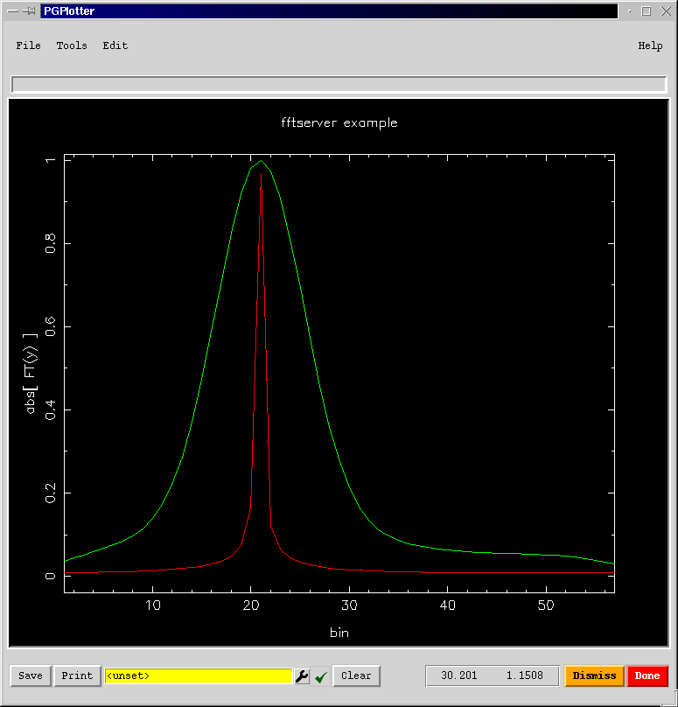
fftserver – an example
  - include 'fftserver.g'
  - myfft:=fftserver()
  - ang:=2*pi*[1:57]/7.0
  - y:=complex(cos(ang),sin(ang))
  - myfft.complexfft(y,-1)
  - mypg.plotxy(seq(shape(y)),
  + abs(y),xtitle='bin',
  + ytitle='abs[FT(y)]’,
  + title='fftserver example')
  - smth:=gaussian1d([-25,25],1.0,0.0,10)
  - ysmth:=myfft.convolve(abs(y),smth)
  - ysmth:=ysmth/max(ysmth)
  - mypg.plotxy(seq(shape(ysmth)),
  + ysmth,newplot=f,linecolor=3)

Slide 11
Fitting
A Glish interface to the C++ Least Squares Fitting routines
  Linear and non-linear
  Real and Complex
  Complete and Singular Value Decomposition
  External Constraints optional
  - include 'fitting.g'

Slide 12
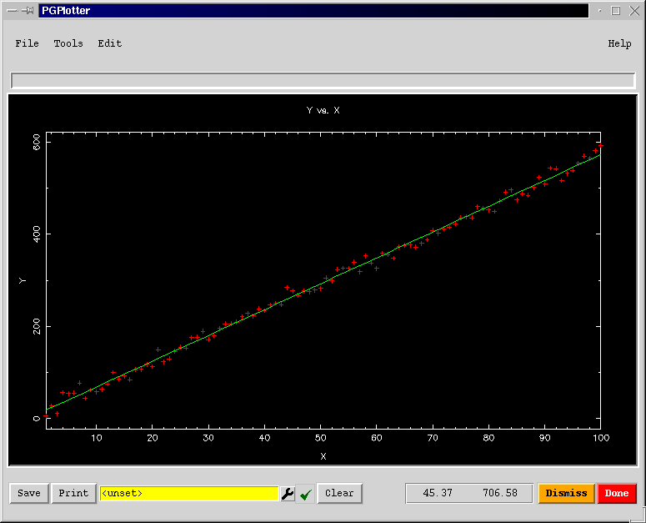
Fitting – an example
- include 'fitting.g'
- x:=seq(100)
- y:= 11.3 + 5.6*x + rand.normal(0.0,200.0,100)
- myfit:=fitter()
- myfit.init(n=2)
- myfit.makepoly(x,y)
- myfit.fit()
- sol:=myfit.solution();
- err:=myfit.error()
- print sol ; print err
[12.4591765 5.60473783]
[2.21460569 0.0380726688]
- yfit:=sol[1] + sol[2]*x
- mypg:=pgplotter()
- mypg.plotxy(x,y,
+ plotlines=F,xtitle='X',
+ ytitle='Y',title='Y vs. X');
- mypg.plotxy(x,yfit,
+ plotlines=T,
+ newplot=F,linecolor=3)

Slide 13
Quanta
Quanta are values with units contained in a record
A variety of physical constants and decimal prefixes are available
Quanta may be combined algebraically:
- include 'quanta.g’
- d:=25 # the diameter of a typical telescope
- print A:=dq.quantity(pi*(d^2)/4,’m2’)
[value=490.873852, unit=m2]
- eff:=0.60 # its aperture efficiency
- print k:=dq.constants('k’) # Boltzmann's constant
[value=1.3806578e-23, unit=J/K]
- print g:=dq.div( dq.mul(eff,A), dq.mul(2,k))
[value=1.06660865e+25, unit=m2/(J/K)]
- print g:=dq.convert(g,’K/Jy’);
[value=0.106660865, unit=K/Jy]
- Tant:='3K’
- S:=dq.div(Tant,g)
- dq.convert(S,’Jy’)
[28.1265297, unit=Jy]

Slide 14
Measures
Measures are quanta describing coordinates in reference frames
  Positions (on earth), directions (in space), epoch, frequency, radialvelocity, doppler, baseline, uvw, earthmagnetic
Conversions between reference frames, which may be combinations of measures of different types
- include 'measures.g’
- print vlapos:=dm.observatory('VLA');
[type=position, refer=ITRF, m2=[value=6373576.28, unit=m],
m1=[unit=rad, value=0.591675099], m0=[unit=rad, value=-1.87829426]]
- print dm.measure(vlapos,'WGS84') # convert to geodetic
[type=position, refer=WGS84, m2=[value=2114.89023, unit=m],
m1=[unit=rad, value=0.5947874898], m0=[unit=rad, value=-1.87829426]]
- dm.doframe(vlapos)
- print tim:=dm.epoch('utc','today') ; dm.doframe(tim)
[type=epoch, refer=UTC, m0=[value=51948.7429, unit=d]]
- print srcdir:=dm.source('0234+285')
[type=direction, refer=J2000, m1=[value=0.502698381, unit=rad],
m0=[unit=rad, value=0.688852767]]
- print 'AZ =', dq.convert( dm.getvalue( dm.measure(srcdir,'AZEL'))[1],'deg')
AZ = [value=60.296389, unit=deg]
- print 'EL =', dq.convert( dm.getvalue( dm.measure(srcdir,'AZEL'))[2],'deg')
EL = [value=7.64888837, unit=deg]

Slide 15
The table system
Aips++ stores all data in tables which consist of columns of associated information
The table tool provides generic access to standard aips++ and user-defined data tables
  Summary & Browsing
  Get/put of cells, columns
  Selection (TaQL), iteration and sorting
  Conversion to table from ascii, FITS formats

Slide 16
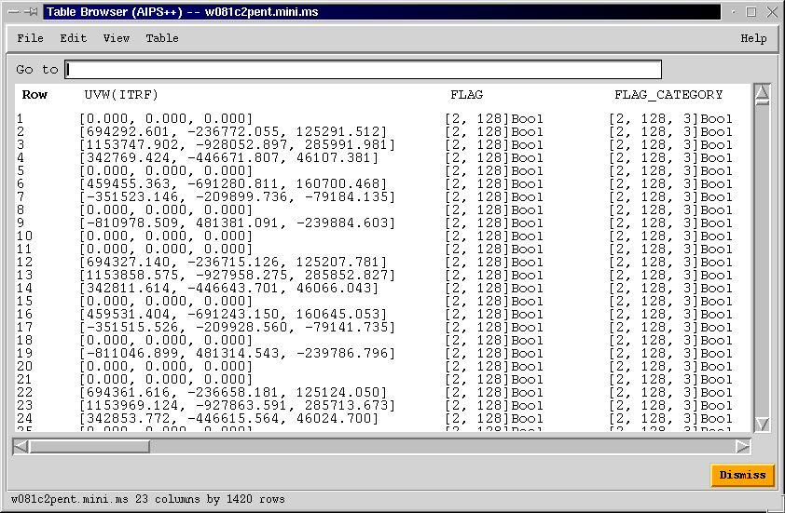
The table browser

Slide 17
Interface to standard radioastronomy analyses
Since the intermediate- and high-level aips++ tools use Glish to "glue" them together, these aggregate methods and their constituents are conveniently available for use in a user's novel applications
  Access to aips++ Measurementset data via the ms tool
  Conversion of Glish arrays to aips++ images
    analysis in the image tool, viewer
    model generation for imager/calibrater
  Conversion of aips++ images to Glish arrays for ad hoc analysis

Slide 18
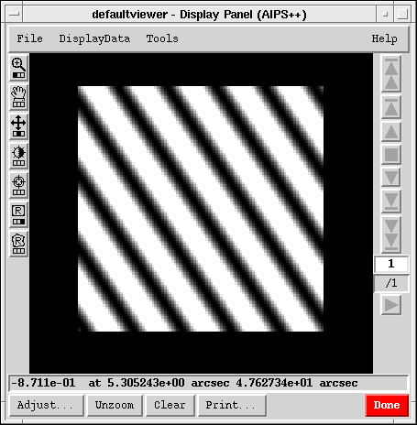
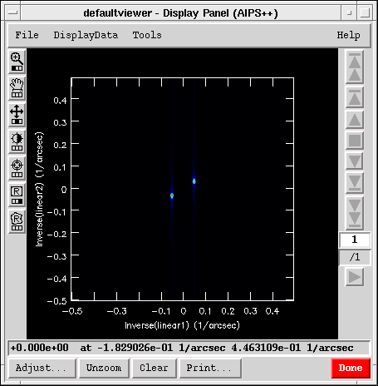
Example: Arrays as images
- include 'image.g'
- y:=array(0,100,100);
- for (i in 1:100) {
+ for (j in 1:100) {
+ y[i,j]:=cos(2+2*pi*i/20 + 2*pi*j/30);
+ }
+ }
- myim:=imagefromarray(outfile='array.im',
pixels=y,
linear=T);
- myim.fft(amp='fft.im',axes=[1,2]);

Slide 19
Other useful scripting concepts
scripter—maintains a record of operations performed via aips++ guis.
logger—maintains a record of operations entered at the command line; can be saved to a script file
simulator—generates simulated data in Measurementset format

Slide 20
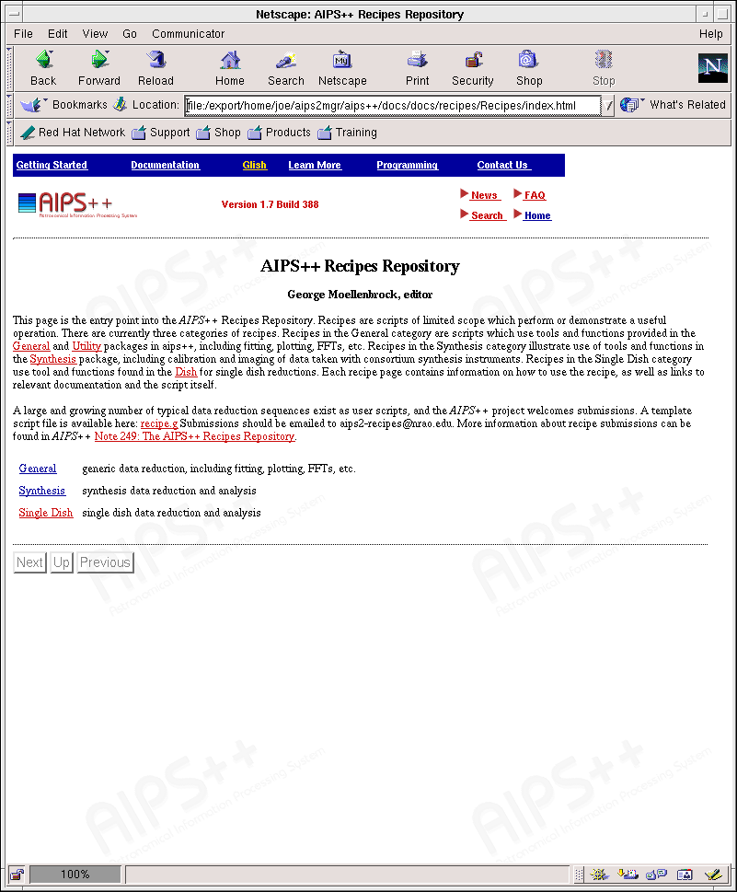
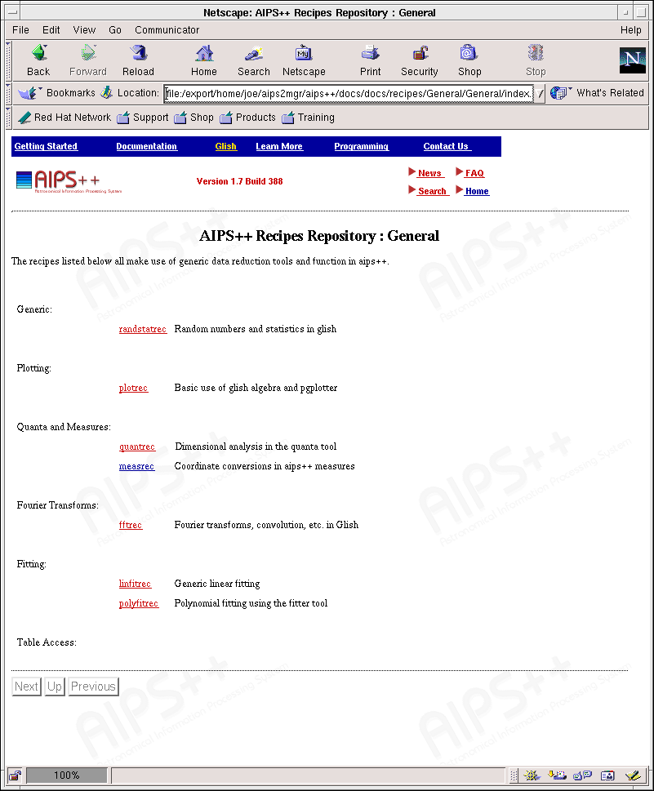
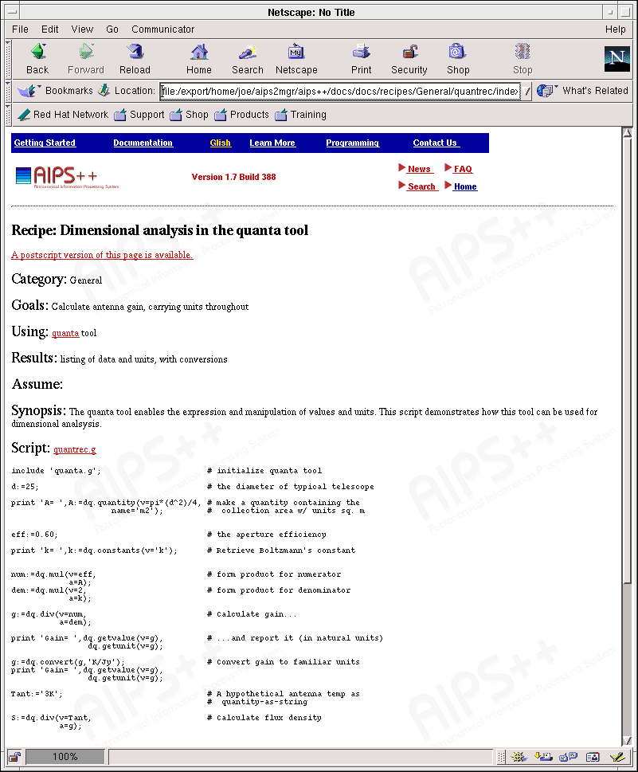
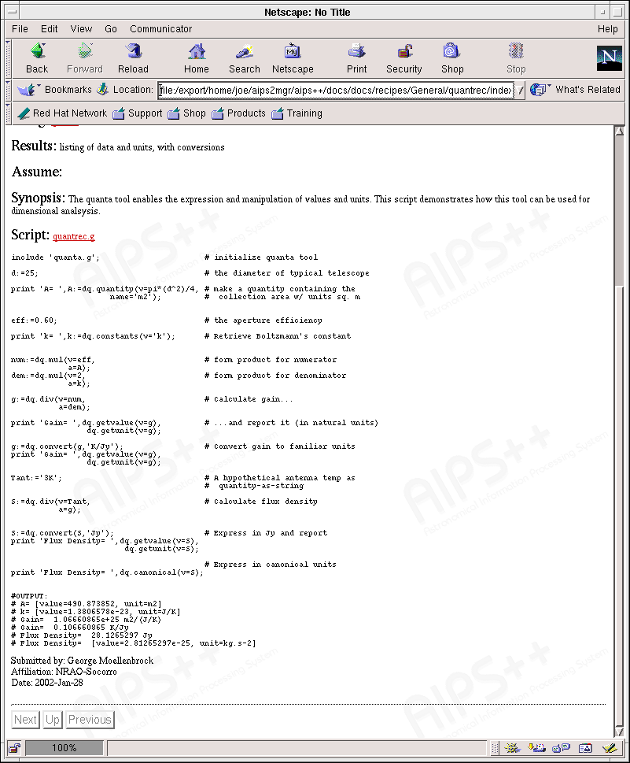
Recipe Repository

