Slide 1





Astronomical Information Processing System
C++, scripting, GUI’s, libraries, toolkits and applications
Designed by a team of astronomers and programmers
Developed by an international consortium of observatories
Fourth public release (v1.6) available here!
http://aips2.nrao.edu

Slide 2
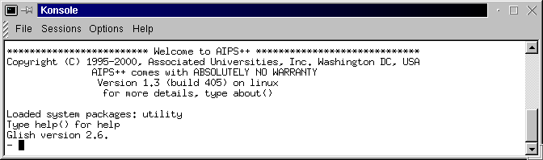
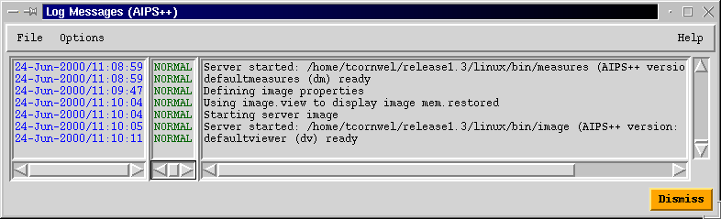
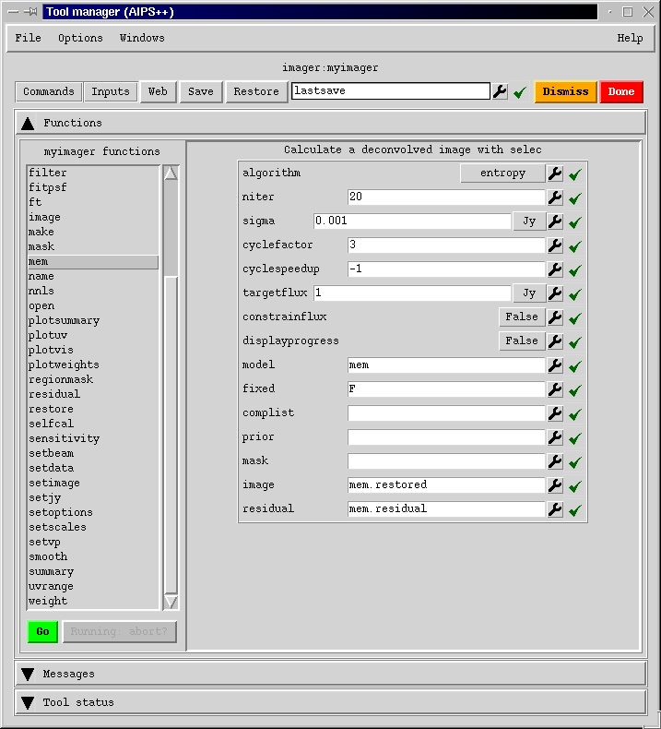
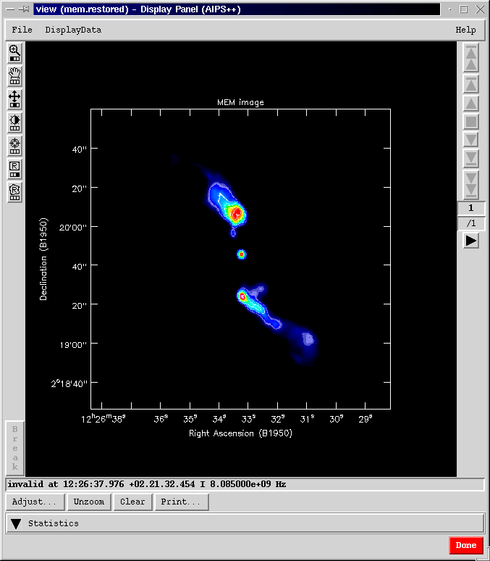
AIPS++
Glish
logger
Standard Gui
viewer

Slide 3
AIPS++ organizational structure
AIPS++ Executive Committee
  Butcher (ASTRON), Crutcher (NCSA), Diamond (JBO), Ekers (ATNF), Vanden Bout (NRAO; Chair)
Project Management reports to EC
  Kemball (NRAO), McMullin (NRAO)
Site Managers manage local staff, work with PM
  Killeen (ATNF), Noble (JBO), Noordam (ASTRON), Plante (NCSA)
AIPS++ User Group advises PM
  Balser (NRAO), H. Dickel (UIUC), Fomalont (NRAO), Viallefond (Obs. De Paris), Owen (NRAO), van Langevelde (JIVE), O'Neil (NAIC), Staveley-Smith (ATNF), Oosterloo (ASTRON), Lucas (IRAM), Pauls (Chair, NPOI), Willis (DRAO)
AIPS++ Technical Advisory Group (TAG) will form and meet this year
Local AIPS++ User Groups
  NRAO AIPS++ User Group, BIMA User Group, plus others

Slide 4
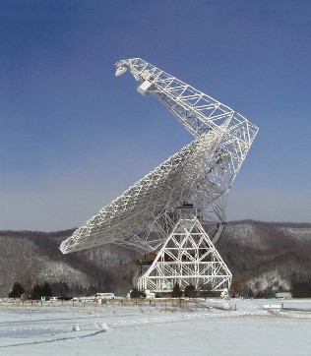
Facility use of AIPS++
  Green Bank Telescope commissioning and science
  Parkes Telescope 21cm multi-beam observations
  WSRT TMS on-line system
  Joint Institute for VLBI in Europe correlator
  Navy Prototype Optical Interferometer development and observing
  HIA/DRAO/ACSIS project for post-correlation processing into an image cube
  ATNF MOPRA telescope for mm observing (in development)
  Consortium data processing and pipelines
  Under evaluation by SMA for commissioning and data reduction.

Slide 5
Software engineering practices
    Traditional software engineering practices
      Requirements documents
      Coding rules and standards
      Design review
      Code review process
      Unit testing
      Daily automated testing of entire system
      Change control process
    Quality Assurance Group
      Code cop
      Chief tester
    Robust code management and distribution system
    Disciplined 6 month plan-design-implement-test-release process

Slide 6
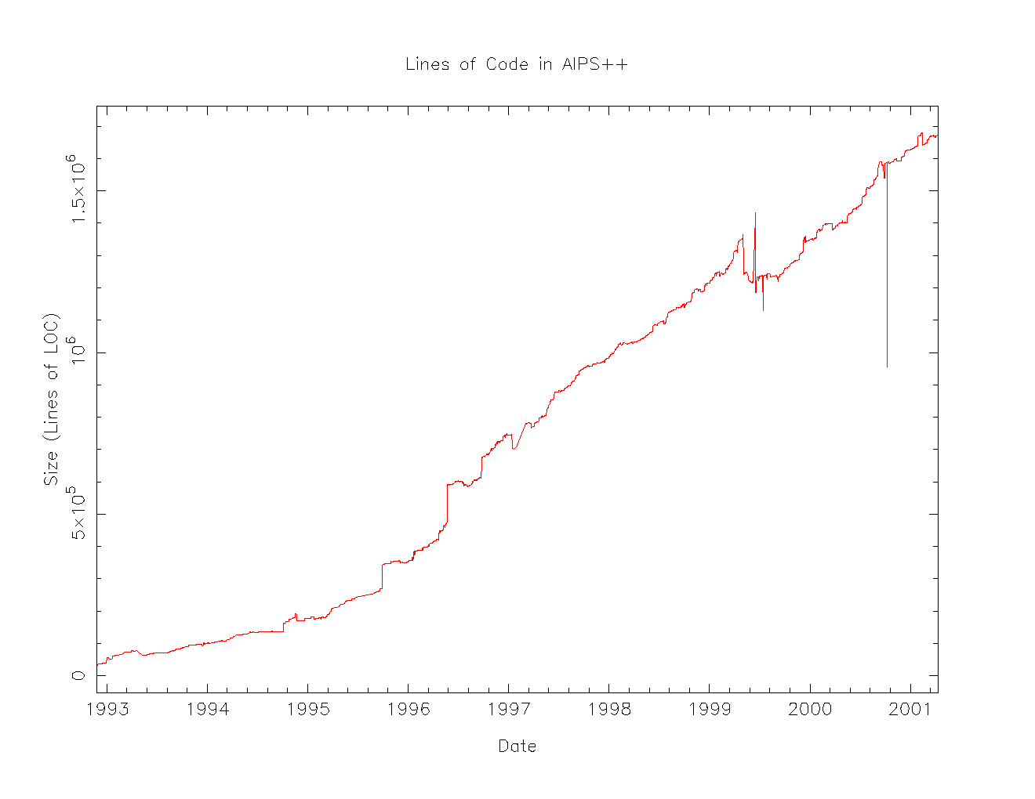
Operations
    C++
      Bulk of code (> 1,700,000 lines)
      C++ libraries have wide range of general utilities for data access, display, calibration and imaging.
      Connected to IDL-like command language and GUI interface
      About 130 person-years effort
      ~12,000 lines of code per person per year
      Good code productivity

Slide 7
Synthesis development: scientific completeness
Data fillers
  available for most consortium instruments and several archive and interchange data formats
Editing and visualization
  editing and visualization of visibility data
Calibration
  solvers for visibility-plane calibration effects; ability to apply image-plane effects.
Imaging
  a range of imaging contexts (mosaic, wide-field etc.) and deconvolution algorithms supported.
Image analysis and visualization
  capable image visualization and analysis tools

Slide 8
Basic principles in synthesis design
Scientific access at multiple levels
  High-level, integrated synthesis applications, and
  A toolkit of low-level synthesis capabilities.
Scientific freedom for end-users
  Support custom reduction and data exploration through scripting using the synthesis toolkit.
  Toolkit applicable to general interferometry
Instrument independence
  Use of a generic data format, as well as calibration and imaging formalism.
New approaches to data reduction
  Improved algorithms, support for new instruments (e.g. ALMA) and automated reduction such as pipelines.

Slide 9
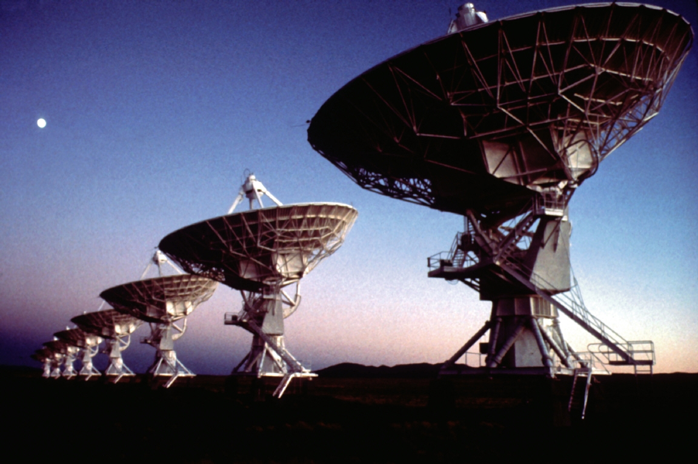
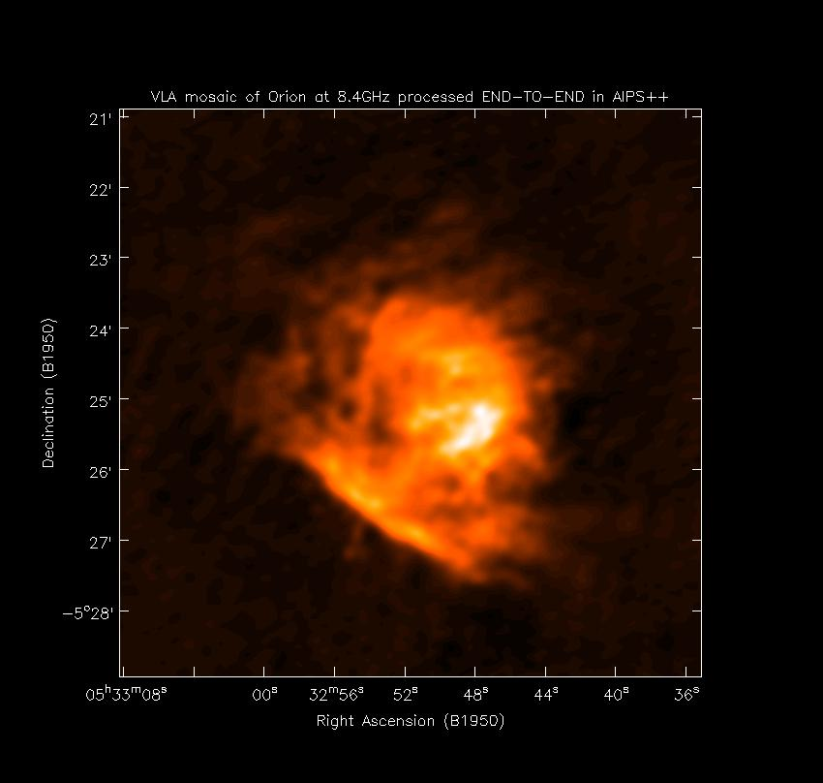
Connected-element end-to-end reduction
A important element of scientific integration efforts:
  NRAO has focused on VLA reduction
  Strategy:
    Select designated test data in all observing modes
    Scientific user groups reduce the data (in collaboration with the project)
    Assess usability improvements based on their experience
    Inter-compare with other packages
    Catalog the reduction scripts and test data in the system
    Use in documentation, tutorial examples and automated system testing
    Other data also selected by the user groups and processed independently
  Similar efforts underway at BIMA, WSRT and ATNF

Slide 10
Structure of applications
Multi-level access possible:
Guided reduction, integrated tasks
Highest level access, non-specialist users, pipeline reduction
Custom scientific reduction and scripting
Intermediate synthesis tools (imaging, calibration, image analysis)
Basic astronomical scripting
Lowest level tools (data access, display, computation)

Slide 11
User interface architecture
Automated GUI
(toolmanager)
Custom GUI’s
Command-line
interface
All tools and functions

Slide 12
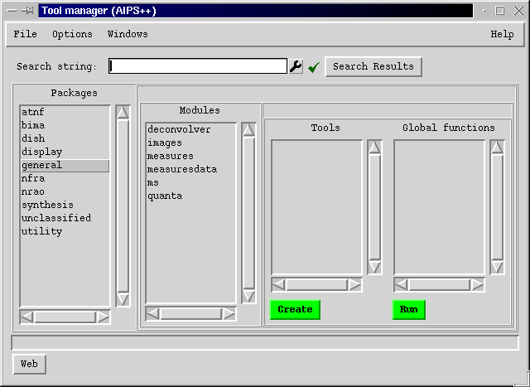
Tool manager
Automatic GUI to manage / create individual tools
Constructed from meta-information
Search for key phrases
List of available types of tools, grouped by package and module

Slide 13
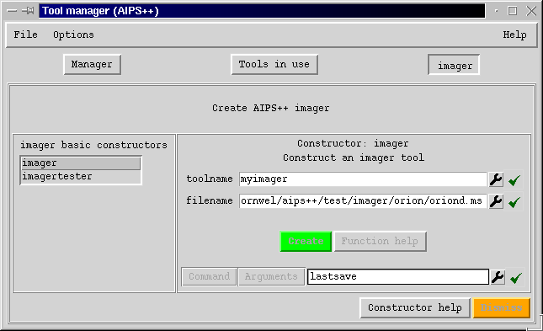
Tool manager
    Creating an individual tool

Slide 14
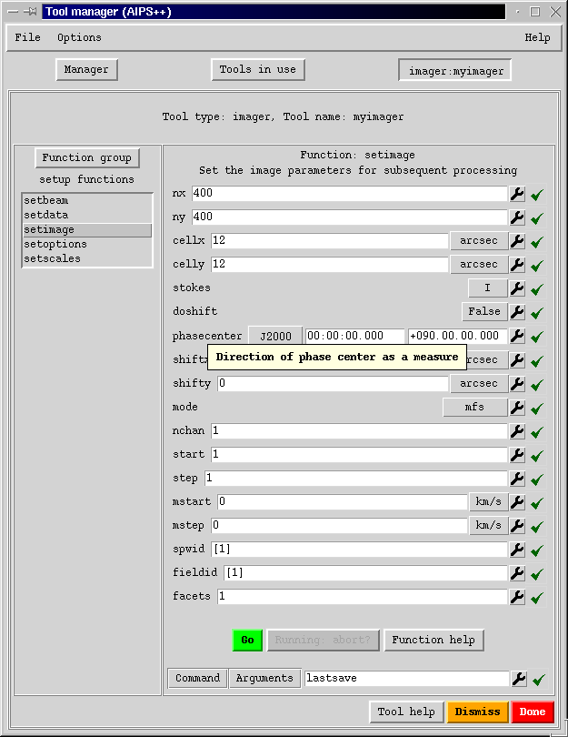
Tool manager
    Standard parameter entry
    Constructed from meta-info
    Intelligent data entry
        Tied to other tools
        e.g. catalog to get files
        e.g. viewer to see images
        e.g. regionmanager
      Cut and Paste
      Save/Restore
    Commands
      Can be viewed and executed
      Saved to a script
      Executed in batch
    Help
      Tight connection to appropriate web-based help

Slide 15
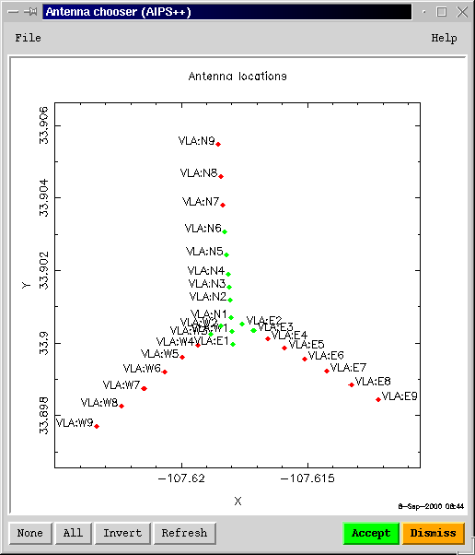
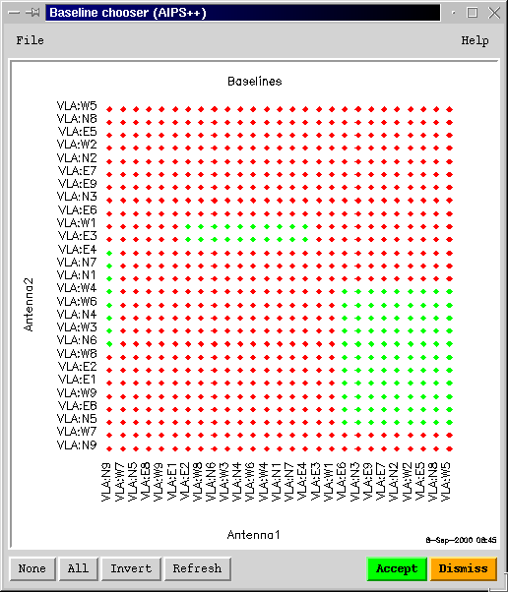
Intelligent data entry capabilities
    Specialized data entry to simplify retrieval of information

Slide 16
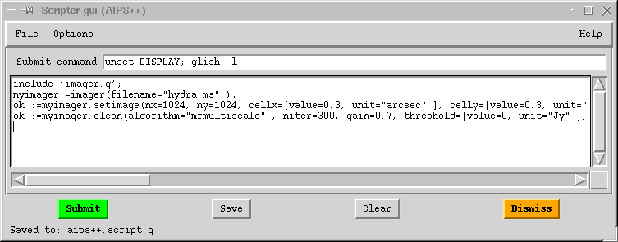
Scripter
    Aids construction of Glish scripts
    Toolmanager and wizards can write equivalent Glish commands to the scripter – these can then be adapted by users

Slide 17
Tools: general purpose
    table:
      access to all AIPS++ data
    tablebrowser:
      edit, plot, query, and select data. Configurable.
    viewer:
      display images, tables, measurementsets
    pgplotter:
      plotting of Glish variables using the Caltech PGPLOT library
    quanta and measures:
      measured quantities with units, coordinates, and reference frames; and their conversion
    catalog:
      file manager

Slide 18
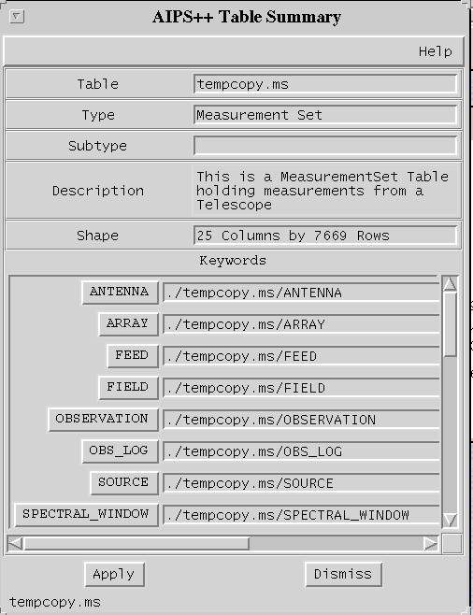
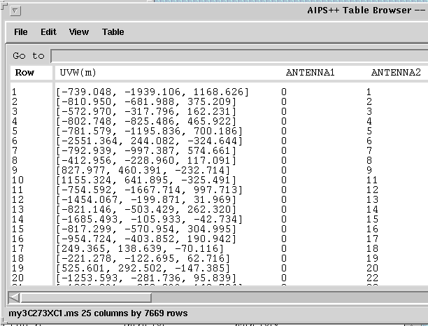
Tools: tablebrowser
    Used to show, edit, select, query tables

Slide 19
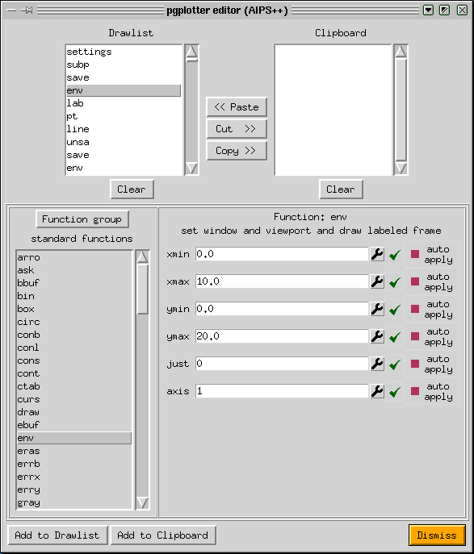
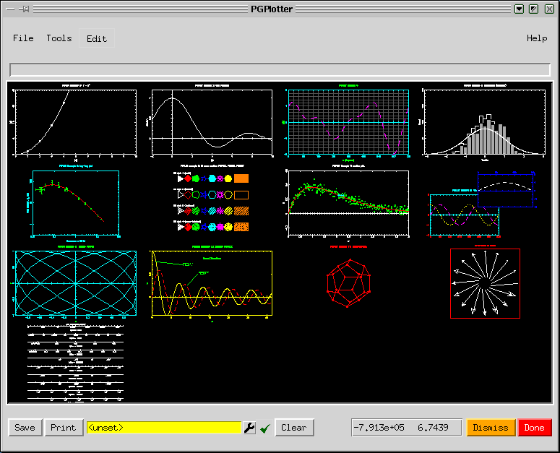
Tools: pgplotter
    Plots from Glish and C++
    Familiar PGPLOT commands

Slide 20
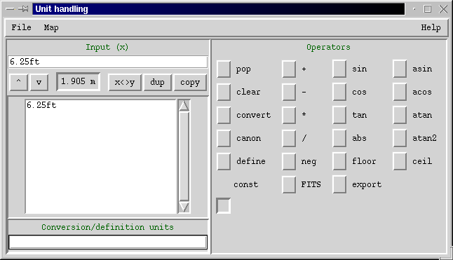
Tools: Quanta
    Values + units: [value=1.905, unit=‘m’]
    Many conversions supported

Slide 21

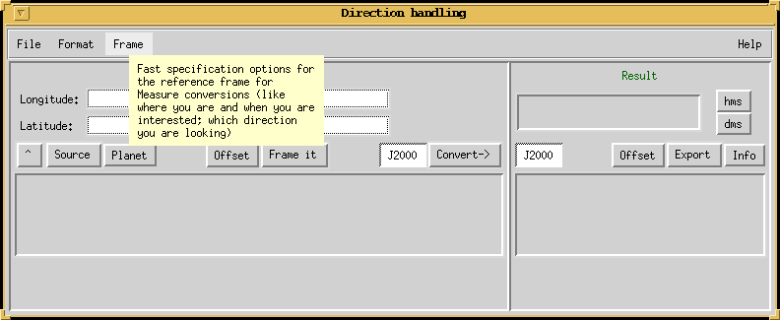
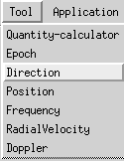
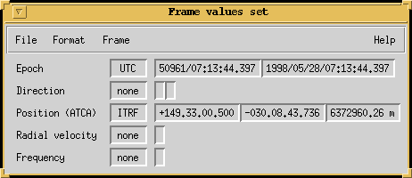
Tools: Measures
    Quanta plus coordinates and reference systems
    Many conversions supported
    Calculate from JPL DE200, DE405; or user-supplied, ephemeredes

Slide 22
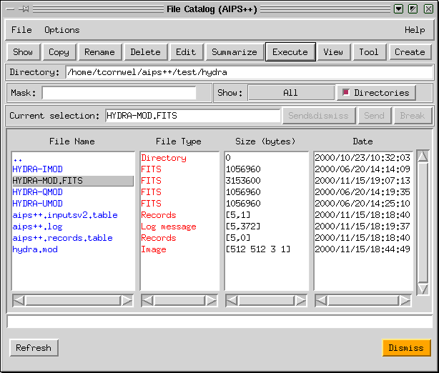
Tools: File Catalog
Used to create, edit, view, delete files

Slide 23
Applications
    dish:
      interactive single dish reduction
    msplot:
      interactive visibility plotting and editing
    calibrater, imager, and simulator:
      calibration and imaging using Hamaker, Bregman, Sault generic model
    image:
      statistics, histograms, moments.
      Image display using viewer
      image calculator
      image regions
      image polarization
    componentmodels:
      modelling of sky by discrete components

Slide 24
Imaging and calibration
    Based on Hamaker-Bregman-Sault measurement equation
    Allows integration of single dish and synthesis
    Extensive development of new formalism for telescope data processing
      Many new capabilities both in imaging and calibration
    Integrates new deconvolution algorithms
    Allows physical models of calibration effects in both antenna and sky planes
      e.g. parametrized phase screen across an array
      e.g. parametrized band-passes
      e.g. non-isoplanatic imaging

Slide 25
Single-dish development
GBT support
  Utilities developed in support of GBT commissioning
  Pointing/focus, data examination, back-end testing
  Data filler expanded to track GBT on-line format
General single-dish reduction
  Expansion of dish tool
  Closer integration of single-dish and interferometry overall
  Significant progress in single-dish imaging
User outreach
  Tutorials
  Workshop with Arecibo users and reciprocal site visits

Slide 26
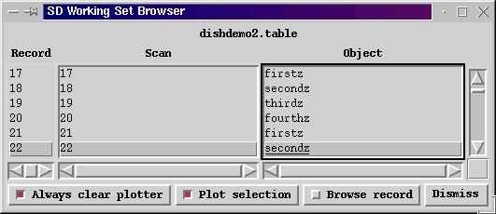
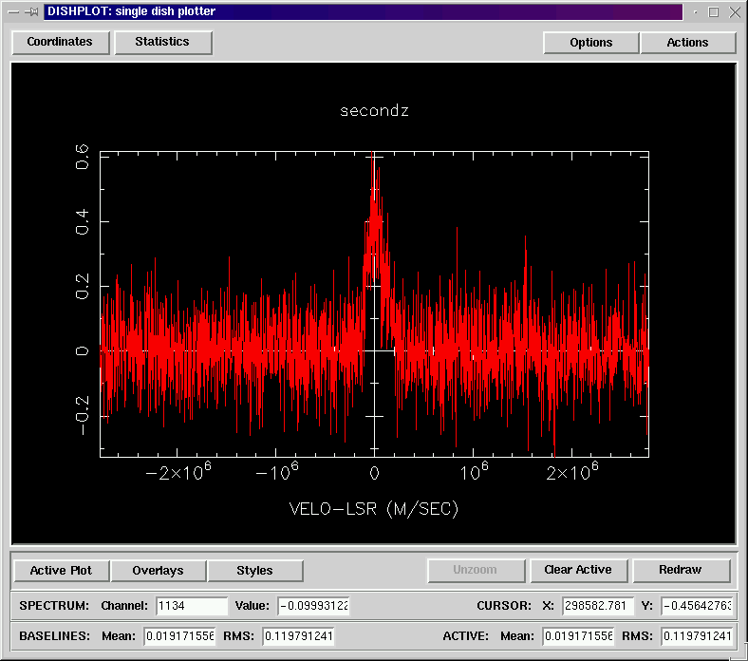
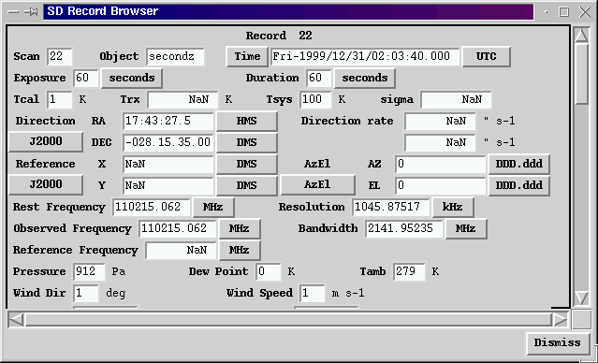
Applications: dish

Slide 27
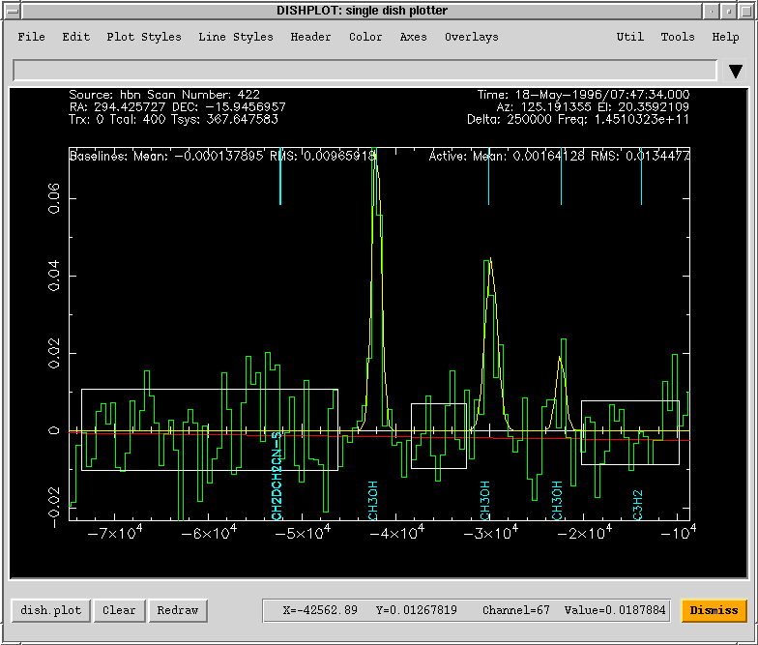
Applications: dish
NRAO 12m observations of Comet Hale-Bopp, fit with first order polynomial and three component Gaussian fit. Line identifications from JPL catalog (added via AIPS++ plugin)

Slide 28
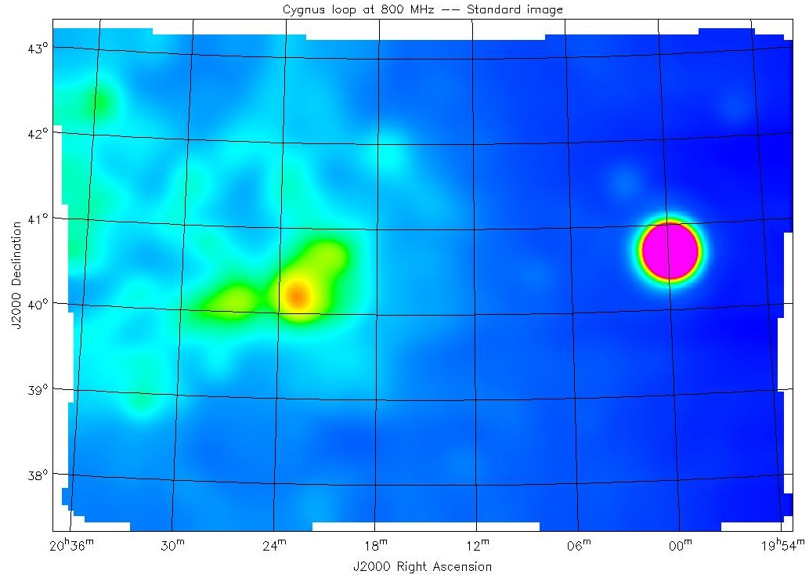
Single-dish imaging
End-to-end single-dish reduction:
GBT image of Cygnus Loop at 800MHz processed end-to-end in AIPS++. The original GBT FITS files for this observation are checked into the AIPS++ data repository and the end-to-end reduction may be repeated using the test function imagersdtest()

Slide 29
Synthesis data format
Data format
  Visibility data are stored in an AIPS++ table defined as a Measurement Set (MS).
  Current revision is v2.0: (Note 229)
    Carefully chosen to be compatible with the calibration and imaging formalism (HBS).
    Instrument-independent; but can be customized as needed.
    VLBI support.
    Improved integration of single-dish and synthesis data.
    Support for advanced synthesis reduction.
    Main table for basic data; sub-tables for auxiliary data.

Slide 30
Data fillers
Data fillers for specific synthesis instruments:
  ATCA
  WSRT
  VLA
  BIMA
  MERLIN (new MERLIN data format; initial version)
  VLBA (initial version)
Data fillers for archive and interchange formats:
  UVFITS
  FITS-IDI (see VLBA)
  FITS binary table archive format for MS
  Other converters (e.g. SCN etc)

Slide 31
Data access, display and editing
Data access and summary
  using ms tool.
Visibility visualization and editing:
  using msplot tool
  utility display methods in imager and calibrater
  transfer of display and editing capabilities to Display Library underway
Editing
  command-based and automated editiing
  available in flagger and ms tool
  new automated editing tool (autoflag)
Concatenation
  using msconcat tool.
    Does physical concatenation.
    Currently requires constant data shape throughout the MS, as defined by the number of polarization correlations (e.g. XX, XY) and the number of frequency channels.
    Merges all main table data, and all required sub-tables.

Slide 32
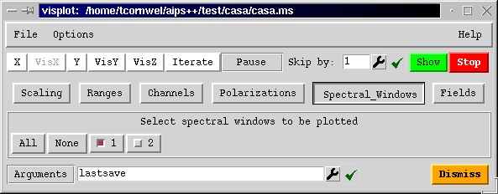
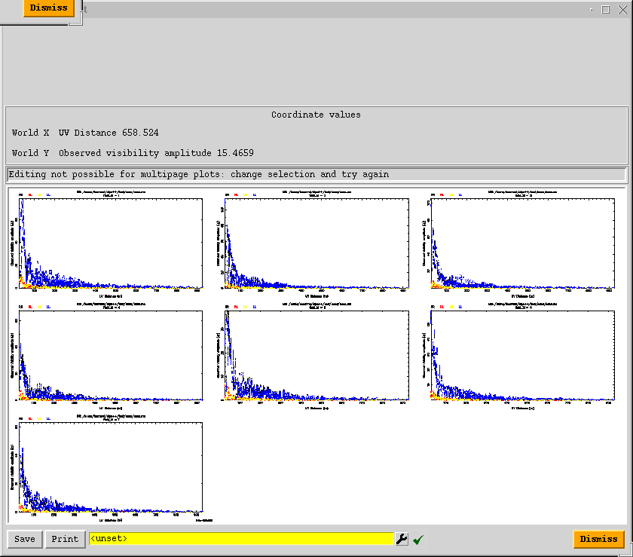
Applications: msplot
    Interactive visibility plotting and editing
Many different types of plot
e.g. Iterate over antennas for diagnosis of problems
e.g. Iterate over fields for mosaic observations

Slide 33
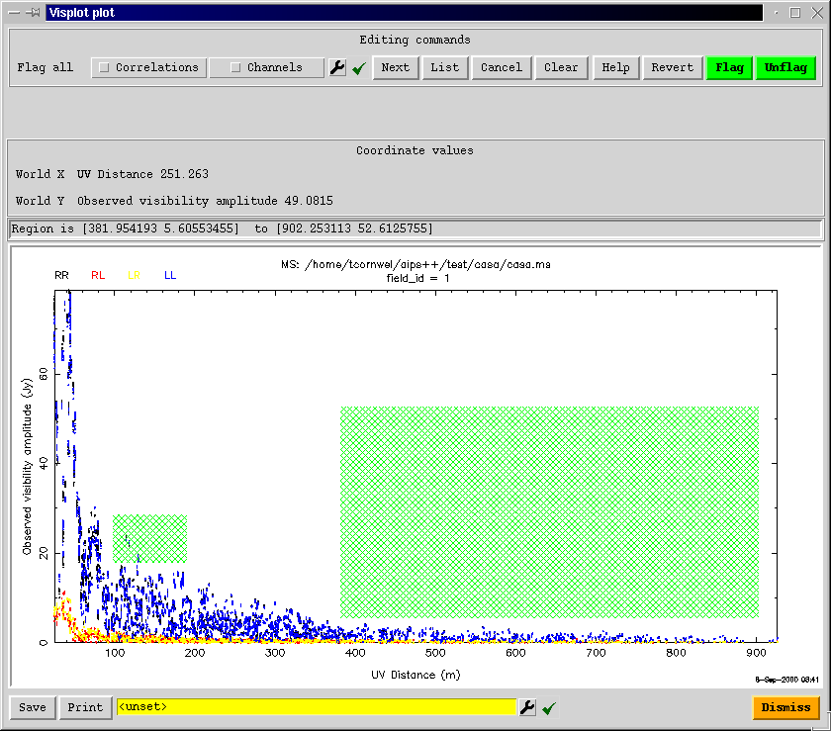
Applications: msplot
    Can edit on any single plot
Regions to be flagged

Slide 34
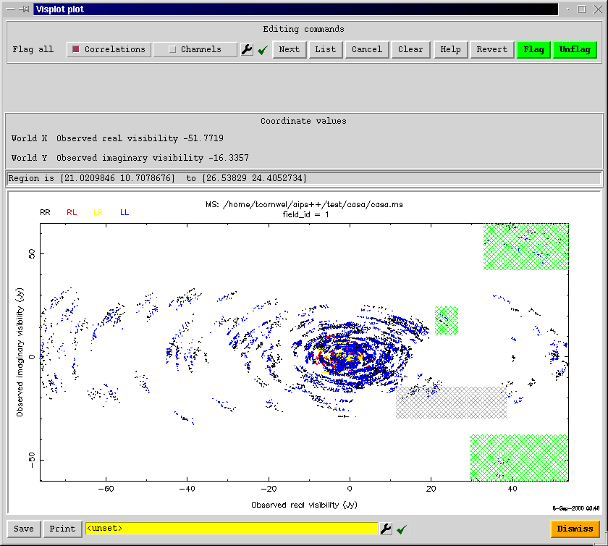
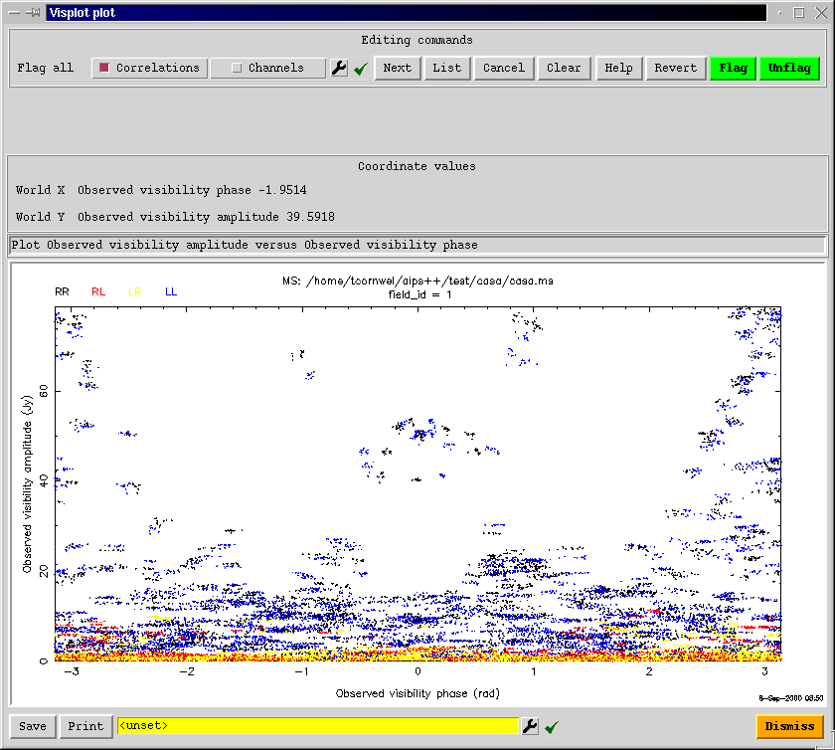
Applications: msplot
    Real vs imaginary of Visibility
    Amplitude vs phase
Flagging regions

Slide 35
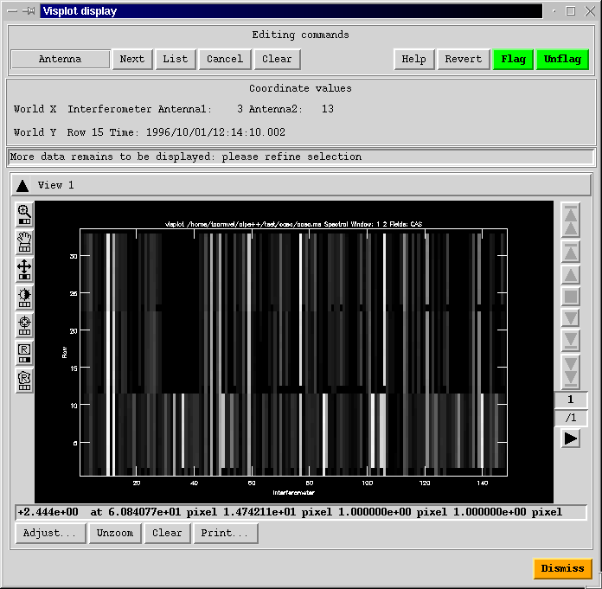
Applications: msplot
Image-like display and editing
Uses standard viewer tool
Axes can be:
  Interferometer
  Time
  Channel
  Polarization
Show and edit in any order

Slide 36
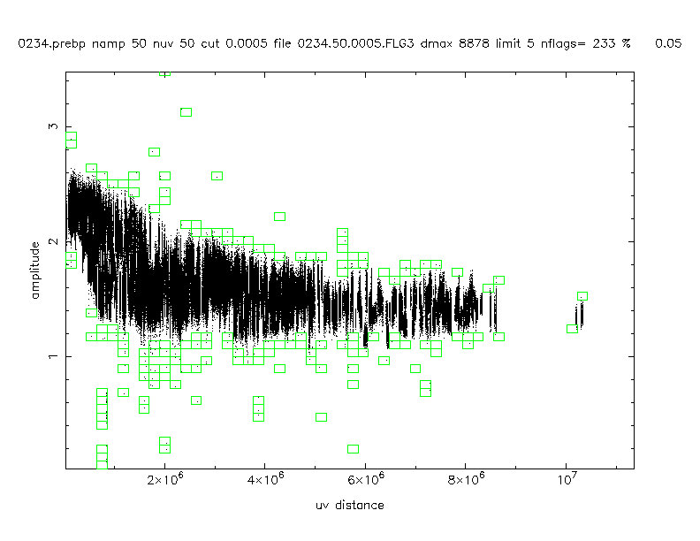
Automated editing
Vital for automated pipeline reduction
Heuristics supported:
  UV-plane binning (as left)
  Median clip in time and frequency
  Spectral rejection (spectral line baseline fitting)
  Absolute clipping in a clip range
Calibrator 0234+285, VLBA project BK31 (Kemball et al.)

Slide 37
Visibility-plane calibration
Visibility-plane components supported in calibrater
  P - parallactic angle correction (pre-computed).
  C - polarization configuration (pre-computed).
  G - electronic gain, solvable.
  T - atmospheric correction, solvable.
  D - instrumental polarization response, solvable.
  B - bandpass response, solvable.
  F - ionospheric correction, pre-computed from global, empirical model (PIM) (initial version).
Pre-computed, or solved using chi-squared computed from the Measurement Equation (ME).
Pre-averaging, phase-only solutions, and reference antenna selection available in solver.

Slide 38
Image-plane calibration
Image-plane calibration supported in imager
  Only pre-computed calibration components supported at present.
    Primary beam voltage pattern, including beam squint
    Wide range of recognized voltage patterns; configured using a voltage pattern utility (vpmanager).
  Image-plane solvers in prototype development (a difficult problem).

Slide 39
Calibration tables
AIPS++ calibration information stored in AIPS++ tables
  Format chosen to be compatible with MS and ME.
  Supports a range of calibration component types:
    Antenna-, or interferometer-based.
    Pre-computed or solvable.
    Parametrized or discretely sampled.
    Image or visibility-plane (image-plane pending solver).
  Current revision is v2.0 (see AIPS++ Note 240).
Full access to calibration table data.
Utility for polynomial fitting and re-gridding developed by BIMA group.

Slide 40
Imaging capabilities
Imaging from synthesis and single dish data
  Supports polarimetry, spectral-line, multiple fields, mosaicing, non-coplanar baselines (simultaneously)
  Also single dish OTF, holography
  Clean algorithms: Hogbom, Clark, Schwab-Cotton, Multi-scale
  Incremental multi-field deconvolution
  Non-Negative Least Squares and Maximum Entropy deconvolution
  Supports imaging in a wide range of coordinate systems
  Tracks moving objects
  Discrete image component processing
  Flexible in image size (2^{n} not needed)
  Novel “sort-less” visibility gridding algorithm
  Advises on argument settings
  User can “plug-in” customized (Glish) modules
  Pixon deconvolution available in the image plane

Slide 41
End-to-end example: 8 GHz VLA mosaic observation of Orion
Data from Debra Shepherd (NRAO); project DSTST
Filling, editing, calibration and imaging of VLA export tape via a Glish script:
# Wait for each result before proceeding
dowait:=T
# load definitions of synthesis processing functions
include ‘synthesis.g’;
# fill data
include 'vlafiller.g';
ok:=vlafillerfromdisk(filename="N13522.vla" , msname="orion.ms" , project="DSTST" , bandname="X");
# flag known bad data
myflagger:=flagger(msfile="orion.ms" );
ok:=myflagger.quack(scaninterval="5.1s" , delta=‘10.0s’, trial=F);
ok:=myflagger.setantennas(ants=21);
ok:=myflagger.timerange(starttime="21-SEP-2000/11:15:48", endtime="21-SEP-2000/13:38:18", trial=F);
ok:=myflagger.filter(column="DATA", operation="range", comparison="Amplitude", range='1e-6Jy 1e3Jy', trial=F);
myflagger.done();

Slide 42
End-to-end example: Orion calibration and imaging (8 GHz VLA mosaic)
# initialize models of known sources
myimager:=imager(filename="orion.ms" );
ok:=myimager.setjy(fieldid=1, spwid=-1, fluxdensity=-1.0);
ok:=myimager.setjy(fieldid=2, spwid=-1, fluxdensity=-1.0);
# calibrate flux scale and visibilities
mycalibrater:=calibrater(filename="orion.ms" );
ok:=mycalibrater.setdata(msselect='FIELD_ID in [1,2]');
ok:=mycalibrater.setsolve(type="G" , t=300, table="orion.gcal");
ok:=mycalibrater.solve();
ok:=mycalibrater.fluxscale(tablein='orion.gcal', tableout='orion.ref.gcal', reference='0518+165',
transfer='0539-057');
ok:=mycalibrater.setdata(msselect='');
ok:=mycalibrater.setapply(type="G", table="orion.ref.gcal", select="FIELD_NAME=='0539-057'");
ok:=mycalibrater.correct();
mycalibrater.done();

Slide 43
End-to-end example: Orion calibration and imaging (8 GHz VLA mosaic)
# make and deconvolve mosaic image
ok:=myimager.setimage(nx=300, ny=300, cellx=‘4.0arcsec’, celly=‘4.0arcsec’, stokes=‘I’, spwid=[1, 2]);
ok:=myimager.setdata(spwid=[1, 2] , fieldid=3:11 , msselect='');
ok:=myimager.weight(type="briggs" , robust=-1);
ok:=myimager.setvp(dovp=T, dosquint=F);
ok:=myimager.mem(algorithm="mfentropy", niter=100, sigma=‘4mJy’, displayprogress=T, model="orion.mem");
myimager.done();
10 pointing VLA 8 GHz mosaic of Orion processed entirely in AIPS++
Filled from VLA export tape, edited, calibrated, and imaged, displayed using AIPS++ tools

Slide 44
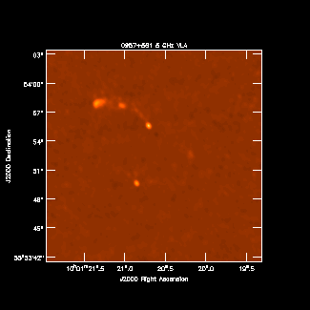
Continuum calibration and single-field imaging
Project AP366:
  Patnaik, Kemball et. al.
24-hour VLA observation in A-configuration of a sample of gravitational lenses
Continuum imaging of 0957+561 at 5 GHz shown here
Phase calibrator 0917+624.
Amplitude calibrator 1331+305

Slide 45
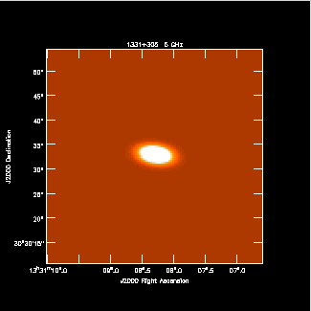
Continuum polarimetry
Continuum polarimetry:
  Solver for instrumental polarization response (D-terms)
  Full second-order model for instrumental polarization.
  D-terms can be time-variable
  Supports (R,L) and (X,Y) data
  Allows polarization self-calibration
1331+305, 5 GHz VLA (part of designated test dataset (G. Taylor (NRAO); project TESTT)

Slide 46
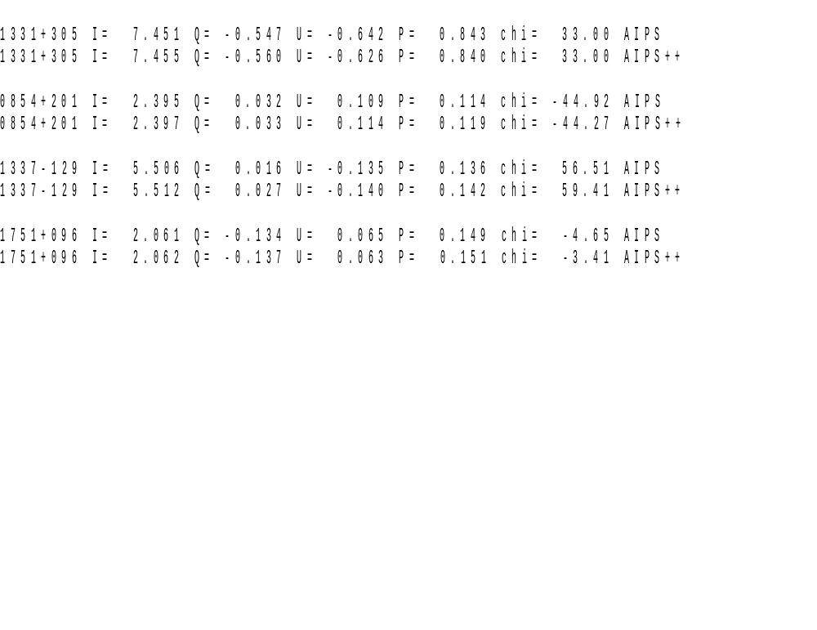
Continuum polarimetry
Sample inter-comparison of polarization calibration: AIPS-AIPS++ (VLA 5 GHz, designated test dataset project TESTT)

Slide 47
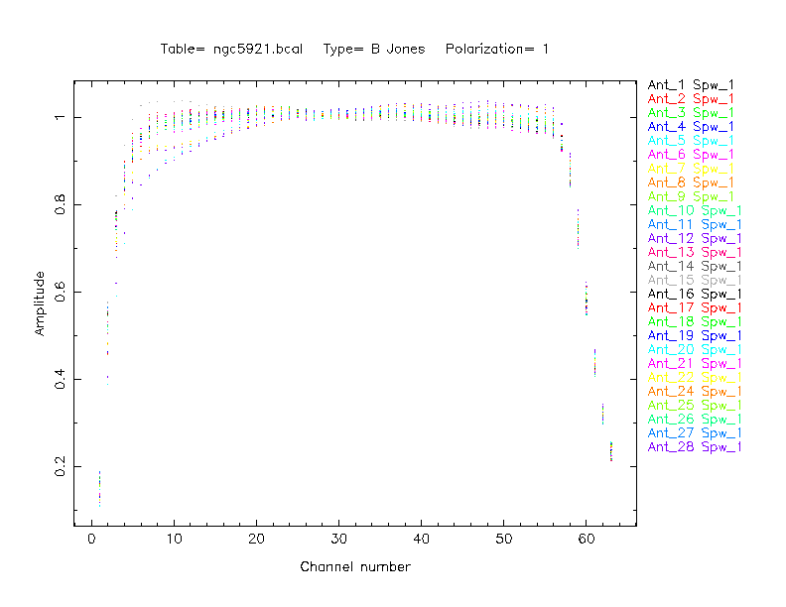
Spectral line calibration and imaging
Spectral line reduction
  Designated test dataset: HI observations of NGC 5921 in VLA D-configuration
  Bandpass response solutions plotted

Slide 48
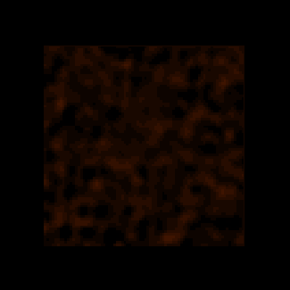
Spectral line calibration and imaging
Spectral line reduction
  Designated test dataset: HI observations of NGC 5921 in D-configuration
  Calibrated and imaged, with map-plane continuum subtraction

Slide 49
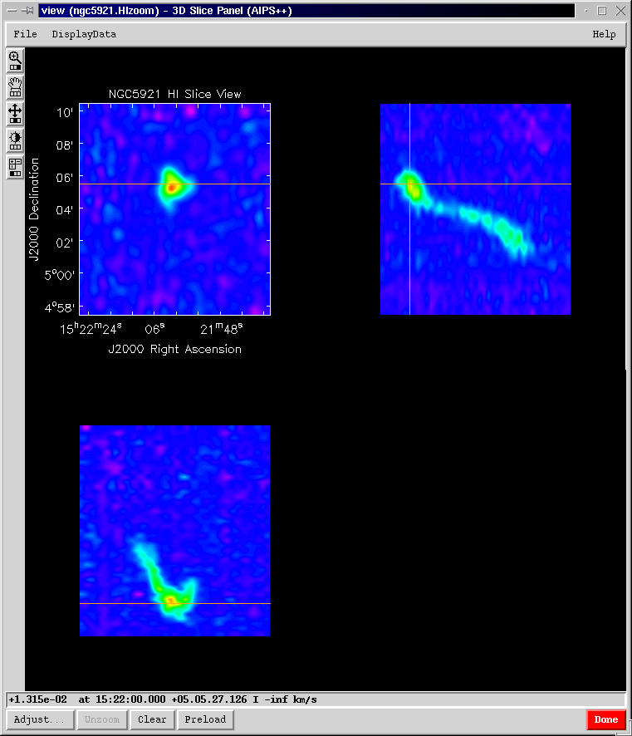
Spectral line calibration and imaging
NGC 5921, HI VLA (designated test dataset)
  Dec vs RA
  Dec vs Frequency
  Frequency vs RA

Slide 50
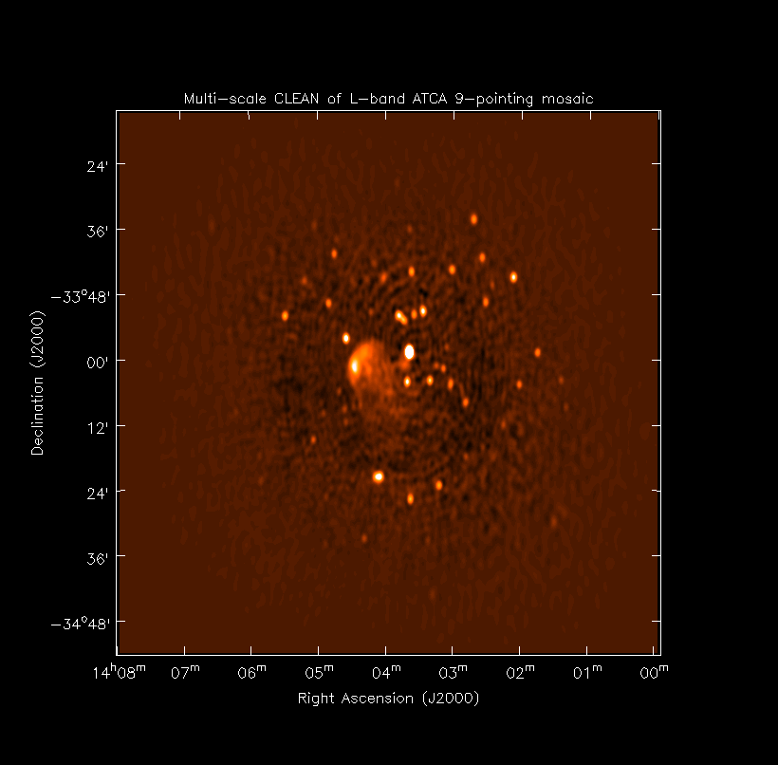
Mosaicing in AIPS++
ATCA 9 pointing mosaic at 1.4 GHz
Uses novel incremental multiscale clean deconvolution algorithm
Maximum Entropy also possible

Slide 51
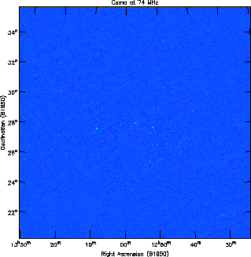
Wide-field imaging
    Wide-field VLA Imaging
      90cm and 4m imaging
      Performs cleaning and self-calibration simultaneously
      Images multiple facets on a single tangent plane
    Written
    entirely in Glish using first tier tools
      imager, calibrater, viewer
    Parallelized version now available

Slide 52
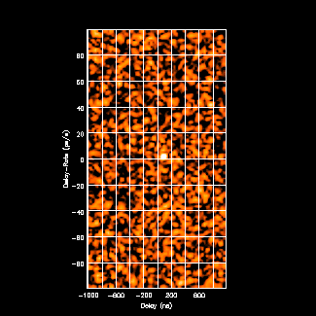
VLBI capabilities
Initial FITS-IDI filler
Initial single-band coherent fringe-fitter with Alef-Porcas global solution
Initial version proto-typed in Glish, then moved to the C++ library
Display at right shows diagnostic Glish script for fringe peak in delay-rate space as an animation in time
Space-VLBI test data from VSOP (Moellenbrock et al.)

Slide 53
Applications: simulator
Simulation of data from synthesis and single dish radio telescopes using the simulator tool.
Complementary to imager and calibrater
Two roles:
  Provide synthetic data for testing AIPS++
  Facility for telescope design e.g. ALMA
Can construct MeasurementSet from description of an observation
Can add noise and corruptions of various types
  Based on HBS measurement equation

Slide 54
Source component models
Spatial and frequency models.
Supported spatial shapes: point, disk and Gaussian components.
Spectral models: constant and spectral index.
Generated manually, from an ASCII catalog or from the imagefitter tool.
Integrated into imager; and used to provide a complete sky model.

Slide 55
Applications: image
    Image operations
      Very flexible use of “on-the-fly” images
    Convert to and from FITS
    Display, statistics, histograms, smoothing
    Numerous moment calculation methods
    Image polarization calculations
    Transfer image pixels to and from Glish
    Image calculator
      Apply math operations to images, using a syntax based on the AIPS++ Lattice Expression Language
    Integrated with regions
      Definition, conversion, math of regions in both pixel and world coordinates
    Coordinate system editing
    Fast, optimized image regridding
    Specialized mage polarimetry operations
    Component fitting

Slide 56
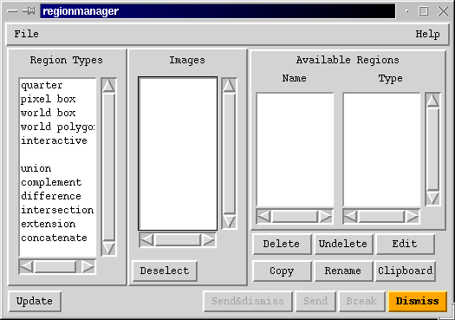
Applications: image
    Regions are much more powerful than traditional BLC, TRC or simple polygon descriptions of regions-of-interest
Types of region
Operations on regions

Slide 57
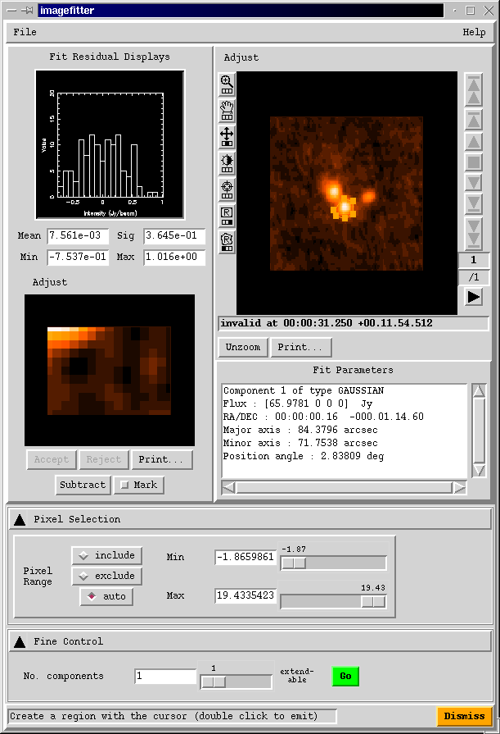
Image analysis: component fitting
Interactive and batch image plane component fitter
Stores results as AIPS++ component models
Can also save regions for subsequent re-fitting

Slide 58
Visualization
Visualization toolkit customized for astronomy
  support for astronomical coordinates, data types and data views.
  available both for scripting and AIPS++ applications.
High-level visualization applications using integrated toolkit capabilities
  e.g. viewer, kslice3d

Slide 59
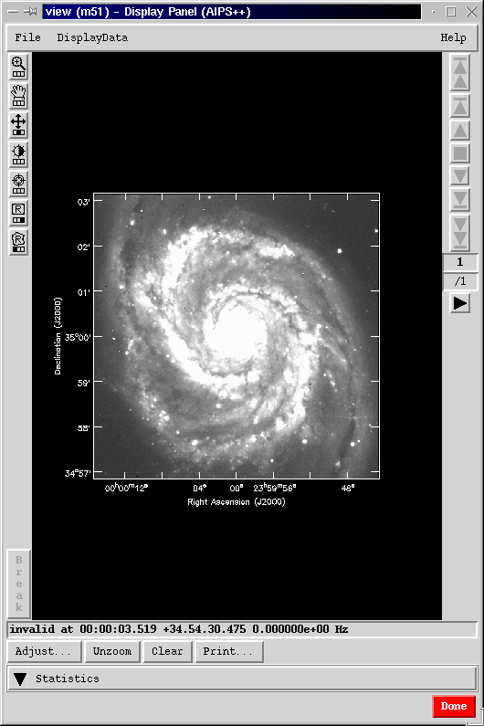
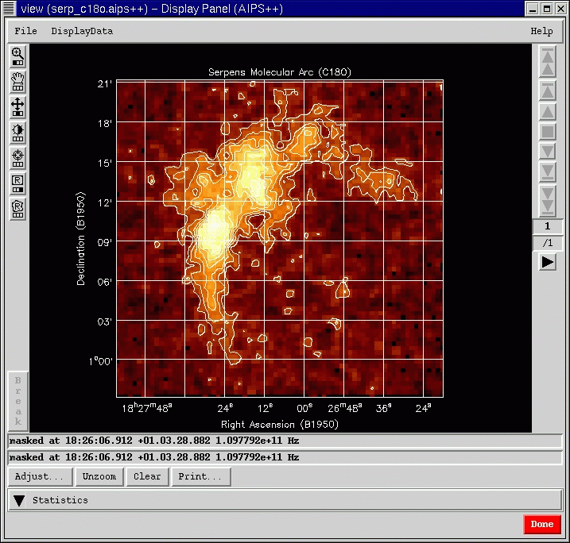
Display Library
  Support for display of all AIPS++ data
    Images, MeasurementSets, Tables, Catalogs etc.
  Programmable via Glish or C++

Slide 60
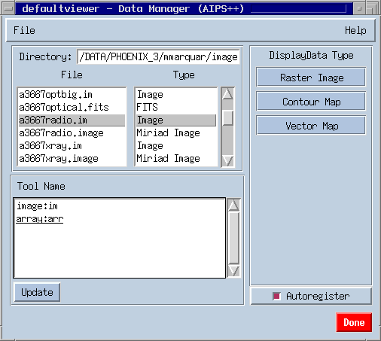
Viewer features
Provides different drawing modes:
Raster Image
Contour Map
Vector Map
Catalog overlays
Displays images and Glish arrays (simultaneously)
Displays foreign image formats:
FITS
Miriad*
Gipsy*
Displays complex images
e.g. Vector maps
* via FITS conversion

Slide 61
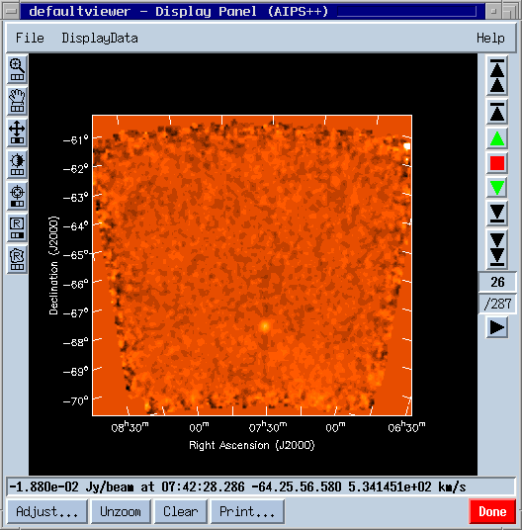
Viewer features
Uses true World Coordinates
Zooming and Panning
Shift/Slope and Brightness/Contrast colormap fiddling
Position tool
Region selection, used in the image tool
Tape Deck: Animation along third axis
Adjust panel – see over

Slide 62

Viewer features
Adjust Panel
The Adjust Panel allows the user to interactively adjust the data’s display properties, e.g.
Display of subregions
On-the-fly masking
Storage of parameters for reuse

Slide 63

Viewer features
Vector Maps
Vector map overlaid on a Raster image (both from the same data).
Real data pixel values are mapped to position angles, amplitude is constant.
See image demo for scientific application and parameters of the Adjust gui.

Slide 64

Viewer features
Sky catalog overlay of bright HIPASS sources on:
A HIPASS cube (J2000)
Galactic coordinate frame
Supergalactic coordinate frame
The catalog is split up into different sub-catalogs, and each of these is registered on on a different image.
Skycatalog does on-the-fly conversion to the direction type used by the image it is registered on.

Slide 65

Viewer features
Viewer in RGB mode:
mapped to optical emission
20cm continuum
HI emission line
Note that contours, vectors and catalogs can be overlaid in any mode

Slide 66
High-level synthesis applications: guided reduction wizards
Termed wizards
  Guide user through processing
imagerwizard for simple imaging
  Built using imager and other tools
  imagerwizard performs step-by-step imaging of synthesis data,
    User selects data
    Cleans a tapered image of the entire primary beam at low resolution
    User interactively selects the region to image at full resolution
    Cleans an image at full resolution
mosaicwizard for mosaicing
  Aids in imaging and deconvolution of mosaics
  Implements nested deconvolution to image broad structures first

Slide 67






imagerwizard

Slide 68


High-level synthesis applications: map
    “Vertical” integration of imager, calibrater and msplot capabilities with no loss of functionality
    ~ Most synthesis processing in one tool
    Complex but very powerful
    At the same level as AIPS tasks such as IMAGR

Slide 69
Parallelization and high-performance computing
Joint initiative with NCSA, as part of the Radio Astronomy Application Team in the broader NCSA Alliance program.
Separately funded
Objectives:
  Address computationally challenging problems in radio astronomy which require supercomputer resources.
  Provide infrastructure within AIPS++ to integrate support for high-performance applications.
  Portable parallelization on supercomputers and Linux clusters

Slide 70
Parallelized scientific capabilities
Parallelized deconvolution in place for spectral-line datasets over frequency.
  Goal is key science project reduction.
  Wide-field (3-D, faceted) imaging now parallelized
    Decompose work per imaging facet
    Parallelized PSF formation, model prediction and residual computation per facet.
    Completed all associated infrastructure changes (data access and algorithms)
    Have evaluated with up to 32 processors (SGI-DSM); currently running on AHPCC Linux cluster

Slide 71

Parallel wide-field imaging
VLA observations of the Coma cluster (Perley et al)
225 imaging facets, 32 processors, speed-up factor ~20 to a net 10 hours elapsed time

Slide 72
Performance of AIPS++ applications
Has to be comparable to other disk-based packages, else considered a bug.
Try to schedule regular profiling to monitor performance.
No inherent optimization problems encountered so far which do not respond to direct fixes; primarily a matter of resource allocation for evolving code
The most computationally demanding applications form part of the parallelization and HPC effort

Slide 73
Documentation
Adopted standard commercial model
  Getting Results
    intent is to act as a cookbook, divided into chapters addressing specific scientific topics (e.g. data editing, calibration, imaging etc.).
    consulted by the scientific end-user.
    linked to Glish recipes and the User Reference Manual.
    separate chapters for end-to-end processing per instrument also (e.g. VLA).
  User Reference Manual
    authoritative guide for each synthesis tool and function.
    consulted for the scientific end-user, particularly when developing scripts.

Slide 74

Correctness and testing
Testing strategy is as follows:
  Unit testing in the C++ code library.
  Glish-level integration testing:
    against simulated data (truth).
    against previous results (regression testing)
    against other packages (e.g. AIPS or MIRIAD)
    using designated test data
    interactive testing by user groups and test utilities

Slide 75

Help services
    FAQ online
    ask() function to ask questions of local contact or AIPS++ Project staff
      Questions are harvested for the FAQ
    bug() function to submit a bug report
      Searchable index of bug reports

Slide 76

Defect tracking and statistics
Use commercial package (ClearDDTS) for tracking defects
Severity scale 1-5
30% of developer time assigned for defect correction; defects taken very seriously
High severity defects fixed immediately
Moderate severity defects fixed within a week
Voluminous feedback on defect processing
User verified fix
Resolved by developer
Being worked on
Assigned
New
Release 1.2
Release 1.3
Release 1.4

Slide 77
Defect mitigation strategies
    Defects are an unavoidable part of all software development
    Expect ~ 3,000 – 5,000 code defects in 1.6 million LOC by industry metrics
    For a sample of 220 recent defect reports
      30% design/enhancement
      55% true defects in code
      15% documentation deficiencies
    For stable code, defect counts decline by a Raleigh function over time, tending asymptotically to zero
    Slope depends on allocated resources; a difficult trade-off for academic software projects
    Accurate defect severity classification is vital
    Respond as rapidly as possible to high-severity defects
    Regular releases for defect feedback

