Slide 1





Astronomical Information Processing System
C++, scripting, GUI’s, libraries, toolkits and applications
Designed by a team of astronomers and programmers
Developed by an international consortium of observatories
Fourth public release now available (v1.5); updated 1.5.1
http://aips2.nrao.edu

Slide 2
What is AIPS++ ?
Primary goal is to facilitate new science
AIPS++…
  …next-generation data reduction package
  … targets radio-astronomy, but also has general astronomical tools.
  … supports new telescopes and observing techniques
  … supports both near-real-time and off-line reduction on an equal footing
  … has a command line interpreter and an open tool-kit for flexible scientific use.
  … is extensible by astronomers, programmers, and observatories.

Slide 3
AIPS++ is….
      AIPS++ is a consortium
        ASTRON, ATNF, BIMA, JBO/MERLIN, NRAO
        Other affiliated groups using the system.
      AIPS++ is a package
        working code, libraries, user environment, applications, documentation, help
      AIPS++ is a process
        plan-design-implement-test-release
        established software engineering rules
      AIPS++ is a way of empowering users
        Allow users to control and customize their own data reduction
        All data should be visible to and editable by the users
        Extensibility by users at all levels is vital

Slide 4
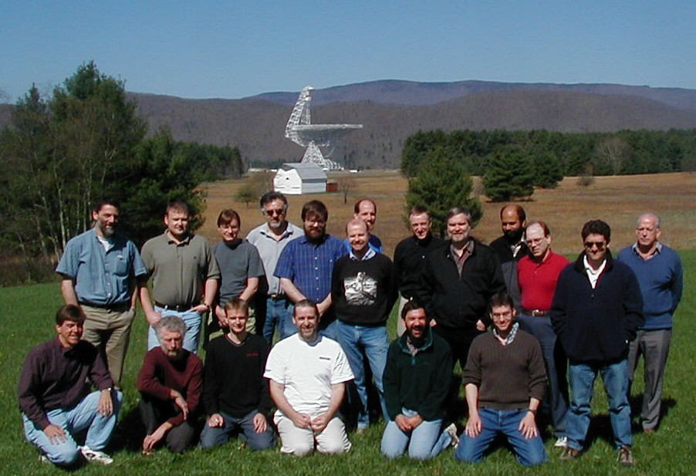
AIPS++ developers
    ATNF
      Wim Brouw, Neil Killeen, Malte Marquarding, Mark Wieringa
    Jodrell Bank Observatory
      No developers at present
    NCSA
      Dave Mehringer, Ray Plante, Harold Ravlin
    NFRA
      Ger van Diepen, Oleg Smirnov
    NRAO
      Jim Braatz, Bob Garwood, Kumar Golap, Athol Kemball, David King, Ralph Marson, Joe McMullin, George Moellenbrock, Darrell Schiebel, Wes Young

Slide 5
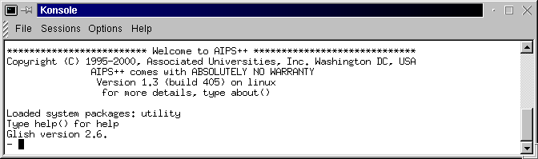
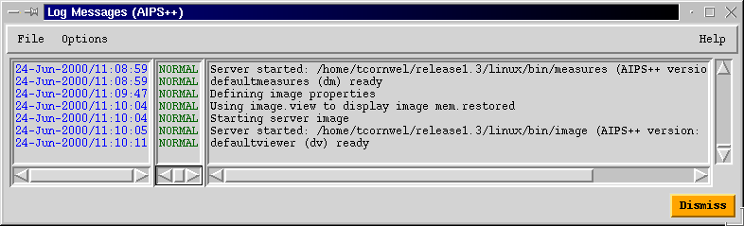
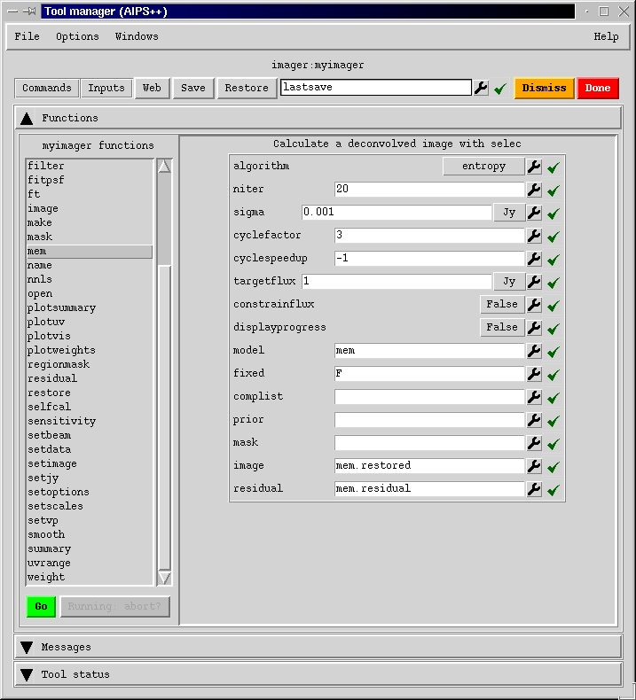
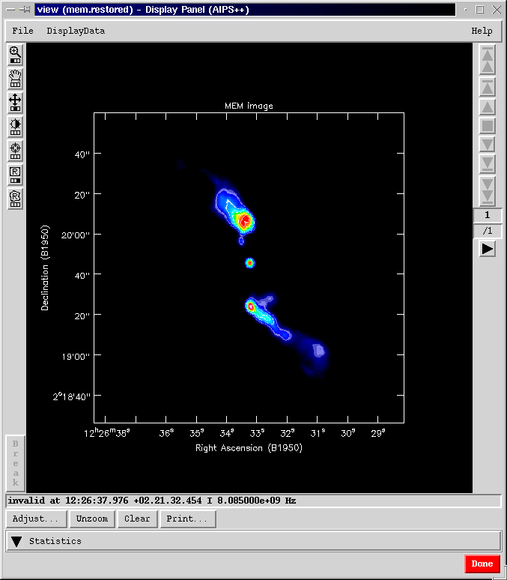
Typical user interaction with AIPS++
Glish
logger
Standard Gui
viewer

Slide 6
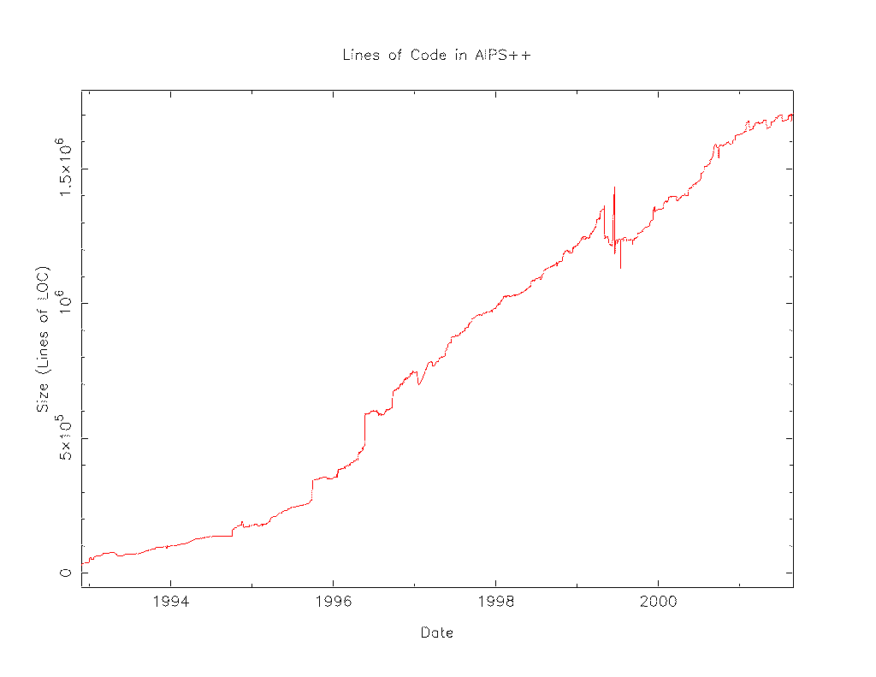

AIPS++ implementation
    C++
      Bulk of code (~ 1,700,000 physical lines)
      C++ libraries have wide range of general utilities for data access, display, calibration and imaging.
    Glish language glues it all together
      ~IDL
      User interface and scripting environment.
      All C++ applications are linked to Glish.
      GUI development via a Tcl/Tk client

Slide 7
Glish language
    ~ Public domain IDL
      C-like syntax instead of FORTRAN-like
      Allows interactive and non-interactive use
    Versatile programming language
      Dynamic typing
      Whole array processing
      Regular expressions
      Heterogeneous records (mixed data types)
      Inter process communication
      Event-driven programming
    Clients can be easily connected to Glish
      Tk widgets for GUI programming
      Make client
      AIPS++ applications

Slide 8
AIPS++ platforms and releases
    Primary compiler is GNU gcc 2.95.3 C++
    Supported operating systems:
      Solaris, Linux, HP/UX, SGI/Irix.
      Linux RedHat 7.*, SuSE 7.*
      Windows NT/2000 in progress
    Canonical desktop machine
      Pentium III or UltraSparc class machine
      128 MB or more memory
      5 - 10 GB disk (or more!)
    Releases
      Every six months for Solaris and Linux
      To obtain AIPS++: request a CDROM from aips2-request@nrao.edu or download the ISO image directly.

Slide 9
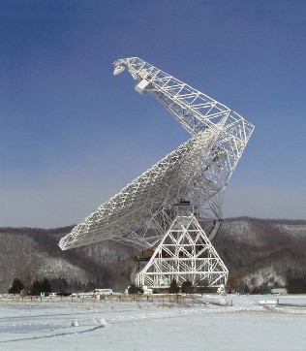
Facility use of AIPS++
  Green Bank Telescope commissioning and science
  Parkes Telescope 21cm multi-beam observations
  WSRT TMS on-line system
  Joint Institute for VLBI in Europe correlator
  Navy Prototype Optical Interferometer development and observing
  HIA/DRAO/ACSIS project for post-correlation processing into an image cube
  ATNF MOPRA telescope for mm observing (in development)
  Consortium data processing and pipelines
  Under evaluation by SMA for commissioning and data reduction.
  Recent adoption by JCMT.
  Proposal for use in NRAL focal-plane arrays.
  Agreed evaluation plan for ALMA through Apr 02 with IRAM data; ALMA membership in the AIPS++ consortium.

Slide 10
AIPS++ Applications
    Applications are packaged in Glish as separate tools
      e.g. imager, calibrater, imagefitter, viewer, etc.
    Each tool has a set of functions for carrying out its associated tasks
      e.g. image statistics, self-calibration.
    Multiple tools may be used together or used in second tier applications
    Tools are extensible by Glish-based plug-ins
      e.g. specialized asciitoimage constructor and image.toascii function to handle conversion of AIPS++ images from and to ASCII formats
      e.g. specialized visibility weighting implemented as a plugin
      Easiest mechanism for user programmability
      Archive and redistribute by email exploder aips2-plugins@nrao.edu

Slide 11
Structure of applications
Multi-level access possible:
Guided reduction, integrated tasks
Highest level access, non-specialist users, pipeline reduction
Custom scientific reduction and scripting
Intermediate synthesis tools (imaging, calibration, image analysis)
Basic astronomical scripting
Lowest level tools (data access, display, computation)

Slide 12
AIPS++ interfaces
    Glish provides the prime command line interface
      Both for user interaction and scripting
    Standard interfaces for tools and functions are constructed from simple meta-information
      Both CLIs and GUIs supported
      Type-specific widgets provide inputs checking, persistence, etc.
      Specialized widgets simplify retrieval of information from data sources
    Customized interfaces for some tools are written in Glish
      e.g. single dish analysis
    Wizards to guide users through sequence of choices
      e.g. standard interferometric imaging
    Vertical integration for complex tools

Slide 13
User interface architecture
Automated GUI
(toolmanager)
Custom GUI’s
Command-line
interface
All tools and functions

Slide 14
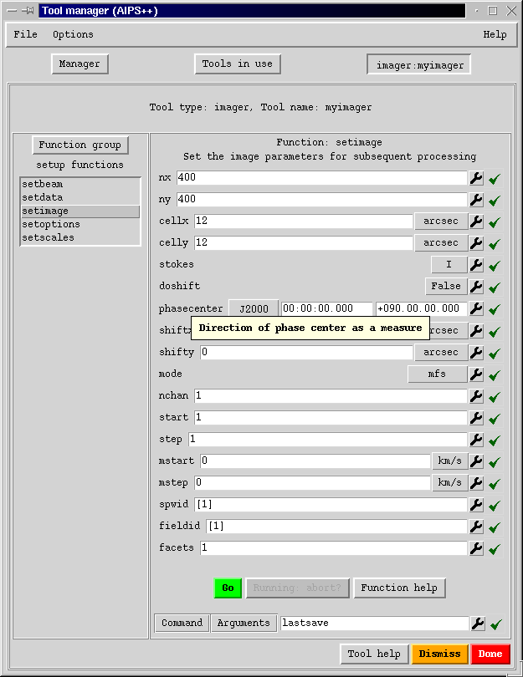
Automated GUI: toolmanager
    Standard GUIs
      Constructed from meta-info
    Intelligent GUI widgets
      Tied to other tools
        e.g. catalog to get files
        e.g. viewer to see images
        e.g. regionmanager
      Cut and Paste
      Save/Restore
    Commands
      Can be viewed and executed
      Saved to a script
      Executed in batch
    Help
      Tight connection to appropriate help

Slide 15
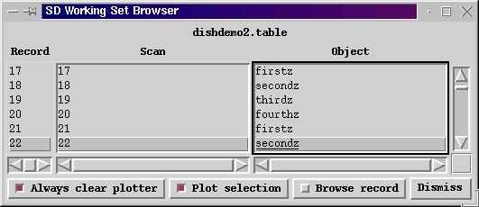
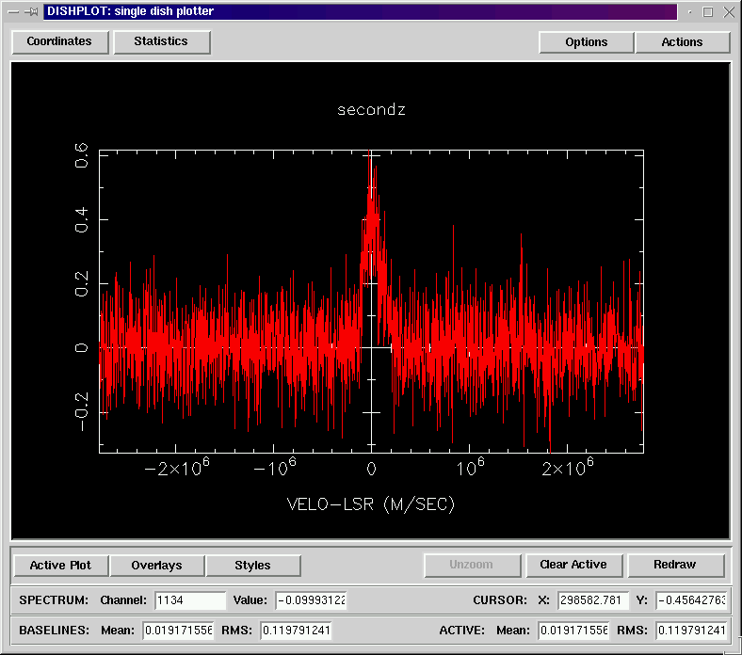
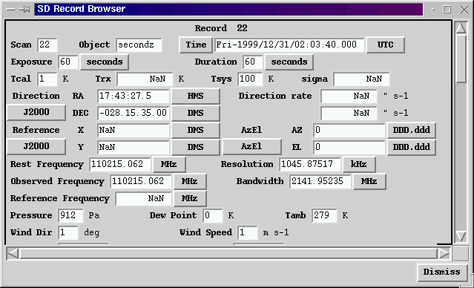
Example custom GUI: dish

Slide 16
Wizards
Simpler but less powerful alternative to vertical integration
  Guide user through processing
setupwizard sets up user environment
  Reads and updates .aipsrc configuration file
imagerwizard for simple imaging
  Built using imager and other tools
  imagerwizard performs step-by-step imaging of synthesis data,
    User selects data
    Cleans a tapered image of the entire primary beam at low resolution
    User interactively selects the region to image at full resolution
    Cleans an image at full resolution
mosaicwizard for mosaicing
  Aids in imaging and deconvolution of mosaics
  Implements nested deconvolution to image broad structures first

Slide 17
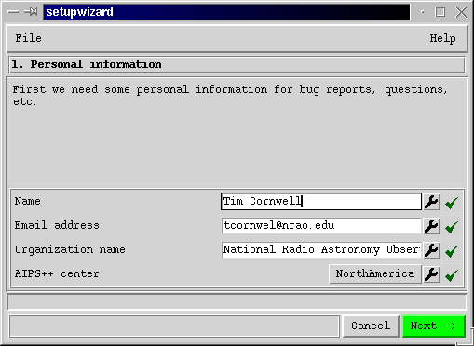
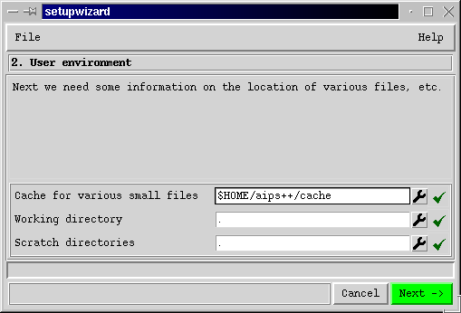
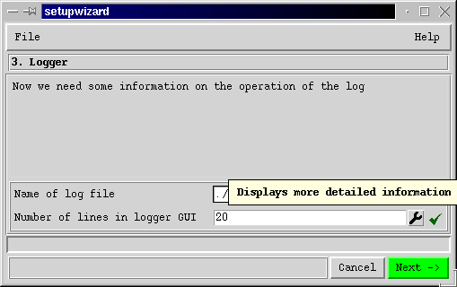
setupwizard

Slide 18
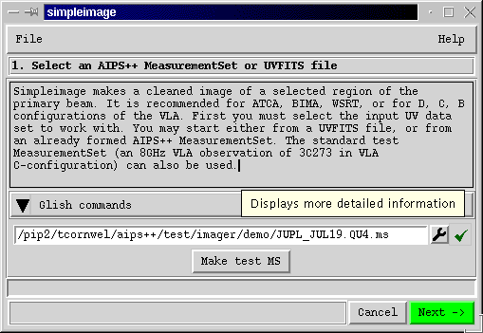
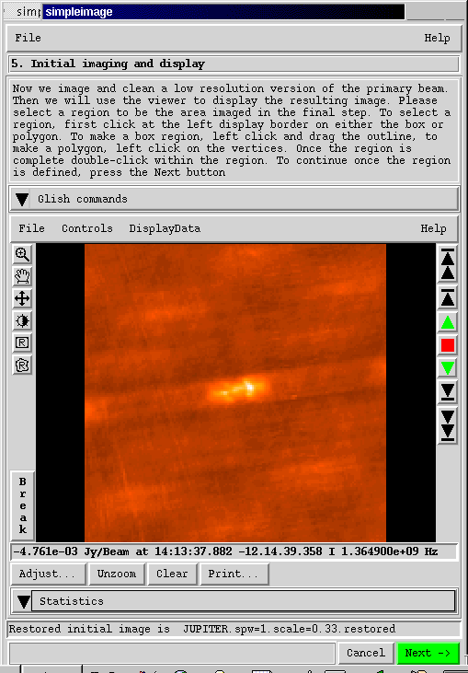
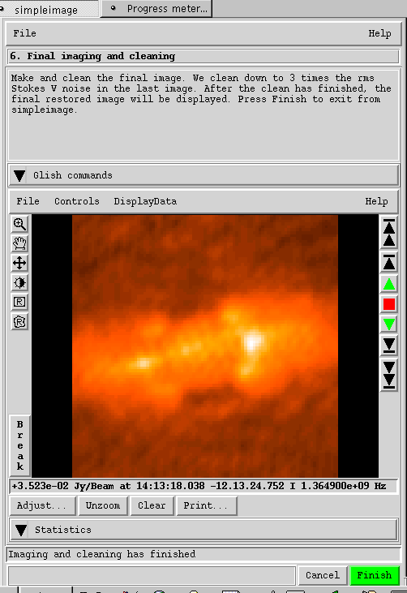
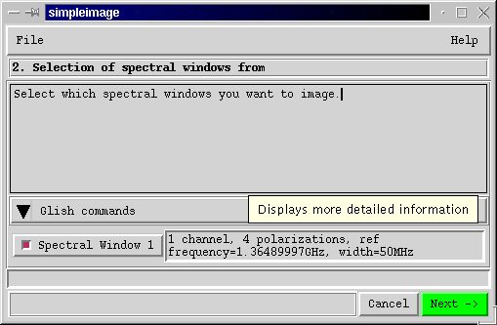
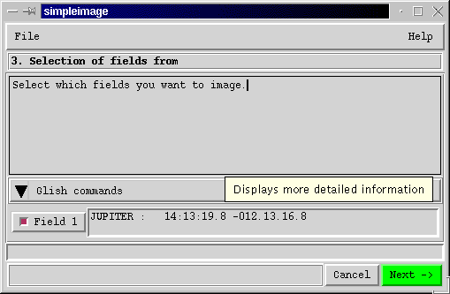
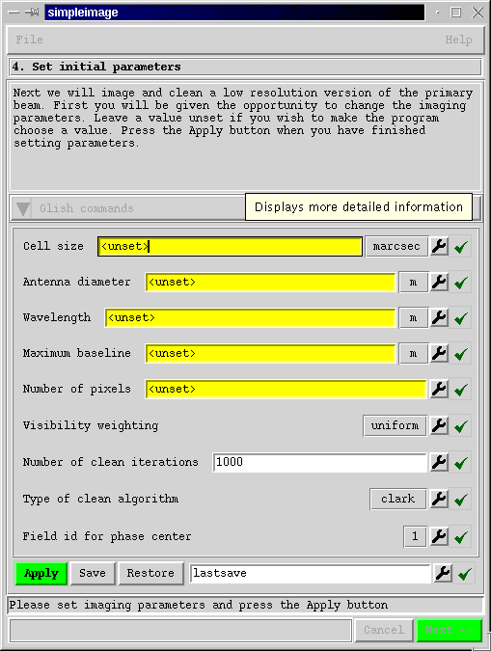
High-level synthesis applications: guided reduction wizards

Slide 19
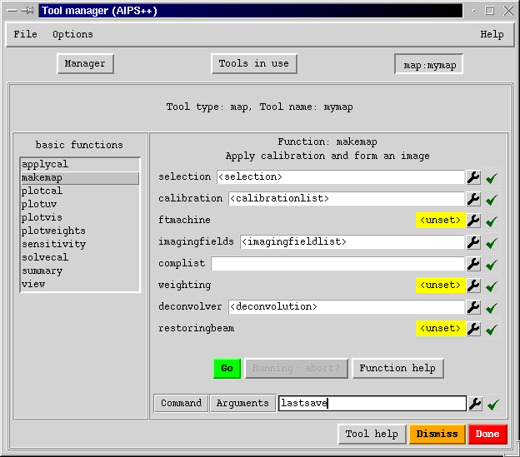
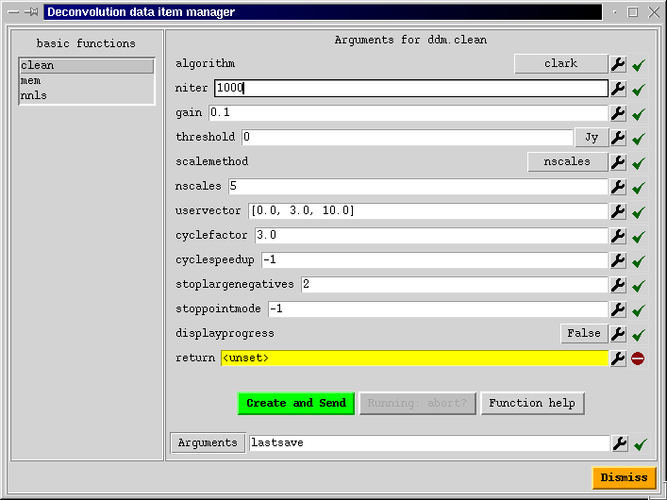
Vertical integration: map
    “Vertical” integration of imager, calibrater and visplot capabilities with no loss of functionality
    ~ Most synthesis processing in one tool
    Complex but very powerful

Slide 20
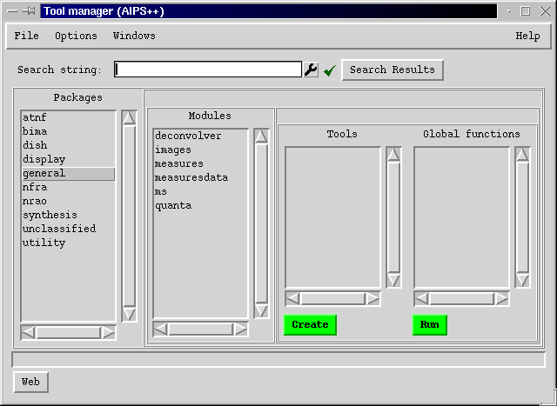
Tool manager
Manage / create individual tools
Constructed from meta-information
Search for key phrases
List of available types of tools, grouped by package and module

Slide 21
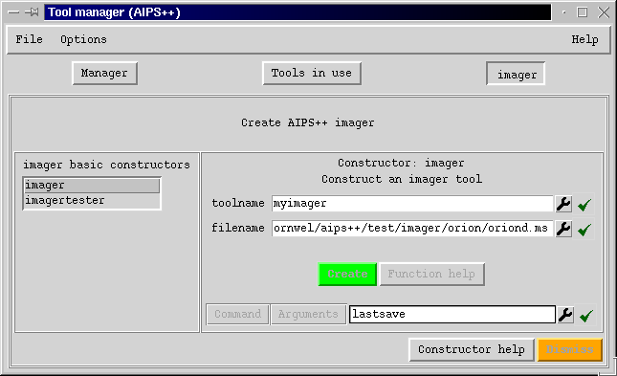
Tool manager
    Creating an individual tool

Slide 22
Tool manager
    Standard GUIs
      Constructed from meta-info
    Intelligent GUI widgets
      Tied to other tools
        e.g. catalog to get files
        e.g. viewer to see images
        e.g. regionmanager
      Cut and Paste
      Save/Restore
    Commands
      Can be viewed and executed
      Saved to a script
      Executed in batch
    Help
      Tight connection to appropriate help

Slide 23
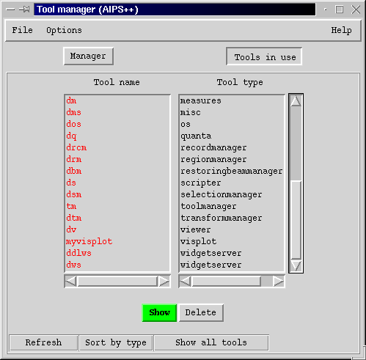
Tool manager
    Tools currently in use
      Shows name and type
      Show GUI
      Delete tool

Slide 24
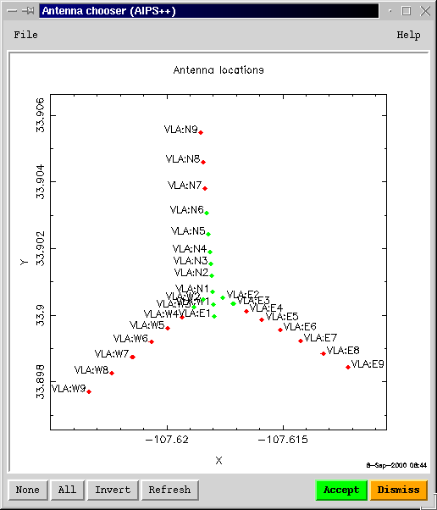
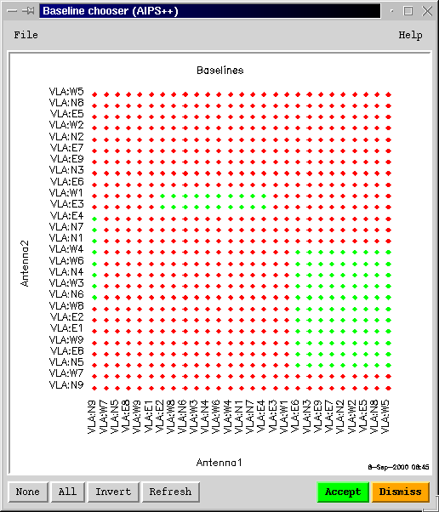
Intelligent data entry capabilities
    Specialized data entry to simplify retrieval of information

Slide 25
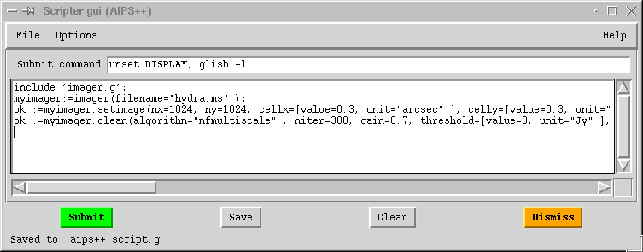
Scripter
    Aids construction of Glish scripts
      Toolmanager and wizards can write equivalent Glish commands to the scripter

Slide 26
Tools: general purpose
    table:
      access to all AIPS++ data
    tablebrowser:
      edit, plot, query, and select data. Configurable.
    viewer:
      display images, tables, measurementsets
    pgplotter:
      plotting of Glish variables using the Caltech PGPLOT library
    quanta and measures:
      measured quantities with units, coordinates, and reference frames; and their conversion
    catalog:
      file manager

Slide 27
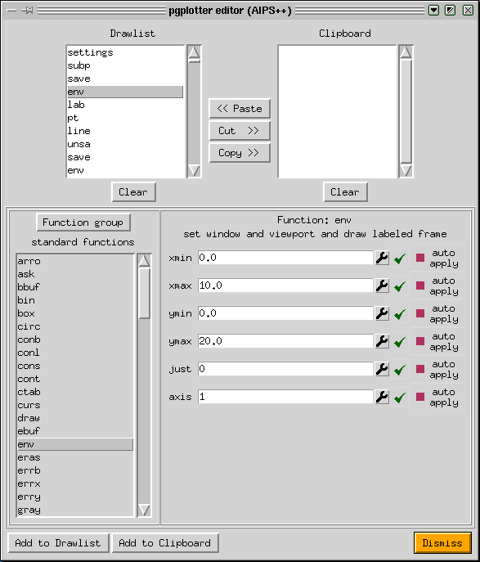
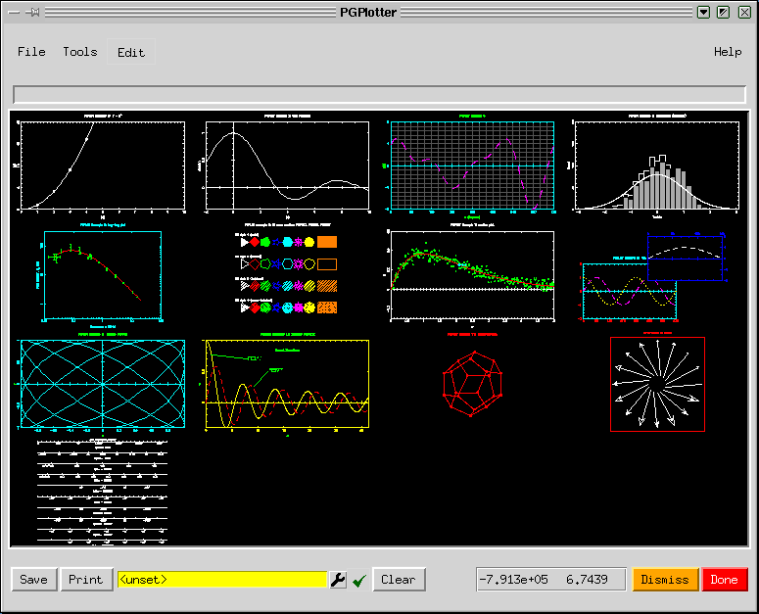
Tools: pgplotter
    Plots from Glish and C++
    Familiar PGPLOT commands

Slide 28
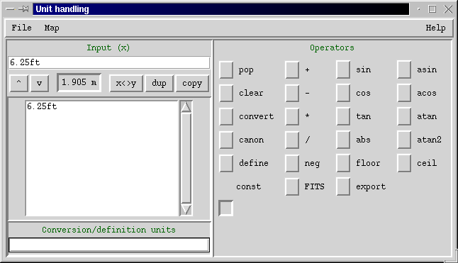
Tools: Quanta
    Values + units: [value=1.905, unit=‘m’]
    Many conversions supported

Slide 29

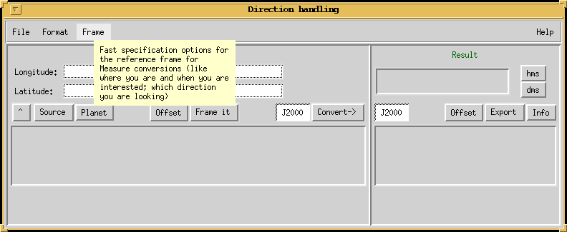
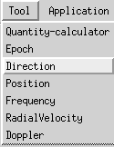
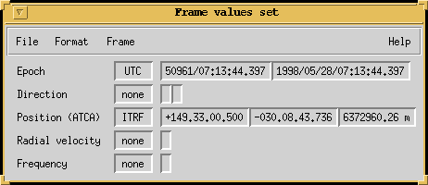
Tools: Measures
    Quanta plus coordinates and reference systems
    Many conversions supported
    Calculate from JPL DE200, DE405; or user-supplied, ephemerides

Slide 30
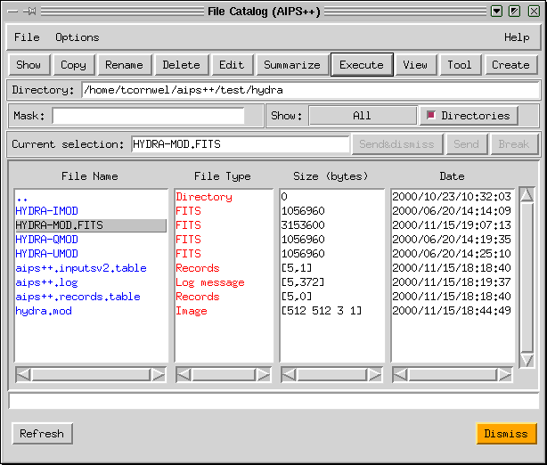
Tools: File Catalog
Used to create, edit, view, delete files

Slide 31
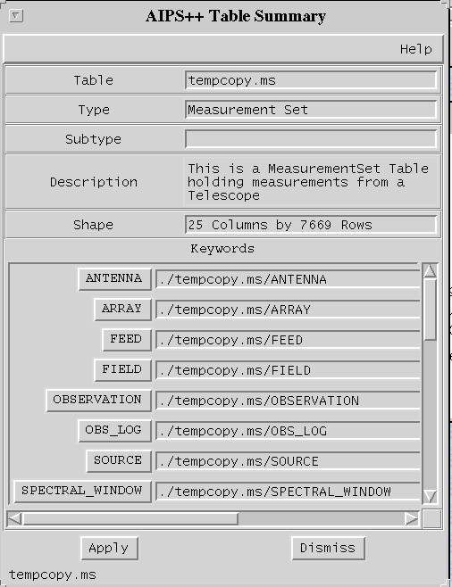
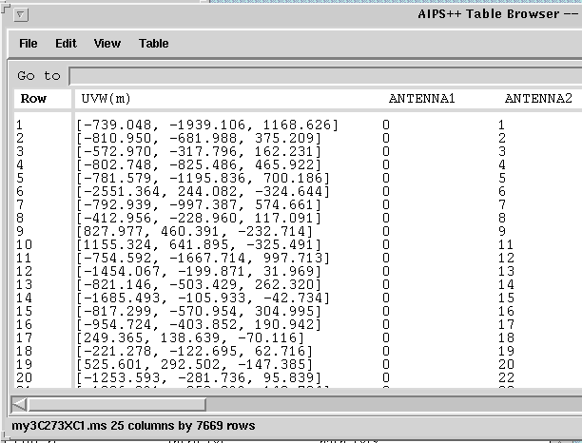
Tools: tablebrowser
    Used to show, edit, select, query tables

Slide 32
Higher-level tools
    dish:
      interactive single dish reduction
    image:
      statistics, histograms, moments.
      Image display using viewer
      image calculator
      image regions
      image polarization
    calibrater, imager, and simulator:
      calibration and imaging using Hamaker, Bregman, Sault generic model
    componentmodels:
      modelling of sky by discrete components
    msplot:
      interactive visibility plotter

Slide 33
Synthesis development: scientific completeness
Data fillers
  available for most consortium instruments and several archive and interchange data formats
Editing and visualization
  editing and visualization of visibility data
Calibration
  solvers for visibility-plane calibration effects; ability to apply image-plane effects.
Imaging
  a range of imaging contexts (mosaic, wide-field etc.) and deconvolution algorithms supported.
Image analysis and visualization
  capable image visualization and analysis tools

Slide 34
Data fillers
Data fillers for specific instruments:
  ATCA
  WSRT
  VLA
  BIMA
  JIVE correlator
  MERLIN (new MERLIN data format; initial version)
  VLBA (initial version)
  JCMT (initial version; written by JCMT)
Data fillers for archive and interchange formats:
  UVFITS
  SDFITS
  FITS-IDI (see VLBA)
  FITS binary table archive format for MS
  Other converters (e.g. SCN etc)

Slide 35
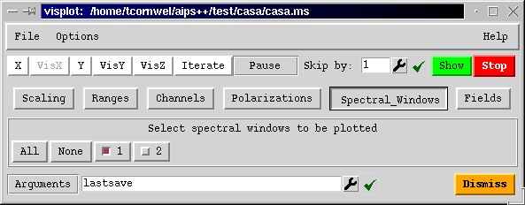
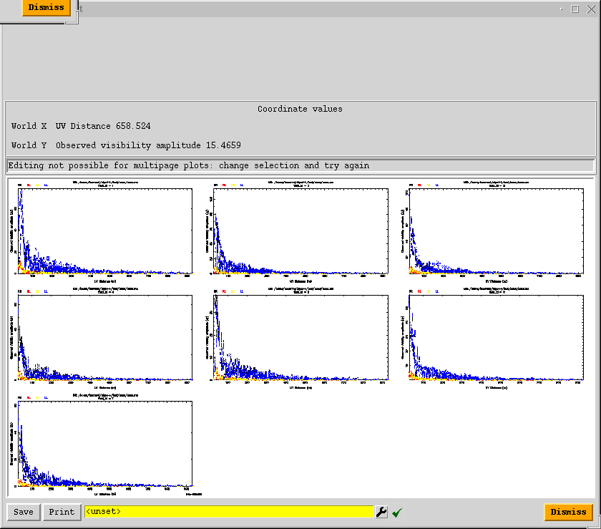
Data display and editing: msplot
    Interactive visibility plotting and editing
Many different types of plot
e.g. Iterate over antennas for diagnosis of problems
e.g. Iterate over fields for mosaic observations

Slide 36
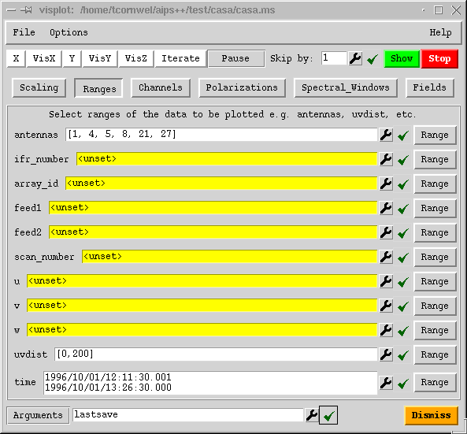
Data display and editing: msplot
    Versatile selection of data

Slide 37
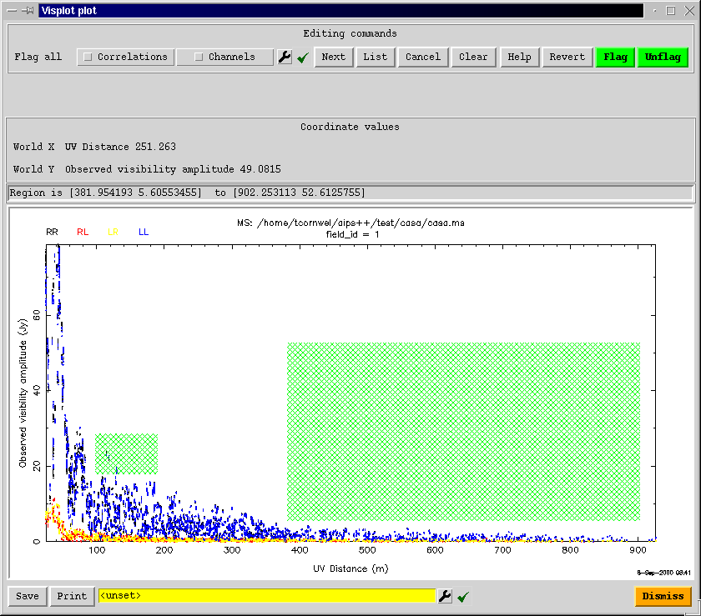
Data display and editing: msplot
    Can edit on any single plot
Regions to be flagged

Slide 38
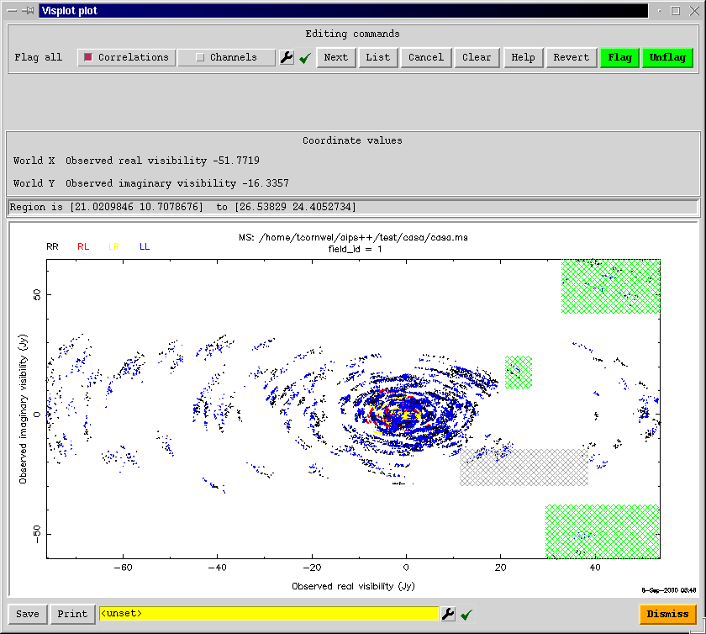
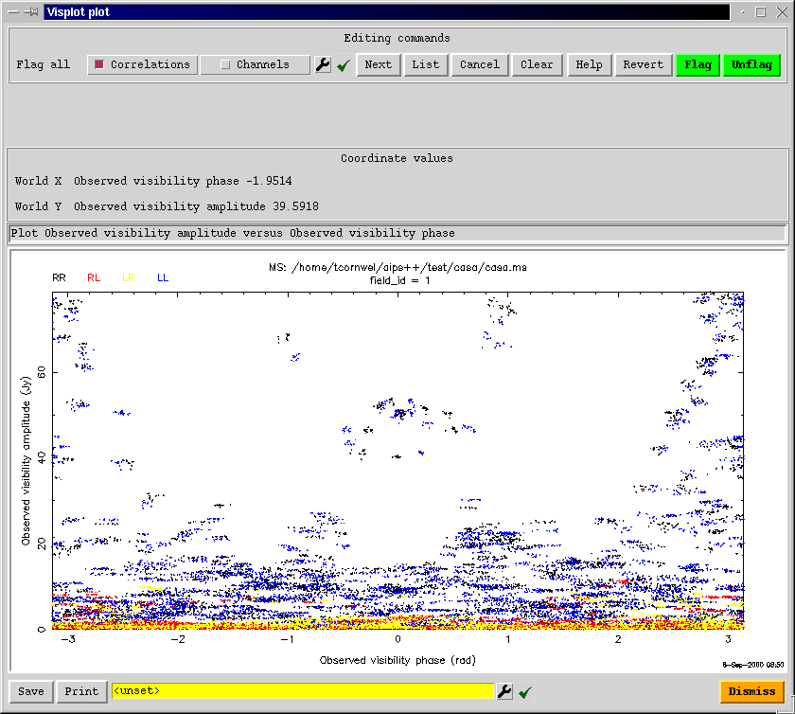
Data display and editing: msplot
    Real vs imaginary of Visibility
    Amplitude vs phase
Flagging regions

Slide 39
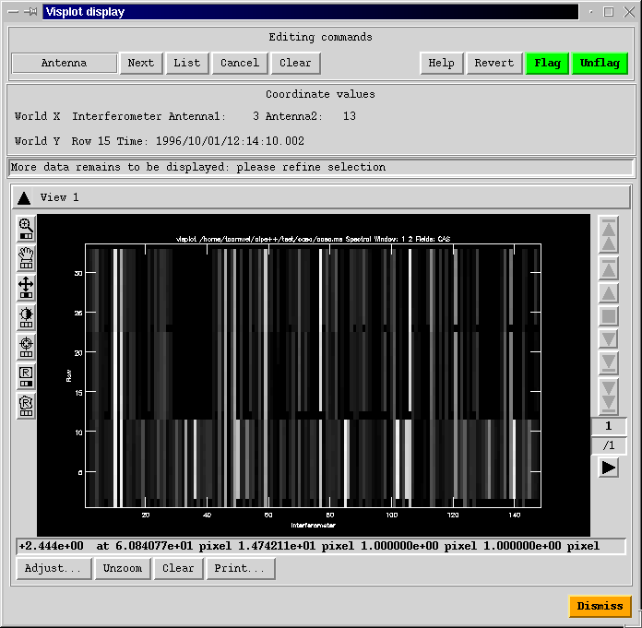
Data display and editing: msplot
Image-like display and editing
Uses standard viewer tool
Axes can be:
  Interferometer
  Time
  Channel
  Polarization
Show and edit in any order

Slide 40
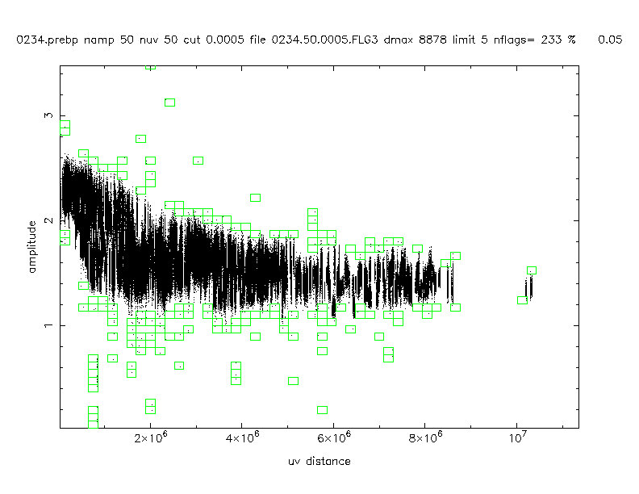
Automated editing
Vital for automated pipeline reduction
Heuristics supported:
  UV-plane binning (as left)
  Median clip in time and frequency
  Spectral rejection (spectral line baseline fitting)
  Absolute clipping in a clip range
Calibrator 0234+285, VLBA project BK31 (Kemball et al.)

Slide 41
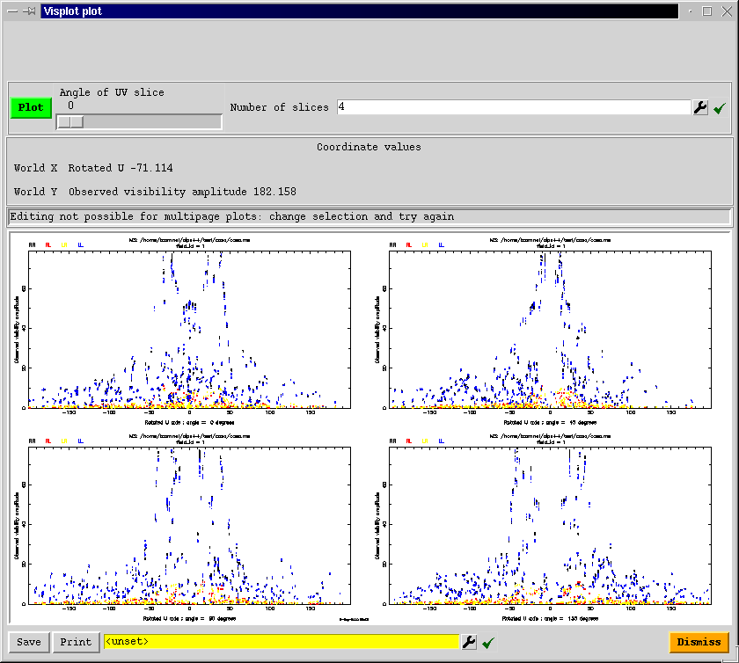
Data display and editing: msplot
    Project to multiple position angles in UV plane
P.A. + 0º
P.A. + 45º
P.A. + 90º
P.A. + 135º

Slide 42
Visibility-plane calibration
Visibility-plane components supported in calibrater
  P - parallactic angle correction (pre-computed).
  C - polarization configuration (pre-computed).
  G - electronic gain, solvable.
  T - atmospheric correction, solvable.
  D - instrumental polarization response, solvable.
  B - bandpass response, solvable.
  F - ionospheric correction, pre-computed from global, empirical model (PIM) (initial version).
Pre-computed, or solved using chi-squared computed from the Measurement Equation (ME).
Pre-averaging, phase-only solutions, and reference antenna selection available in solver.

Slide 43
Imaging capabilities
Imaging of synthesis and single dish data
  Supports polarimetry, spectral-line, multiple fields, mosaicing, non-coplanar baselines (simultaneously)
  Also single dish OTF, holography
  Clean algorithms: Hogbom, Clark, Schwab-Cotton, Multi-scale
  Incremental multi-field deconvolution
  Non-Negative Least Squares and Maximum Entropy deconvolution
  Supports imaging in a wide range of coordinate systems
  Tracks moving objects
  Discrete image component processing
  Flexible in image size (2^{n} not needed)
  Novel “sort-less” visibility gridding algorithm
  Advises on argument settings
  User can “plug-in” customized (Glish) modules
  Pixon deconvolution available in the image plane
  Simulation capabilities

Slide 44
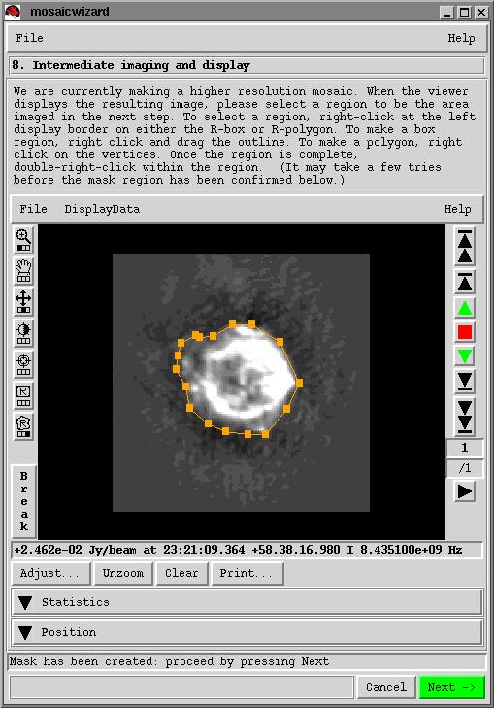
Mosaicing in AIPS++
Mosaicing is standard processing
  Data format supports mosaicing
  Standard tool imager performs mosaicing
Many primary beam models
  e.g. can correct beam squint
Mosaicwizard aids in processing
But also easy to accomplish in glish
# make and deconvolve mosaic image
myimager:=imager(‘orion.ms’);
ok:=myimager.setimage(nx=300, ny=300, cellx=‘4.0arcsec’, celly=‘4.0arcsec’,
stokes=‘I’, spwid=[1, 2]);
ok:=myimager.setdata(spwid=[1, 2] , fieldid=3:11 , msselect='');
ok:=myimager.weight(type="briggs" , robust=-1);
ok:=myimager.setvp(dovp=T, dosquint=F);
ok:=myimager.mem(algorithm="mfentropy", niter=100, sigma=‘4mJy’, displayprogress=T, model="orion.mem");
myimager.done();

Slide 45
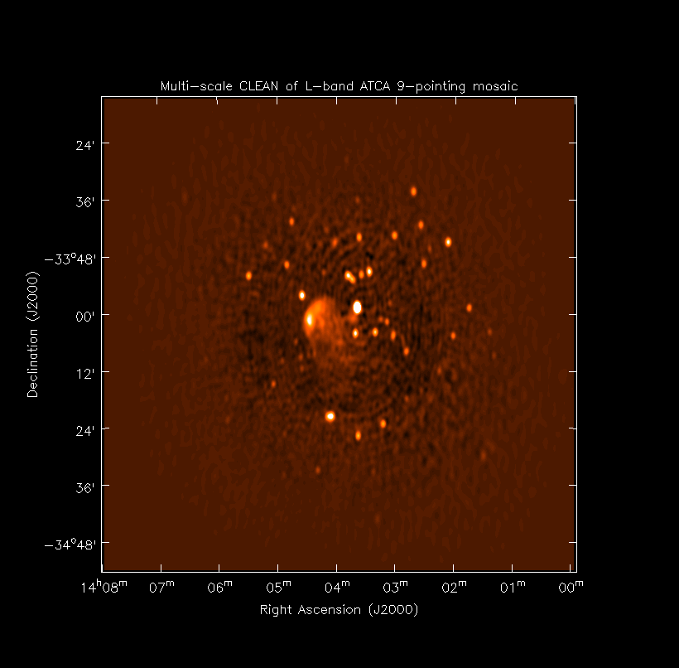
Mosaicing in AIPS++
ATCA 9 pointing mosaic at 1.4 GHz
Uses novel incremental multiscale clean deconvolution algorithm
Maximum Entropy also possible

Slide 46
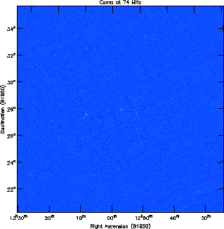
Wide-field imaging
    Wide-field VLA Imaging
      90cm and 4m imaging
      Performs cleaning and self-calibration simultaneously
      Images multiple facets on a single tangent plane
    Written entirely in Glish using first tier tools
      imager, calibrater, viewer
    Parallelized version now available

Slide 47
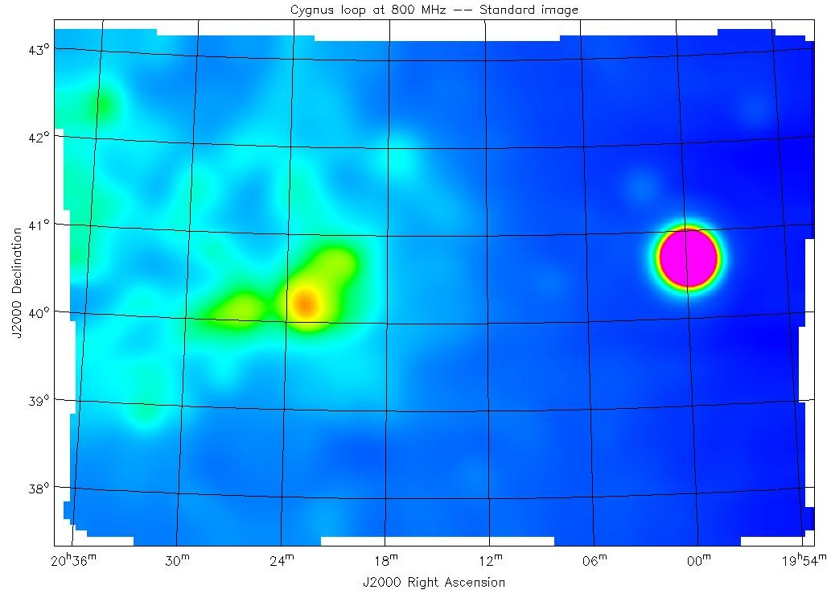
Single-dish imaging
End-to-end single-dish reduction:
GBT image of Cygnus Loop at 800MHz processed end-to-end in AIPS++. The original GBT FITS files for this observation are checked into the AIPS++ data repository and the end-to-end reduction may be repeated using the test function imagersdtest()

Slide 48


Connected-element end-to-end reduction
A important element of scientific integration efforts:
  NRAO has focused on VLA reduction
  Strategy:
    Scientific user groups reduce the data (in collaboration with the project)
    Assess usability improvements based on their experience
    Inter-compare with other packages
    Catalog the reduction scripts and test data in the system
    Use in documentation, tutorial examples and automated system testing
    Other data also selected by the user groups and processed independently
    Select designated test data in all observing modes
  Similar efforts underway at BIMA, WSRT and ATNF

Slide 49
Filling and editing
Filling, editing, calibration and imaging of VLA export tape via a Glish script:
# Wait for each result before proceeding
dowait:=T
# load definitions of synthesis processing functions
include ‘synthesis.g’;
# fill data
include 'vlafiller.g';
ok:=vlafillerfromdisk(filename="N13522.vla" , msname="orion.ms" , project="DSTST" , bandname="X");
# flag known bad data
myflagger:=flagger(msfile="orion.ms" );
ok:=myflagger.quack(scaninterval="5.1s" , delta=‘10.0s’, trial=F);
ok:=myflagger.setantennas(ants=21);
ok:=myflagger.timerange(starttime="21-SEP-2000/11:15:48", endtime="21-SEP-2000/13:38:18", trial=F);
ok:=myflagger.filter(column="DATA", operation="range", comparison="Amplitude", range='1e-6Jy 1e3Jy', trial=F);
myflagger.done();

Slide 50
Calibration
# initialize models of known sources
myimager:=imager(filename="orion.ms" );
ok:=myimager.setjy(fieldid=1, spwid=-1, fluxdensity=-1.0);
ok:=myimager.setjy(fieldid=2, spwid=-1, fluxdensity=-1.0);
# calibrate flux scale and visibilities
mycalibrater:=calibrater(filename="orion.ms" );
ok:=mycalibrater.setdata(msselect='FIELD_ID in [1,2]');
ok:=mycalibrater.setsolve(type="G" , t=300, table="orion.gcal");
ok:=mycalibrater.solve();
ok:=mycalibrater.fluxscale(tablein='orion.gcal', tableout='orion.ref.gcal',
reference='0518+165', transfer='0539-057');
ok:=mycalibrater.setdata(msselect='');
ok:=mycalibrater.setapply(type="G", table="orion.ref.gcal",
select="FIELD_NAME=='0539-057'");
ok:=mycalibrater.correct();
mycalibrater.done();

Slide 51
Mosaicing
# make and deconvolve mosaic image
ok:=myimager.setimage(nx=300, ny=300, cellx=‘4.0arcsec’, celly=‘4.0arcsec’, stokes=‘I’, spwid=[1, 2]);
ok:=myimager.setdata(spwid=[1, 2] , fieldid=3:11 , msselect='');
ok:=myimager.weight(type="briggs" , robust=-1);
ok:=myimager.setvp(dovp=T, dosquint=F);
ok:=myimager.mem(algorithm="mfentropy", niter=100, sigma=‘4mJy’, displayprogress=T, model="orion.mem");
myimager.done();
10 pointing VLA 8 GHz mosaic of Orion processed entirely in AIPS++
Filled from VLA export tape, edited, calibrated, and imaged, displayed using AIPS++ tools

Slide 52

Continuum calibration and single-field imaging
Project AP366:
  Patnaik, Kemball et. al.
24-hour VLA observation in A-configuration of a sample of gravitational lenses
Continuum imaging of 0957+561 at 5 GHz shown here
Phase calibrator 0917+624.
Amplitude calibrator 1331+305

Slide 53

Continuum polarimetry
Continuum polarimetry:
  Solver for instrumental polarization response (D-terms)
  Full second-order model for instrumental polarization.
  D-terms can be time-variable
  Supports (R,L) or (X,Y) data
  Allows polarization self-calibration
1331+305, 5 GHz VLA (part of designated test dataset (G. Taylor (NRAO); project TESTT)

Slide 54

Continuum polarimetry
Sample inter-comparison of polarization calibration: AIPS-AIPS++ (VLA 5 GHz, designated test dataset project TESTT)

Slide 55

Spectral line calibration and imaging
Spectral line reduction
  Designated test dataset: HI observations of NGC 5921 in D-configuration
  Calibrated and imaged, with map-plane continuum subtraction

Slide 56

Spectral line calibration and imaging
Spectral line reduction
  Designated test dataset: HI observations of NGC 5921 in VLA D-configuration
  Bandpass response solutions plotted

Slide 57

Spectral line calibration and imaging
NGC 5921, HI VLA (designated test dataset)
  Dec vs RA
  Dec vs Frequency
  Frequency vs RA

Slide 58
Applications: simulator
Simulation of data from synthesis and single dish radio telescopes
Complementary to imager and calibrater
Two roles:
  Provide synthetic data for testing AIPS++
  Facility for telescope design e.g. ALMA
Can construct MeasurementSet from description of an observation
Can add noise and corruptions of various types
  Based on HBS measurement equation

Slide 59

Image analysis
Image operations
Convert to and from FITS
  Very flexible use of “on-the-fly” images
Display, statistics, histograms, smoothing
Numerous moment calculation methods
Image polarization calculations
Transfer image pixels to and from Glish
Image calculator
  Apply math operations to images, using a syntax based on the AIPS++ Lattice Expression Language
Integrated with regions
  Definition, conversion, math of regions in both pixel and world coordinates
    Coordinate system editing
    Fast, optimized image regridding
    Specialized mage polarimetry
    Component fitting

Slide 60

Image analysis: regions
    Regions are much more powerful than traditional BLC, TRC or simple polygon descriptions of regions-of-interest
Types of region
Operations on regions

Slide 61


Visualization: Display Library and viewer
  Support for display of all AIPS++ data
    Images, MeasurementSets, Tables, Catalogs etc.
    Programmable via Glish or C++

Slide 62

Visualization: viewer features
Vector Maps
Vector map overlaid on a Raster image (both from the same data).
Real data pixel values are mapped to position angles, amplitude is constant.
See image demo for scientific application and parameters of the Adjust gui.

Slide 63
Parallelization and high-performance computing
Joint initiative with NCSA, as part of the Radio Astronomy Application Team in the broader NCSA Alliance program.
Separately funded
Objectives:
  Address computationally challenging problems in radio astronomy which require supercomputer resources.
  Provide infrastructure within AIPS++ to integrate support for high-performance applications.
  Portable parallelization on supercomputers and Linux clusters

Slide 64

Parallel wide-field imaging
VLA observations of the Coma cluster (Perley et al)
225 imaging facets, 32 processors, speed-up factor ~20 to a net 10 hours elapsed time
Work decomposed per imaging facet

Slide 65
Performance of AIPS++ applications
Has to be comparable to other disk-based packages (such as AIPS), else considered a bug.
Try to schedule regular profiling to monitor performance.
No inherent optimization problems encountered so far which do not respond to direct fixes; primarily a matter of resource allocation for evolving code
Have recently been trying to address the degree of user control over memory use
The most computationally demanding applications form part of the parallelization and HPC effort

Slide 66
User documentation
Adopted standard commercial model
  Getting Started
    basic introductory tutorial
  Getting Results
    intent is to act as a cookbook, divided into chapters addressing specific scientific topics (e.g. data editing, calibration, imaging etc.).
    consulted by the scientific end-user.
    linked to Glish recipes and the User Reference Manual.
    separate chapters for end-to-end processing per instrument also (e.g. VLA).
    have recently assigned an editor for GR within AIPS++
  User Reference Manual
    authoritative guide for each synthesis tool and function.
    consulted for the scientific end-user, particularly when developing scripts.

Slide 67

Correctness and testing
Testing strategy is as follows:
  Unit testing in the C++ code library.
  Glish-level integration testing:
    against simulated data (truth).
    against previous results (regression testing)
    against other packages (e.g. AIPS or MIRIAD)
    using designated test data
    interactive testing by user groups and test utilities

Slide 68

Quality assurance
Monitor defect distribution in the package to locate trouble spots
Those to the left are ~ mature
Those to the right are still maturing

Slide 69

Help services and defect reporting
    FAQ online
    ask() function to ask questions of local contact or AIPS++ Project staff
      Questions are harvested for the FAQ
    bug() function to submit a bug report
      AIPS++ Project uses ClearDDTS to manage bug (defect) reports
      Searchable index of bug reports

Slide 70
AIPS++ builds
    release
      last public release of AIPS++ (v1.4), with subsequent patches applied.
    stable
      certified build of development system, which passes a suite of quality assurance standards. A stable build is designated approximately once per month.
    weekly
      weekly build of the current development system; not guaranteed for general use but more stable than daily.
    daily
      daily build of code development system; not recommended for public use.

Slide 71
AIPS++ benefits
    Targeted at radio-astronomy
      but general astronomical tools available
    Supports both off-line and quasi-real-time processing
    Develop in Glish and C++
      Glish for rapid prototyping
      C++ for industrial strength applications
    Tool-kit approach enables ”policy-free" processing
      Total access to all data
    Generic calibration and imaging model
      Applies to both synthesis and single dish reduction

