Slide 1
Code Review
By Matt Eck

Slide 2
Overview
Template.html – This is the base line template that will be used on most of the pages for our project, this pages include, badge overview, my Troop, financial, events, and awards.
TemplateCSS.css – Css file to style the Template page, can be modified to add style for each specific page the template is used for.

Slide 3
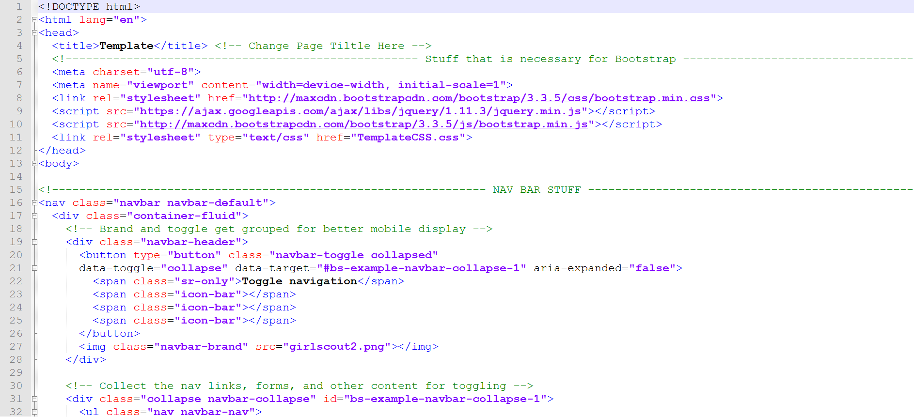
Template.html

Slide 4
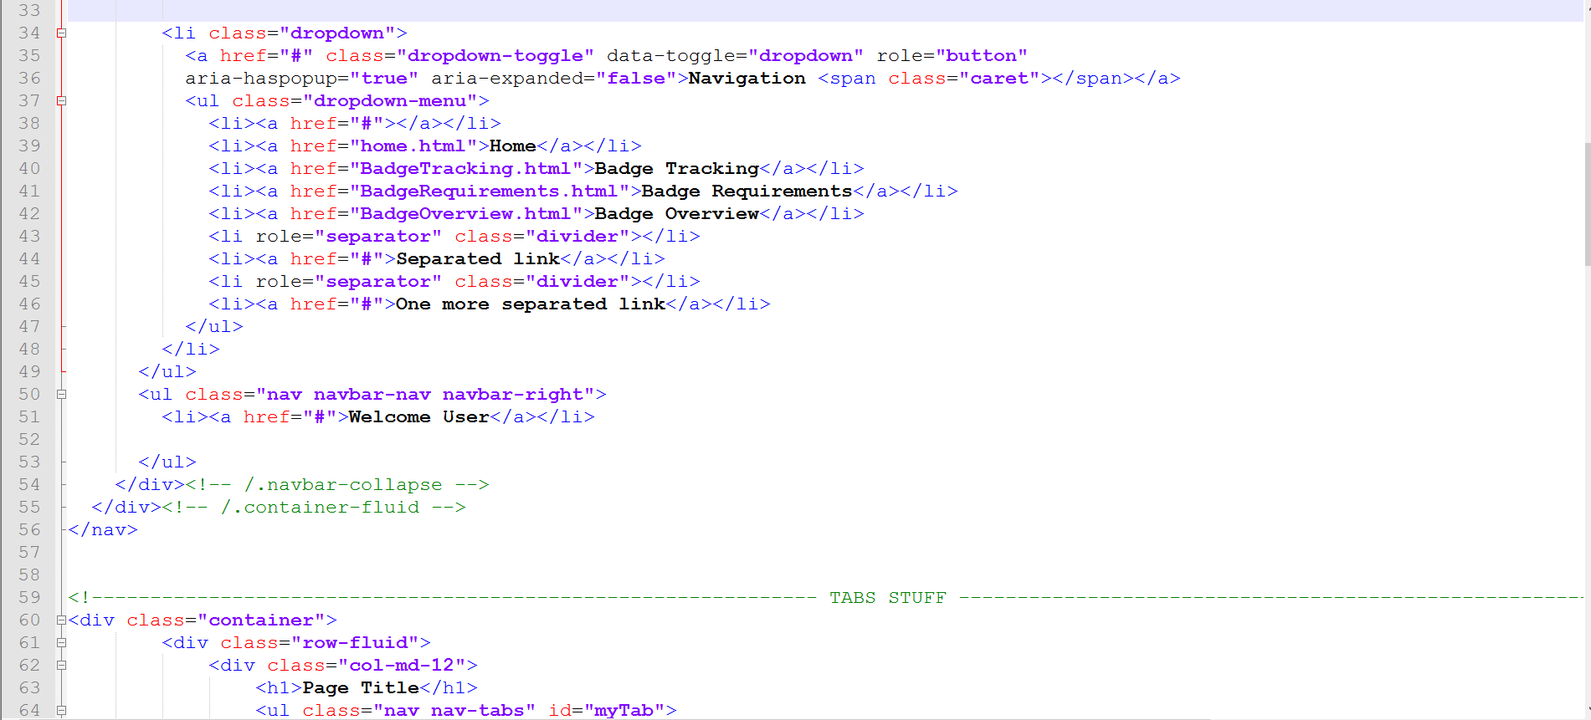

Slide 5
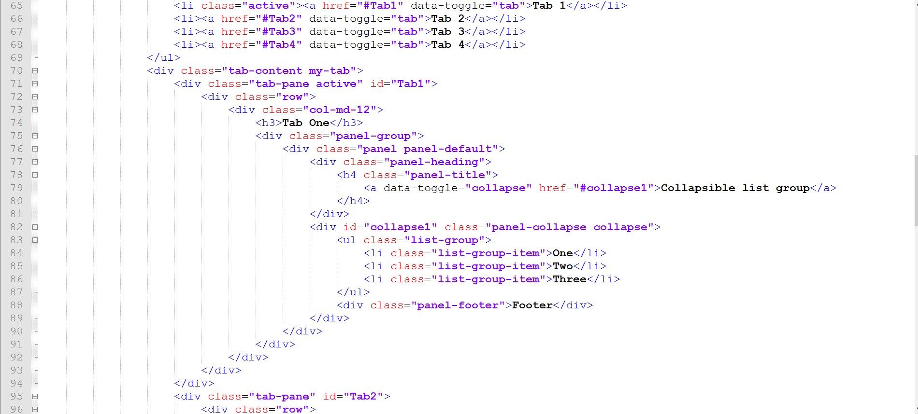

Slide 6
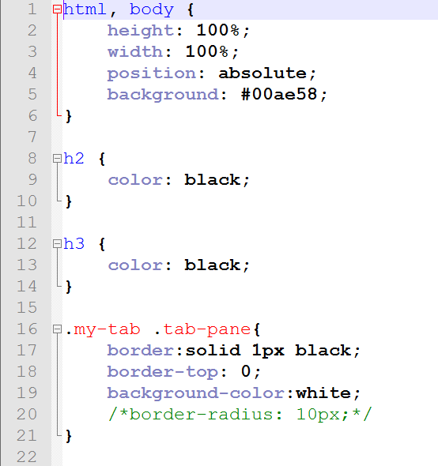
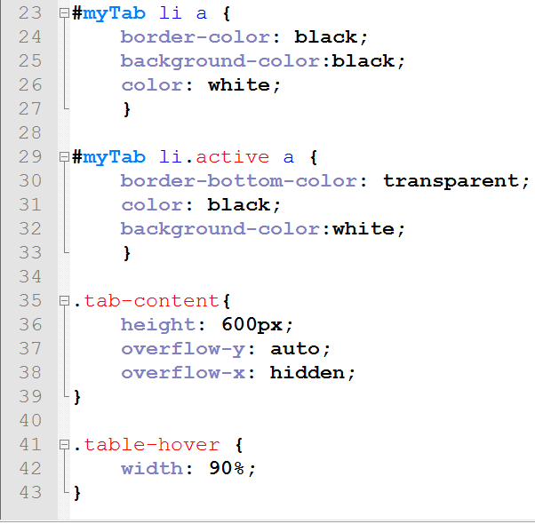
TemplateCSS.css

