Slide 1
Code Review By Ryan Schroeder

Slide 2
Overview
InsertJourneys.py – script used to create INSERT statements for the MySQL database from CSV files.
IS.sql – this file was generated from the above script then loaded into the database
GSA_DB.sql – file created after above inserts were fed into phpmyadmin and exported

Slide 3
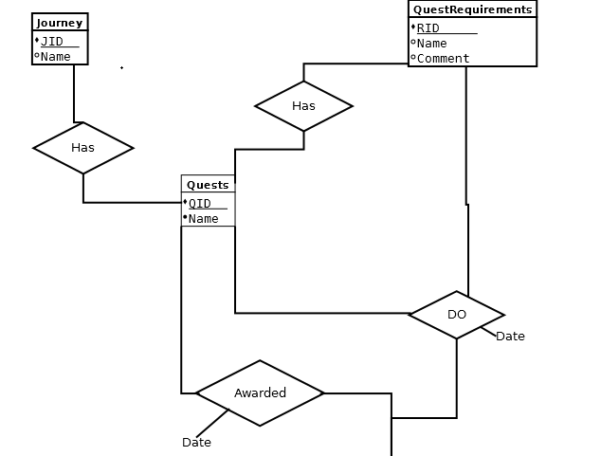
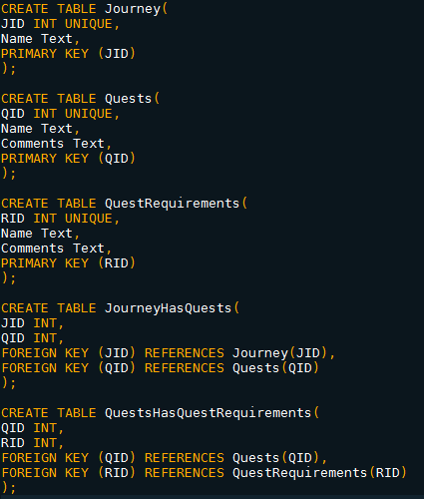
ERD
Schema

Slide 4
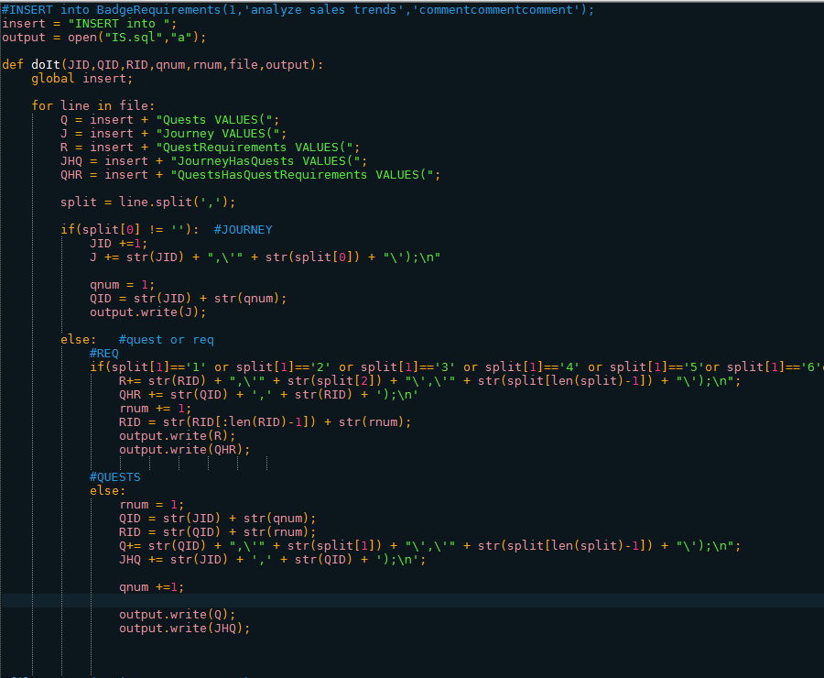
InsertJourneys.py

Slide 5
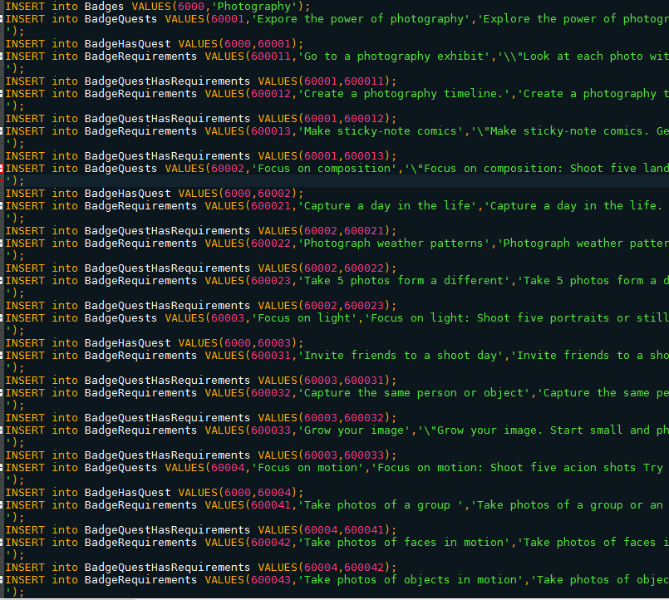
IS.sql

Slide 6
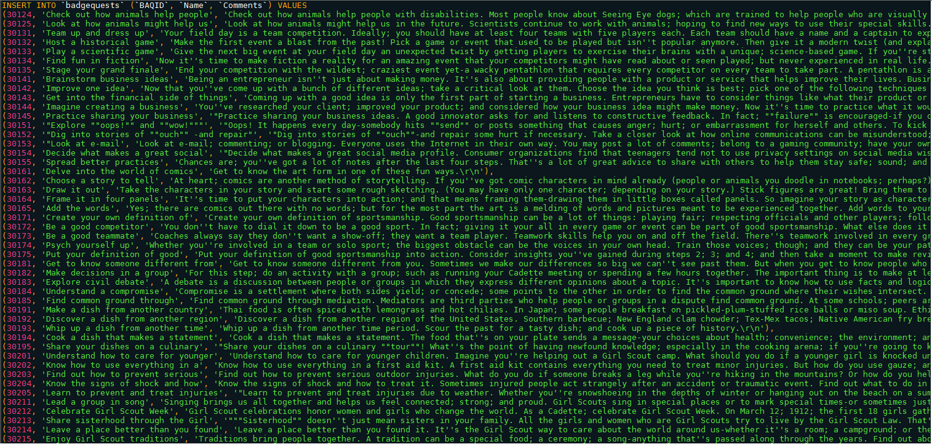
GSA_DB.sql

