Slide 1
Advanced Image Analysis: Overview
Yuting Ma
W4249: Applied Data Science
March,2, 2016

Slide 2
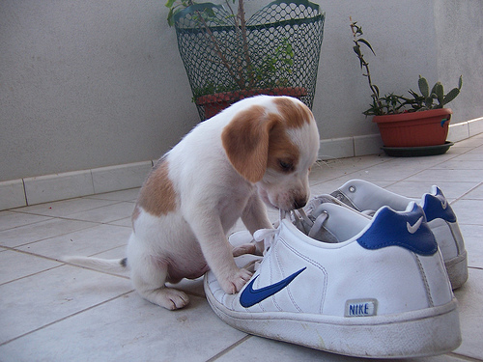
Visual Classification Challenges
Scale
Objects of different sizes
Perspective

Slide 3

Visual Classification Challenges
Viewpoint
Object pose

Slide 4

Visual Classification Challenges
Occlusion
3D scene layout
Articulated entities

Slide 5

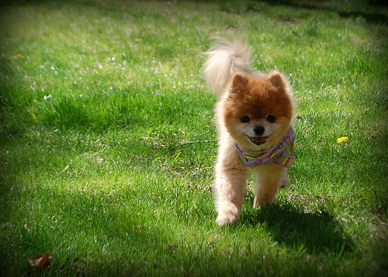

Visual Classification Challenges
Intra-class Difference

Slide 6
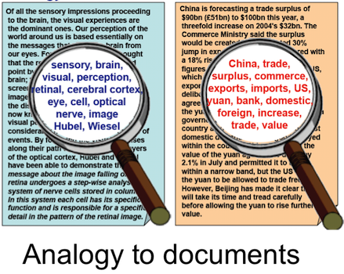
Bag-of-Words (BoW) Model
In natural language processing, a text corpus, such as a sentence or a document, is represented as an unordered "bag" of individual words, regardless of grammar and word ordering.
The bag-of-words model is commonly used in methods of document classification, where the (frequency of) occurrence of each word is used as a feature for training a classifier.

Slide 7
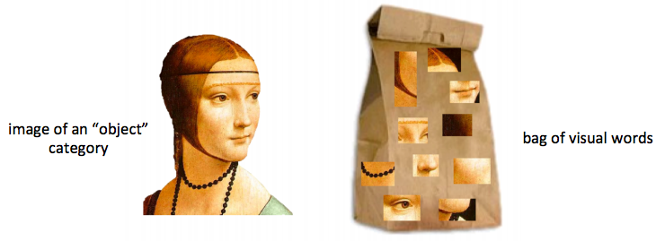
Visual Bag-of-Words Representation
An image can be treated as a document
Local features extracted from the images are considered as the "visual words"
Demo credit: Fei-Fei Li http://vision.stanford.edu/teaching/cs231a_autumn1112/lecture/lecture15_bow_part-based_cs231a_marked.pdf

Slide 8
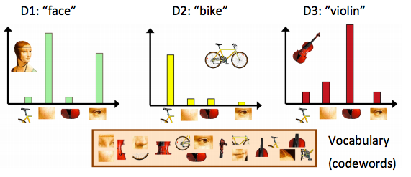
Visual Bag-of-Words Representation
An image can be represented as an unordered collection of visual words, such as histogram.
Demo credit: Fei-Fei Li http://vision.stanford.edu/teaching/cs231a_autumn1112/lecture/lecture15_bow_part-based_cs231a_marked.pdf

Slide 9
Pipeline
Feature extraction
Feature Detection
Feature Description
Visual vocabulary (codebook) construction
Image representation based on learned vocabulary
Learning and Recognition

Slide 10
Pipeline
Feature extraction
Feature Detection
Feature Description
Visual vocabulary (codebook) construction
Image representation based on learned vocabulary
Learning and Recognition

Slide 11
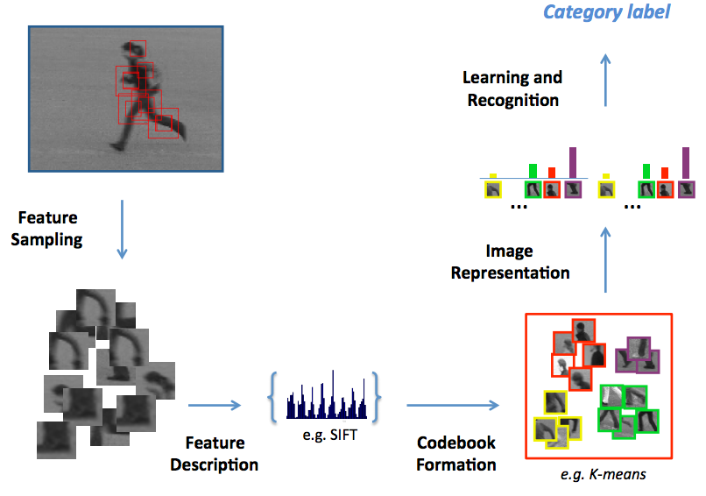
Pipeline
Feature Detection
Demo credit: http://www.micc.unifi.it/downloads/tutorial_bow/tutorial_bow_iciap13_1.pdf

Slide 12
Feature Extraction
Regular Grid
Eg: Dense SIFT
Interest Point Detection
Other Method
Random Sampling
Segmentation-based patches

Slide 13
Feature Detection
Harris Corner Detection
Maximally Stable Extremal Regions (MSER) Feature Detector
Difference of Gaussian (DoG) Feature Detector
Scale Invariant Feature Transformation (SIFT) detector

Slide 14
Feature Description
SIFT Descriptor
Speeded-Up Robust Features (SURF)

Slide 15
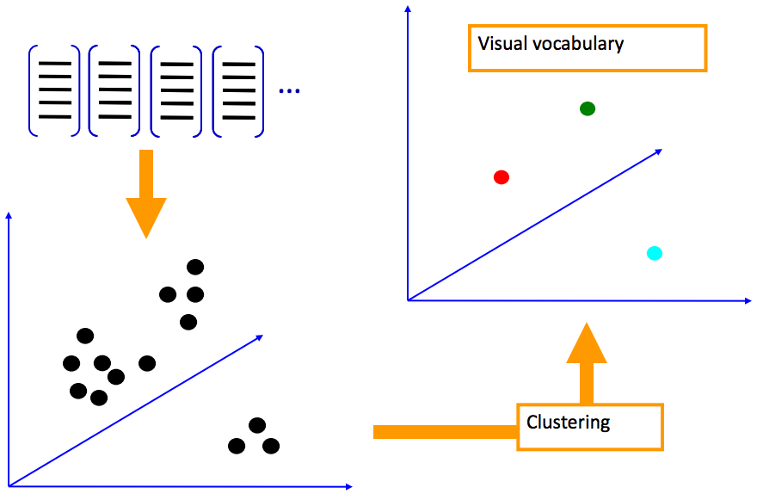
Visual Vocabulary Formation
Demo credit: http://cs.nyu.edu/~fergus/teaching/vision_2012/9_BoW.pdf

Slide 16
Visual Vocabulary Formation
The visual vocabulary can be learned by clustering over detected points with corresponding descriptors.
K-means clustering is commonly used for this purpose.
Randomly initialize K cluster centers
Iterate until convergence
Assign each point to the nearest center
Recompute each cluster center as the mean of all points assigned to it

Slide 17
From clustering to vector quantization
Clustering is a common method for learning a visual vocabulary or codebook
Unsupervised learning process
Each cluster center produced by k-means becomes a codevector
Codebook can be learned on separate training set
Provided the training set is sufficiently representative, the codebook will be “universal”
The codebook is used for quantizing features
A vector quantizer takes a feature vector and maps it to the index of the nearest codevector in a codebook
Codebook = visual vocabulary
Codevector = visual word

Slide 18
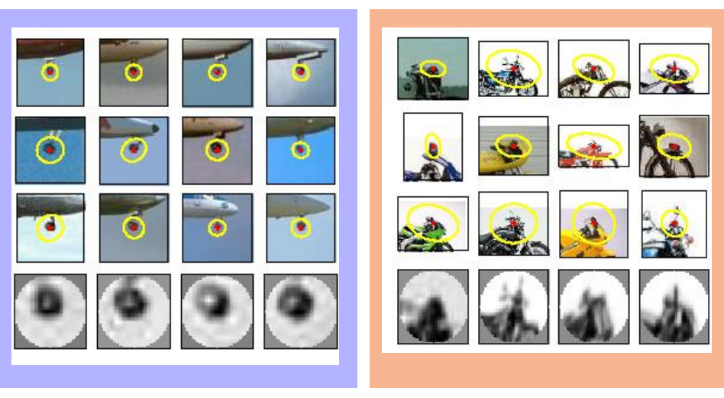
Example Codebook
Demo credit: http://cs.nyu.edu/~fergus/teaching/vision_2012/9_BoW.pdf

Slide 19
Issues of Visual Vocabulary
How to choose vocabulary size?
Too small: visual features are not representative
Too large: visual features are not generalizable & high computational cost
Computational efficiency
May incur high computational time when the number of detected points is large
Subsampling before clustering
K-d tree for efficient storage and search

Slide 20
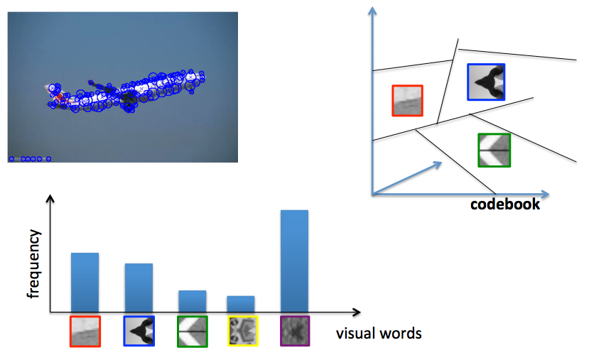
Image Representation
Once the codebook is constructed, each image can be represented by a histogram of visual word frequencies.
Demo credit: http://www.micc.unifi.it/downloads/tutorial_bow/tutorial_bow_iciap13_1.pdf

Slide 21
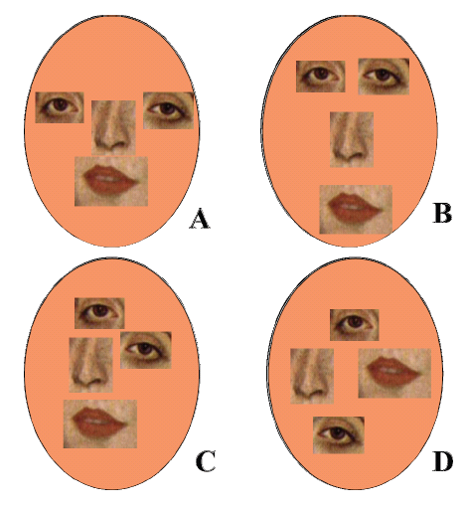
Spatial information
The BoW removes spatial layout.
This increases the invariance to scale, translation, and deformation,
But sacrifices discriminative power, especially when the spatial layout is important.

Slide 22
Spatial Histogram
Represent each local patch of a image with a histogram feature
Concatenate local features as the joint representation
Spatial histograms consist of marginal distributions of an image over local patches
To capture the invariance of object translation, rotation, and scaling
Preserve texture and shape information of an object simultaneously
Reference: http://www.jdl.ac.cn/user/xlchen/Paper/IVC06.pdf

Slide 23
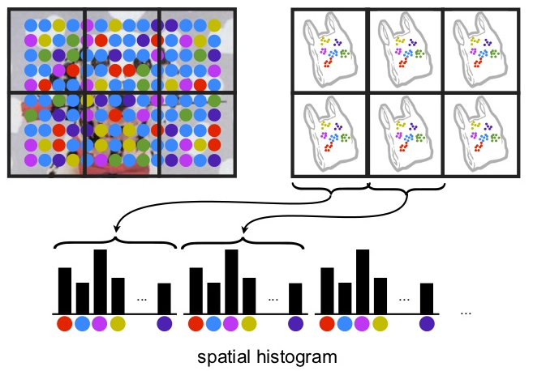
Spatial Histogram
Reference: Lazebnik, Svetlana, Cordelia Schmid, and Jean Ponce. "Beyond bags of features: Spatial pyramid matching for recognizing natural scene categories." Computer Vision and Pattern Recognition, 2006 IEEE Computer Society Conference on. Vol. 2. IEEE, 2006.

Slide 24
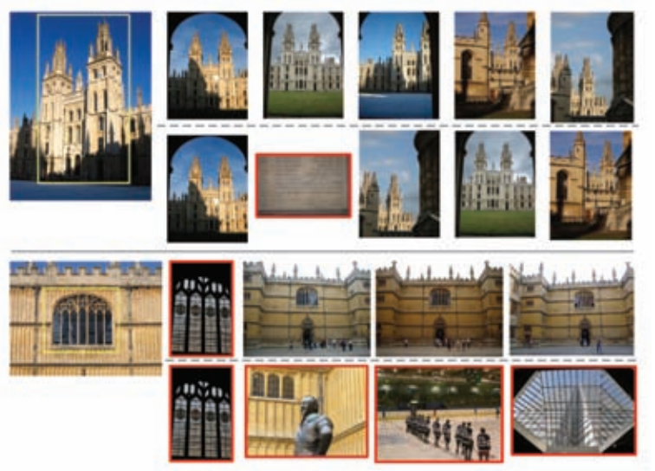
Spatial Histogram
Reference: Cao, Yang, et al. "Spatial-bag-of-features." Computer Vision and Pattern Recognition (CVPR), 2010 IEEE Conference on. IEEE, 2010.

Slide 25
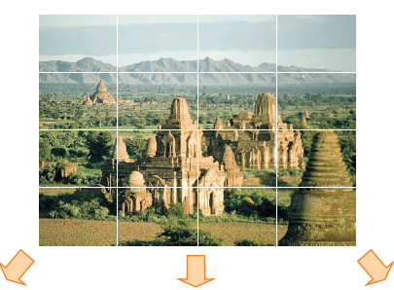
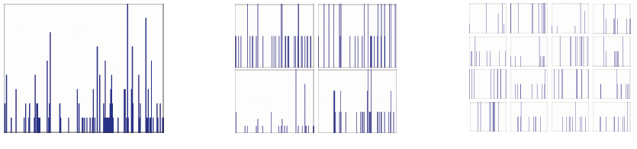
Spatial Pyramid Matching
Compute BoW for image regions at different locations in various scales
Reference: Lazebnik, Svetlana, Cordelia Schmid, and Jean Ponce. "Beyond bags of features: Spatial pyramid matching for recognizing natural scene categories." Computer Vision and Pattern Recognition, 2006 IEEE Computer Society Conference on. Vol. 2. IEEE, 2006.

Slide 26
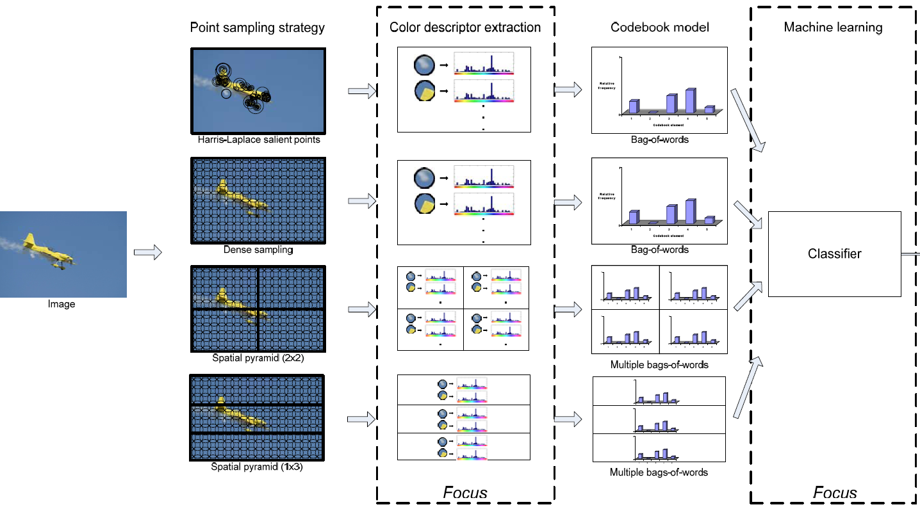
Combining Multiple Descriptors
Multiple Feature Detectors
Multiple Descriptors: SIFT, shape, color, …
VQ Coding and Spatial Pooling
Nonlinear SVM
Demo Credit: SurreyUVA_SRKDA, winner team in PASCAL VOC 2008

Slide 27
Next Step
Image Classification/Recognition based on extracted features.

Slide 28
References
Stanford vision Lab: http://vision.stanford.edu/teaching/cs231a_autumn1112/lecture/lecture15_bow_part-based_cs231a_marked.pdf
NYU Computer Vision Course: http://cs.nyu.edu/~fergus/teaching/vision_2012/9_BoW.pdf
U Texas Visual Recognition Course: http://www.cs.utexas.edu/~grauman/courses/fall2009/papers/bag_of_visual_words.pdf
Int‘l Conference on Image Analysis and Processing (ICIAP) 2013 Tutorial https://sites.google.com/site/iciap13handsonbow/
ECCV-2010 Tutorial: Feature Learning for Image Classification http://ufldl.stanford.edu/eccv10-tutorial/

