Slide 1
INSIGHTS ON US MASS SHOOTINGS
SAI AMARNATH CHINTHA
DHARA MANDAL

Slide 2
INTRODUCTION

Slide 3
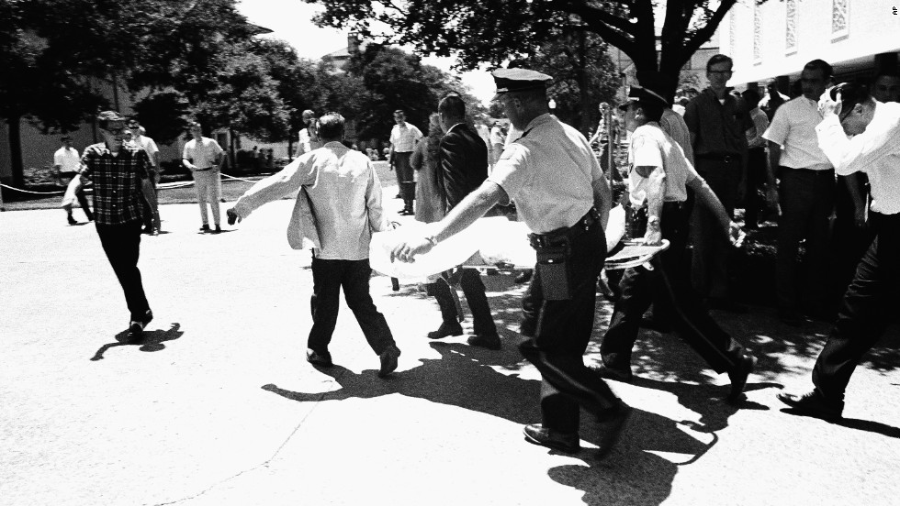
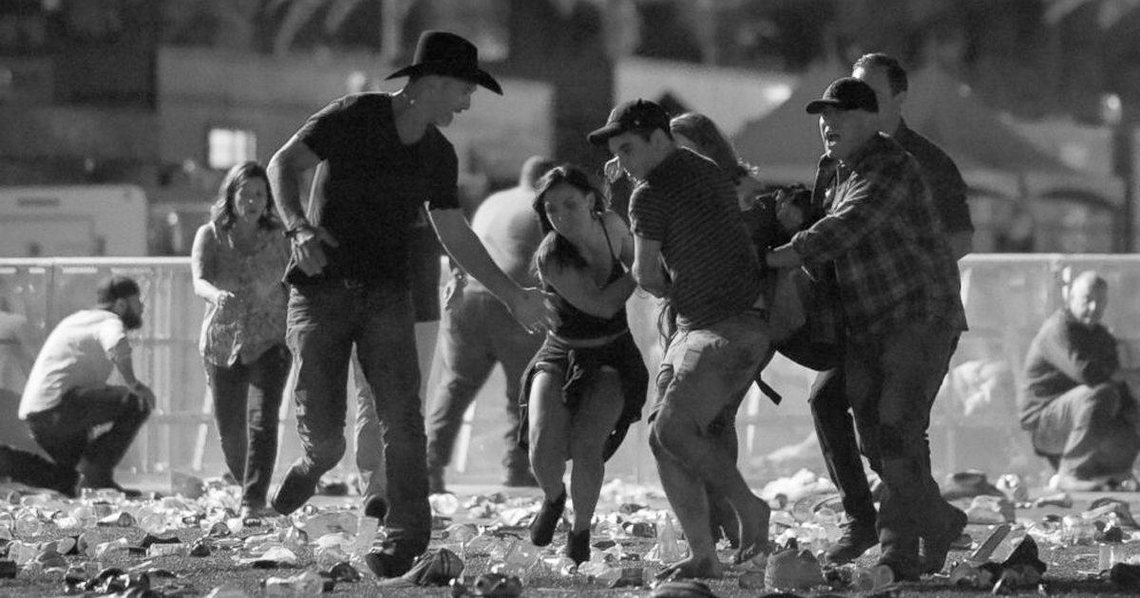
MASS SHOOTING IN FLORIDA AND LAS VEGAS

Slide 4
STATISTICS
2009 -2017 there were 398 mass shootings
1,187 victims shot
848 people were shot and killed, and 339 people were shot and injured.
66 perpetrators killed themselves after a mass shooting,
Another 17 perpetrators were shot and killed by responding law enforcement.

Slide 5
HOW WE CAN AVOID THIS ????
The shooter executes a warning signs before shooting

Slide 6
DATA MINING TECHNIQUES AND DATA ANALYSIS
Key elements to predict the future
Figuring out the root of the issue
Analyzing the real time data. Example Twitter
Victim and also Victimizer data plays a major role

Slide 7
DATASET DESCRIPTION
shootings.csv taken from Kaggle
Details of mass shootings in United States from 1966-2017
The dataset contains detailed information of 398 mass shootings in the United State

Slide 8
DATA DESCRIPTION
Case
Title
Location
Date
Summary
Fatalities
Injured
Total Victims
Mental Health Issue
Prior sign
Gender
Lat-Long information

Slide 9
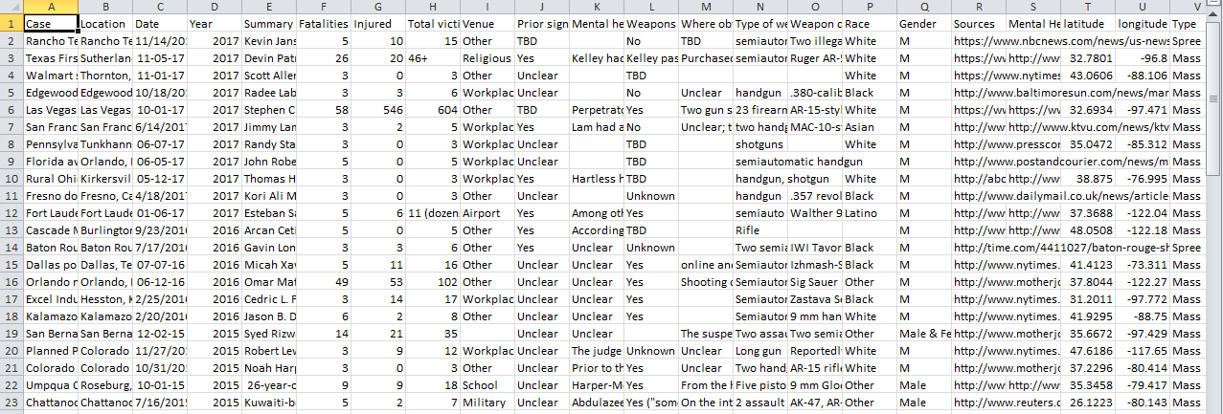
SHOOTING.CSV

Slide 10
ACCESS THE DATA
Pandas library in Python is used.
Pandas stands for “Python Data Analysis Library”.
OPEN SOURCE PROJECT
Pandas is a NumFOCUS sponsored project.
Pandas take data (like a CSV or TSV file, or a SQL database) and creates a Python object with rows and columns called data frame.

Slide 11
INSIGHTS
How many people got killed and injured per year?
Is there any correlation between shooter and his/her gender.
What cities and states are more prone to such attacks.
How many shooters have some kind of mental health problem? Can we compare that shooter with general population with same condition.

Slide 12
GRAPH ANALYSIS
1. Number of attacks per year
2. Number of attacks by state
3. Number of attacks by Gender
4. Number of attacks by the mental health of the shooter

Slide 13
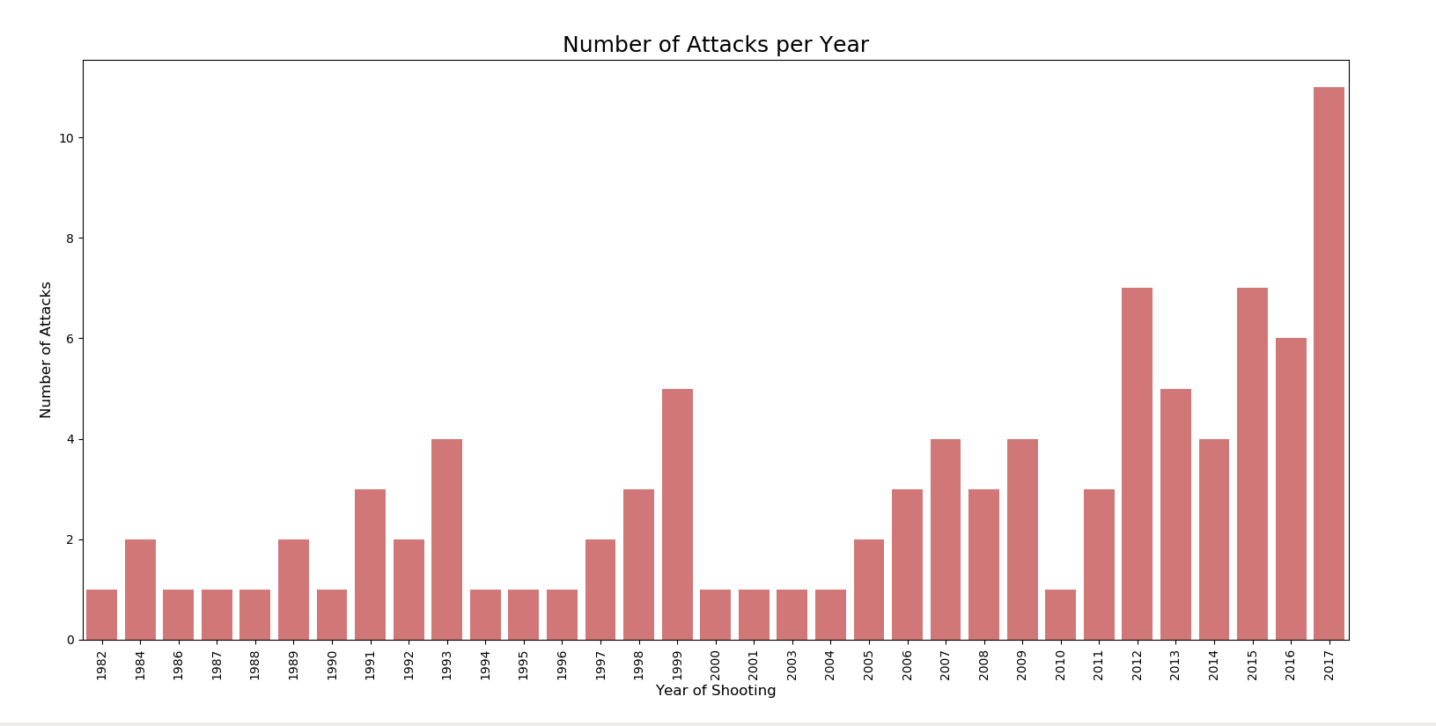
NUMBER OF ATTACKS PER YEAR

Slide 14
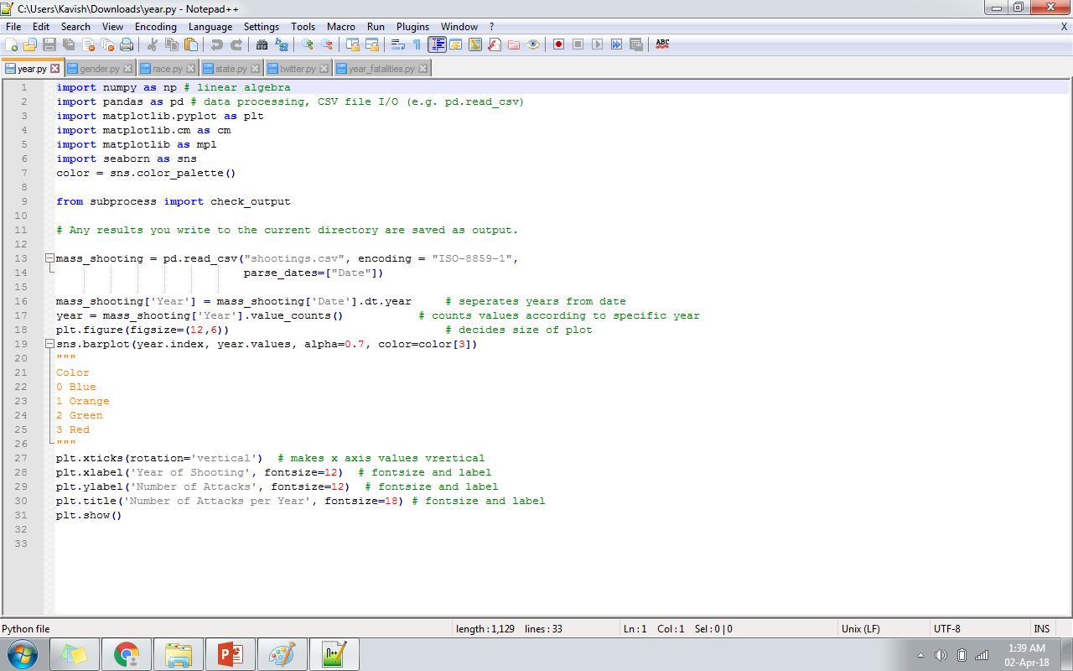
CODE:

Slide 15
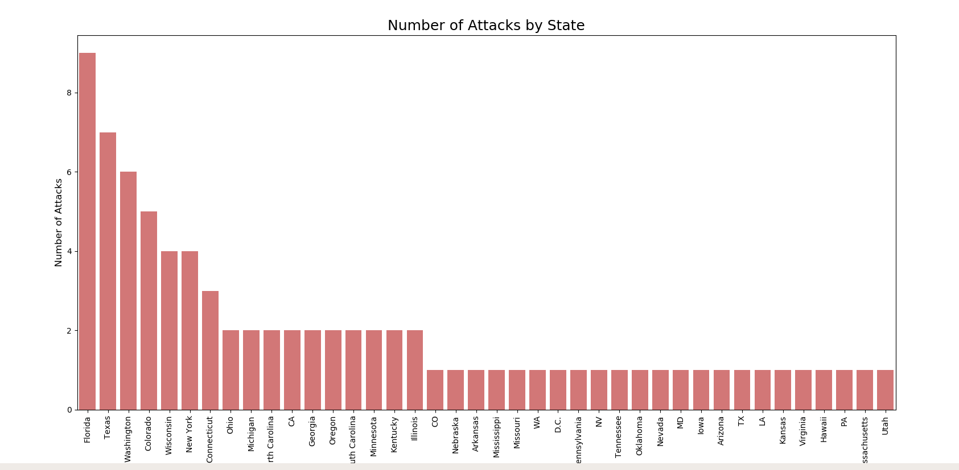
NUMBER OF ATTACKS BY STATE

Slide 16
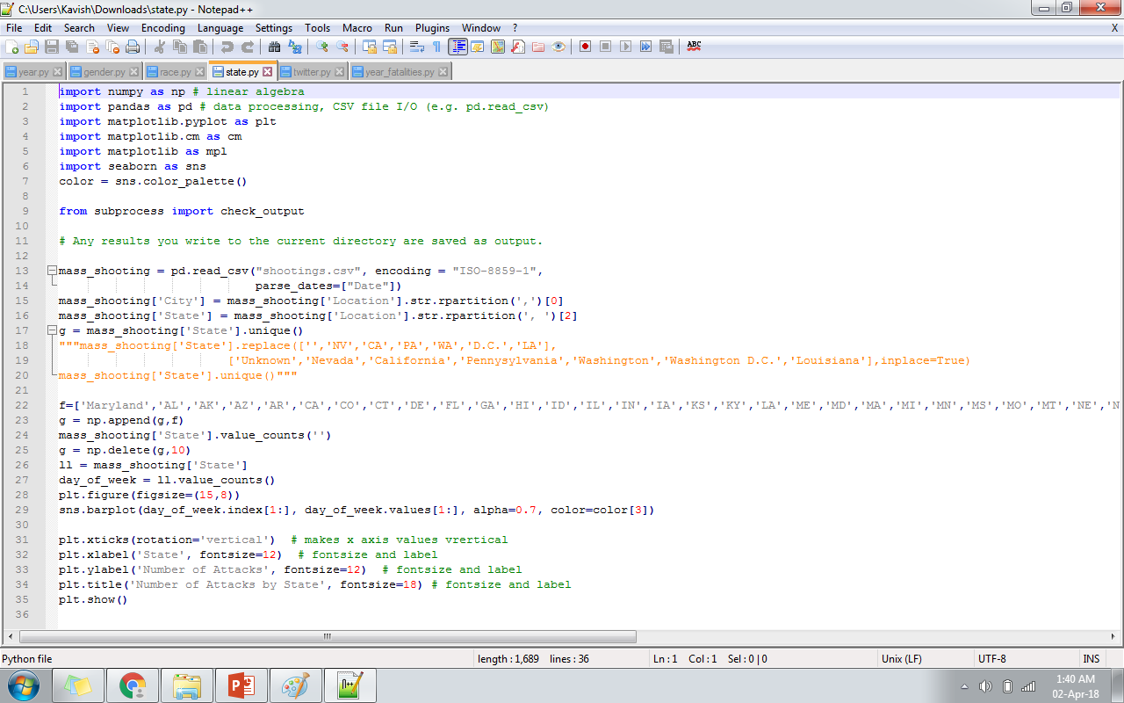
CODE:

Slide 17
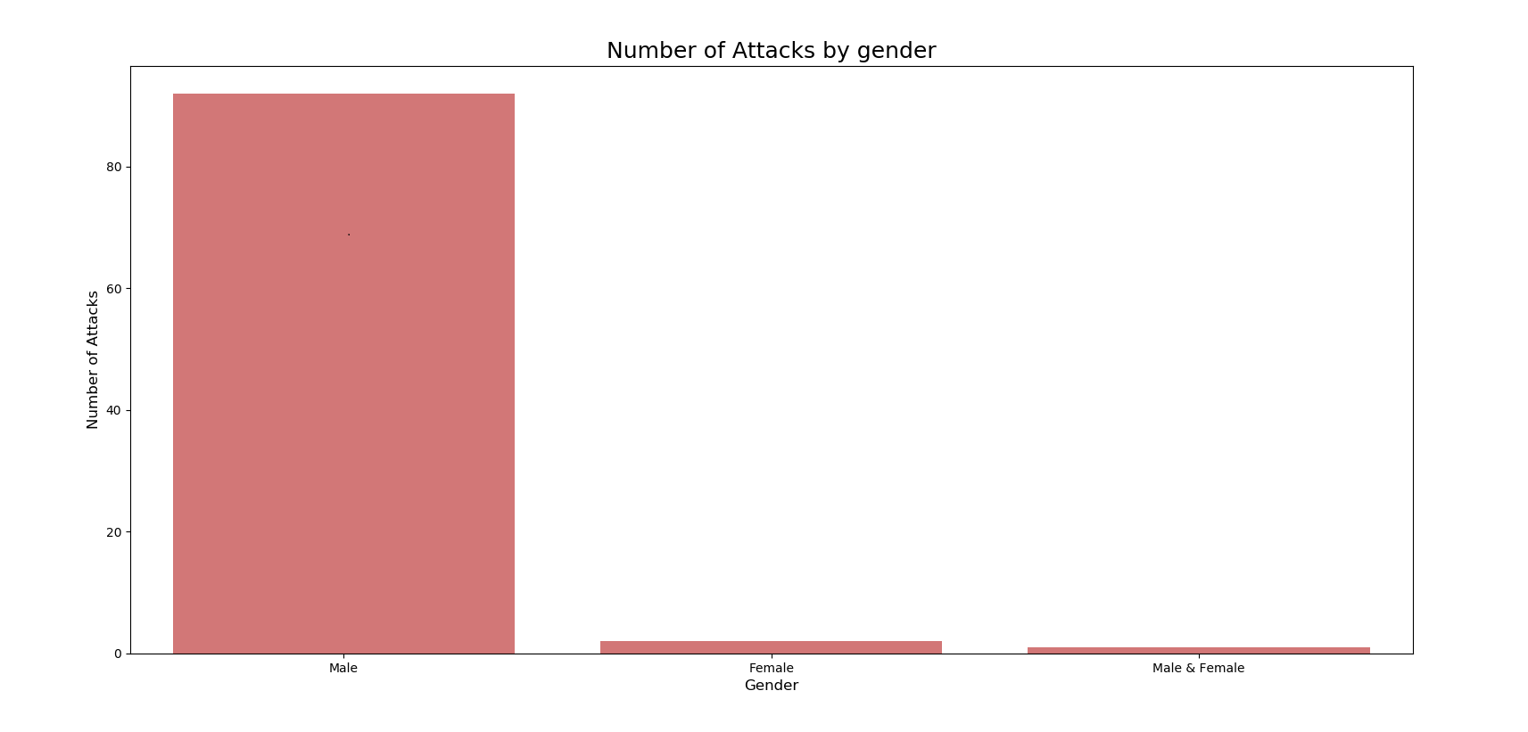
NUMBER OF ATTACKS BY GENDER

Slide 18
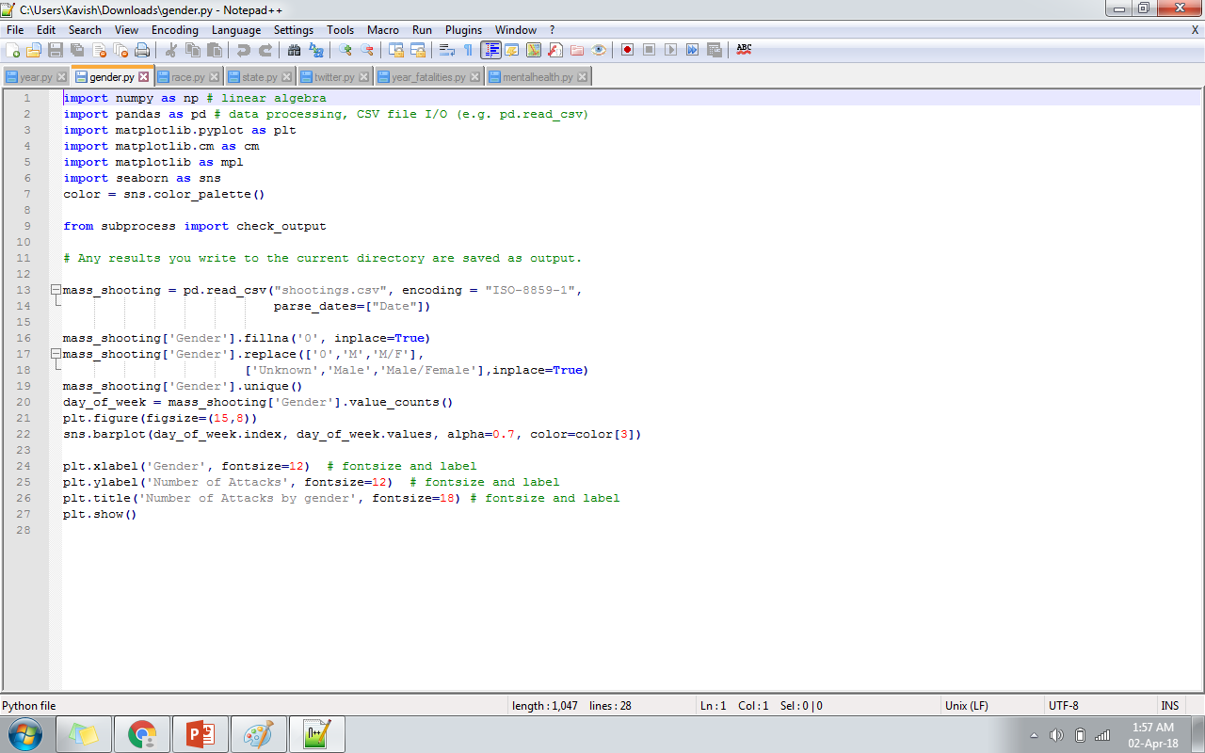
CODE:

Slide 19
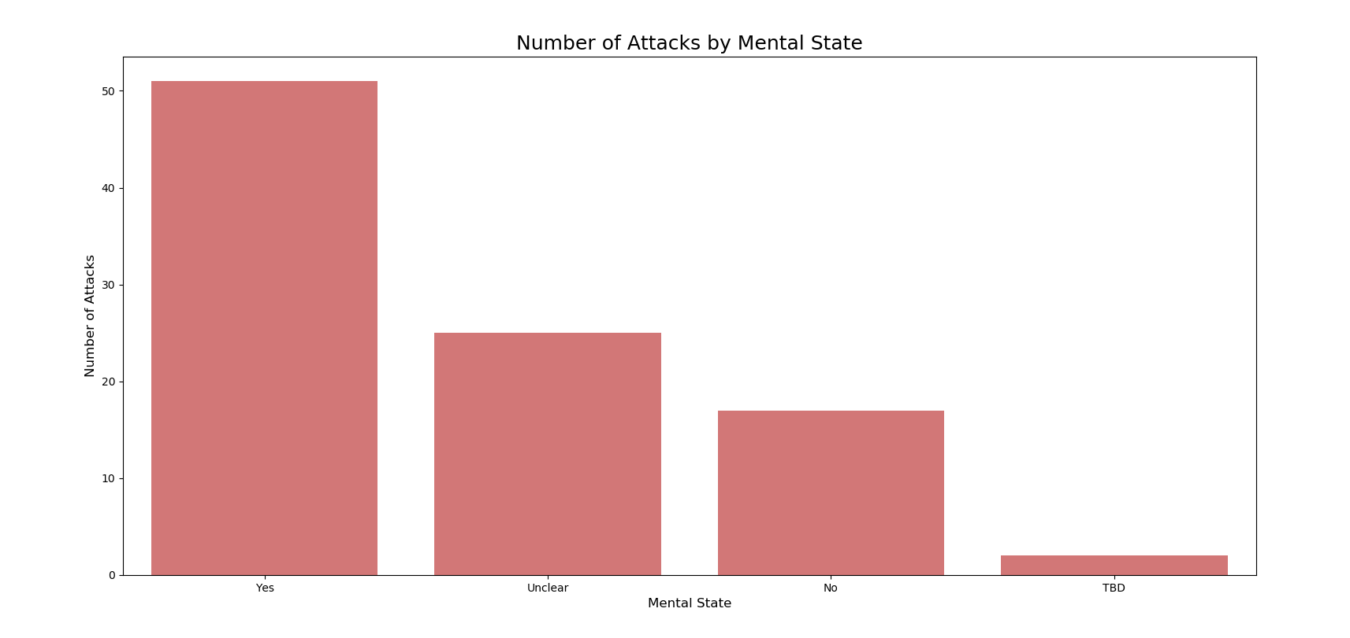
NUMBER OF ATTACKS BY THE MENTAL HEALTH OF THE SHOOTER

Slide 20
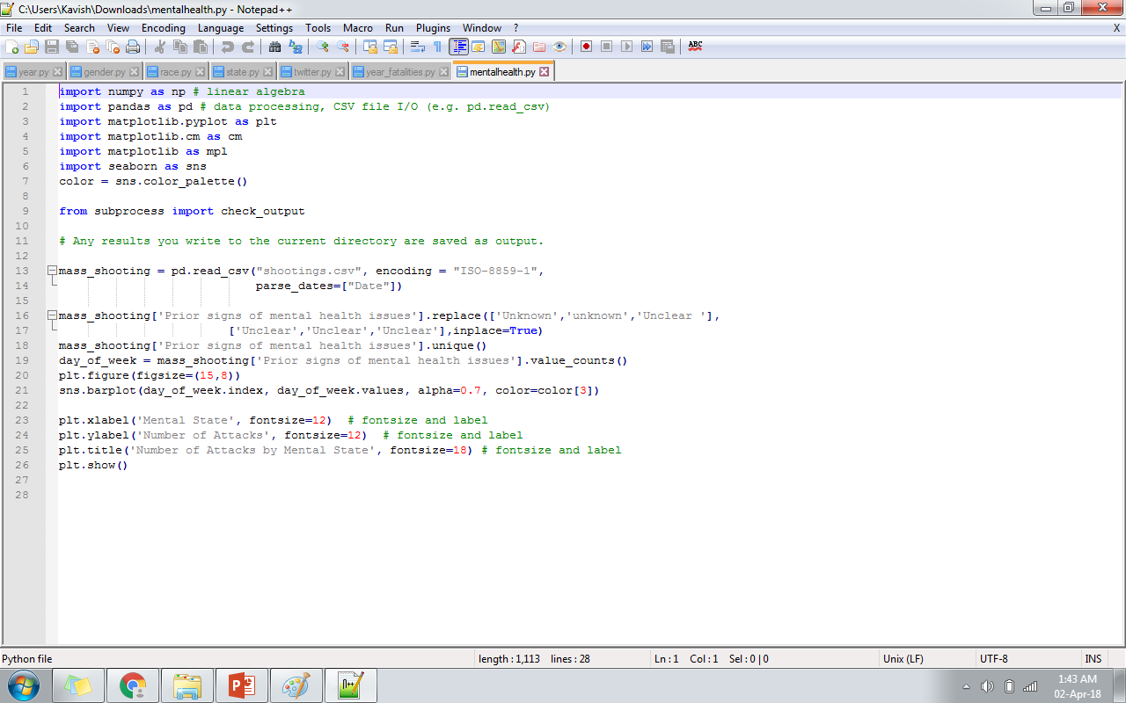
CODE:

Slide 21
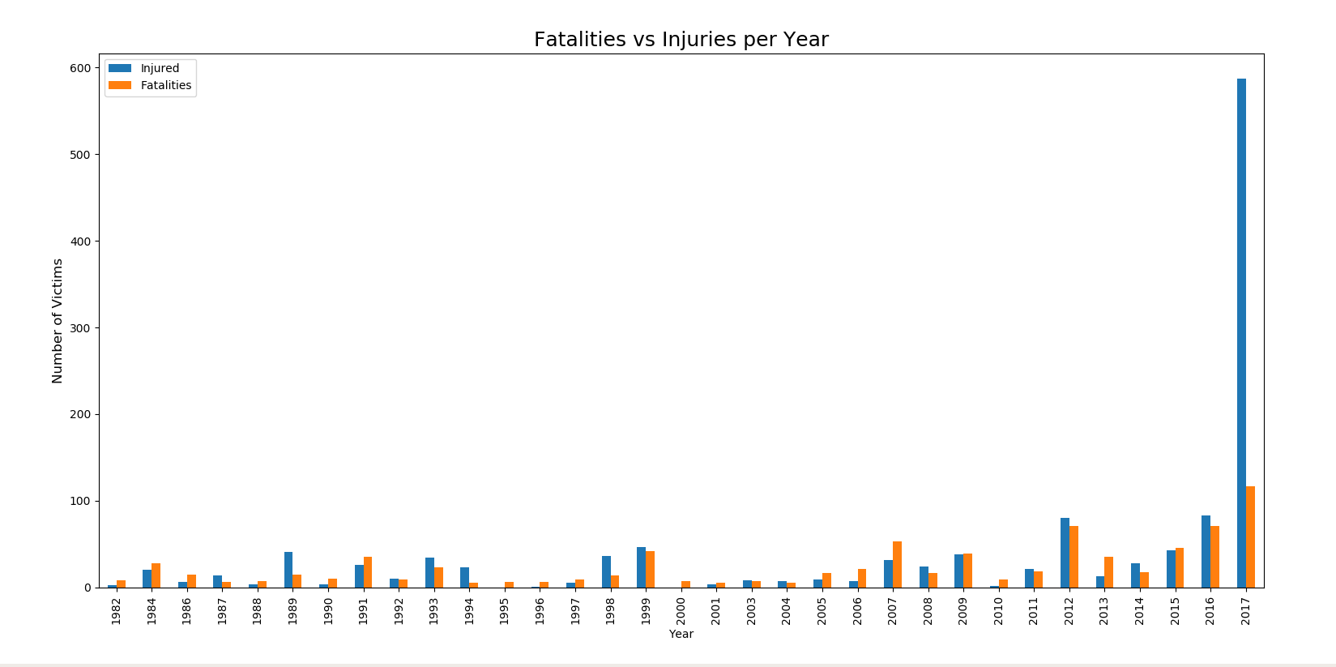
FACILITIES VS INJURIES

Slide 22
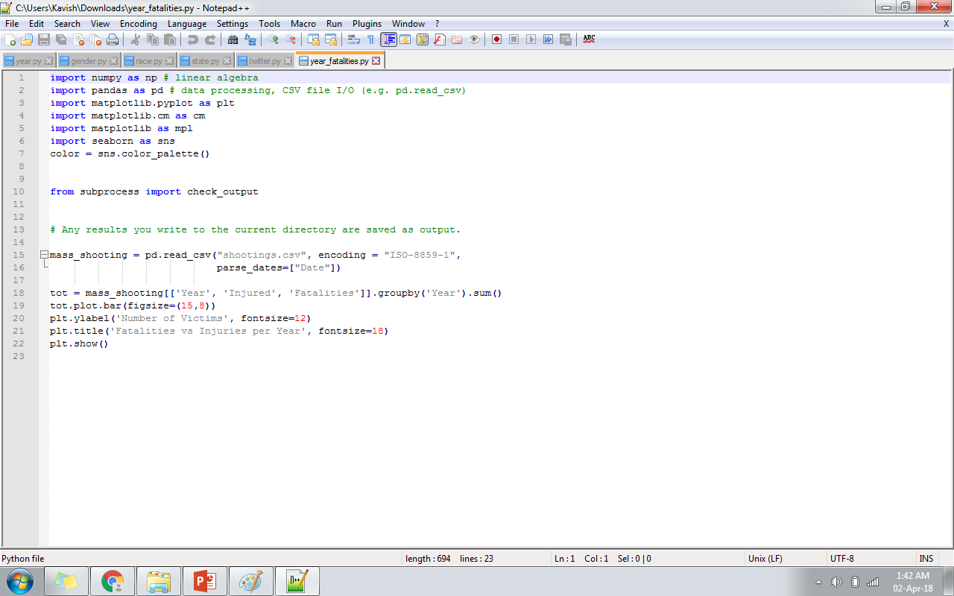
CODE:

Slide 23
PROPOSED METHODOLOGY

Slide 24
NAMED ENTITY RECOGNITION
Motivation: Factual information and knowledge are normally expressed by name entities. (Who, Whom, Where, When, Which…..)

Slide 25
APPLICATIONS
Predicting the probability of an incident.
Forecast the mental malady of a person.

Slide 26
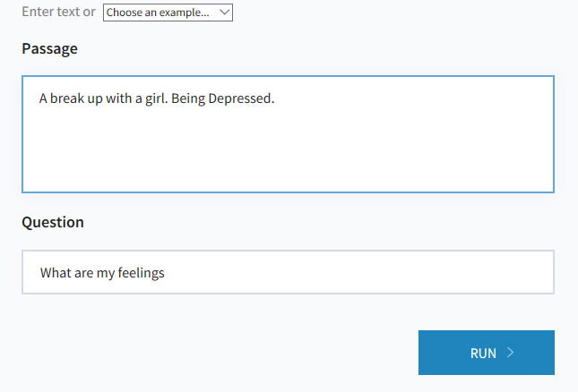
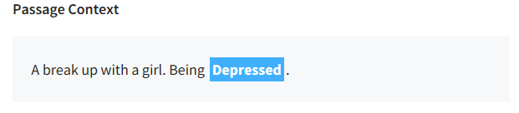
SAMPLING IMPLEMENTATION

Slide 27
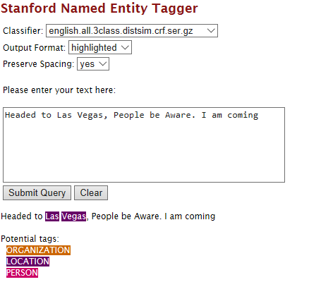
CONTINUE…..

Slide 28
CHUNKING
Breaks long string of information into units or chunks
Process of selecting a set of tokens to form a meaningful sense

Slide 29
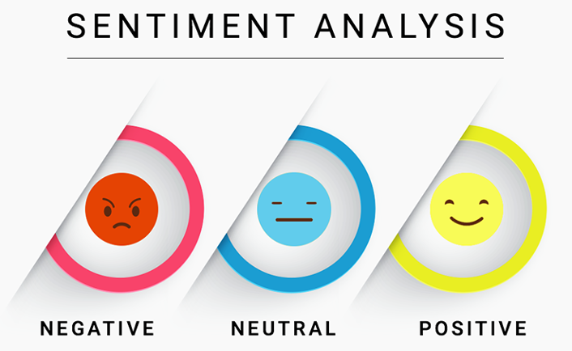
SENTIMENT ANALYSIS
Also known as opinion mining
Deriving the opinion or attitude of a speaker
Finding the target of sentiments.

Slide 30
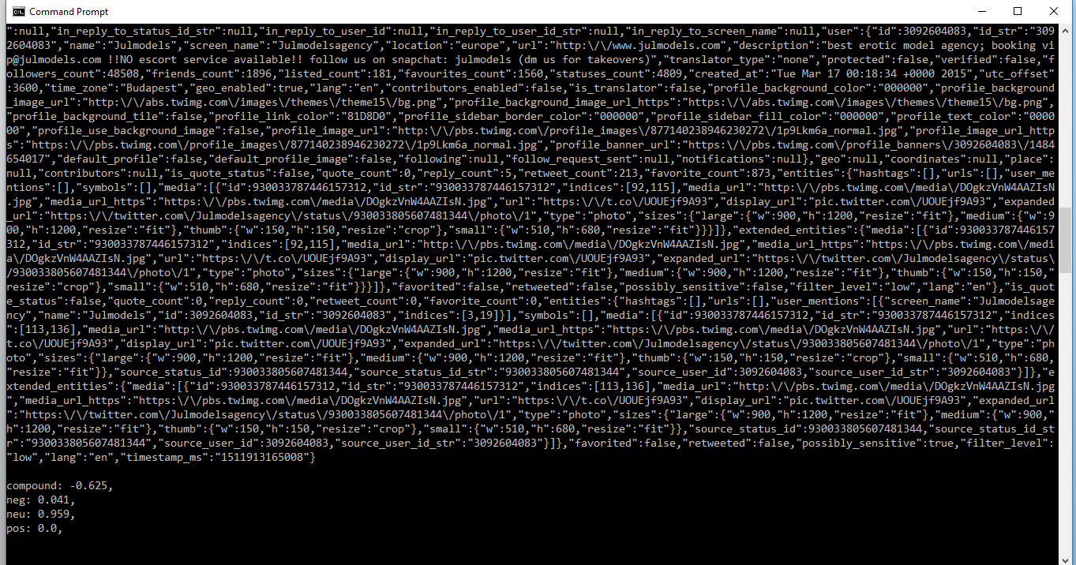
OUTPUT

Slide 31



Slide 32
CONCLUSION
Number of Victims are gradually increasing and are maximum in the year 2017
Number of injured are more than number of deaths per each year
Florida tops among the most number of attacks
Male attackers are dominantly more in number
Majority of the attackers are suffering from some Mental Health Issues

Slide 33


Slide 34
REFERENCES
https://hpi.de/fileadmin/user_upload/fachgebiete/plattner/teaching/NaturalLanguageProcessing/NLP2015/NLP04_POS_NER.pdf
https://nlp.stanford.edu:8080/ner/
https://nlp.stanford.edu/software/CRF-NER.shtml
https://www.kaggle.com/carlosparadis/last-50-years-us-mass-shootings

Slide 35
THANK YOU

