Slide 1

Insights on NBA Players
with Apache Spark + MLLIB with Clustering Model
SCS 3252-010 – Steven Chiu

Slide 2

Why Advanced Analytics in Sports?
NOTE:
To change images on this slide, select a picture and delete it. Then click the Insert Picture icon
in the placeholder to insert your own image.
Multibillion dollar industry
Millions of dollars invested in resources (i.e Players)
Maximize Player value
Cluster & Compare with other players

Slide 3
Clustering with Apache Spark and MLLIB - Workflow
Download Data from basketball-reference.com
Create Model for Clustering
Upload data to databricks.com
Perform Exploratory Data Analysis
Perform Correlation Analysis
OneHot Encode Categorical Variables
Dimension Reduction using Principal Component Analysis
Visualize
Standard Scale Values
Create Pipeline
Components
Data Source | Basketball-reference.com
Environment | Databricks.com Apache Spark + MLLIB + Pyspark
Databricks notebook published | https://databricks-prod-cloudfront.cloud.databricks.com/public/4027ec902e239c93eaaa8714f173bcfc/1793597675784580/3496336848243693/8868352524310076/latest.html
GitHub | https://github.com/schiu73/SCS3252_Project_NBA

Slide 4
Step 1: Data Source Retrieval
Basketball-reference.com
Relatively easy CSV file downloads
File was uploaded to databricks.com
Step 2: Exploratory Data Analysis (EDA)
Exploratory Data Analysis with Business Domain Knowledge
30 of features in data file
Performed descriptive analytics – mean/median/stddev/max/min
Removed players that didn’t have more than 10 minutes of play per game
Minor data cleansing – Player Name and their id was in 1 field.

Slide 5
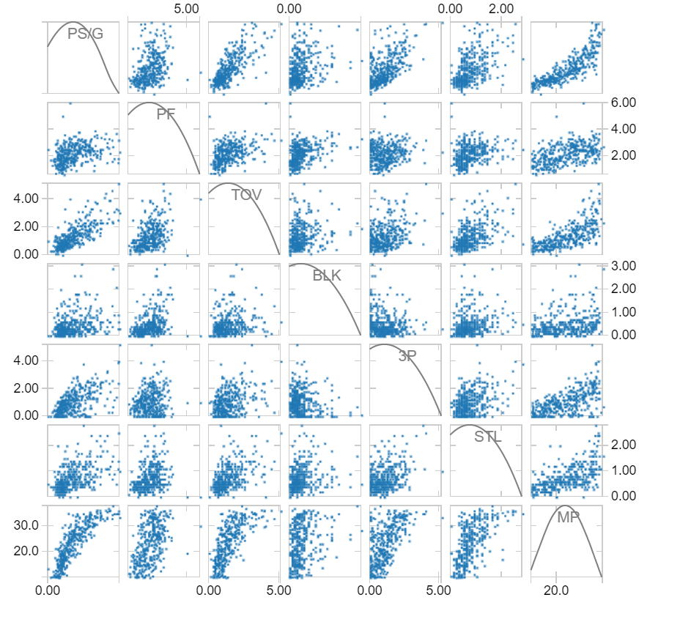
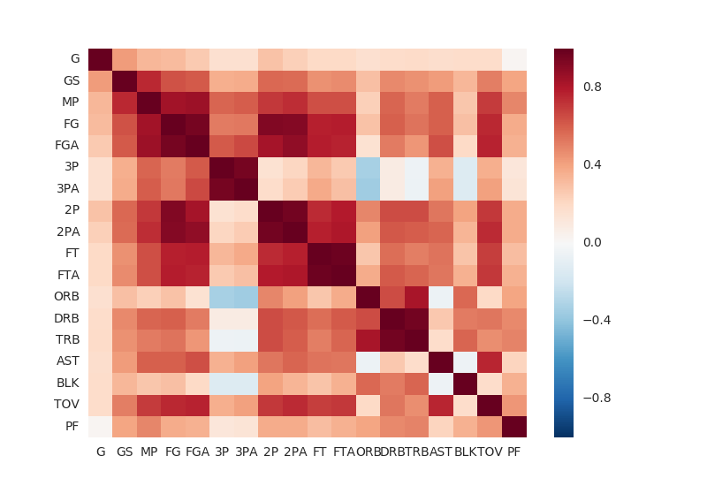
Step 3: Correlation Matrix Analysis
Correlation Matrix Analysis
Purpose: Find features that are correlated
Visually used Scatter Plot.
Used Pandas Dataframe + Correlation Matrix + Seaborn to visualize as Heatmap
Result: Removed 10 correlated features

Slide 6
Step 5: Standard Scale features
Step 4: Taking care of Categorical Variables
Categorical Variables
One-Hot Encoded categorical variables (Team) into vectors.
Scaling the values
Purpose: Reduce bias in the size of the values

Slide 7
Step 7: Cluster using k-means
Step 6: Principal Component Analysis (PCA)
PCA
Purpose: Dimension reduction
We will reduce our dimensions into 2 dimensions so it can be visualized in a scatter plot.
Clustering using MLLIB Library
Set number of clusters to 10

Slide 8
Step 7: Setup MLLIB Pipeline
Spark Pipeline
Purpose: Chain the libraries together to be run with dataframe as input
Pipeline will chain all the steps above with nba data as input

Slide 9
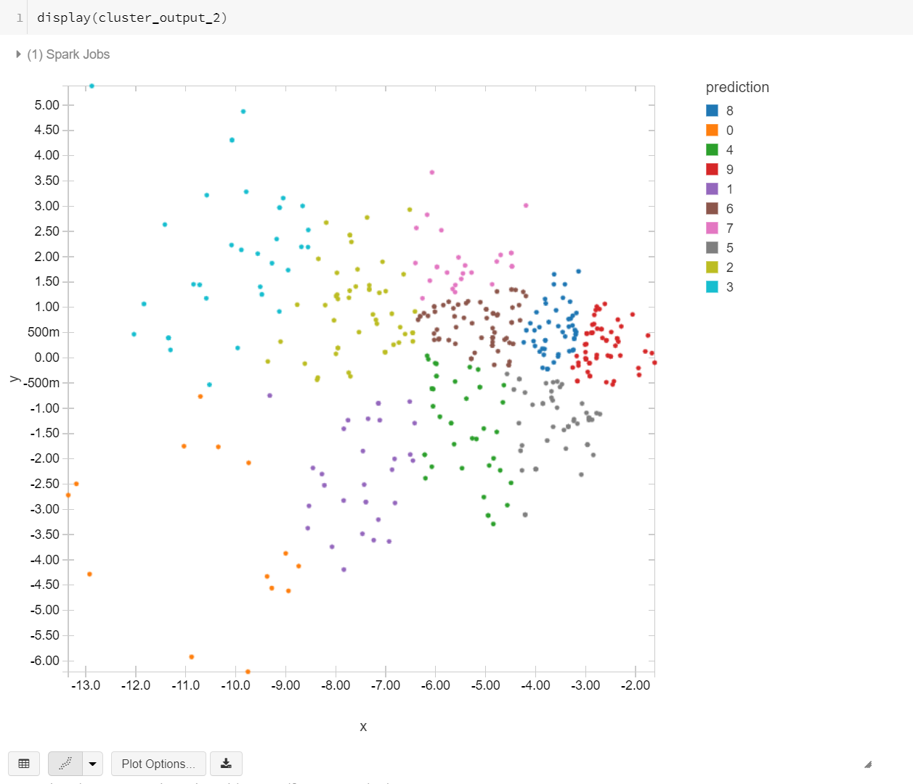
Step 8: Retrieve Results, Visualize
Clustering using MLLIB Library
Set number of clusters to 10

Slide 10
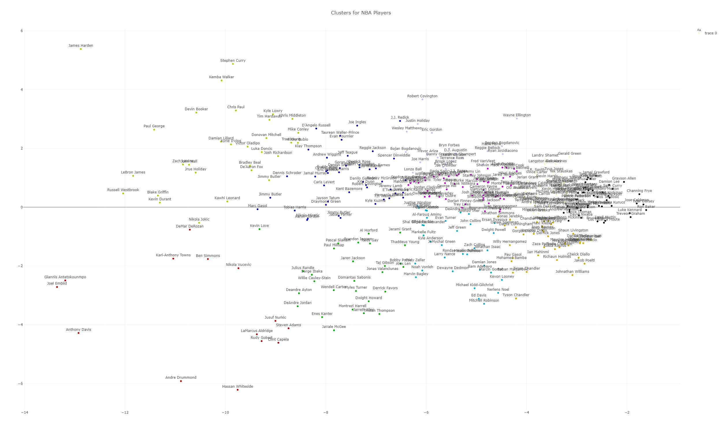
Visualize using Plotly Library
POINT GUARDS
James Harden
SMALL/POWER FORWARDS
SECONDARY PLAYERS (BENCH)
Lebron James
Joel Embiid
CENTERS

Slide 11
Results & Insights:
The various clusters differentiated the following categories of players:
Super Stars (example: James Harden)
Players who perform a role within the team (Centers, Backup players)
Business Questions that the clusters may have answers to:
Does the amount of salary that is paid to a particular player living up to his reputation – Example: Has LeBron James performed as expected?
Do we have hidden stars amongst the cluster of players – Example Luka Doncic (Rookie) is being clustered amongst stars like Jimmy Butler, Kyrie Irving and Damian Lillard
Further Analysis:
Predictive Model for Fantasy Points
Dendogram clustering for better visuals.

Slide 12
Thank You

