Slide 1
Named Entity Recognition using Hidden Markov Models
Team Mavericks:
1) Swayam Agrawal (2021101068)
2) Mitansh Kayathwal (2021101026)

Slide 2
What is NER?
NER is an Information Retrieval task which aims to classify named entities into a predetermined category of classes. The category can be generic like Organization, Person, Location, or a custom category depending on a specific use case.
[“John”, “works”, “at”, “Apple”, “Inc”, “.”] (Sentence)
[“B-PER”, “O”, “O”, “B-ORG”, “I-ORG”, “O”] (Named Entities)
NER

Slide 3
Methods for Performing NER
There are broadly three methods to perform NER on a dataset:
1. Rule Based Methods (classify on basis of manually crafted rules)
2. Statistical Methods (classify on basis of likelihoods derived from training data eg: HMMs)
3. Deep Learning Methods (harness the power of neural networks eg: LSTMs)

Slide 4
Why NER?
The primary objective is to comb through unstructured text and identify specific chunks as named entities, subsequently classifying them into predefined categories.
NER is highly useful when we want a high-level overview of a very big text dataset.
This conversion of raw text into structured information makes data more actionable, facilitating tasks like data analysis and information retrieval.
In language datasets, NER can help to study text of languages which have very less annotated corpora available for it.

Slide 5
Problem Statement
Our project highlights the need for NER in Indian Languages.
We propose a HMM based NER Model which would generalize well with Indic Data i.e. the idea is to develop a model which is not specific to a particular language or a domain.
The model should be able to generalize on various different corporas and provide good results on corporas involving Cross Domain Variability as well.
The HMM implementation takes a Statistical approach for solving the NER Problem.

Slide 6
Challenges with NER Models for Indic Languages
1) Every Indian language is unique in it’s own way and thus requires domain experts to construct rule based models for every language.
2) Indian languages do not have the notion of capitalization which is present in the English languages and helps NER models to generalize better as named entities(usually nouns) start with a Capital letter.
3) Indian languages are relatively free-order languages.
These are just a few of the problems with pre-existing models for Indic NER.
The lack of annotated corpora and biases due to label imbalances in data further highlight why it is tough to generalize NER for Indic languages.

Slide 7
Role of HMMs in NER
HMMs model the data as a sequence.
Let us take an example to see why modeling as a sequence makes sense:
Given a phrase "I like playing …", it is highly likely to be followed with "guitar," "football," etc.
In such examples, the previous word helps us better guess the state of next word/words. This is an example of language modeling.
Markov Chains mathematically describes a sequence of possible events. The probability of each event depends on past events.

Slide 8

HMM Assumptions
There are 2 key assumptions that HMMs make:
1) Markov Assumption: A key assumption with HMMs is that to predict anything in the future, the only thing which matters is the current state. The states before the current state have no impact on the future except via the current state.
2) Independence Assumption: The output observation depends only on the state which produces the observation and not on any other state or any other observation.

Slide 9
Data Preprocessing
The first task is to perform preprocessing on the corpus. so as to make it suitable to be used in the HMM framework for all the languages.
Our preprocessing steps include:
i) Tokenization: Breaking down large blocks of text such as paragraphs and sentences into smaller, more manageable units.
ii) Punctuation removal: They do not add much value to the dataset, hence we remove them.

Slide 10
Data Preprocessing
iii) Stemming: Reducing words to their base or root form. This helps in treating different inflections or derivations of a word as the same, improving the efficiency and accuracy of text analysis.
Shown for Cross-Domain dataset

Slide 11
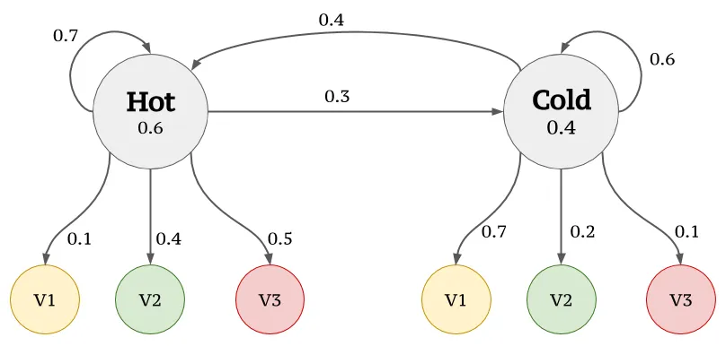
Parameter Estimation (Model Training)
Computing start probabilities, transition probabilities and emission probabilities.
Example for HMM:

Slide 12
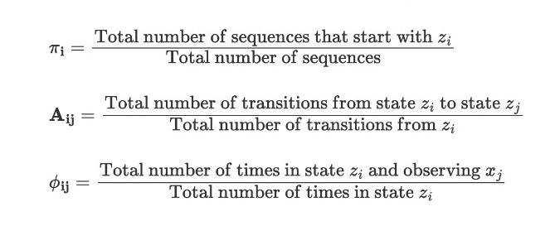

Slide 13
Testing the HMM Model
After calculating all these parameters we apply these parameters to Viterbi algorithm and test the sentences as observations to predict named entities.
Viterbi Algorithm: Given the parameters and the sequence of observations, we want to estimate the most probable sequence of states that resulted in the observations.
After evaluating the model parameters, we apply Viterbi’s algorithm for decoding the best path sequence on the test data.
Viterbi Algorithm performs better than a direct brute force approach(checking for all possible computations → N^T computations, NP-hard) by using Dynamic Programming through reuse of computations.

Slide 14
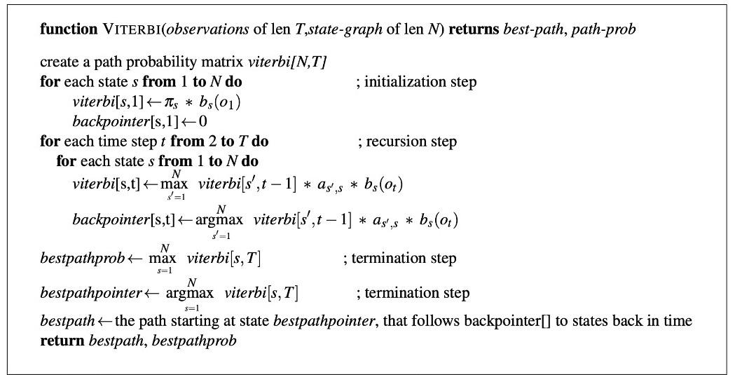
Pseudocode for Viterbi Algorithm

Slide 15
Handling Out of Vocabulary words
A major problem faced with HMM Model for NER is about out of Vocabulary words. For handling this, we tried and tested 2 approaches:
1) Using a pseudo-word “UNK”: We insert a pseudo-word while training the model. All words having a frequency less than a particular threshold were relabelled as “UNK” and then the emission probabilities were computed. This ensures a closing effect on our vocabulary. (Courtesy: Reference Link(Columbia))
2) Assigning a finite emission probability(1e-4) to every out of Vocabulary word. This ensures a finite emission probability so that we could perform the Viterbi Algorithm. This ensures a smoothing effect to the Emission probabilities without any contradictory change in the Emission Probability.

Slide 16
Evaluation
We have evaluated our model on:
i) Indic Language Datasets: Hindi, Gujarati, Tamil, Telugu, Assamese
ii) Cross Domain Datasets: AI, Literature, Science, Music, Political Corpus
We evaluate the model's performance on its F1 Score.
Why not accuracy?
→ Imbalanced Classes: In NER tasks, entities of interest (e.g., person names, locations) are often a small proportion of the overall text. If one class ("OTHER") significantly outweighs the others, a model that simply predicts the majority class for every instance could achieve a high accuracy but fail to identify the named entities, which is the primary goal of NER.
The F1-score is less affected by class imbalance and provides a more comprehensive evaluation.

Slide 17
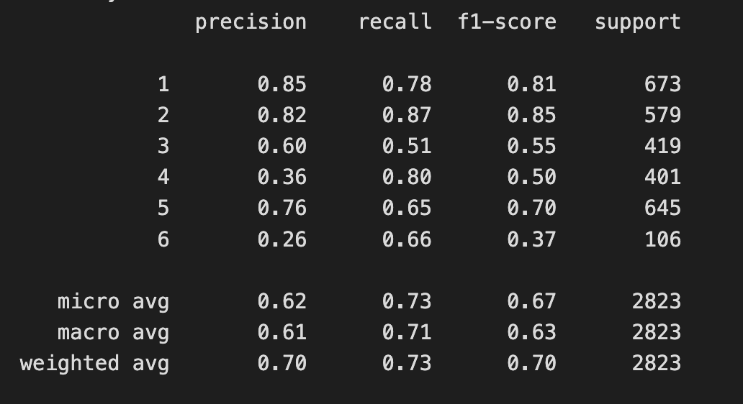
Results on Indic Language Datasets.
We trained our HMM model on Gujarati train dataset and then evaluated its performance on Gujarati test dataset.
The performance of the model:
Note that the state 0 i.e. the "OTHER" state has been removed from the metrics computation.
We obtain these metrics using the model utilizing method-2 described on Slide-15.

Slide 18
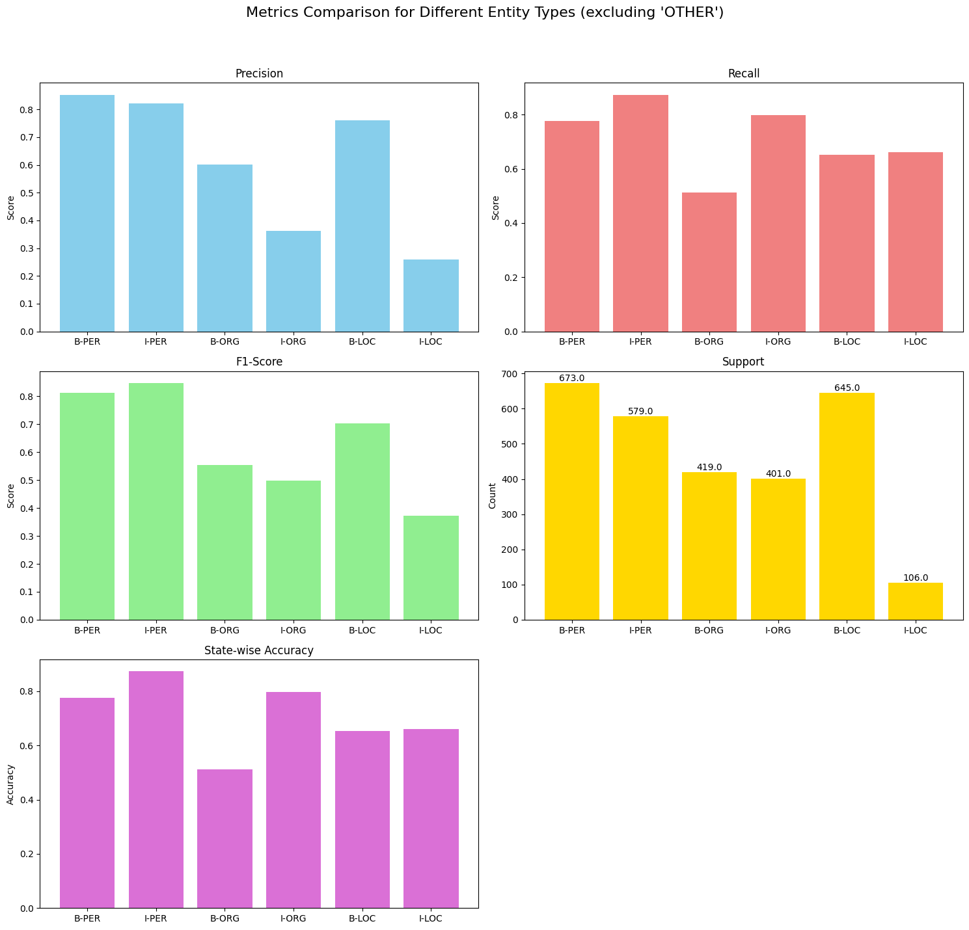
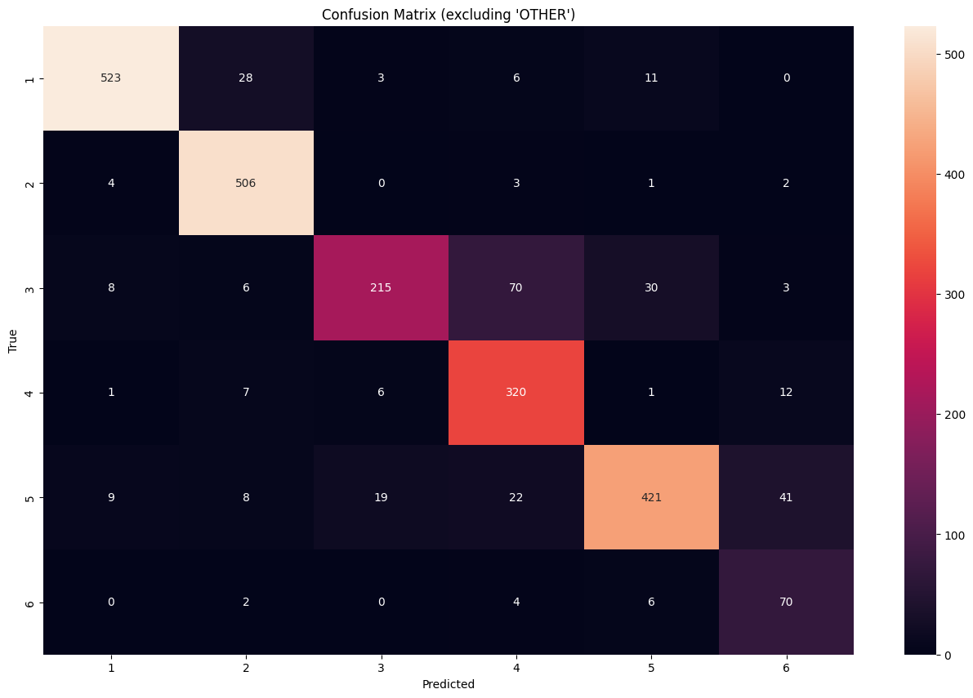
These two diagrams show the metrics comparison for different entity types (excluding "Others") and the Confusion Matrix.

Slide 19
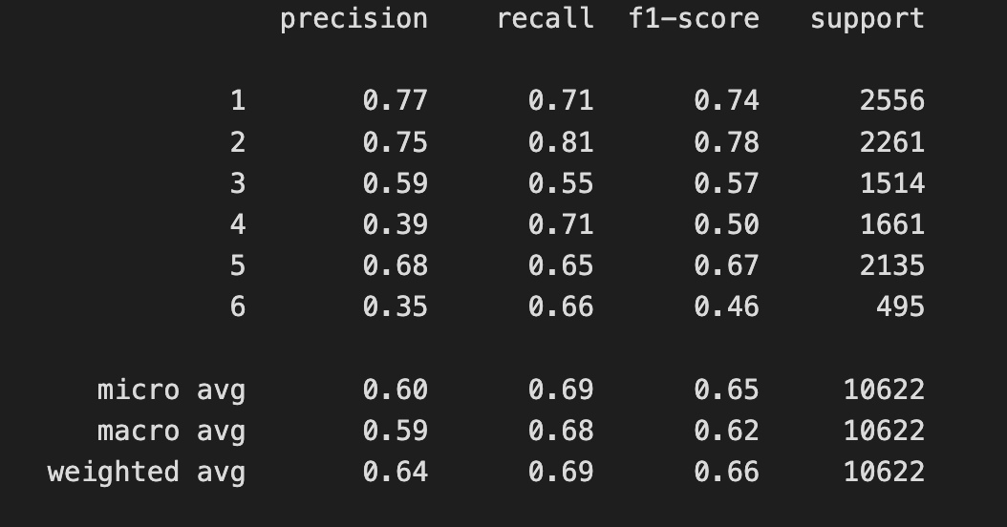
Results on Multilingual dataset.
Next, we combined the training and testing datasets for all languages to create a combined training dataset and testing dataset and evaluated our model on this pair.
The performance of the model:
Note that here too the state 0 i.e. the "OTHER" state has been removed from the metrics computation.
We obtain these metrics using the model utilizing method-2 described on Slide-11.

Slide 20
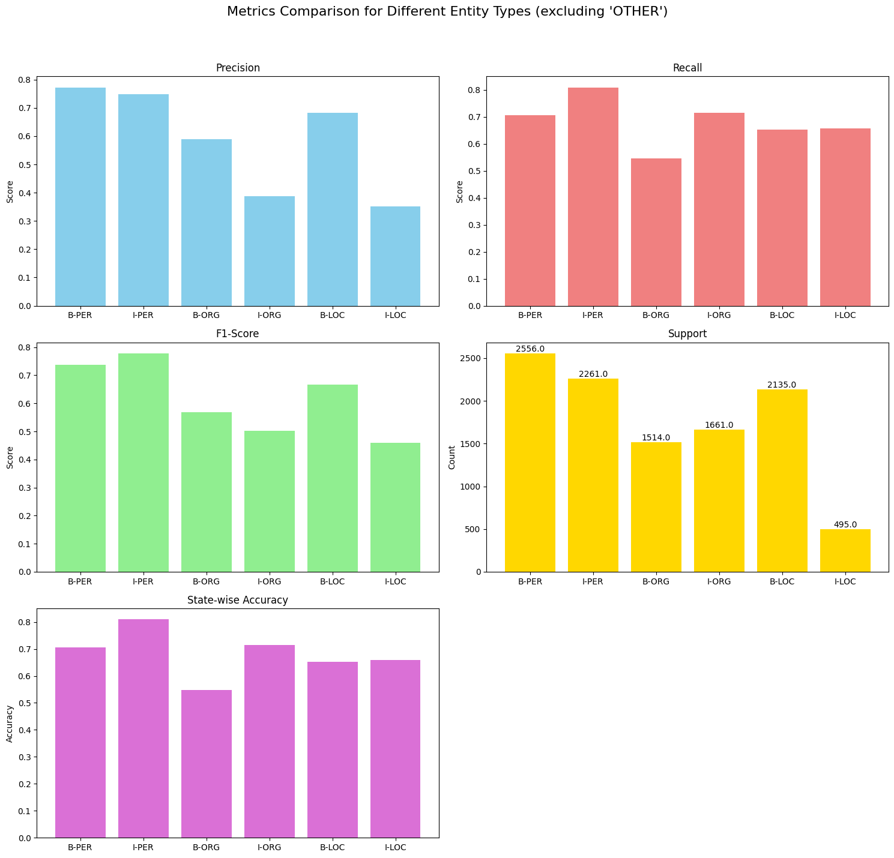
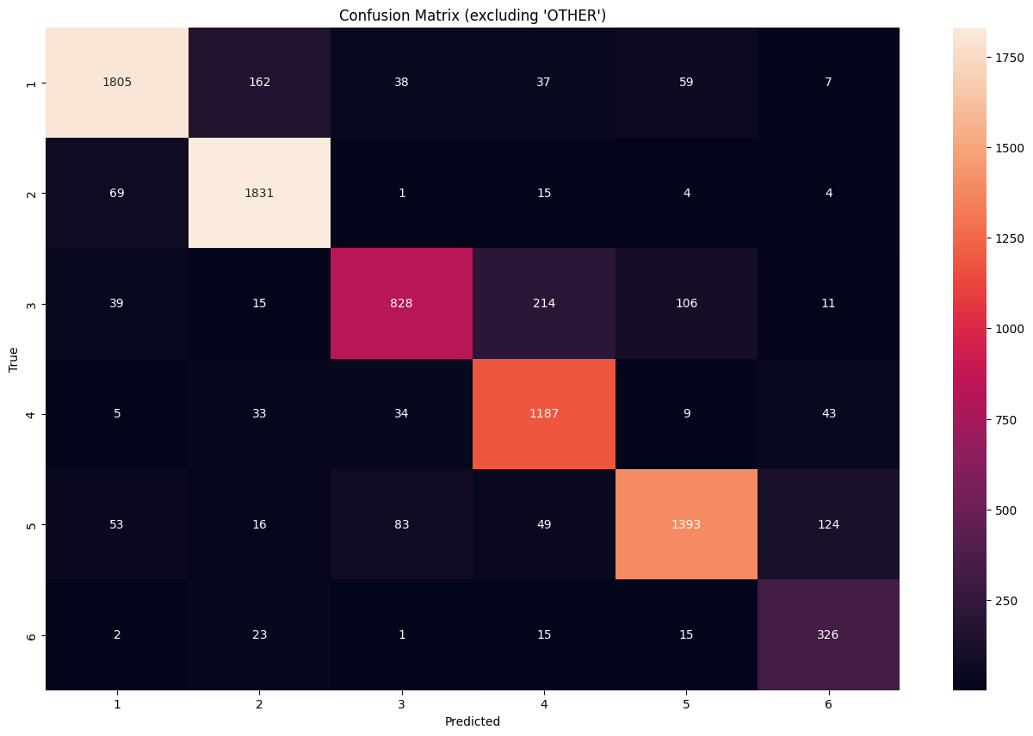
These two diagrams show the metrics comparison for different entity types (excluding "Others") and the Confusion Matrix.

Slide 21
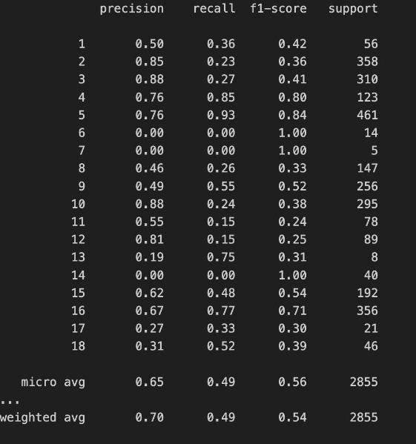
Results on Cross-Domain Datasets
The performance of the model on Cross Domain datasets: (data shown for only one Cross Domain corpus):

Slide 22
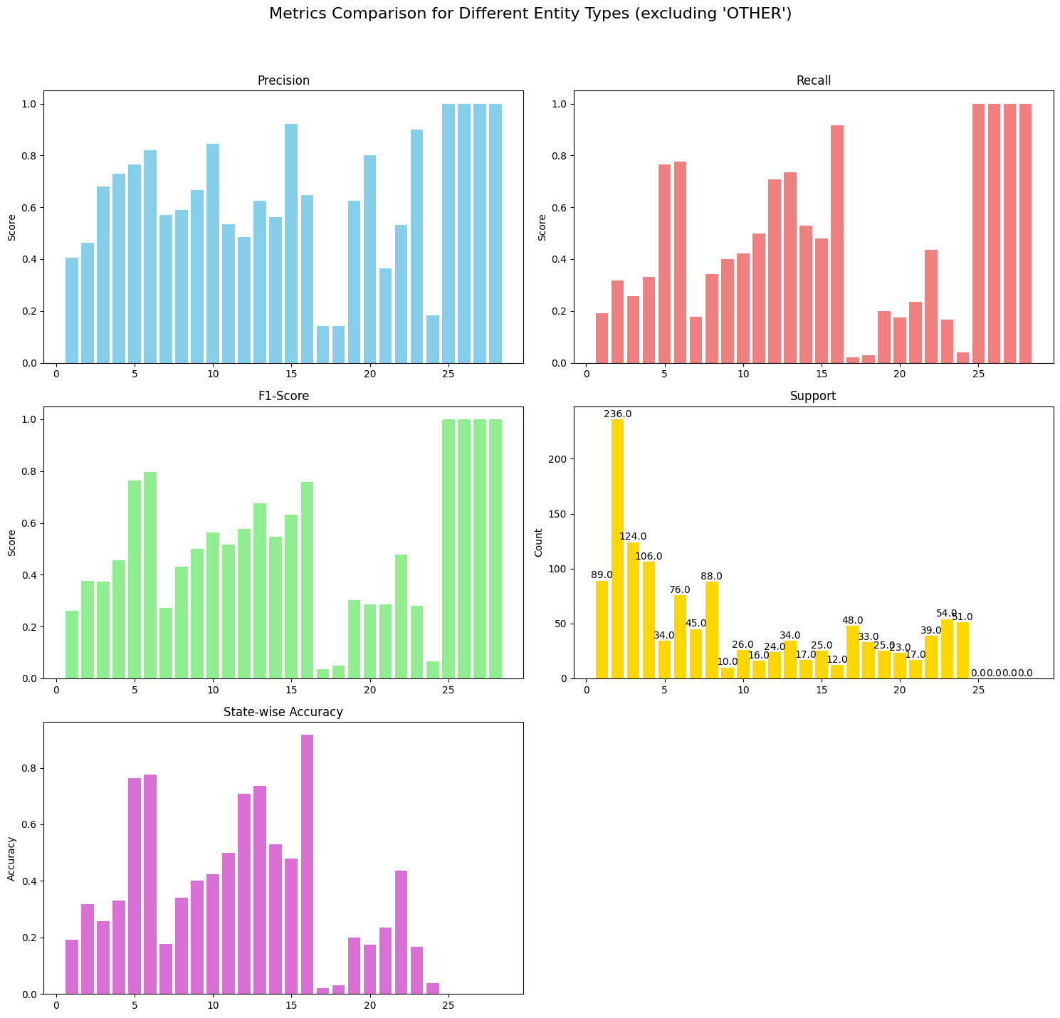
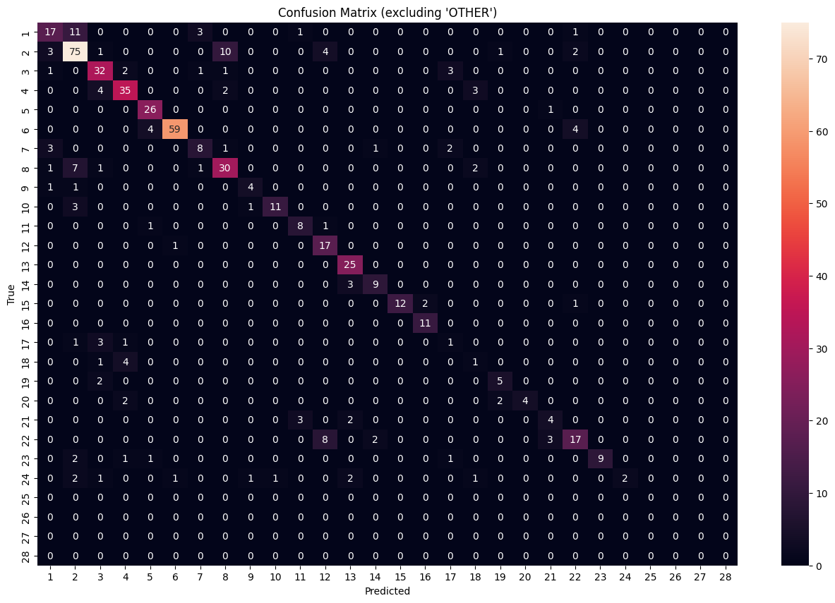
These two diagrams show the metrics comparison for different entity types (excluding "Others") and the Confusion Matrix for a specific domain dataset.

Slide 23
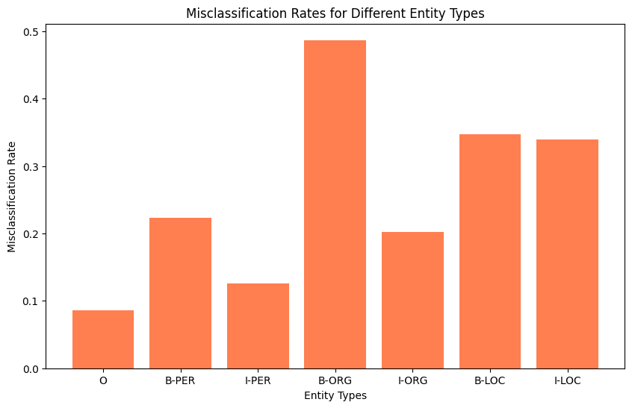
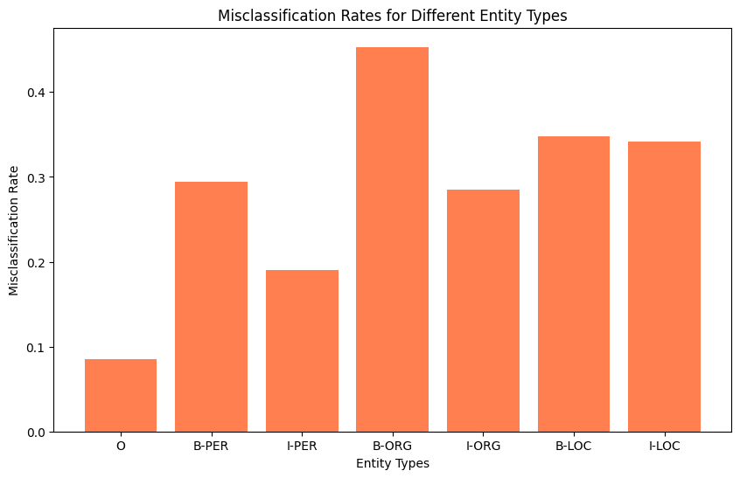
Inferences and Analysis:
Gujarati Dataset
Multilingual Dataset
We observe a similar pattern of misclassification across both datasets because the ratio of support of any two entities is similar in both datasets.
We can infer that state-3 i.e. (B-ORG) has highest Misclassification Rate. State-0 naturally has the lowest misclassification rate across all NER corpora because a majority of the samples belong to "Other" state.

Slide 24
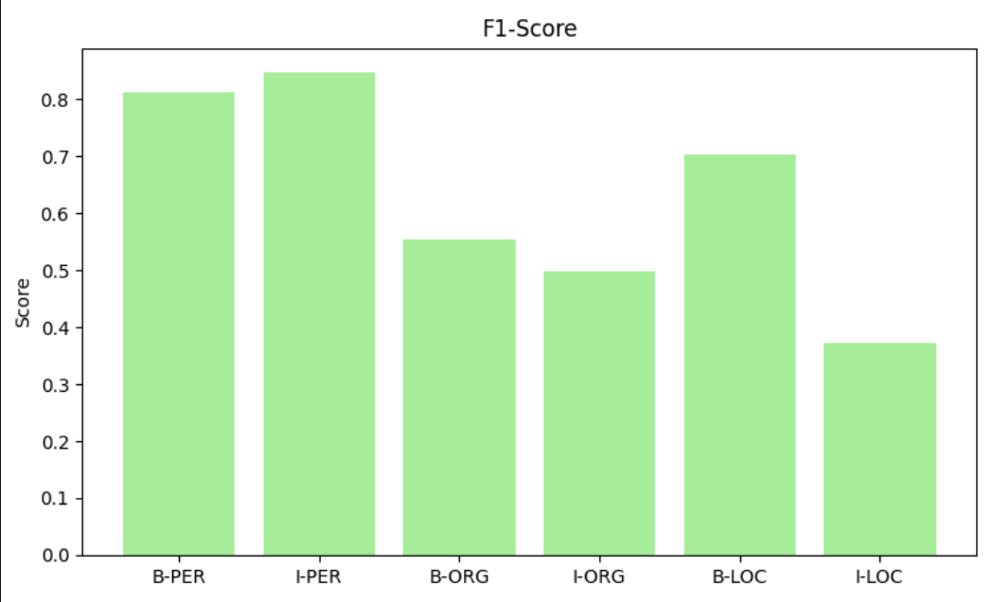
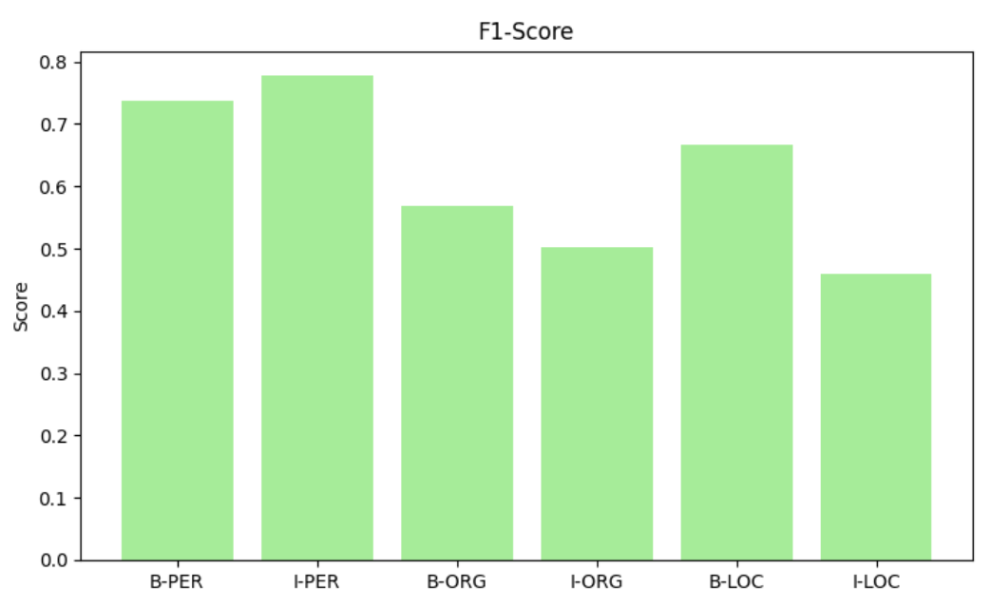
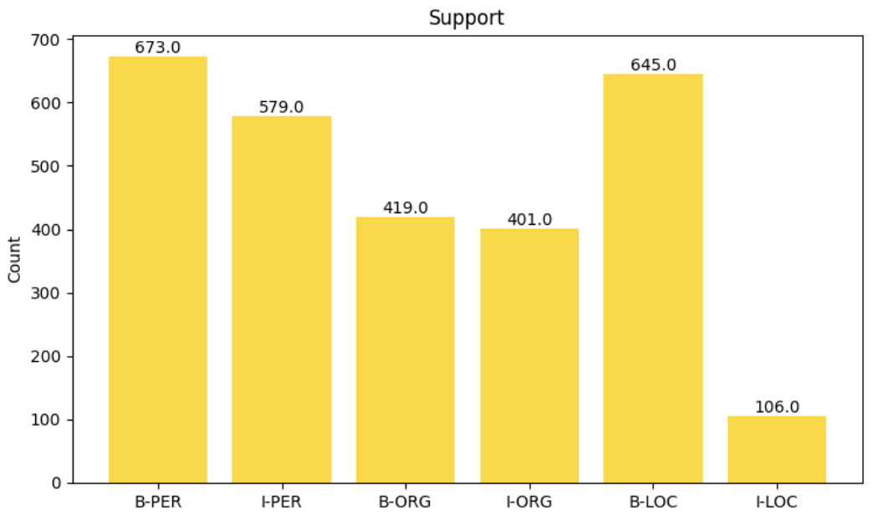
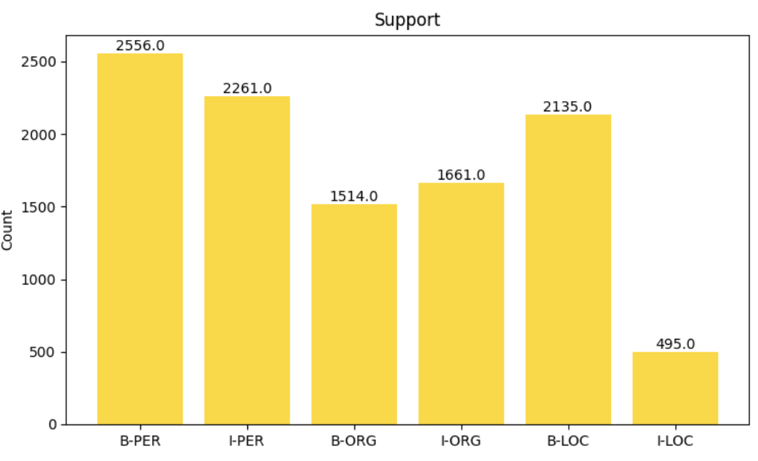
Gujarati Dataset
Multilingual Dataset

Slide 25
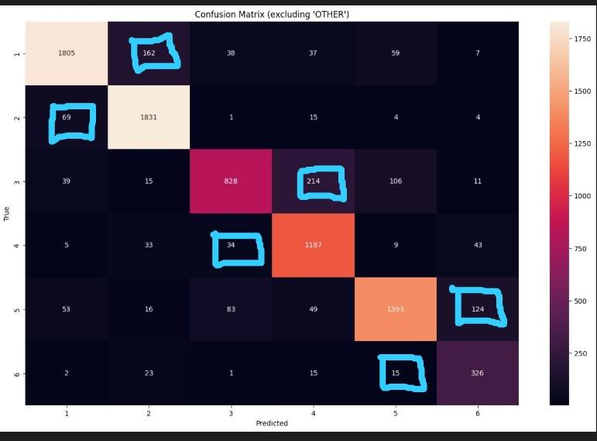
Inference and Analysis(Multilingual Dataset)
When the model is run for combined Multi-lingual data, we observe results similar to what the model gives on every individual language corpora, this indicates that the model is not being affected by the languages which are being fed to the model. We are achieving a weighted average F1 Score of 66%. The SOTA using BiLSTM on the Language Corpora is above 80%
On observing the confusion matrices, the major misclassification is happening between the I and B classes of the same entity. This is clearly indicative that the model is unable to judge between 2 subclasses of the same Named Entity as being Inside or Beginning of the Named Entity.

Slide 26
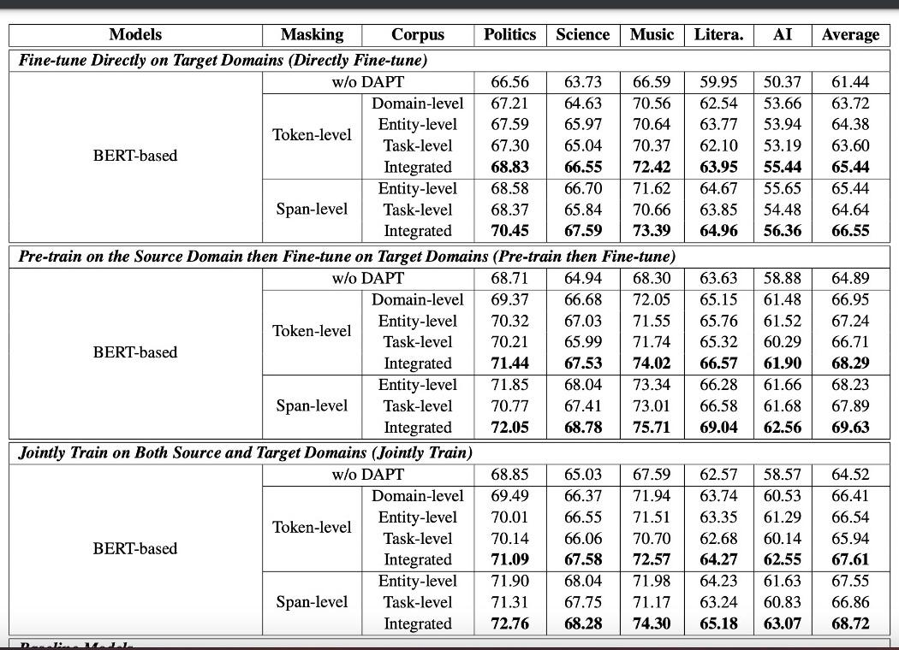
Inference and Analysis(Cross-Domain Dataset)
We are getting an approximate F1 Score of 45% on all the Cross-Domain datasets we tested our model on. The results of the paper from which the dataset was taken has a SOTA of >70% on each of the cross-domain datasets. The major reason for a lower F1 score is the large number of Named entities(every model has > 20) that our model is trying to predict the correct outcome from.

Slide 27
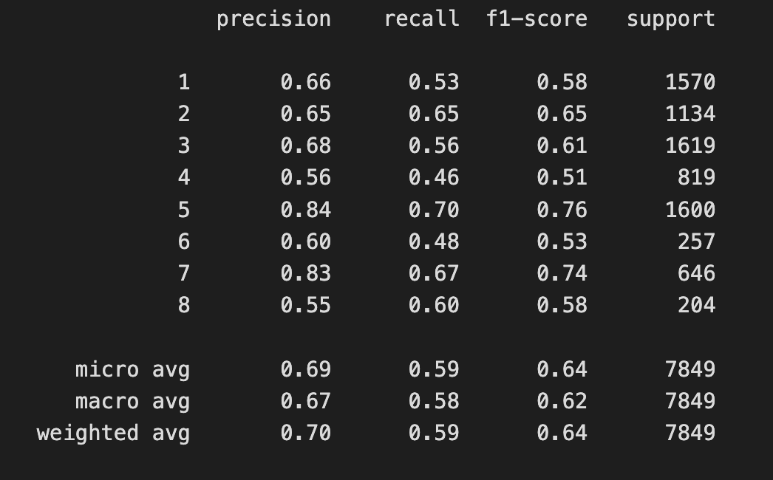
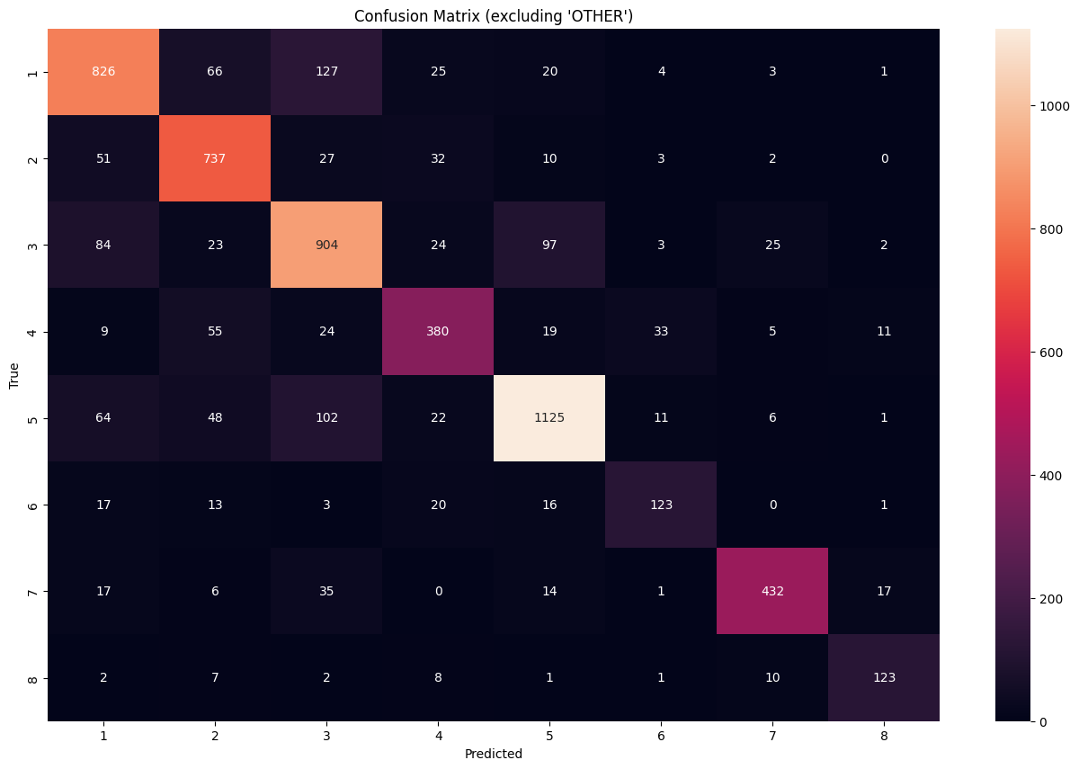
Comparison with better models for NER Task
To compare our model with better models utilizing Deep Learning Methods like Bidirectional-LSTM-CNNs (SOTA), we evaluated our HMM Model on CoNLL-2003 dataset, the weighted average F1 score for the SOTA model is 90.9 % with ~70 epochs. We obtained a weighted average F1 score of 64%. Our model's performance:

Slide 28
Analysis of reasons behind the results:
HMMs are inherently unidirectional, meaning they model sequences from left to right or right to left but not both simultaneously.
Bidirectional LSTM-CNN models capture contextual information from both past and future words for each word in the sequence. Bidirectional models process the input sequence in both forward and backward directions, allowing them to capture dependencies from both sides.
LSTMs, with their ability to capture long-range dependencies, can effectively model relationships between words that are farther apart in the sequence.
We take an example on the next slide to demonstrate this.

Slide 29
Analysis of reasons behind the results:
"Kabul is controlled by President Burhanuddin Rabbani’s government, which Taliban is fighting to overthrow."
"Kabul is controlled by President Burhanuddin Rabbani’s government, which Taliban is fighting to overthrow."
OTHER
OTHER
B-LOC
B-MISC
HMM
B-LOC
B-PER
I-PER
B-MISC
BiLSTM
This sentence has been extracted from the CoNLL-2003 Dataset manually
and both models have been evaluated on this sentence. 2/4 entities are predicted correctly by our HMM model and 4/4 entities are predicted correctly by the BiLSTM Model.

Slide 30
Concluding Remarks
The paper suggests that on a rich corpora, their performance reaches till about 90%. However, after testing on multiple corpora we were not able to verify such kind of performance. The paper does not provide any proofs for it’s result. We however have verified that HMM as a model is generalizing very nicely across Cross Domain and Multilingual datasets. Our results thus lead us to conclude that HMM for NER is indeed Language independent and invariant to Cross Domain or for that matter any corpus which is fed to it. However, we cannot ignore the training data dependence in order for HMMs to work well for any corpora. Thus, we need to maintain caution while evaluating our HMM Model and drawing inferences from it. For a rich corpora, the model does tend to perform well and generalize better.

Slide 31
References and Citations
@misc{author = {Mhaske, Arnav and Kedia, Harshit and Doddapaneni, Sumanth and Khapra, Mitesh M. and Kumar, Pratyush and Murthy, Rudra and Kunchukuttan, Anoop}, title = {Naamapadam: A Large-Scale Named Entity Annotated Data for Indic Languages}}
https://github.com/kamalkraj/Named-Entity-Recognition-with-Bidirectional-LSTM-CNNs/tree/master : SOTA model used for comparison with our HMM Model.
https://arxiv.org/pdf/2012.04373.pdf : SOTA model for Cross Domain NER.

Slide 32
Thank You :)

