Slide 1

PayTo Final Project Update — Universität Hamburg (Summer 2026)
Hybrid Recommendation System
& Noah AI Assistant
Presenter: Swapnanil Chakraborty — Technical Lead, PayTo Technologies UG
Alle Händler. Alle Vorteile. Eine App.
Team: Kamran Anwar · Sagnic Das · Hailin Wang · Madina Haidari
Degree: MSc., Universität Hamburg
Date: 21 September 2026
Final Project Update — Universität Hamburg | Summer 2026

Slide 2
01
Context & Motivation
02
Company Infrastructure
CONTENTS
03
A · Recommendation Engine
04
A · Pipeline, Demo & Video
Table of
Contents
05
A · Evaluation & Risks
06
A · Future Considerations
07
B · Noah — Overview & Flow
08
B · Intent & Evaluation
09
B · Grounding & Integration
10
B · Risks & Future Considerations
11
Work Plan & Milestones
12
Conclusion & References
Final Project Update — Universität Hamburg | Summer 2026
02

Slide 3












Context & Motivation
WHAT EXISTS TODAY
WHAT WE BUILT
A different app for every step of shopping
PayTo — one app, and an assistant
Offers, live prices, loyalty cards and points in one place — with a personalised offer layer instead of manual QR scanning.
kaufDA
offers
marktguru
offers
idealo
price comparison
PAYBACK
points
DeutschlandCard
points
This project adds two independent AI systems on top of the existing app — both live:
Lidl Plus
points & coupons
REWE
store card
EDEKA
store card
Mein dm
store card
Bring!
shopping list
LIVE
LIVE
Fragmented: offers here, prices there, a loyalty app per retailer, a list app on top.
① Hybrid recommendation engine
② Noah — agentic AI assistant
Manual & impersonal: QR codes scanned at checkout, points redeemed by hand, the same offers for every user.
SBERT content-based + ALS collaborative filtering
Grounded, bilingual, asks instead of guessing
Academic project delivered in partnership with Universität Hamburg.
Final Project Update — Universität Hamburg | Summer 2026
03

Slide 4
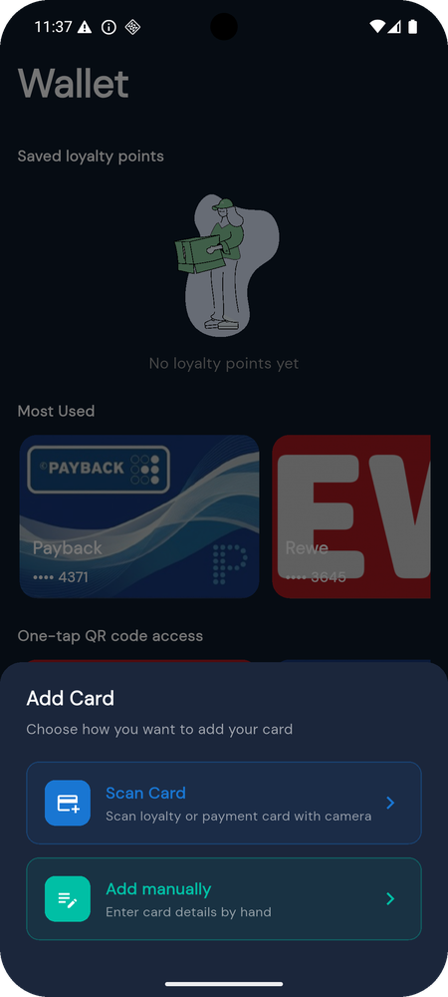




What’s Already Built — Company Infrastructure
Developed by PayTo Technologies UG. Both AI systems build on top of these production components.
Flutter Mobile App
React Web App
Backend & Search API
iOS & Android
Merchant & Admin Portal
Firebase · FastAPI · SBERT + ALS
Home screen with nearby offers, merchant cards, loyalty wallet.
Location-based discovery, QR code generation and scanning.
Onboarding, auth (OTP, Google, Apple), profile, consent & legal pages.
Merchant dashboard: offer management, analytics.
Admin portal: user management, verification, reporting.
Responsive design, live data via Firestore listeners.
Firestore: users, merchants, offers, transactions.
Search & recommendation API (FastAPI), hybrid pipeline, live.
all-MiniLM-L6-v2, 384-dim embeddings, in-memory index.
The Flutter app’s loyalty wallet — cards added by scan or by hand.
Final Project Update — Universität Hamburg | Summer 2026
04

Slide 5
PART A
Hybrid
Recommendation
Engine
A1
Architecture — content, CF, adaptive blend
A2
Pipeline in production & technology stack
A3
Live demo — dashboard & demo video
A4
Evaluation plan
ALS collaborative filtering and SBERT content-based similarity, blended per user with an adaptive weight — in production behind the PayTo search & recommendation API.
A5
Risks, open questions & mitigations
A6
Future considerations
Final Project Update — Universität Hamburg | Summer 2026
05

Slide 6



A · Hybrid Recommendation Engine
ALS collaborative filtering + SBERT content-based similarity, blended with an adaptive weighting scheme.
✓ IMPLEMENTED · LIVE
1
PHASE 1
2
PHASE 2
3
PHASE 3
Content-Based Layer
Collaborative Filtering
Adaptive Hybrid Blend
Uses existing SBERT embeddings
Recommends similar products
No training required
Handles cold-start users
ALS on user–product interactions (view / cart / purchase)
Trained matrix-factorisation model
Recommends based on similar users
Per-user blend weight α between CF and content-based
Scores min-max normalised before blending
Higher α → collaborative signal dominates as history accrues
Blend formula
Event taxonomy
Tiered fallback — live
S_{hybrid}(u, p) = α_{u} · S_{ALS}(u, p) + (1 − α_{u}) · S_{CF}(u, p)
view
= 1
add_to_cart
= 3
purchase
= 5
New user → SBERT content similarity (α low)
Some history → blended, α increasing
Full history → ALS-dominant collaborative filtering
α_{u} = 0.2 + 0.6 · min(N_{u} / 20, 1) → 0.2 ≤ α_{u} ≤ 0.8
S′ = (S − S_{min}) / (S_{max} − S_{min}) — min-max normalisation of both scores
Higher weight = stronger personalisation signal, feeding the ALS confidence matrix.
S_CF is the content-based score; N_u is the number of recorded interactions for user u.
Final Project Update — Universität Hamburg | Summer 2026
06

Slide 7




A · Recommendation Pipeline — In Production
What was a “planned extension” at mid-term is delivered and serving the PayTo app.
Technology stack — recommender
Recommendation Pipeline
Flutter
React
Product Catalogue
Mobile app (iOS & Android) — live
Merchant & admin portal — live
Firestore offers & products
↓
FastAPI
Firestore
SBERT Encoding
Search & recommendation API
Users, offers, transactions, interactions
all-MiniLM-L6-v2, 384-dim
↓
ALS Interaction Matrix
SBERT · MiniLM
ALS
view / cart / purchase weights
all-MiniLM-L6-v2, 384-dim embeddings
Implicit-feedback matrix factorisation
↓
Adaptive Hybrid Merge
Python
In-memory index
α-weighted, min-max normalised
Data, training, hybrid scoring
384-dim embeddings served from memory
Final Project Update — Universität Hamburg | Summer 2026
07

Slide 8
A · Live Demo — Recommendation Dashboard
Frontend prototype for the PayTo recommendation system: personalised recommendations and user-profile management.
Recommended products for u000
Users management
Personalised recommendations · hybrid score
View, create, update and delete user profile data
# | Product | Category | Price | Score
1 | Pretzel Roll | Bakery | €1.50 | 0.95
2 | Body Lotion | Personal care | €6.13 | 0.92
3 | Bio Butter | Dairy | €0.92 | 0.89
4 | Fruit Gummies | Snacks | €1.75 | 0.86
5 | Wholegrain Bread | Bakery | €1.22 | 0.83
User ID | Country | Device | Preferred categories
u000 | Germany | mobile | drinks
u001 | Germany | mobile | bakery
u002 | Germany | web | bakery
u003 | Germany | mobile | snacks
u004 | Germany | web | bakery, personal_care
u005 | Germany | web | personal_care, bakery
Score = normalised hybrid score S′ for user u000 (α-blend of ALS and SBERT similarity).
User interaction / profile view — preferred categories seed the content-based layer for new users.
Final Project Update — Universität Hamburg | Summer 2026
08

Slide 9
A · Demo — Recommendation Engine in Action
Screen recording of the recommendation dashboard: personalised ranking, user profiles and the α-blend in practice.
▶
Demo video — recommendation dashboard
Placeholder: insert the screen recording here (Insert ▸ Video ▸ from file).
Final Project Update — Universität Hamburg | Summer 2026
09

Slide 10

A · Evaluation — Recommendation Engine
Offline ranking quality on a holdout set now; online engagement metrics once the pilot is live in the app.
OFFLINE
ONLINE
Ranking quality on the holdout set
Engagement once live in the app
NDCG@5 / NDCG@10 — ranking quality of the top-K list.
Click-through rate — on recommended offers.
Add-to-cart conversion — from recommendations.
MRR — mean reciprocal rank of the first relevant product.
Time to first relevant offer — how quickly a user finds something useful.
Precision@K — top-K accuracy on the holdout set.
A/B counterfactual uplift — on historic interaction data.
Status. Offline metrics are computed on the holdout split of the simulated interaction dataset (50 → 1,000 products). Online metrics need real user traffic and belong to the pilot after the academic handover.
Final Project Update — Universität Hamburg | Summer 2026
10

Slide 11




A · Risks, Open Questions & Mitigations
Recommendation engine only — Noah has its own risk register (Part B).
Cold-start for new users
Sparse interaction data early on
Preference drift
Falls back to SBERT content similarity on viewed items and the declared preferred categories — the ALS weight α stays at its 0.2 floor until interaction history accrues.
Synthetic / simulated interactions for initial training (50 → 1,000 products), supplemented with implicit feedback such as session time and scroll depth.
Interests change over time; periodic retraining and recency weighting of interactions keep the ALS factors current.
GDPR / privacy
Opaque rankings
Simulated catalogue & interactions
Hashed user IDs in all training data; explicit opt-in consent gate in the app before any interaction is logged for personalisation.
ALS and content scores are min-max normalised and exposed per product (score transparency), so every recommendation can be explained by its two components.
The demo runs on a simulated catalogue; real product feeds (kaufDA, Netto Plus, REWE Plus) are on the roadmap, so live behaviour will differ from the demo.
Final Project Update — Universität Hamburg | Summer 2026
11

Slide 12




A · Future Considerations
Where the recommendation engine goes after the academic handover.
Context-aware signals
Real product data
Merchant feedback loop
Location, time-of-day and seasonality enter the ranking alongside the α-blend.
kaufDA, Netto Plus and REWE Plus APIs replace the simulated catalogue.
Merchants tune campaign targeting on recommendation performance via the React admin portal.
Online evaluation
CI/CD & retraining
System-API integration
CTR, add-to-cart conversion and time-to-first-relevant-offer measured in the pilot, closing the offline/online loop.
Continuous training on fresh interactions, deployment gates on offline metrics, latency and error dashboards.
The demo web app showcases the recommender; the functionality moves into the official PayTo website and app surfaces.
Final Project Update — Universität Hamburg | Summer 2026
12

Slide 13
PART B
Noah
AI Assistant
B1
Overview, status & how a request flows
B2
Understanding intent & an honest evaluation
B3
Sources of truth · Noah in action · demo video
B4
Context, deployment & Flutter integration
A grounded, bilingual conversational and agentic assistant for the PayTo app — live at noah-z7qr.onrender.com, integrated with the Flutter client.
B5
Technology stack & evaluation — measured
B6
Risks, mitigations & future considerations
Final Project Update — Universität Hamburg | Summer 2026
13

Slide 14
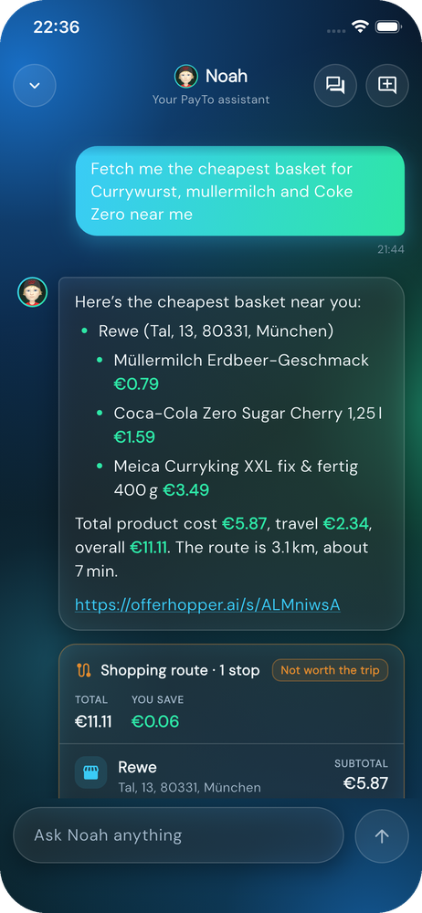





B · Noah does it for you
A grounded, bilingual conversational and agentic assistant that lets PayTo users search, compare, navigate and manage their loyalty wallet in plain English or German — and that asks a question instead of guessing when it is not sure.
✓ IMPLEMENTED · LIVE
KEY CAPABILITIES — AS SHIPPED
Product & merchant search with live prices
OfferHopper across Aldi, Lidl, REWE, Edeka, dm, Rossmann and more.
Shopping recommendations within a budget
Several options, price and store, ending with a map link.
Loyalty card, barcode, points and rewards
Payback, DeutschlandCard, Lidl Plus, Netto Plus, REWE Bonus, Edeka.
Grounded answers about PayTo and about itself
Retrieved from published docs — never invented.
Natural language in English and German
Follow-ups resolved from conversation history; replies in the user’s language.
Live in the PayTo app: cheapest basket near the user, with the shopping-route card.
Final Project Update — Universität Hamburg | Summer 2026
14

Slide 15




B · Noah — Status at a Glance
Everything below is measured on the live service, not projected.
Live
EN + DE
65 routes
Live + RAG
noah-z7qr.onrender.com · POST /api/chat
Languages — replies in the user’s language
0.94 route accuracy on a leakage-free split
OfferHopper prices · RAG over allow-listed docs
0.38 floor
+ context
139 tests
~150 ms
Confidence floor → clarifying question; out-of-scope declined
Conversation history and device location — both optional
Automated tests · frozen 24-key API contract
Routing · 3–20 s with a live price lookup
Final Project Update — Universität Hamburg | Summer 2026
15

Slide 16




B · Noah — How a Request Flows
One deterministic pipeline: the model decides what to do, the tools fetch facts, the language model only phrases the reply.
1
2
3
4
5
6
Instruction
→
Route classifier
→
Registry & planner
→
Tools
→
Reply generator
→
Structured JSON
Plain text, optionally with device location and the last 6 turns
Predicts (sub-intent, actions) with a calibrated confidence; 65 routes
Domain, intent, tool and response mode derived — cannot contradict each other
Wallet · Maps · OfferHopper MCP (live prices) · RAG over PayTo docs
LLM phrases from the facts it is given; deterministic fallback if none
24 fixed keys → Flutter dispatcher opens the card, map or wallet
Below the confidence floor, Noah asks
Nothing is invented
Firing the wrong action opens the wrong card, launches maps or spends a paid price lookup. A clarifying question costs one tap. The floor (0.38) is tuned by expected cost on hand-written probes the model has never seen.
Prices, stores, opening hours and policy facts come only from the tool results and retrieved documents. The user’s text is fenced inside the prompt as data, never as instructions. If a lookup returns nothing, the reply says exactly that.
Final Project Update — Universität Hamburg | Summer 2026
16

Slide 17

B · Noah — Understanding Intent
From thirteen classifiers that could disagree to one route model that cannot.
MID-TERM BASELINE
NOW LIVE
13 independent classifiers
One route model + a registry
Domain, intent, sub-intent, tool, mode … each predicted separately — and they disagreed: WALLET / OPEN_CARD / SMALL_TALK on one request.
Never abstained — “what’s the weather in Berlin” opened directions.
Reported 1.00 accuracy on a corpus where 86% of the test set was in training verbatim.
Predicts the pair (sub-intent, action sequence) — 65 routes. Every other field is looked up from that route, so a contradictory response is unrepresentable.
Word + character n-gram TF-IDF into a calibrated linear model; confidence is meaningful, so Noah can abstain and ask.
Out-of-scope requests are a route of their own — declined with a clarifying question, nothing fires.
65
0.94
0.97
0.38
139
routes, one model
route accuracy, leakage-free split
domain / intent accuracy
confidence floor (cost-tuned)
automated tests, offline by default
Final Project Update — Universität Hamburg | Summer 2026
17

Slide 18
B · Noah — An Honest Evaluation
The mid-term corpus reported 1.00 accuracy. That number was leakage, not learning.
WHAT WE FOUND
Never-seen phrasing — hand-written probes
21,000
4,377
Legacy 13-head model vs Noah today, same protocol (%)
rows in the legacy corpus
of them unique — rest duplicates
86%
4
of the test set was in training verbatim
unique greetings behind 2,080 rows
WHAT WE BUILT
9,983 unique utterances · 28% German · 141 out-of-scope negatives · min 62 per route (was 4).
Split grouped by surface template — a paraphrase of a training line cannot land in the test set.
Hand-written probes never enter the corpus; the trainer refuses to run if one leaks.
Final Project Update — Universität Hamburg | Summer 2026
18

Slide 19


B · Noah — Where Every Answer Comes From
Three sources of truth, and a language model that is only allowed to phrase them.
Live prices
Documents
Language model
OfferHopper MCP
Retrieval-augmented, scoped
Phrases only — never decides
Queried at request time — nothing cached
Starts from device coordinates; a typed place wins
Price, 3 alternatives, “worth the trip?”, map link
Only user-facing docs: privacy policy, FAQ, Noah sheet
Two shelves — Noah vs PayTo — never cross-ranked
26 / 26 test queries return the right passage
Receives the plan, a fact block and fenced user text
Writes 1–3 sentences in the user’s language
Never sees name, email or payment data
+ Aldi, Penny, Netto,
Kaufland, Rossmann, Müller, Globus
Privacy policy
Published FAQ
About Noah (EN/DE)
Groq · qwen3.6 / 3.8
Gemini 3.5 Flash-Lite
→ deterministic templates when every model is unavailable
Final Project Update — Universität Hamburg | Summer 2026
19

Slide 20
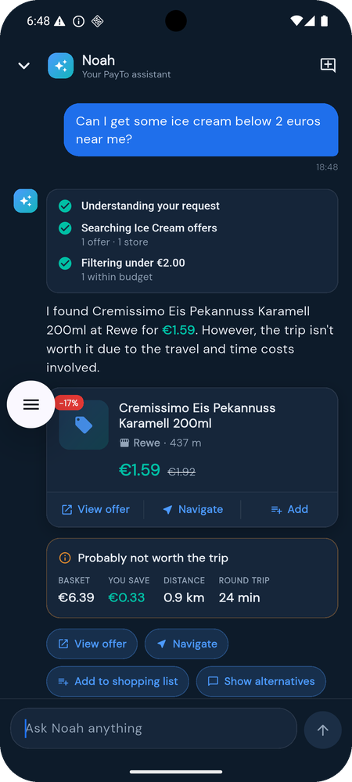
B · Noah in Action — Real Replies from the Live Service
Zeig mir meine Lidl Plus Karte
WALLET · OPEN_WALLET_CARD
Hier ist deine Lidl Plus Karte – halt den Barcode einfach an den Scanner, dann passt das.
Opens the wallet card; reply in German because the user wrote German.
Recommend me something for breakfast near me
RECOMMENDATION · OfferHopper · location
A few breakfast options at dm near you: Müsli Basis ohne Rosinen €1.35, Müsli Crunchy Hafer €2.25, Müsli Crunchy Schoko €2.35. Note the trip is considered not worth the time for the savings. https://offerhopper.ai/s/qG3FYLg4
Several options, real prices, the honest verdict, and the map link.
Do you serve from real time data and RAG systems?
KNOWLEDGE · APP_HELP · scoped retrieval
Yes — I use real-time data from OfferHopper for prices and stock, and I use RAG to answer questions about PayTo from its published documentation and FAQ.
Answered from the capability document, not improvised.
transfer 50 euros to my brother
CHAT · UNKNOWN · no action
I’m not sure what you need there. I can find products and offers, open your loyalty cards, or plan a cheaper shopping trip — which would you like?
Budget search from device location, offer card, and the honest verdict.
Out of scope: declined with a clarifying question, nothing fires.
Final Project Update — Universität Hamburg | Summer 2026
20

Slide 21
B · Demo — Noah in the PayTo App
Screen recording of Noah on the phone: search, basket, wallet card, follow-ups and an out-of-scope request.
▶
Demo video — Noah assistant
Placeholder: insert the phone screen recording here (Insert ▸ Video ▸ from file).
Final Project Update — Universität Hamburg | Summer 2026
21

Slide 22


B · Noah — Context-Aware, Contract-Safe
Two optional, additive request fields. The 24-key response has never changed.
Conversation history
Device location
Frozen wire contract
history — optional
location — optional
contract test — always on
The app sends the last six turns
“Take me there” → route to the store just found
“Which one is cheapest?” answered from carried results — no new lookup
Latitude/longitude or a postcode from the phone
Used only when the text names no place — “in Hamburg” wins
Without it: default area, and the reply says so
Pins request shape, the 24 keys, their types and vocabularies
Green on the mid-term code, green now
The Flutter client never had to move
REQUEST
RESPONSE
instruction
location · optional
history · optional
→
24 fixed keys
actions ⊆ registry
null data on any failure
POST /api/chat
Label vocabularies frozen: domain, response_mode, workflow_type, tools
Final Project Update — Universität Hamburg | Summer 2026
22

Slide 23



B · Noah — Deployment & Flutter Integration
Push to main, live in minutes; the app talks to one endpoint with one frozen contract.
Deployment
Render · Frankfurt · Docker
From commit to phone
Auto-deploys on every push to main — a fix is live ~2–4 minutes after commit.
Image cut from ~2.5 GB to a few hundred MB so the free tier fits; LLM keys stay on the platform, never in the repo.
→
→
→
Wire contract
Frozen, tested, additive-only
GitHub
Docker
Render
FastAPI
POST /api/chat with instruction; location and history optional.
Exactly 24 response keys and frozen label vocabularies; contract tests green since mid-term.
push to main
image ~300 MB
Frankfurt · 2–4 min
POST /api/chat
⇅
Flutter integration
Self-contained brief for the app team
location + last 6 turns ↑ ↓ 24-key JSON · 60 s timeout
One location fix per session; the last 6 turns travel with every request.
Dispatcher: text-only when no action, GET_DIRECTIONS added, null-data guard, 60 s timeout, /health warm-up.
PayTo Flutter app
Dispatcher opens the card, map or wallet · warms /health on launch · unknown actions ignored
Final Project Update — Universität Hamburg | Summer 2026
23

Slide 24


B · Noah — Technology Stack
Everything Noah runs on, from the route model to the phone.
FastAPI
Python
scikit-learn
OfferHopper MCP
POST /api/chat — routing, planning, tools, reply; frozen 24-key contract
Service, corpus tooling, evaluation and probes
TF-IDF route model (65 routes, calibrated) and scoped retrieval
Live German supermarket prices, baskets, routes, “worth the trip?”
Groq
Gemini 3.5 Flash-Lite
Docker
Render
qwen3.6-27b → qwen3.8-27b for phrasing the fact block
Third rung of the fallback chain, before deterministic templates
Container trimmed to a few hundred MB so the free tier fits
Frankfurt; auto-deploy on push to main; keeps itself warm
pytest
GitHub
Flutter
RAG documents
139 tests, offline by default: contract, routing, grounding, follow-ups
Source, PR process and the deploy trigger
Client dispatcher: card, map or wallet; sends location + last 6 turns
Privacy policy, published FAQ and the bilingual Noah sheet
Final Project Update — Universität Hamburg | Summer 2026
24

Slide 25
B · Noah — Evaluation: From Plan to Results
Every number below is measured on the shipped system.
Retrieval quality
Grounding accuracy
Hallucination check
26 / 26 scoped test queries return the right passage (EN + DE).
Every knowledge claim traceable to context; a suspected hallucination was traced to a real FAQ chunk.
Facts only from tools and documents; three honest failure states; nothing invented under test.
Task success
Turns per query
Latency
87.5% intent accuracy on never-seen phrasing (mid-term model: 30%).
Follow-ups resolved server-side from history; 14.6% of valid requests ask first, wrong actions ≈ 4%.
~150 ms routing · ~1 s reply · 3–20 s with a live price lookup.
Final Project Update — Universität Hamburg | Summer 2026
25

Slide 26
B · Noah — Risks, Open Questions & Mitigations
Assistant only — the recommendation engine has its own register (Part A).
OfferHopper rate limits
LLM quota and availability
Synthetic phrasing in the corpus
One retry honouring Retry-After; on failure the reply says the service is unreachable — never a stale or invented price.
Per-day caps per model: qwen3.6 → qwen3.8 → Gemini → deterministic templates. Routing and grounding are identical on every rung.
94% on the split vs 87.5% on hand-written probes: the gap is real user wording. Next lever is real logs, not tuning.
Free-tier cold start
Privacy
Prompt injection & scope
Service sleeps after ~15 min idle; first request ~50 s. The service keeps itself warm and the app pings /health on open; 60 s client timeout.
Noah never receives name, email or payment data; user text is fenced as data inside the prompt, never as instructions.
Internal engineering docs are unreachable by retrieval; out-of-scope requests are a route of their own and never fire an action.
Final Project Update — Universität Hamburg | Summer 2026
26

Slide 27

B · Future Considerations
Where the assistant goes after the academic handover.
Real user logs → retrain
Voice in and out
Local LLM option
Noah’s corpus is template-generated. Real phrasing from the pilot closes the split-vs-probe gap and lowers the ask rate.
Speech-to-text on the phone, text-to-speech for replies; the API is already text-in, text-out.
The reply layer is provider-agnostic; a local open-weight model swaps in for fully on-prem phrasing.
Personalised suggestions
Context-aware suggestions
Monitoring & deployment gates
For signed-in users, re-rank Noah’s suggestions with the app’s personalised ranking instead of price alone.
Time-of-day and seasonality alongside location in Noah’s recommendations.
Offline test suite already exists; add latency/error dashboards and gate deploys on the contract and probe suites.
Final Project Update — Universität Hamburg | Summer 2026
27

Slide 28
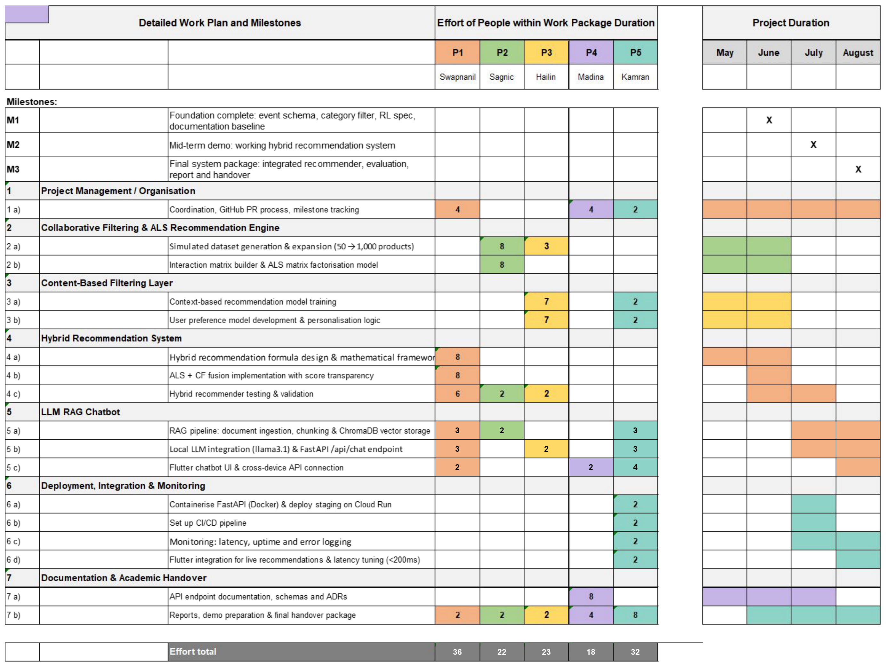
Work Plan & Milestones
Note: Dates and work distribution are approximate and subject to change.
Final Project Update — Universität Hamburg | Summer 2026
28

Slide 29
Work Plan & Milestones — Delivered
Status of every work package in the plan. Dates and work distribution approximate; effort totals per person as in the plan.
WP | Work package | Part | Lead | Delivered | Status
M1 | Foundation: event schema, category filter, RL spec, documentation baseline | — | Team | June | ✓ delivered
M2 | Mid-term demo: working hybrid recommendation system | A | Team | July | ✓ delivered
2 | ALS collaborative filtering: simulated dataset (50 → 1,000 products), interaction matrix, factorisation | A | Sagnic · Hailin | June – July | ✓ delivered
3 | Content-based layer: SBERT model training, user preference model | A | Hailin · Kamran | June – July | ✓ delivered
4 | Hybrid recommender: formula design, ALS + CF fusion with score transparency, testing | A | Swapnanil | July | ✓ delivered
5 | Noah: corpus rebuild & route model, RAG ingestion, /api/chat, conversation context, Flutter brief | B | Swapnanil · Kamran · all | Jul – Sept | ✓ delivered
6 | Deployment & monitoring: Docker, Render auto-deploy, offline test suite, logging | A + B | Kamran | Sept | ✓ delivered
7 | Documentation & handover: API contract, ADRs, integration prompts, final report | A + B | Madina · all | Sept | in progress
M3 | Final system package: integrated recommender + assistant, evaluation, report and handover | A + B | Team | Sept | this presentation
Final Project Update — Universität Hamburg | Summer 2026
29

Slide 30
Conclusion & References
Key Takeaways
References
A · Recommendation engine
A hybrid of SBERT content similarity and ALS collaborative filtering, blended per user (0.2 ≤ α ≤ 0.8), handles cold start and personalises as history accrues — in production.
B · Noah assistant
One route model and a registry make contradictory responses unrepresentable; facts come only from live tools and scoped documents, and Noah asks instead of guessing.
Evaluated honestly: 87.5% on never-seen phrasing (was 30%), 139 tests, a frozen 24-key contract — live and integrated with the Flutter app.
Noah — live API docs:
https://noah-z7qr.onrender.com/docs
Noah — source repository:
https://github.com/schlechtswapnanil/Noah
OfferHopper (live prices):
https://offerhopper.ai/
SBERT — Reimers & Gurevych (2019):
https://www.sbert.net/
ALS — Hu, Koren & Volinsky (2008), Collaborative Filtering for Implicit Feedback Datasets:
https://doi.org/10.1109/ICDM.2008.22

Slide 31
Thank You
Questions?
Swapnanil Chakraborty · Kamran Anwar · Sagnic Das · Hailin Wang · Madina Haidari
PayTo Final Project Update — Universität Hamburg, Summer 2026
Try Noah: noah-z7qr.onrender.com/docs · github.com/schlechtswapnanil/Noah

