Slide 1


Master - Security – Threat Modelling
Prof. Dr.-Ing. Sebastian Schlesinger
Professor of Business Computer Science (Security and Embedded Systems Engineering)

Slide 2
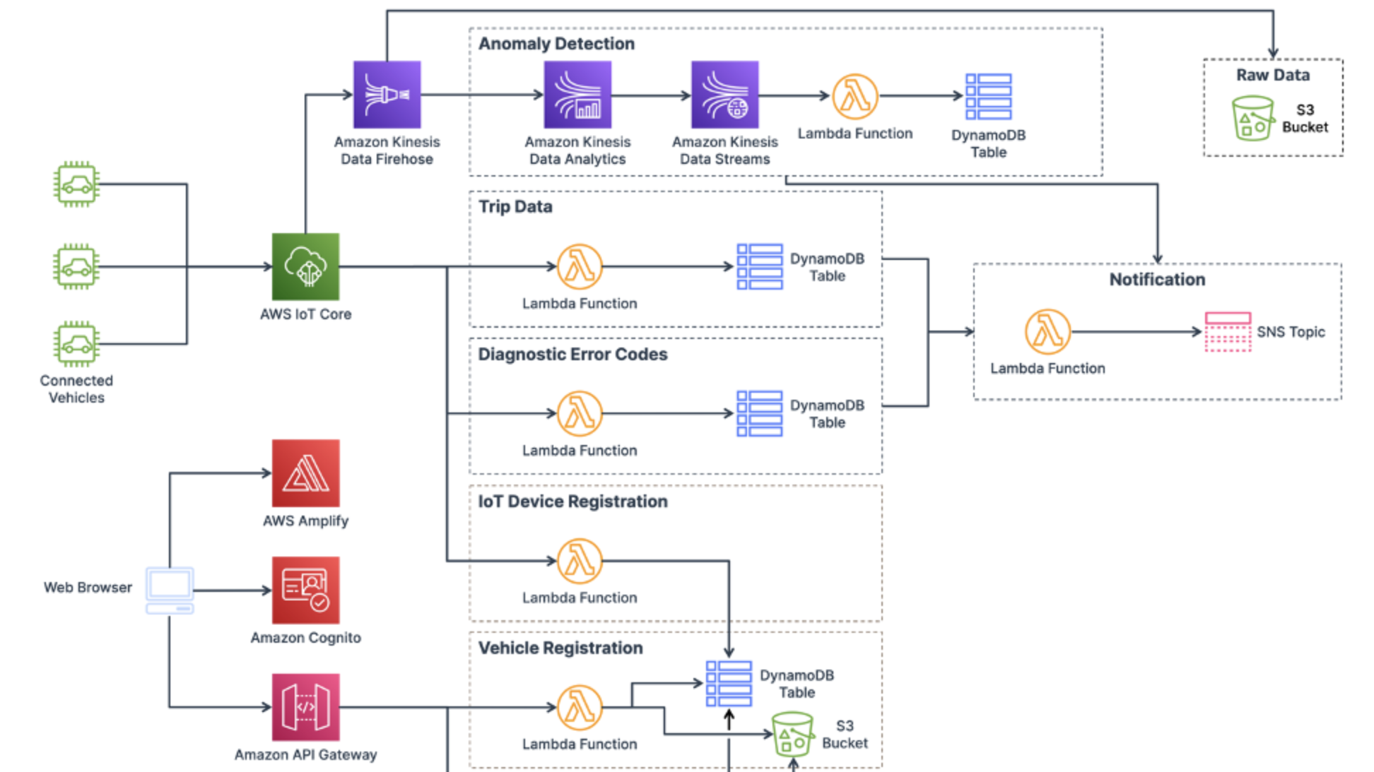

Slide 3
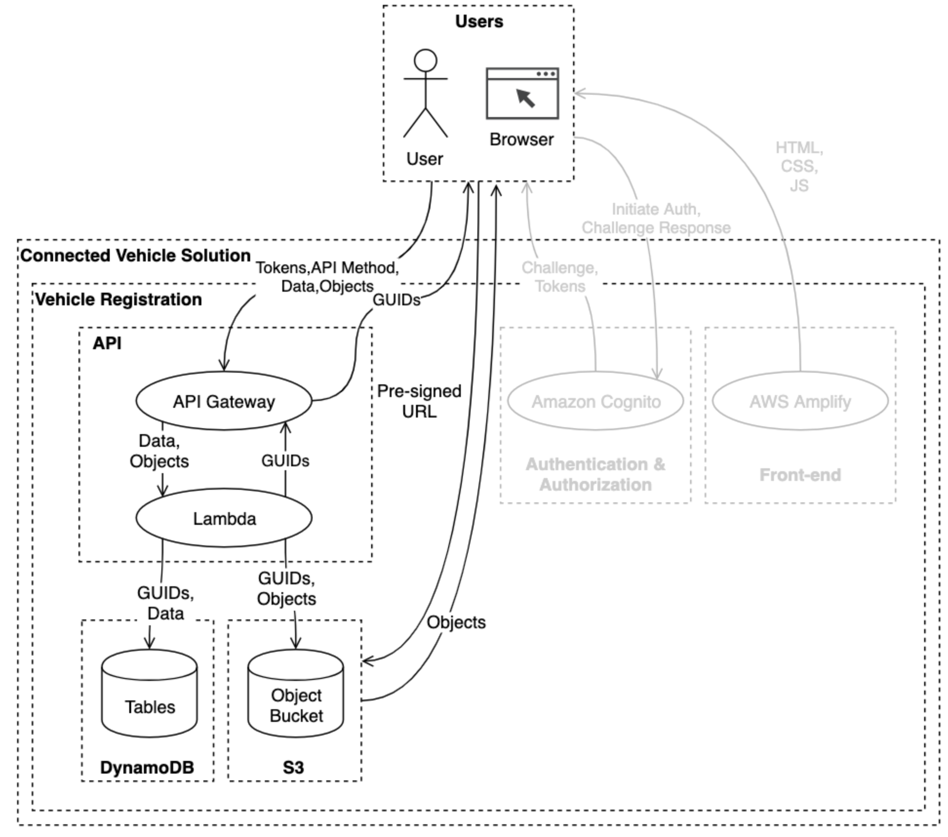
Use Case

