Slide 1
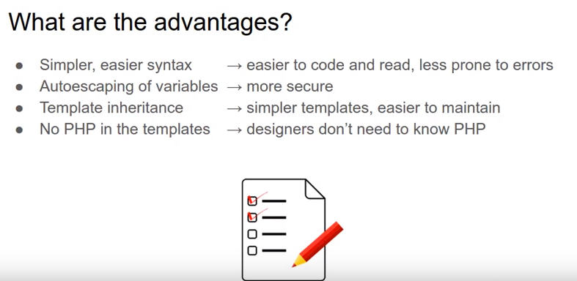

Slide 2
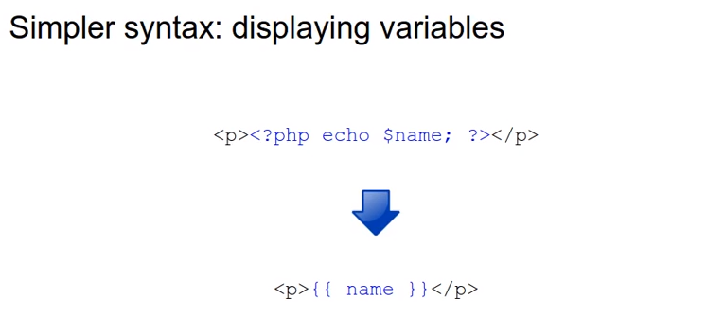

Slide 3
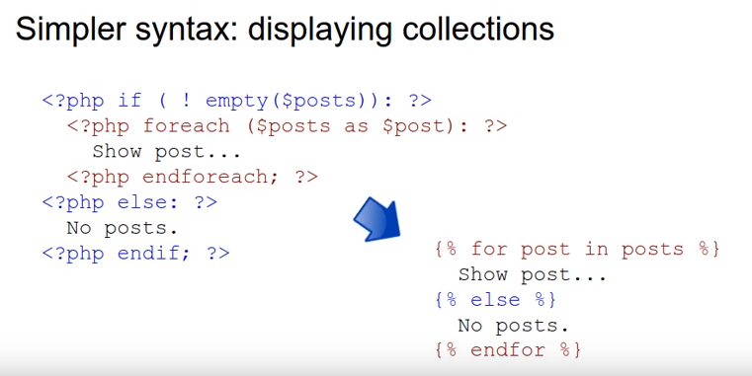

Slide 4
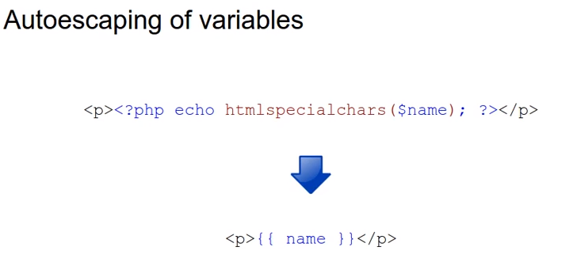

Slide 5
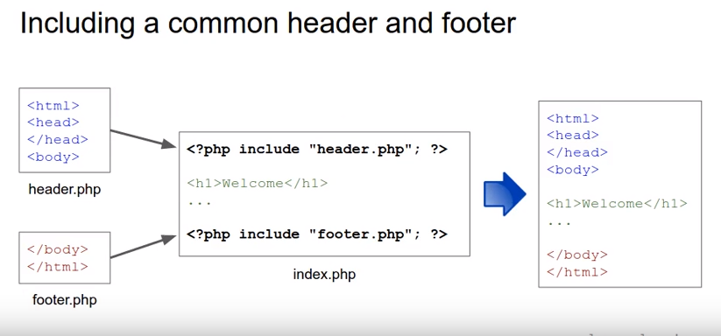

Slide 7
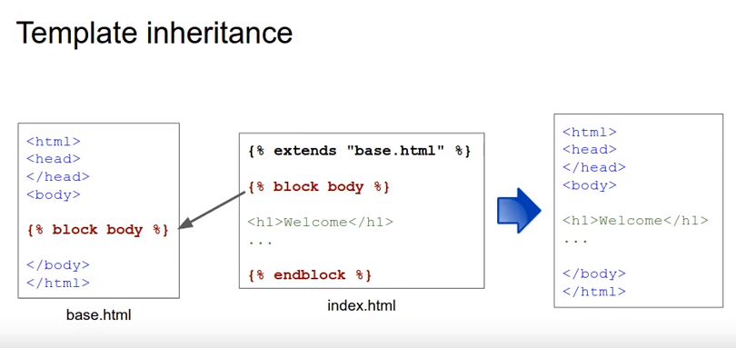

Slide 8
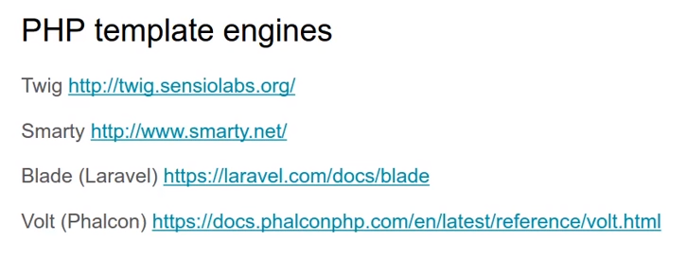

Slide 9
twig1_index.php
<?php
require 'C:\xampp\php\lib\vendor\autoload.php';
$loader = new Twig_Loader_Filesystem('views');
$twig = new Twig_Environment($loader);
echo $twig->render('twig1_index.html', array(
'name' => 'Michael',
'age' => 52
));

