Slide 1
RNAseq Workshop
AIM: to get an overview of differential gene expression
Identify genes most highly differentially expressed between a condition

Slide 2
Software that will help you …
All users: Filezilla https://filezilla-project.org/download.php please install this. You can always remove it later.
Windows: Notepad++ (this is the King of Editors). https://notepad-plus-plus.org/downloads/ (This software understand Linux line ending)
Windows (optional): Mobaxterm Home edition (free) https://mobaxterm.mobatek.net/download.html

Slide 3
R studio : essential …
All users: R studio (choose the free version https://rstudio.com/products/rstudio/download/)
(open R studio) Install the package:
install.packages("BiocManager")
BiocManager::install("edgeR")
# load the package to check it worked
library("edgeR")

Slide 4
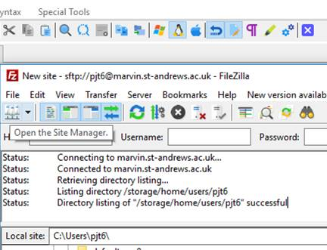
Downloading: transfer files Filezilla https://filezilla-project.org/download.php
Step 1. Open host

Slide 5
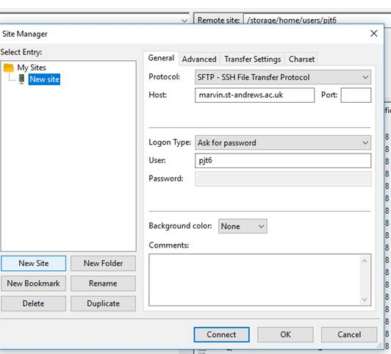
Downloading: transfer files Filezilla
2) When the next dialogue page comes up, click on “new site” (button , not the folder). Change the Protocol to SFTP. This is essential. Fill out the rest, use this host and port: 22.
Once connected, you can drag and drop files from one window to the next.
sfpt
Once connected: You can drag the files from the right hand window (this is Marvin) to the left window – this is your computer. Where ever you want the files to go!!!

Slide 6
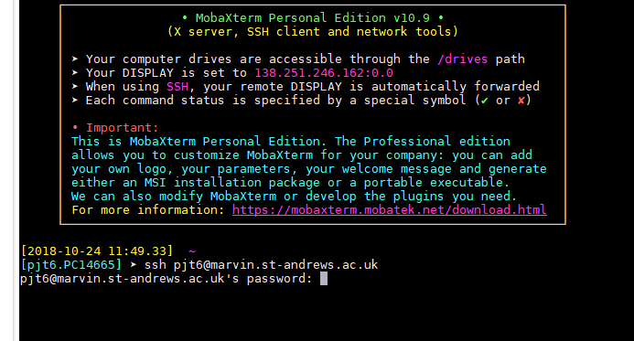
QUICK start - Getting connected:
ACTIVITY
Type: ssh USERNAME@marvin.st-andrews.ac.uk (whatever your username is)
Then enter your password (when prompted). This is the same way for all the programs (Windows/ MAC/ Linux).

Slide 7
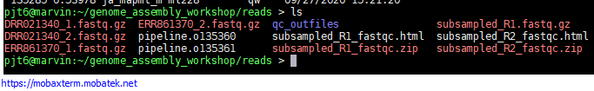
QUICK start: copy paste
Copy: If you highlight (drag over, or double click) something in a terminal – this is now copied to your clipboard.
Paste: this is different for different programs. But Right click, or the middle button on a mouse…

Slide 8
2) Getting connected: getting the files
Paste the following into the terminal to copy all the data to your home directory.
cp -rv /shelf/Computational_Genomics/RNAseq_workshop/ ~/
Make sure you have the software ready to use (note dot space):
. /shelf/apps/pjt6/conda/etc/profile.d/conda.sh

Slide 9
Get some long jobs running
Submit some jobs to the cluster.
cd into the shell_scripts folder (tab auto complete!!)
cd $HOME/genome_assembly_workshop/shell_scripts
conda activate unicyclerENV
qsub -V unicycler.sh
qsub -V spades.sh

