Slide 1
Slides
Denis Schluppeck

Slide 2
In the morning
Getting up
Turn off alarm
Get out of bed
Breakfast
Eat Kenyan fruit
Drink lots of coffee

Slide 3
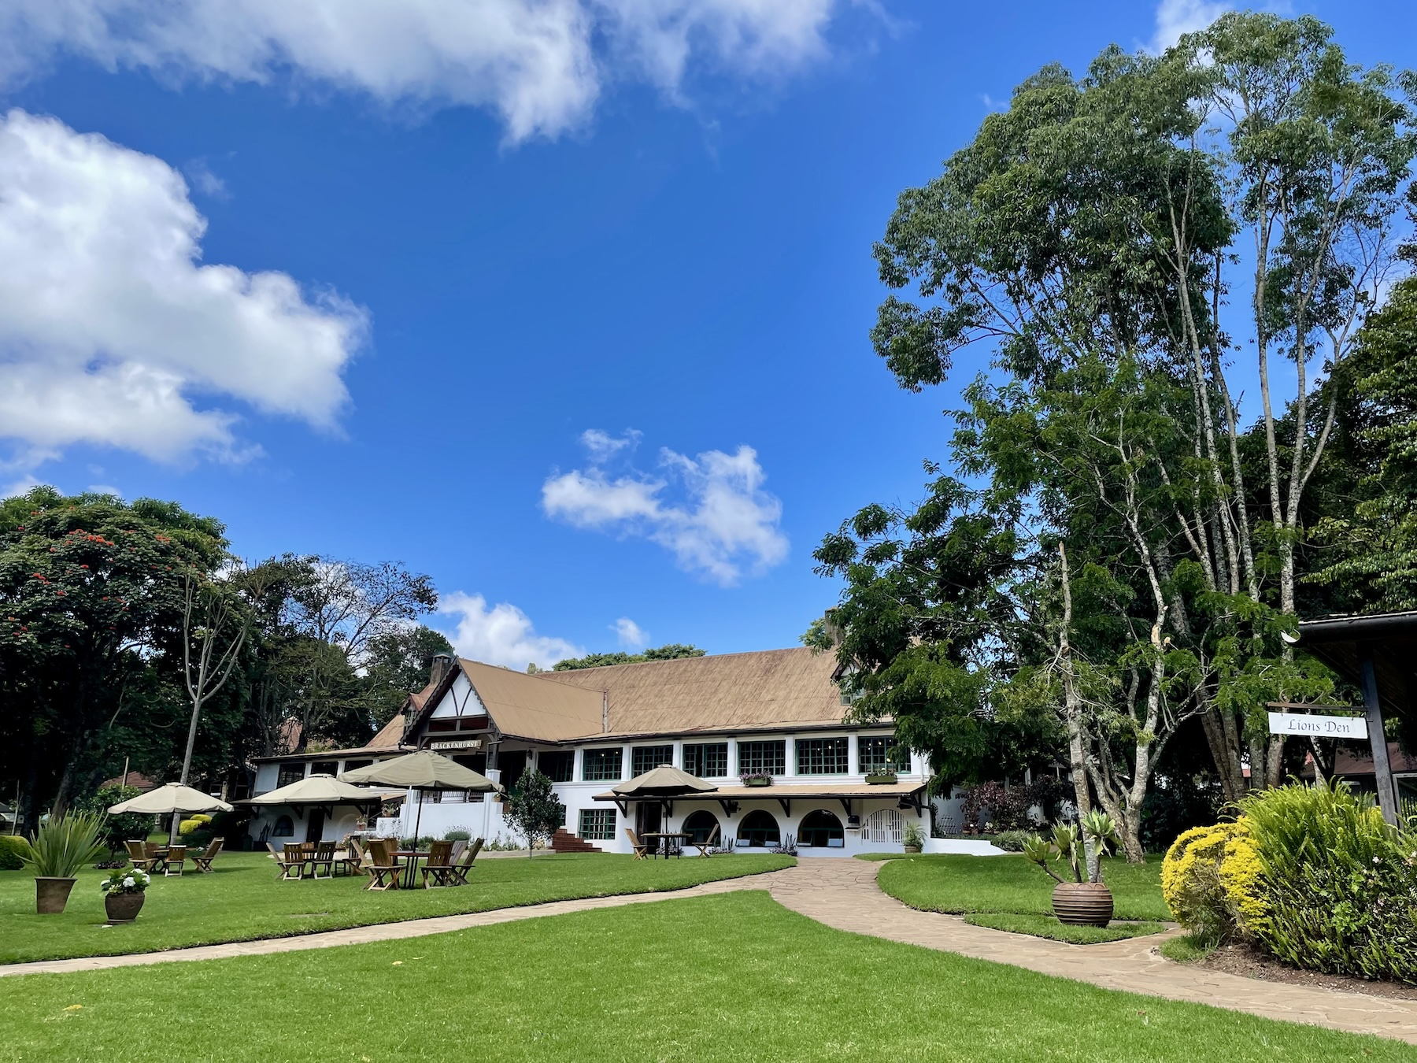
In the afternoon

Slide 4
Dinner
Eat spaghetti
Drink wine
Going to sleep
Get in bed
Count sheep

