Slide 1
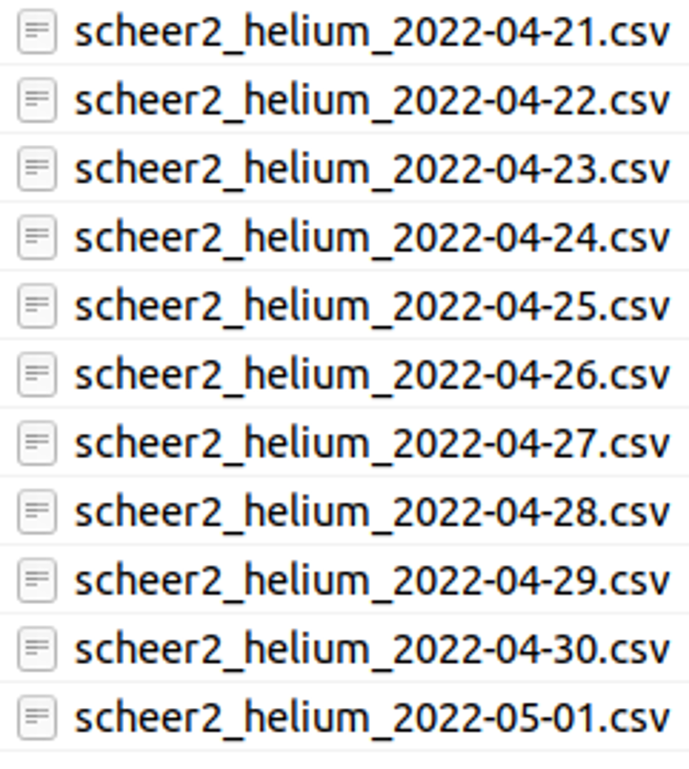

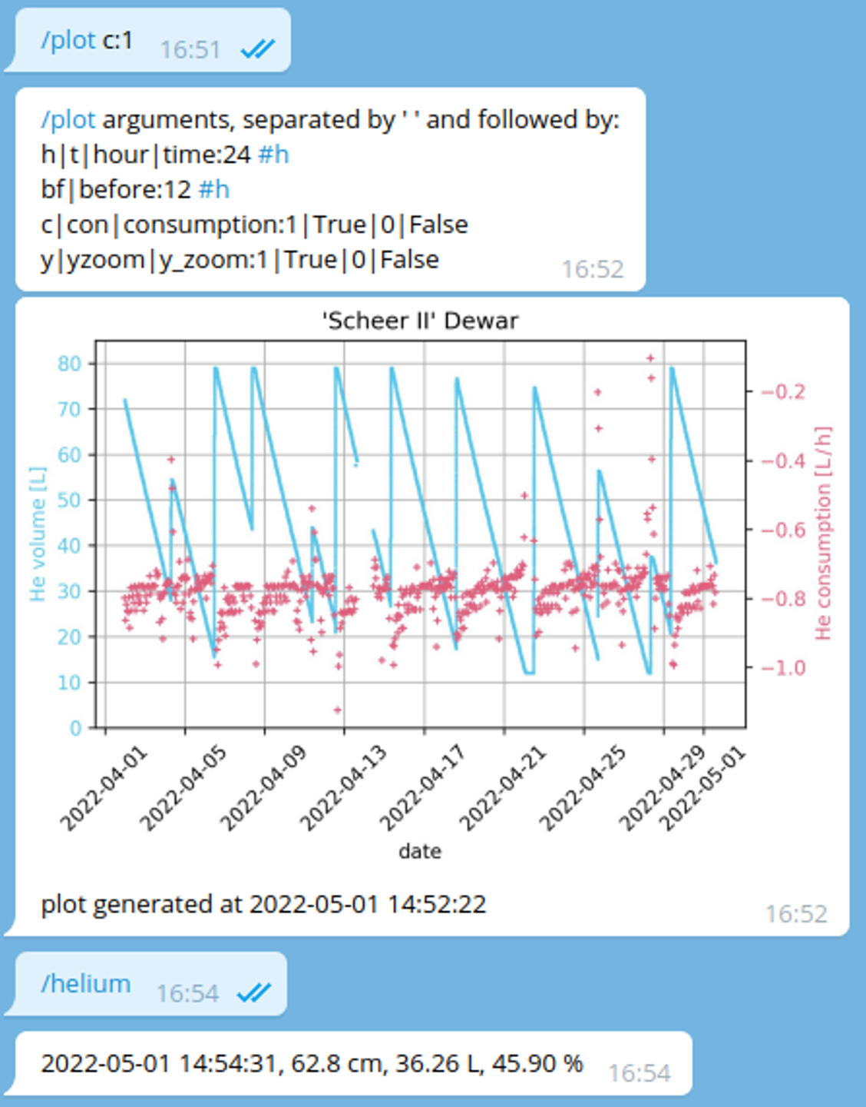

HeliumBot
AMI135
device driver
RS232
PyVISA
Level Meter
holds AMI135
holds values
Logger
writes values to *.csv files
new file each day
/notification
resends string each given time
with alarm
/notification
resend string each given time
with alarm
/notification
resend string each given time
with alarm
/plot
generates and send plot to telegram
/helium
answers with string
Scheer II Dewar
argument handler
parses arguments
@scheer2_dewar_bot

