Slide 1



Creating a Standardized Risk Assessment Framework Library for Healthcare Information Technology
Dr. Suzanna Schmeelk, St. John’s University, Queens, New York
HICSS-53, Maui, HI, 2020
January 11, 2020

Slide 2
Class Session Outline (15 minutes)
Introduction
Risk Assessment Standards
Risk Assessment Literature Review
Risk Assessment Model
Risk Assessment Library Considerations
A Risk Assessment Library Example
Future Work and Implications
Conclusions

Slide 3
Introduction

Slide 4
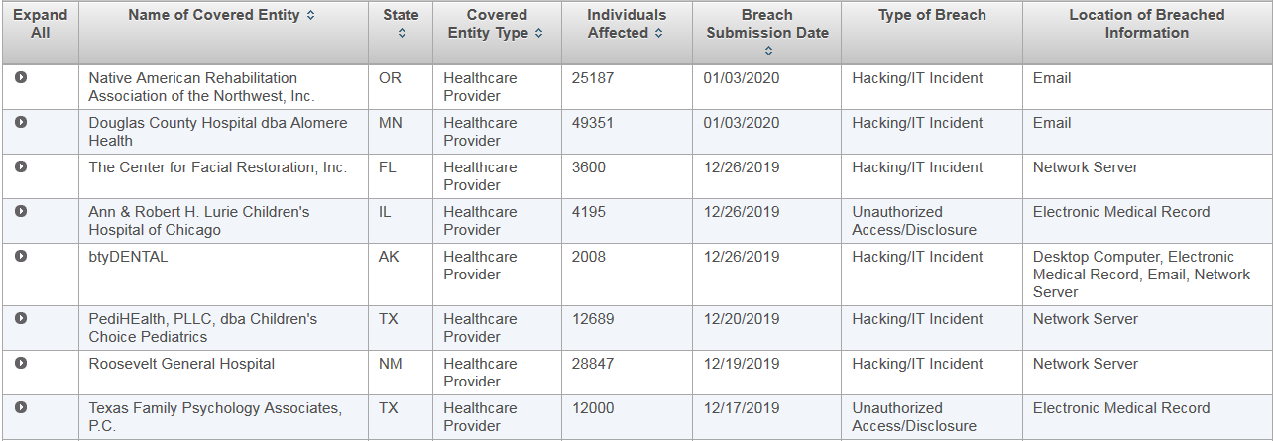
Top Breaches of 2020

Slide 5
Introduction
Health Insurance Portability and Accountability Act (HIPAA) and Health Information Technology for Economic and Clinical Health Act (HITECH) [2] are regulations at the federal-level to protect the privacy and security of patient health information (PHI) such as name, birthdate, social security numbers, medical record numbers, etc.
This specific digital patient information is considered electronic patient health information (ePHI). Medical entities may also be under other legal requirements such as non-disclosure or confidentiality requirements of other data (e.g. research, employee, drug, etc.).

Slide 6
Introduction
Since many covered entities are siloed:
Different components of the organizational risk (e.g. legal, budget, security, privacy, technology, etc.) are being managed by different department entities without a standardized and well-connected system
organizations deal with frustrations both when needing to produce detailed and accurate audit records
when communicating risks to the business.

Slide 7
Risk Assessment Standards

Slide 8


National Institute of Standards and Technology (NIST)
National Vulnerability Database (NVD)
Bug Framework (BF)

Slide 9


MITRE
Common Weakness Enumeration (CWE)
Common Vulnerability Enumeration (CVE)

Slide 10
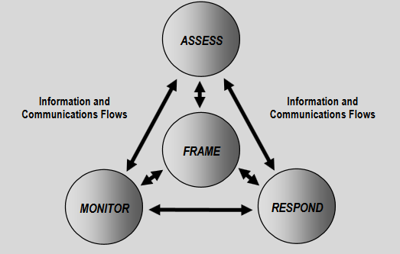

Can we Manage Security?
Manage Risk ->
Frame
Assess/Mitigate (i.e. Tech,, Ph., Admin. Controls)
Monitor
Respond
Notes:
https://nvlpubs.nist.gov/nistpubs/Legacy/SP/nistspecialpublication800-30r1.pdf

Slide 11

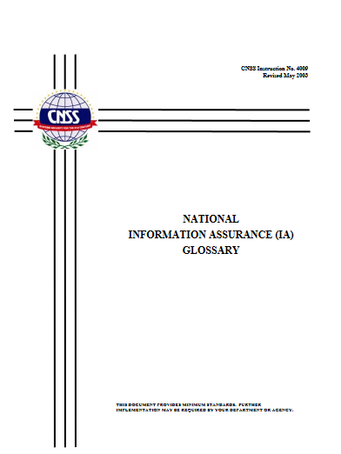

Risk (NIST SP 800-30 Definition)
A measure of the extent to which an entity is threatened by a potential … event, and typically a function of: (i) the adverse impacts that would arise if the circumstance or event occurs; and (ii) the likelihood of occurrence.
Source: CNSSI No. 4009
Notes:
https://nvlpubs.nist.gov/nistpubs/Legacy/SP/nistspecialpublication800-30r1.pdf

Slide 12
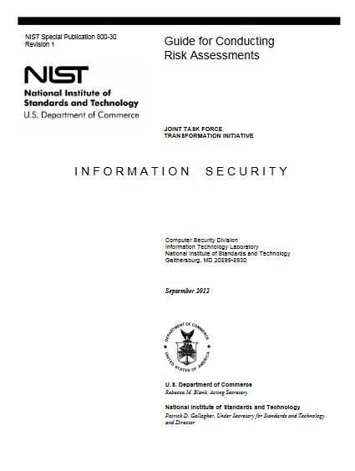
How to Manage Risk?
Frameworks for Managing Risk
Quantitative, Qualitative
NIST SP 800-30, FAIR (Factor Analysis of Information Risk)
Threat-oriented; asset/impact-oriented; or vulnerability-oriented
Notes:
https://nvlpubs.nist.gov/nistpubs/Legacy/SP/nistspecialpublication800-30r1.pdf
https://www.fairinstitute.org/what-is-fair
NIST:
Analysis approaches differ with respect to the orientation or starting point of the risk assessment, level of detail in the assessment, and how risks due to similar threat scenarios are treated. An analysis approach can be: (i) threat-oriented; (ii) asset/impact-oriented; or (iii) vulnerability-oriented.30 A threat-oriented approach starts with the identification of threat sources and threat events, and focuses on the development of threat scenarios; vulnerabilities are identified in the context of threats, and for adversarial threats, impacts are identified based on adversary intent. An asset/impact-oriented approach starts with the identification of impacts or consequences of concern and critical assets, possibly using the results of a mission or business impact analyses and identifying threat events that could lead to and/or threat sources that could seek those impacts or consequences. A vulnerability-oriented approach starts with a set of predisposing conditions or exploitable weaknesses/deficiencies in organizational information systems or the environments in which the systems operate, and identifies threat events that could exercise those vulnerabilities together with possible consequences of vulnerabilities being exercised. Each analysis approach takes into consideration the same risk factors, and thus entails the same set of risk assessment activities, albeit in different order. Differences in the starting point of the risk assessment can potentially bias the results, causing some risks not to be identified. Therefore, identification of risks from a second orientation (e.g., complementing a threat-oriented analysis approach with an asset/impact-oriented analysis approach) can improve the rigor and effectiveness of the analysis.

Slide 13
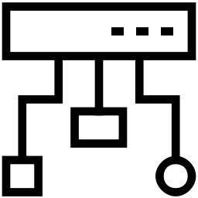
Threats and Vulnerabilities (NIST SP 800-30 Definitions)
Threat – any … event with the potential to adversely impact organizational operations …
Threat events are caused by threat sources. (e.g. Incorrect privilege settings, etc.)
Vulnerability - weakness in an information system, system security procedures, … that could be exploited by a threat source.
Notes:
https://nvlpubs.nist.gov/nistpubs/Legacy/SP/nistspecialpublication800-30r1.pdf

Slide 14

Likelihood (NIST SP 800-30 Definition)
Weighted risk factor based on … probability that a given threat is capable of exploiting a given vulnerability ....
Traditional Mitigations
Technical Controls
Physical Controls
Administrative Controls
Calculate Qualitatively: Low, Med, High, Critical
Notes:
https://nvlpubs.nist.gov/nistpubs/Legacy/SP/nistspecialpublication800-30r1.pdf

Slide 15

Impact (NIST SP 800-30 Definition)
Magnitude of harm that can be expected to result from the consequences of a threat exploiting a vulnerability
(e.g unauthorized disclosure of information, unauthorized modification of information, unauthorized destruction of information, or loss of information or information system availability)
Typical Information Classifications:
Public (L)
Internal Only (M)
Sensitive (e.g. regulated) (H)
Life Critical or DMZ (C)
Calculate Qualitatively: Low, Med, High, Critical
Notes:
https://nvlpubs.nist.gov/nistpubs/Legacy/SP/nistspecialpublication800-30r1.pdf

Slide 16
Risk Assessment Literature Review

Slide 17
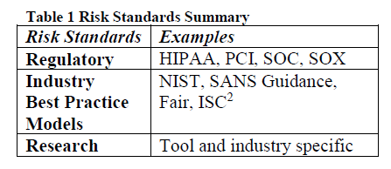
Literature
Risk Assessment Automation
Risk Assessment Education
Risk Assessment Standards

Slide 18
Risk Assessment Model

Slide 19
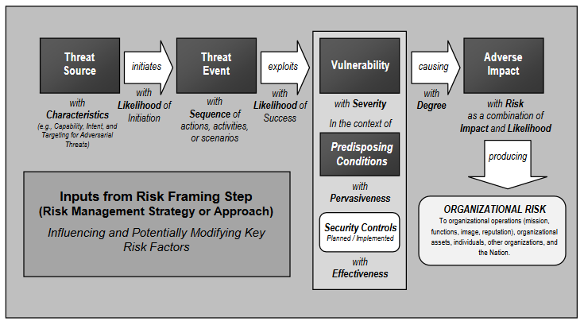
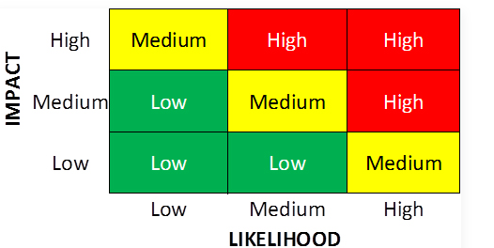
NIST Organizational Risk Model
Calculating Risk for each Issue: Qualitatively
Notes:
https://nvlpubs.nist.gov/nistpubs/Legacy/SP/nistspecialpublication800-30r1.pdf
https://itsecurity.uiowa.edu/sites/itsecurity.uiowa.edu/files/sampleriskassessmentreport.pdf
http://examples.complianceforge.com/cybersecurity-risk-assessment-template-it-security-risk-assessment.pdf
https://www.nccoe.nist.gov/publication/1800-8/VolA/index.html
https://www.nccoe.nist.gov/publication/1800-8/VolC/index.html#risk-assessment

Slide 20
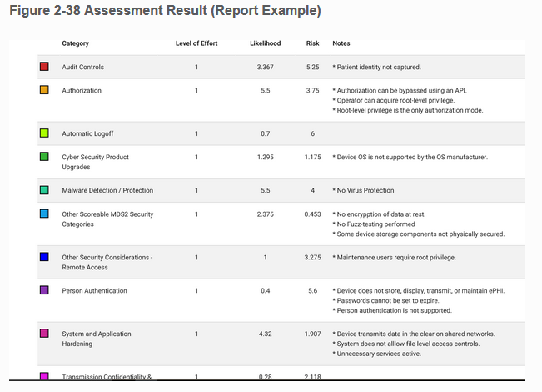
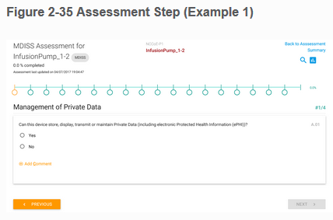

NIST Assessment Example: Medical Wireless Infusion Pumps
Notes:
https://nvlpubs.nist.gov/nistpubs/Legacy/SP/nistspecialpublication800-30r1.pdf
https://itsecurity.uiowa.edu/sites/itsecurity.uiowa.edu/files/sampleriskassessmentreport.pdf
http://examples.complianceforge.com/cybersecurity-risk-assessment-template-it-security-risk-assessment.pdf
https://www.nccoe.nist.gov/publication/1800-8/VolA/index.html
https://www.nccoe.nist.gov/publication/1800-8/VolC/index.html#risk-assessment

Slide 21
Risk Assessment Library Considerations

Slide 22
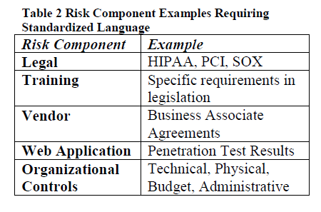
Risk Assessment Library Considerations
Legal Requirements
Training Requirements
Vendor Requirements
Application and System Requirements
Budget for Adverse Events

Slide 23
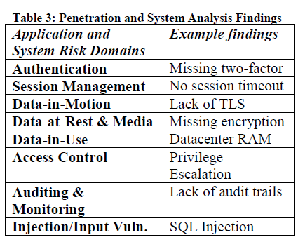
Application and System Requirements
Authentication
Session Management
Data-in-Motion
Data-at-Rest and External Media
Data-in-Use
Access Control
Auditing and Monitoring
Injection and Input Vulnerabilities
Organizational Control Requirements
Policies and Procedures
Physical Security

Slide 24
A Risk Assessment Library Example

Slide 25
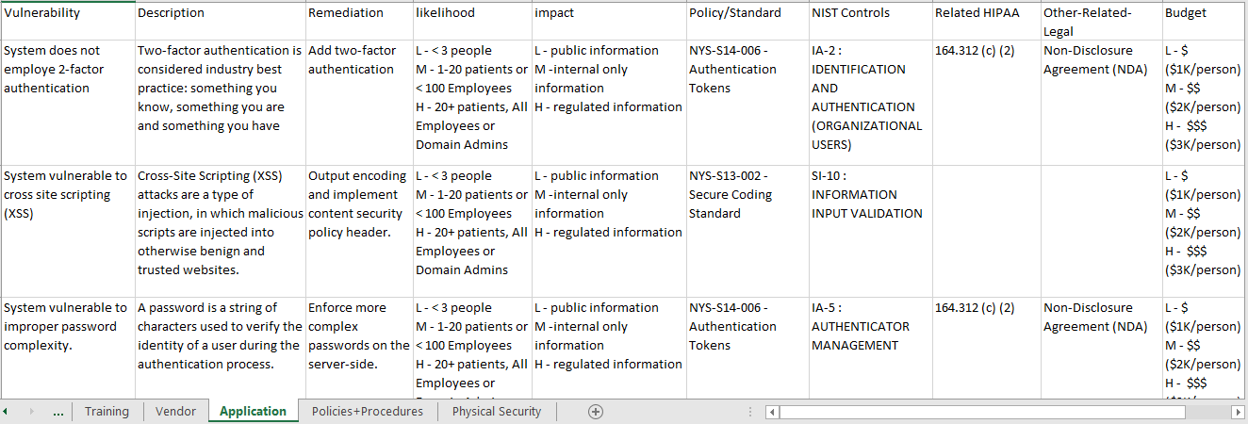
Example Risk Assessment Library
https://github.com/schmeelk/HICSS-53

Slide 26
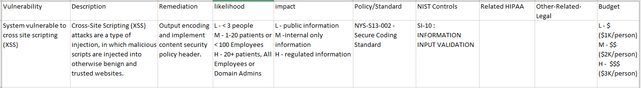
Findings 1: Stored Cross-Site Scripting (XSS).
Cross-site scripting is considered an injection/input validation software development error.
HIPAA does not specifically mention cross-site scripting within the law itself, but other interpretations about access control, confidentiality, integrity and availability could potentially affect legal recourse.
Considering the NYS policies, accepting an XSS vulnerability may be in violation of the organizational Secure Coding Standard (NYS-S13-002), as it requires systems free of such software bugs.
During a risk assessment, not only should the finding be identified, it should be mapped

Slide 27
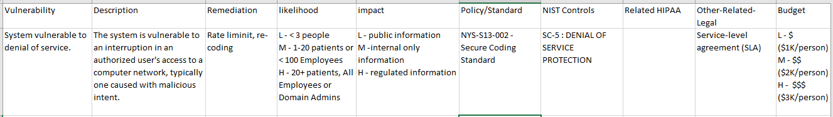
Findings 2: Denial of Service
The application is susceptible to a denial of service attack based on how the application is constructed.
Denial of service is not mentioned in HIPAA directly; however, organizations are required maintain the availability of ePHI which is within an application.
Connecting this finding to policies, for example the NYS ITS policies, a violation of the Secure Coding Standard (NYS-S13-002) occurs, which should be managed.

Slide 28
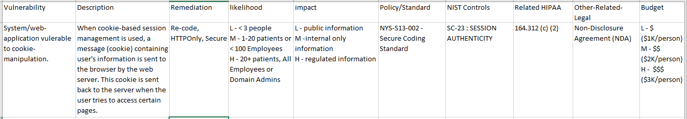
Findings 3: Cookie Manipulation
The application is susceptible to cookie manipulation meaning that the session management vulnerable.
This particular finding is not discussed directly in HIPAA; however, HIPAA discusses access control standards, which may come into question in such a case where a known vulnerability exists.
This particular finding violates the NYS Secure Coding Standard (NYS-S13-002).

Slide 29
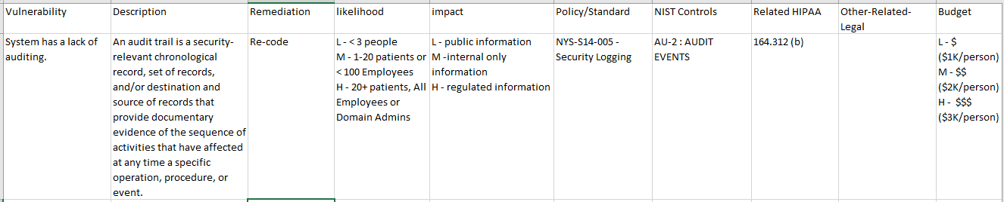
Findings 4: Lack of Application Auditing
This particular application may be found to be improperly auditing associated activities.
If the application were to house ePHI, then it would be required to provide auditing records under HIPAA. This would be a direct violation of the federal law.
This particular finding would also be in violation of the NYS Security Logging (NYS-S14-005) policy, so a policy exception should be put into place.

Slide 30
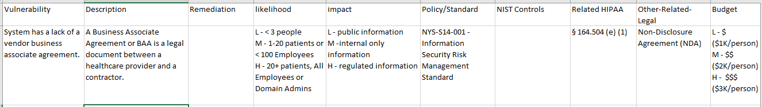
Findings 5: Lack of Vendor Agreements
This particular application may be from a vendor.
In such a case, proper agreements such as a Business Associate Agreement (BAA) or other vendor requirements must be in place based on Federal requirements.
If the application is housing ePHI, then both HIPAA and the organizational polices/standards (e.g. NYS ITS Information Security Risk Management Standard (NYS-S14-001)) may be violated and are at stake so the connection to the laws and policies/standards needs to be clear to effectively manage the risks to the organization.

Slide 31
Future Work and Implications

Slide 32
Future Work and Implications
Risk is currently being distributed across many departments in medical institutions across the US
Most IRM solutions require the institutions to configure and customize the software to meet their needs.
Organizational risk owners may face frustrations as to what risk they are inheriting and for what exactly they are liable during a breach of regulations by the organization.
As people leave/retire and newer staff replace existing medical staff roles, the newer staff legally need to know what responsibilities and risks have already been accepted at their job-level by their predecessor.
Perhaps future job postings should reflect the expected level of risk, which is associated with position.
For example, breaches investigated by the US HHS OCR which result in organizational corrective action plans are inherited and stay with the breached organization for the duration of the

Slide 33
Conclusions

Slide 34
Conclusions
Databreaches are occurring at an unprecedented rate
e.g. Facebook appropriate budget for cybersecurity issues.
A risk assessment from one hospital cannot currently be compared with a risk assessment from another hospital.
No standardized language
No standardized process
No standardized analysis
No standardized library
All the unstandardized unknowns lead to unknown risks resulting in unknown cyber insurance costs.

