Slide 1
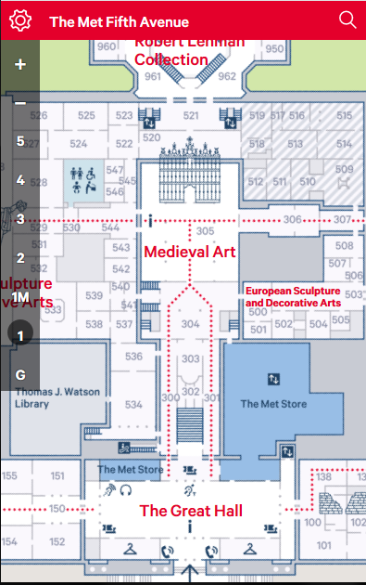


Printer

Slide 2
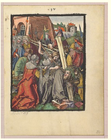
The Bearing of the Cross 1485
From the Small Woodcut Passion

Slide 3
Printer

