Slide 1
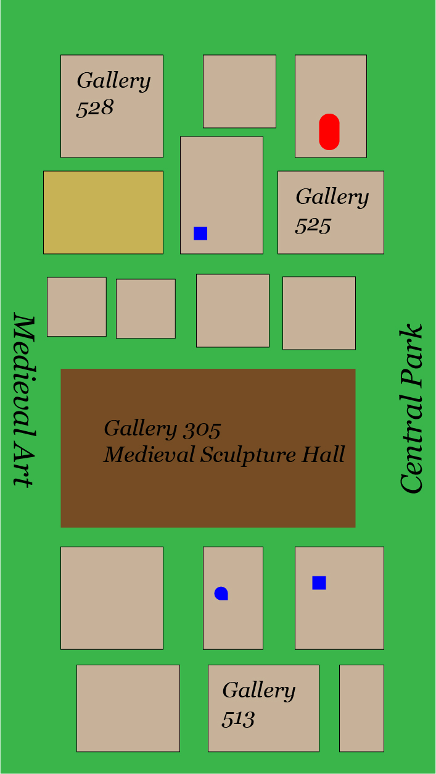

Click

Slide 2
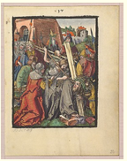
The Bearing of the Cross 1485
From the Small Woodcut Passion

