Slide 1
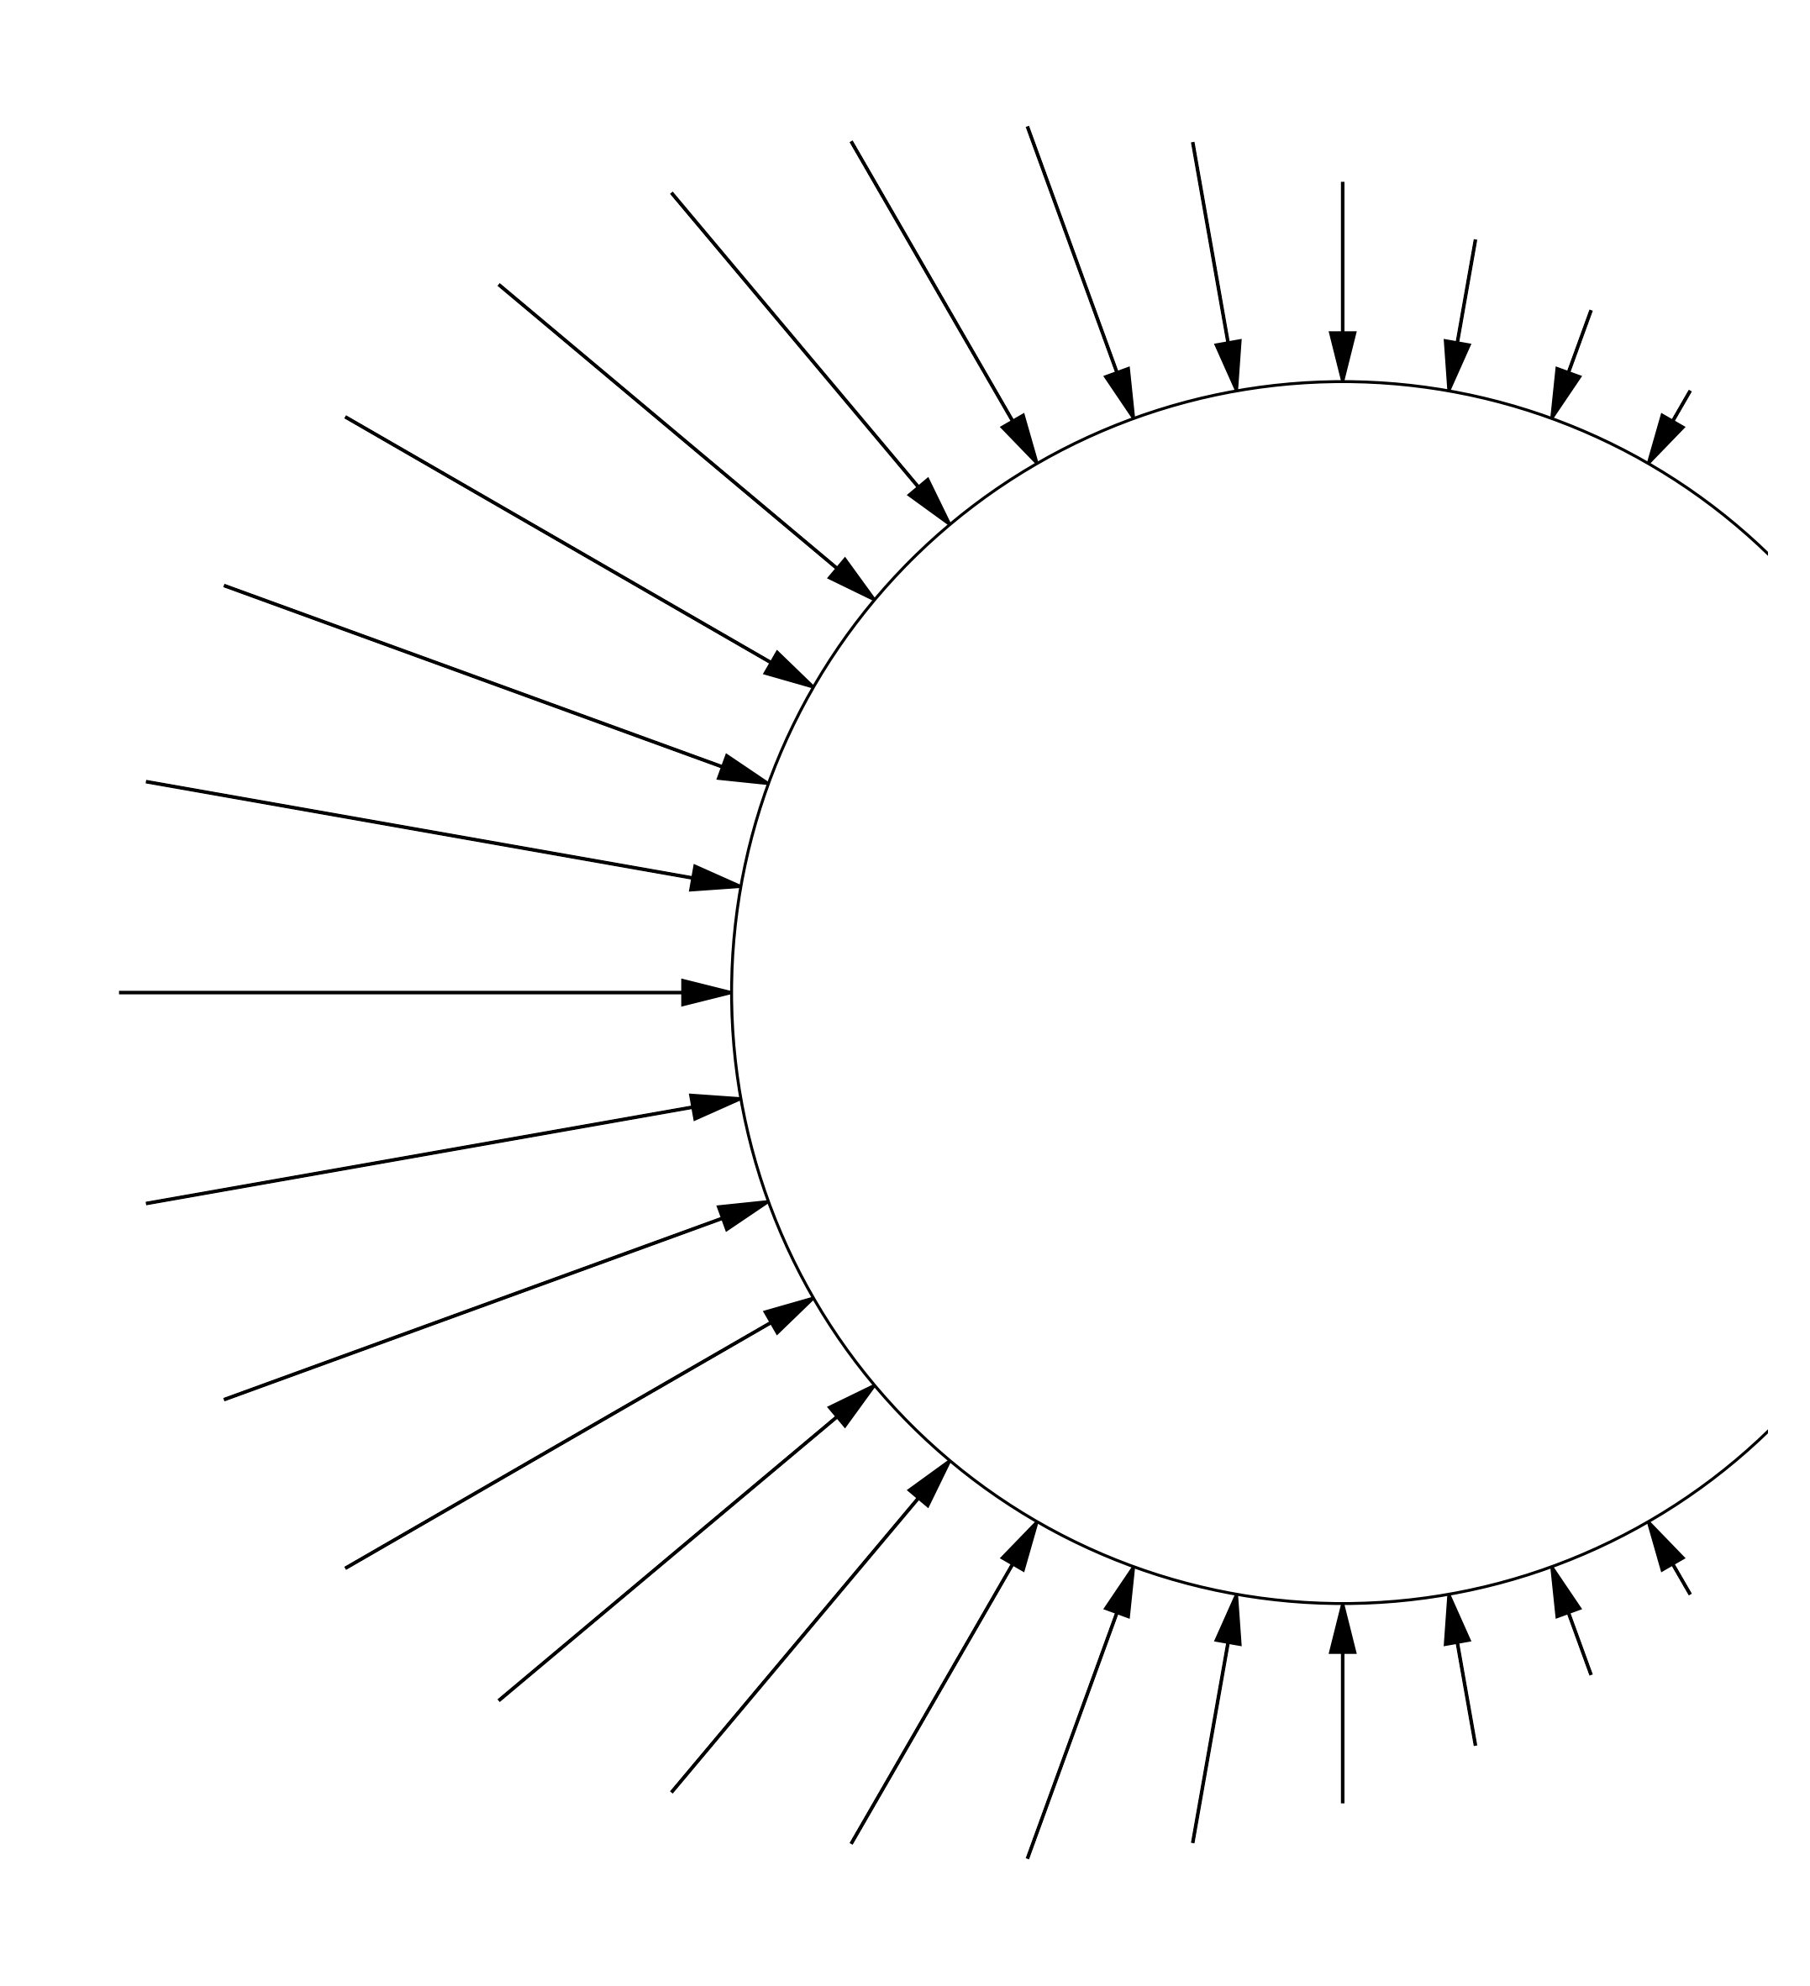

Mixed Integer Stochastic Optimization of relative Position of two Wind Turbines using using Neural Network based Constraint Learning
– Simon Schmetz –
Universidad Carlos III de Madrid
Master Thesis Defense
Madrid the 14th of July 2025
Supervisor: Carlos Ruiz Mora

Slide 2
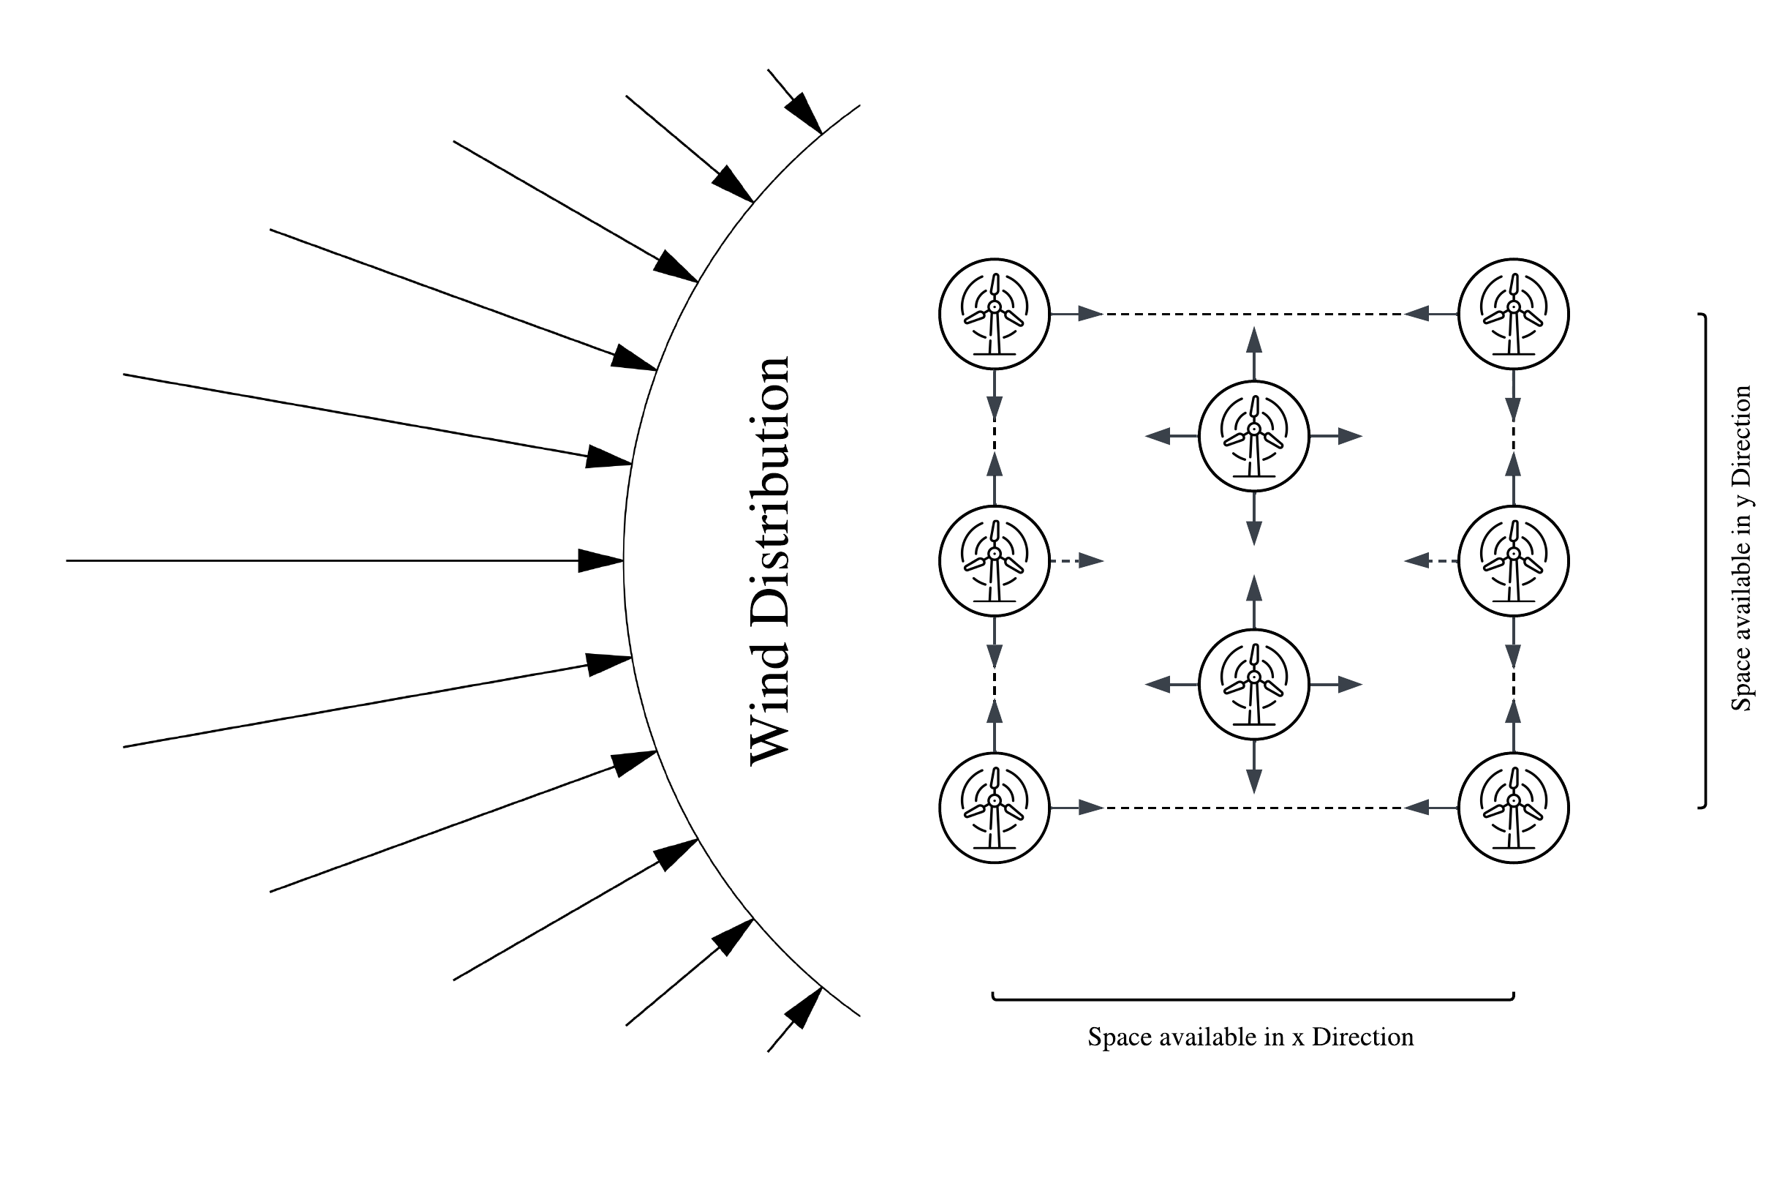
The Problem: Maximize Power
Required Components:
Objective Function
Constraints
Solver

Slide 3
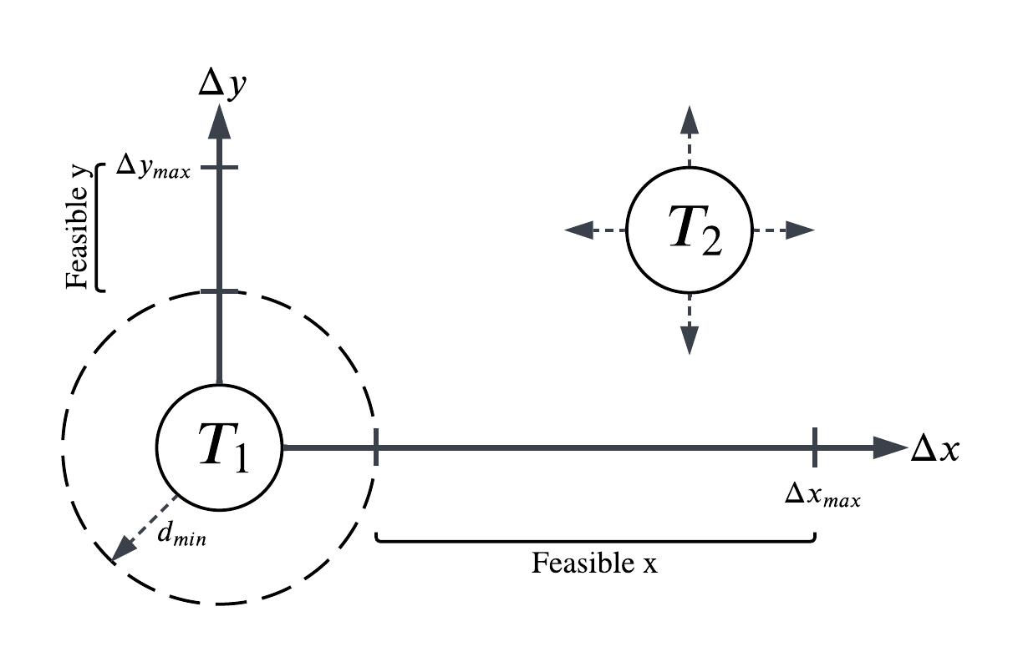
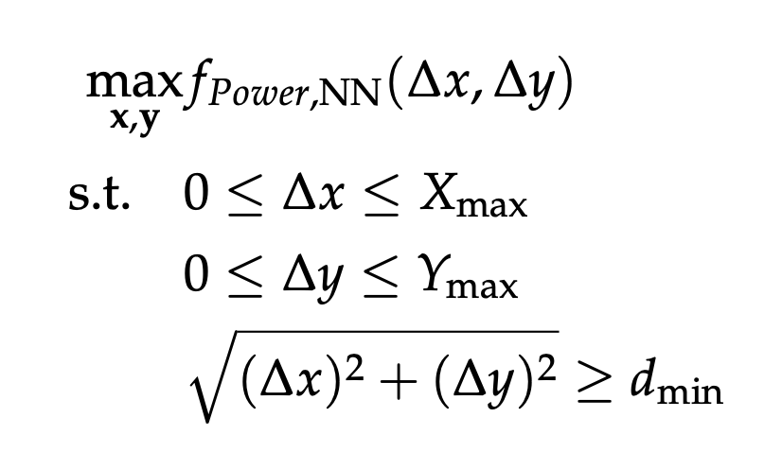
Problem Definition: General Two Turbine Problem

Slide 4
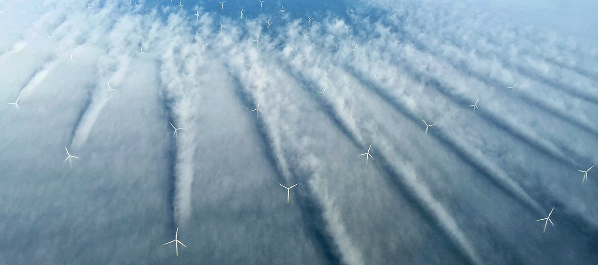
Objective Function: Physical Reality

Slide 5
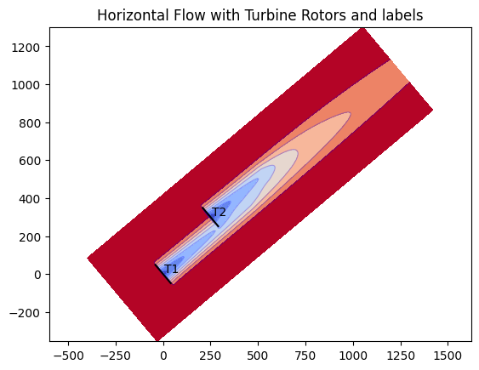
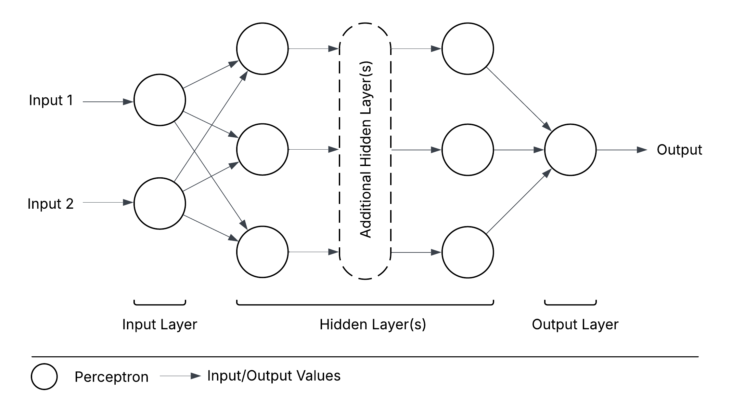
Objective Function: Data to Surrogate Model

Slide 6
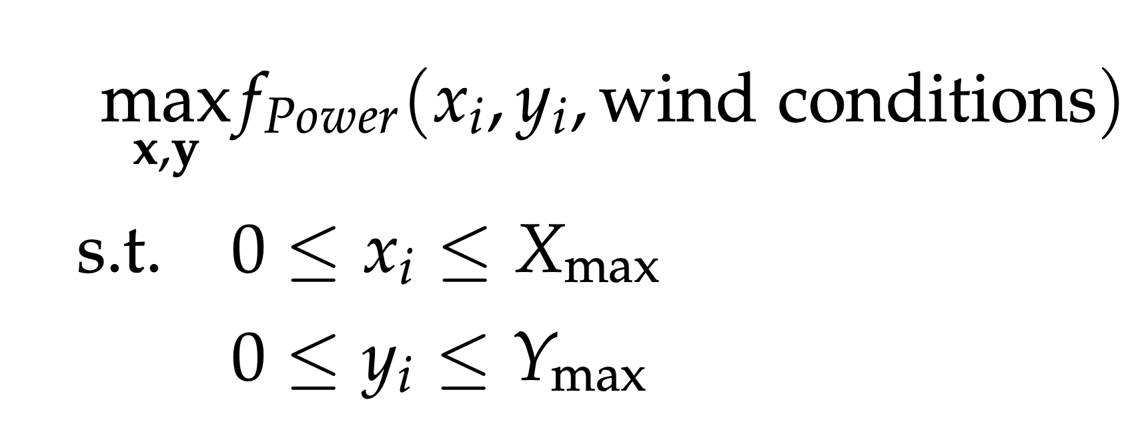
Objective Function: Constraint Learning (CL)

Slide 7
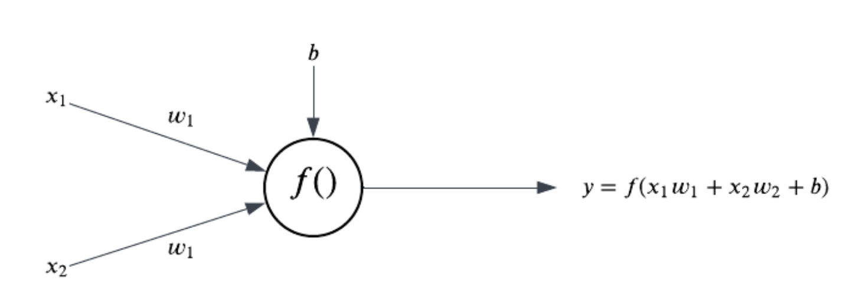
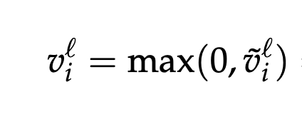
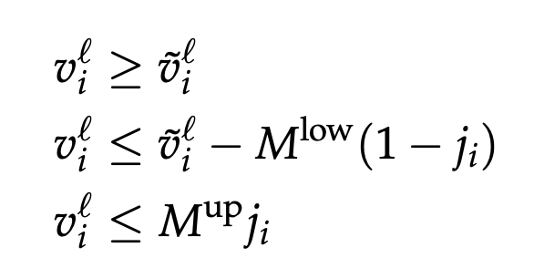
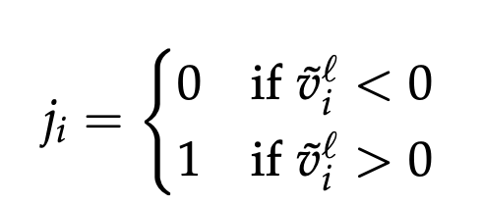
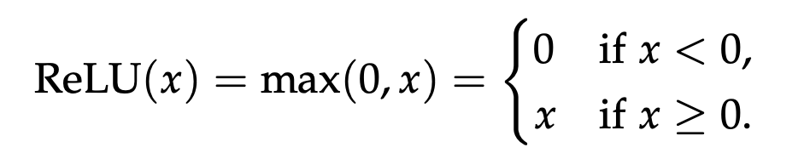
CL-Approach: Neural Network Decomposition
Neuron Output
Weighted Sum

Slide 8
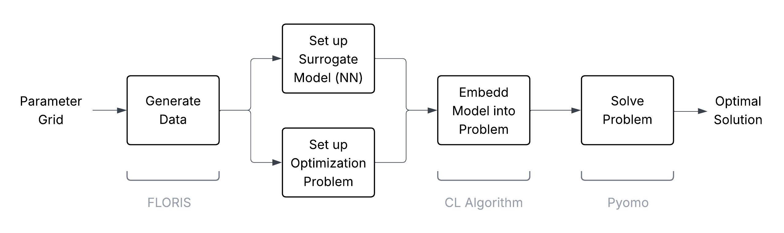
Steps to Solving the Two Turbine Problem

Slide 9
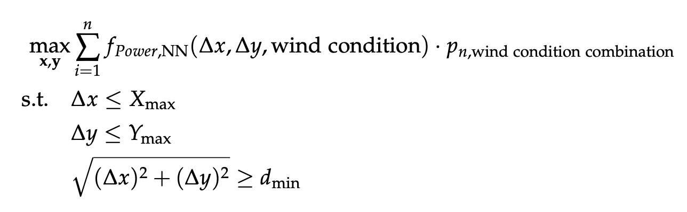
Approach: Wind condition Independent Neural Network

Slide 10
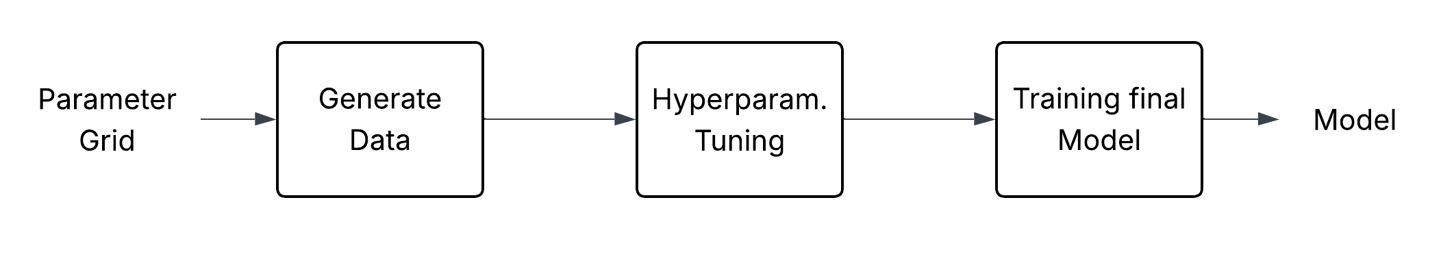
Modeling Process

Slide 11
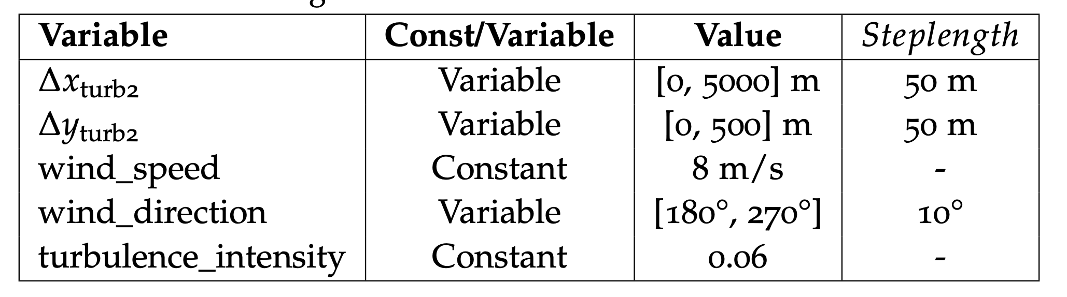
Parameter Grid
Generate Data Using FLORIS

Slide 12
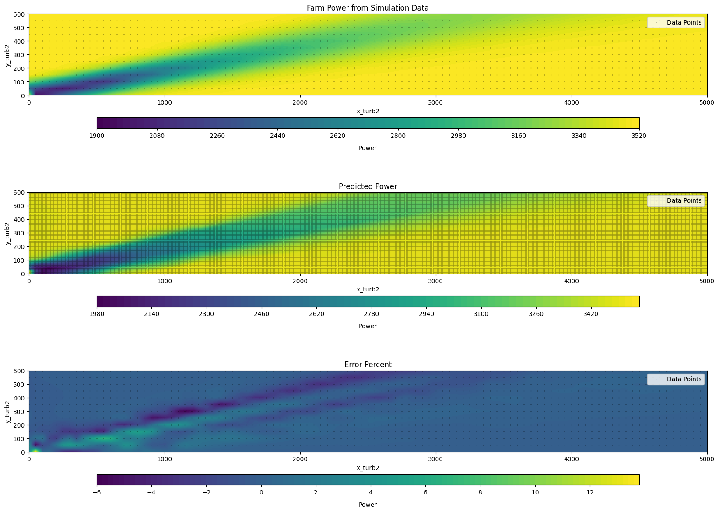
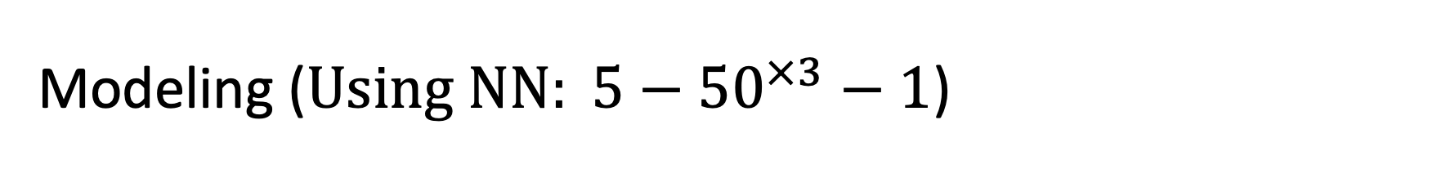
Modeling ($Using NN: 5−{50}^{×3}−1$)

Slide 13
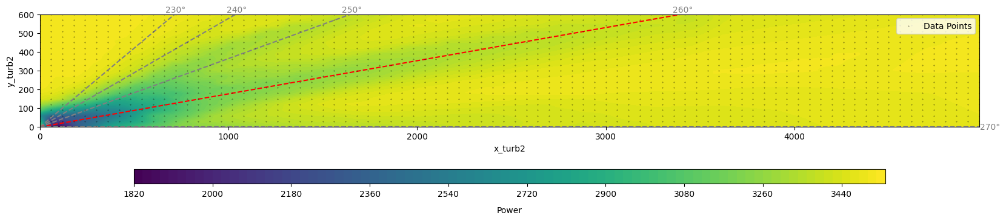
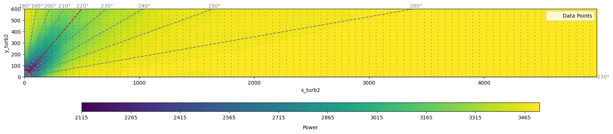
Modeling (Expectation)

Slide 14
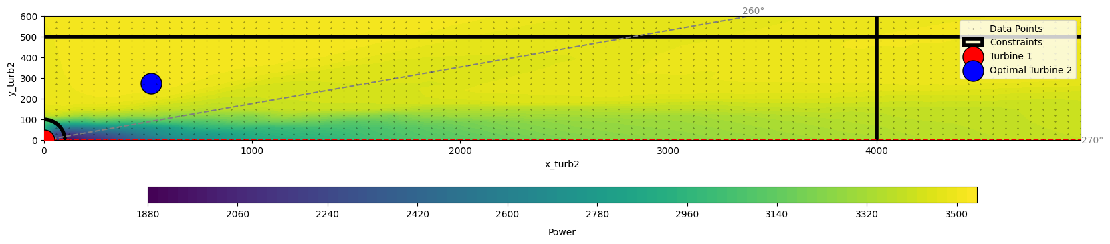
Optimization
With two scenarios from a discretized $N(270°,5°)$ as wind direction distribution

Slide 15
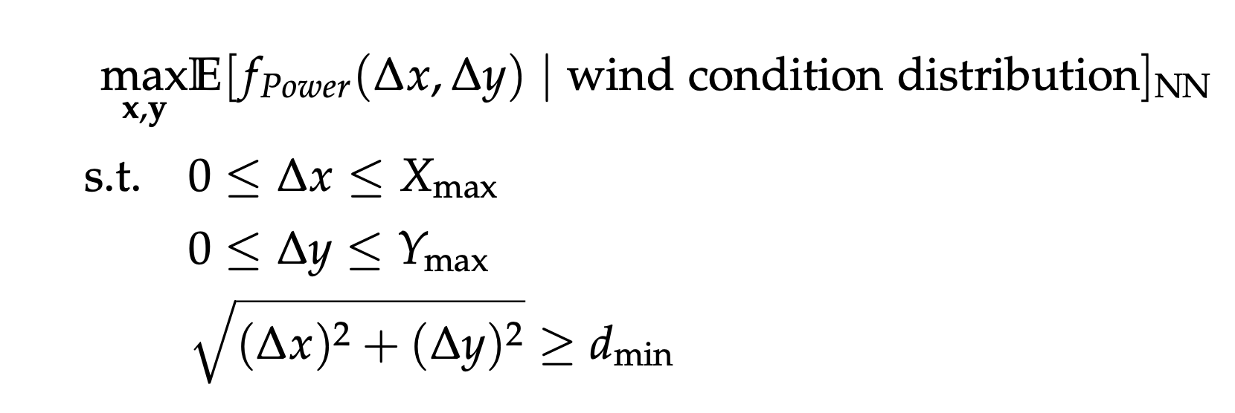
Wind Expectation Neural Network

Slide 16
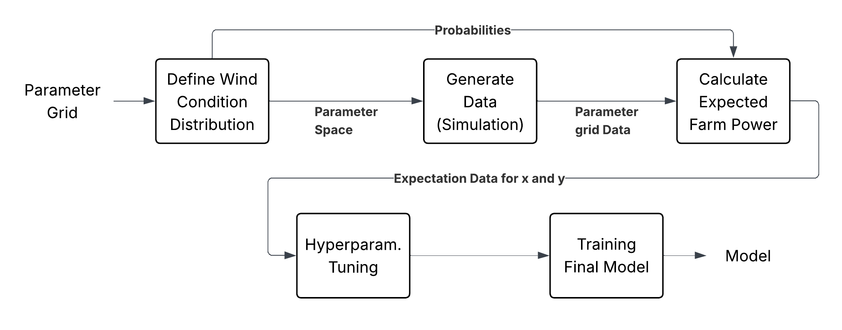
Modeling Process

Slide 17
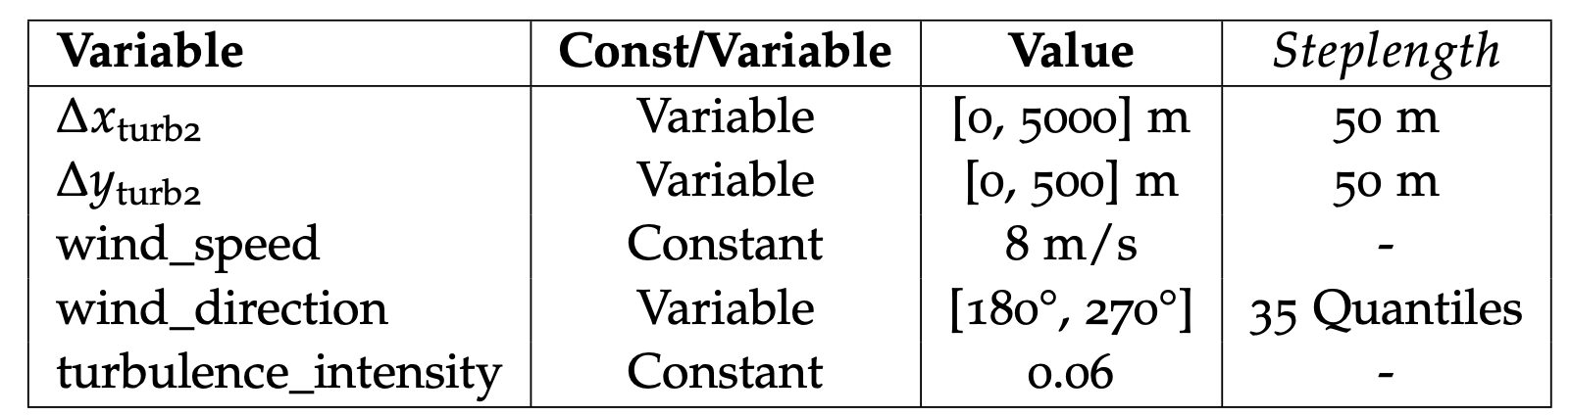
Parameter Grid
With w$ind direction distribution as N(270°,10°)$
Generate Data Using FLORIS

Slide 18
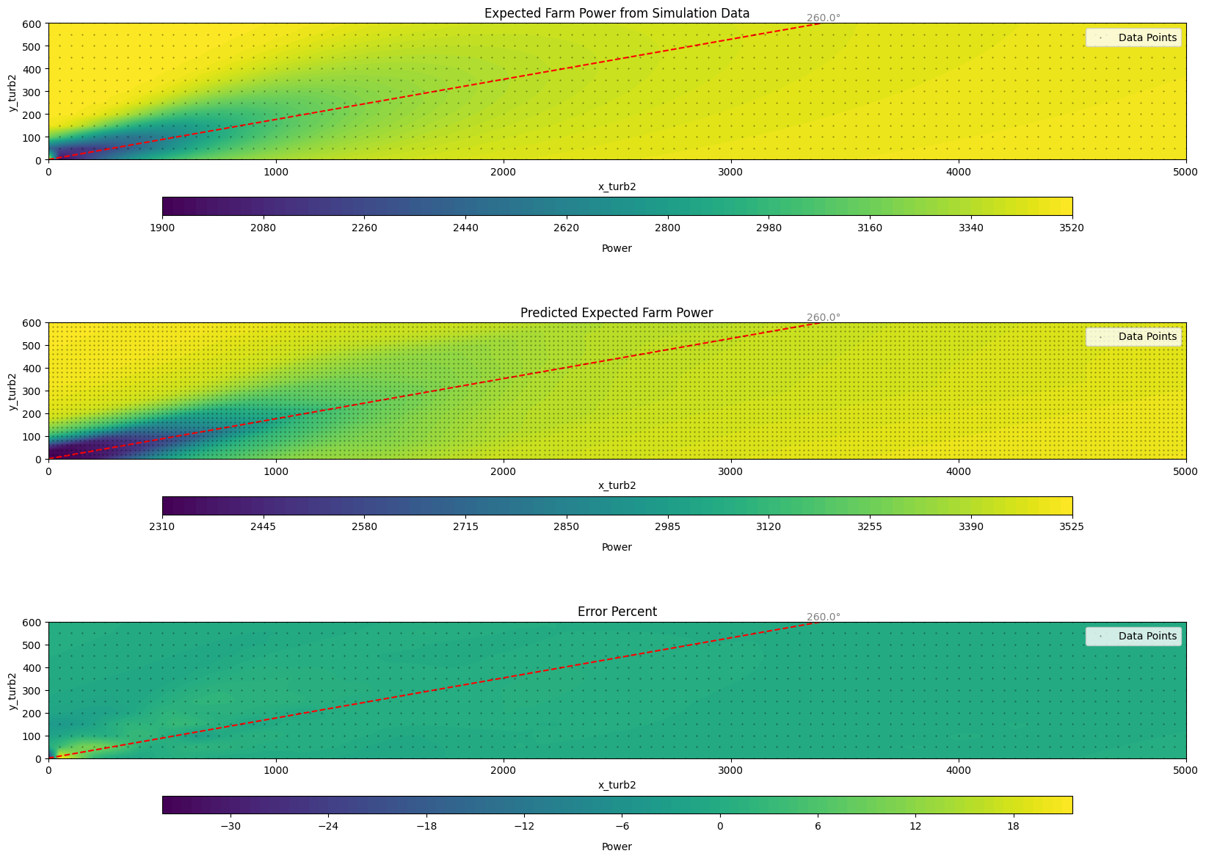
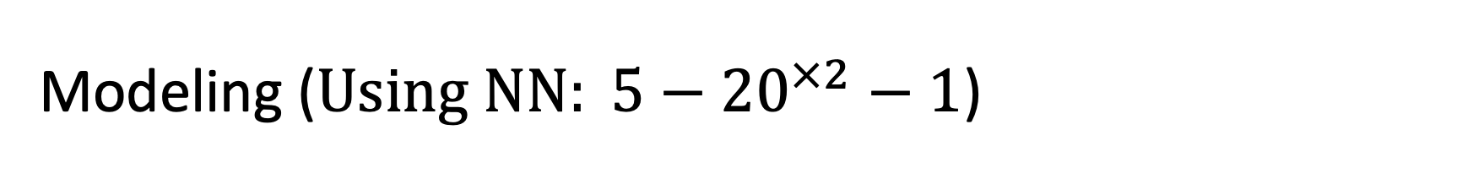
Modeling ($Using NN: 5−{20}^{×2}−1$)

Slide 19
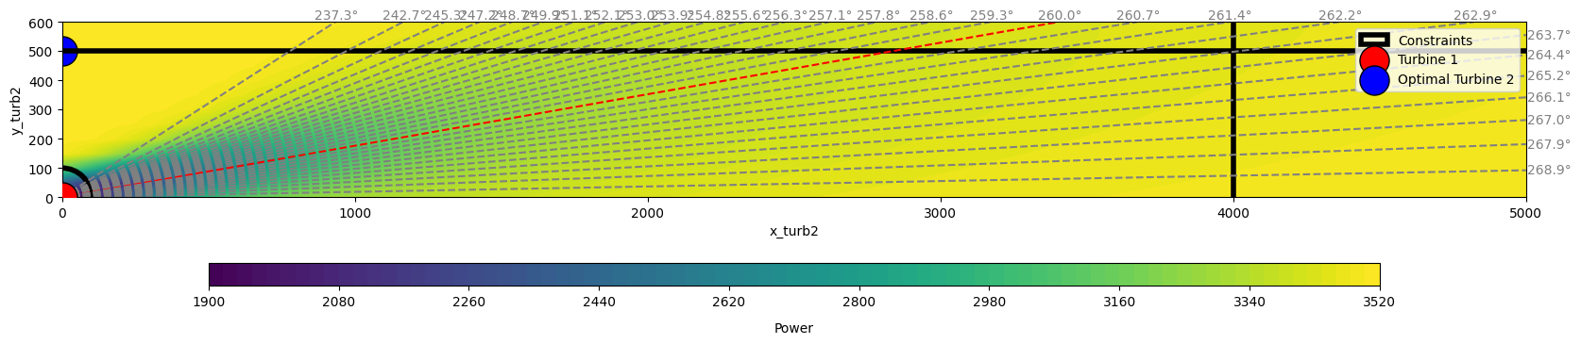
Optimization

Slide 20
Comparison
Wind Distribution independent Approach
Direct Expectation Modeling Approach
Delivers generally applicable solution independent of location/wind condition distribution
Has limitations due to model complexity and number of possible scenarios
Delivers a Model conditional on a specific location/wind condition distribution
Allows for a large number of scenarios using a small neural Network

Slide 21
Conclusion
Wind Distribution independent Approach
Direct Expectation Modeling Approach
Delivers generally applicable solution independent of location/wind condition distribution
Has limitations due to model complexity and number of possible scenarios
Delivers a Model conditional on a specific location/wind condition distribution
Allows for a large number of scenarios using a small neural Network

Slide 22
Questions?
Wind Dist. Indip.
Expect. NN

Slide 23
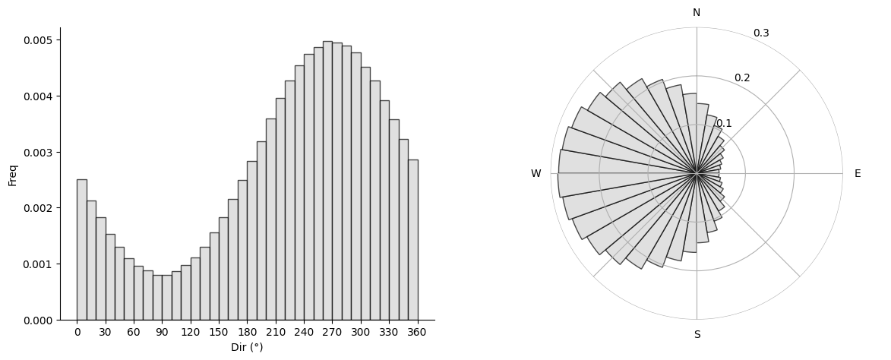
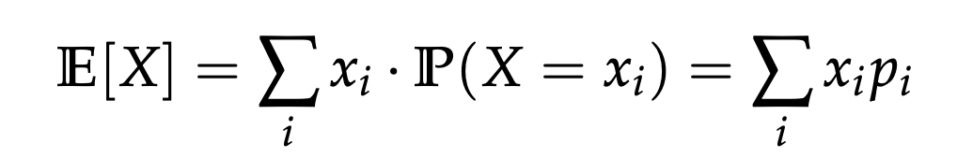
Expectation Maximization

Slide 24
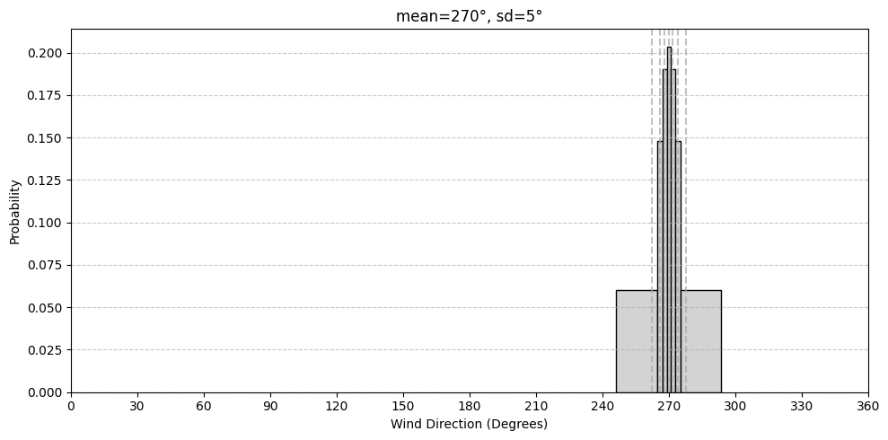
Probability density function discretization

Slide 25
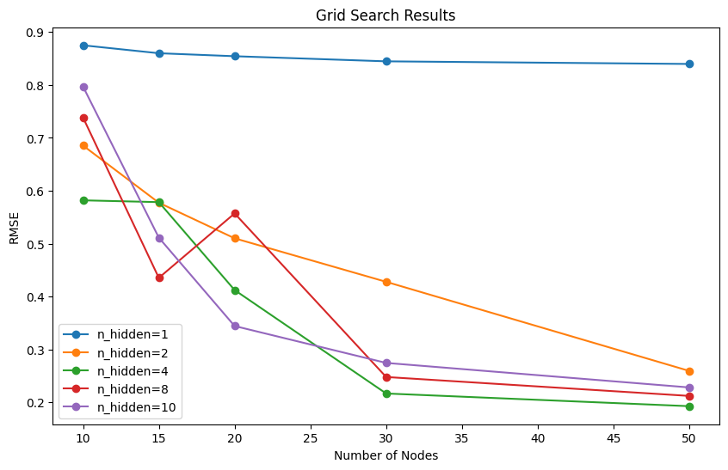
Appendix: Wind Condition indip NN

Slide 26
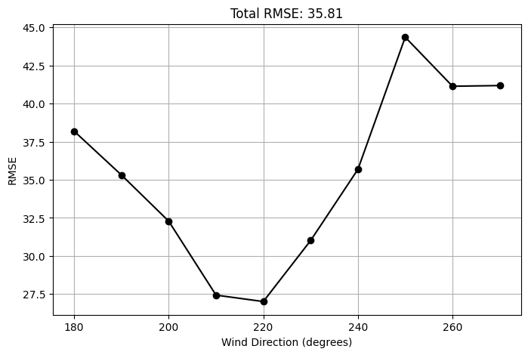
Appendix: Wind Condition indip NN

Slide 27
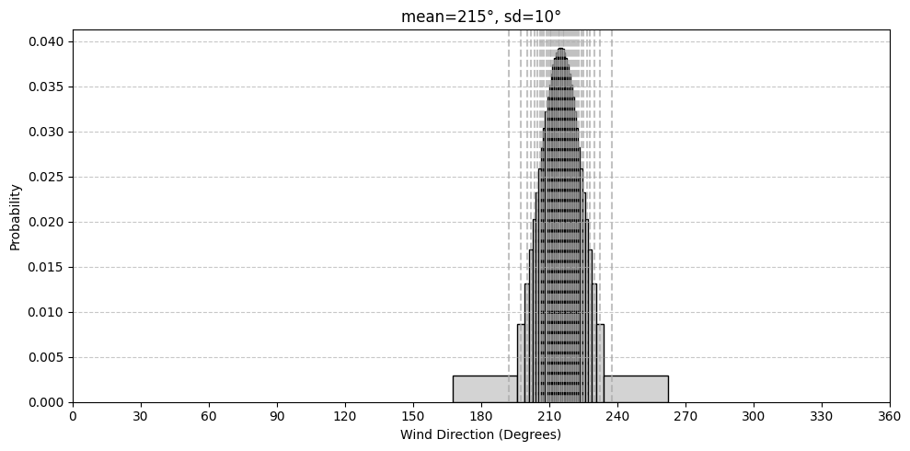
Appendix: Expectation Neural Network

Slide 28
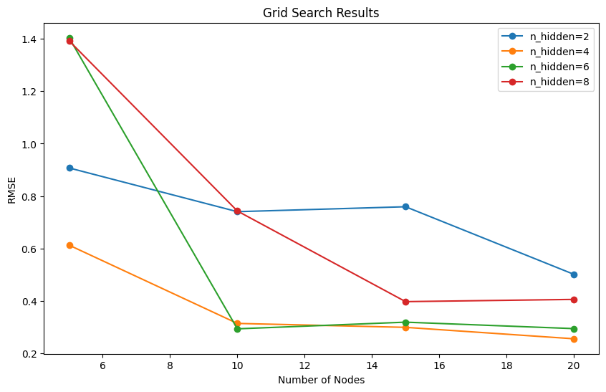
Appendix: Expectation Neural Network

