Slide 1
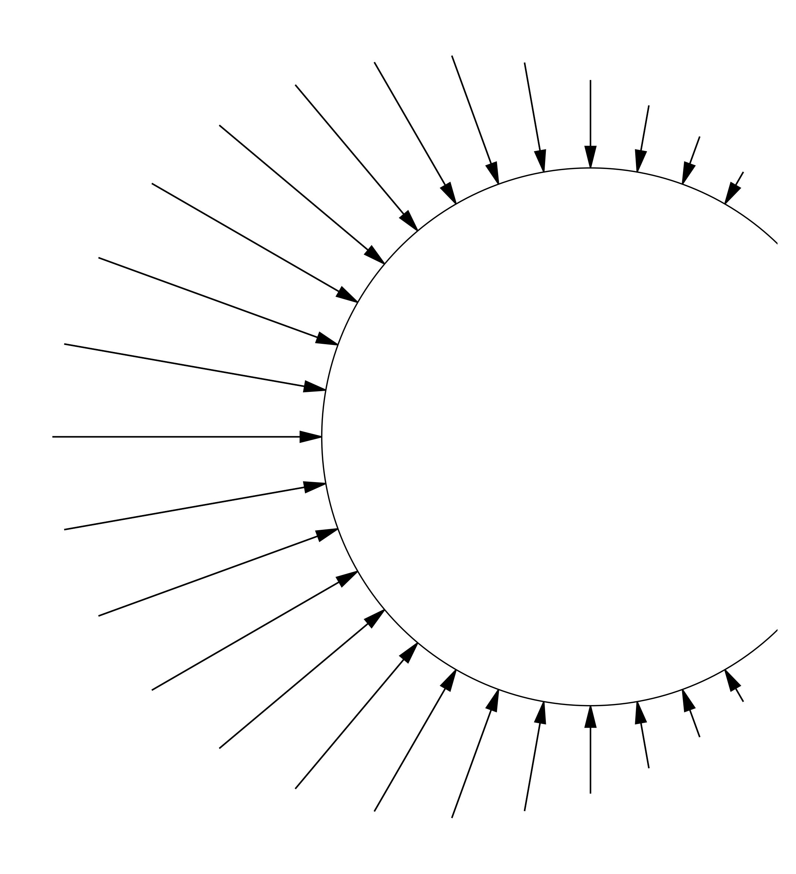

Mixed Integer Stochastic Optimization of relative Position of two Wind Turbines using using Neural Network based Constraint Learning
– Simon Schmetz –
Universidad Carlos III de Madrid
Master Thesis Defense
Madrid, XX.XX.2025
Supervisor: Carlos Ruiz Mora

Slide 2
Introduction

Slide 3
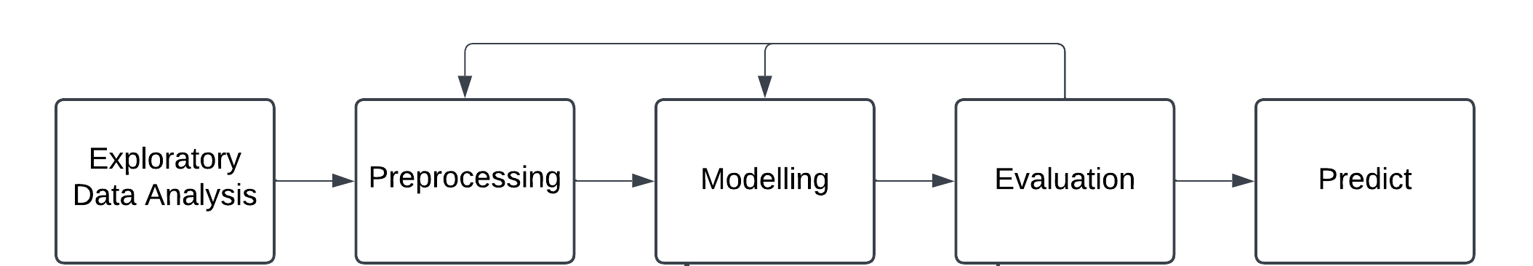
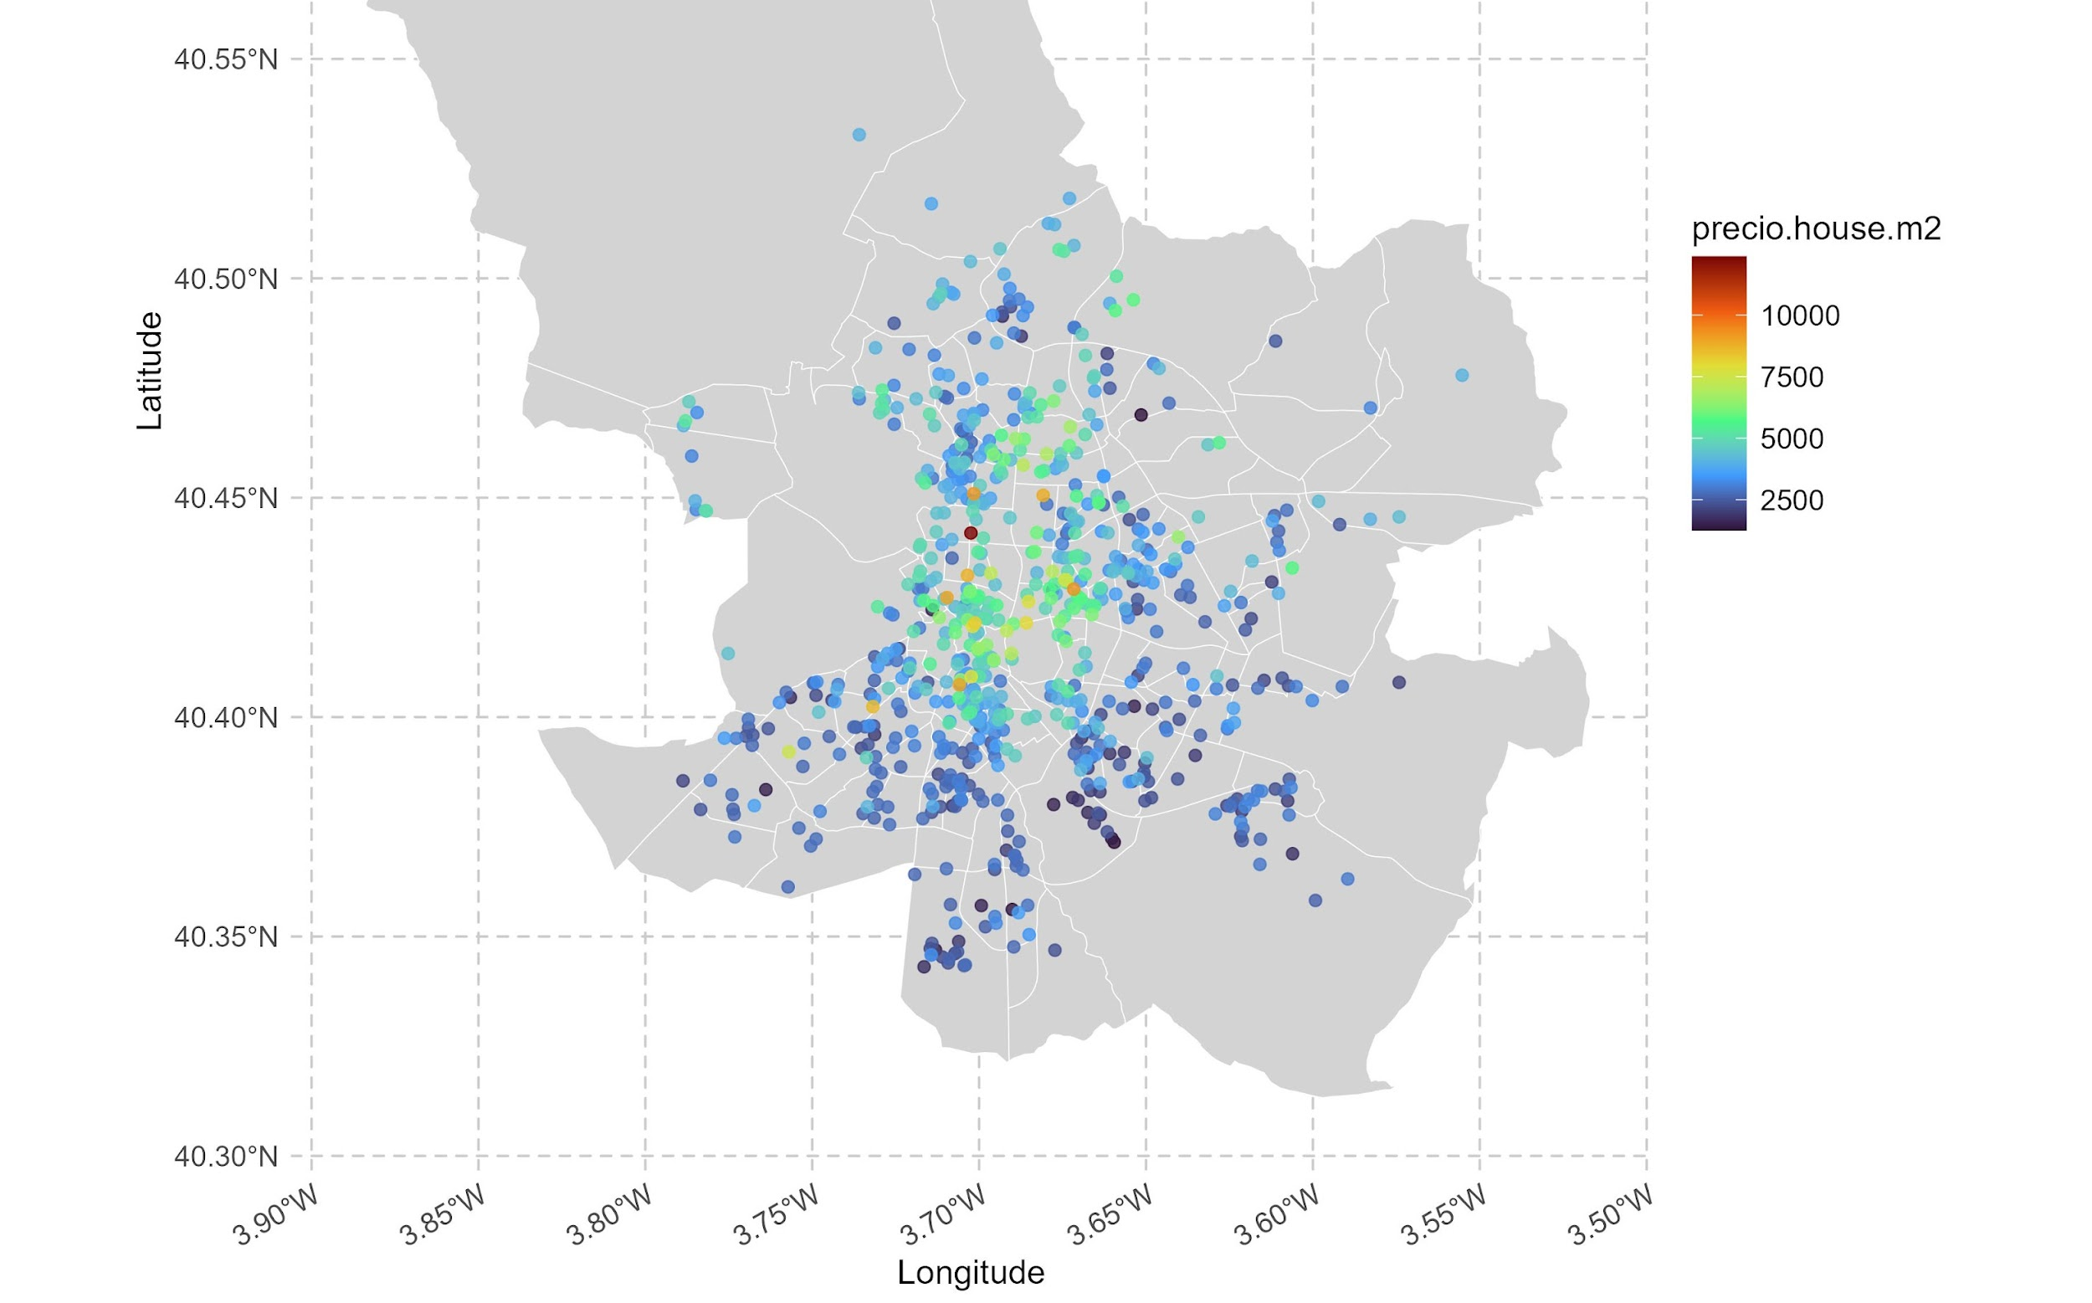
EDA – Price

Slide 4
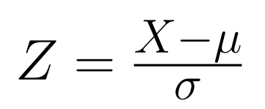
Preprocessing – Continuous
Standardized predictors lead to fairer coefficient comparisons and better model performance.

