Slide 1

Cheat Engine

Slide 2
Cheat Engine
Free, Open Source Memory scanner and debugger
Mostly used to create cheats for single-player (offline) games
Most online games have an in-built CE detector
Can be used with plugins to effectively create online game cheats
Generally used for reverse engineering of games and other applications

Slide 3
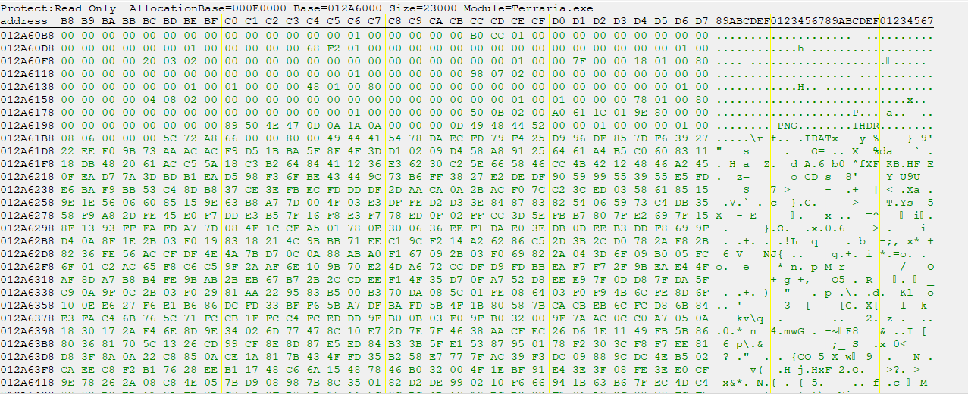
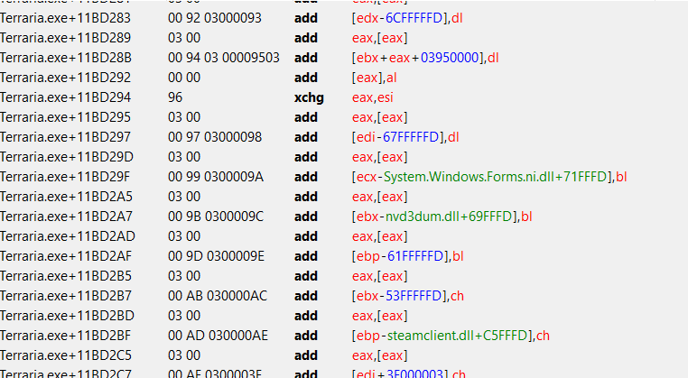

Step 1: Cheat Engine Basics
Basic Value Scanning
Value Editing/Freezing
Speedhack
Memory View
Disassembler

Slide 4

Step 2: Complex Value Scanning

Slide 5
Step 3: Combatting Memory Shuffling

Slide 6
Step 3: Combatting Memory Shuffling
Variables: (multileveled) Pointers
PID+8D8BE8
057AB064
+94
057AAFD0
172
Player
Player.PositionX

Slide 7
Step 3: Combatting Memory Shuffling
Instructions: Array of Bytes(AOB)

Slide 8
Step 4: Code Injection Basics
Address Access Scanning (Read/Write)
Instruction Disassembly/Editing
Breakpoints/Instruction Tracing
AOB Code Injection

Slide 9
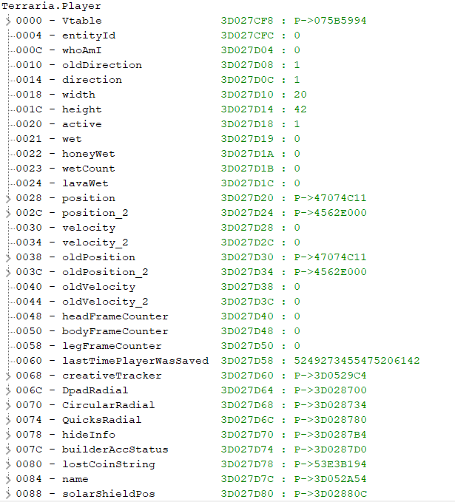
Step 5: Data Structures

