Slide 1
ArcSOM
Martin Lacayo
Charlie Schmidt

Slide 2
What is a SOM?
Neural Network
Dimensionality Reduction
Visualization

Slide 3
Codebook File
Represents SOM
Universal Format
Each line is one neuron
Header contains
  Dimensionality of data
  Dimensions of SOM
  Topology

Slide 4
Topology
Rectangular
Hexagonal
Spherical

Slide 5
Rectangular

Slide 6
Hexagonal

Slide 7
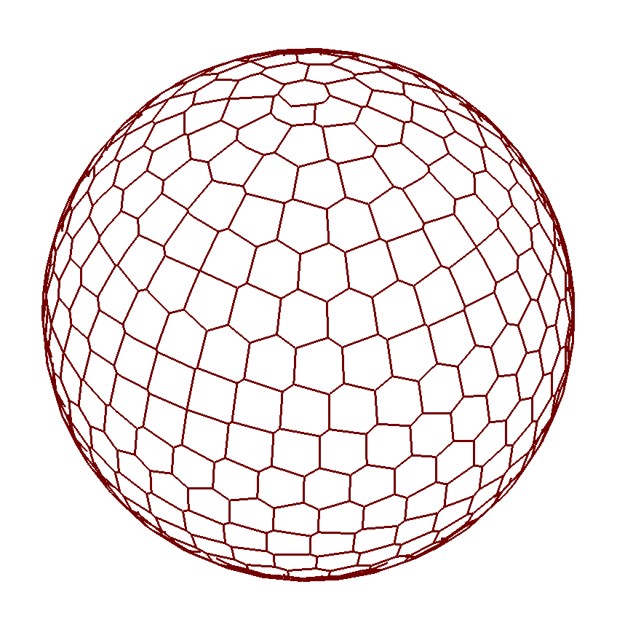
Spherical

Slide 8
The Toolbox Features
SOM Creation (Spherical only)
SOM Training (Spherical only)
Codebook Visualization
  Rectangular
  Hexagonal
  Spherical
Data Mapping
Component Plane Separation

Slide 9
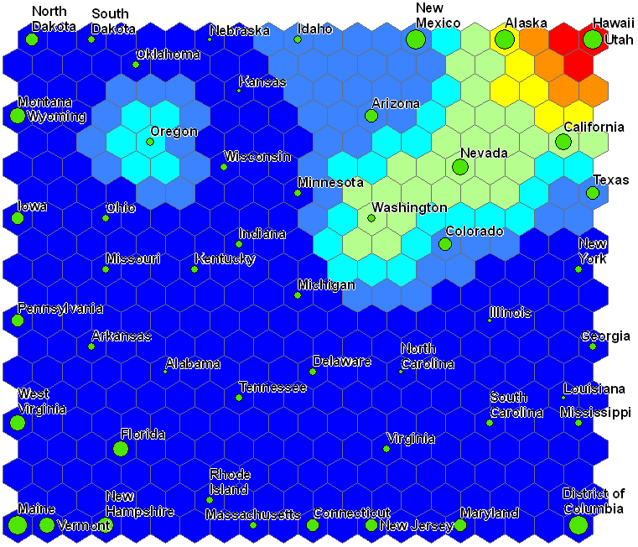

Slide 10
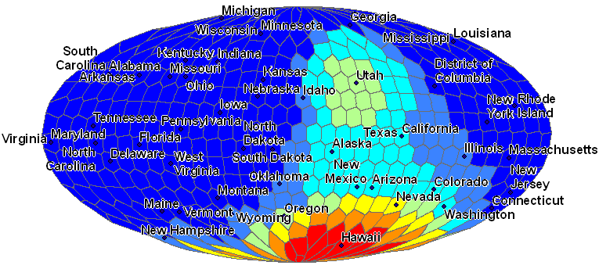

Slide 11
Future Work
Statistical Tools
Least Path Analysis
Similarity Network Creation
Integrating Other Toolboxes

